Slide 1
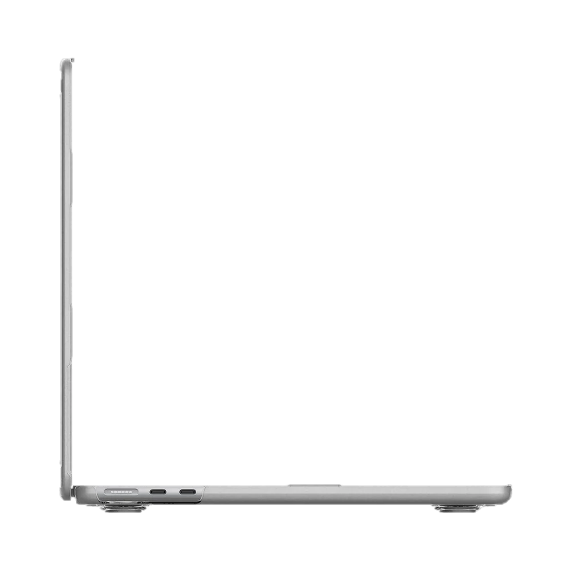
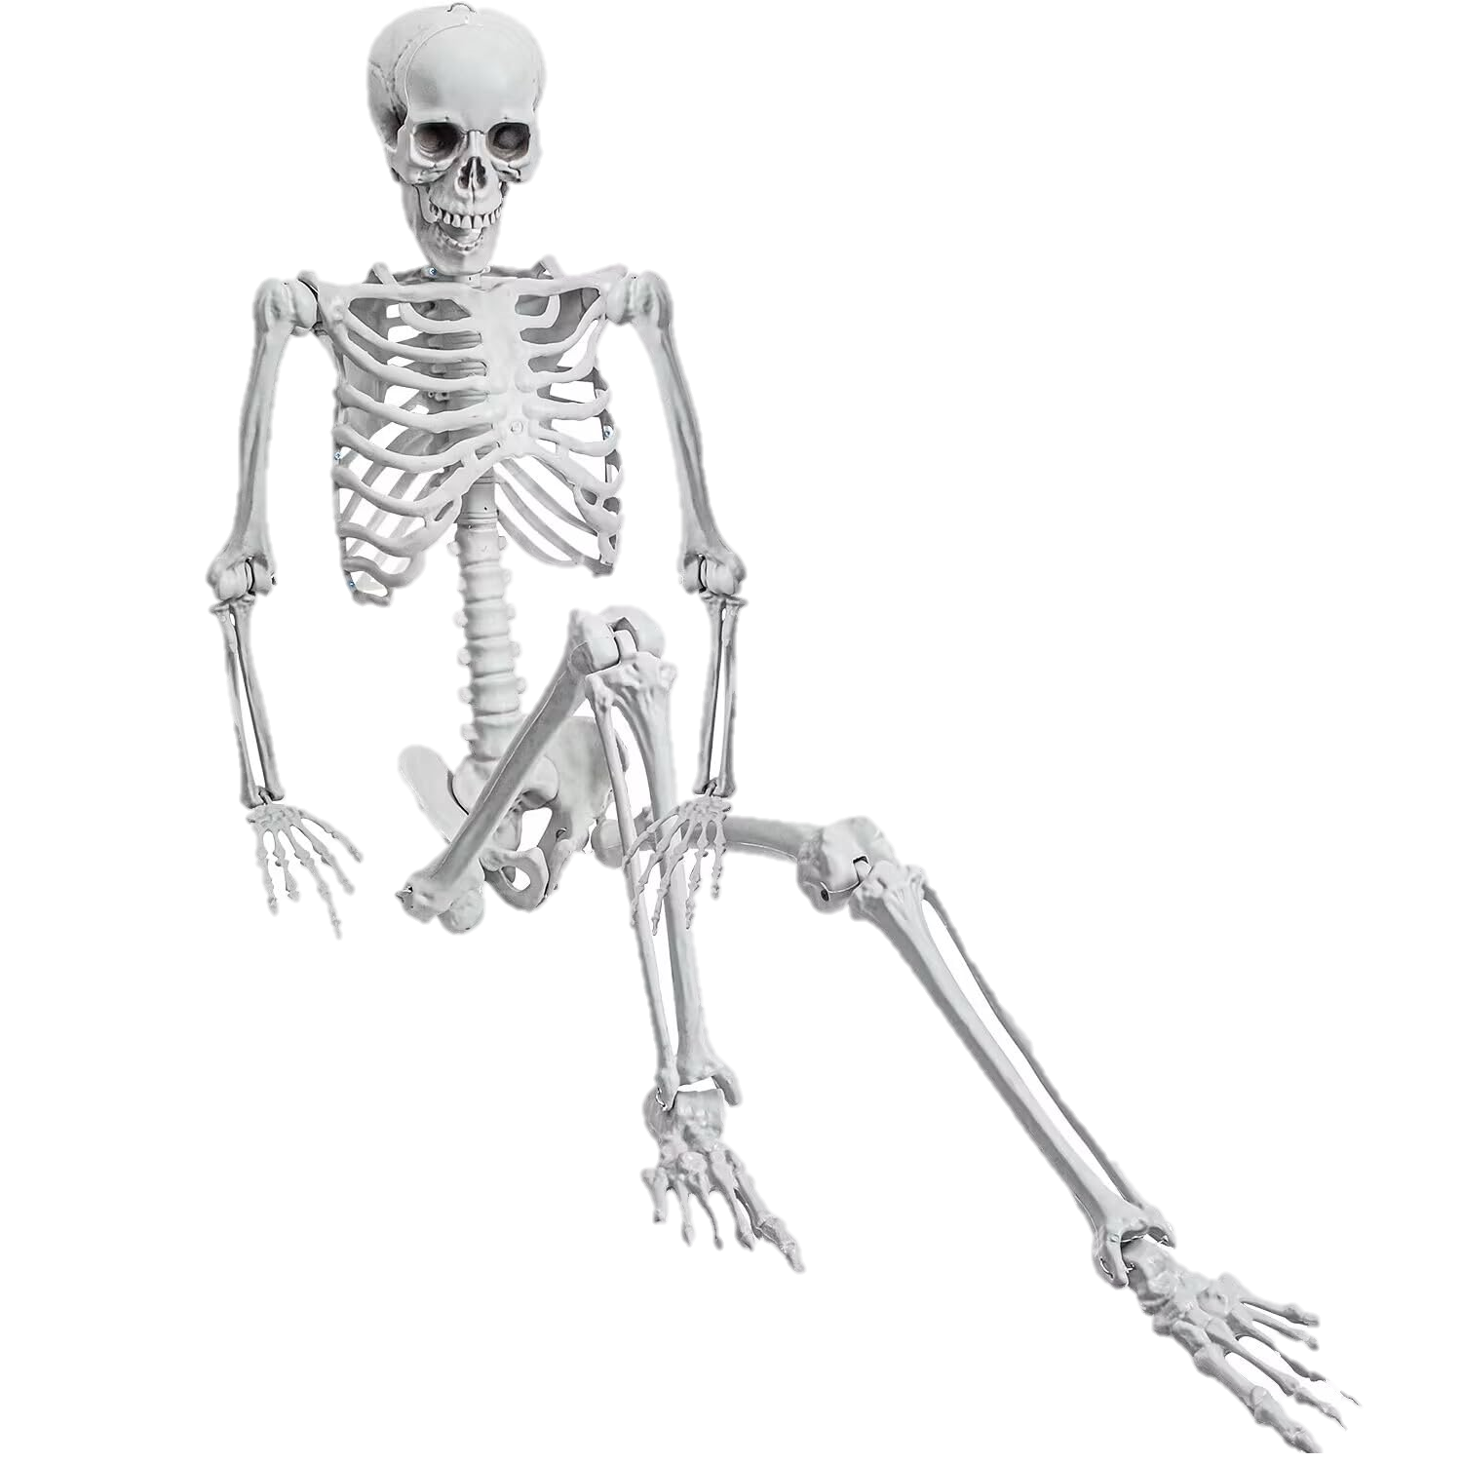
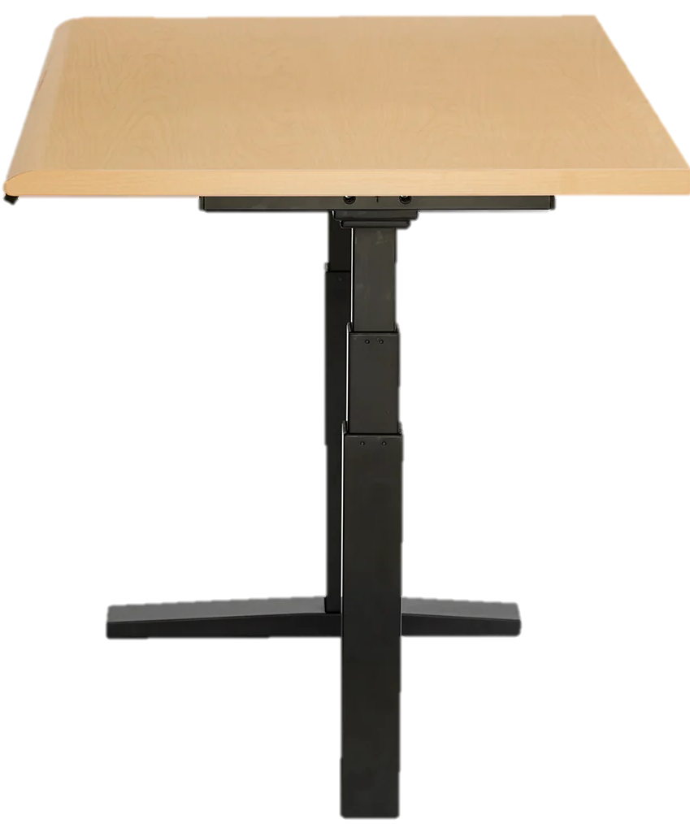
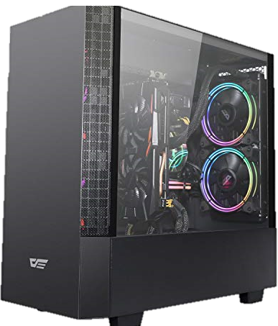

Slide 2
Macbook
Bottom Text
Webcam (eyes)
Text Recognition
Game (Geforce NOW)
Mouse, Keyboard Input Device
Recognized Command
Raspberry Pi Keyboard
PC
State Management
Action to Take
Screen
YOLO Perception
Mouse, Keyboard Commands
Map Awareness

Slide 3
