Slide 1
CS 373 Question Presentation
Baptiste Saliba

Slide 2
Question
Let A and B be regular languages. Is the set of strings of odd length from A beginning with 0 concatenated with the set of strings of even length from B ending with 0 a regular language (yes or no).
What is this really saying?
‘A’ is a set of strings, each of which has an odd length and starts with 0
‘B’ is a set of strings, each of which has even length and ends with 0
Is the concatenation of these two sets a regular language?

Slide 3
Regular Language Rules
The regular languages are closed under both concatenation and intersection so…
Concatenation of A and B is regular if A and B are each regular

Slide 4
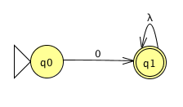
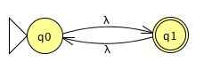
Machine for ‘A’
Note: λ = any letter in ’A’s alphabet
Odd length
Starts with 0

Slide 5
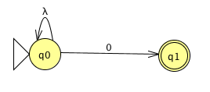
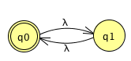
Machine for ‘B’
Note: λ = any letter in ’B’s alphabet
Even length
Ends with 0

Slide 6
Conclusion
Yes the concatenation of A and B is a regular language
Both A and B are regular languages
So the concatenation of both must also be regular

