Slide 1
Snowflake’s Data Cloud is powered by an advanced data platform provided as Software-as-a-Service (SaaS). Snowflake enables data storage, processing, and analytic solutions that are faster, easier to use, and far more flexible than traditional offerings.
The Snowflake data platform is not built on any existing database technology or “big data” software platforms such as Hadoop. Instead, Snowflake combines a completely new SQL query engine with an innovative architecture natively designed for the cloud. To the user, Snowflake provides all of the functionality of an enterprise analytic database, along with many additional special features and unique capabilities.

Slide 2
Data Platform as a Cloud Service
Snowflake is a true SaaS offering. More specifically:
There is no hardware (virtual or physical) to select, install, configure, or manage.
There is virtually no software to install, configure, or manage.
Ongoing maintenance, management, upgrades, and tuning are handled by Snowflake.
Snowflake runs completely on cloud infrastructure. All components of Snowflake’s service (other than optional command line clients, drivers, and connectors), run in public cloud infrastructures.
Snowflake uses virtual compute instances for its compute needs and a storage service for persistent storage of data. Snowflake cannot be run on private cloud infrastructures (on-premises or hosted).
Snowflake is not a packaged software offering that can be installed by a user. Snowflake manages all aspects of software installation and updates.

Slide 3
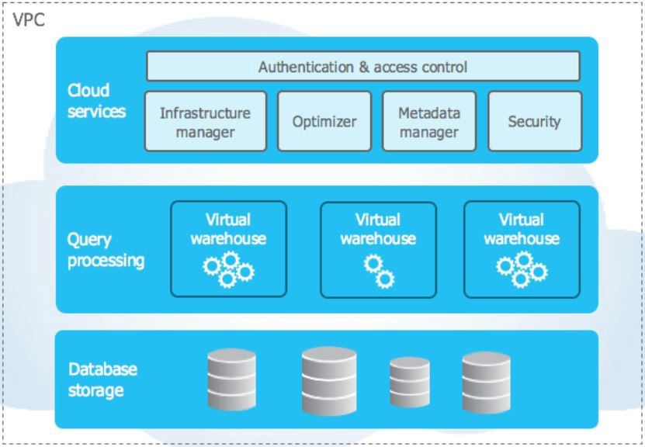

Slide 4
Snowflake runs completely on public cloud infrastructure. It cannot run on private cloud infrastructure. It uses AWS EC2 (if deployed on AWS) instances to provide compute capabilities and offer them as virtual warehouses. For persistent storage of data, it uses AWS S3 (if deployed on AWS).
Cloud Services:
The cloud services layer is a collection of services that coordinate activities across Snowflake. These services tie together all the different components of Snowflake in order to process user requests, from login to query dispatch. The cloud services layer also runs on compute instances provisioned by Snowflake from the cloud provider.
Among the services in this layer:
Authentication
Infrastructure management
Metadata management
Query parsing and optimization
Access control

Slide 5
Query Processing:
The query processing layer takes advantage of the shared nothing architecture. Query execution takes place inside this layer. Queries are processed using virtual warehouses. Each virtual warehouse is an MPP (Massive Parallel Processing)compute cluster composed of many compute nodes allocated by Snowflake from a cloud provider. These compute clusters are basically AWS EC2 instances if the cloud provider is AWS.
Each virtual warehouse is an independent compute cluster and does not share compute resources with other clusters or virtual warehouses. That is why performance of one virtual warehouse does not impact the performance of other virtual warehouse.

Slide 6
Database Storage:
When data is loaded into Snowflake, Snowflake reorganizes that data into its internal optimized, compressed, columnar format. Snowflake stores this optimized data in cloud storage. Shared disk architecture is utilized in this layer.
Snowflake manages all aspects of how this data is stored — the organization, file size, structure, compression, metadata, statistics, and other aspects of data storage are handled by Snowflake. The data objects stored by Snowflake are not directly visible nor accessible by customers; they are only accessible through SQL query operations run using Snowflake.

Slide 7
Virtual Warehouses
A virtual warehouse, often referred to simply as a “warehouse”, is a cluster of compute resources in Snowflake. A warehouse provides the required resources, such as CPU, memory, and temporary storage, to perform the following operations in a Snowflake session:
Executing SQL SELECT statements that require compute resources (e.g. retrieving rows from tables and views).
Performing DML operations, such as:
Updating rows in tables (DELETE , INSERT , UPDATE).
Loading data into tables (COPY INTO <table>).
Unloading data from tables (COPY INTO <location>).

Slide 8
Costs
In Snowflake, cost is calculated by two factors:
Storage - You pay a certain amount per terabyte per month.
Compute - For each second a warehouse is running, you use an amount of credits. The price of a credit depends on the edition of Snowflake you use. An XS warehouse consumes one credit for one full hour of compute. A small warehouse 2 credits, a medium warehouse 4 credits and so on.
When you execute a query, the warehouse starts using compute for at least one minute. After the first minute, you pay for each extra second the warehouse is running. To save costs, you can configure a warehouse to auto-suspend after a certain amount of time. If no queries are executed after said time period, the warehouse shuts down. When a new query is launched, the warehouse auto-resumes.
Because Snowflake always has a pool of idle virtual machines, resuming a warehouse or changing its scale is super-fast. It’s hardly noticeable and transparent for running queries.

Slide 9
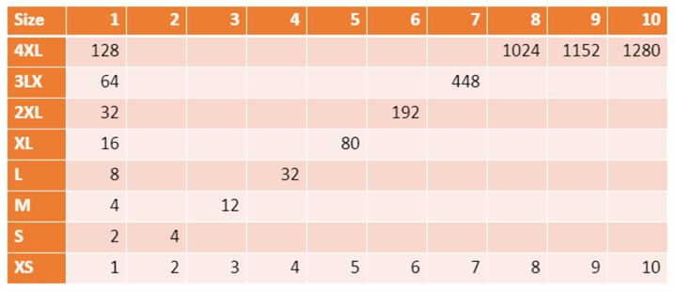
The following table gives an overview of credit consumption for horizontal and vertical scaling:
The largest unit of compute is a 10-node cluster of 4XL warehouses. This consumes 1280 credits per hour. For Enterprise edition, a credit is about $4. This means over $5,000 an hour! It’s clear you can save the most costs by minimizing compute. Storage typically has a much lower impact than compute.

Slide 10
