Slide 1

Buffer overflow attack
Balasaheb Salunke
bsalunke@outlook.com

Slide 2
Outline
Memory layout of a Process
Stack?
Buffer overflow vulnerability
Attack?
Exploit using vulnerability(Demo)
Real world BFO attacks
How to mitigate vulnerability
Defenses against attack

Slide 3
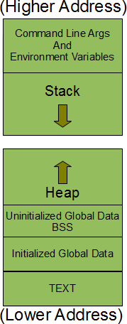
Memory layout of a Process

Slide 4
*Stack
Stack?
LIFO
Usage of stack in function call.
Holds local variables

Slide 5
*Stack
#include <stdio.h>
int add(int x, int y) {
int a = x;
int b = y;
return a + b;
}
int main() {
int q = 100;
add(22, 44);
return 0;
}
continue..
Local Variables 2
Local Variable 1
Old frame pointer
Return address
Command line argument
Caller function (i.e. main())

Slide 6
*Stack…
#include <stdio.h>
void func(int a, int b) {
char buff[15];
int v =0;
strcpy(buff, “null meet pune”)
if(v == 0) {
printf(“ element v is non-zero\n”);
}
return;
}
int main() {
func(10, 22);
return 0;
}
buff
v
%ebp
%eip
20 10
main() (caller of func())

Slide 7
Buffer overflow vulnerability?
What is buffer?
When buffer overflow can happen
Example

Slide 8
Attack?
What can be achieved?
Inject malicious code.
Change the execution path of running process.

Slide 9
Exploit using vulnerability
Inject code using buffer overflow vulnerability
Get control of host system
DEMO
continue..

Slide 10
Exploit using vulnerability
Find the buffer which can be overrun
Pass malicious code as input to the program.
Overwrite the return address with buffer start address
Shell can spawned.

Slide 11
Real world BFO attacks
Morris worm (1988)
CodeRed : MS-IIS (2001)
SQL Slammer : MS-SQL server(2003)
Glibc getaddrinfo stack based buffer overflow(2015)
Ghost Vulnerability (2015) etc..

Slide 12
Mitigations
Memory safe programming languages
Avoid bug in coding
  Code review
  Secure coding practices
  Program analysis

Slide 13
Defenses against such attacks
Stack Canaries
Make stack non-executable
Address space layout randomization(ASLR)

Slide 14
Q & A

Slide 15
Thank you!

