Slide 1
Twitter Sentiment and Intrinsic Attention with Fastai
Blake Samaha

Slide 2

TABLE OF CONTENTS
THE DATA
01
METHODOLOGY
02
RESULTS
03
04
CONCLUSIONS
Overview and Insights
Neural Nets and NLP with Fastai
Model Performance and Intrinsic Attention
Takeaways and Future Work

Slide 3
INTRODUCTION -
Sentiment Understanding
Customer Service
Brand Monitoring
Product Analysis
Legal Documents
So many documents so little time to read
Voice of your Employees
Understand employees’ needs
Natural Language Processing (NLP) Market to Exhibit 32.4% CAGR; Increasing Technological Advancement to Drive Growth: Fortune Business Insights™

Slide 4

01
THE DATA
Overview and Insights

Slide 5
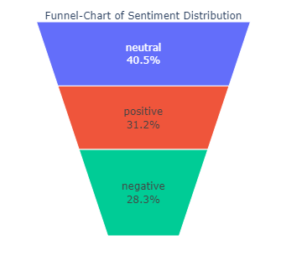
Distribution of Data
Data set containing
~30k Tweets

Slide 6
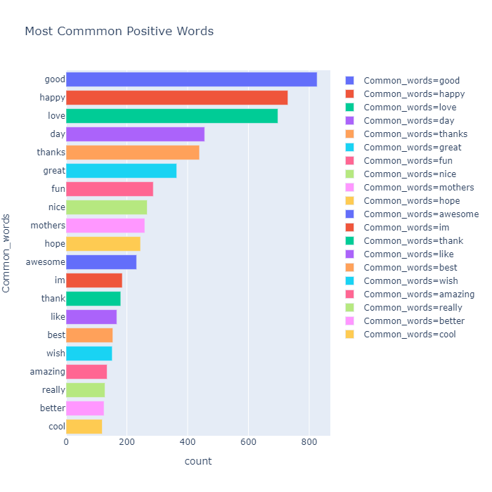
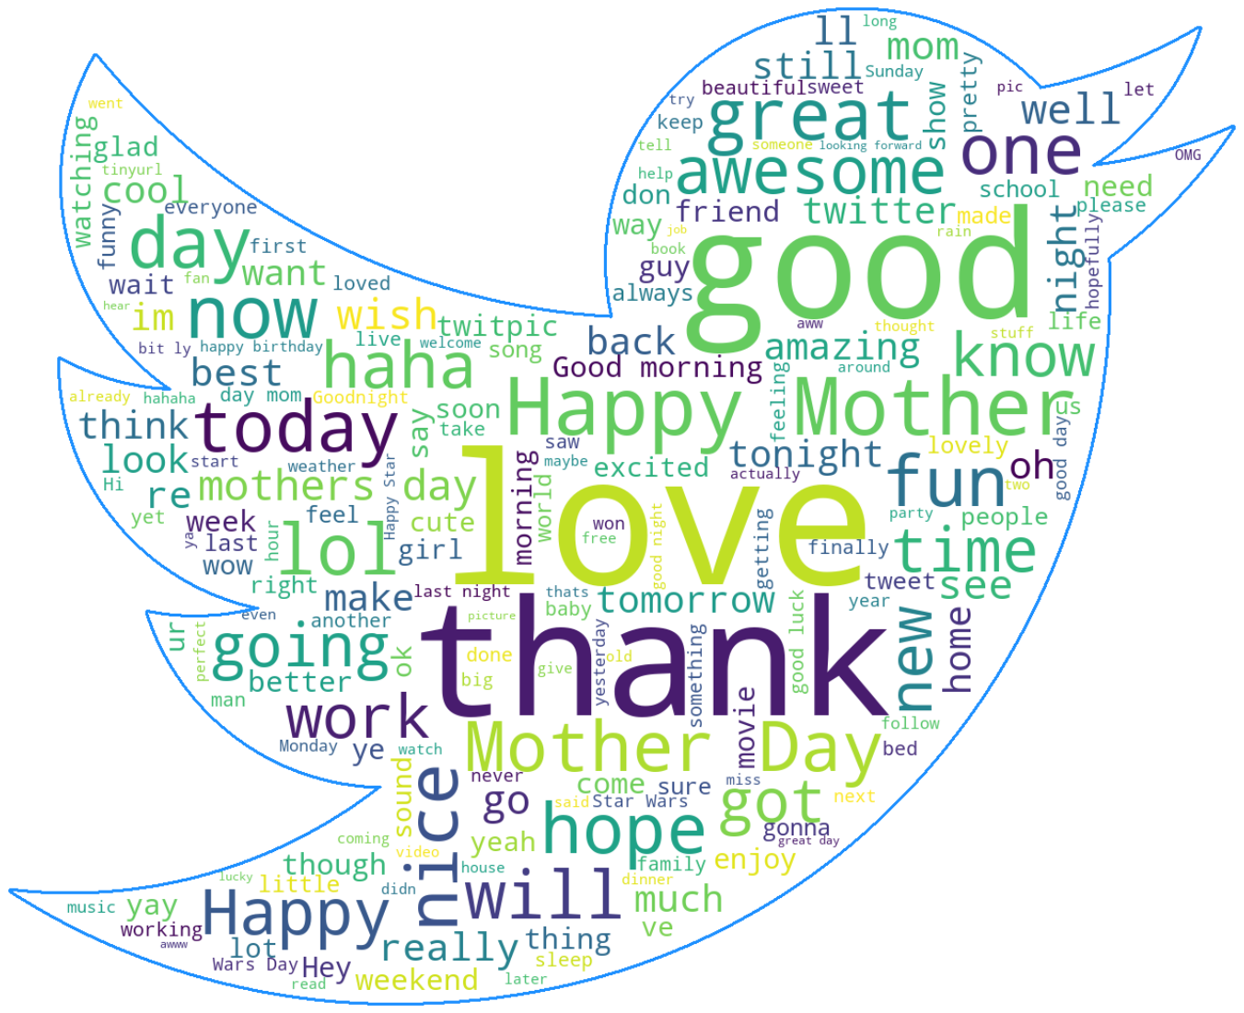
Common words associated with positive tweets

Slide 7
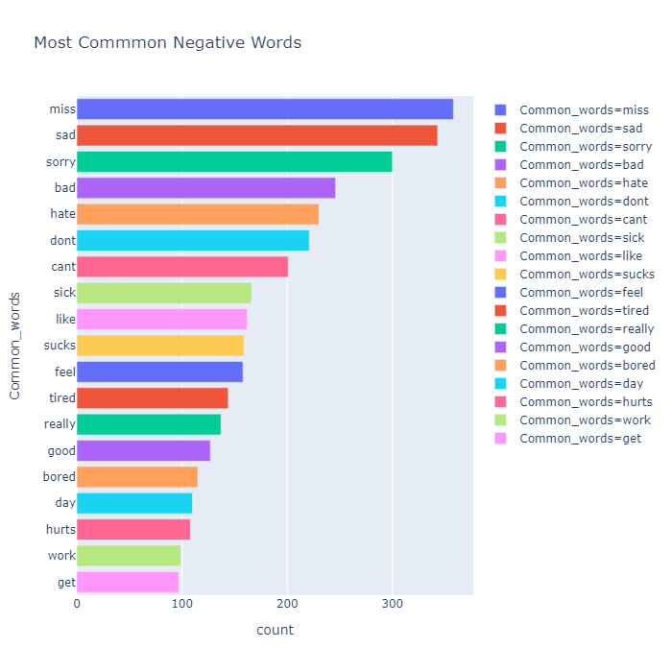
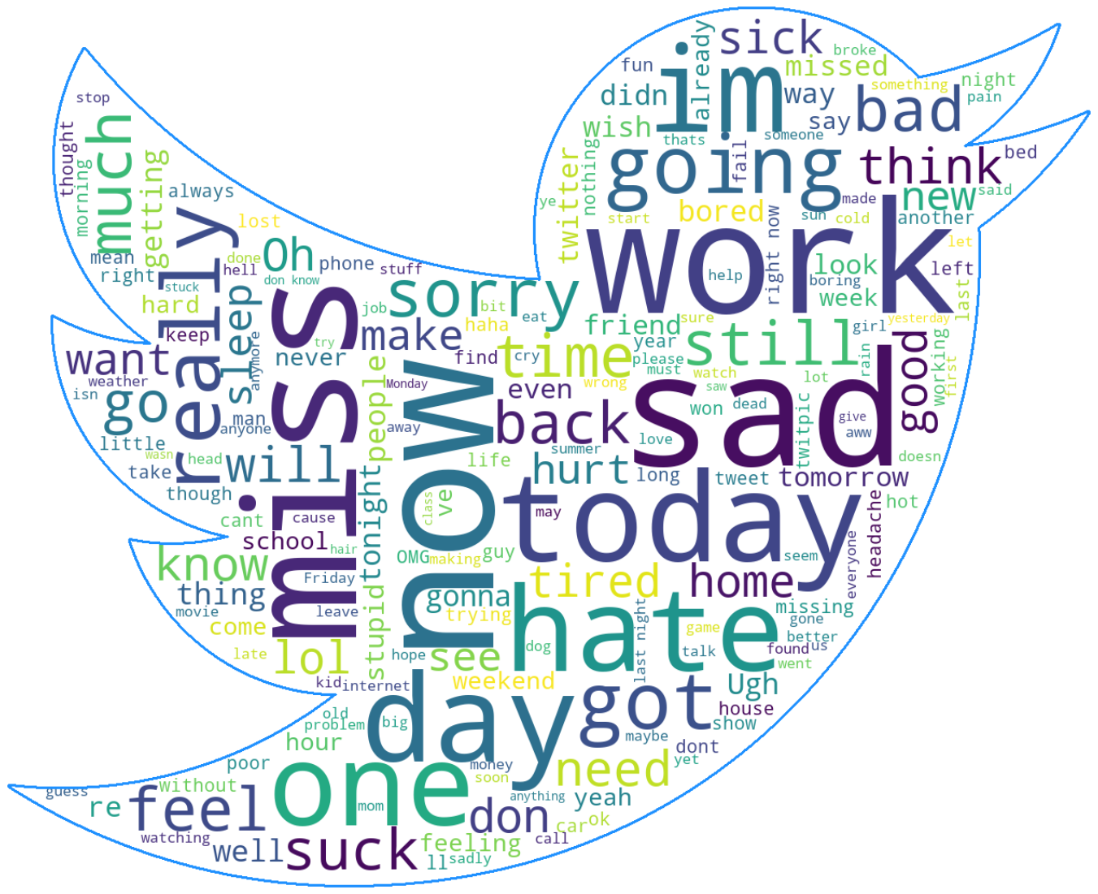
Common words associated with negative tweets

Slide 8
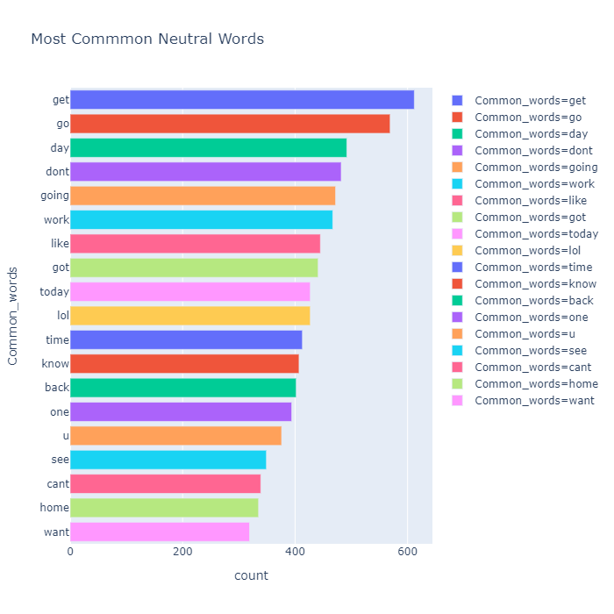
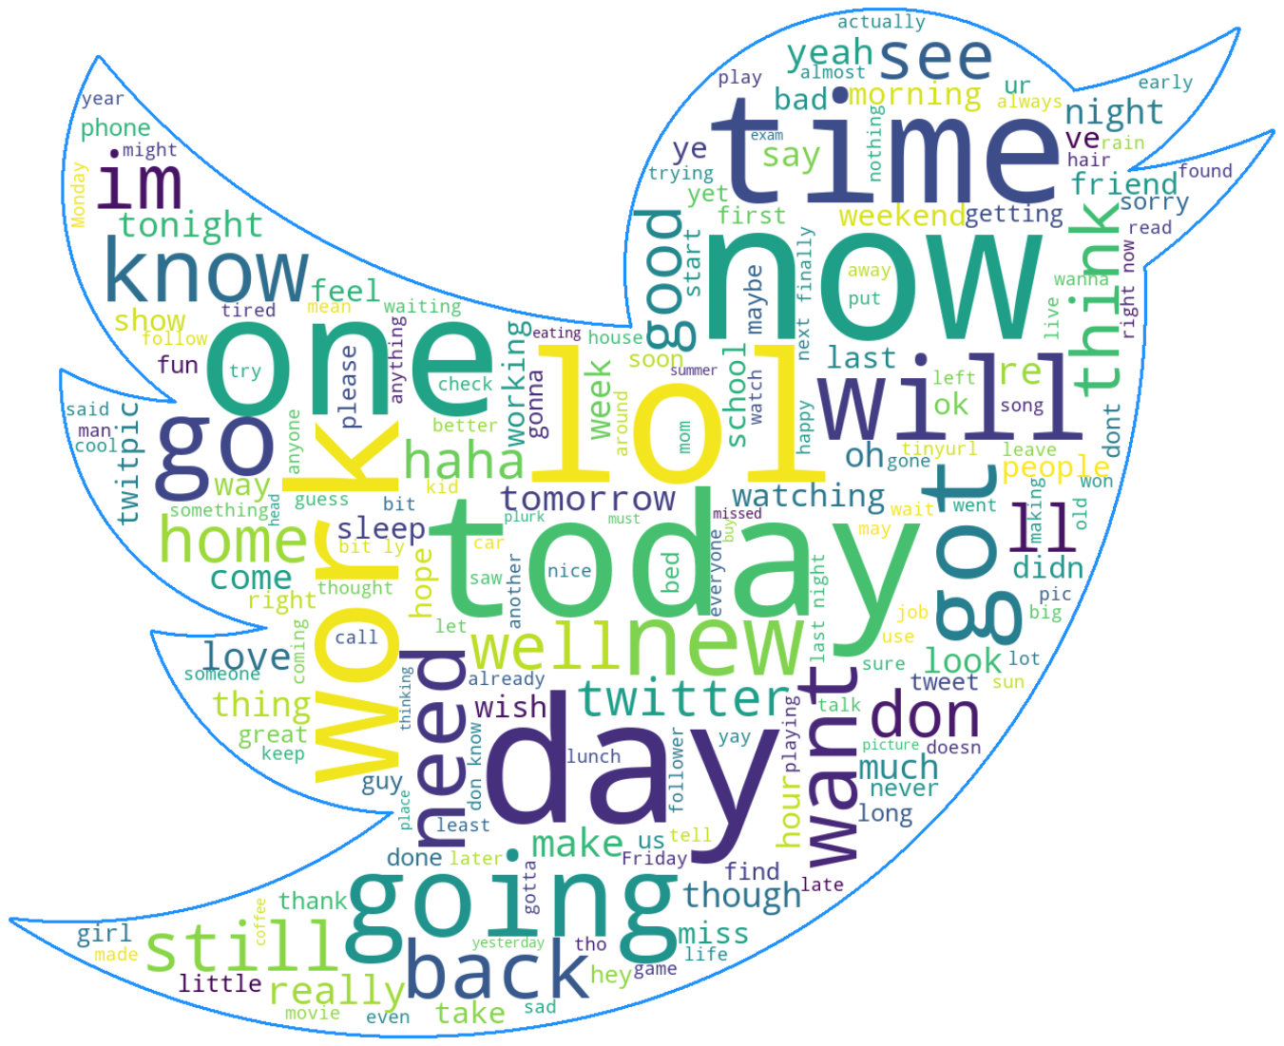
Common words associated with neutral tweets

Slide 9
02
METHODOLOGY
Neural Nets and NLP with Fastai

Slide 10

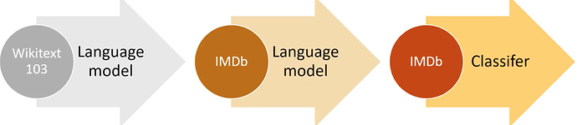
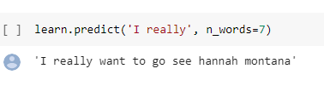
METHODS
ULMFiT - Universal Language Model Fine Tuning
Our Tweet based language model

Slide 11
Intrinsic Attention - What is it?
Essentially a ranking of words based upon significance to its classification
Allows quick, at a glance, identification of keywords

Slide 12
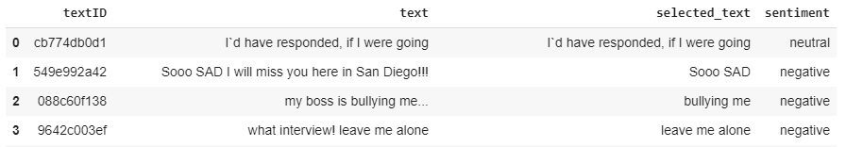

Our Kaggle Dilemma and Intrinsic Attention
Fastai’s built-in Intrinsic Attention method

Slide 13

Obtaining Selected Text using Intrinsic Attention

Slide 14
03
RESULTS
Model Performance and Intrinsic Attention

Slide 15
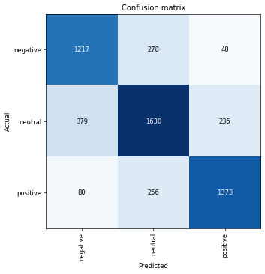
Model Performance
Average Overall Accuracy
~76%

Slide 16
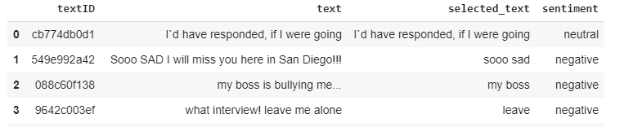
Intrinsic Attention
Desired Output
Our Output

Slide 17
04
CONCLUSIONS
Takeaways and Future Work

Slide 18
Takeaways
Twitter
Fastai
Unique dialect
Character limit
Slang
Typos
A lot of non alphanumeric characters
URLs
Powerful and efficient library built on pytorch, but takes some time to understand the inner-workings.
Highly recommend the fast.ai course!

Slide 19
FUTURE WORK
Improvements to Vocab creation
Experiment with stop words...etc
Experiment with different Tokenizers
BERT, ROBERTA, GPT-2...etc
Refinement of our “Selected Text” function
Words in different parts of the sentence may have similar weights
Attempting additional tuning parameters or starting from a different pretrained model
Explore alternative methods to intrinsic attention and compare results

Slide 20


