Slide 1


New Geometries for Cellular Automata
Samanvitha Basole, Phyllis Lau, Dr. Tim Hsu

Slide 2
Introduction
Tree Life is adapted from an existing game called Game of Life (or simply Life) invented by John Conway
Cellular automaton: game that is played by itself, giving results through its previous states after one initialization
Uses 2D square grid where a cell has eight adjacent neighbors
Two states only: a cell is either alive or dead
Rules: At time t + 1, a cell survives if it had 2-3 neighbors at time t. At time t + 1, a dead cell comes alive (is born) if 3 of its neighbors were alive at time t.
1 | 2 | 3
4 |  | 5
6 | 7 | 8

Slide 3
Game of Life in Action
survives: 2 neighbors
dies: 1 neighbor
Initial: at time t
at time t + 1
at time t + 2
is born: 3 neighbors
survives: 2 neighbors
dies: 1 neighbor
dies: 1 neighbor
dies: 1 neighbor
is born: 3 neighbors
survives: 2 neighbors
Rule to survive: 2-3 Rule to spawn: 3

Slide 4
Tree Life Design
2
1
Changes in structure and neighbors
  tree structure with nodes
  maximum number of neighbors: 3
Change in rules for spawning and surviving
    Possible rules: any combination of 1, 2, 3
Starts with root node in center to build tree
1
3
3
2
3
1
2

Slide 5
Tree Life Design
ac
ba
Letters to represent nodes
  a, b, c
  no repeats
  root of tree represented by empty string
Length of word represents radius (height) of tree
  ex: abcba = radius of 5
ab
a
b
bc
E
c
ca
cb
radius of 1
radius of 2

Slide 6
Tree Life in Action
Initial: at time t
at time t + 1
at time t + 2
is born: 3 neighbors
dies: no neighbor
dies: no neighbor
dies: 2 neighbors
survives:
1 neighbor
survives: 1 neighbor
Radius of 3
Rule to survive: 1 Rule to spawn: 3
dies: 2 neighbors
dies: no neighbors

Slide 7
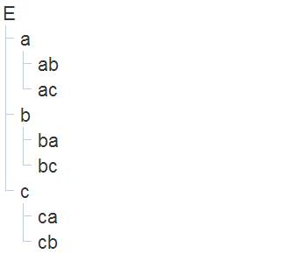
Implementing Design
root
By choosing the identity E as the root, the tree is visualized as a file tree.
neighbors
radius of 1; neighbors
radius of 2

Slide 8
ac
ba
root
ab
a
b
bc
neighbors
radius of 1; neighbors
E
radius of 2
c
ca
cb

Slide 9
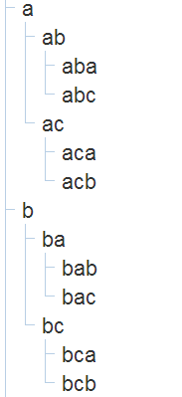
Tree of Cells
A graph with parent and child nodes
Parent node
Child nodes
The child node of a parent is the string of the parent name concatenated with a, b, or c

Slide 10
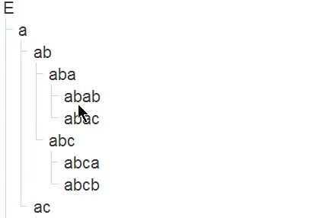
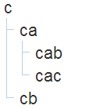
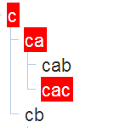
Evolution of Cells
Cells set to living or dead with color change

Slide 11
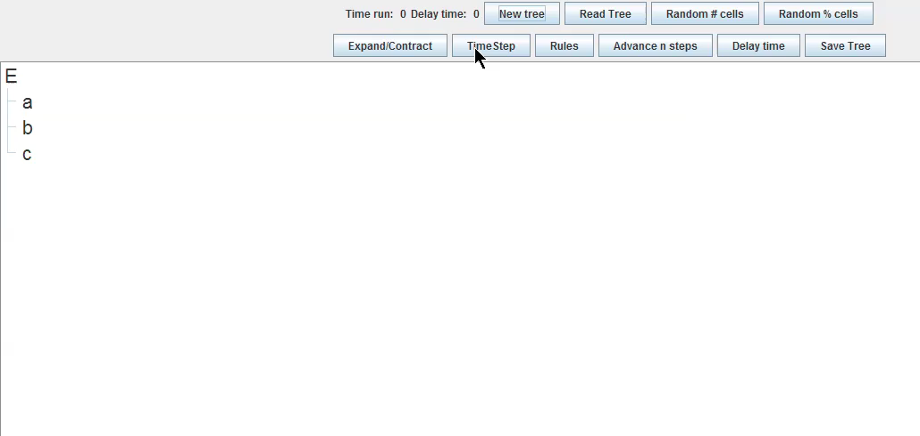
Features
Creates a new tree with the specified radius
New Tree

Slide 12
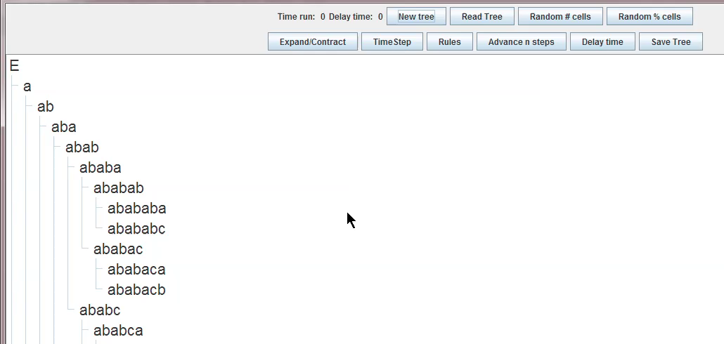
Expands/contracts the child nodes
Expand/Contract

Slide 13
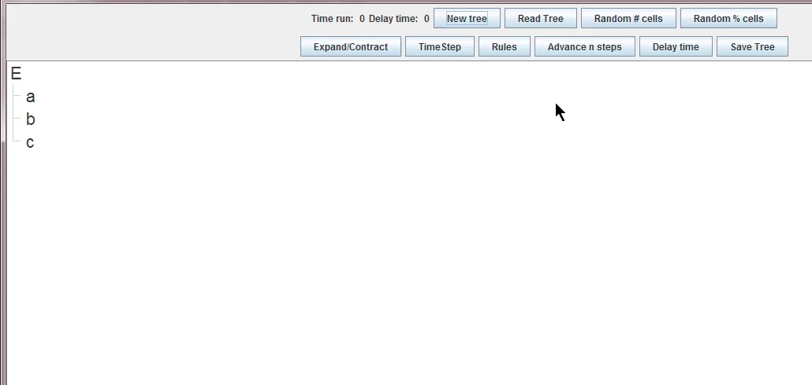
Sets randomly the inputted number
of nodes as living
Random # Cells

Slide 14
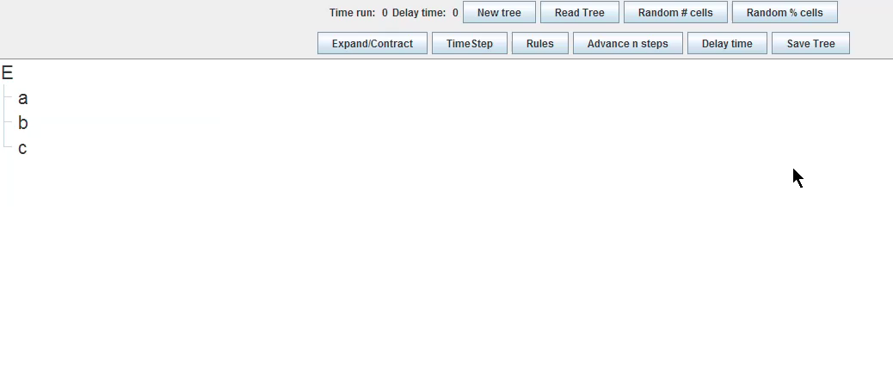
Sets randomly the inputted percentage
of nodes as living
Random % Cells

Slide 15
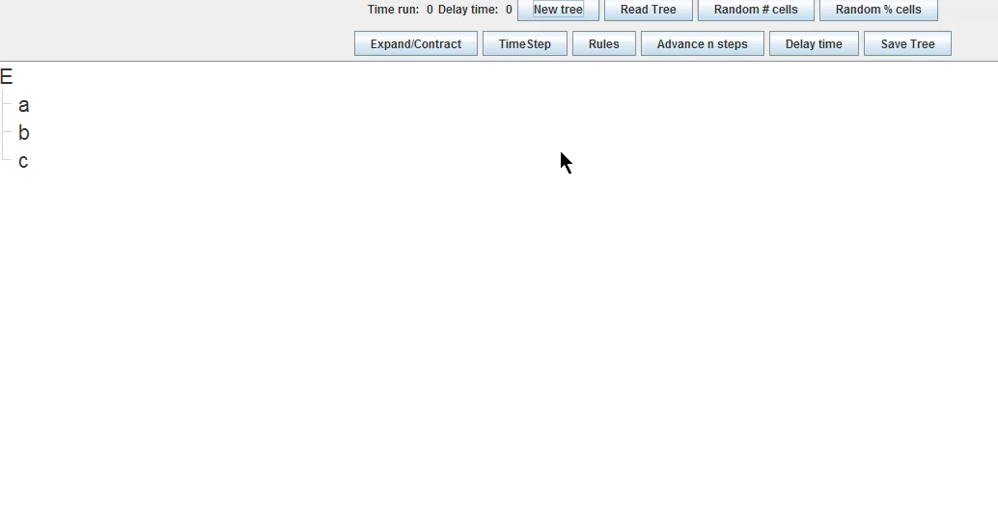
Loads a file, reads the radius and
the list of nodes, draws them on the
visual tree
Read Tree

Slide 16
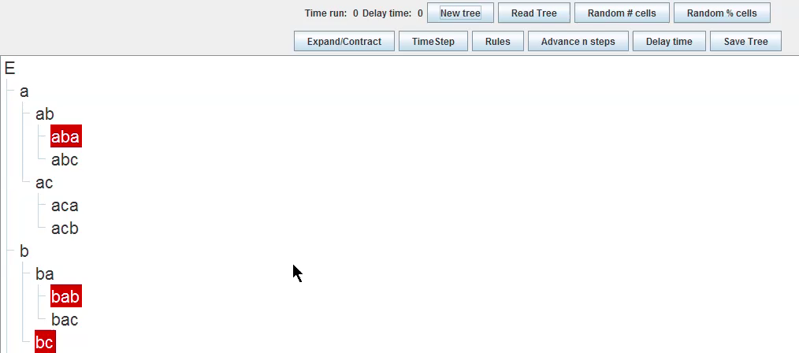
Prints on a file the radius and the list
of nodes living
Save Tree

Slide 17
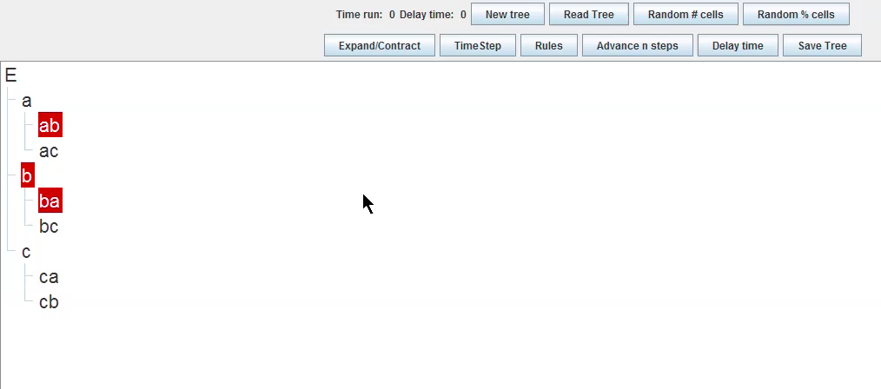
Displays LIFE at time t+1 given the
LIFE at time t
TimeStep

Slide 18
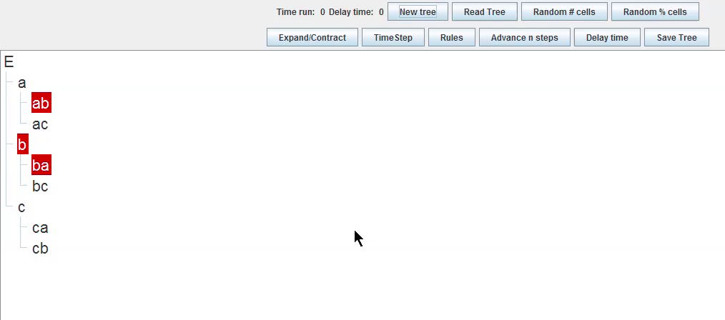
Runs TimeStep n times
Advance n Steps

Slide 19
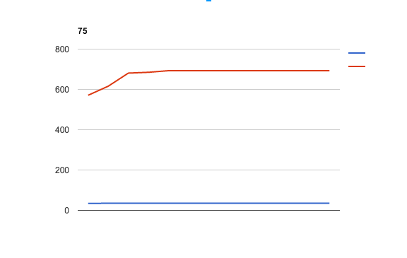
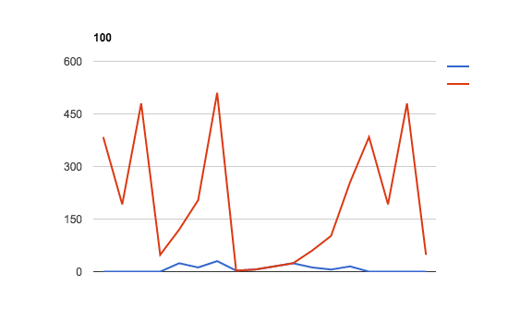
Population Growth
Results on number of survivors include:
  repeating/alternating numbers
  constant trends
Conclusion: most interesting rules are
  Rule to Survive: 1-1, 2-2, 3-3
  Rule to Spawn: 1-1, 1-2
75%, RTS: 1-3, RTB: 1-1
100%, RTS: 1-1, RTB: 1-2

Slide 20
Open Question 1: Glider
Game of Life
Tree Life
?
the glider moves one square diagonally after 4 generations

Slide 21
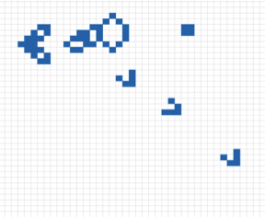
Open Question 2: Glider Gun
Game of Life
Tree Life
?
line of gliders shot through glider gun

Slide 22
Thank You

