Slide 1
STROKE PREDICTION UCSF
Classification model to predict stroke in patients
Sameera Bellary
May 2022

Slide 2
INTRODUCTION
According to CDC, 5% of deaths in the world are caused by strokes
Stroke is a disease that affects the arteries leading to and within the brain
A stroke occurs when a blood vessel that carries oxygen and nutrients to the brain is either blocked by a clot or bursts (or ruptures).
Age and high hypertension are the main factors of a stroke.

Slide 3
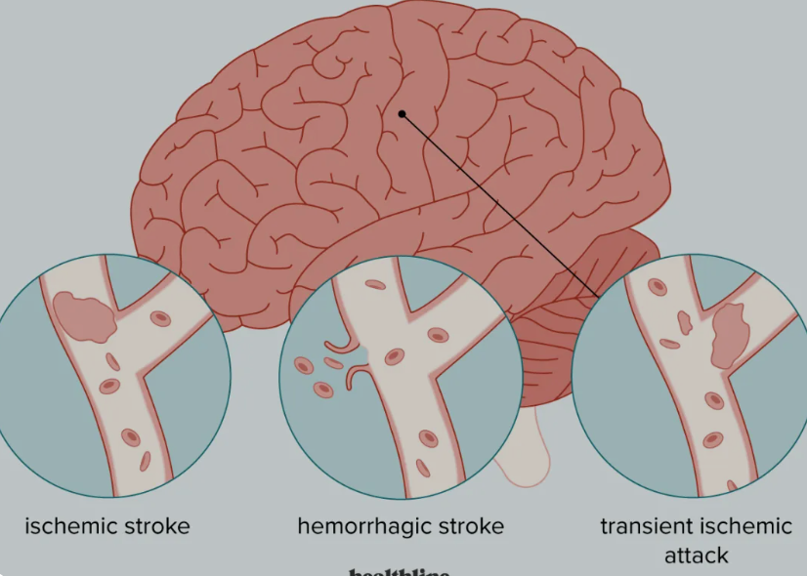
Types of stroke
Ischemic stroke
Caused by a blockage or clot in a blood vessel in your brain. The blockage can be caused when a substance called plaque builds up on the inside wall of an artery.
Hemorrhagic stroke
Caused when an artery in the brain breaks open. The interrupted blood flow causes damage to your brain.
Transient ischemic attack (TIA)
Caused by a small clot that briefly blocks an artery. It is sometimes called a mini-stroke or warning stroke. The TIA symptoms usually last less than an hour.

Slide 4
GOAL –
UCSF stroke clinic wants to predict which patient is at a higher risk for a stroke.
The risk can be classified as
No risk
High risk

Slide 5
Methodology -
Data Set
Around 5,000 entries of patient data
16 predictors – categorical and numerical
Categorical features were binarized
Target Variable – Stroke
1 == Yes
0 == No
Highly imbalanced
95.75% Negatives (0) to 4.25% Positives (1)

Slide 6
Tools -
Pandas – Clean, Explore and Feature Engineering
Scikit-Learn – Build different Classification models and perform cross validation, variable selection and regularization
Matplotlib/ Seaborn – Visualizing data exploration, modeling and results
Python 3.8.5 – to run all of the above

Slide 7
Results -
Seven individual models and two ensembles built :
1. Logistic Regression (regularization optimized for AUC metric with class weight adjustment)
2. Logistic Regression (regularization optimized for log loss metric with class weight adjustment)
3. Logistic Regression (regularization optimized for AUC metric)
4. Random Forest Classifier (hyperparameters optimized for AUC metric)
5. Random Forest Classifier (hyperparameters optimized for log loss metric)
6. XG Boost Classifier (hyperparameters optimized for AUC metric)
7. XG Boost Classifier (hyperparameters optimized for log loss metric)
8. Ensemble Voting Classifier (combining the last five models)
9. Ensemble Voting Classifier (combining the first two models)

Slide 8
Goal : Maximize Recall (True positive rate, or TPR)
Recall = TP/(TP + FN)
Minimize false negatives, so the misses a very few high risk patients
As FN decreases, TPR or recall increases
As Recall increases, precision decreases (False positive rate)

Slide 9
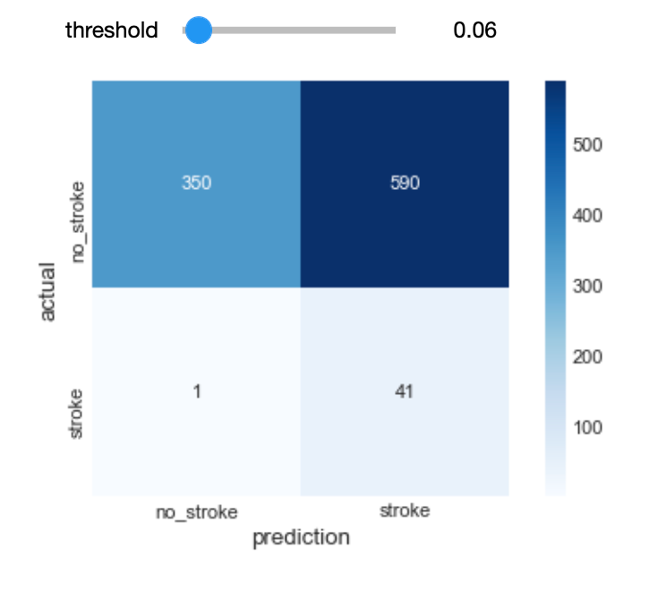
Best Model : Voting classifier (Soft) Logistic Regression with weights adjusted
Accuracy Score – 0.92
Recall – 0.97
False negatives minimized
At threshold 0.06

Slide 10
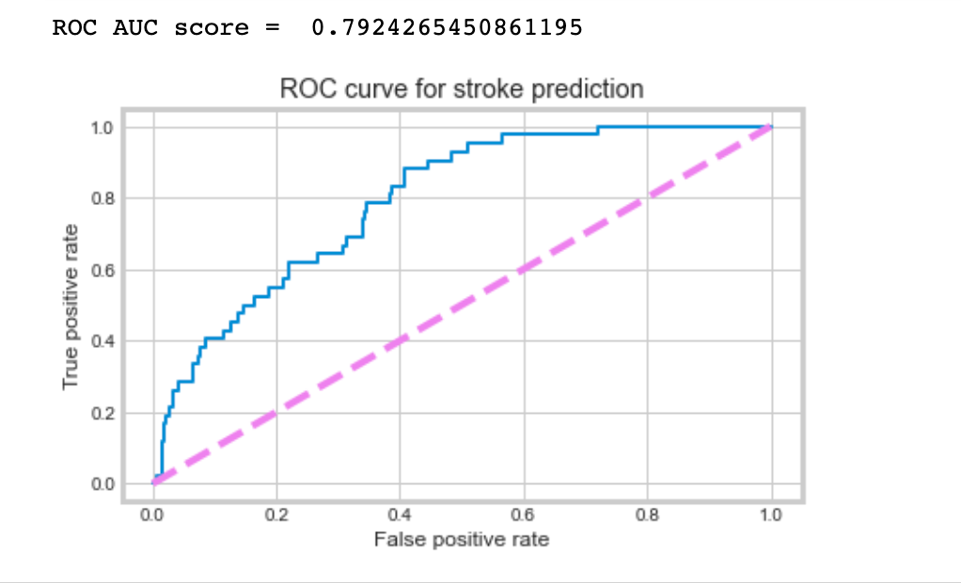
AUC Score - 79%
Precision – 0.0756
Precision decreases
True positive rate or recall increases

Slide 11
CONCLUSIONS
Recommendations :
Deploy the model
Develop a multi class model predicting high, medium and low risk patients

Slide 12
Future Work :
Collect more data
Collect more features which increase the risk of stroke
Retrain the model periodically and decrease the precision or false positive rate
Build a deep learning model

