Slide 1
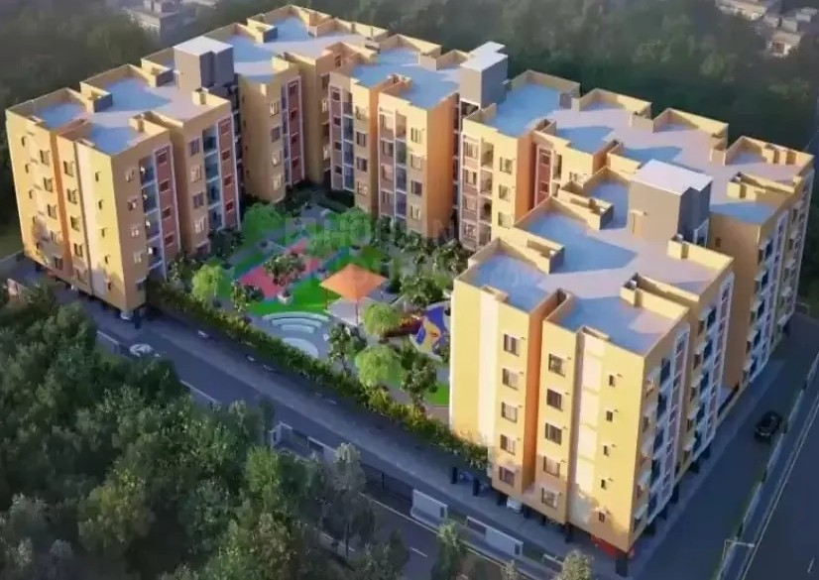
AMAZE by Urban Tree Apartment Owners Association
Together we win

