Slide 1
AWS S3 Honeypot as a Service (HPaaS) Project Proposal
Bradley Sanchez
Cloud Architect
Diagram Design
Observability Engineer
Alonzo Izzo
Applications Provisioner
Documentation
Monitoring Analyst

Slide 2
Problem Statement
This project creates a low-cost, ethical AWS S3 honeypot that safely logs unauthorized access for educational purposes.

Slide 3
Project Objectives
Implement a low-interaction web honeypot using AWS S3 to mimic a login or admin page.
Capture and log access attempts (IP addresses, timestamps, HTTP methods) for analysis of attacker behavior.
Demonstrate cloud-based security monitoring using free-tier AWS services such as CloudWatch and SNS.
Use AWS Lambda for automated processing/alerts when the honeypot is accessed.
Stay fully within AWS Free Tier to avoid costs while maintaining functionality.

Slide 4
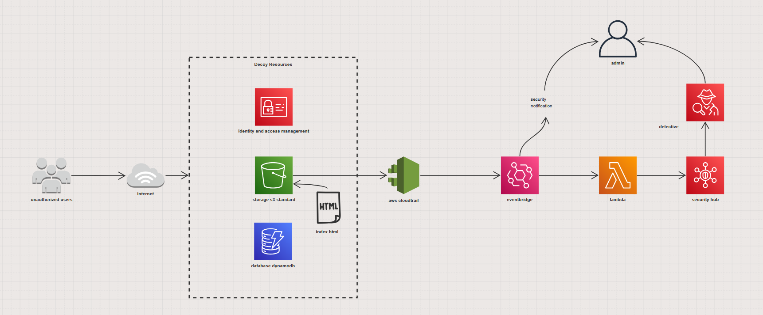
Proposed solution overview
A low-cost AWS S3 honeypot that safely logs unauthorized access for educational purposes.

Slide 5





Cloud Services and Tools
Amazon Simple Storage Service
Amazon Identity and access management
Aws Lambda
CloudTrail
Amazon detective

Slide 6
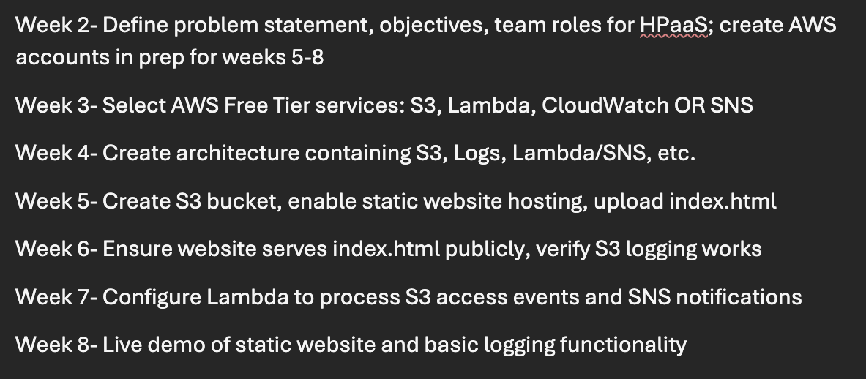
Timeline (For Weeks 2-8)

Slide 7


SENTINELS3- HPAAS
Team Members: Bradley Sanchez & Alonzo Izzo

Slide 8
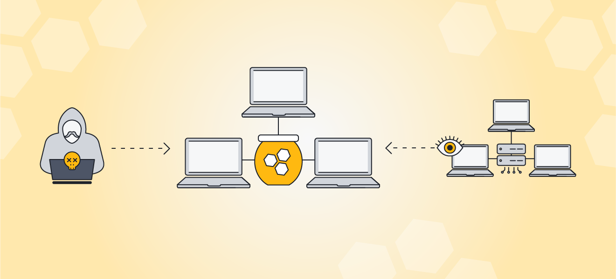
FUNCTIONAL REQUIREMENTS
Host a public-facing decoy website and database
Mimic a legitimate web interface
Log all access attempts and requests for ssh and failed login attempts
Trigger alerts on suspicious activity and failed logins
Support basic investigation of access patterns

Slide 9

NON-FUNCTIONAL REQUIREMENTS
Low cost
Serverless
Secure and fault tolerant
Scalable to support varying traffic needs
Reliable and highly available

Slide 10

SELECTED CLOUD PROVIDER & JUSTIFIER
Our Selected Cloud Provider:
Amazon Web Services (AWS)
Why?
Free tier serverless svc
Security & monitoring tools
Industry-standard cloud platform
Event-driven architectures
Ease of use

Slide 11

CLOUD SERVICES OVERVIEW
Amazon S3
AWS Lambda
Amazon EventBridge (Optional/may me redundant with Lambda)
Amazon SNS
Amazon CloudWatch
Amazon Detective (Optional)
AWS IAM
*Selected services may be adjusted as project objectives evolve*

Slide 12



TECHNOLOGY STACK AND TOOLS
Frontend: HTML, CSS, JavaScript
Backend Logic: AWS Lambda (Python or Node.js)
Logging & Monitoring: S3, CloudWatch
Notifications: Amazon SNS
Development Tools: AWS Console, GitHub

Slide 13

KEY DESIGN CONSIDERATIONS
Ethical and safe honeypot
Free Tier cost awareness
No collection of sensitive user data
Minimal attack surface
Educational and demonstrative focus

Slide 14
Week 4 Milestone: System Architecture & Design Diagram
Alonzo Izzo & Bradley Sanchez

Slide 15
Week 3 recap
Selected cloud provider: Amazon Web Services
Technology stack and tools: HTML, AWS lambda, CloudWatch, etc
Functional requirements: mimic a legitimate website, log all suspicious attempts
Key design considerations: ethical and safe, educational and demonstrative focus, free tier cost awareness

Slide 16
Architecture Overview
Low-interaction, serverless web honeypot
Static website hosted on Amazon S3
Logs unauthorized access attempts safely
Uses AWS-managed services
Designed for AWS Free Tier compliance

Slide 17
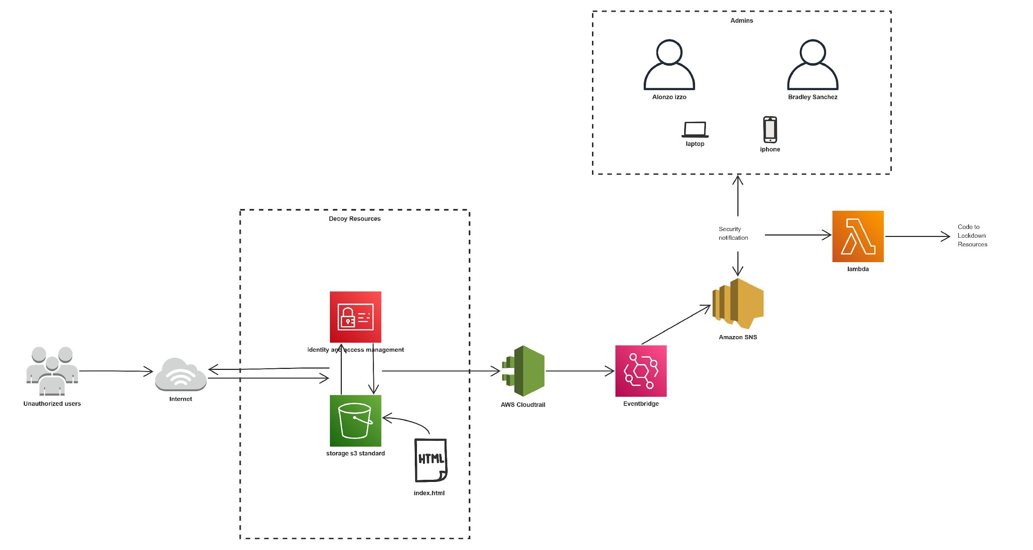
System Architecture Diagram

Slide 18
Component Interaction & Data Flow
a
•A user accesses the honeypot website via the public S3 endpoint
•Amazon S3 serves the static the static content to the user’s browser
•All access requests are logged by Amazon S3
•Logs are stored in S3 and monitored through CloudWatch
•AWS Lambda processes logs and triggers alerts via SNS

Slide 19
Scalability & Availability
•Amazon S3 automatically scales to handle varying traffic levels
•The serverless design removes single points of failure
•AWS-managed services ensure high availability without manual intervention
•No capacity planning is required due to the static and event-driven architecture

Slide 20
Security Overview
No real authentication or sensitive data is collected
IAM roles enforce least-privilege access
The honeypot is isolated from any production systems
Logs are strictly for educational and analytical purposes

Slide 21

Key Design Decisions
Chose S3 for simplicity and cost efficiency
Avoided databases and servers
Used optional automation for alerts
Designed for ethical, academic use

