Slide 1
CLOUD COMPUTING — MIDTERM PRESENTATION
SENTINEL-S3
Cloud Honeypot Simulation & Intrusion Analysis
Bradley Sanchez & Alonzo Izzo

Slide 2
WHAT IS A HONEYPOT?
Definition
Cowrie SSH Honeypot
A honeypot is a deliberately exposed security resource designed to attract attackers. It simulates a real system, logging every interaction without risk to production infrastructure.
Cowrie is a medium-interaction SSH honeypot that emulates a real Linux shell. Attackers believe they have breached a live server.
Cowrie captures:
Why it matters:
Login username & password attempts
Shell commands executed by attacker
Session timing & source IP address
Full structured JSON logs per event
Observe real attack patterns safely
Capture attacker credentials & commands
Study threat actor behavior first-hand

Slide 3
TECHNOLOGY STACK
Honeypot
Data Pipeline
• Cowrie SSH Honeypot
• AWS Lambda (Python 3.12)
• Python 3 runtime
• Amazon S3 (log storage)
• EC2 t2.micro (Free Tier)
• DynamoDB (cowrieEvents)
• Public subnet / VPC
• Amazon SNS (email alerts)
Web Frontend
Auth & API
• Plain HTML5 / CSS3 / JS
• Amazon Cognito (PKCE)
• Dimension by HTML5 UP
• Lambda Function URL
• Amazon S3 (static host)
• OAuth 2.0 + JWT tokens
• CloudFront CDN (HTTPS)
• IAM roles & policies

Slide 4
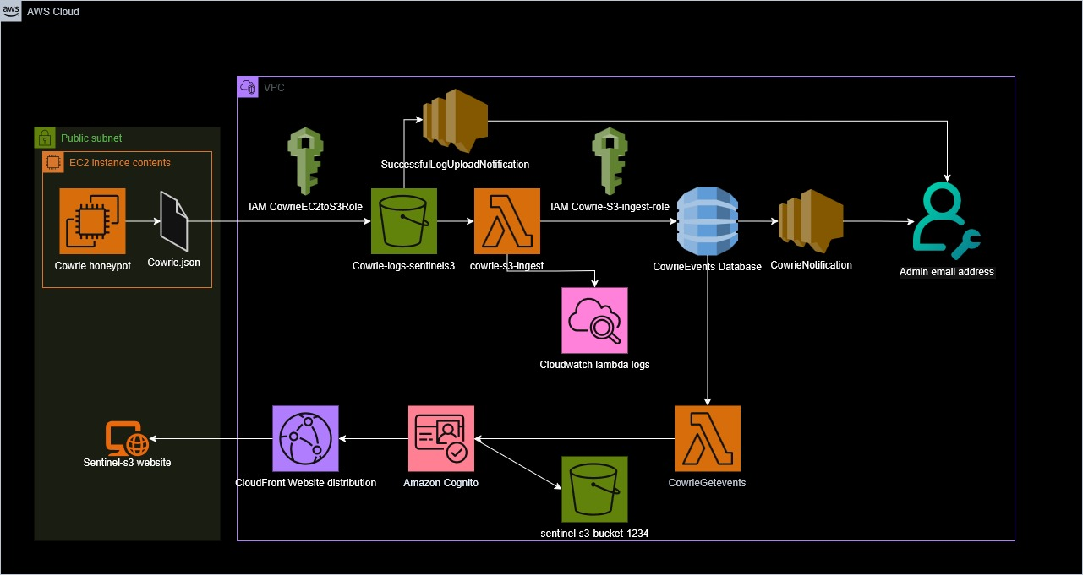
SYSTEM ARCHITECTURE
→

Slide 5
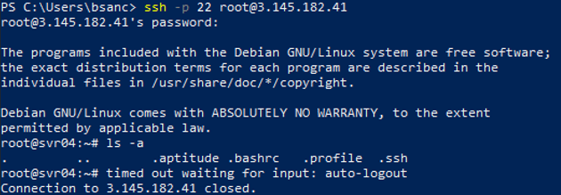
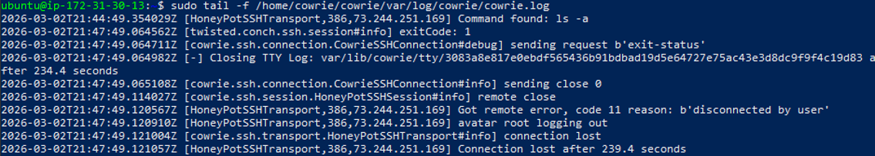
EC2 Instance
→

Slide 6
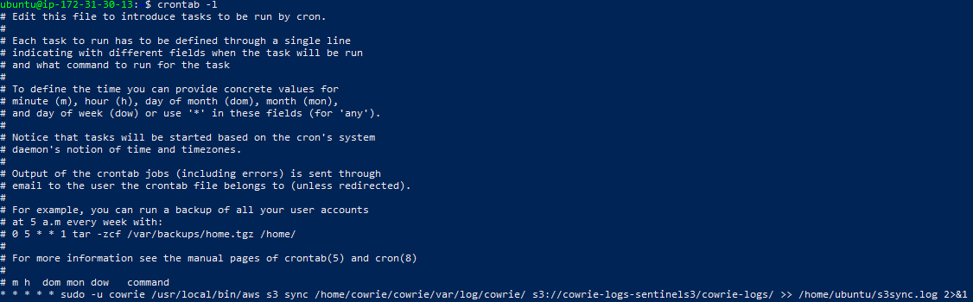
EC2 instance
→

Slide 7
LIVE DATA & RESULTS
2,009
38
112
~7 Days
Total Events
Unique Attacker IPs
Usernames Tried
Collection Period
Most Common Attacker Credentials Captured
Event Types Observed
Username | Password
root | 123456
admin | 12345
admin | admin
user | password
es | es123
cowrie.login.failed
Failed auth attempt
cowrie.session.connect
New attacker session
cowrie.command.input
Command executed
cowrie.login.success
Successful login
cowrie.session.closed
Session terminated

Slide 8
CHALLENGES & SOLUTIONS
CORS preflight blocking
→ Solution:
Switched from API Gateway to Lambda Function URL with dedicated CORS config
Cognito UI overhaul
→ Solution:
Remapped all settings from the old 'App Integration' tab to the new left-sidebar layout
Lambda scan timeout
→ Solution:
Increased timeout to 30s and memory to 256MB; rewrote to paginate DynamoDB internally
Wrong S3 upload path
→ Solution:
Updated upload script to write to cowrie-logs/cowrie.json matching the Lambda trigger prefix
Client secret conflict
→ Solution:
Deleted app client and recreated as SPA type — automatically disables client secret for PKCE

Slide 9
NEXT STEPS
Planned Improvements
Add more DynamoDB columns (dst_ip, session, message)
Improve dashboard visualizations and charts
Minor website design tweaks for presentation
Sentinel-S3 • Bradley Sanchez & Alonzo Izzo • Cloud Computing Midterm
https://d1lntby3a9gmd4.cloudfront.net

