Slide 1

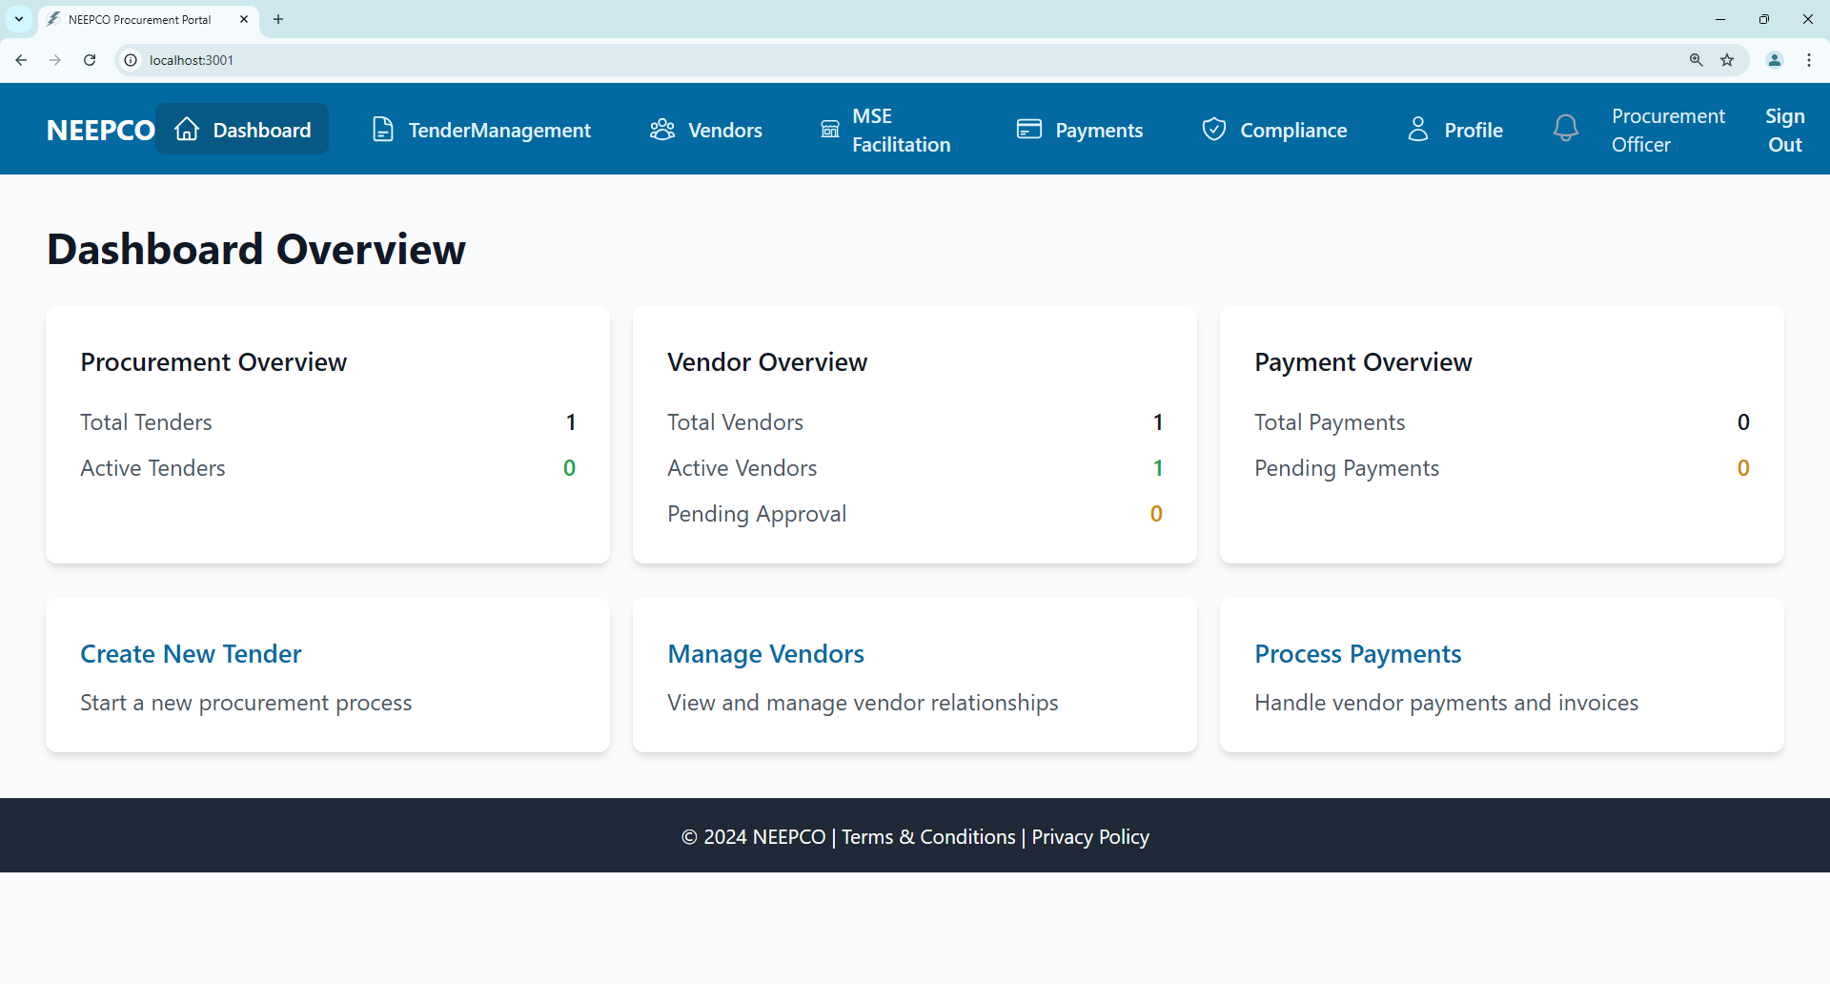
Department of Computer Science & Engineering
Project Title:
PORTAL FOR NEEPCO PROCUREMENT PROCESS AND VENDOR PAYMENT DETAILS
ABSTRACT
Guide:
Dr. Raghu Kumar L,
Associate Professor &
Head of the Department
Batch No:A_02
NEEPCO struggles with slow and inefficient procurement processes, mainly due to manual work, delayed payments, and poor record-keeping. This lack of organization makes it hard to track transactions, and manage vendor relationships effectively.
Students:(21QM1A05__)
Komminni Umadevi(58)
Alli Sravani (05)
Bobbili Sandeep (23)
Venkat Tarun (60)
Trilokeshwar Rao (51)
Department:
CSE
AIM/OBJECTIVE
The aim is to address major problem of NEEPCO's procurement process is the difficulty in managing procurement activities and vendor payments efficiently. This issue is more significant when dealing with Micro and Small Enterprises (MSEs) and purchases through the Government e-Marketplace (GeM) portal. The absence of a structured system makes it challenging to track and manage procurement data, causing delays and inefficiencies.
The criteria and constraints are Efficiency, Transparency, Data Management, User-Friendly Interface, Compliance, and Support for MSE and GeM Transactions.
At last, mostly the end users are NEEPCO procurement officers, managers, finance staff, and vendors.
RESULT & APPLICATION
The NEEPCO Portal streamlines procurement processes, improves data accuracy, and enhances transparency. It simplifies tender management, vendor tracking, and payment workflows while ensuring compliance. Future upgrades may include mobile support and advanced analytics for better insights.
METHODOLOGY
The system will use:
React.js for the frontend and Supabase for the backend.
Role-based access control for secure authentication.
Core modules for user management, tender management, vendor management, payment processing, and reporting.
Security features like JWT authentication, data encryption, and secure password handling.
This design ensures streamlined workflows, improved transparency, and better data management for NEEPCO.
CONCLUSION
The NEEPCO Portal effectively addresses procurement challenges, ensuring efficiency, improved communication, and better management of MSE transactions. End users include procurement officers, managers, finance staff, and vendors.

