Slide 1
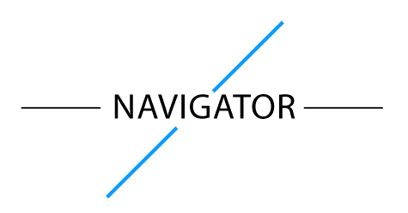





A guide to the most frequently used forms
Navigator is a scalable, progressive web app that utilizes a rules engine to guide policy holders, agents, customer service reps and beneficiaries to the most commonly used forms on nyl.com -- reducing the 25% error rate in forms filing, increasing policy holders’ familiarity with online service solutions and limiting call inquiries. Navigator is a differentiator in simplicity of design and enterprise scalability.
On average, a policy owner interacts with a policy less than five times over the life of the product
Policy holders rely heavily on service centers due to unfamiliarity with the website and lack of policy knowledge
Navigator, by asking a few pointed questions and using familiar web design principles, will direct users to the correct forms online
Scalable Rules Engine
Using dynamic rules design, Navigator handles multiple different scenarios and is scalable for an full solution.
Clear Design
Due to the infrequency with which policy holders access the forms, it is crucial that the design be both clear and familiar.
Ben saphier – baki mumkaya – peter Mascarenhas – Eileen Hengel – sean walsh

