Slide 1

Introduction to the ColdFusion API Manager and ColdFusion RESTful web services
Webinar API SERIES – Brian SAPPEy

Slide 2

Agenda Items
Download and Installation
Accounts (Admin / Portal –Sub/Pub)
Discovery / REST
Birds Eye View

Slide 3
Important Installation Item's
ColdFusion Enterprise
APACHE Config
Account

Slide 4
WHAT IS THE API Manager?
OVERVIEW
PURPOSE
TECHNICAL

Slide 5
Download Location
Link
https://www.adobe.com/support/coldfusion/downloads.html#cf2021apim

Slide 6
POST Installation – URL STRUCTURE + PORTS
PORTAL
ADMIN

Slide 7
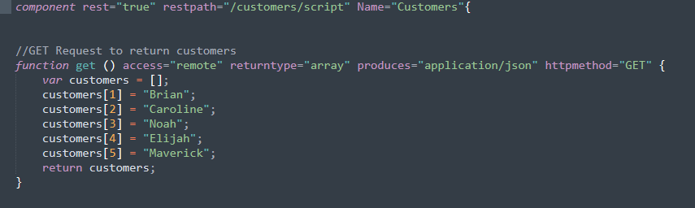
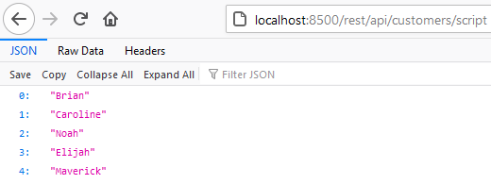
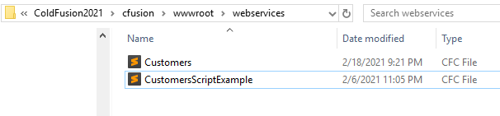
COLDFUSION + REST

Slide 8
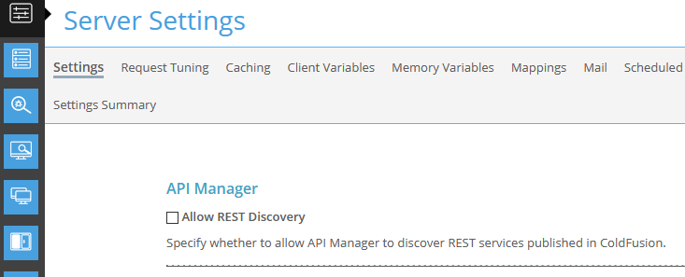
SERVER Settings ColdFusion ADMIN - API MANAGER ALLOW

Slide 9
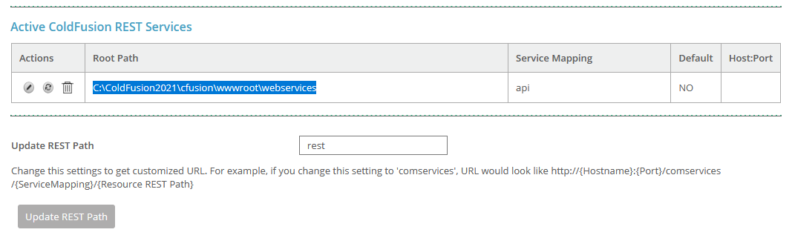
SERVER Settings ColdFusion ADMIN - API MANAGER ALLOW

Slide 10
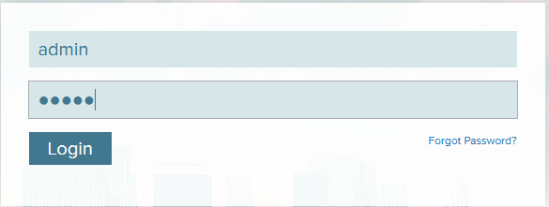
Initial Login – Admin or PORTAL

Slide 11
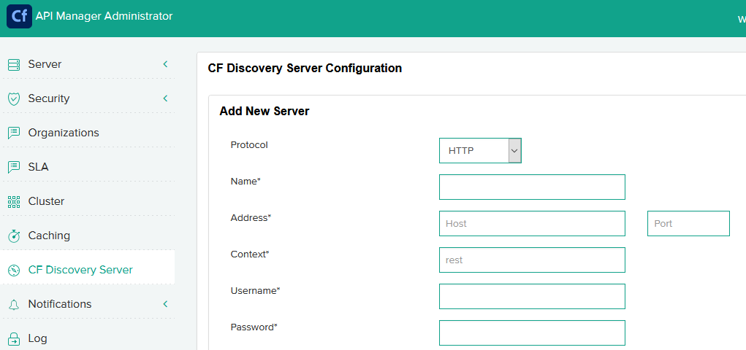
SERVER Discovery - ADMIN

Slide 12
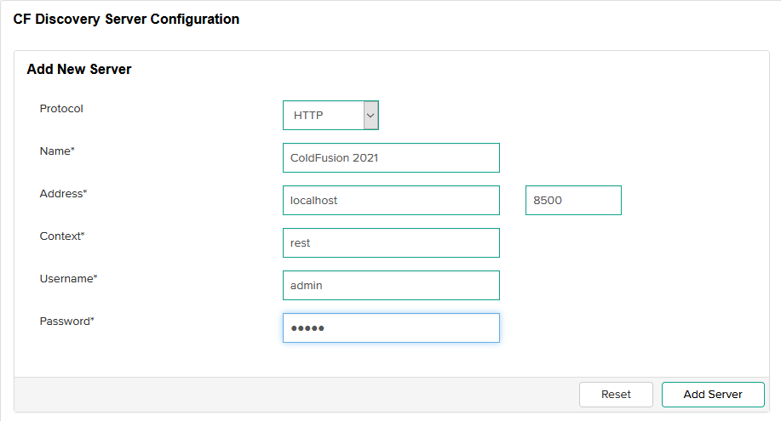
CF Discovery Server VALUES - ADMIN

Slide 13
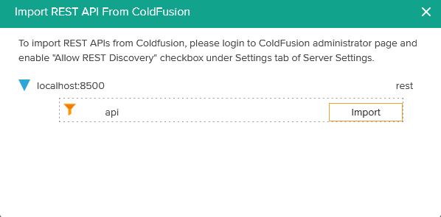
API MANAGER DISCOVERY – PORTAL/PUBLISHER

Slide 14
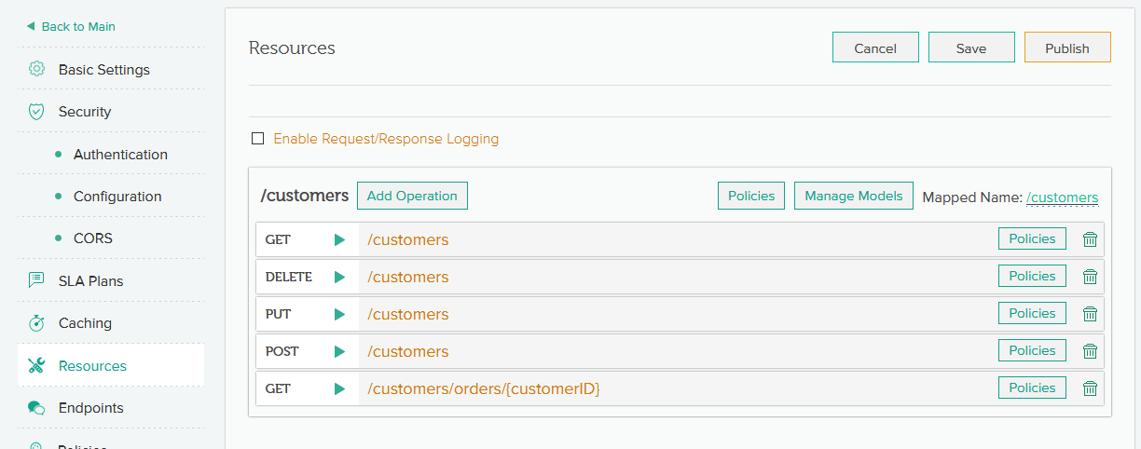
Final Import – COLDFUSION REST

Slide 15
DEMOS and TAKEAWAYS
REST – Samples and Demos
Next Topic and Preparation
Review / Q&A

Slide 16

Thank You
Brian Sappey
SAPPEY CONSULTING LLC
https://www.linkedin.com/in/brian-sappey/

