Slide 1

ColdFusion API Manager: Create and Publish APIs with Multiple Resources
Webinar API SERIES – Brian SAPPEy

Slide 2

Agenda Items
Manual Creation
Swagger Creation
SOAP and SOAP to REST
ColdFusion Native

Slide 3
Swagger, SOAP and REST Links
Link
Swagger :
https://petstore.swagger.io/v2/swagger.json
SOAP:
https://www.dataaccess.com/webservicesserver/NumberConversion.wso?wsdl
CF REST GIT Script : https://raw.githubusercontent.com/bsappey/ColdFusionRestExamples/main/CustomersScriptExample.cfc
https://raw.githubusercontent.com/bsappey/ColdFusionRestExamples/main/Customers.cfc

Slide 4
Important Notes
Not Automatic
Wizards
Pub versus Sub

Slide 5
WHAT IS THE Creation and PUBLISHING Process?
OVERVIEW
PURPOSE
TECHNICAL

Slide 6
WHEN PUBLISHING WHICH ACCOUNT?
PORTAL
ADMIN

Slide 7
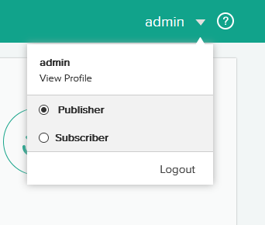
PORTAL – PUBLISHER/Subscriber WHICH ONE to USE? A: PUBLISHER WE will cover subscriber functions later

Slide 8
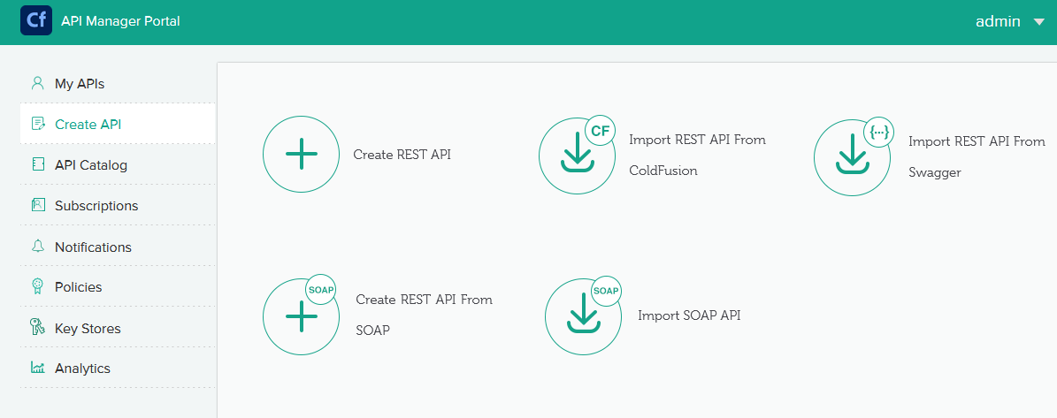
CREATE API – PORTAL – Publisher

Slide 9
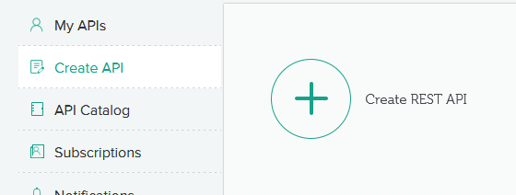
MANUAL CREATION

Slide 10
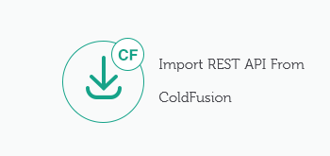
IMPORT REST API FROM Coldfusion
CF REST GIT RAW (.cfc) :
https://raw.githubusercontent.com/bsappey/ColdFusionRestExamples/main/CustomersScriptExample.cfc
https://raw.githubusercontent.com/bsappey/ColdFusionRestExamples/main/Customers.cfc

Slide 11
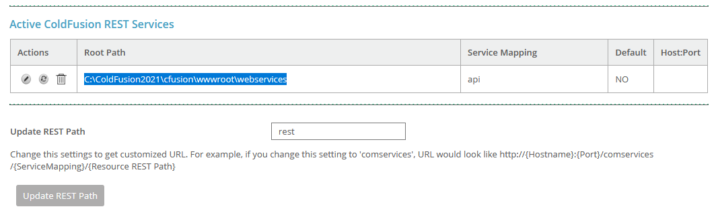
SERVER Settings ColdFusion ADMIN - API MANAGER ALLOW

Slide 12
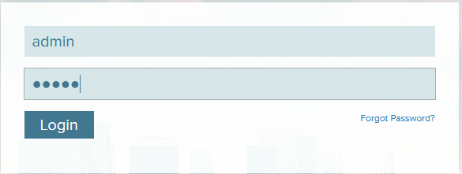
Initial Login – Admin or PORTAL

Slide 13
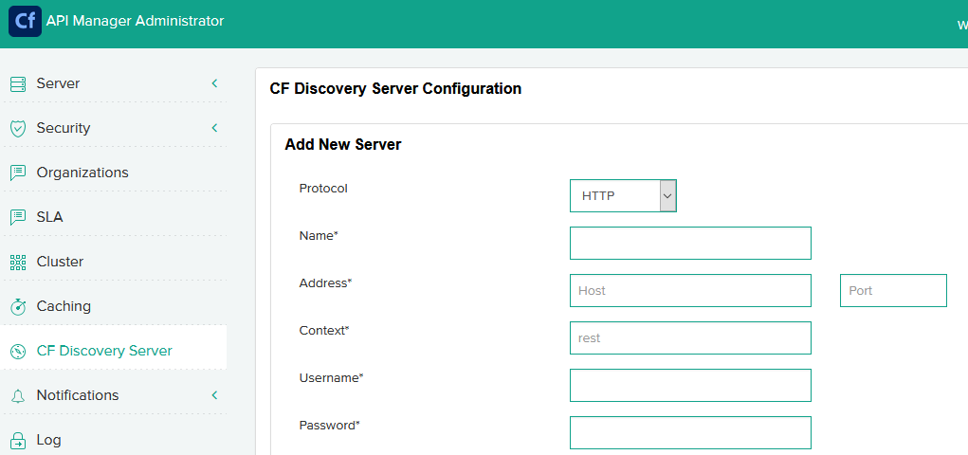
SERVER Discovery - ADMIN

Slide 14
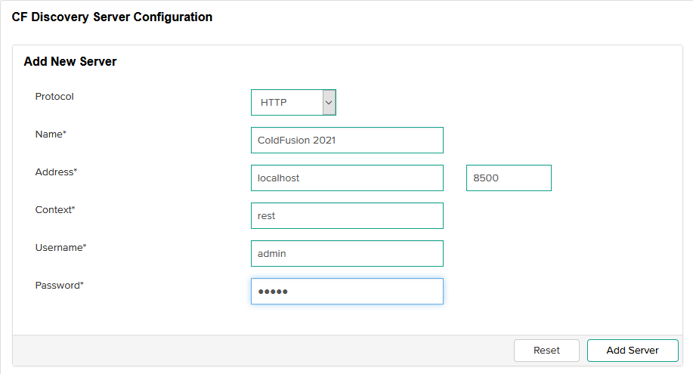
CF Discovery Server VALUES - ADMIN

Slide 15
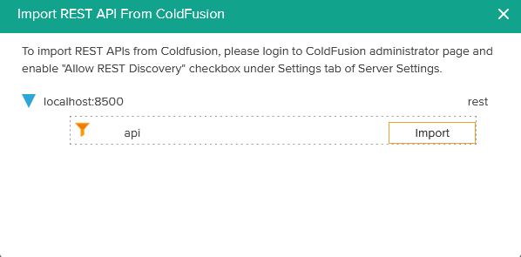
API MANAGER DISCOVERY – PORTAL/PUBLISHER

Slide 16
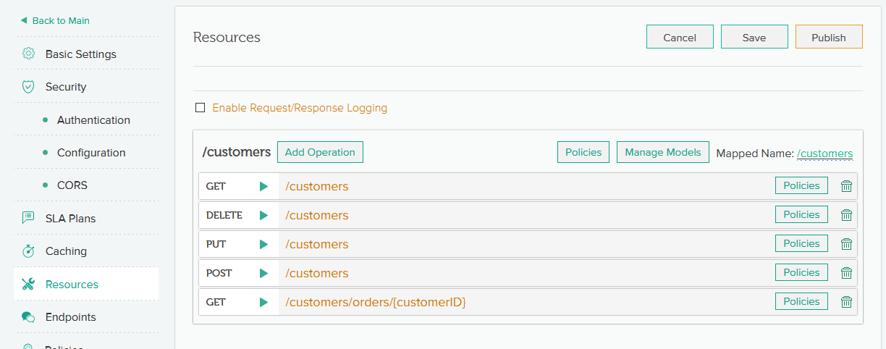
Final Import – COLDFUSION REST

Slide 17
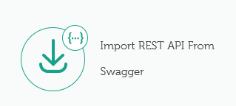
IMPORT REST API FROM SWAGGER
Swagger :
https://petstore.swagger.io/v2/swagger.json

Slide 18
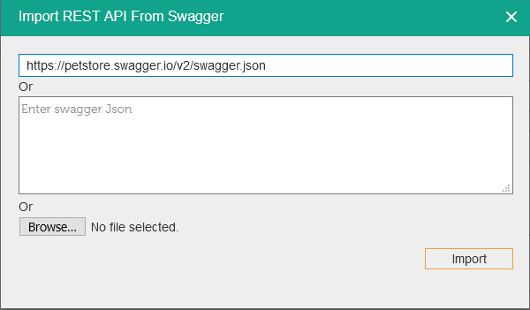
IMPORT REST API FROM SWAGGER - Options
Swagger :
Direct URL
COPY/PASTE
Upload File

Slide 19
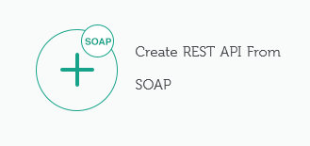
Create REST API From SOAP
SOAP WSDL :
https://www.dataaccess.com/webservicesserver/NumberConversion.wso?wsdl

Slide 20
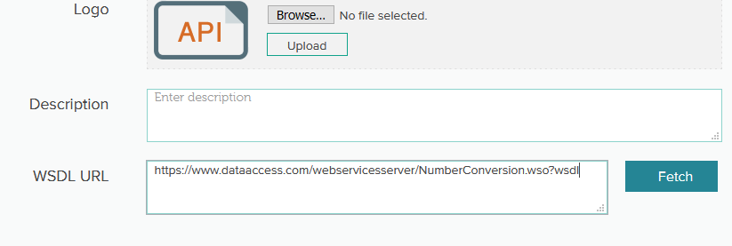
WSDL + FETCH

Slide 21
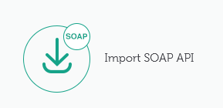
IMPORT SOAP API
SOAP WSDL :
https://www.dataaccess.com/webservicesserver/NumberConversion.wso?wsdl

Slide 22
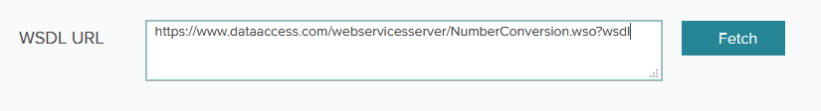
WSDL + FETCH

Slide 23
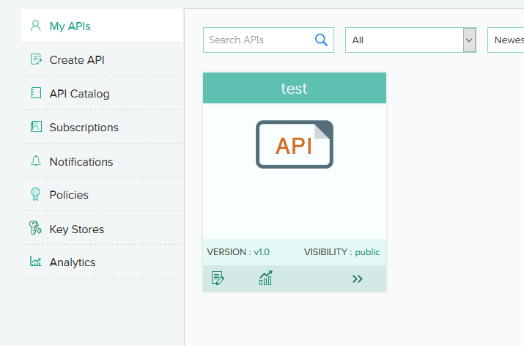
MY APIS AND Management

Slide 24
TAKEAWAYS
Creation and Publishing
Next Topic and Preparation
Review / Q&A

Slide 25

Thank You
Brian Sappey
SAPPEY CONSULTING LLC
https://www.linkedin.com/in/brian-sappey/

