Slide 1

ColdFusion API Manager: VERSIONING and lifecycle management
Webinar API SERIES – Brian SAPPEy

Slide 2

Agenda Items
Catalog and Inventory/Blueprint
Versioning
Lifecycles
Subscriptions

Slide 3
Swagger, SOAP and REST Links
Link
Swagger :
https://petstore.swagger.io/v2/swagger.json
SOAP:
https://www.dataaccess.com/webservicesserver/NumberConversion.wso?wsdl
CF REST GIT Script : https://raw.githubusercontent.com/bsappey/ColdFusionRestExamples/main/CustomersScriptExample.cfc
https://raw.githubusercontent.com/bsappey/ColdFusionRestExamples/main/Customers.cfc

Slide 4
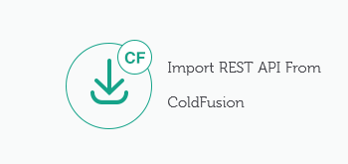
IMPORT REST API FROM Coldfusion
CF REST GIT RAW (.cfc) :
https://raw.githubusercontent.com/bsappey/ColdFusionRestExamples/main/CustomersScriptExample.cfc
https://raw.githubusercontent.com/bsappey/ColdFusionRestExamples/main/Customers.cfc

Slide 5
Important Notes
Subscriptions
API Key
Notifications

Slide 6
WHAT IS Versioning and Lifecycle process?
OVERVIEW
PURPOSE
TECHNICAL

Slide 7
WHEN Versioning/Lifecycle Changes, WHICH ACCOUNT?
PORTAL
ADMIN

Slide 8
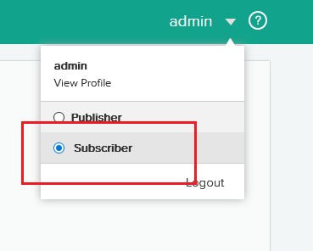
PORTAL – PUBLISHER/Subscriber WHICH ONE to USE? A: Subscriber WE will cover subscriber functions later

Slide 9
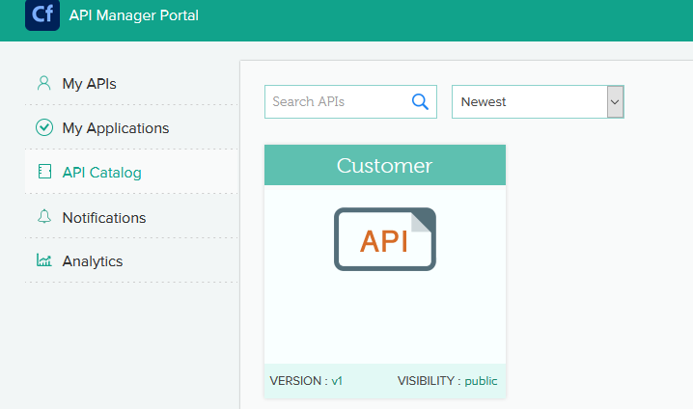
API Catalog – PORTAL – SUBSCRIBER

Slide 10
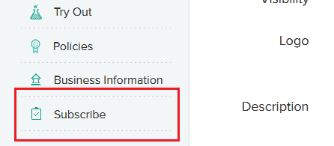
API Subscribe – PORTAL – SUBSCRIBER

Slide 11
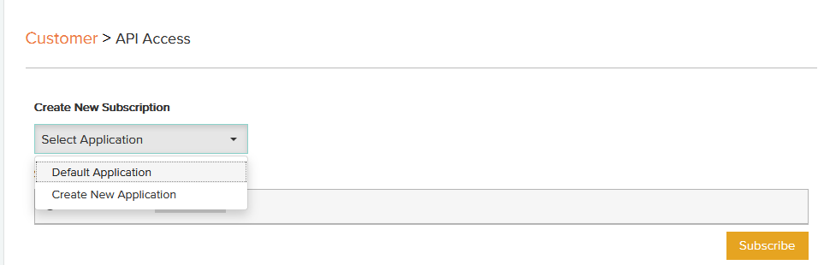
SUBSCRIBE API ACCESS – Portal - Subscriber

Slide 12
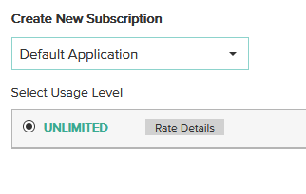
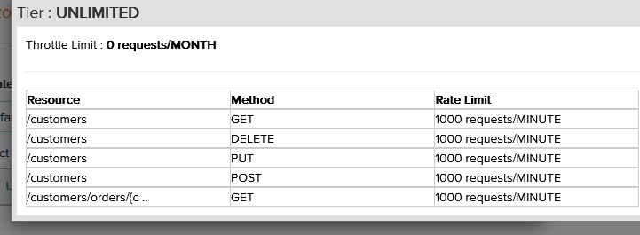
Subscription – Application– Portal - Subscriber

Slide 13
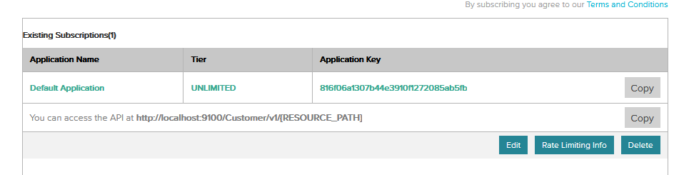
Completed Subscription – Portal - Subscriber

Slide 14
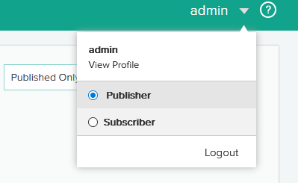
Switch Accounts to View Subscriptions - Publisher

Slide 15
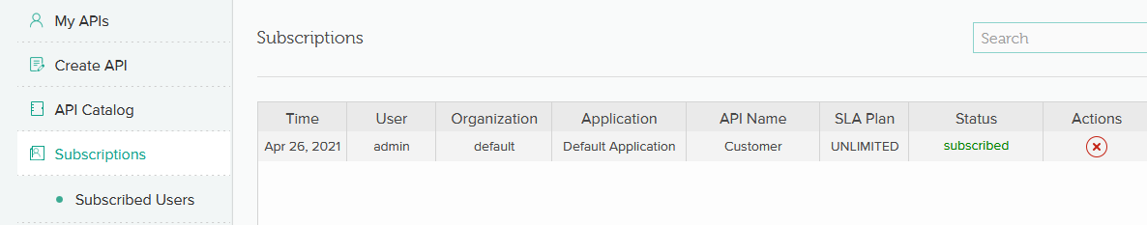
Subscribed Users – Details and Actions – Admin Publisher

Slide 16
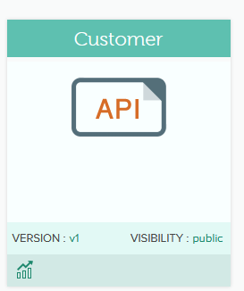
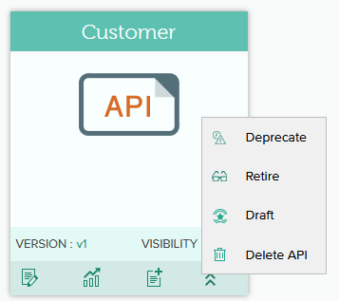
Publisher Versus Subscriber Functions - My APIS

Slide 17
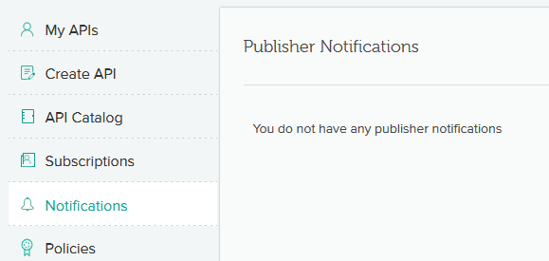
Notifications – Publisher and Subscriber
API Changes :
Deprecation
Versioning
Limits

Slide 18
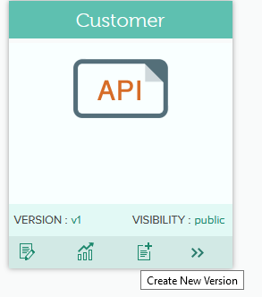
Create NEW Version – Portal - Publisher
Create New Version:
Publisher – create new version (myapis)

Slide 19
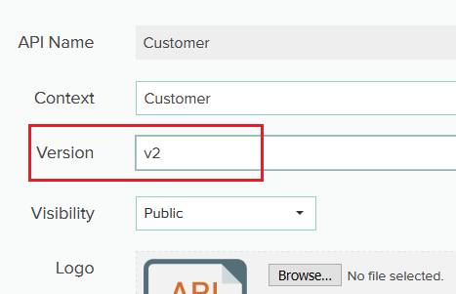
Keeping the same versioning structure – v2 from v1 – Publisher

Slide 20
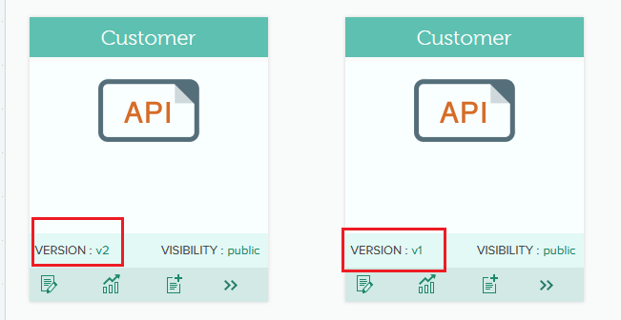
TWO Versions Now – v1 and v2 - Cataloged

Slide 21
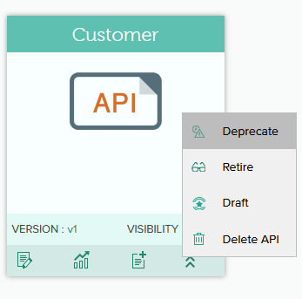
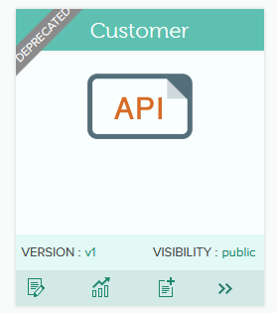
DEPRECATE Version V1 Check Notifications

Slide 22
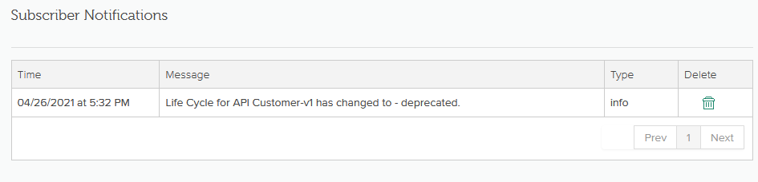
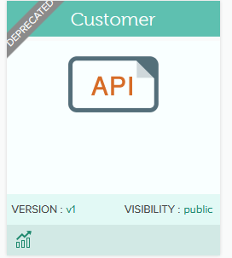
Subscriber Notified – Email and Interface

Slide 23
TAKEAWAYS
Lifecycles / Demos
Next Topic and Preparation / Rate Limiting
Review / Q&A

Slide 24

Thank You
Brian Sappey
SAPPEY CONSULTING LLC
https://www.linkedin.com/in/brian-sappey/

