Slide 1

ColdFusion API Manager: Rate Limiting and Throttling
Webinar API SERIES – Brian SAPPEy

Slide 2

Agenda Items
SLA Creation
Rate and Throttle Limiting
API Key
Notifications

Slide 3
Swagger, SOAP and REST Links
Link
Swagger :
https://petstore.swagger.io/v2/swagger.json
SOAP:
https://www.dataaccess.com/webservicesserver/NumberConversion.wso?wsdl
CF REST GIT Script : https://raw.githubusercontent.com/bsappey/ColdFusionRestExamples/main/CustomersScriptExample.cfc
https://raw.githubusercontent.com/bsappey/ColdFusionRestExamples/main/Customers.cfc

Slide 4
Important Notes
SLA – Custom and Default
Throttle Types
Rate Limiting

Slide 5
WHAT IS THE SLA Process?
OVERVIEW
PURPOSE
TECHNICAL

Slide 6
WHEN PUBLISHING WHICH ACCOUNT?
PORTAL
ADMIN

Slide 7
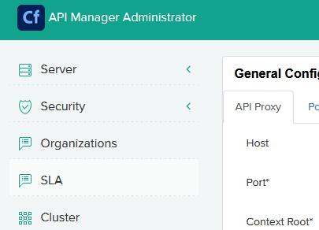
PORTAL – Admin WHICH ONE to USE? A: ADMIN DEFINE Custom SLA’s and Manage Existing ones

Slide 8
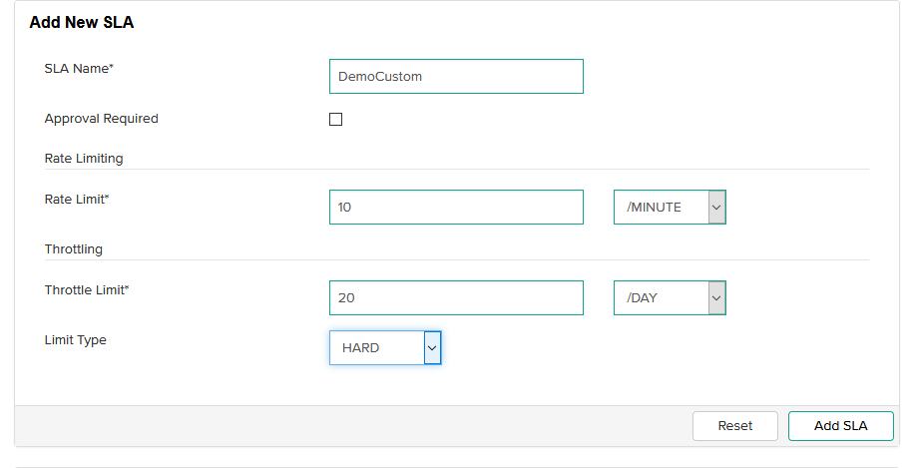
ADD SLA - ADMIN HARD Versus Soft Hard Options

Slide 9
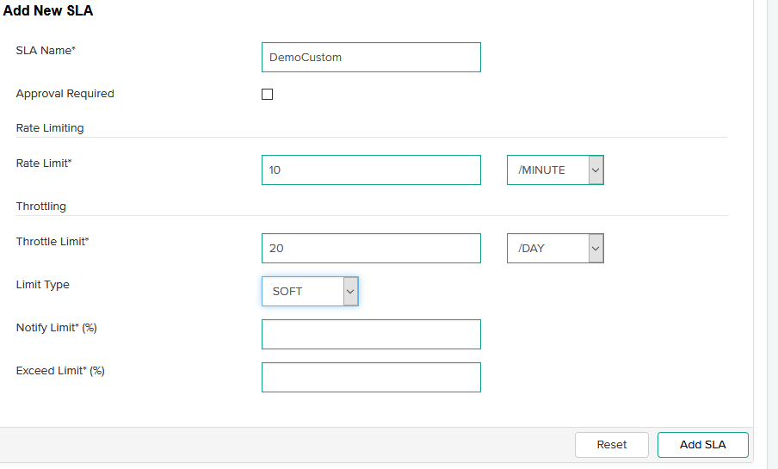
ADD SLA – ADMIN HARD Versus Soft SOFT Options

Slide 10
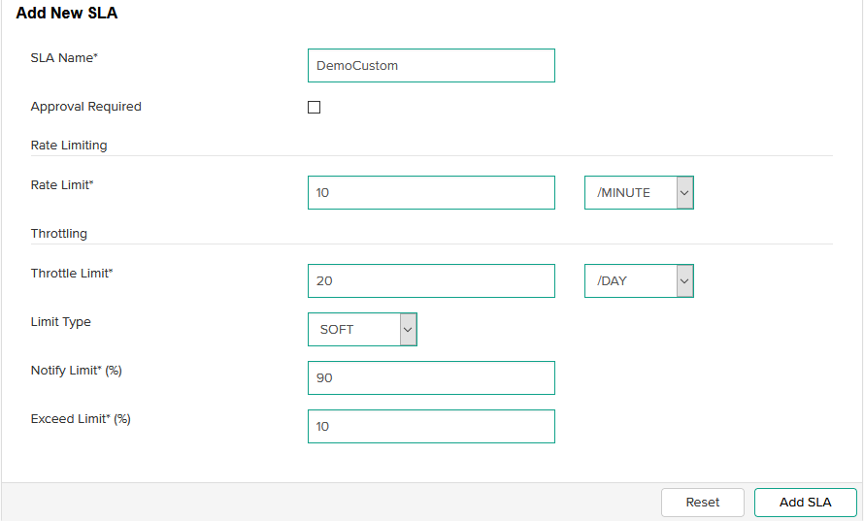
ADD SLA – ADMIN SOFT OPTIONS NOTIFY LIMIT (0-100) Exceed limit (0-100)

Slide 11
SLA – DEMO Custom

Slide 12
SWITCH TO PORTAL FROM ADMIN - PUBLISHER
PORTAL
ADMIN

Slide 13
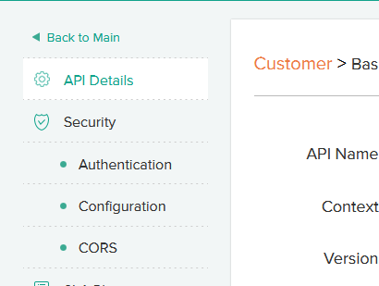
MANAGE API - Authentication – API KEy
Authentication:
API Key required for custom SLA’s
API Key is not really an Auth method, more for identity, even that is generous

Slide 14
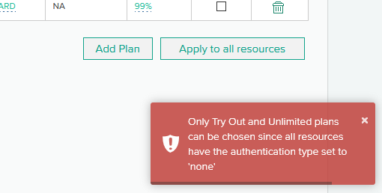
No Auth, NO SLA Options

Slide 15
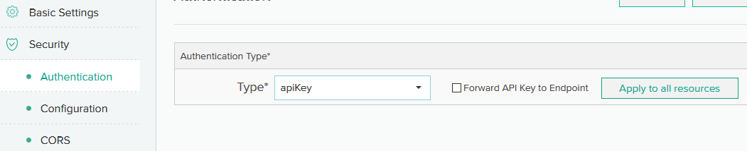
SELECT API Key – APPLY TO ALL Resources - Publisher

Slide 16
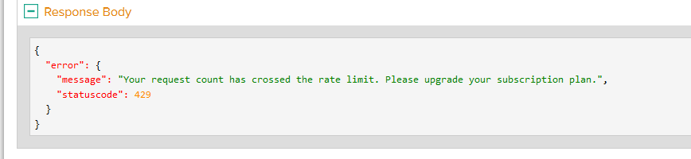
Example of Rate LIMIT Violation

Slide 17
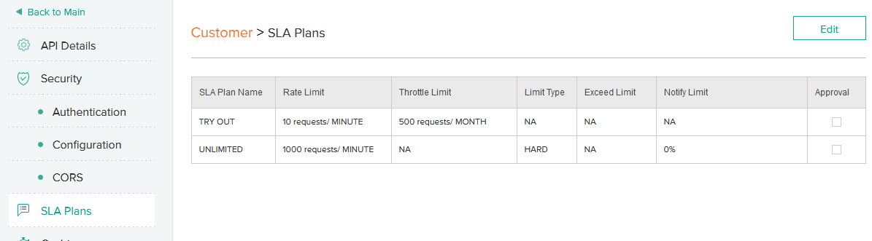
Adding a Custom SLA to Existing API – Manage APIS - Publisher

Slide 18
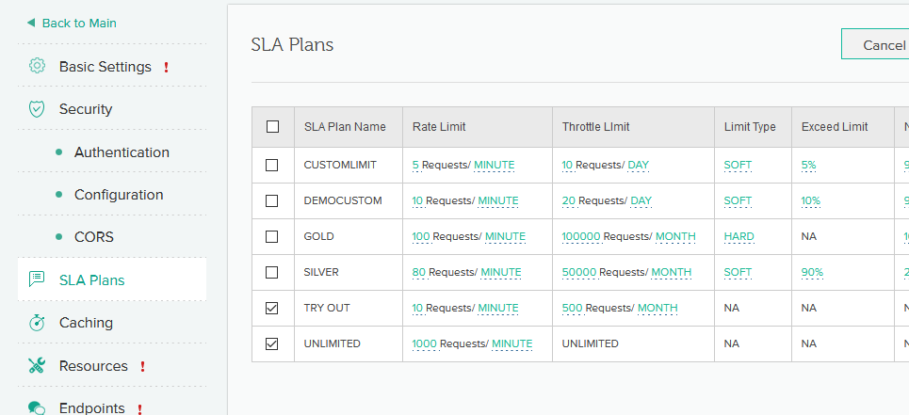
ONLY New services can see GLOBAL SLA’s

Slide 19
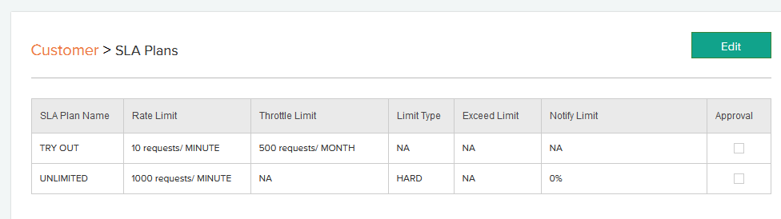
Manage API EDIT Custom Plan

Slide 20
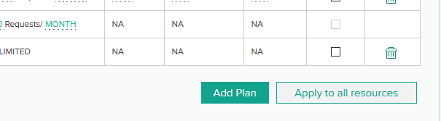
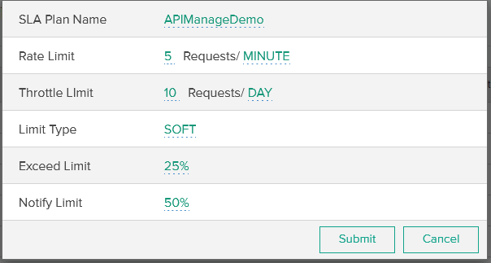
Custom SLA – API Level – Apply to ALL Resources - Publisher

Slide 21
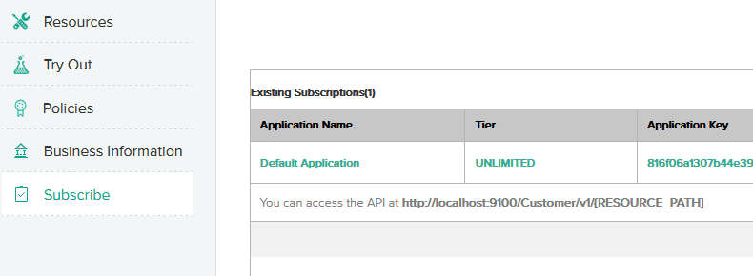
SWITCH TO SUBSCRIBER – Subscribe Menu Option - Subscriber

Slide 22
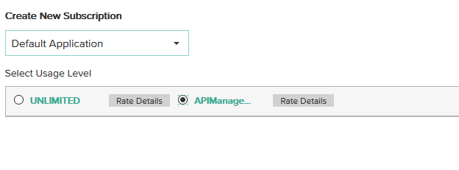
SELECT SUBSCRIPTION and APPLICATION - Subscriber

Slide 23
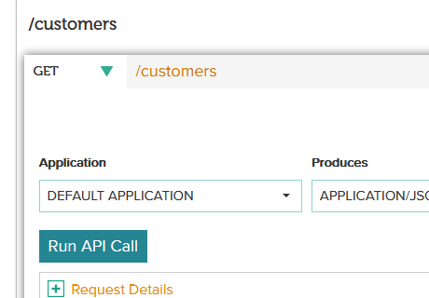
TRY IT NOW – SUBSCRIBER

Slide 24
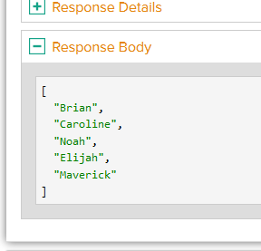
Successful test – Subscriber – with NEW app and SLA
Application with New SLA :
First call 200 ok, response is fine.
We will try to max out the calls.
Review alerts and warnings, via notifications

Slide 25
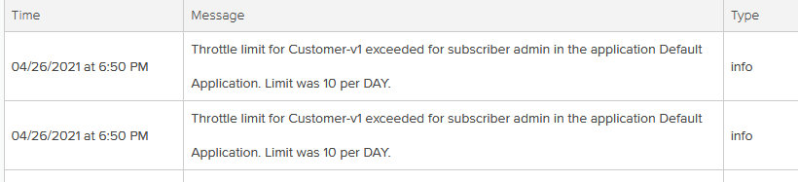
NOTIFICATIONS ALERTS

Slide 26
TAKEAWAYS
SLA’s – Rate and Throttle Limits
Next Topic and Preparation - Security
Review / Q&A

Slide 27

Thank You
Brian Sappey
SAPPEY CONSULTING LLC
https://www.linkedin.com/in/brian-sappey/

