Slide 1

ColdFusion API Manager: Security
Webinar API SERIES – Brian SAPPEy

Slide 2

Agenda Items
API Key
User Stores
Basic Auth
OAuth

Slide 3
Important Notes
User Stores
OAuth
Basic Auth

Slide 4
WHAT Security offerings?
OVERVIEW
PURPOSE
TECHNICAL

Slide 5
WHEN Managing Security, WHICH ACCOUNT?
PORTAL
ADMIN

Slide 6
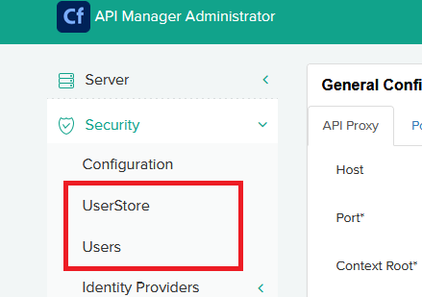
Administrator UserStore Multiple Options Users Existing Users in your system

Slide 7
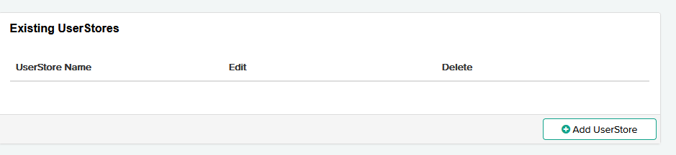
All Existing user stores will be listed Ability to edit and Delete Add UserStore

Slide 8
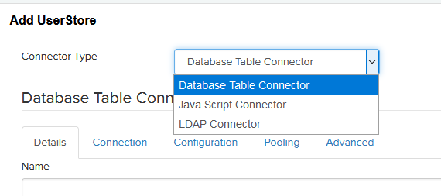
User Store OPtions Database JavaScript LDAP

Slide 9
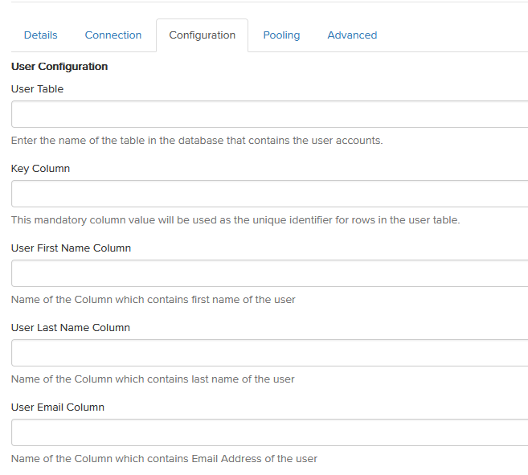
DATABASE Config Table Specifications Column Specifications

Slide 10
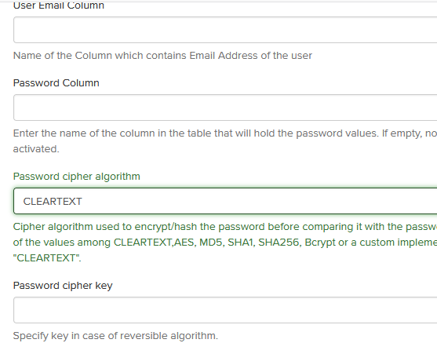
Email and Password Columns – Cipher Algos

Slide 11
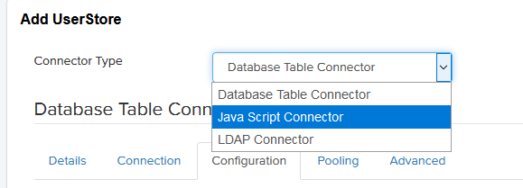
JAVASCRIPT Config

Slide 12
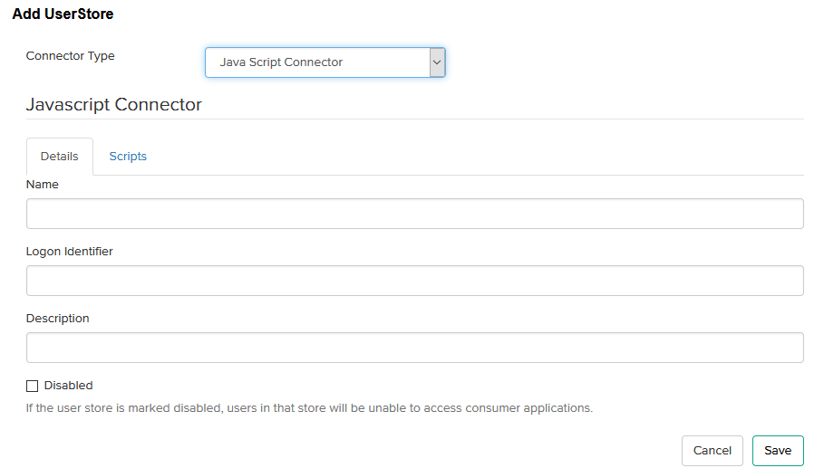
JAVASCRIPT Config Details Section Scripts Section

Slide 13
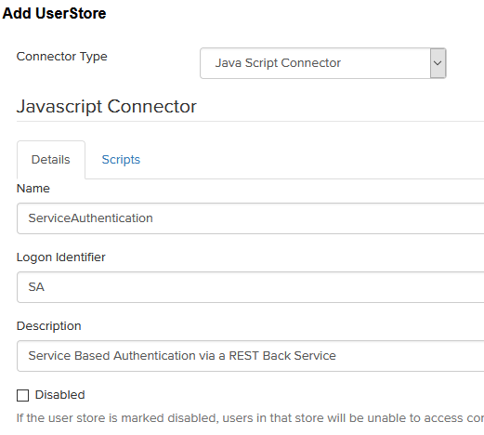
UserStore – OAUTH - Details
Details:
Name
Identifier
Description

Slide 14
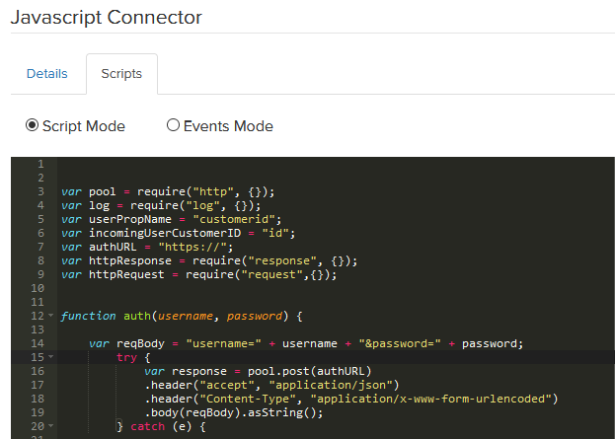
UserStore – OAUTH - Details
Scripts:
Javascript
Variables
Description

Slide 15
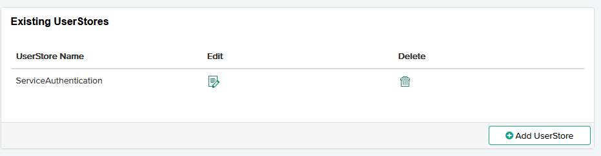
UserStore Completed with Oauth Connector - JS

Slide 16
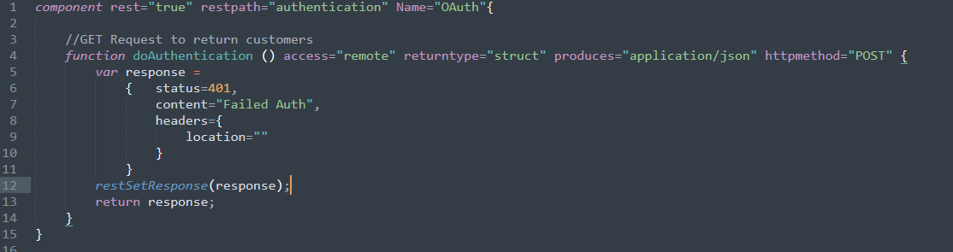
Sample Backservice for Authentication

Slide 17
WHEN Enforcing Security, WHICH ACCOUNT?
PORTAL
ADMIN

Slide 18
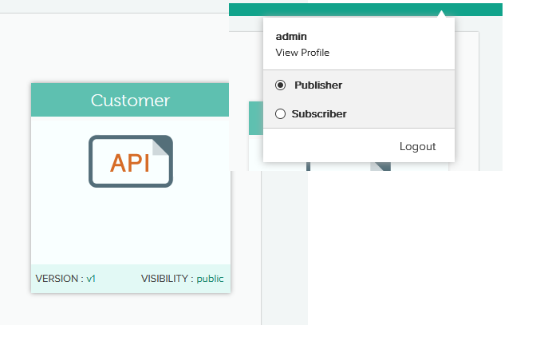
Publisher Account Security

Slide 19
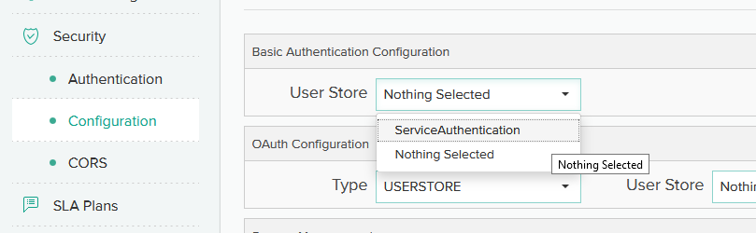
Configuration – User Store

Slide 20
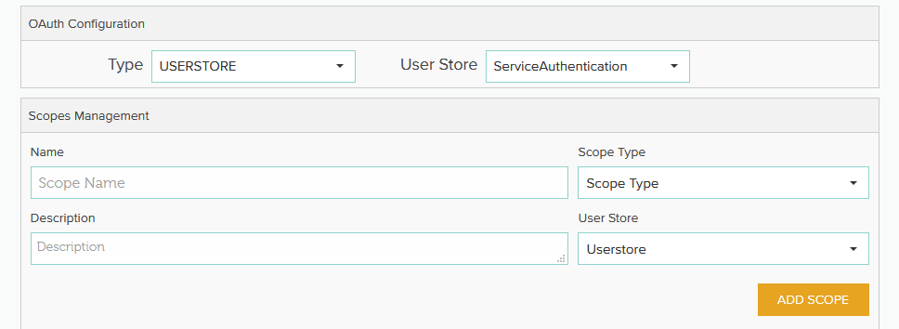
Configuration – User Store – SCOPES??

Slide 21
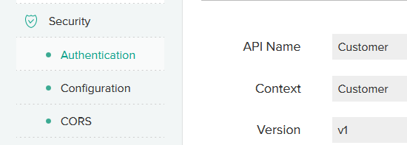
SELECT Security – Authentication

Slide 22
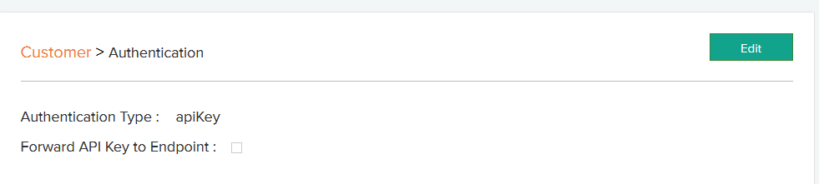
Customer > Authentication - > Edit

Slide 23
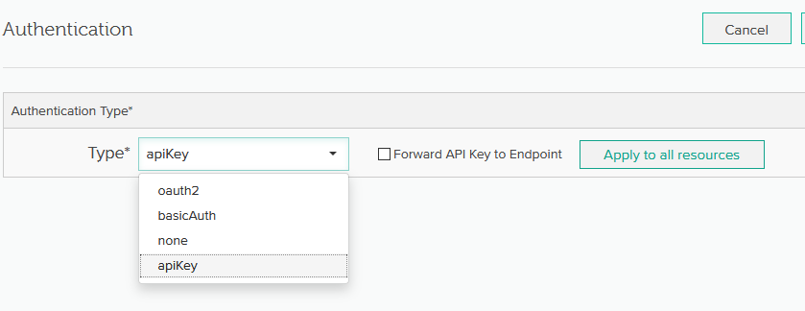
Select Security – oauth2

Slide 24
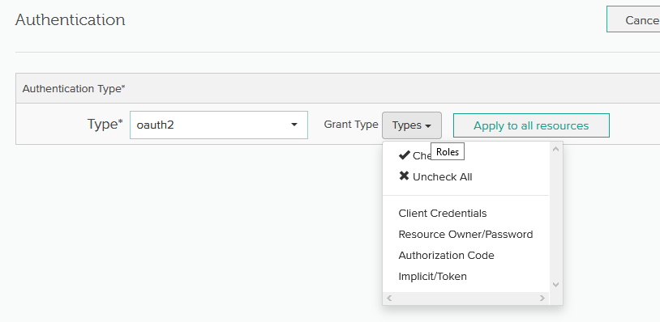
Authentication – Grant Types

Slide 25
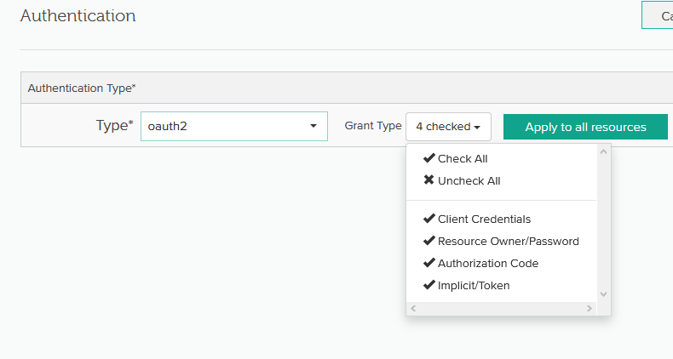
Apply to all Resources

Slide 26
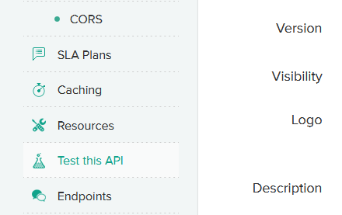
Publisher – TEST API

Slide 27
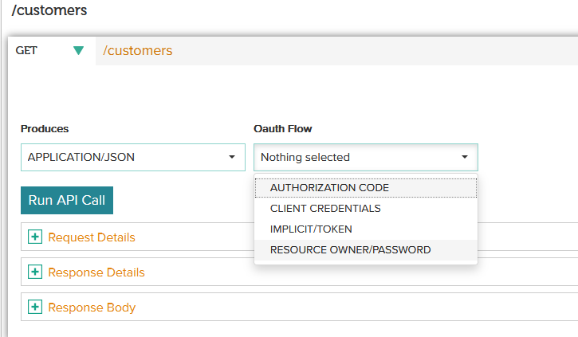
Select resource – select oauth flow – RO/password

Slide 28
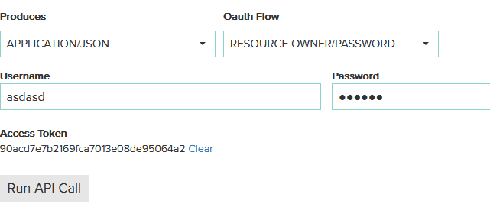
Access Token Returned – OAUTH2

Slide 29
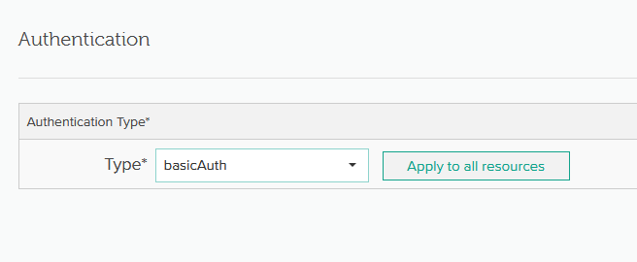
Basic Auth – Publisher

Slide 30
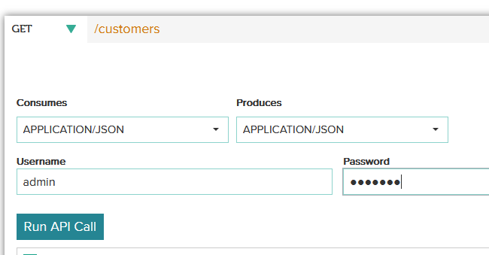
Basic Auth – Test it out
Basic Auth Test:
User name and password

Slide 31
TAKEAWAYS
Security
Next Topic and Preparation – Alerting, logging
Review / Q&A

Slide 32

Thank You
Brian Sappey
SAPPEY CONSULTING LLC
https://www.linkedin.com/in/brian-sappey/

