Slide 1

ColdFusion API Manager: Alerting & Monitoring
Webinar API SERIES – Brian SAPPEy

Slide 2

Agenda Items
UI Components
Kibana
Elastic
Alerting

Slide 3
Important Notes
UI
Kibana
Elastic

Slide 4
Analytics offerings?
OVERVIEW
PURPOSE
TECHNICAL

Slide 5
Analytics Administration Options
PORTAL
ADMIN

Slide 6
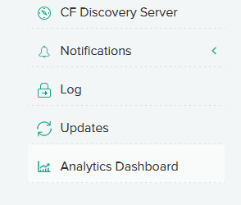
Administrator Analytics Dashboard Multiple Options

Slide 7

Adjust your timeframe Main Toolbar across the top

Slide 8
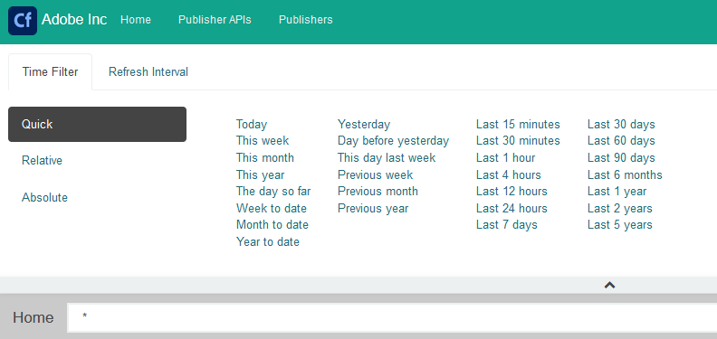
Time Filters Publisher APIS Publishers

Slide 9
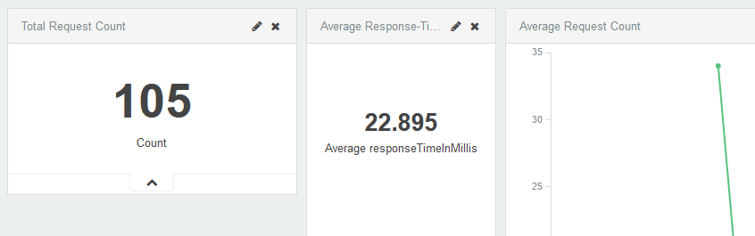
Widgets for quick summary Total Request Average Response Time Average Request Count

Slide 10
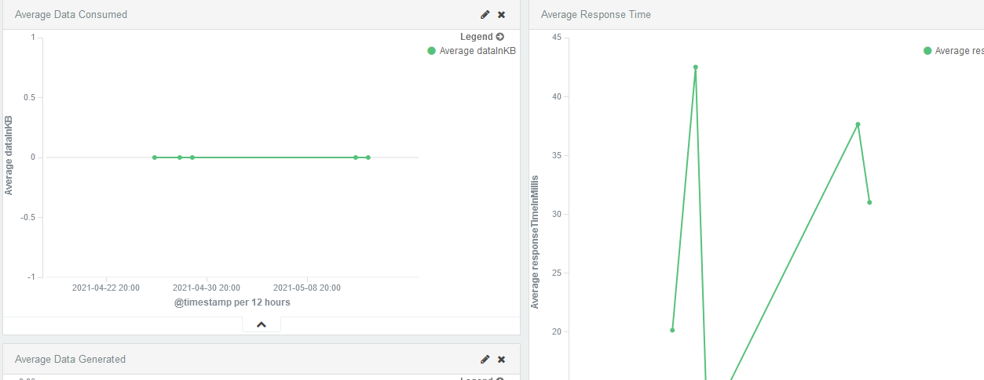
Average Response time and average data consumed

Slide 11

Discover Menu option

Slide 12
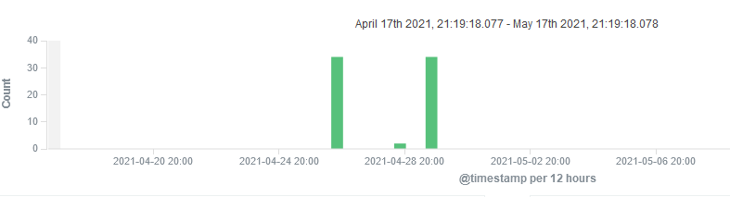
Hit counts summary

Slide 13
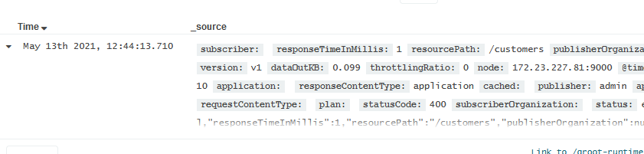
_source data attributes

Slide 14
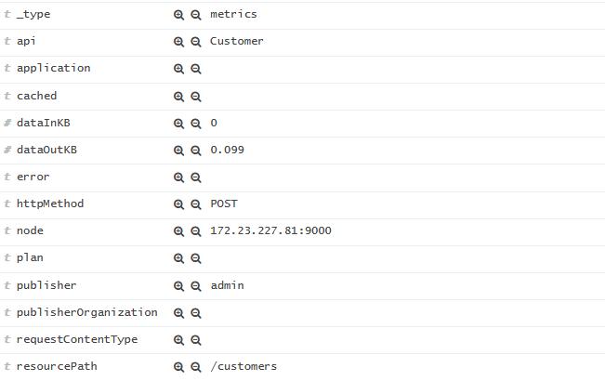
Attributes
Details:
API
Response Time
HTTP Status

Slide 15
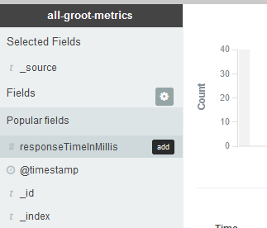
Groot Metrics - Filters
Fields:
Add
Remove
Filter

Slide 16
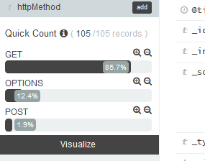
Groot Metrics – Filters – HTTP METHOD
Options (HTTP Method):
Get
Options
POST

Slide 17
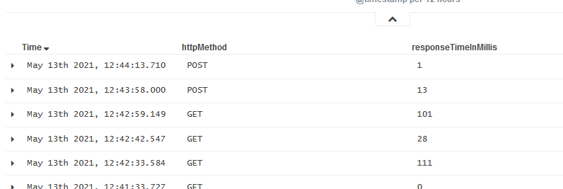
Filters APPLIED ON FIELDS ( METHOD, RTIM, TIME)

Slide 18
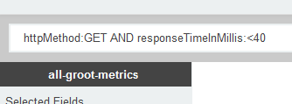
Kibana Query Syntax

Slide 19
Kibana Query Reference
https://www.elastic.co/guide/en/kibana/master/kuery-query.html

Slide 20
Switch to Portal Publisher?
PORTAL
ADMIN

Slide 21
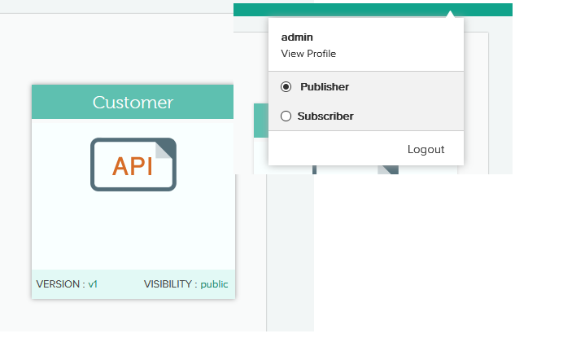
Publisher Account Analytics

Slide 22
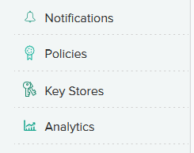
Analytics Menu Option

Slide 23
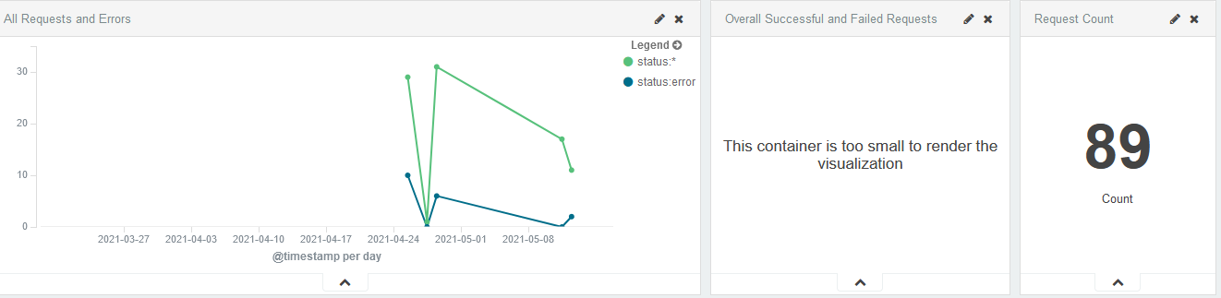
ONLY Analytics for Publisher OWNED APIS

Slide 24
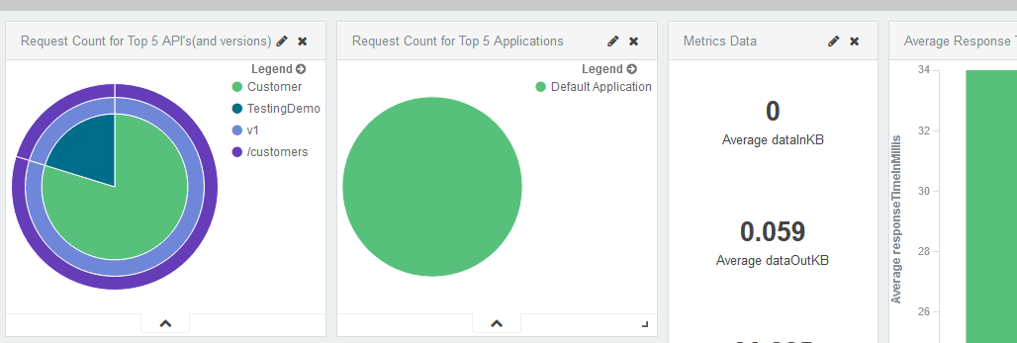
Publisher Owned APIS

Slide 25
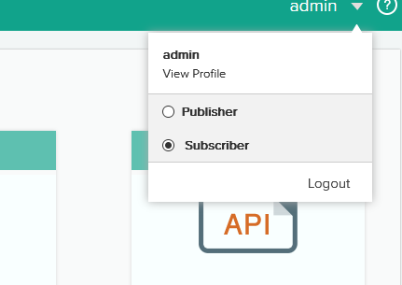
Subscriber Account Analytics

Slide 26

Portal – Subscriber – Menu options

Slide 27
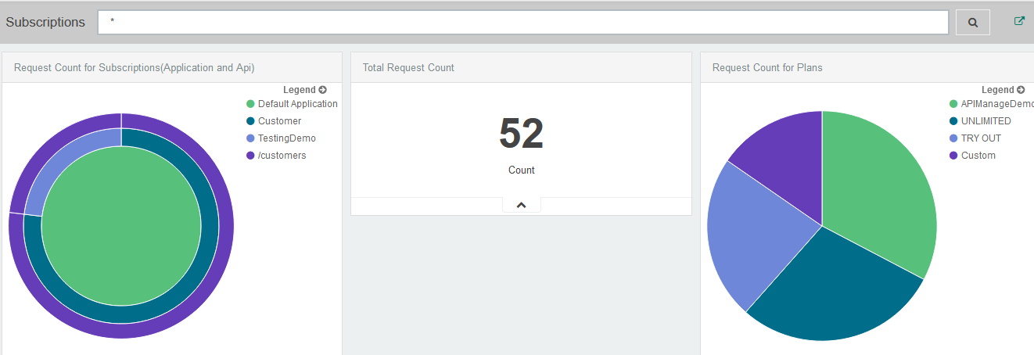
DATA for Subscriptions usage

Slide 28
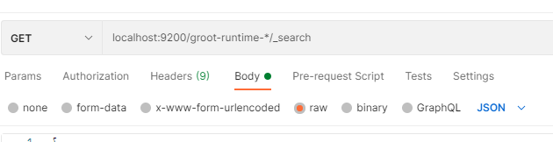
Elastic Queries – POSTMAN EXAMPLE – ENDPOINT + PORT

Slide 29
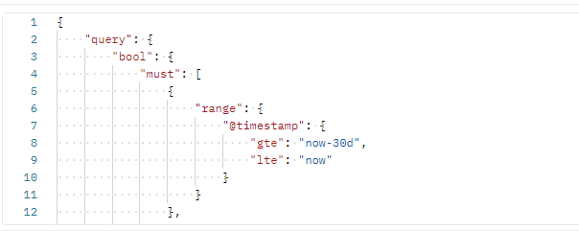
Elastic Queries – POSTMAN EXAMPLE – JSON

Slide 30
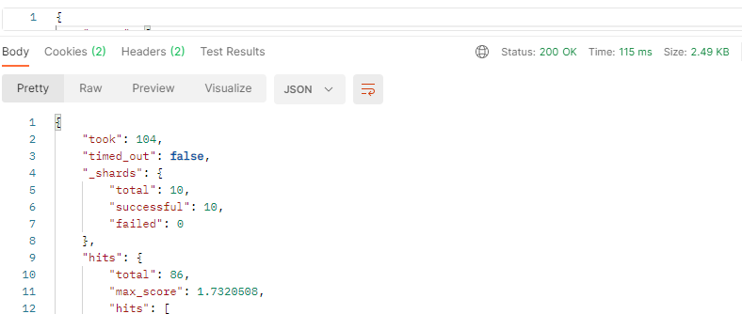
Elastic Queries – POSTMAN EXAMPLE – Response

Slide 31
TAKEAWAYS
Reporting and Alerting
Review / Q&A

Slide 32

Thank You
Brian Sappey
SAPPEY CONSULTING LLC
https://www.linkedin.com/in/brian-sappey/

