Slide 1

ColdFusion API Manager: Policy Management and Access Controls
Webinar API SERIES – Brian SAPPEy

Slide 2

Agenda Items
Threat Protection
Data Transformation
Demonstration
Questions

Slide 3
Important Notes
UI
Threat
Data

Slide 4
Policy Management
OVERVIEW
PURPOSE
TECHNICAL

Slide 5
Policy Administration Options
PORTAL
ADMIN

Slide 6
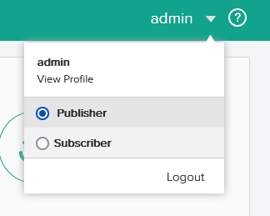
Publisher Policies Publisher Only Not for Subscribers

Slide 7
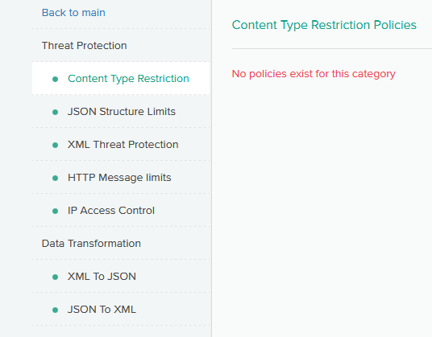
Policy Management for your apis ----- Threat Protection

Slide 8
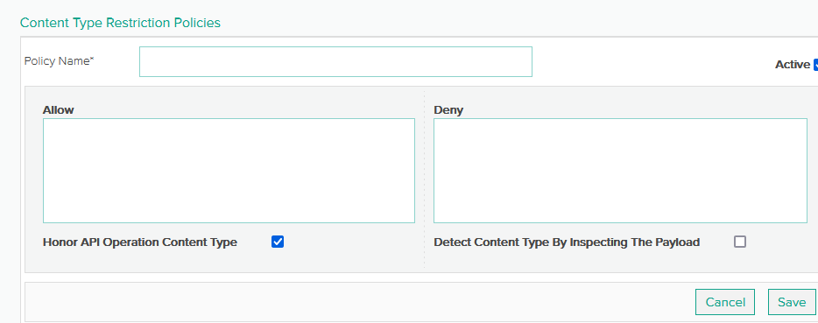
Threat Protection – Content Type Restriction Policies

Slide 9
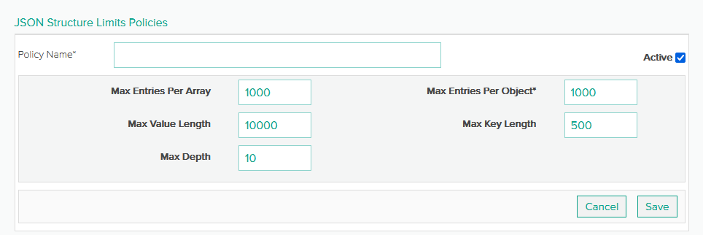
Threat Protection – JSON Structure Limit Policies

Slide 10
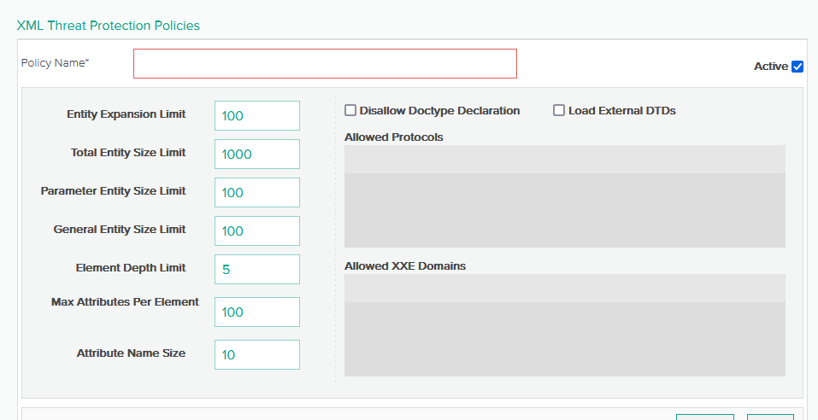
Threat Protection – XML Threat protection

Slide 11
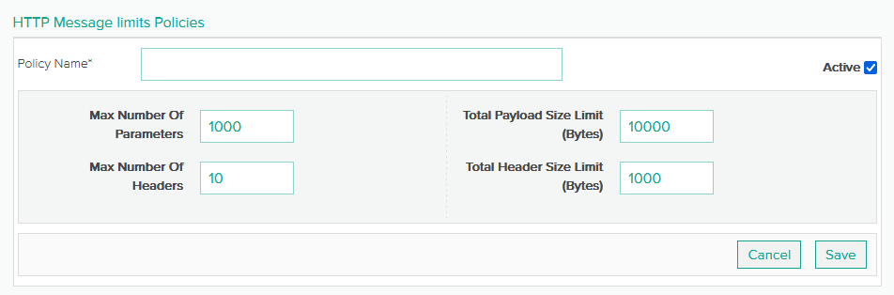
Threat Protection – HTTP Message Limits

Slide 12
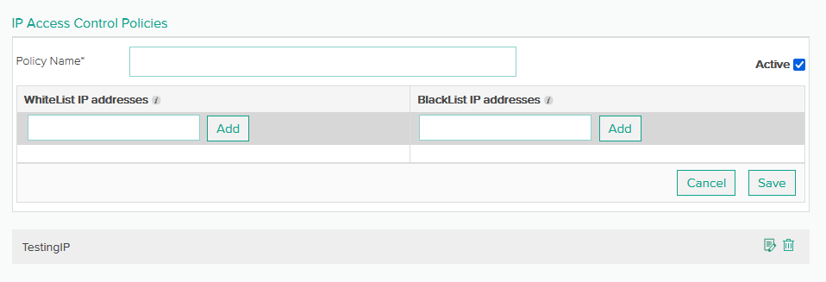
Threat Protection – IP Access control

Slide 13
Policy Management for your apis ----- Data Transformation

Slide 14
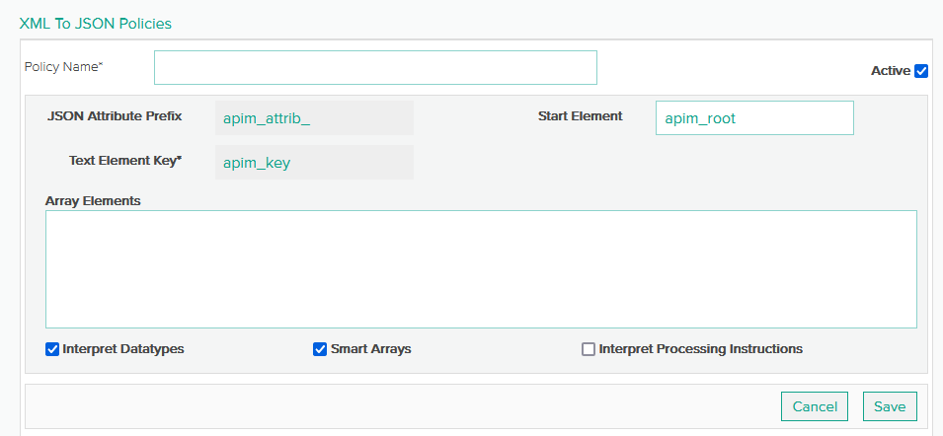
DATA Transformation – XML to JSON

Slide 15
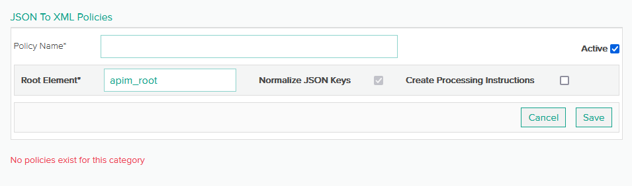
DATA Transformation – JSON to XML

Slide 16
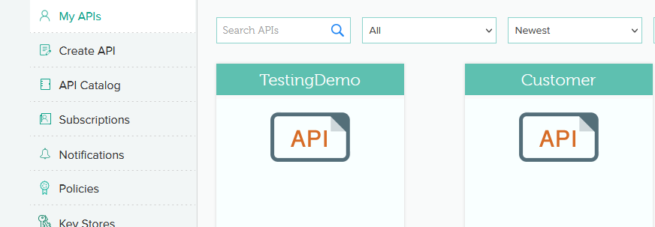
My APIs – API selection

Slide 17
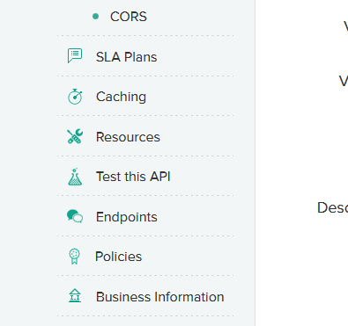
Policies PER API

Slide 18
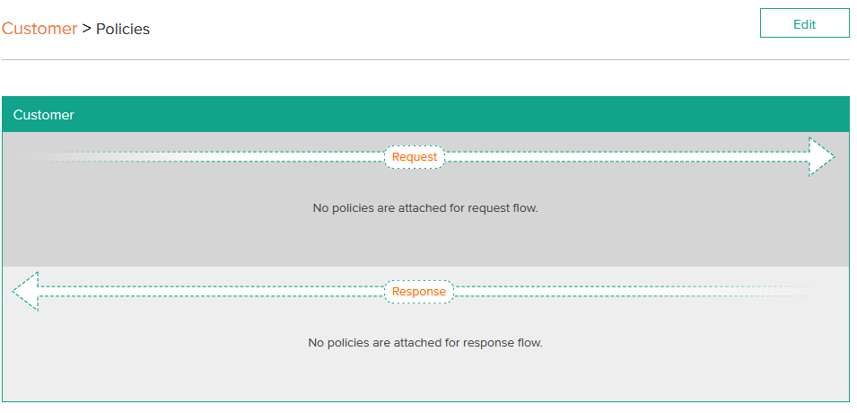
Policy Selection

Slide 19
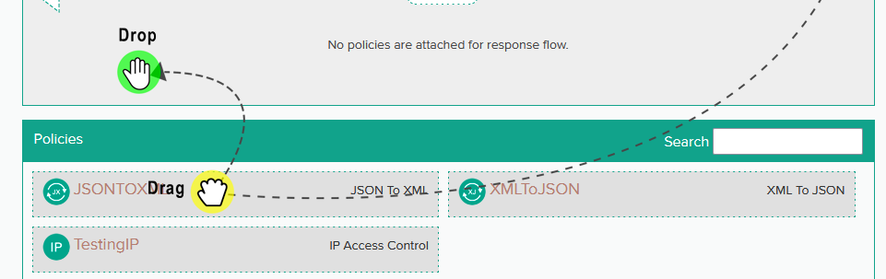
Policy Selection – Existing Policies

Slide 20
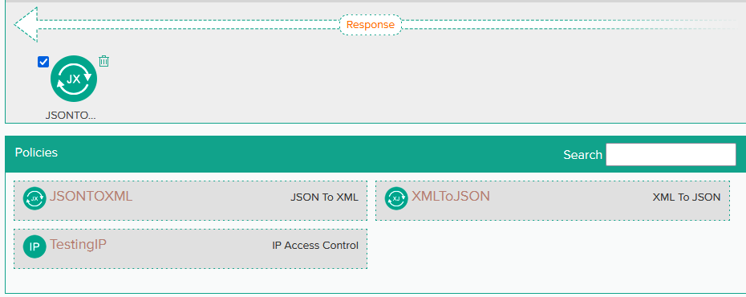
Policy Selection – Response - JSONTOXML

Slide 21
JSON to XML Example
http://localhost:8500/rest/api/customers/
http://localhost:9100/Customer/v1/customers?api_key=5c3c611a393e44fa80a84f5163c81413

Slide 22
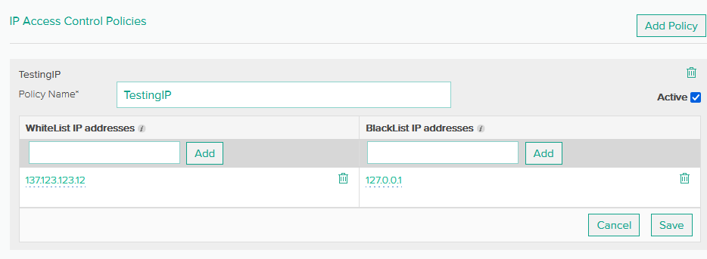
IP Black List Control

Slide 23
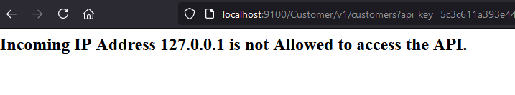
IP Black List Control

Slide 24
TAKEAWAYS
Policy Management
Review / Q&A

Slide 25

Thank You
Brian Sappey
SAPPEY CONSULTING LLC
https://www.linkedin.com/in/brian-sappey/

