Slide 1
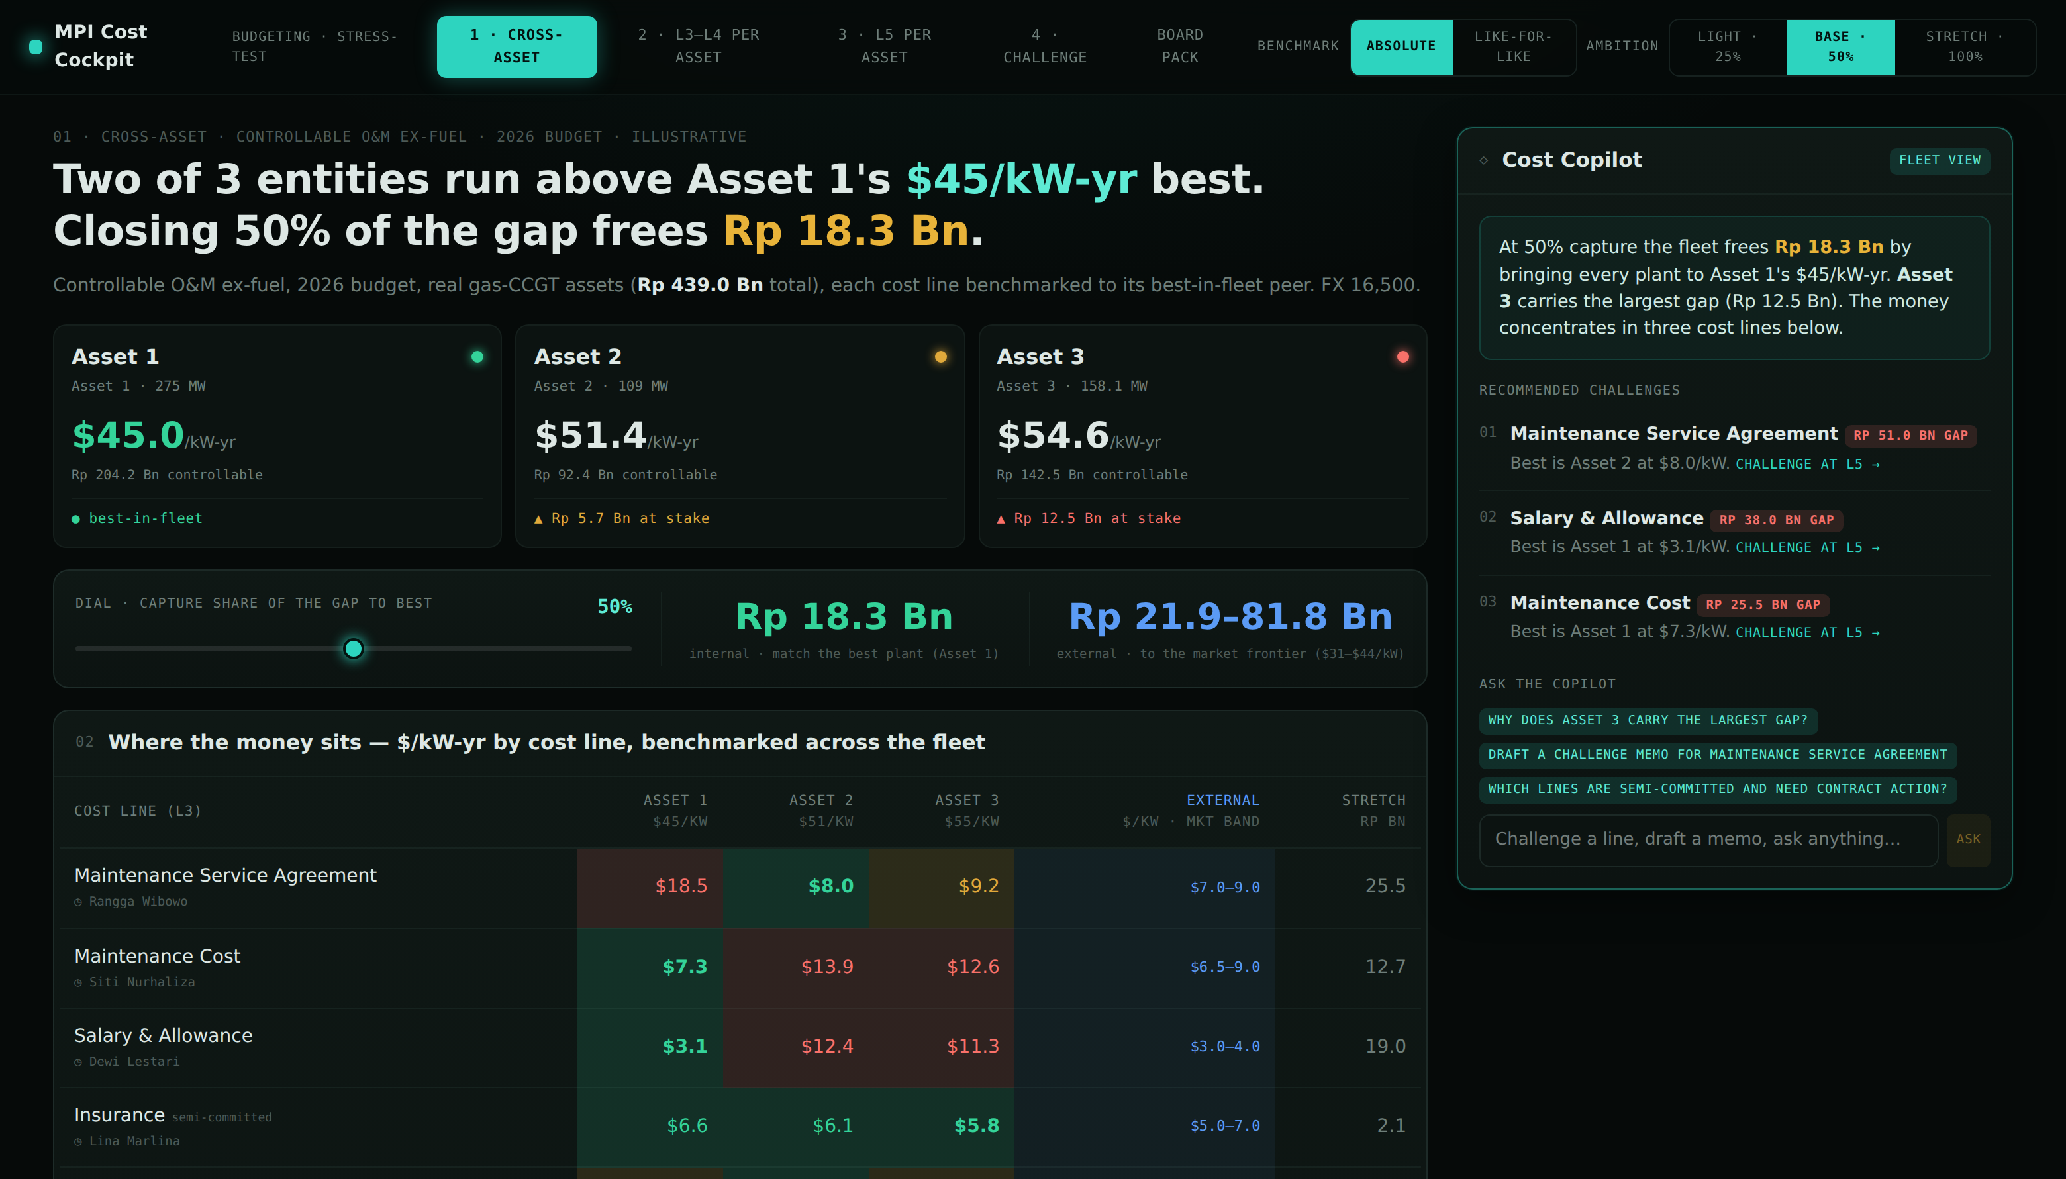
Integrated Cost Cockpit
MΣ
MPI Budget Cockpit | Zero-based budgeting that benchmarks spending to best-in-fleet — down to PO level (L5), pinpointing inefficiencies and surfacing savings
MedcoEnergi
POWER
MPI Budget Cockpit
POC
Zero-based budgeting, benchmarked to best. A cost cockpit that benchmarks controllable O&M across every asset down to PO level (L5) — pinpointing inefficiencies and surfacing savings in one view.
Key Features
1
Asset Cost Scorecard
A card per asset: cost intensity ($/kW-yr), total controllable spend, and whether it leads the fleet or has money at stake.
2
3-Way Benchmark Matrix
Every cost line compared across assets and against best-in-fleet, the external market, and like-for-like (size-normalized) — with an accountable owner named on every line.
3
Savings Simulator
Dial how aggressively to close the gap and see the efficiency prize benchmarked three ways at once — best plant, external market, and the stretch frontier.
4
Prioritized Recommendations
Automatically ranks the biggest savings opportunities and pre-drafts a challenge memo for each cost owner — every figure cited, the decision yours.
5
Drill-Down Workflow
Trace any gap from fleet level to its root, L3 to L5 per asset, then straight into a board-ready challenge pack.
◇ Analyst-grade & auditable — every figure traces to its source line; benchmarks span best-in-fleet, the external market, and like-for-like.
18
Progress. Growth. Future.

