Slide 1

ReRouteAI
AI-assisted flight disruption recovery
Business AI Application | Project proposal
MIS520 · Worcester Polytechnic Institute · Fall 2026
WORKING PROTOTYPE INCLUDED
Notes:
Title. Introduce the team and roles in one sentence each. Say up front that we already have a working prototype, so everything we propose is grounded in something that runs.

Slide 2
0:00–1:00
The missed connection
One 95-minute delay turns into a costly, rushed decision
LX53 lands 95 min late
Warsaw connection has already left
Which of 18 possible reroutes should the agent book, in the next few minutes?
✕
BOS
ZRH
WAW
95 min
18
€600
inbound delay into Zürich; ready to board again at 09:50
feasible recovery routes in our prototype network, each with a different risk
EU261 compensation per passenger if the final arrival is 4+ hours late
Opening scenario from a teammate's travel experience · EU261: Regulation (EC) 261/2004 (Boston–Warsaw journey > 3,500 km)
02
Notes:
0:00–1:00. Tell the story: Boston to Zürich to Warsaw, the inbound flight lands 95 minutes late and the Warsaw connection is gone. The traveller needs a new plan; the airline needs one that does not blow up its costs. There are many possible reroutes, and they differ in how likely they are to work. Under European rules, arriving four or more hours late on this journey can cost the airline 600 euros per passenger.

Slide 3
1:00–2:00
Who we help, and what it is worth
Primary user: the airline rebooking agent; the traveller is phase two
Airline rebooking & disruption agents
Cost of one misconnected passenger
Decide in minutes, with a queue of stranded passengers
Must follow rebooking rules and passenger-rights law
Today: a timetable screen plus personal judgement
Phase two: travellers see the same trade-offs in self-service
Rebooking or a seat bought on another airline
EU261 compensation: €0 / €300 / €600 by arrival delay
Meals, and a hotel if the passenger is stuck overnight
Agent handling time and lost customer goodwill
We will help airline rebooking agents choose the recovery route with the lowest expected cost by combining a delay-risk model, route search and policy retrieval, which will cut compensation, care costs and decision time.
Scope: decision support for one disrupted itinerary · recommendation only; no ticket is booked automatically
03
Notes:
1:00–2:00. Name the end user clearly: the airline agent who rebooks misconnected passengers. List what one misconnection costs. Read the one-sentence pitch at the bottom slowly; it is the rubric's problem statement format.

Slide 4
2:00–3:00
Why AI, and why now
The three tests from class: real problem, right tool, feasible
C1
Real business problem
C2
AI is the right tool
C3
Feasible this semester
Every delayed hub arrival creates misconnections
Cost is concrete: seats, compensation, hotels, time
The status quo rule, “next direct flight on our airline”, ignores risk
Uncertain: needs prediction of delays
Combinatorial: needs search over routes
Rule-bound: needs retrieval of policy text
A fixed rule handles none of the three
Public U.S. BTS delay history, millions of flights
Small search graph; LLM through an API
A working prototype already runs end to end
Criteria C1–C3: MIS520 Project Instructions, “What makes a good AI project?”
04
Notes:
2:00–3:00. Walk through C1, C2 and C3. The key line is C2: this decision is uncertain, combinatorial and governed by written rules, so it needs prediction, search and retrieval. A single fixed rule cannot do any of that.

Slide 5
3:00–3:50
From business question to technical problem
Input → processing → output, with a human at the end
INPUT
PROCESSING
OUTPUT
BTS on-time history
Timetable, connection times, seats left
Traveller's priority: cost vs. time
Policy text: EU261, carrier rules
① Delay model → chance each connection works
② Flight graph + Dijkstra / A* → feasible routes
③ Expected-cost optimizer → ranking
④ Retrieval + LLM → cited explanation
Ranked recovery options
Chance each plan works
Expected arrival and cost
Plain-language explanation
Agent approves or overrides → reason is logged → overrides reviewed weekly to recalibrate costs
Architecture follows the class pattern: rule / policy gate → model → validation → human approval (Class 2)
05
Notes:
3:00–3:50. Frame it as input, processing, output. Four AI components, each mapped to a course module: supervised learning, search, optimization, and RAG with an agent. Stress that the system recommends and a human approves.

Slide 6
3:50–4:40
Decision model: one score, in dollars
Different priorities produce different optimal routes
EU261 is a step, not a slope
Expected cost of a recovery route =
< 3 h late
€0
cash cost (fares, seats on other airlines)
+ value of time × expected delay
+ Σ P(plan fails at leg i) × cost of the fallback
+ inconvenience per extra connection
airline view adds: expected EU261 + meals / hotel
3–4 h late
€300
4 h+ late
€600
The priority slider sets the value of time; the traveller / airline switch sets whose costs count.
Like the VectorDash late-delivery penalty: a few minutes can flip the cost.
Compensation for a Boston–Warsaw journey (> 3,500 km), halved when re-routing keeps the delay under 4 h · simplified, to be verified
06
Notes:
3:50–4:40. Everything becomes dollars so very different outcomes can be compared, exactly like the VectorDash exercise. The failure term matters: a tight connection that fails sends the traveller to a worse fallback. On the right, EU261 is a step function, which is why arriving just under four hours late can save the airline 300 euros.

Slide 7
4:40–5:30
Prediction feeds the search
Machine learning estimates risk; graph search finds the routes
Delay model (supervised learning)
Route search (Dijkstra and A*)
Gradient boosting predicts the whole delay distribution: 10 delay bands + cancelled
Features transfer across airports: hour, month, weekday, distance, airport busyness
P(connection works) = P(inbound delay ≤ slack after minimum connection time)
Tested on held-out months, with calibration checks
Node = “landed at airport X at time t”; edge = a flight you can still make
Too-tight connections and full flights get no edge: infinite cost
Weight = time + cash + λ·(−ln P): probabilities add, so search stays exact
A*: 4 nodes vs. Dijkstra: 8 nodes · same route
Prototype measurements · A* heuristic: fastest remaining flight time (never overestimates)
07
Notes:
4:40–5:30. Left: the model predicts a full delay distribution, so we can ask the exact question a connection needs. Right: the time-expanded graph from Class 4. Taking minus log of the probability turns multiplied risks into added costs, so Dijkstra and A* still find the true best route. In the prototype A* checks half as many nodes and gets the same answer.

Slide 8
5:30–6:20
Prior work, and what is new here
We build on operations research and delay prediction
Operations research
Our edge
Airline disruption management and passenger recovery models (e.g. Clausen et al., 2010; Bratu & Barnhart, 2006)
Scores the chance each connection works, not just the timetable
Prices rule-based step costs such as EU261
Lets the user set the time-versus-cost priority
Explains with cited policy text
Always ends with human approval
Delay prediction
Predicting flight delays from U.S. BTS data is a widely studied ML benchmark
Industry tools
Airline apps that auto-rebook; airline disruption-management systems; delay forecasts in travel search
Clausen, Larsen, Larsen & Rezanova (2010), Computers & Operations Research · Bratu & Barnhart (2006), Journal of Scheduling · verify before presenting
08
Notes:
5:30–6:20. Research on airline recovery exists, mostly optimizing the airline's whole schedule. Delay prediction on BTS data is common. Our contribution is the combination for one passenger: calibrated risk, regulatory step costs, adjustable priorities and cited explanations. Team: read both papers before presenting so you can answer questions on them.

Slide 9
6:20–7:00
Data and feasibility
Real history where it exists; clearly labelled scenarios where it does not
Real history
Backtest scenario
Motivating scenario
U.S. BTS on-time performance: train on Jan–Sep, test on Oct–Dec
Loader for the monthly BTS files is built
An all-U.S. connection (e.g. BOS→ORD→MSP)
Replay real 2024 delays to test decisions on actual outcomes
Zürich case uses a documented timetable
Fares, seats and connection times labelled as illustrative
We do not claim: live seat inventory, interline ticketing rights, or delay calibration for European airports.
Data source: U.S. Bureau of Transportation Statistics, TranStats “Reporting Carrier On-Time Performance (1987–present)”
09
Notes:
6:20–7:00. We train on real BTS history. To prove decisions on real outcomes, we add a U.S. backtest scenario where the data is real end to end. The Zürich story stays as the motivating example, clearly labelled. Be explicit about what we do not claim.

Slide 10
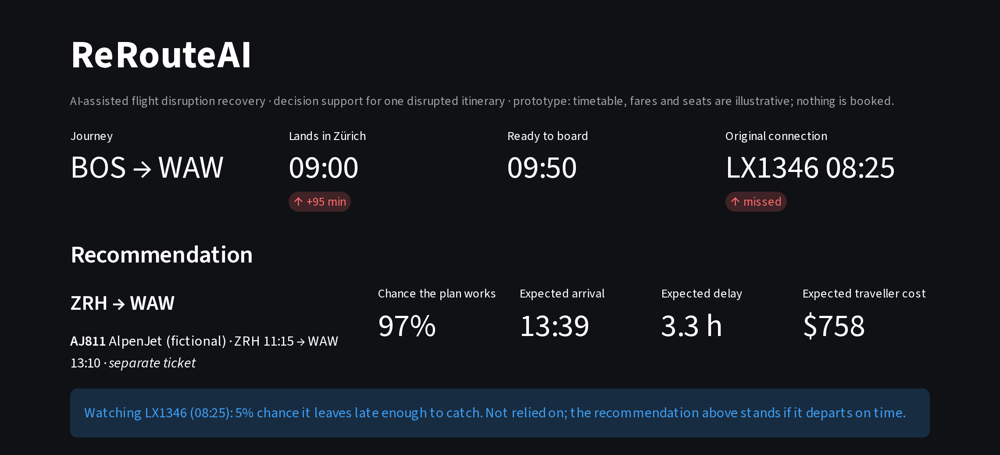
7:00–8:00
Live demo: the priority changes the answer
Same disruption, same flights; only the objective moves
Who is deciding | Recommended route
Student ($0–10/h) | Next direct, 14:20 · free, 96% sure
Leisure ($25–100/h) | Via Vienna · free, earliest, 65% sure
Business / urgent | Paid nonstop, 11:15 · $260, 97% sure
Airline, EU261 applies | Buy that $260 seat: cheaper than €600
Airline, weather delay | Late-evening flight · no compensation due
Streamlit dashboard: ranked options, chance each plan works, cost breakdown, cited explanation, agent approval log
Illustrative timetable, fares and seats · “AlpenJet” is a fictional airline · delay model on synthetic BTS-format data until real data is loaded
10
Notes:
7:00–8:00. This is the live demo moment. Move the priority slider: a student gets the free, reliable direct flight; a business traveller gets a paid nonstop. Then switch to the airline view: buying a competitor's seat is cheaper than paying 600 euros of compensation. Flip EU261 off, as for a weather delay, and the airline's best choice becomes the cheap late-evening flight. Nothing about the flights changed; only the objective did. Keep a backup video of this in case the live demo fails.

Slide 11
8:00–10:00
Build plan and responsibilities
Four workstreams, tied to the course modules
When | Course module | Milestone
By proposal | Unsupervised learning | Real BTS 2024 loaded; backup demo video
Oct 14 | LLMs & prompting | Delay model on real data; calibration report
Oct 21 | RAG | Real policy texts indexed; retrieval ≥ 90% top-3
Oct 28 | Agentic AI & MCP | Agent workflow; U.S. backtest scenario
Nov 4 | Multimodal AI | Documented Zürich timetable; sensitivity analysis
Nov 11 | Ethics | Ethics review; 5-person user test
Nov 18–25 | Review | Feature freeze; rehearse; final slides
Data lead
BTS data, timetable, assumptions
Model lead
Delay model, calibration, baselines
Optimization lead
Graph, search, expected cost
Product lead
App, evaluation, ethics, demo
Shared GitHub repo · weekly check-in · pull requests reviewed by a second teammate
Final presentation: Dec 2 or Dec 9 (confirm with instructor) · final slides due three days later
11
Notes:
8:00–10:00. Each milestone lines up with the module we learn that week, so class content feeds straight into the build. Name who owns each workstream. Mention the backup demo video and the dates we are confirming with the instructor.

Slide 12
10:00–11:00
How we will prove it works
Baselines: earliest arrival · lowest fare · next direct on the same airline
Technical
PR-AUC and calibration on held-out months
Response time: under 1 second (prototype ≈ 0.2 s)
Policy retrieval: right section in top 3
Business
Realised cost per disruption vs. baselines
Share arriving within 3 hours
ROI = savings × volume − running cost
User experience
5 agents or travellers try realistic cases
Task time and agreement with expert choice
Prototype simulation, ≈120 traveller cases × 30 delay draws each, synthetic BTS-format data · to be re-run on real BTS 2024 data
12
Notes:
10:00–11:00. Three kinds of metrics, as the instructions ask: technical, business and user experience. The chart is an early prototype result: in simulated disruptions, ReRouteAI's choice had the lowest realised cost for travellers. Be honest: this is synthetic data, and for the airline view, simply taking the earliest arrival is almost as good because compensation rewards earliness. The real test is the U.S. backtest on actual 2024 delays.

Slide 13
11:00–12:00
Ethics, risks and safeguards
What could go wrong, and what we build in
Value-of-time bias
Automation bias
LLM errors on legal rights
Low-fare travellers always get the slow option
Agents rubber-stamp the top option
Confident but wrong claims about compensation
Priority rules first (minors, reduced mobility, medical); use stated, not inferred, priority
Named approver; written reason to override; weekly review
LLM may only use retrieved text and our numbers, with citations
Privacy
Hidden risk shifting
Model limits
Itineraries are personal data
Separate tickets leave the traveller unprotected
U.S.-trained model used in Europe
Itinerary only: no names, no payment data; minimal retention
Such options are labelled; bag re-check time added
Stated domain shift; U.S. backtest; show uncertainty, not one number
Q&A: 3 minutes • Main uncertainty: timetable data and booking rights
13
Notes:
11:00–12:00. Lead with the value-of-time bias: if an airline plugs in a traveller's worth by fare class, cheap-ticket passengers always wait longest. Our fix is to apply the airline's priority rules first and use the passenger's stated priority. Then automation bias, LLM errors and privacy. Close by inviting questions.

