Slide 1
ReRouteAI: AI-Assisted Flight Disruption Recovery
MIS520 Project Proposal | Agnieszka, Regina, Delice, Kofi
Notes:
Title (a few seconds). Introduce the team. Mention that a working prototype already exists.

Slide 2
The crisis: a missed connection
LX53 lands 95 min late
Warsaw connection already left
The agent has minutes to choose one of 18 recovery paths.
BOS
ZRH
WAW
95 min
inbound delay into Zürich; the passenger can board again at 09:50
18
feasible recovery paths, each with different risk and cost
€300–€600
EU261 compensation per passenger if final arrival is 3–4+ hours late
EU261: Regulation (EC) No 261/2004. Boston–Warsaw journey is over 3,500 km.
Notes:
0:00–1:00 (Problem). A 95-minute inbound delay into Zürich means the passenger misses the Warsaw connection. The rebooking agent has minutes to evaluate 18 possible recovery paths. Under EU261, arriving more than 3 hours late costs the airline 300 euros per passenger, and more than 4 hours costs 600 euros.

Slide 3
The agent dilemma
Default rule: “book the next flight on our airline”
  Ignores the risk that the new connection also fails
  Ignores seats on other airlines that may arrive hours earlier
  Ignores hotel, meal and compensation costs that grow with each hour
What the research says
  How passengers are transferred (refund, same airline, other airline, overnight stay) changes recovery cost; recovering every flight is not always cheapest (Lu et al., 2025)
  Future directions include real-time recovery that handles uncertainty and human factors (Wu et al., 2025)
Our goal: help airline rebooking agents choose the route with the lowest expected total cost, while the agent stays in charge.
Notes:
1:00–2:00 (Problem). Under pressure, agents fall back on one rule: book the next flight on our own airline. That rule ignores the chance that the reroute fails, seats on other airlines, and the hotel, meal and compensation costs that build up. Lu et al. 2025 show that the way passengers are transferred drives recovery cost, and the 2025 review by Wu et al. calls for real-time recovery that handles uncertainty.

Slide 4
Why AI: problems simple rules cannot solve
Problem | AI technique | Why a fixed rule falls short
Delay uncertainty | Machine learning (gradient boosting) | A timetable assumes the flight lands on time; the model estimates the real probability
Many possible routes | Graph search (Dijkstra / A*) | Dozens of flights and connection times; search checks every feasible path in milliseconds
Strict regulations | Policy retrieval (RAG) | EU261, rebooking and baggage rules are looked up and cited instead of guessed
21.3% of U.S. flights were delayed and 1.65% were cancelled in 2023 (BTS data, reported in Wu et al., 2025).
Project criteria: real business problem, AI is the right tool, feasible (MIS520 Project Instructions).
Notes:
2:00–3:00 (Problem). Why AI and not a better rule? Three problems are tied together: delay uncertainty needs machine learning, the number of possible routes needs graph search, and the regulations need policy retrieval. A fixed rule handles none of them. And the scale is real: about 21 percent of U.S. flights were delayed in 2023.

Slide 5
How ReRouteAI works
1. Predict
Connection risk from a delay model trained on BTS history
2. Score
Every feasible route by total cost, including EU261
3. Recommend
Ranked options with a cited explanation
The human agent decides: approve the recommendation or choose another option. Every override is logged with a reason. Nothing is booked automatically.
Inputs: BTS on-time history, timetable, connection times and seats, traveller priority, policy text.
Notes:
3:00–3:40 (Technical). Three steps: predict the real connection risk, score every feasible route by total cost, and recommend. The agent keeps the final decision. The next slides cover each step.

Slide 6
Step 1: Predict real connection risk
Delay model
  Gradient boosting trained on U.S. BTS on-time data
  Predicts the full delay distribution (10 delay bands plus cancellation)
  Features: hour, month, weekday, distance, airport size
  Tested on held-out months, with calibration checks
Example: Zürich → Vienna → Warsaw
  50-minute connection in Vienna
  Timetable view: 100% chance to connect
  Model estimate: 65% chance to connect
P(connection works) = P(inbound delay ≤ connection slack) × P(next flight operates). Prototype figures.
Notes:
3:40–4:50 (Technical). Step 1. We do not assume flights land on time. A gradient-boosting model trained on BTS history predicts the whole delay distribution, so we can estimate the chance of making each connection. Example: the Vienna reroute looks fine on the timetable, but the model gives it about a 65 percent chance.

Slide 7
Step 2: Score routes by total cost
Graph search removes impossible routes (connections that are too short, full flights)
Each remaining route gets one dollar score: ticket price + value of time + risk of a missed connection
Airline view adds EU261 compensation, meals and hotel
A* finds the same best route as Dijkstra while checking fewer options (4 vs 8 nodes)
EU261 compensation for this journey
Arrival delay | Compensation
Less than 3 hours | €0
3 to 4 hours | €300
More than 4 hours | €600
Like the late-delivery penalty in the VectorDash case, a few minutes can change the cost.
Regulation (EC) No 261/2004. Amount halved when rerouting keeps the delay under 4 hours (journeys over 3,500 km).
Notes:
4:50–6:00 (Technical). Step 2. Graph search removes impossible routes. Each remaining route gets one dollar score: ticket price, the value of the traveller's time, and the risk of missing a connection. For the airline we add EU261 compensation, which jumps at 3 and 4 hours.

Slide 8
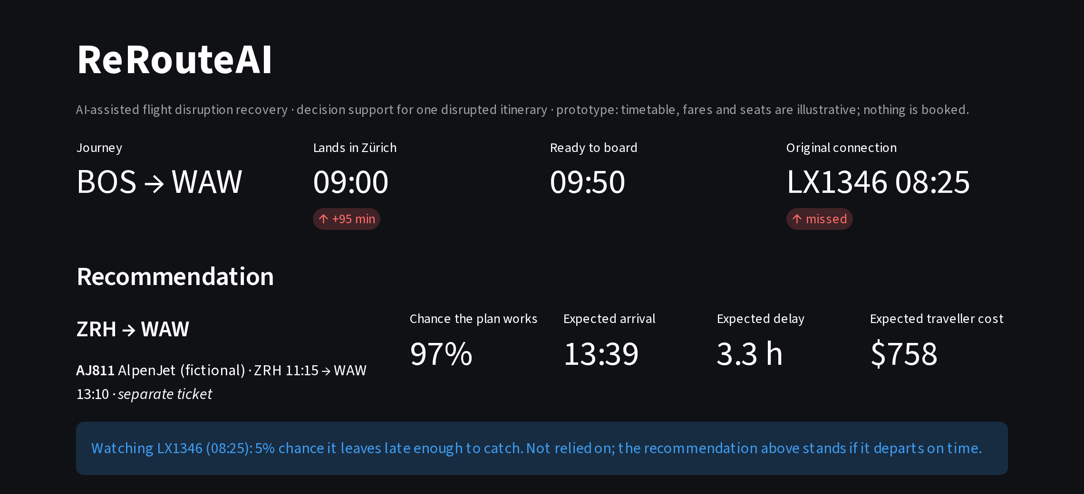
Step 3: Recommend and adapt (live demo)
Who decides | Recommended route
Student ($0–10/h) | Next direct flight, 14:20; free
Leisure ($25–100/h) | Via Vienna; free, earliest
Business / urgent | $260 nonstop, 11:15; 97% reliable
Airline, EU261 applies | Buy the $260 seat
Airline, weather delay | Late-evening flight; no compensation
Rebooking agent | Approves, or overrides with a logged reason
Key example: buy a $260 seat on another airline to avoid a €600 compensation payment.
Illustrative timetable (AlpenJet is fictional). Delay model currently uses synthetic BTS-format data.
Notes:
6:00–8:00 (Technical). Step 3, live demo. Move the priority slider: a student gets the free direct flight, a business traveller gets the paid nonstop. In the airline view, buying a 260-dollar seat is cheaper than 600 euros of compensation. With EU261 turned off, as for a weather delay, the cheapest plan becomes a late-evening flight. Show the agent approving or overriding. Have a backup video ready.

Slide 9
Roadmap and roles
Month | Work
October | Train the delay model on real BTS data; build the policy retrieval (EU261, airline rules)
November | Build the agent workflow; run U.S. historical backtests; 5-person user test
December | Final delivery: live demo, results and slides
Team member | Role
Agnieszka | Data and timetable
Regina | ML delay model
Delice | Graph search and cost model
Kofi | Interface, RAG and ethics
Shared GitHub repository, weekly check-ins, each change reviewed by a second teammate, backup demo video.
Final presentation date to be confirmed with the instructor.
Notes:
8:00–10:00 (Implementation). October: train the delay model on real BTS data and build the policy retrieval. November: build the agent workflow, run backtests on real U.S. history and test with five users. December: final delivery. Roles: Agnieszka data and timetable, Regina the delay model, Delice graph search and the cost model, Kofi the interface, retrieval and ethics.

Slide 10
How we will evaluate it
Compare against
  Earliest arrival
  Lowest fare
  Next direct flight on the same airline (current default)
Measure
  Cost saved per disruption
  Share of passengers arriving within 3 hours
  Response time (about 0.2 s in the prototype)
  User test with 5 participants
Prototype simulation, about 120 traveller cases × 30 delay draws, synthetic BTS-format data. To be re-run on real 2024 data.
Notes:
10:00–11:00 (Evaluation). We compare against the rules agents use today: earliest arrival, lowest fare, and the next direct flight on our own airline. We measure cost saved, the share arriving within 3 hours, response time, and a 5-person user test. The chart is an early prototype result on synthetic data; the real test is the backtest on 2024 BTS data.

Slide 11
Ethics and safeguards
Human in the loop
Decision support only. A named agent signs off every rebooking; overrides are logged and reviewed.
Equity
Priority rules for minors, medical needs and reduced mobility come before any value-of-time calculation.
Legal accuracy
Explanations may only use retrieved, cited policy text and the model's numbers, so passenger rights are not invented.
Also: itinerary data only (no payment data), separate-ticket options clearly labelled, and stated limits of a U.S.-trained model.
Questions welcome. Appendix: prior work, data sources, references.
Notes:
11:00–12:00 (Ethics). Three safeguards. Human in the loop: a named agent signs off every rebooking and overrides are logged. Equity: priority rules for minors, medical needs and reduced mobility come before any value-of-time calculation. Legal accuracy: the explanation can only use retrieved, cited policy text. Then take questions.

Slide 12
Appendix
Prior work, data sources and references
Notes:
Appendix: use only for questions.

Slide 13
Appendix A: Prior work
Wu et al. (2025): review of 169 key airline recovery studies; future directions include real-time recovery with uncertain parameters and human factors
Lu et al. (2025): passenger transfer costs (refunds, same-airline and other-airline rebooking, overnight stays); recovering every flight is not always cheapest
Clausen et al. (2010); Bratu & Barnhart (2006): disruption management and passenger-aware recovery
What ReRouteAI adds
  Decision for one passenger in real time
  Probability for each connection instead of fixed rates
  Other-airline seats and EU261 in one cost score
  User-set time vs cost priority
  Cited explanation and human approval
Notes:
Appendix, for questions.

Slide 14
Appendix B: Data and feasibility
Real history: U.S. BTS TranStats, “Reporting Carrier On-Time Performance (1987–present)”; train on January–September, test on October–December
Backtest: an all-U.S. connection (for example BOS → ORD → MSP), replaying real 2024 delays
Zürich scenario: documented timetable; fares, seats and connection times marked as illustrative
Not claimed: live seat inventory, interline ticketing rights, or delay calibration for European airports
Download path: transtats.bts.gov → Aviation → Airline On-Time Performance Data.
Notes:
Appendix, for questions.

Slide 15
Appendix C: References
Bratu, S., & Barnhart, C. (2006). Flight operations recovery: New approaches considering passenger recovery. Journal of Scheduling, 9(3), 279–298.
Clausen, J., Larsen, A., Larsen, J., & Rezanova, N. J. (2010). Disruption management in the airline industry: Concepts, models and methods. Computers & Operations Research, 37(5), 809–821.
Lu, L., Xu, Y., Fan, W., Pan, H., Ip, W., & Yung, K. L. (2025). Research on the recovery method of disrupted flights considering passenger transfer and cancellation costs. Operations Management Research, 18, 691–717. https://doi.org/10.1007/s12063-024-00530-z
Wu, S., Liu, E., Cao, R., & Bai, Q. (2025). Airline recovery problem under disruptions: A review. Computers & Operations Research, 175, 106915. https://doi.org/10.1016/j.cor.2024.106915
Regulation (EC) No 261/2004 of the European Parliament and of the Council. Official Journal of the European Union, L 46, 1–8.
Court of Justice of the EU: Sturgeon and Others, C-402/07 and C-432/07 (2009); Folkerts, C-11/11 (2013).
U.S. Bureau of Transportation Statistics. Reporting Carrier On-Time Performance (1987–present). TranStats.
Notes:
Appendix: references.

