Slide 1


Paper ID: W67.5
How were you created?
Explaining synthetic face images generated by diffusion models
Bhushan Atote, Victor Sanchez
Department of Computer Science,
The University of Warwick, UK

Slide 2
Outline
  Introduction
    Diffusion Probabilistic Models
    Explainable AI
    Motivation
  Proposed EDIPR Model
    Pre-processing stage
    Synthesizing stage
    Explaining stage
  Experiments
    Implementation Details
    Explanability
    Influence Scores
  Conclusion

Slide 3
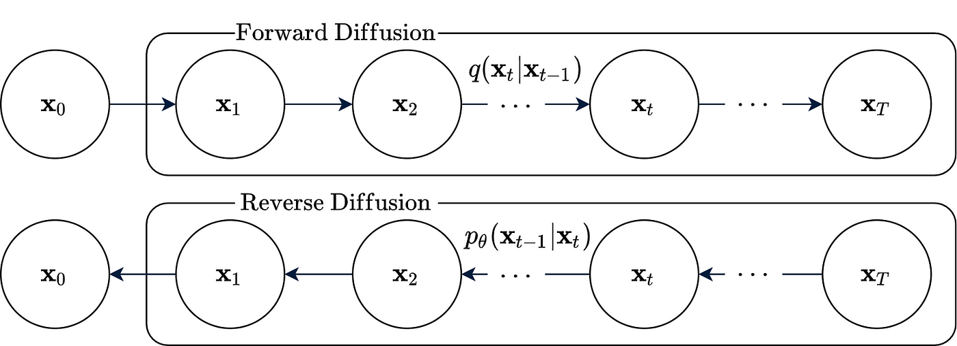
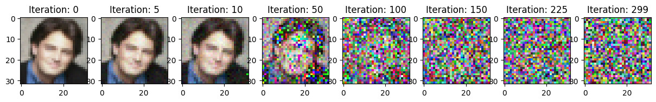


Introduction
Diffusion Probabilistic Models
Initial dist.
$$q(x0)$$
$$T=299$$
Fig. 1 – Denoising Diffusion Probabilistic Model
Introduction
Proposed Model
Experiments
Conclusion

Slide 4
Explainable AI
Passive approach
Feature Analysis
Explanation of DNN decisions
Feature
Visualization
Network
Dissection
Input Feature
Attribution
Concept – based Explanation
Visual
Explanations
Linguistic
Explanation
Deconvolution
Activation
Maximization
Active approach
Regularization
Technique
Built-in Attention
Mechanism
Prototype – driven
Explanation
Fig. 2 – Taxonomy of Explainable AI methods
Introduction
Proposed Model
Experiments
Conclusion

Slide 5
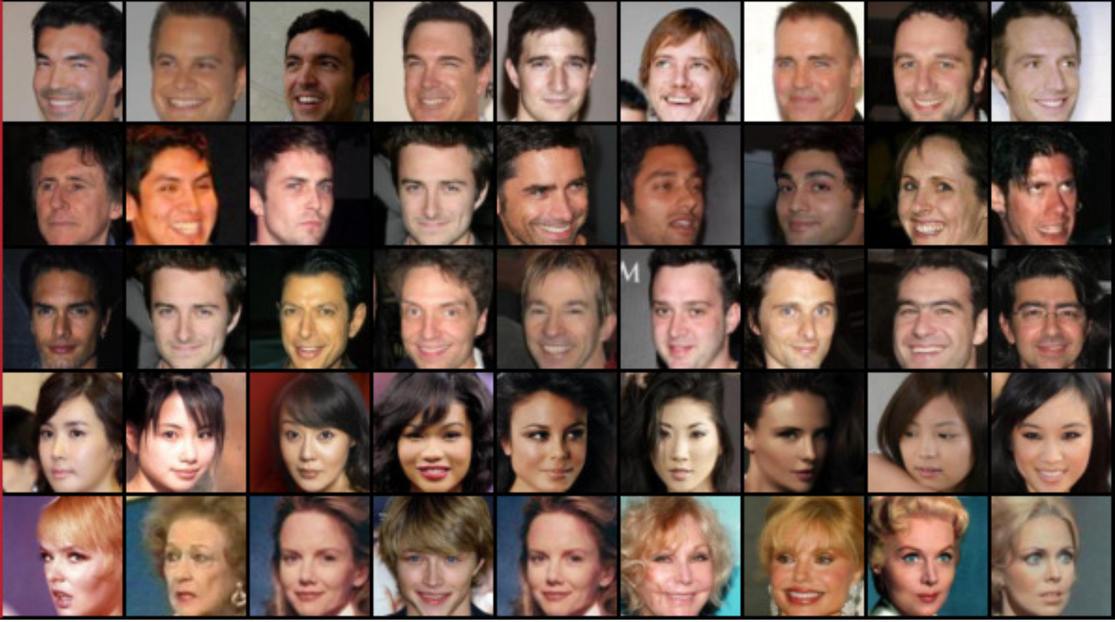





Motivation - DeepFakes
Generated synthetic
images
Images from training data
0.26
0.32
Diffusion
Model (DM)
0.25
0.17
Influence score
Fig. 3 – Motivation
Introduction
Proposed Model
Experiments
Conclusion
Introduction

Slide 6
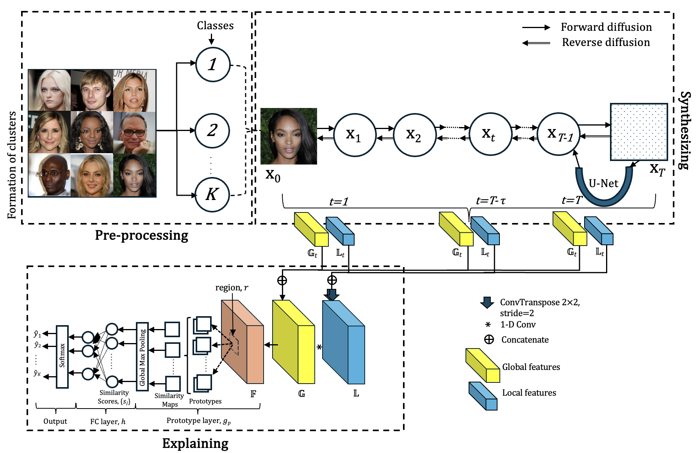
Proposed EDIPR Model
Fig. 4 – Architecture of the Explainable DIffusion PRobabilistic (EDIPR) model
Introduction
Proposed Model
Experiments
Conclusion

Slide 7
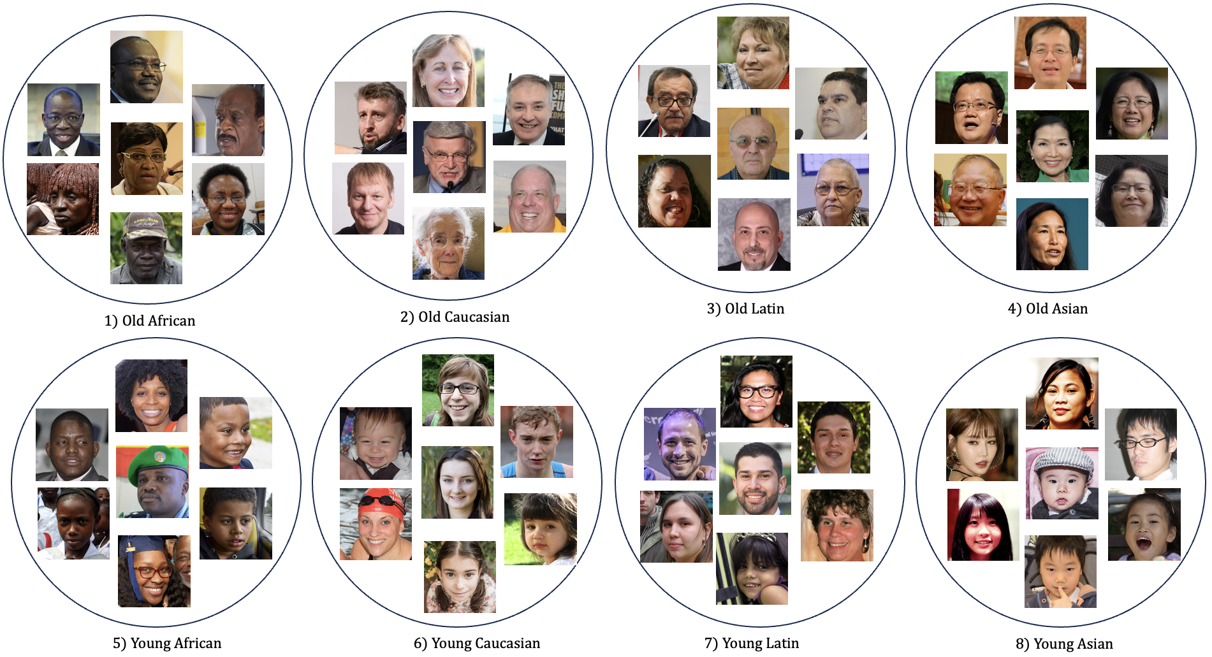
Pre-processing stage
Dataset: FFHQ dataset
(70k real face
images)
Fig. 5 – Classes/ formation of clusters
Introduction
Proposed Model
Experiments
Conclusion

Slide 8
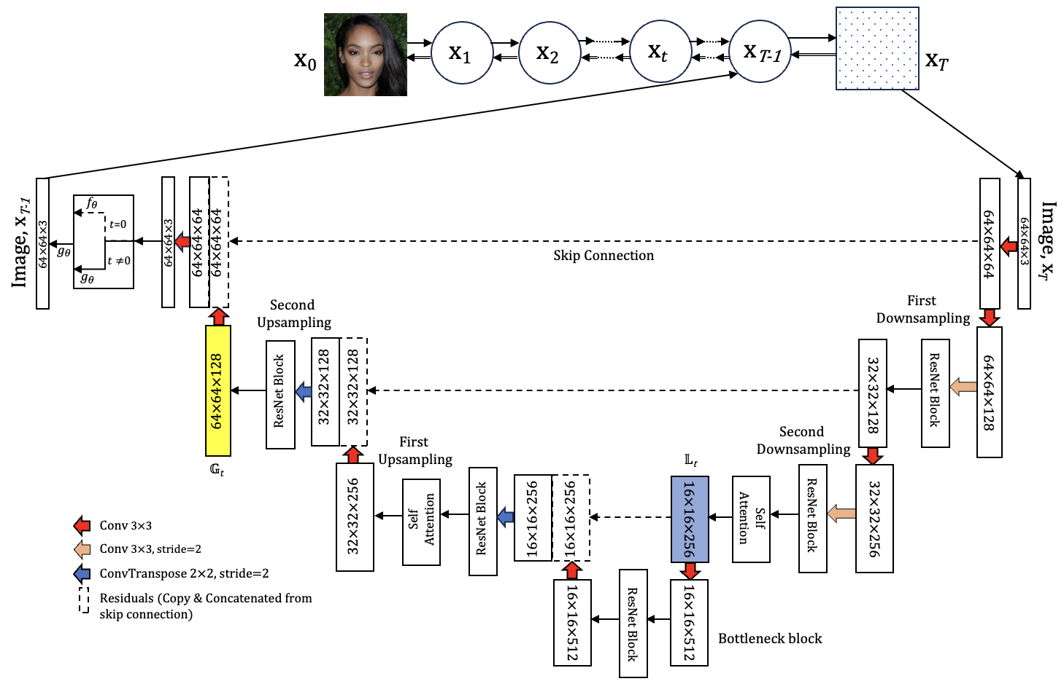
    Synthesizing stage
Fig. 6 – U-Net for EDIPR
Introduction
Proposed Model
Experiments
Conclusion

Slide 9
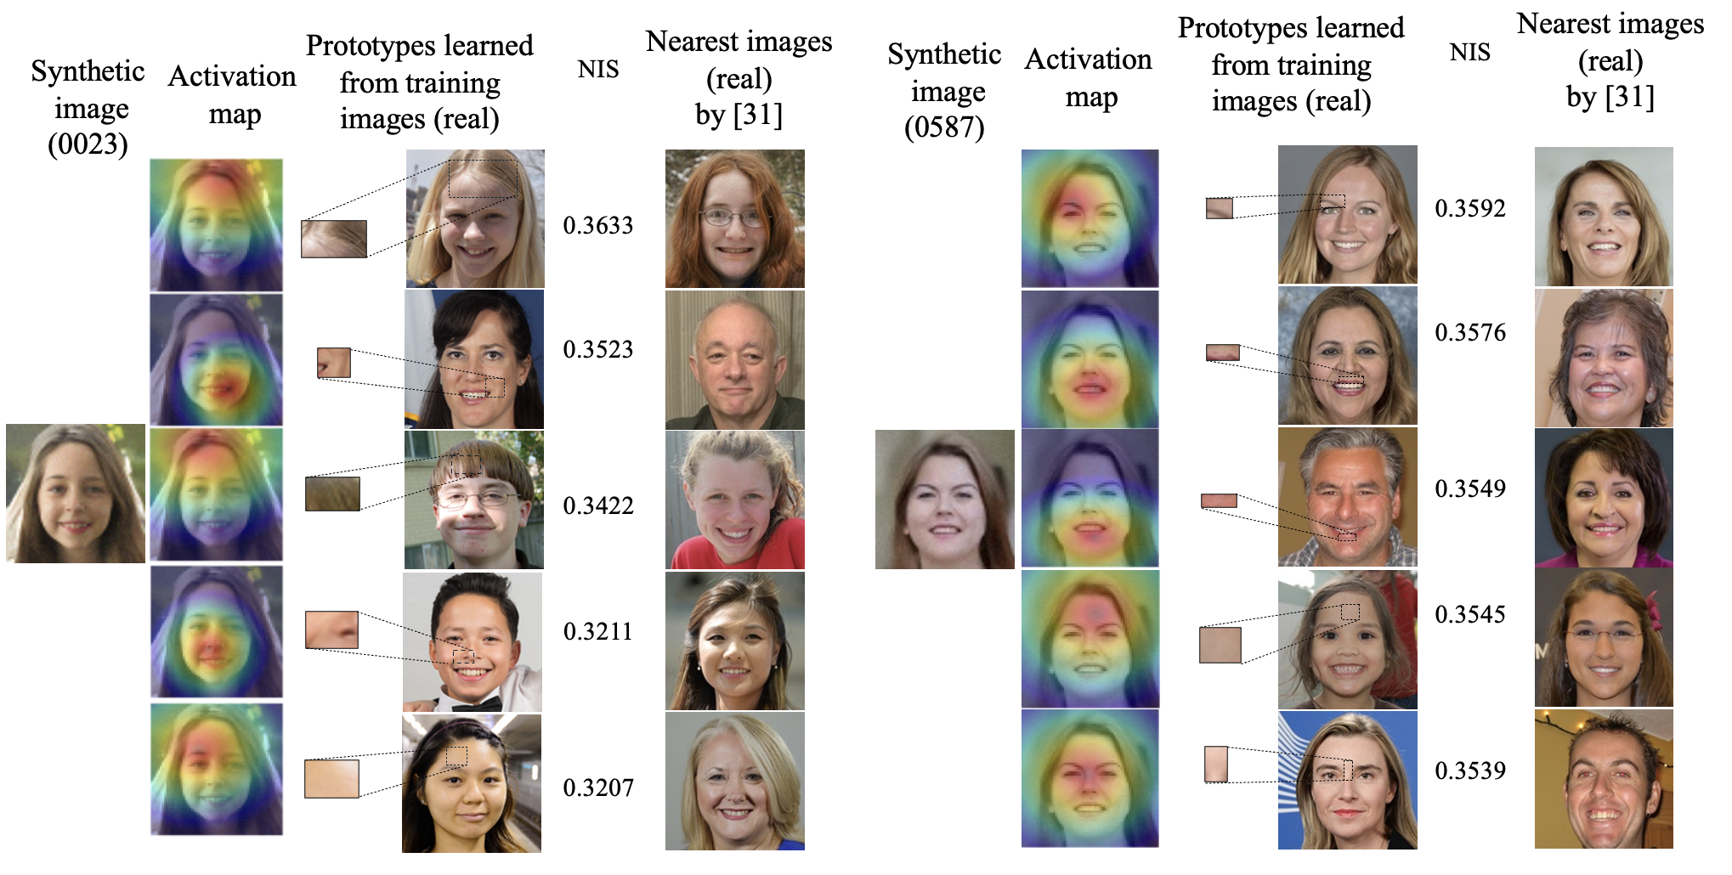
Explaining stage
Fig. 7 – Prototypes in the form of explanations
Introduction
Proposed Model
Experiments
Conclusion

Slide 10
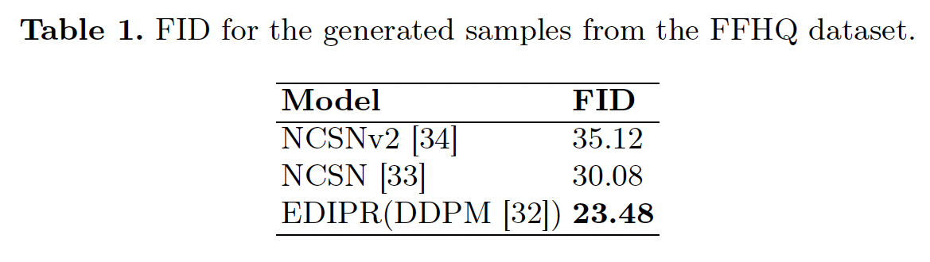
Experiments
    Implementation Details
Dataset: FFHQ dataset (70k real face images)
In explaining state (EPPNet),
we identify 350K distinct
prototypes, 10 prototypes
per image
Introduction
Proposed Model
Experiments
Conclusion

Slide 11
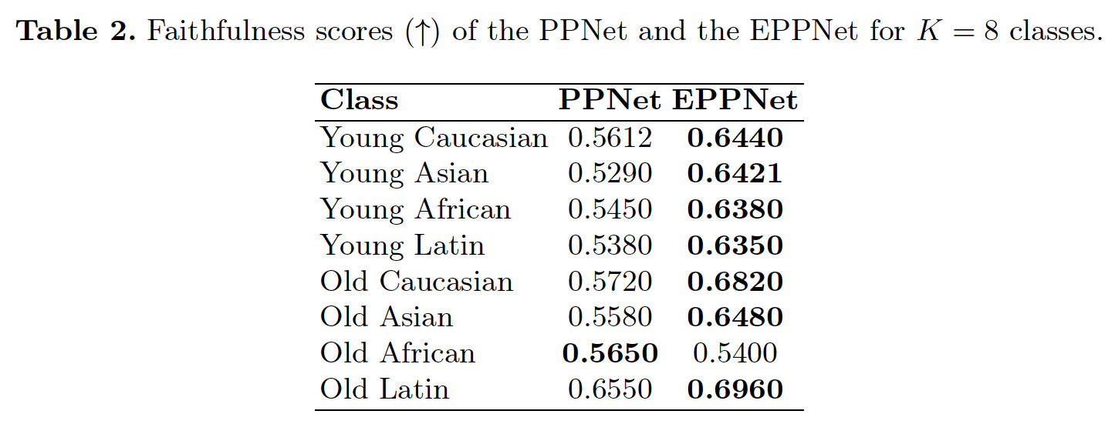
Experiments
Introduction
Proposed Model
Experiments
Conclusion

Slide 12
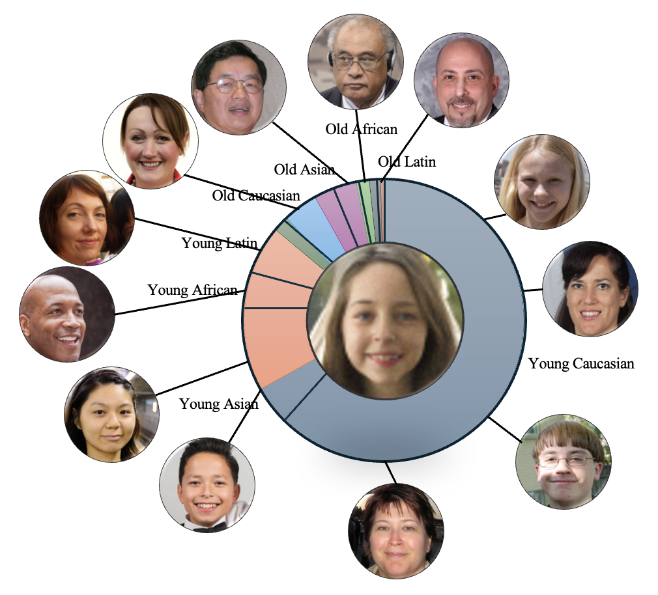
Explainability
Fig. 8 – Explanations at region level, image level & class level
Introduction
Proposed Model
Experiments
Conclusion

Slide 13
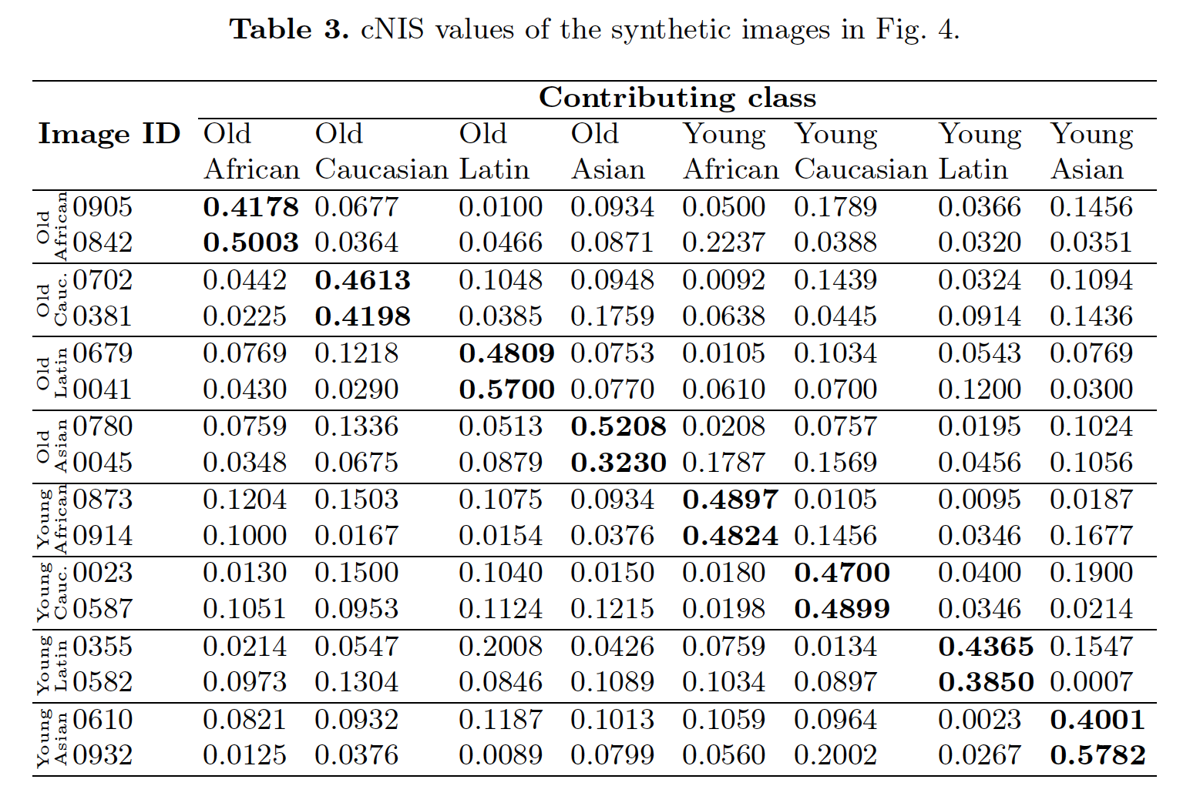
Influence Scores
Introduction
Proposed Model
Experiments
Conclusion

Slide 14
Conclusion
We have tackled a previously overlooked aspect of the intersection between GenAI and xAI: the lack of explainability in models that generate new data.
We introduced a new active approach for explainability, EDIPR, which is specifically designed to explain face images created by a diffusion model.
We proposed two scores – Normalized Influence Score (NIS) and the class-Normalized Influence Score (cNIS) for explainability.
Introduction
Proposed Model
Experiments
Conclusion

Slide 15
Thank you!
Q&A

