Slide 1


Paper ID: 1810
Enhanced Prototypical Part Network (EPPNet)
for explainable image classification via prototypes
Bhushan Atote, Victor Sanchez
Department of Computer Science,
The University of Warwick, UK

Slide 2
Outline
  Introduction
    XAI Methods
    Prototype – Driven Explanations
  Proposed Architecture
    Mean – Cluster loss
    Faithfulness score
  Experiments
    Implementation Details
    Explanability
    Faithfulness score
  Conclusion

Slide 3
Introduction
Passive approach
Feature Analysis
Explanation of DNN decisions
Feature
Visualization
Network
Dissection
Input Feature
Attribution
Concept – based Explanation
Visual
Explanations
Linguistic
Explanation
Deconvolution
Activation
Maximization
Active approach
Regularization
Technique
Built-in Attention
Mechanism
Prototype – driven
Explanation
Fig. 1 – Taxonomy of Explainable AI methods
Introduction
Proposed Model
Experiments
Conclusion

Slide 4
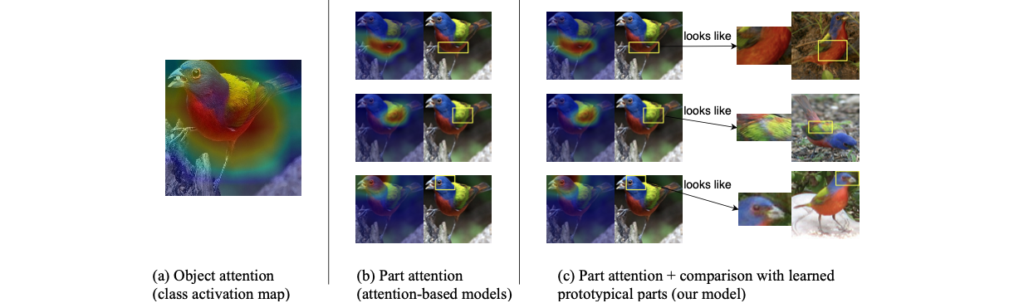
Prototype – Driven Explanations
Fig. 1 Prototype driven explanations
Introduction
Proposed Model
Experiments
Conclusion

Slide 5
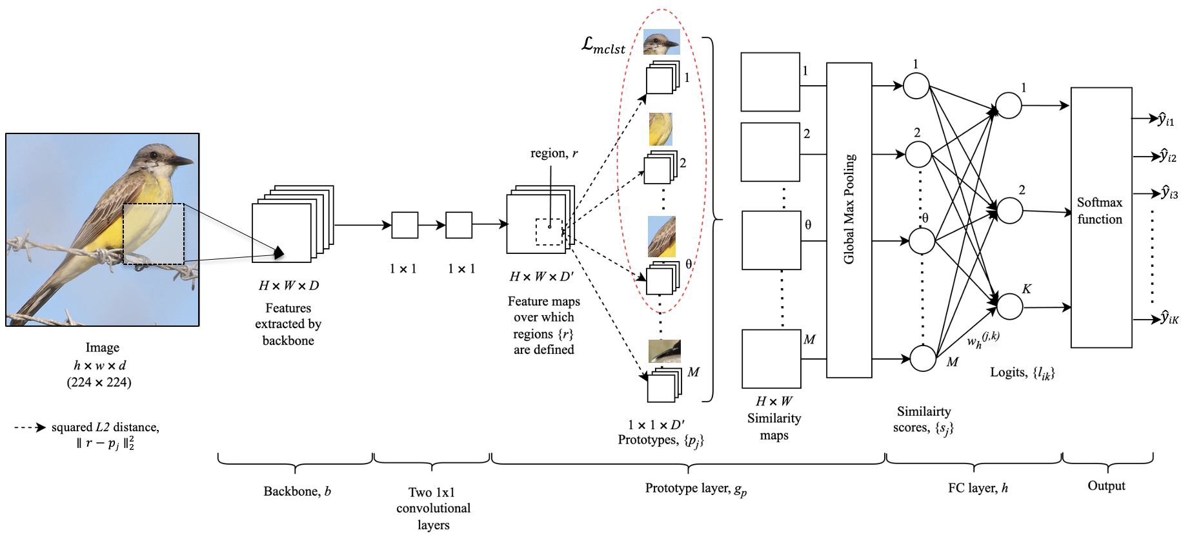
Proposed Architecture
Fig. 2 Enhanced Prototypical Part Network (EPPNet)
Introduction
Proposed Model
Experiments
Conclusion

Slide 6
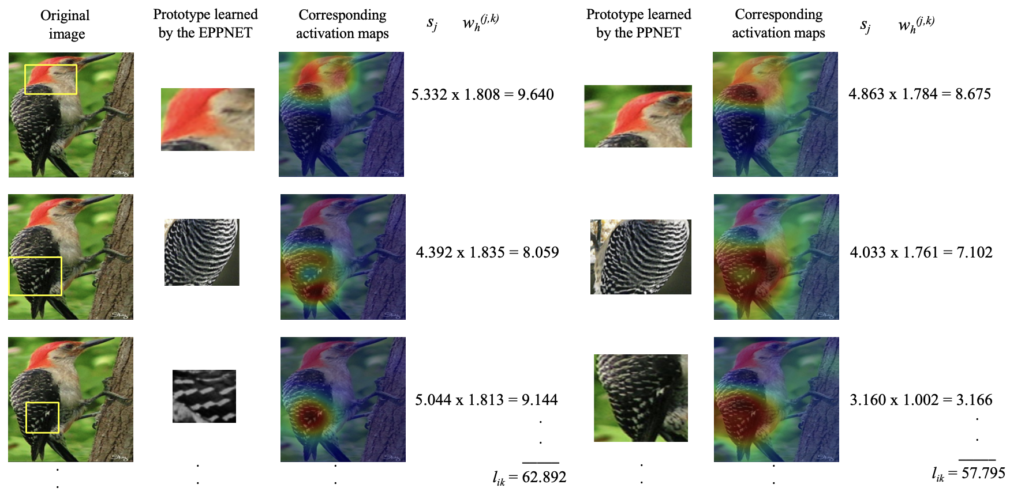
Fig. 3 Sample activation maps and their corresponding prototypes as learned by the proposed EPPNet (left) and the PPNet
(right) from a training image
Introduction
Proposed Model
Experiments
Conclusion

Slide 7
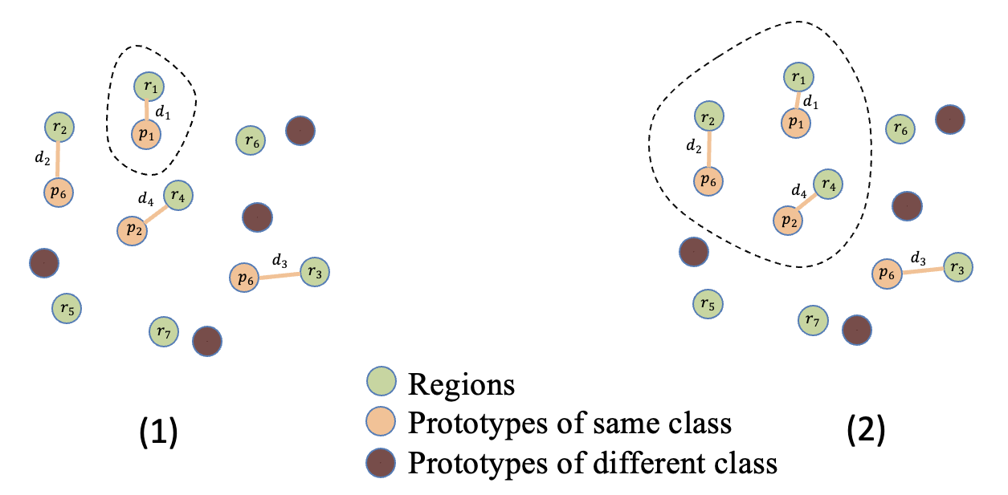
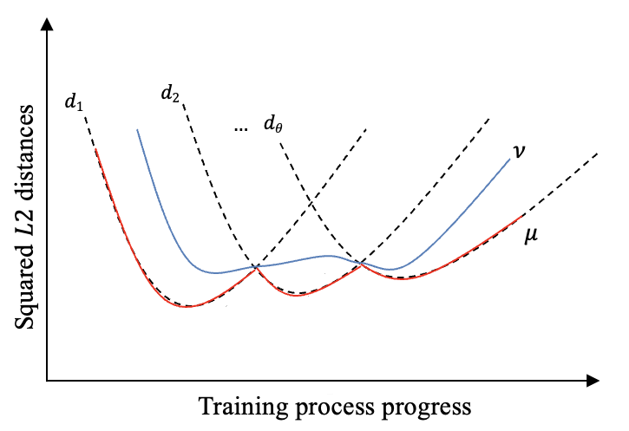
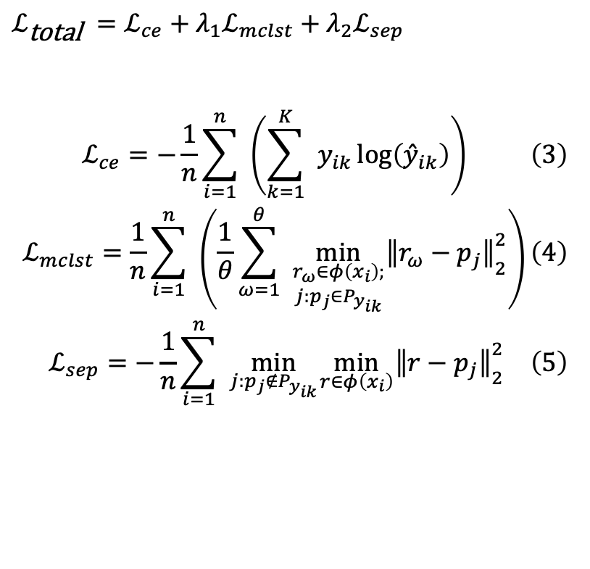
Mean – Cluster Loss
$ℒ_{\text{total }}=ℒ_{ce}+λ_{1}ℒ_{mclst}+λ_{2}ℒ_{sep}$
$$\begin{aligned}ℒ_{ce}=−\frac{1}{n}\sum_{i=1}^{n}{ } \left(\sum_{k=1}^{K}{ } y_{ik}\log\left({\overset{ˆ}{y}}_{ik}\right)\right)\#\left(3\right) \\ ℒ_{mclst}=\frac{1}{n}\sum_{i=1}^{n}{ } \left(\frac{1}{θ}\sum_{ω=1}^{θ}{ } \min_{\begin{matrix}r_{ω}∈φ\left(x_{i}\right); \\ j:p_{j}∈P_{y_{ik}}\end{matrix}} {∥r_{ω}−p_{j}∥}_{2}^{2}\right)\#\left(4\right) \\ ℒ_{sep}=−\frac{1}{n}\sum_{i=1}^{n}{ } \min_{j:p_{j}∉P_{y_{ik}}} \min_{r∈φ\left(x_{i}\right)} {∥r−p_{j}∥}_{2}^{2}\#\left(5\right)\end{aligned}$$
Fig. 4 Cluster formation in (1) the PPNet and
(2) the EPPNet when θ = 3
Fig. 5 Example curves representing a set of squared distance
distances {d₁, d₂,…, d_{θ}} as the training process progresses
(i.e., number of epochs)
Introduction
Proposed Model
Experiments
Conclusion

Slide 8
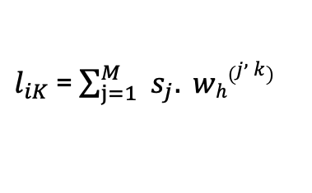
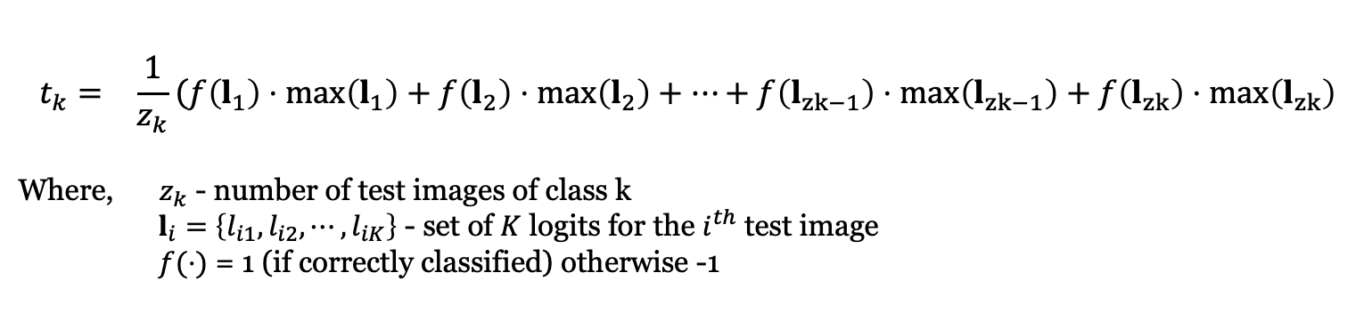
Faithfulness score
$$\begin{matrix}t_{k}= & \frac{1}{z_{k}}\left(f\left(l_{1}\right)⋅max\left(l_{1}\right)+f\left(l_{2}\right)⋅max\left(l_{2}\right)+…+f\left(l_{zk−1}\right)⋅max\left(l_{zk−1}\right)+f\left(l_{zk}\right)⋅max\left(l_{zk}\right)\right.\end{matrix}$$
Where, $z_{k}$ - number of test images of class k
$l_{i}=$ $\left\{l_{i1},l_{i2},⋯,l_{iK}\right\}$ - set of $K$ logits for the $i^{th}$ test image
$f(⋅)$ = 1 (if correctly classified) otherwise -1
$l_{iK}$ = $\sum_{j=1}^{M}{ } s_{j}. wh\left(j,k\right)$
Classification Accuracy
Interpretability
Introduction
Proposed Model
Experiments
Conclusion

Slide 9
Experiments
Implementation details:
Dataset: CUB-200-2011
Backbone networks: VGG-19, ResNet-34,
ResNet-152, DenseNet-121, and DenseNet-161
Introduction
Proposed Model
Experiments
Conclusion

Slide 10
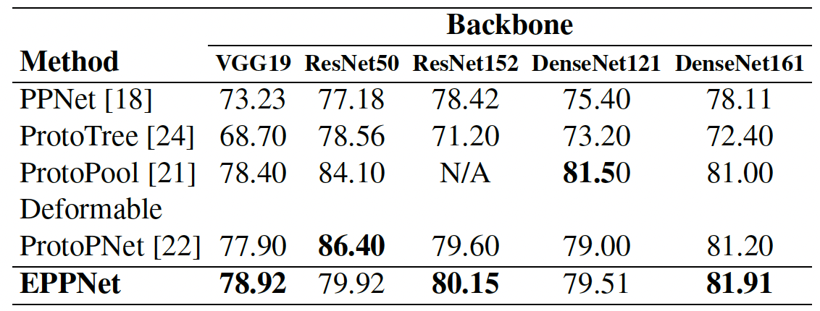
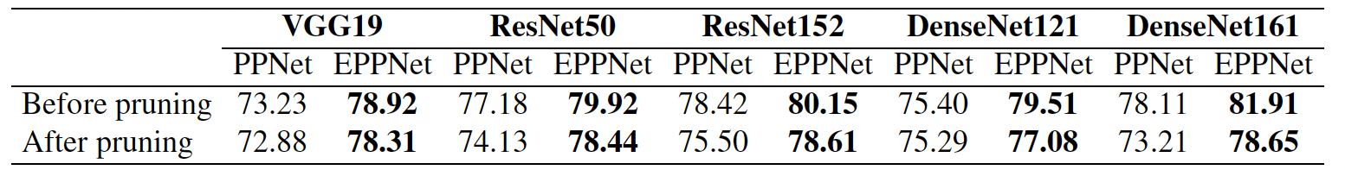
Table 1: Accuracy (%) of the EPPNet and other xAI-based
models for different backbones
Table 2: Accuracy (%) of the PPNet and the EPPNet for different backbones
after pruning half of the learned prototypes
Introduction
Proposed Model
Experiments
Conclusion

Slide 11
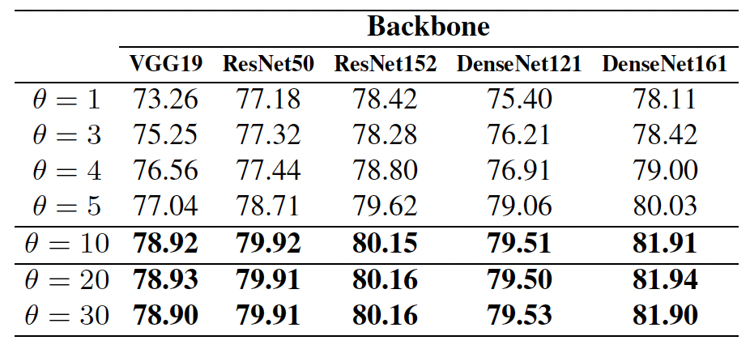
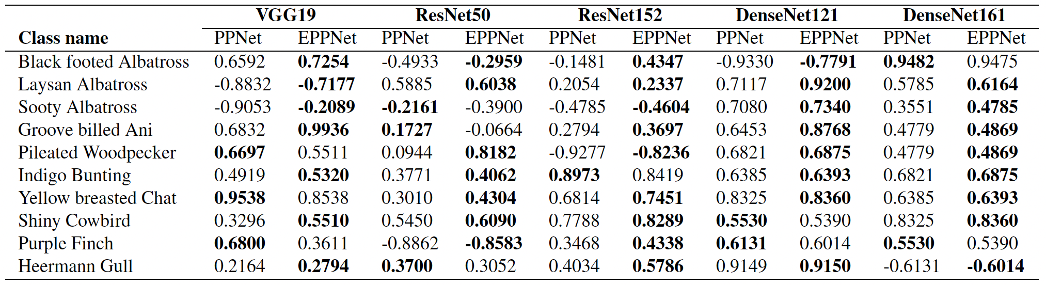
Table 3: Accuracy (%) of the EPPNet for different values of θ
(mean-cluster loss) when 10 prototypes are learned per class
Table 4: Faithfulness scores (↑) of the PPNet and the EPPNet
for different backbones and the ten hardest-to-classify classes
Introduction
Proposed Model
Experiments
Conclusion

Slide 12
Conclusion
We have introduced the EPPNet, an active xAI-based method for image classification that leverages prototypes for enhanced explainability
The EPPNet uses a novel mean cluster loss that relies on multiple prototypes to distinguish between classes more effectively
This work also introduced the faithfulness score to measure, the relevance of prototypes in ensuring explainability
Introduction
Proposed Model
Experiments
Conclusion

Slide 13
Thank you!
Q&A

