Slide 1
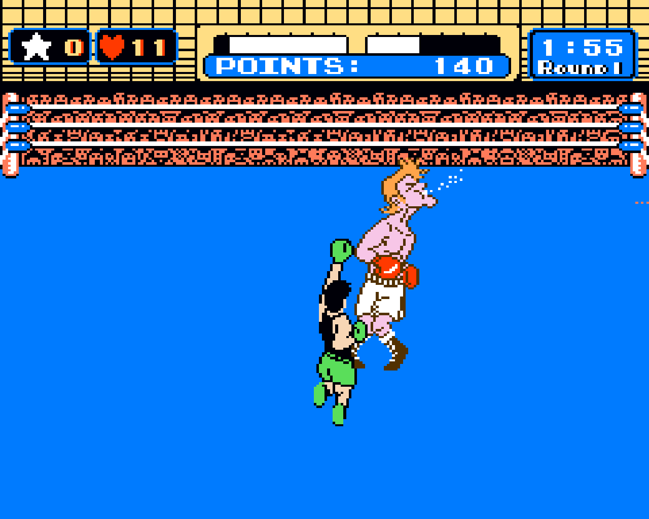
MVVM in JavaScript with KnockoutJS
Brandon Satrom
@brandonsatrom
www.userinexperience.com
Notes:
Photo used with permission from http://www.flickr.com/photos/charlesonflickr/368744129/
For the next 45 minutes or so, I’m going to talk about building rich, maintainable JavaScript with MVVM and KnockoutJS. I’ll discuss the need for rich client app frameworks, what MVVM is, how KnockoutJS fits into this picture and finally, how KnockoutJS integrates with ASP.NET MVC.

Slide 2


About Me
www.userinexperience.com
@BrandonSatrom
brsatrom@microsoft.com
Husband and father
Web Evangelist, Microsoft
Based in Austin, TX
Notes:
But first, a little bit about myself.

Slide 3
JavaScript... it’s kind of a big deal
JavaScript
1990’s
Client
Server
Database
JavaScript
2000’s
Client
Server
Database
JavaScript
Today
Client
Server
Database
Notes:
Now for a newsflash. JavaScript is kind of a big deal…
In fact, just looking at how the relationship between the client, server and database has evolved, and how the expansion of JavaScript correlates with those changes should be enough to convince you that JavaScript is a serious language. In the late 90s, JavaScript was more of a nuisance that anything else for most developers. Not only that, but it wasn’t even supported or enabled in all browsers. Ajax changed all of that, and by the time 2005 rolled around and the term Ajax was officially coined, JavaScript had contributed to providing another level of richness on the Web. The client “grew” as more work was deferred to JavaScript on the client. This growth has only continued over the last six years, and HTML5 is proof that JavaScript is a key cornerstone of the web.

Slide 4
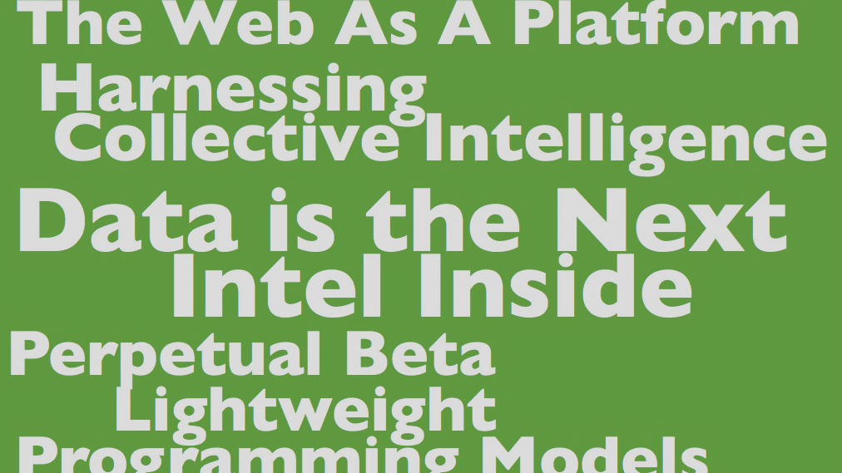
Notes:
The growth of JavaScript has enabled us to build web applications with rich, responsive and dynamic clients, the kinds of things often wrapped up in the Web 2.0 hype that kicked off in the middle of the last decade.

Slide 5

Spaghetti Script?
Notes:
Image Used with Permission from http://www.flickr.com/photos/gotosira/4699302559/
But rich, responsive and dynamic also means more code, in many cases. Every additional client feature and behavior on a page or site, even when simplified with a framework like jQuery, is more code to manage. And more code can often lead to spaghetti code, or Spaghetti Script in the case of JavaScript, and even the best of developers have produced an app or two with a well-structured back end and an absolute mess of JavaScript on the front.
Many strategies exist for managing JavaScript in our applications, from isolating all JavaScript into separate files, to the use of Script Loaders for conditional loading or increased performance. These practices are all worth the time and effort to adopt in our applications.
But what about when your UI grows to a certain level of sophistication, and the volume of JavaScript you need to manage dynamic behavior starts to spin out of control? The truth is, rich client applications betray the need for better patterns and frameworks in our front-end development efforts. The great news is that there are libraries that exist to help you create clean and well-organized JavaScript for rich, responsive UIs.

Slide 6





Notes:
KnockoutJS, or Knockout, is one such library. Created by Steve Sanderson, Knockout is a JavaScript library that aims to “simplify dynamic JavaScript UIs” through use of the MVVM pattern. By adding ViewModels--JavaScript objects that define both data and behavior for a view--Knockout helps you create well-organized and maintainable JavaScript with a clean underlying model. Knockout also provides automatic dependency tracking and declarative bindings that keep your UI in sync when you model changes, saving you from doing that work your self.

Slide 7
Knockout works with any server-side web development framework…
Notes:
Knockout is also a pure JavaScript library that works well with any server-side web development framework. We’ll be using ASP.NET MVC in the demo today, but Knockout works well with Rails, PHP and others. That can’t be overstated, so let me say it again: We’ll be talking about using KnockoutJS with ASP.NET MVC today, but as a pure JavaScript framework, there’s nothing stopping you from using it with any server-side framework, or even without a backend at all.

Slide 8
MVVM
Model
View
ViewModel
Notes:
If you haven’t heard of MVVM before, or still aren’t sure what it is, MVVM stands for Model, View, ViewModel. MVVM is a dialect of MVC that was created by Microsoft to describe a flavor of application that relied on data bindings for UI synchronization and rich, responsible behavior. The key difference between MVVM and MVC is the ViewModel, which is an object that defines both view-specific data and behavior.

Slide 9
Getting Started with Knockout
Notes:
Photo used with permission from http://www.flickr.com/photos/charlesonflickr/368744129/
Let’s talk now about how you can get started with KnockoutJS.

Slide 10
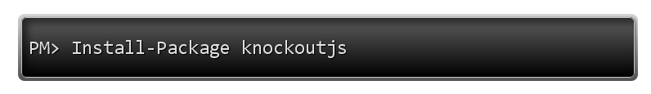
You got options…
Knockoutjs.com - read the docs, check out the samples, download and go
Learn.knockoutjs.com – Killer tutorials in the style of JSFiddle
Get the source at github.com/stevesanderson/knockout
Install it via nuget

Slide 11

Simple as 1, 2, 3…
Declare bindings
Create viewModel
Apply bindings to
viewModel
Notes:
Image used with permission from http://www.flickr.com/photos/lrargerich/3029485203/
Once you have knockout, using it is easy. You first need to declare bindings on the elements of your view, or HTML page. Then you need to define a viewModel in your JavaScript that maps data from the model to your view. Finally, you need to instruct Knockout to apply the bindings from your view onto your viewModel.

Slide 12
data-bind=“text: name”
Notes:
Step one looks like this. Every element in your markup will need to use a data-bind attribute to define the bindings that element should subscribe to. Data-* syntax is part of the HTML5 specification and is a perfectly legal way to define custom metadata on your markup.

Slide 13
var viewModel = { name: “Hugo Reyes”; };
Notes:
For step two, the viewModel is a simple JavaScript object literal with properties that match bound elements on the page

Slide 14
ko.applyBindings(viewModel);
Notes:
Finally, you’ll call the ko.applyBindings method to tie your view and viewModel together.

Slide 15
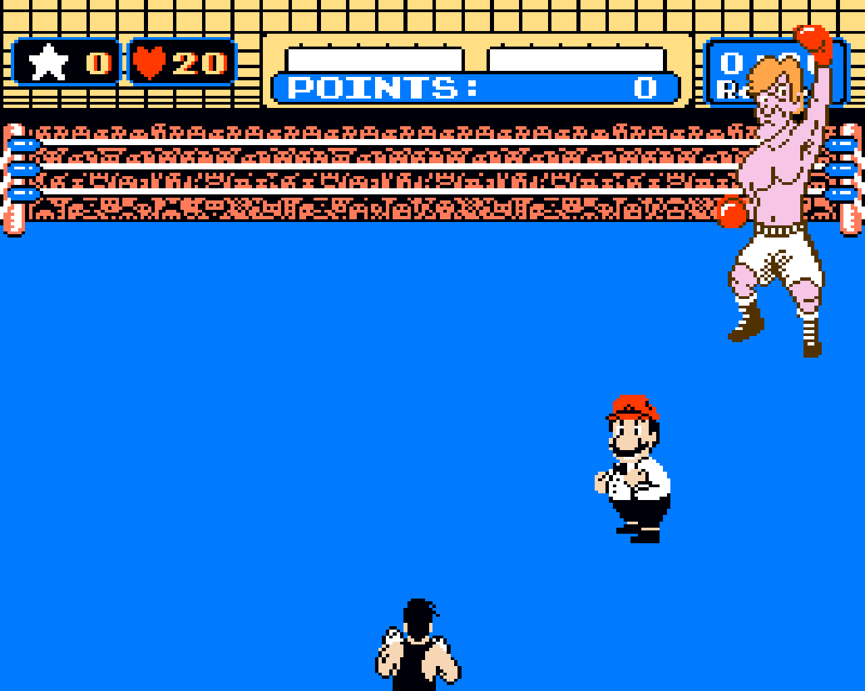
Demo :: Knockout Basics
Notes:
Image used with permission from http://www.flickr.com/photos/charlesonflickr/368744063/
[Use WebMatrix for this demo]
Let’s take a quick look at some of the basics of using knockoutjs.

Slide 16
Templating with Knockout
<div data-bind='template: "peopleTemplate"'> </div>
<script type="text/html" id=“peopleTemplate">
<ul>
{{each $data}}
<li> ${ this } </li>
{{/each}}
</ul>
</script>
Notes:
Beyond the basics of using knockout for two-way binding of Uis, you can also leverage Knockout to help with templating of repetitive elements or content. Knockout doesn’t require a certain templating approach or framework, so you can roll you own, but it works especially well with jQuery Templating. To use it, you define a template block in a script tag, give it an id, and then add a data-bind attribute to the container element that will hold the results of that template.

Slide 17
Demo :: Templates
Notes:
Image used with permission from http://www.flickr.com/photos/charlesonflickr/368744063/
[Use WebMatrix for a quick templating demo]
Lets take a quick look at templating now.

Slide 18
MVVM + MVC = ?
@Html.TextBoxFor(m => m.State, new { data_bind= "value: state" })
viewModel.addSpeaker = function () {
$.ajax({
url: "/speakers/create/",
type: 'post',
data: ko.toJSON(this),
contentType: 'application/json',
success: function (result) { $(‘#notify’).val(result); }
});
};
Notes:
There’s a lot more to knockout and templating than what I’ve shown here, so I encourage you to check out Knockoutjs.com as soon as you can. Now let’s switch to talking about Knockout and ASP.NET MVC
So far, you probably have noticed that we’ve been using Knockout in a pretty framework agnostic way. I’ve been writing my markup by hand and making no assumptions about where the data is coming from, or where it’s going. But chances are, you’ll want to use Knockout with a server framework like php, rails or asp.net mvc or web forms.
The good news that that all of these work well with knockout.

Slide 19
Demo :: Using Knockout with ASP.NET MVC
Notes:
Image used with permission from http://www.flickr.com/photos/charlesonflickr/368744063/
[Demos us VS 2010]
So lets take a look at using Knockout with an Existing ASP.NET MVC application
Using with strongly-typed helpers
Posting data back to MVC
Using the mapping plugin? (if you have time)

Slide 20

data-bind?
Notes:
Image used with permission from: http://www.flickr.com/photos/brian-fitzgerald/3334353375/
Knockout, of course, is not without its critics. For many people, the data-bind syntax seems like a bit of a code smell. This criticism seems to come more often from the traditional web development community who, like me, have spent the last several years in the pursuit of what is often called “unobtrusive javascript,” where presentation and behavior should be strictly separated. And sometimes data-bind doesn’t seem far off from the inline onclick handlers of old.
Thankfully, there are several ongoing efforts to give developers the option to use Knockout without declarative bindings. One such effort is Knockout.Unobtrusive, an open-source library that I’ve been working on for the last few months.

Slide 21
Demo :: Knockout.Unobtrusive
Notes:
Image used with permission from http://www.flickr.com/photos/charlesonflickr/368744063/
[Do this demo in VS 2010]
Let’s take a look at that now.
1) Take existing profile page demo and modify it to use Knockout.Unobtrusive

Slide 22

Notes:
Image used with permission from http://www.flickr.com/photos/charlesonflickr/368744048/
That’s a whirlwind tour of kockout. Now the only thing left is for you to try knockout out for yourself…

Slide 23
Resources
KnockoutJS
Knockoutjs.com
Learn.knockoutjs.com
github.com/stevensanderson/knockout
Knockout.Unobtrusive
bsatrom.github.com/knockout.unobtrusive
userinexperience.com/?p=689
Download WebMatrix for free from: http://web.ms/webmatrix
Notes:
Page of links

Slide 24

Questions?
@BrandonSatrom
www.userinexperience.com
http://github.com/bsatrom
Notes:
Image used with permission from http://www.flickr.com/photos/av_hire_london/5579137689/

