Slide 1

ssid: stedwards-guests Take this survey while you wait…
http://svy.mk/html5tx
This is SurveyMonkey, and they are hiring!
Notes:
Link to online survey

Slide 2
Welcome to…
#html5tx

Slide 3
Logistical Stuff

Slide 4
You are in Jones Auditorium

Slide 5
Did you Check in?
Notes:
If not, check in outside

Slide 6
Meals will be served outside Jones
Notes:
Once you get your food, you can come back in here to sit down, head outside or up to the second floor.

Slide 7
Bathrooms are on the second floor

Slide 8
WiFI and Power
SSID: Stedwards-Guests
(Open “newrepublicbrewing.com” and click “accept”)
Power Strips on Floor around the perimeter of room.
Please be courteous and share if

Slide 9
Session Logistics
“New” Track Meets in Jones Auditorium
“Improved” Track Meets in Mabee Ballroom (3rd Floor)
Open Spaces Meet In the Maloney Room (Main Building, 3rd Floor)
Notes:
→ The Maloney Room is in the main building, across the courtyard

Slide 10
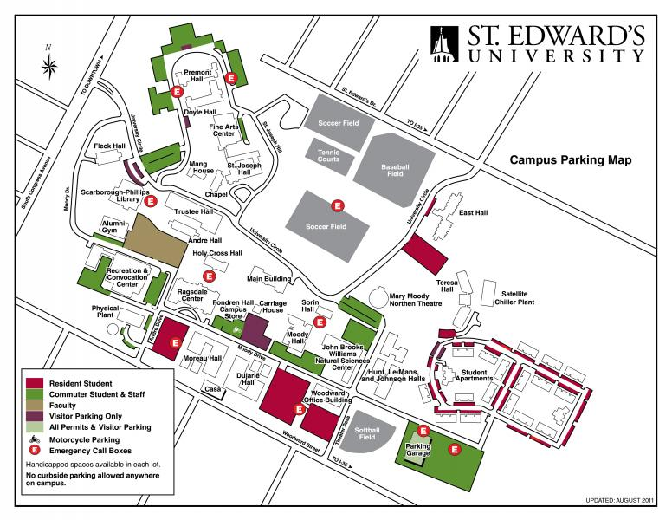
Sessions
Maloney Room

Slide 11
Parking

Slide 12
Schedule
http://html5tx2011.sched.org

Slide 13
#html5tx

Slide 14
Rate your Sessions!
http://bit.ly/html5tx11

Slide 15
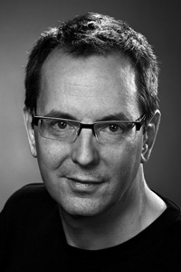
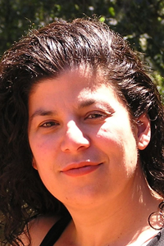
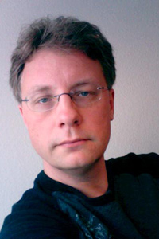
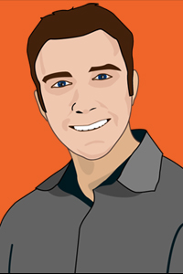
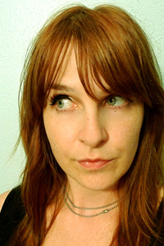
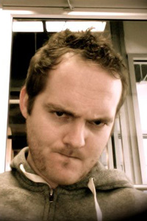
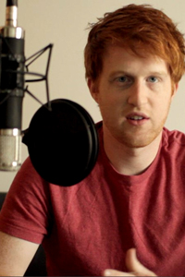
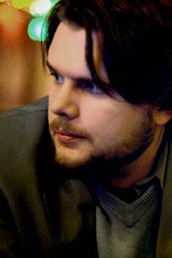

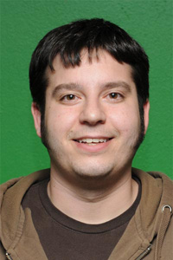
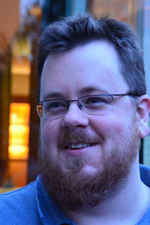
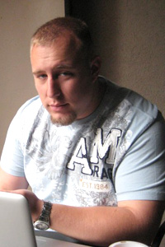
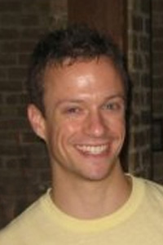
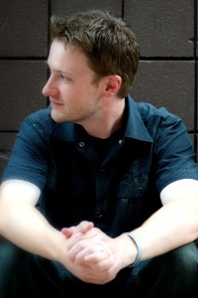
Speakers
Notes:
Thank all of the speakers for coming

Slide 16
Rate your Sessions!
http://bit.ly/html5tx11

Slide 17









Thanks to our sponsors!

Slide 18

Thanks to the people who made HTML5.tx possible!
Gavin Brahman | Jeff Carouth
Keith Casey | Sharon Cichelli
Sam Hooker | Martin Hooper
Clark Sell | Robert Stackhouse
Tim Thomas | Jake Wong
Notes:
Introduce the staff. Ask them to come up to the front
Ask everyone to look for these people if they have a question
A few people who donated company time to make this happen…
Give Sam Hooker a chance to talk about Frog Slayer
Give Gavin and Martin a chance to talk about Drifting Creatives

Slide 19



Thanks to the people who made HTML5.tx possible!
Notes:
Introduce the staff. Ask them to come up to the front
Ask everyone to look for these people if they have a question
A few people who donated company time to make this happen…
Give Sam Hooker a chance to talk about Frog Slayer
Give Gavin and Martin a chance to talk about Drifting Creatives

Slide 20
Closing Party
@ HubAustin (hubaustin.com/)
4930 S. Congress Ave, Suite 307
5:30 – 10 pm
Notes:
At this point, invite Kyle up to talk briefly about HubAustin

Slide 21
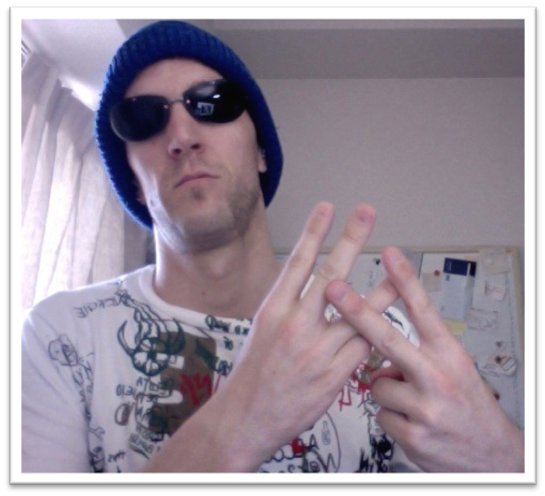

Why Are We here?
Notes:
We’re about to transition into the Opening Circle for our open spaces, and the rest of the day. But before we do, I want to talk about why we (the people who have been planning this event for the last 4 months) are here.
We are students
A place to come together and learn about HTML5
A place to teach others about HTML5
A place to meet other passionate developers, start new project or companies or be reenergized

Slide 22
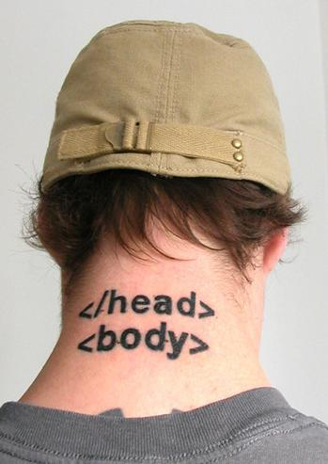
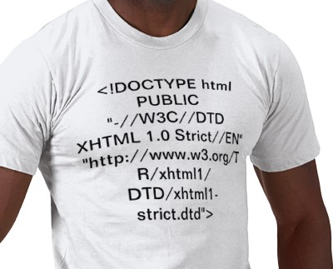
Why are you here?
Notes:
So why are you here? Think about it. You’re expecting something. It might be to hear a certain speaker or about a certain topic.
As you go throughout the day, I want to encourage you to do several things
This is your conference!
If you leave disappointed, its your fault!
Rate your sessions! Rate the conference!
Talk to speakers and ask questions!
Propose something in the open spaces!

Slide 23
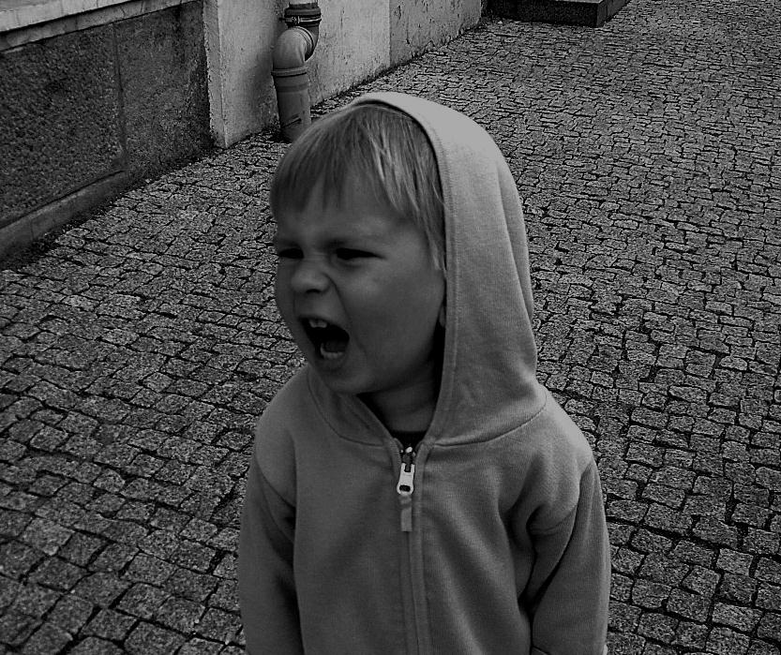
Don’t look for an excuse to be disappointed…
Notes:
You’ll probably find one.

Slide 24
Speak Up!
Notes:
It could be as simple as asking a question, or proposing a session for the open spaces. Either way, this became your conference to shape the moment you walked in here today.

Slide 25
Brandon Satrom @brandonsatrom bsatrom@gmail.com
Notes:
And if all else fails, you can contact me directly with any issues, complaints or feedback you have

Slide 26
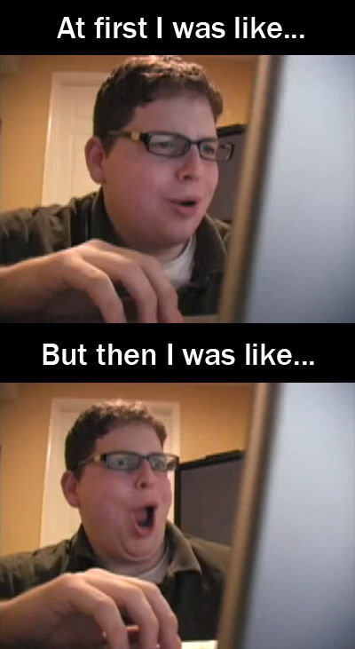
Allow yourself to be surprised…
Notes:
And finally, we ask that you allow yourself to be surprised. Discover something new and different today. Make a connection with someone you never thought you’d meet.

Slide 27
Rate your Sessions!
http://bit.ly/html5tx11

Slide 28
Open Spaces

