Slide 1
Figure 1
Translate
Refine
Agree

Slide 2
Figure 2

Slide 3
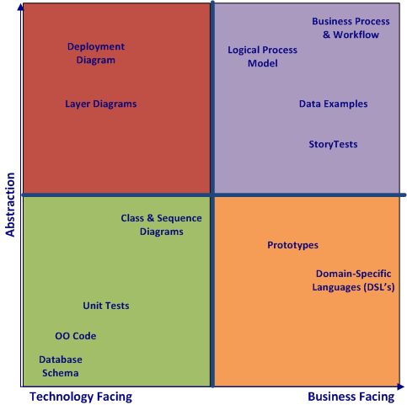
Figure 3

