Slide 1

MAHATMA GANDHI INSTITUTE OF TECHNOLOGY (A) DEPARTMENT OF INFORMATION TECHNOLOGY
Industrial Oriented Mini Project (IT653PC)
On
ESSENTIAL VOICE DELIVERY SYSTEM
BRIDGING THE GAP BETWEEN UNLETTERED
By
B Satyanarayana Reddy(22261A1209)
Thota Advith(22261A1245)
Batch ID: IT 25-09
Internal Supervisor IOMP Supervisor
Mrs.B Meenakshi Dr. U. Chaitanya
Assistant Professor Assistant Professor

Slide 2
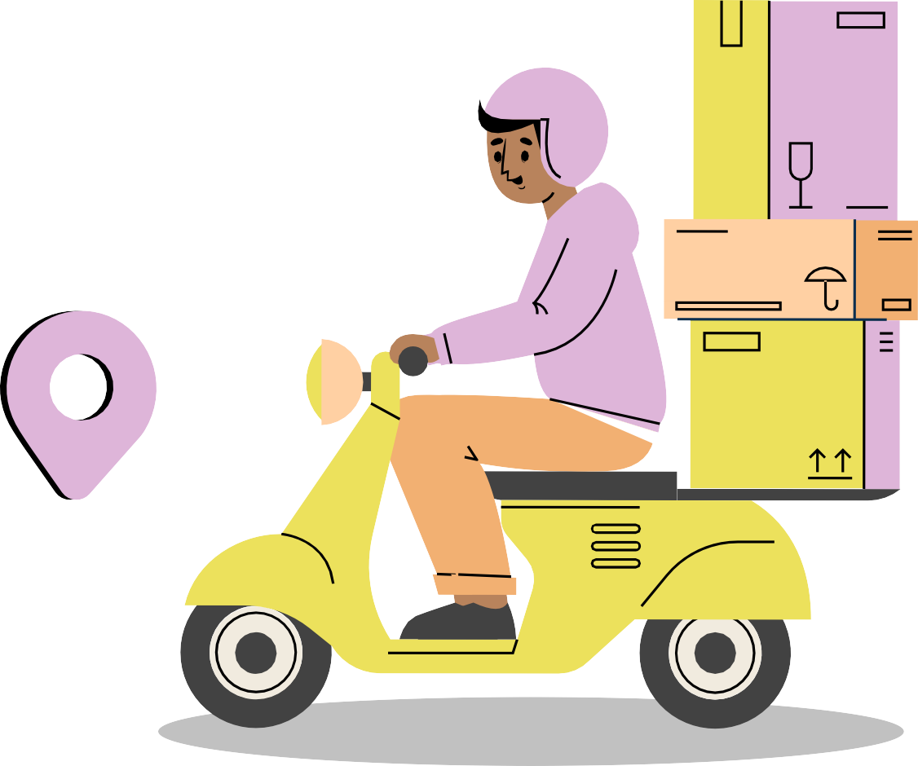
ESSENTIAL VOICE DELIVERY SYSTEM
BRIDGING THE GAP BETWEEN UNLETTERED
IOMP ID: IT-25 - 09
Name 1: B Satyanarayana Reddy
Roll No: 22261A1209
Name 2: Thota Advith
Roll No: 22261A1260
Mrs. B Meenakshi Internal Supervisor
Mrs.U. Chaitanya IOMP Supervisor

Slide 3
OUTLINE
ABSTRACT
INTRODUCTION
EXISTING SYSTEM
PROPOSED SYSTEM
APPLICATIONS
REQUIREMENTS
LITERATURE SURVERY
PROBLEM STATEMENT
OBJECTIVES
MODULES DESCRIPTION
ALGORITHM
DESIGN ARCHITECTURE&UML DIAGRAMS
TEST CASES
RESULTS
FUTURE ENHANCEMENTS
REFERENCES

Slide 4
ABSTRACT
-Problem Statement: Uneducated individuals who can communicate verbally but cannot read or write face challenges in accessing essential goods due to reliance on written communication in traditional ration ordering systems.
Solution: Development of a voice-based ration ordering system that allows users to order daily necessities via a
simple voice call.
Key Features:
Multilingual speech-to-text conversion.
Natural Language Processing (NLP) to extract item names, quantities, and delivery preferences.
User confirmation before finalizing the order.
Impact: Enhances accessibility and convenience for uneducated individuals, promoting inclusivity and digital empowerment.

Slide 5
INTRODUCTION
-Background: In many communities, literacy barriers prevent individuals from independently accessing essential goods and services.
-Objective: To create a voice-driven system that bridges the gap between unlettered individuals and essential services.
-Scope:The system focuses on providing a simple, intuitive interface for ordering daily necessities without the need for literacy or intermediaries.
-Goal: To ensure that basic services are accessible to all, regardless of literacy levels, contributing to a more inclusive and digitally empowered society.

Slide 6
EXISTING SYSTEM
Public Distribution System (PDS) – Manual Process
Ration is typically distributed through government-run PDS centers.
Requires physical presence, manual verification, and literacy to fill forms or rea receipts.
Limitations:
Highly dependent on literacy and documentation.
Time-consuming and prone to human error.
Vulnerable to corruption and misuse by intermediaries. Online Grocery Ordering Apps (e.g., Amazon, BigBasket) Allow users to order groceries through smartphones and apps. Tech: Mobile app, internet-based UI, and payment gateways. Limitations:
Text-based, requires reading and digital literacy.
Most interfaces are in English or major Indian languages. Needs smartphone access and a stable internet connection.
IVR-based Systems (Basic Voice Menu Services)
Used in some regions for basic service inquiries via Interactive Voice Response (IVR). Tech: Pre-recorded voice menu and keypad inputs.
Limitations:
Rigid structure with limited options.
No support for natural speech or regional dialects.
Cannot handle dynamic order input like item names and quantities.

Slide 7
PROPOSED SYSTEM
The proposed system is an AI-powered solution designed to enable unlettered individuals to place ration orders using natural spoken language. The system captures voice commands and uses Speech-to-Text (STT) technology to convert the spoken input into text. This text is then analyzed using Natural Language Processing (NLP) techniques to extract meaningful details such as item names, quantities, and delivery preferences.
The system is unique due to its multilingual voice interface and voice-based confirmation mechanism. After understanding the user's spoken request, it generates a structured order and uses Text-to-Speech (TTS) technology to provide audible feedback in the user's native language. This ensures the user can confirm or correct the order without the need for reading or writing.
By combining speech recognition, language processing, and voice feedback, the system offers an inclusive and accessible platform for individuals who may be unfamiliar with written communication or digital interfaces, thereby promoting autonomy and ease in accessing essential goods

Slide 8
APPLICATIONS
Voice-Based Ration Ordering
Enables illiterate individuals to order essential goods using voice commands, removing the need for written communication.
Support for Rural and Remote Communities
Offers accessible solutions to people in rural areas with limited literacy and digital infrastructure. Inclusive Public Distribution System (PDS)
Facilitates voice-driven access to government-subsidized ration and welfare schemes. Multilingual E-commerce Access
Breaks language barriers by supporting local dialects and languages through speech-to-text conversion.
Elderly and Special Needs Assistance
Helps elderly or differently-abled users who struggle with reading or using smartphones to order daily essentials independently.
Emergency and Humanitarian Aid
Can be deployed during crises or disasters for quick voice-based ordering of relief supplies.

Slide 9
HARDWARE AND SOFTWARE
Hardware Requirements:
Smartphone or basic mobile phone with voice call capability.
Server for processing and storing orders.
Software Requirements:
Speech-to-Text Conversion: Multilingual support for user-friendly communication.
Natural Language Processing (NLP): To extract and process key details from spoken input.
Order Management System: To generate, confirm, and process orders.
User Interface: Simple voice-based interaction for ease of use.
Technologies Used:
Speech recognition APIs (e.g., Google Speech-to-Text, IBM Watson).
NLP libraries (e.g., spaCy, NLTK).
Backend frameworks (e.g., Django, Flask).

Slide 10
Literature survey
Author(s) | Year | Title | Methodology | Findings | Research Gaps / Future Work
Indrani Medhi et al. | 2011 | Designing Mobile Interfaces for Novice and Low-Literacy Users | Ethnographic study + controlled experiments with mobile UIs | Graphical and voice interfaces performed better than text; live operator most accurate | Explore scalable hybrid designs (e.g., graphical + speech); cost-effective alternatives to human operators
Shahana Bano et al. | 2020 | Speech to Text Translation Enabling Multilingualism | Prototype STT system tested across Indian languages | Enabled multilingual speech translation; improved inclusivity | Enhance real-time accuracy, robustness across dialects, and speaker independence
Muhammad Nazrul Islam et al. | 2023 | Designing User Interfaces for Illiterate and Semi-Literate Users: A Systematic Review | Systematic review of 45 articles from 2001–2022 | Proposed 16 design principles and 5 UI rules (text, interaction, AV, pictography, info architecture) | Research needed on public UI design, context-aware systems, and new usability frameworks
Restyandito & Alan Chan | 2014 | A Review on Voice User Interface for Illiterate People | Literature review on cognitive usability and VUI | VUI helps access but users struggle due to abstract thinking and memory load | VUI must consider cognitive constraints, transient nature of audio, and cultural context
Saloni & Dr. Williamjeet Singh | 2020 | Multilingual Speech to Text Conversion – A Review | Technical review of ASR technologies and architectures | E2E ASR systems are promising; useful for multilingual real-time conversion | Need better support for low-resource languages, noise handling, and flexible deployment

Slide 11
PROBLEM STATEMENT
Uneducated individuals in rural and underprivileged areas face challenges accessing ration supplies.
Current systems require literacy or tech skills, excluding non-literate users.
Text-based digital platforms support limited languages and are not user-friendly for the illiterate.
Dependence on intermediaries causes delays, errors, and exploitation.
A voice-based ration ordering system in native languages is needed to ensure inclusive, accurate, and accessible service.

Slide 12
OBJECTIVES
To develop a voice-based ration ordering system that allows unlettered users to place orders using simple voice commands without needing to read or write.
To implement multilingual speech recognition and natural language processing
(NLP) so users can interact with the system in their native languages for better accessibility.
To ensure real-time conversion of spoken input to structured text orders, enabling
timely and accurate order processing.
To design a user-friendly and intuitive voice interface that removes the need for text-based interaction and supports low-literacy individuals.
To promote inclusivity and digital empowerment by bridging the gap between
essential services and underprivileged, uneducated populations.
To make the system scalable and adaptable, supporting various dialects, regional languages, and integration with local ration vendors or public distribution systems.

Slide 13
MODULES
Voice Input Module
Allows users to place orders through a voice . Supports multilingual speech input based on user preference.
Ensures accessibility for unlettered and digitally unskilled individuals.
Speech-to-Text Conversion Module
Converts spoken input into text using multilingual speech recognition. Handles different regional accents and dialects.
Prepares input for further processing by NLP engine.
Natural Language Processing (NLP) Module
Extracts relevant information from converted text:
Item names , Quantity
Delivery address or preferences

Slide 14
Order Management Module
Structures the extracted information into a valid order format. Handles inventory checking and price calculations (if applicable). Prepares the order for confirmation.
Voice Confirmation & Text-to-Speech (TTS) Module
Converts the order summary back to voice for user confirmation. Asks user to confirm, modify, or cancel the order via voice.
Ensures user validation before order placement.
Delivery & Notification Module
Sends finalized orders to delivery partners or ration shop vendors. Notifies the user of order status via call or SMS.
Can also collect voice-based feedback post delivery.

Slide 15
ALGORITHM
Step 1: Voice Call Initialization
User initiates a voice call to the system (through mobile or landline).
Step 2: Speech Input Collection
The system prompts the user to speak their order (e.g., item names, quantity, address). User responds verbally in their preferred language.
Step 3: Speech-to-Text Conversion
The system uses a Multilingual Speech-to-Text (STT) Engine to convert the spoken input into written text.
Step 4: Natural Language Processing (NLP)
NLP techniques are applied to: Identify and extract item names. Detect quantities and units.
Understand delivery preferences or location.
Step 5: Order Generation
Based on the extracted data, the system compiles a structured order.
Example: 2 kg rice, 1 packet salt, delivery to home.

Slide 16
Step 6: User Confirmation
The system reads back the order to the user via text-to-speech (TTS). Asks for confirmation (e.g., “Do you want to place this order?”).
User confirms or corrects the order via voice.
Step 7: Order Finalization
Once confirmed, the order is logged into the system.
A confirmation ID or message is generated (can be delivered via call or SMS).
Step 8: Delivery Processing
The system forwards the order to the ration distribution center or vendor. Delivery is arranged to the user’s specified address.
Step 9: Order Completion
After successful delivery, the system may follow up with a voice call to confirm receipt and collect optional feedback.

Slide 17
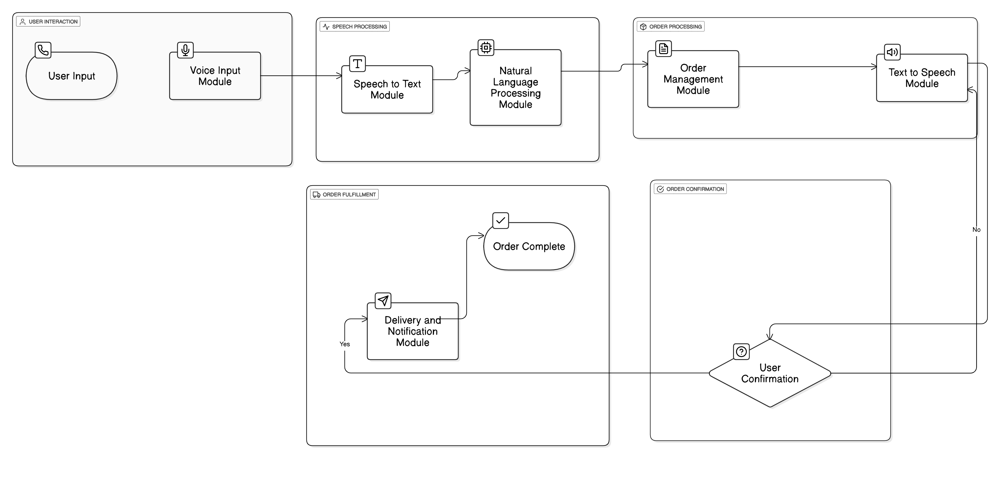
DESIGN ARCHITECTURE
VOICE BASED RATION ORDERING SYSTEM ARCHITECTURE

Slide 18
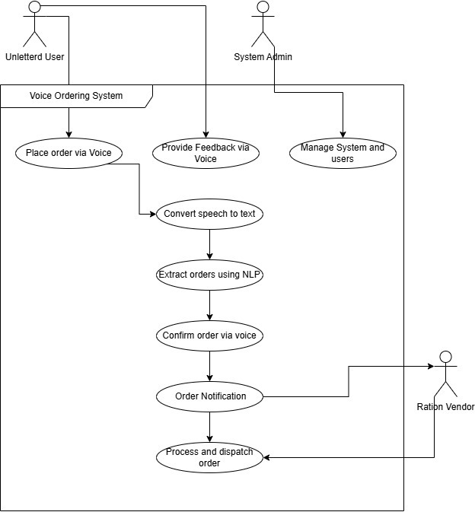
USE-CASE DIAGRAM
USE-CASE DIAGRAM OF VOICE BASED RATION ORDERING SYSTEM

Slide 19
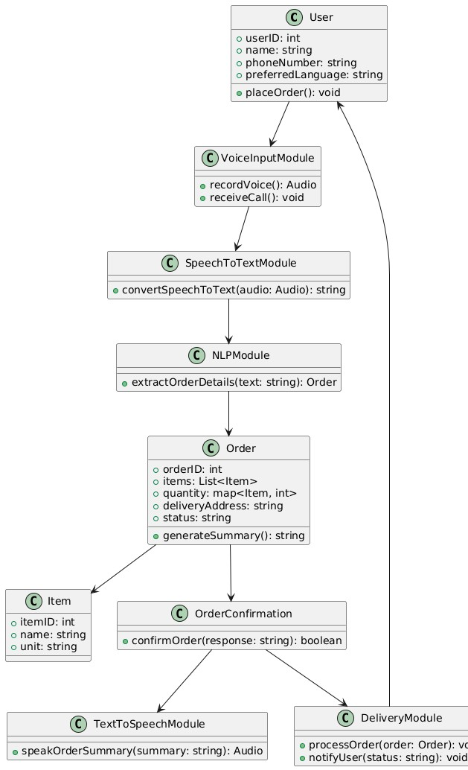
CLASS DIAGRAM
CLASS DIAGRAM OF VOICE BASED RATION ORDERING SYSTEM

Slide 20
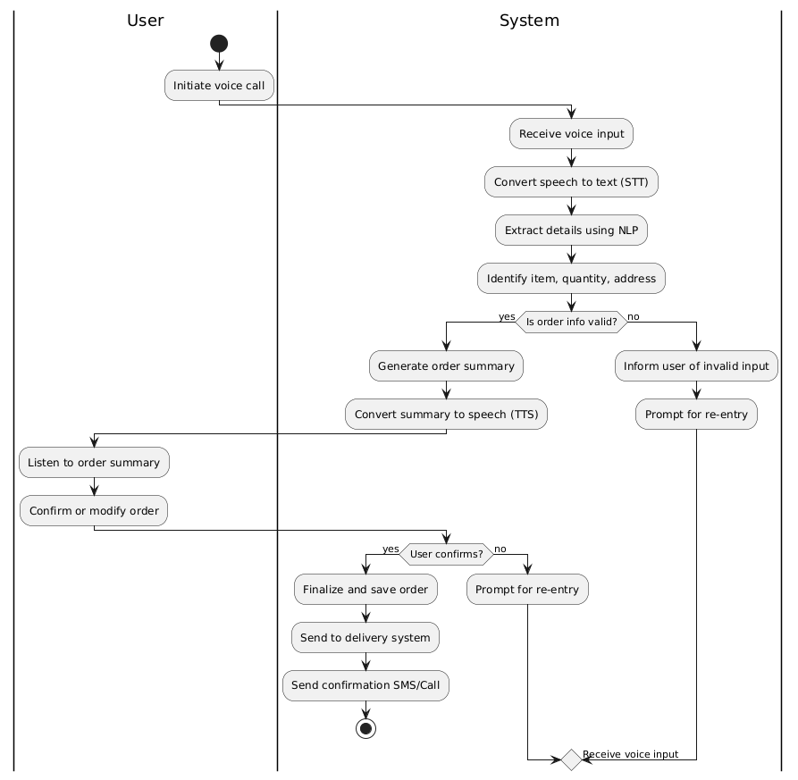
ACTIVITY DIAGRAM
ACTIVITY DIAGRAM OFVOICE BASED RATION ORDERING SYSTEM

Slide 21
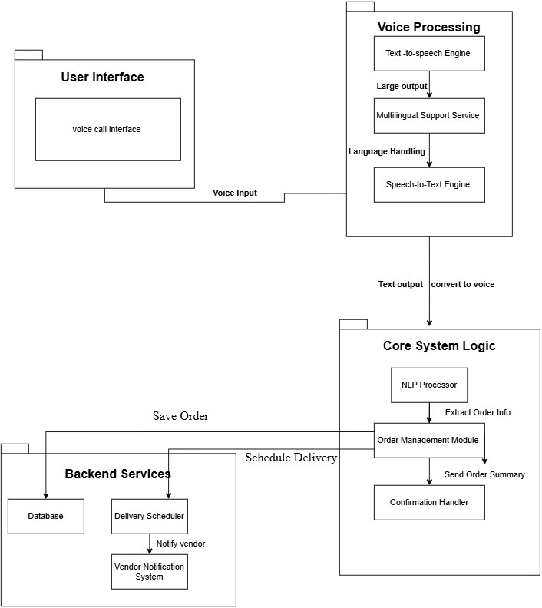
COMPONENT DIAGRAM
COMPONENT DIAGRAM OF VOICE BASED RATION ORDERING SYSTEM

Slide 22
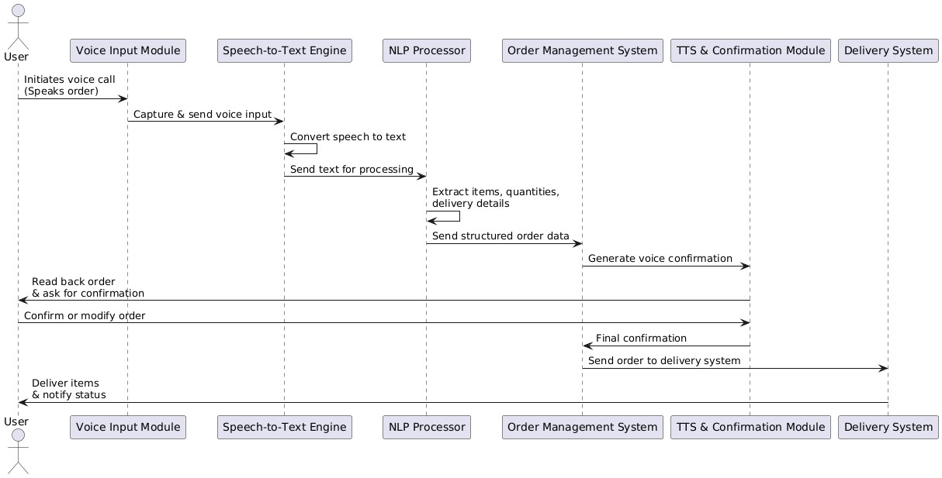
SEQUENCE DIAGRAM
SEQUENCE DIAGRAM OF VOICE BASED RATION ORDERING SYSTEM

Slide 23
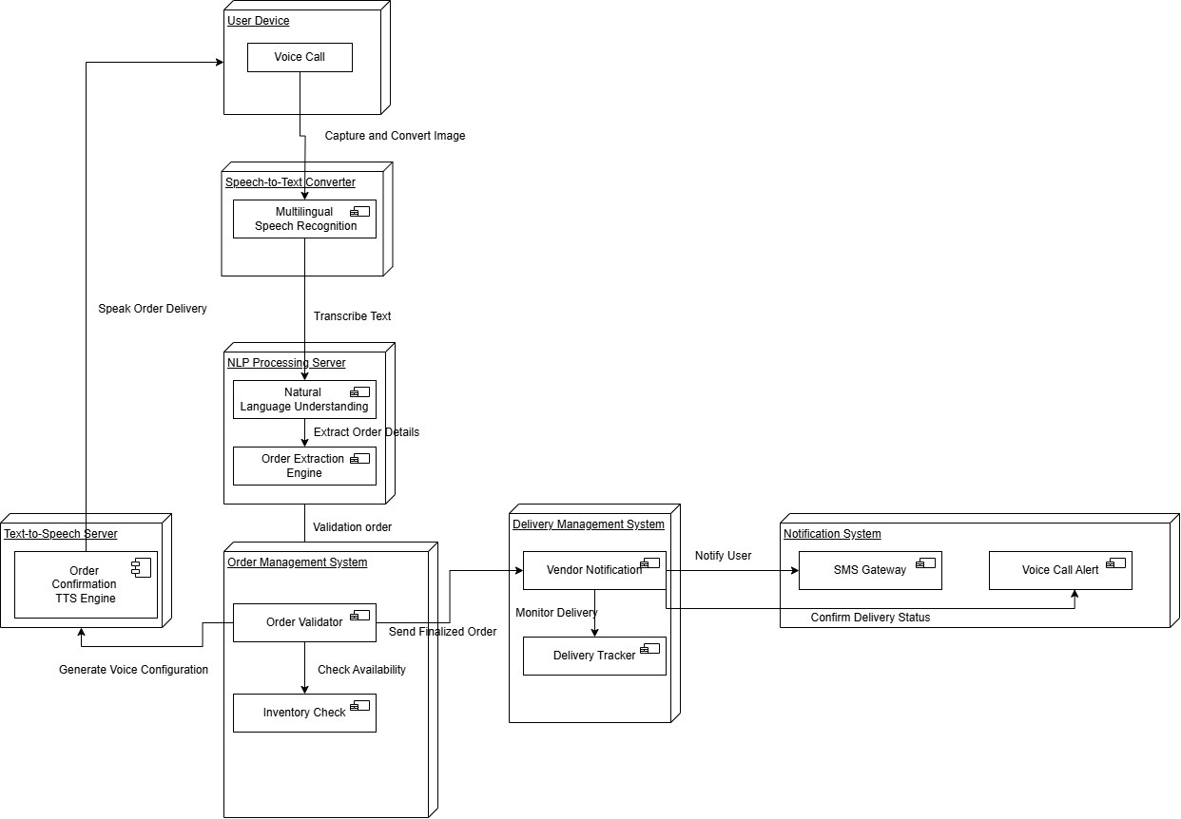
DEPLOYMENT DIAGRAM
DEPLOYMENT DIAGRAM OF VOICE BASED RATION ORDERING SYSTEM

Slide 24
Video implementation link https://drive.google.com/file/d/1ztTGZccdPXumjWVnHdPIBEbF0RFzSZl2/view?usp=drive_link

Slide 25
CODE
Voice_pipeline.py mport speech_recognition as sr from googletrans import Translator from gtts import gTTS import pygame import os import uuid import spacy import pandas as pd from word2number import w2n import inflect import logging from typing import List, Dict, Tuple, Optional import re from fuzzywuzzy import fuzz import json from datetime import datetime import threading import time # Configure logging logging.basicConfig(level=logging.INFO, format='%(asctime)s - %(levelname)s - %(message)s') logger = logging.getLogger(__name__) class VoiceGrocerySystem: def __init__(self, csv_path: str = "Daily_Grocery_Prices.csv"): """Initialize the voice grocery system with improved error handling.""" self.csv_path = csv_path self.translator = Translator() self.p = inflect.engine() # Enhanced language support self.lang_map = { 'english': 'en', 'hindi': 'hi', 'spanish': 'es', 'french': 'fr', 'german': 'de', 'tamil': 'ta', 'telugu': 'te', 'japanese': 'ja', 'korean': 'ko', 'chinese': 'zh-cn', 'portuguese': 'pt', 'russian': 'ru', 'arabic': 'ar', 'italian': 'it' }

Slide 26
App.py from flask import Flask, render_template, request, redirect, url_for import json import os from voice_pipeline import VoiceGrocerySystem app = Flask(__name__) system = VoiceGrocerySystem("Daily_Grocery_Prices.csv") # Combined login and signup route @app.route('/auth', methods=['GET', 'POST']) def auth(): if request.method == 'POST': action = request.form.get('action') if action == 'login': username = request.form['username'] password = request.form['password'] # 🔒 Dummy check (replace with real DB check) if username == 'admin' and password == '1234': return render_template('app.html') # or return success JSON return "Invalid credentials", 401 elif action == 'signup': # Extract signup details from form username = request.form['username'] password = request.form['password'] # TODO: Add logic to save user to DB or file return "Signup successful! Please log in." # Or redirect to login else: return "Invalid action", 400 # GET request renders combined login/signup page return render_template('auth.html') @app.route('/') def home(): latest_bill = system.get_latest_bill() order_history = system.get_order_history() return render_template( 'main.html', bill=latest_bill, history=order_history ) @app.route('/process_order', methods=['POST']) def process_order(): success = system.run_voice_order_pipeline() return redirect(url_for('home'))

Slide 27
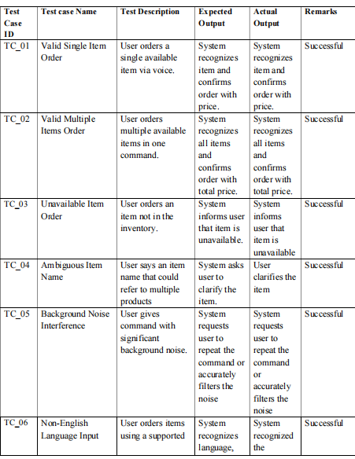
TEST CASES

Slide 28
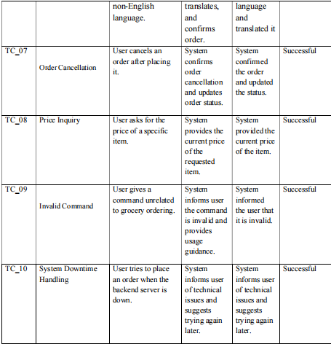

Slide 29
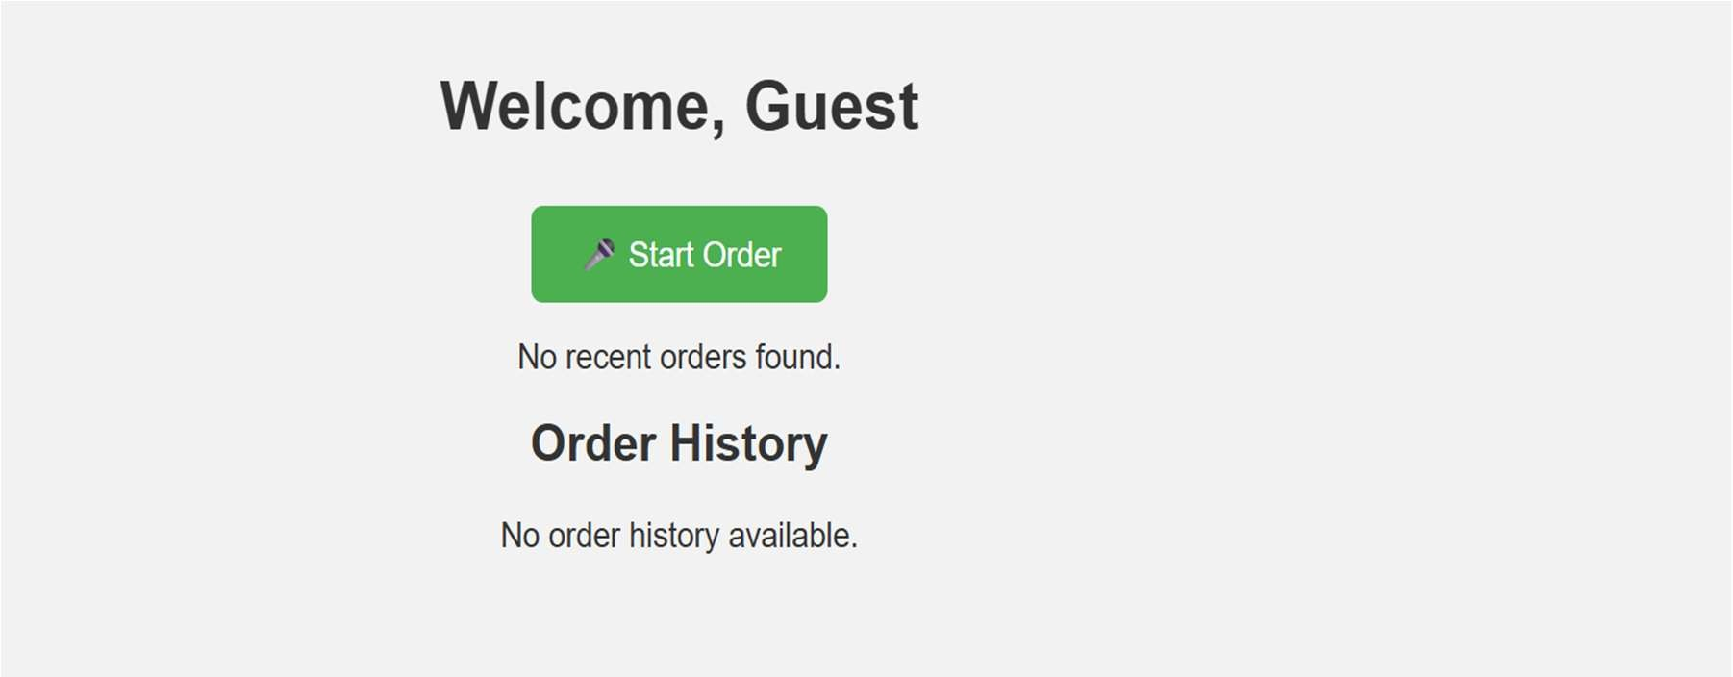
RESULTS
Fig 1: Initial Page The interface welcomes the guest user with a "Start Order" button to begin voice-based ordering. Since no orders have been placed, the screen shows no recent or past order history.

Slide 30
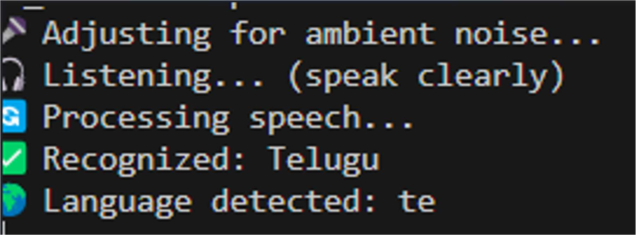
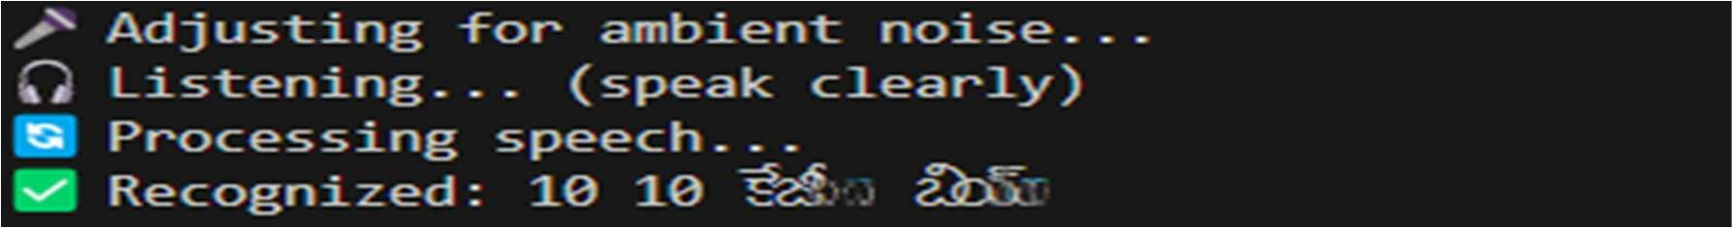
Fig 2: Language recognition The console output shows the system adjusting for noise, then listening and recognizing the user's speech as Telugu ("te"). This confirms its ability to support regional languages for voice-based grocery ordering.
Fig 3: User Input taking(1) The terminal shows the system adjusting for noise, capturing user speech, and successfully recognizing the spoken phrase during the voice-based ordering process.

Slide 31
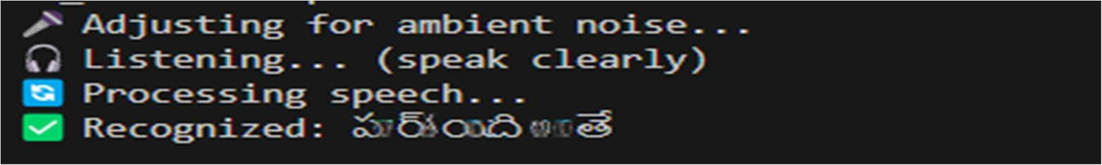
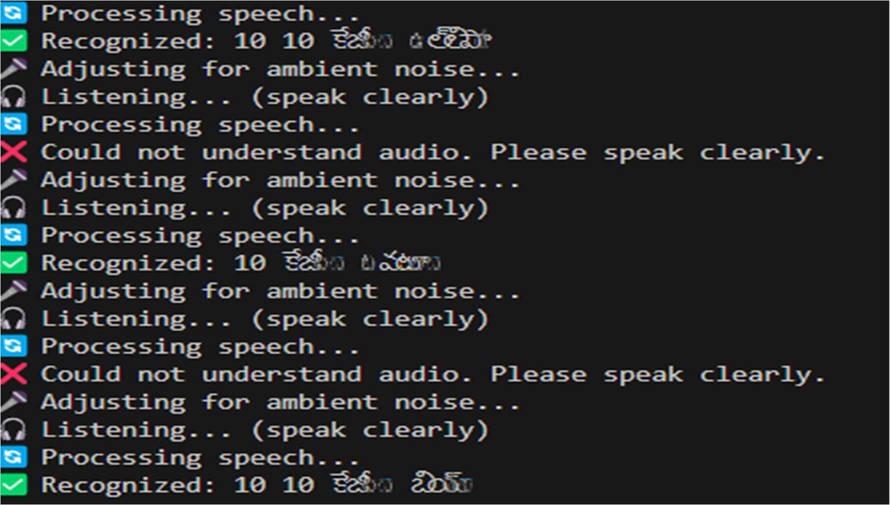
Fig 4: User Input taking(2) The terminal output shows the system adjusting for noise, listening to the user's voice, and processing the speech successfully.
Fig 5: User Input taking(3) The terminal shows multiple speech recognition attempts where the system adjusts for noise and successfully recognizes Telugu inputs like "10 kg onion."

Slide 32
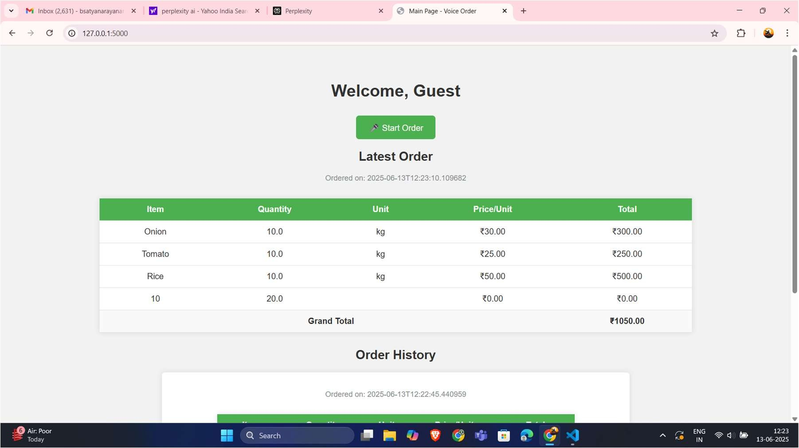
Fig 6: Main Order Page The interface on the local server shows a welcome message and a summary of the latest order, listing items like Onion, Tomato, and Rice, along with a grand total of ₹1050.00 and order history.

Slide 33
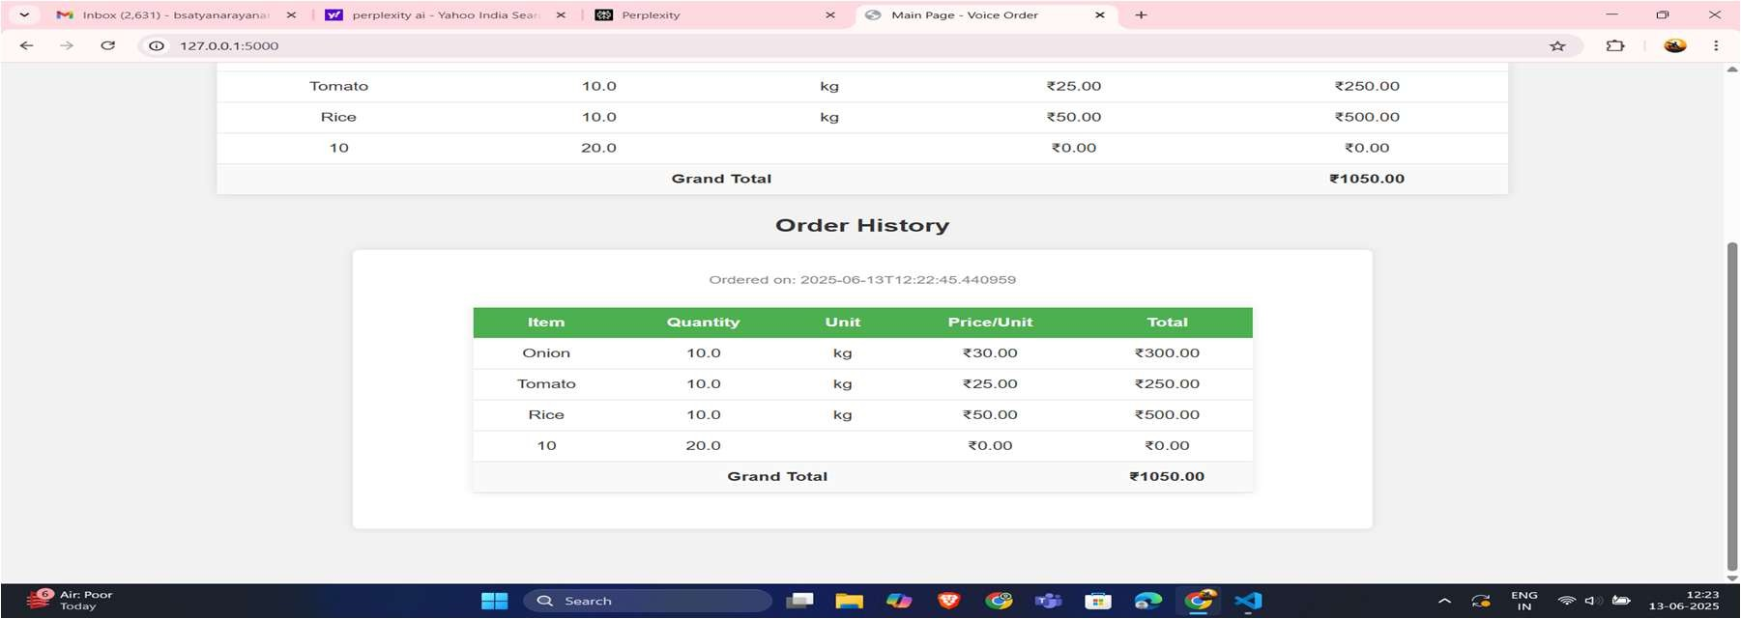
Fig 7:Order history The "Order History" section shows a past order with items like Onion, Tomato, and Rice, along with their quantities, units, price per unit, and total cost.

Slide 34
REFERENCES
[1] Medhi, I., Patnaik, S., Brunskill, E., Gautama, S. N. N., Thies, W., & Toyama, K.( 2011). Designing mobile interfaces for novice and low- literacy users. ACM Transactions on Computer-Human Interaction (TOCHI), 18(1), 1–28.
[2] Bano, S., Jithendra, P., Niharika, G. L., & Yalavarthi, S. (2020, November). Speech to text translation enabling multilingualism. In 2020 IEEE International Conference for Innovation in Technology (INOCON) (pp. 1–5). IEEE.
[3] Islam, M. N., Khan, N. I., Inan, T. T., & Sarker, I. H. (2023). Designing user interfaces for illiterate and semi-literate users: A systematic review and future research agenda. SAGE Open, 13(2), 1–14.
[4] Restyandito, R., & Chan, A. H. S. (2014, December). A review on voice user interface for illiterate people. In SEANES 2014: 3rd South East Asian Network of Ergonomics Societies Conference.
[5] Saloni, & Singh, W. (2020). Multilingual speech to text conversion – A review.EasyChair Preprint No.3064.
[6] Edim Azom Emmanuel & Muyingi Hippolyte N. (2014). Speech user interface for low literacy users of ICT services. European Journal of Computer Science and Information Technology, 2(1), 18-29.

Slide 35
THANK YOU

