Slide 1
Lecture 10: It's Data Structure Week!
(Or, what Ben did at his conference)

Slide 2
Announcements
2
Project 2 has been released! Get started!
Necessary material on B+Tree latching this Wendesday in class.
Reminder: project 2 will not work unless project 1 is 100%. If you still need to fix up P1, come to office hours!

Slide 3
Indexes vs. Filters
3
An index data structure of a subset of a table's attributes that are organized and/or sorted to the location of specific tuples using those attributes.
Example: B+Tree
A filter is a data structure that answers set membership queries; it tells you whether a key (likely) exists in a set but not where it is located.
Example: Bloom Filter
Notes:
+Allow the DBMS to quickly find data. Alternative is a sequential scan.
+OLTP or transactional workloads, almost always need some form of index.
The DBMS ensures that the contents of the table and the index/filters are logically synchronized.

Slide 4
Today's Agenda
Bloom Filters
Skip Lists
Tries / Radix Trees
Inverted Indexes
Vector Indexes

Slide 5
Bloom Filters
Probabilistic data structure (bitmap) that answers set membership queries.
False negatives will never occur.
False positives can sometimes occur.
See Bloom Filter Calculator.
Insert(x):
Use k hash functions to set bits in the filter to 1.
Lookup(x):
Check whether the bits are 1 for each hash function.
Notes:
Widely used in different parts of the DBMS
In-Memory Caches
Join Algorithms

Slide 6
Bloom Filters
Insert 'RZA'
Insert 'GZA'
Lookup 'RZA'
Lookup 'Raekwon'
Lookup 'ODB'
Bloom Filter
0
1
2
3
4
5
6
7
0
0
1
0
0
1
0
1
0
0
1
0
→ TRUE
hash₁('RZA') = 2222 % 8 =
hash₁('GZA') = 5555 % 8 =
hash₁('Raekwon') = 3333 % 8 =
hash₁('ODB') = 6699 % 8 =
3
3
6
5
→ FALSE
hash₂('Raekwon') = 8899 % 8 =
hash₂('RZA') = 4444 % 8 =
hash₂('GZA') = 7777 % 8 =
hash₂('ODB') = 9966 % 8 =
6
4
1
3
→ TRUE
Notes:
CREATE EXTENSION pg_prewarm;
SELECT pg_prewarm('emails');
CREATE EXTENSION IF NOT EXISTS bloom;
-- Default length is 80 bits
-- # of bits per entry is 2
CREATE INDEX idx_emails_bloom ON emails USING bloom (email);

Slide 7
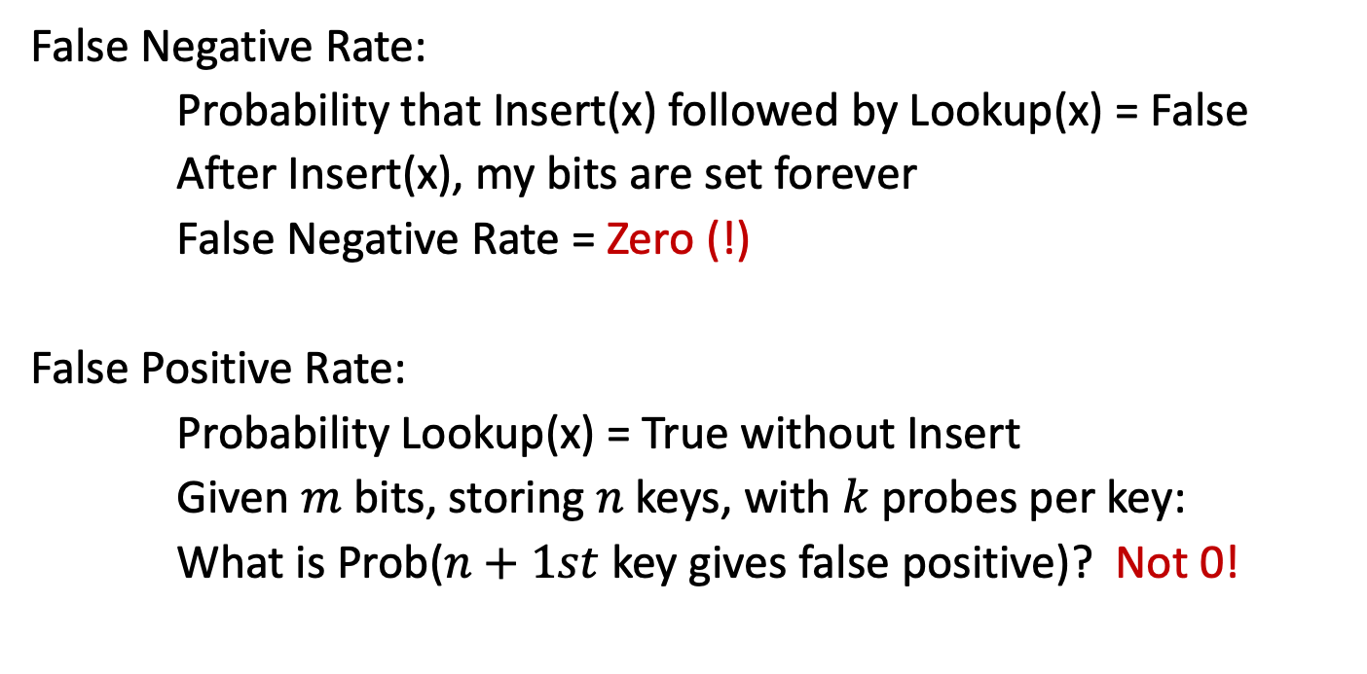
Bloom Filters
False Negative Rate:
Probability that Insert(x) followed by Lookup(x) = False
After Insert(x), my bits are set forever
False Negative Rate = Zero (!)
False Positive Rate:
Probability Lookup(x) = True without Insert
Given $m$ bits, storing $n$ keys, with $k$ probes per key:
What is Prob($n+1st$ key gives false positive)? Not 0!

Slide 8
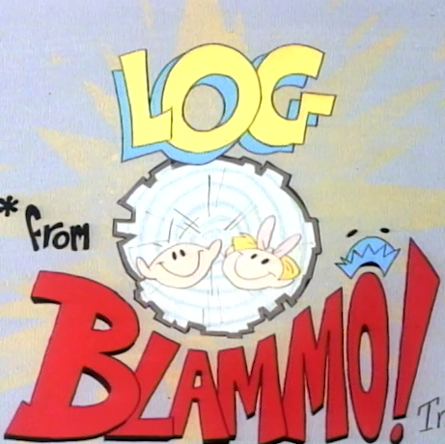
It's Log!

Slide 9


Log-structured Storage
GET (key101)
MemTable
SSTable
PUT (key101,a₂)
SummaryTable
Min/Max Key Per SSTable
Key Filter Per Level
PUT (key102,b₁)
Key Low→High
PUT (key103,c₁)
Memory
Bloom Filter
SSTable
SSTable
Newest→Oldest
Level #0
Bloom Filter
SSTable
Level #1
SSTable
Disk
Bloom Filter
Level #2
SSTable

Slide 10
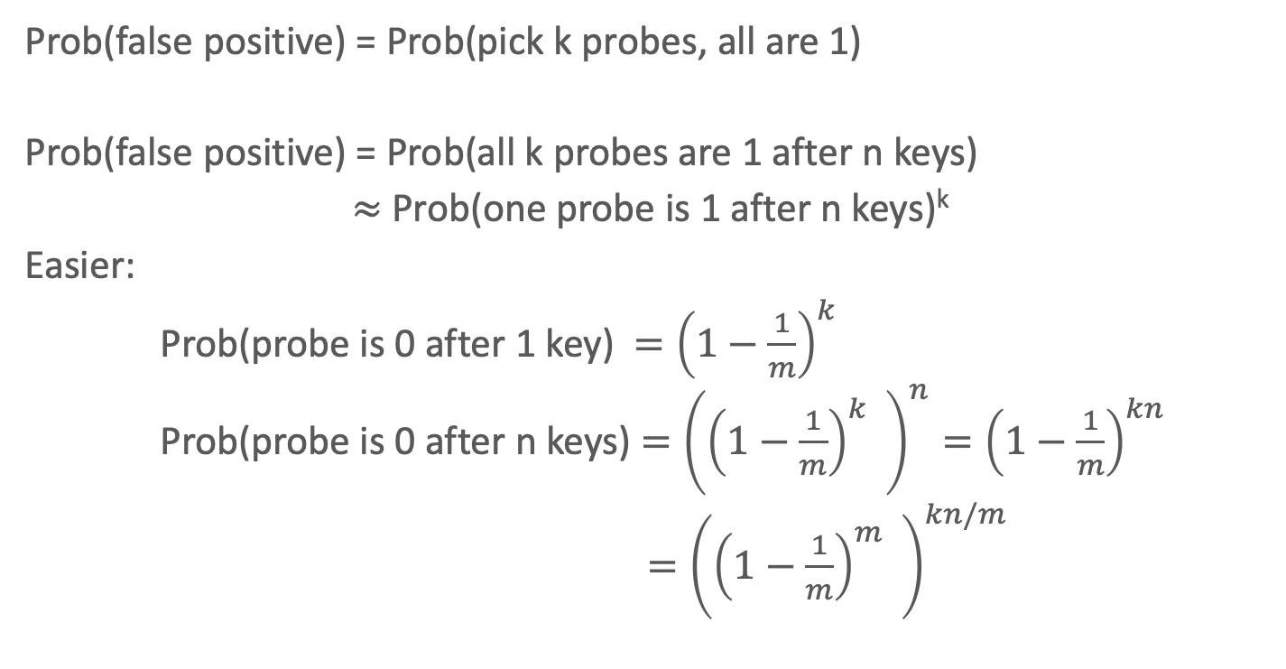
Bloom Filter Math
Prob(false positive) = Prob(pick k probes, all are 1)
Prob(false positive) = Prob(all k probes are 1 after n keys)
$≈$ Prob(one probe is 1 after n keys)^{k}
Easier:
Prob(probe is 0 after 1 key) $={\left(1−\frac{1}{m}\right)}^{k}$
Prob(probe is 0 after n keys) $={\left({\left(1−\frac{1}{m}\right)}^{k} \right)}^{n}={\left(1−\frac{1}{m}\right)}^{kn}$
$={\left({\left(1−\frac{1}{m}\right)}^{m} \right)}^{kn/m}$

Slide 11
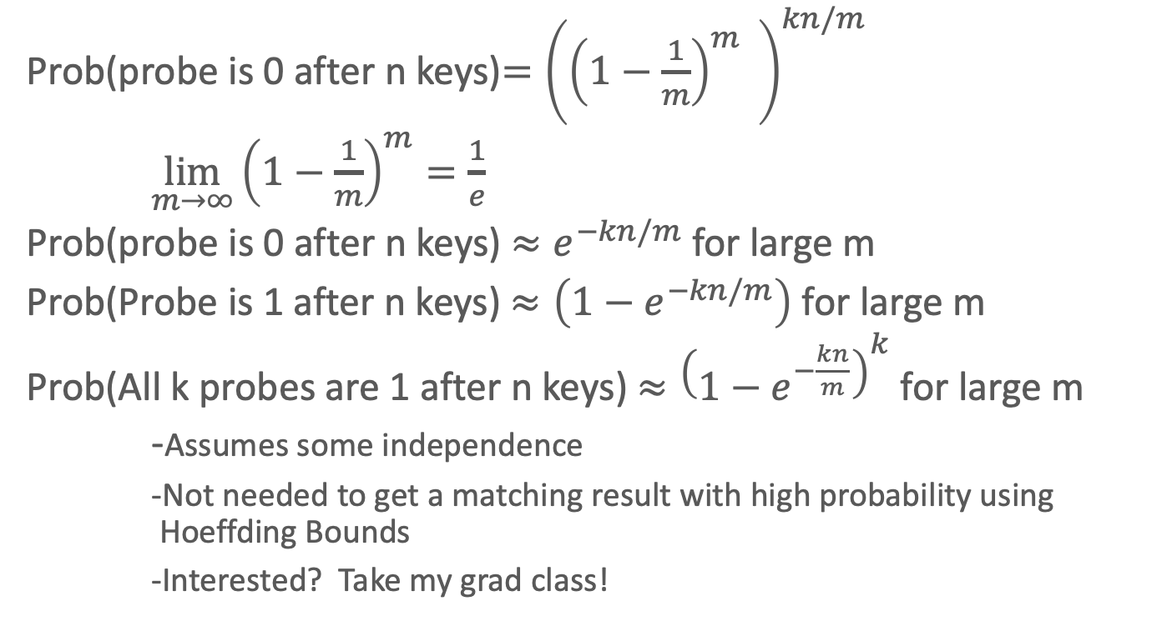
Bloom Filter Math
Prob(probe is 0 after n keys)$={\left({\left(1−\frac{1}{m}\right)}^{m} \right)}^{kn/m}$
$\lim_{m→∞}{\left(1−\frac{1}{m}\right)}^{m}=\frac{1}{e}$
Prob(probe is 0 after n keys) $≈e^{−kn/m}$ for large m
Prob(Probe is 1 after n keys) $≈\left(1−e^{−kn/m}\right) \text{for} \text{large} \text{m}$
Prob(All k probes are 1 after n keys) $≈{\left(1−e^{−\frac{kn}{m}}\right)}^{k} \text{for} \text{large} \text{m}$
-Assumes some independence
-Not needed to get a matching result with high probability using Hoeffding Bounds
-Interested? Take my grad class!
(wat?)
(!)

Slide 12
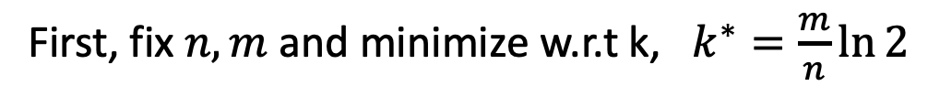
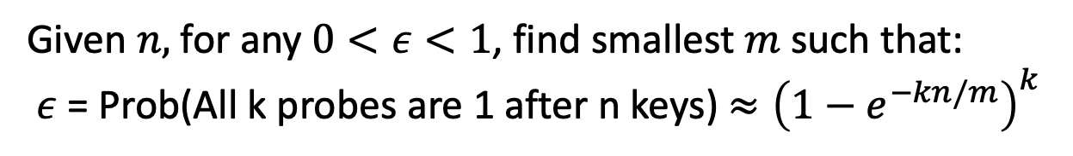
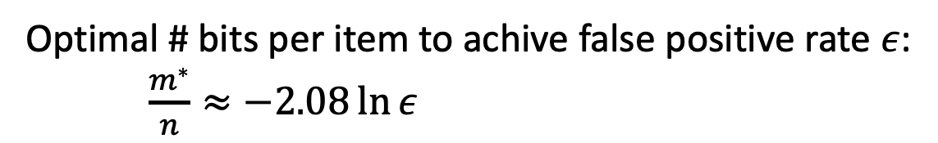
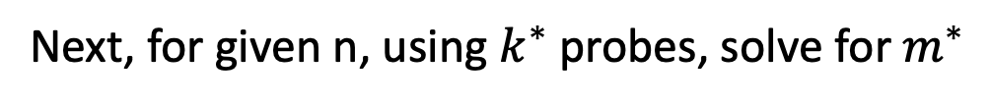
Bloom Filters IRL
Given $n,$ for any $0<ε<1$, find smallest$m$ such that:
$ε$ = Prob(All k probes are 1 after n keys) $≈{\left(1−e^{−kn/m}\right)}^{k}$
First, fix $n,m$ and minimize w.r.t k, $k^{∗}=\frac{m}{n}\ln{2}$
Next, for given n, using $k^{∗}$ probes, solve for $m^{∗}$
Optimal # bits per item to achive false positive rate $ε$:
$\frac{m^{∗}}{n}≈−2.08\ln{ε}$

Slide 13
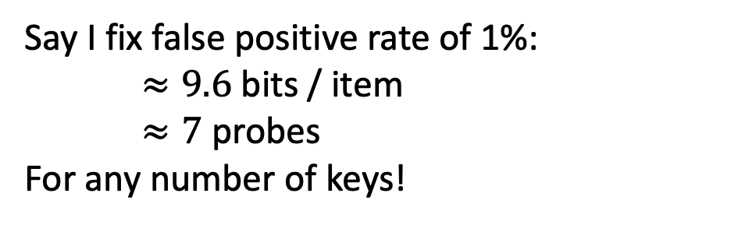
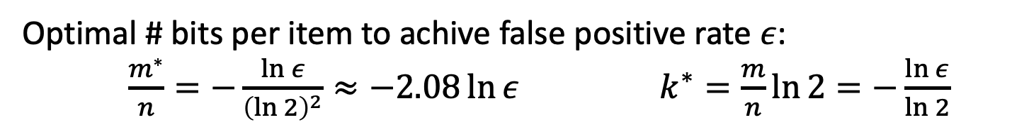
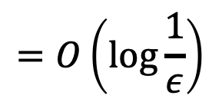
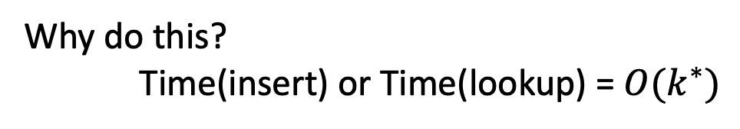
Bloom Filters IRL
Optimal # bits per item to achive false positive rate $ε$:
$\frac{m^{∗}}{n}=−\frac{\ln{ε}}{{\left(\ln{2}\right)}^{2}}≈−2.08\ln{ε}$ $k^{∗}=\frac{m}{n}\ln{2}=−\frac{\ln{ε}}{\ln{2}}$
Why do this?
Time(insert) or Time(lookup) = $O(k^{∗})$
$$=O\left(\log{\frac{1}{ε}}\right)$$
Say I fix false positive rate of 1%:
$≈9.6$ bits / item
$≈7$ probes
For any number of keys!
sizeof(ptr)=32 bits
sizeof(char)=8 bits

Slide 14
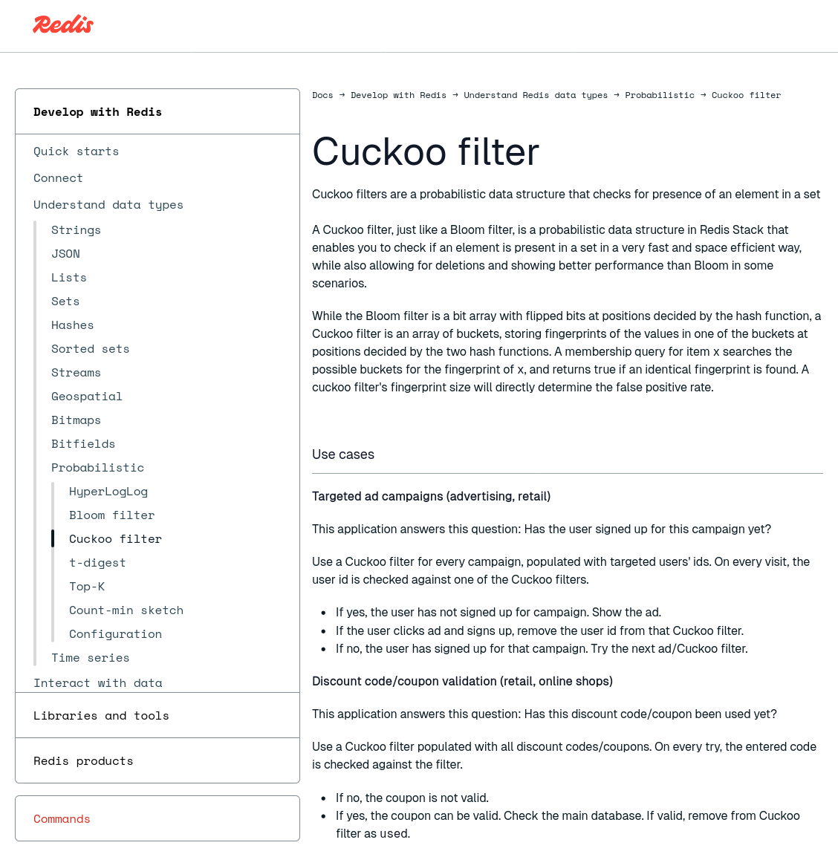
Other Filters
Counting Bloom Filter
Supports dynamically adding and removing keys.
Uses integers instead of bits to count the number of occurrences of a key in a set.
Cuckoo Filter
Also supports dynamically adding and removing keys.
Uses a Cuckoo Hash Table but stores fingerprints instead of full keys.
Succinct Range Filter (SuRF)
Immutable compact trie that supports approximate exact matches and range filtering.

Slide 15
Indexes vs. Filters
15
An index data structure of a subset of a table's attributes that are organized and/or sorted to the location of specific tuples using those attributes.
Example: B+Tree
A filter is a data structure that answers set membership queries; it tells you whether a key (likely) exists in a set but not where it is located.
Example: Bloom Filter
Notes:
+Allow the DBMS to quickly find data. Alternative is a sequential scan.
+OLTP or transactional workloads, almost always need some form of index.
The DBMS ensures that the contents of the table and the index/filters are logically synchronized.

Slide 16
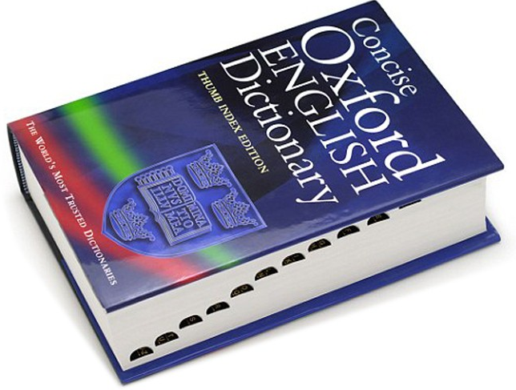
B+Trees as Fancy Linked Lists
20
<20
≥20
10
35
<10
≥10
<35
≥35
6
10
20
31
38
44
Index Key(s) Low→High
"M words begin here"
Notes:
+Tree with degree or order 4
+Only inner node is also the root node

Slide 17
Observation
Linked lists are "simplest" index, but...
All operations have to linear search.
Average Cost: O(n)
More than one way to index a linked list...
K₁
K₂
K₃
K₄
K₅
K₆
K₇
Notes:
high-level example of what a Skip List is.
Multiple levels of linked list where the upper levels allow you to skip across your linked list.

Slide 18
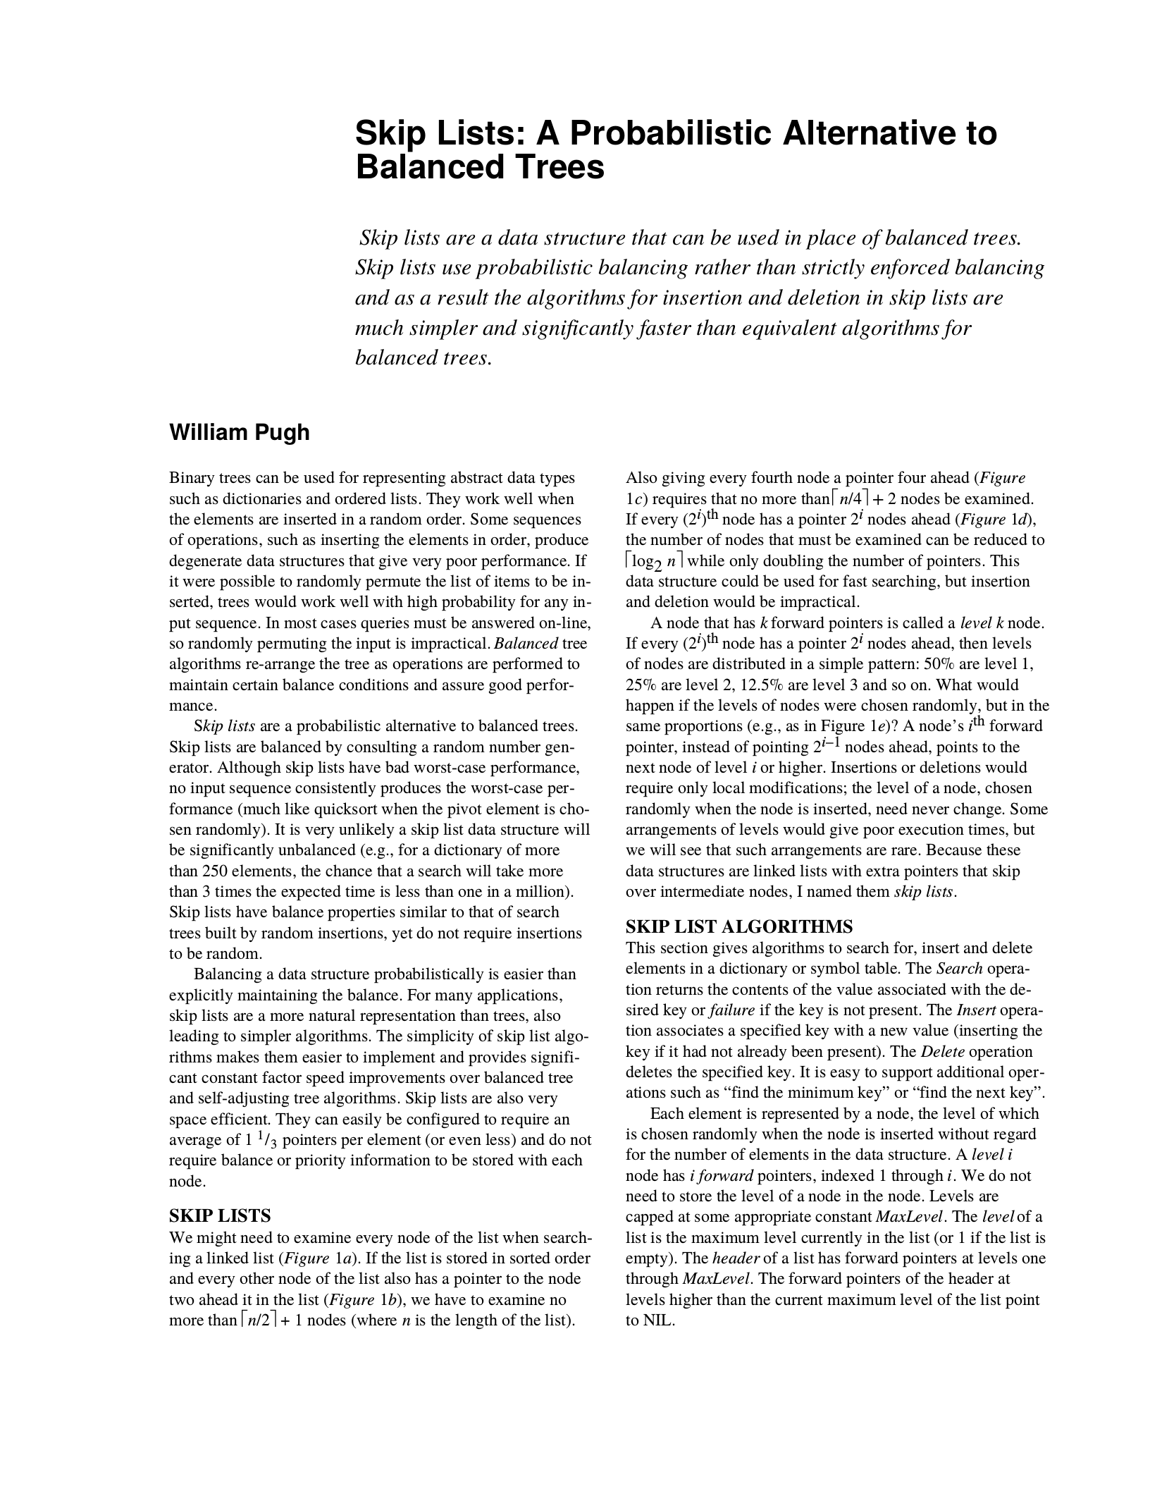



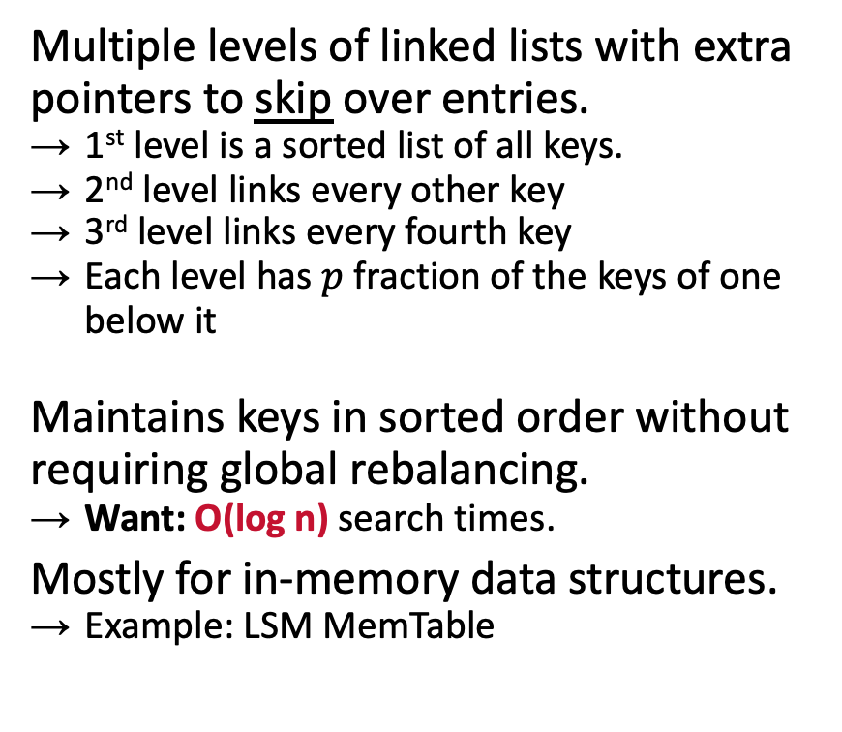
Skip Lists
Multiple levels of linked lists with extra pointers to skip over entries.
1st level is a sorted list of all keys.
2nd level links every other key
3rd level links every fourth key
Each level has $p$ fraction of the keys of one below it
Maintains keys in sorted order without requiring global rebalancing.
Want: O(log n) search times.
Mostly for in-memory data structures.
Example: LSM MemTable
Notes:
Invented in 1990 at the University of Maryland.

Slide 19



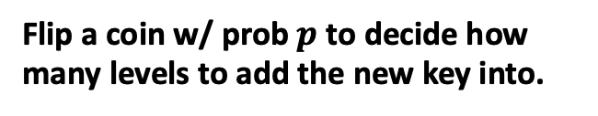

Skip Lists Basics
Flip a coin w/ prob $p$ to decide how many levels to add the new key into.
Levels
End
How many levels in expectation?
$$\log_{1/p}{N}$$
∞
$$E\left[L_{3}\right]=p^{2}N$$
K₂
K₄
∞
$$E\left[L_{2}\right]=pN$$
K₁
K₂
K₃
K₄
K₆
∞
$E[L_{1}]$=N
V₁
V₂
V₃
V₄
V₆

Slide 20
Skip Lists: INSERT
Insert K₅
Levels
End
K₅
∞
K₂
K₄
K₅
∞
K₁
K₂
K₃
K₄
K₅
K₆
∞
V₁
V₂
V₃
V₄
V₅
V₆

Slide 21
Skip Lists: SEARCH
Find K₃
Levels
End
K₃<K₅
K₅
∞
K₃>K₂
K₃<K₄
K₂
K₄
K₅
∞
K₁
K₂
K₃
K₄
K₅
K₆
∞
V₁
V₂
V₃
V₄
V₅
V₆

Slide 22
Skip Lists: DELETE
First logically remove a key from the index by setting a flag to tell threads to ignore.
Then physically remove the key once we know that no other thread is holding the reference.

Slide 23
Skip Lists: DELETE
Delete K₅
Levels
End
K₅
∞
K₂
K₄
K₅
∞
K₁
K₂
K₃
K₄
K₅
K₆
∞
Del?
false
Del?
false
Del?
false
Del?
false
Del?
true
V₁
V₂
V₃
V₄
V₅
Del?
false
V₆
Del?
false

Slide 24
Skip List Math
Find K₄
Levels
End
K₅
∞
K₂
K₄
K₅
∞
K₁
K₂
K₃
K₄
K₅
K₆
∞
V₁
V₂
V₃
V₄
V₅
V₆

Slide 25
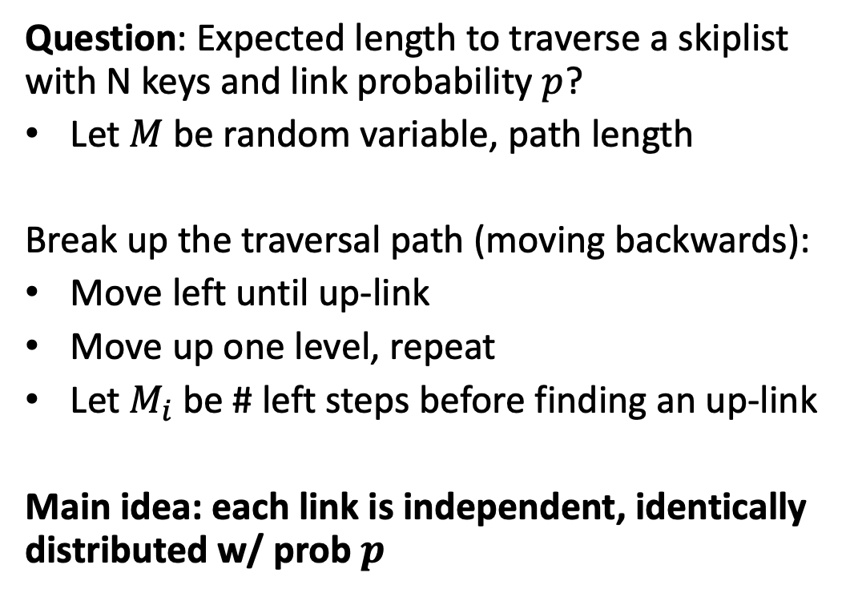
Skip List Math
Question: Expected length to traverse a skiplist with N keys and link probability $p$?
Let $M$ be random variable, path length
Break up the traversal path (moving backwards):
Move left until up-link
Move up one level, repeat
Let $M_{i}$ be # left steps before finding an up-link
Main idea: each link is independent, identically distributed w/ prob $p$

Slide 26
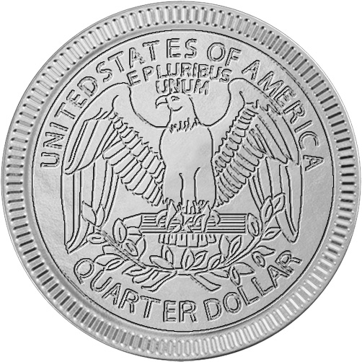


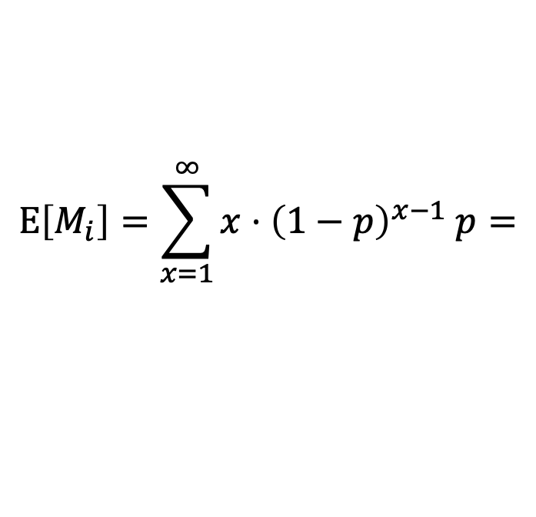
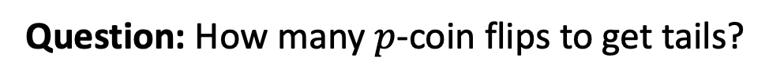
Skip List Math
Question: Starting at any node, how many steps left until up-link?
Question: How many $p$-coin flips to get tails?
$$M_{i}\sim Geometric\left(p\right); Pr\left(M_{i}=x\right)={\left(1−p\right)}^{x−1} p$$
$$E\left[M_{i}\right]=\sum_{x=1}^{∞}{x⋅{\left(1−p\right)}^{x−1} p}=$$
$$\frac{1}{p}$$
Left steps per up-link (expected)
K₁
K₂
K₃
K₄
K₅
K₆
V₁
V₂
V₃
V₄
V₅
V₆

Slide 27
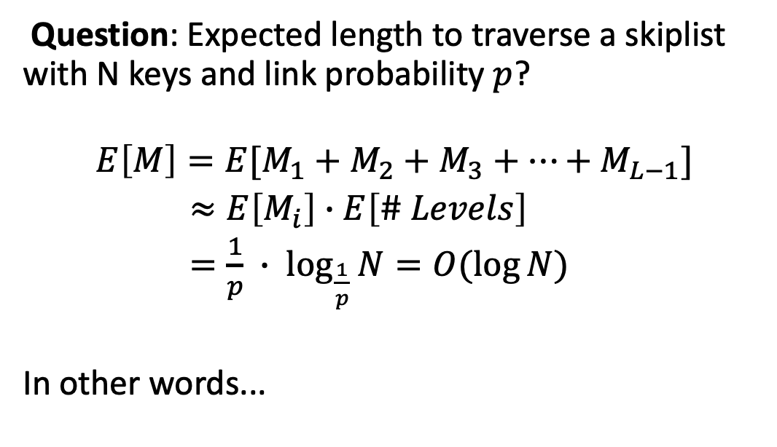
Skip List Math
Question: Expected length to traverse a skiplist with N keys and link probability $p$?
$$E\left[M\right]=E[M_{1}+M_{2}+M_{3}+…+M_{L−1}]$$
$≈E\left[M_{i}\right]∙E\left[\# Levels\right]$
$=\frac{1}{p} ∙ \log_{\frac{1}{p}}{N}=O(\log{N)}$
In other words...

Slide 28
It's Log!

Slide 29
Skip Lists
Advantages:
Uses less memory than a typical B+Tree if you do not include reverse pointers.
Insertions and deletions do not require rebalancing.
Disadvantages:
Not disk/cache friendly because they do not optimize locality of references.
Reverse search is non-trivial.

Slide 30
We stopped here in class because I decided to focus more on the internals of Bloom filters and skip lists. The rest of these slides will not be covered, but cover some good-to-know data structures for indexing

Slide 31
Observation
Both B+Trees and Skip Lists have the same weakness: Lookup(x) == full traversal
Lookup for keys that don't exist are slow
"Negative caching", insert tombstone for objects that don't exist
Want: Best of both worlds. An index data structure with filter-like properties

Slide 32
Trie Index
Use a digital representation of keys to examine prefixes one-by-one.
aka Digital Search Tree, Prefix Tree.
Shape depends on keys and lengths.
Does not depend on existing keys or insertion order.
Does not require rebalancing operations.
All operations have O(k) complexity where k is the length of the key.
Path to a leaf node represents a key.
Keys are stored implicitly and can be reconstructed from paths.
Keys: HELLO, HAT, HAVE
H
A
E
T
V
L
¤
E
L
¤
O
¤
Notes:
Discovered in 1959 by a French dude. Edward Fredkin coined the name trie after "retrieval tree" 2 years later. He is apparently faculty where at CMU but I don't think he's around.

Slide 33
Trie Key Span
The span of a trie level is the number of bits that each partial key / digit represents.
If the digit exists in the corpus, then store a pointer to the next level in the trie branch. Otherwise, store null.
This determines the fan-out of each node and the physical height of the tree.
n-way Trie = Fan-Out of n

Slide 34
Trie Key Span
1-bit Span Trie
Keys: K10,K25,K31
0
¤
¤
Ø
1
Ø
0
¤
¤
Ø
1
Ø
Repeat 10x
K10→ 00000000 00001010
0
¤
¤
¤
1
¤
K25→ 00000000 00011001
0
Ø
1
¤
Ø
¤
Ø
¤
0
Ø
1
¤
K31→ 00000000 00011111
0
¤
1
¤
¤
Ø
Ø
0
¤
¤
1
¤
0
Ø
1
Ø
¤
Ø
¤
¤
0
¤
¤
1
Ø
Ø
0
Ø
1
¤
0
¤
1
¤
¤
Ø
Ø
0
Ø
Ø
1
¤
¤
Ø
0
Ø
1
¤
Tuple Pointer
Node Pointer

Slide 35




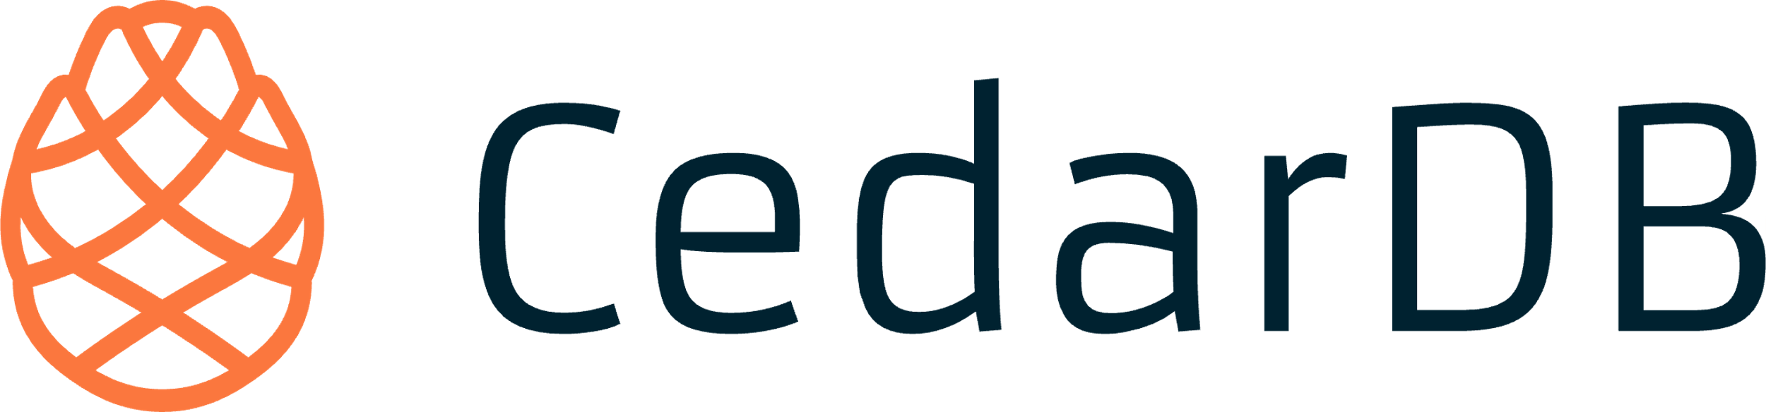



Radix Tree
1-bit Span Radix Tree
Vertically compressed trie that compacts nodes with a single child.
Also known as Patricia Tree.
Can produce false positives, so the DBMS always checks the original tuple to see whether a key matches.
¤
Ø
¤
Ø
Repeat 10x
¤
¤
Ø
¤
¤
¤
Tuple Pointer
Node Pointer

Slide 36
Observation
revisions(id,content,…)
The indexes that we've discussed are useful for "point" and "range" queries:
Find all customers in the 15217 zipcode.
Find all orders between June 2024 and September 2024.
They are not good at keyword searches:
Example: Find all Wikipedia articles that contain the word "Pavlo"
id | content
11 | Wu-Tang Clan is an American hip hop musical collective formed in Staten Island, New York City, in 1992...
22 | Carnegie Mellon University (CMU) is a private research university in Pittsburgh, Pennsylvania. The institution was established in 1900 by Andrew Carnegie...
33 | In computing, a database is an organized collection of data or a type of data store based on the use of a database management system (DBMS), the software...
44 | Andrew Pavlo, best known as Andy Pavlo, is an associate professor of Computer Science at Carnegie Mellon University. He conducts research on database...
CREATE INDEX idx_rev_cntnt ON revisions (content);
SELECT pageID FROM revisions WHERE content LIKE '%Pavlo%';
Notes:
If we create an index on the content attribute, what does that do?
This doesn't help our query.
Our SQL is also not correct...
All the data structures we've looked at so far perform poorly when there are many duplicate keys…
This index is terrible because it's going be the entire wiki article.
SQL is not correct because it will find any occurrence of the string Pavlo. It won't find exactly the word 'Pavlo'.

Slide 37









Inverted Index
revisions(id,content,…)
An inverted index stores a mapping of terms to records that contain those terms in the target attribute.
Sometimes called a full-text search index.
Originally called a concordance (1200s).
Many major DBMSs support these natively. But there are also specialized DBMSs and libraries.
id | content
11 | Wu-Tang Clan is an American hip hop musical collective formed in Staten Island, New York City, in 1992...
22 | Carnegie Mellon University (CMU) is a private research university in Pittsburgh, Pennsylvania. The institution was established in 1900 by Andrew Carnegie...
33 | In computing, a database is an organized collection of data or a type of data store based on the use of a database management system (DBMS), the software...
44 | Andrew Pavlo, best known as Andy Pavlo, is an associate professor of Computer Science at Carnegie Mellon University. He conducts research on database...
Dictionary
Posting Lists
Wu-Tang|2
11
44
Term / Frequency
22
33
44
Carnegie|3
Database|2
33
44
⋮
Notes:
Map words to records that contain those words.
Concordance – Some lady in the 1800s build an index of every word used in the entire Shakespeare corpus. Took 16years.
Extensions to SQL that allow you to do more complicated things than just the LIKE that I showed before.
Dictionary stores term + frequency.
DBMS uses frequency to choose most/least selective term based on query needs.

Slide 38
Inverted Index: Lucene
Dictionary
Find PAV
Uses a Finite State Transducer for determining offset of terms in dictionary.
Incrementally create dictionary segments and then merge them in the background.
Uses compression methods we previously discussed (e.g., delta, bit packing).
Also supports precomputed aggregations for terms and occurrences.
1
BR
2
BRAV
P
weight=2
B
weight=1
3
PAV
4
PLA
R
weight=0
A
weight=1
L
weight=2
A
weight=1
V
weight=0
A
weight=0
Offset=
3
4
0

Slide 39
Inverted Index: PostgreSQL
PostgreSQL's Generalized Inverted Index (GIN) uses a B+Tree for the term dictionary that map to a posting list data structure.
Posting list contents varies depending on number of records per term:
Few: Sorted list of record ids.
Many: Another B+Tree of record ids.
Uses a separate "pending list" log to avoid incremental updates.
Dictionary
Pending List
mod log
Posting List
Posting List
Posting Tree

Slide 40
OBSERVATION
Inverted indexes search data based on its contents.
There is a little magic to tweak terms based on linguistic models.
Example: Normalization ("Wu-Tang" matches "Wu Tang").
Instead of searching for records containing exact keywords (e.g., "Wu-Tang"), an application may want search for records that are related to topics (e.g., "hip-hop groups with songs about slinging").

Slide 41
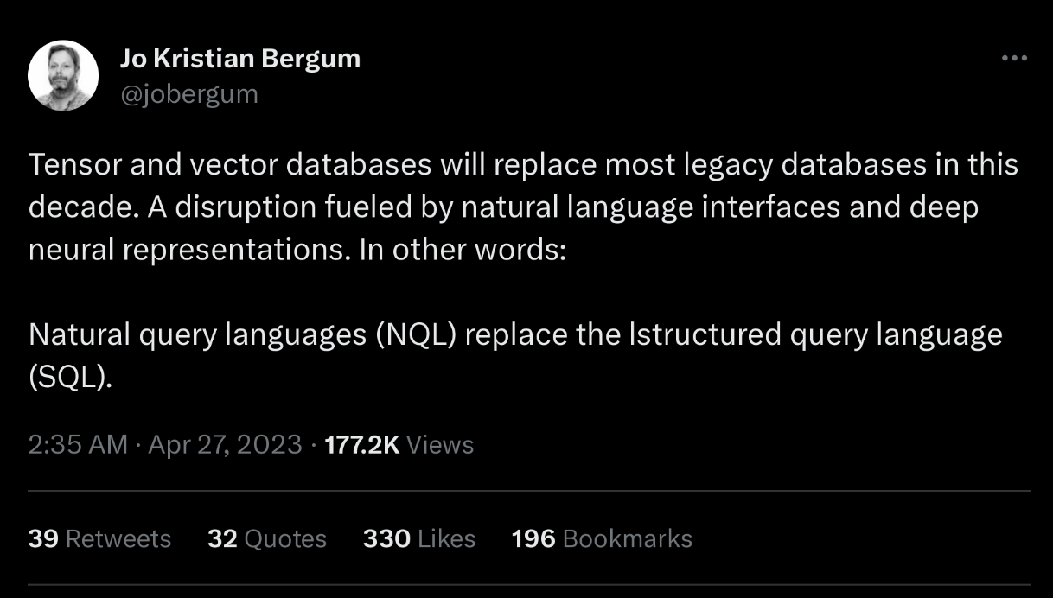





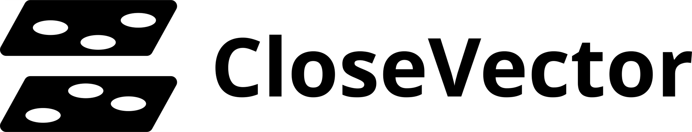
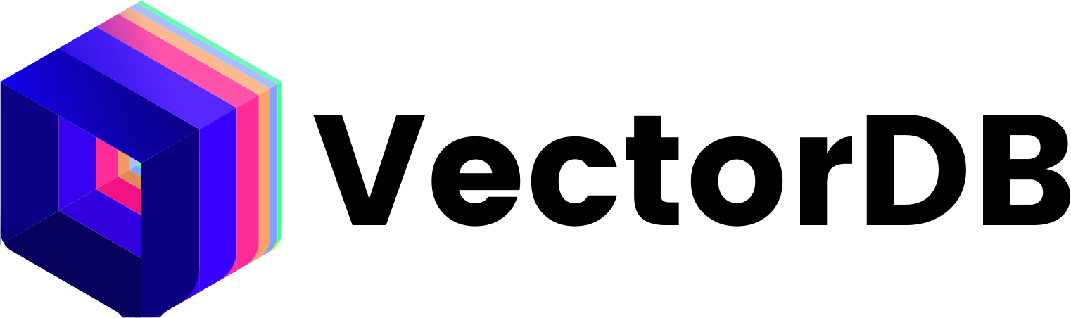
Vector Indexes
Specialized data structures to perform nearest-neighbor searches on embeddings.
An embedding is an array of floating point numbers.
May also need to filter data before / after vector searches.
The correctness of a query depends on whether the result "feels right".

Slide 42
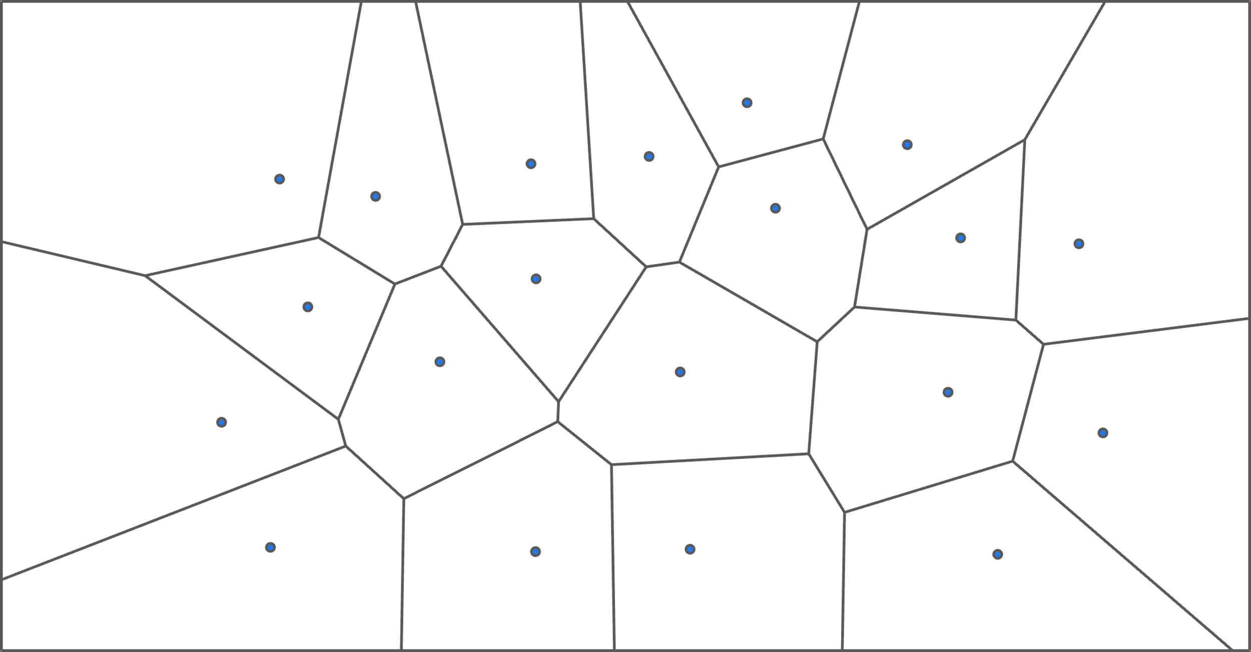
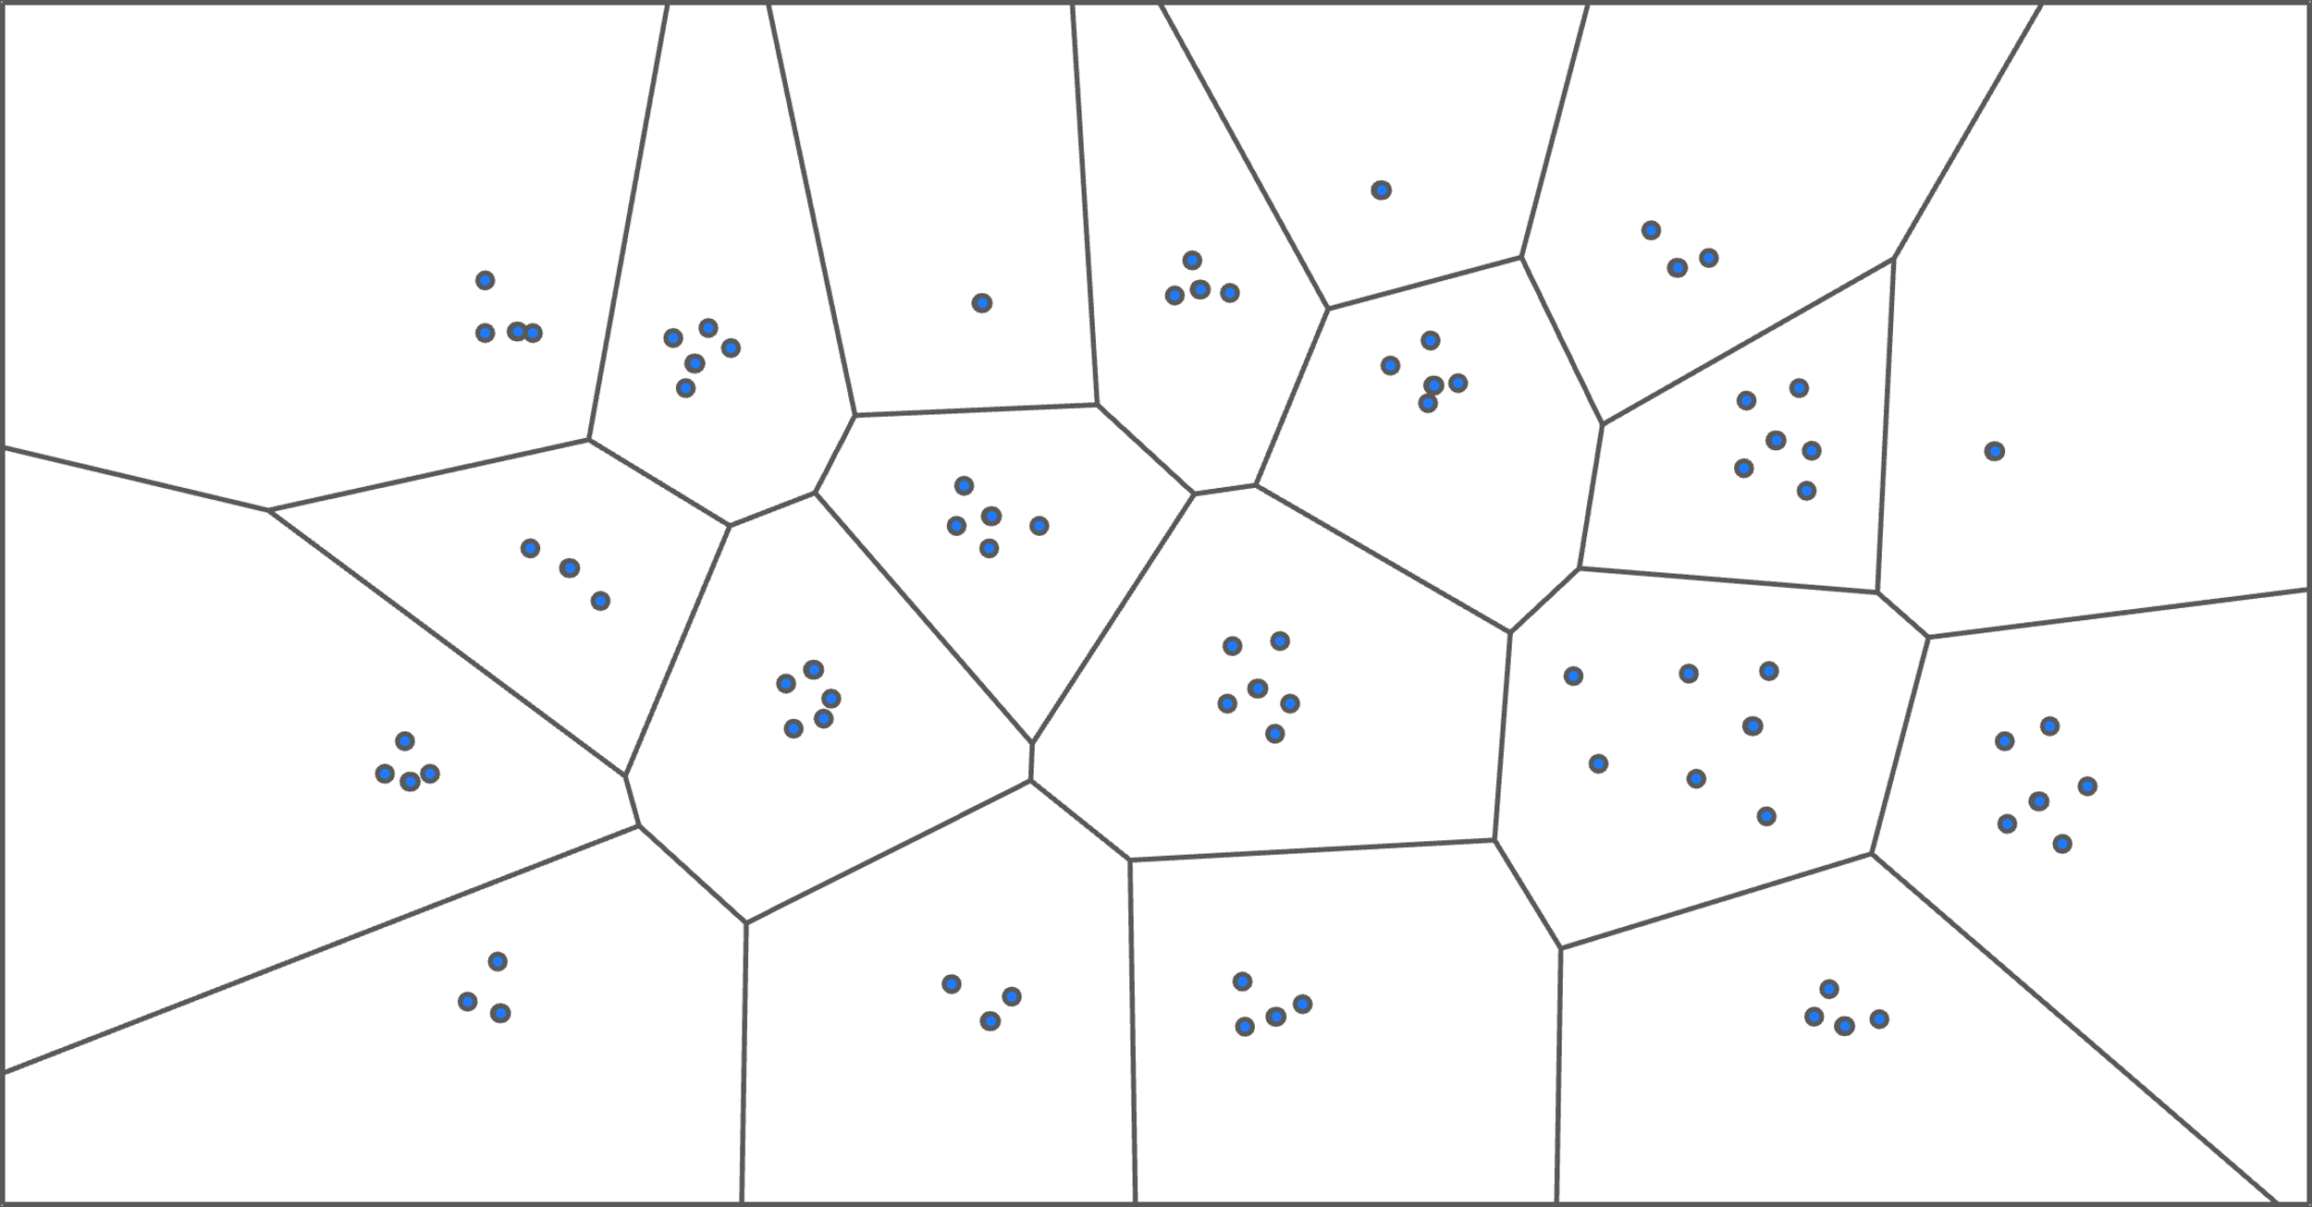
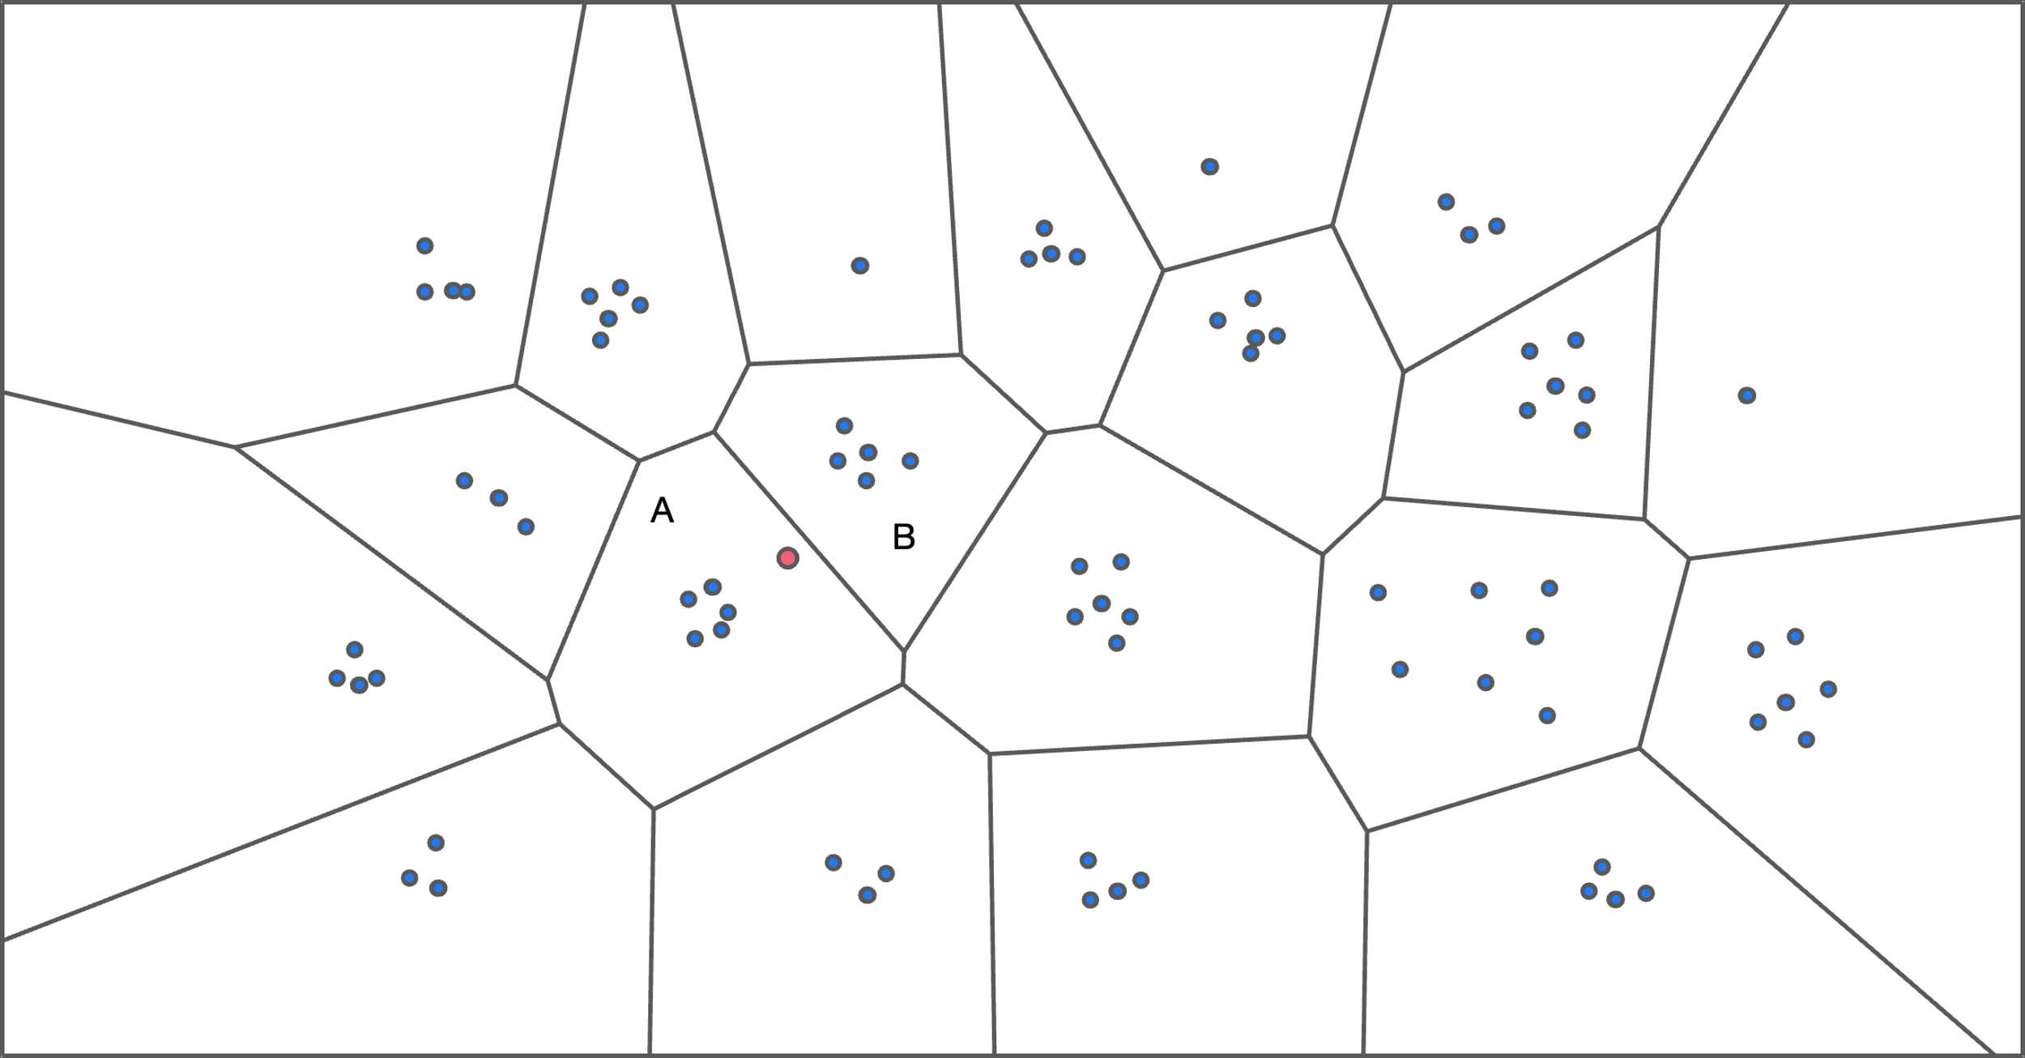
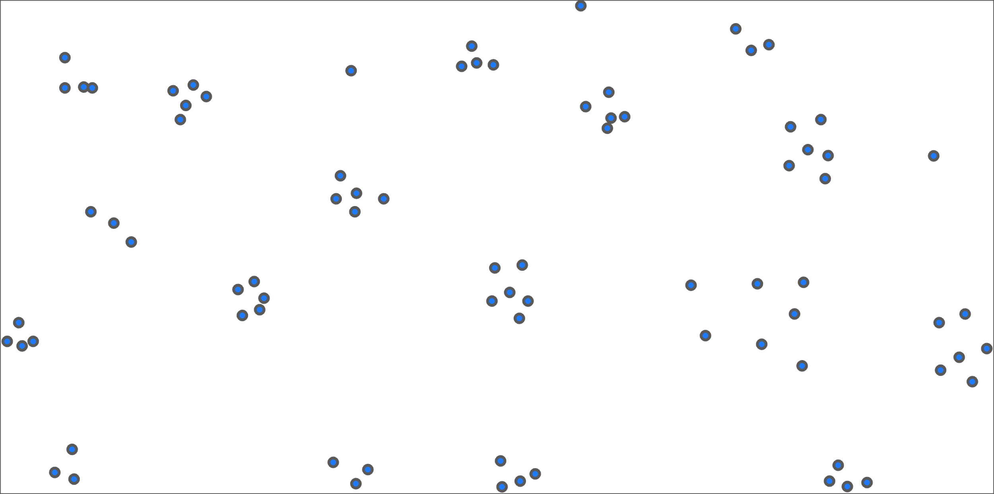
Vector Indexes: Inverted File
Partition vectors into smaller groups using a clustering algorithm.
To find a match, use same clustering algorithm to map into a group, then scan that group's vectors.
Also check nearby groups to improve accuracy.
Preprocess / quantize vectors to reduce dimensionality.
Example: IVFFlat
Source: Chi Zhang

Slide 43
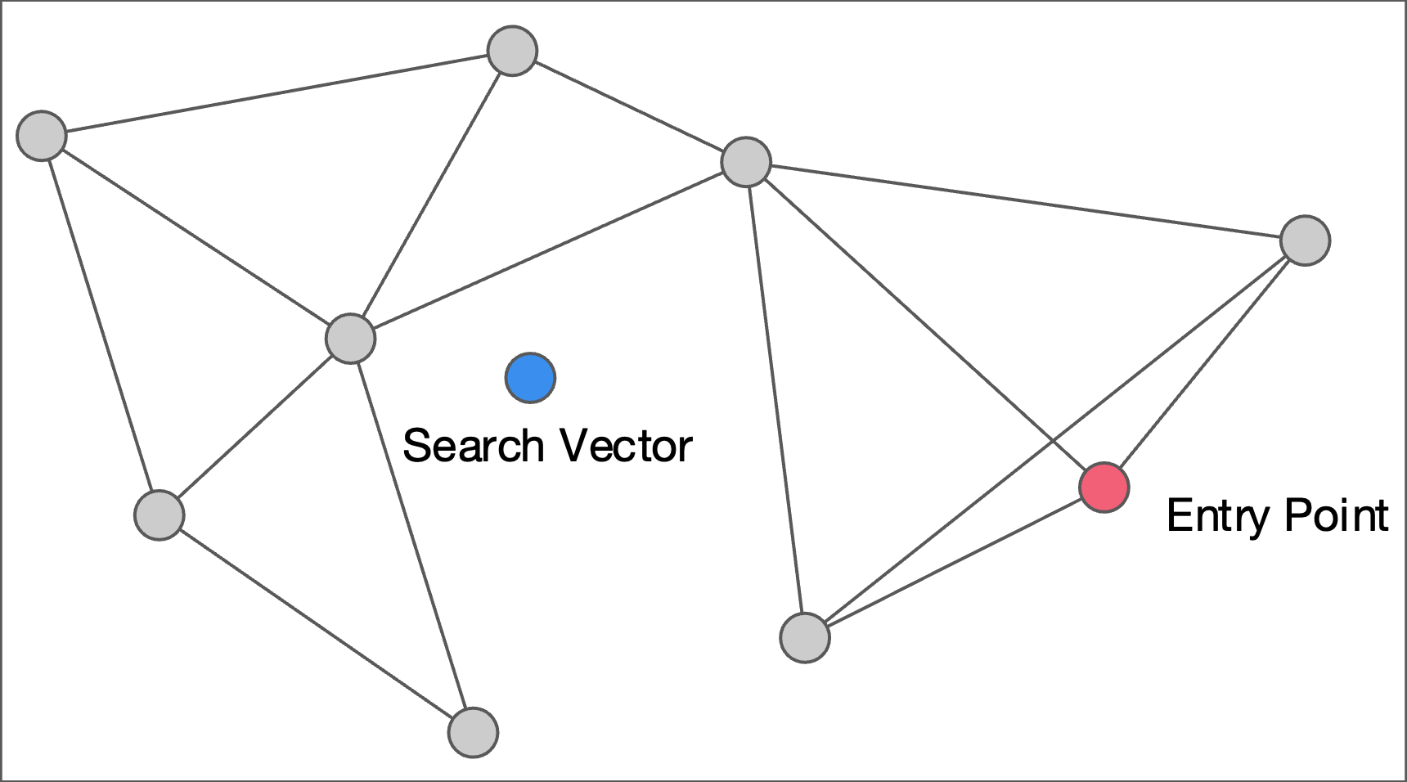
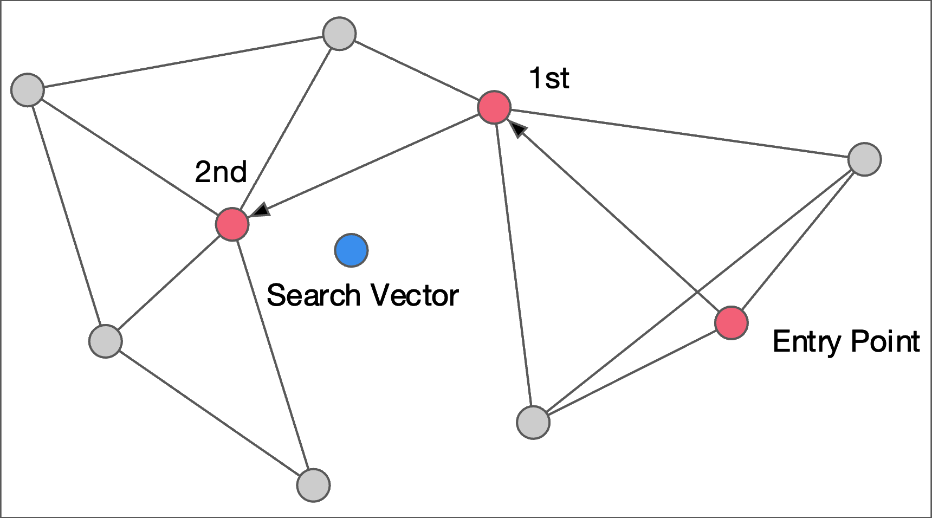
Vector Indexes: Navigable Small Worlds
Build a graph where each node represents a vector and it has edges to its n nearest neighbors.
Can use multiple levels of graphs (HNSW)
To find a match for a given vector, enter the graph and then greedily choose the next edge that moves closer to that vector.
Example: Faiss, hnswlib
Source: Chi Zhang

Slide 44
Conclusion
We will see filters again this semester.
B+Trees are still the way to go for tree indexes.
We did not discuss geo-spatial tree indexes:
Examples: R-Tree, Quad-Tree, KD-Tree

Slide 45
Next Class
How to make indexes thread-safe!

Slide 46
Leaderboard Results
46
The top 20 fastest valid implementations in the class will receive extra credit for this assignment.
#1: 50% bonus points
#2–10: 25% bonus points
#11–20: 10% bonus points
Bonuses applied manually at the end. Best leaderboard performer gets swag/prize TBD

Slide 47
RADIX TREE: MODIFICATIONS
Insert HAIR
H
Delete HAT
ELLO
A
AIR
Delete HAVE
¤
VE
¤
T
IR
¤
¤
¤

Slide 48
IN-MEMORY TABLE INDEXES
Processor: 1 socket, 10 cores w/ 2×HT Workload: 50m Random Integer Keys (64-bit)
Source: Ziqi Wang

Slide 49
SKIP LISTS: EXAMPLE
Levels
End
∞
P=N/4
K₂
K₄
∞
P=N/2
K₁
K₂
K₃
K₄
K₆
∞
P=N
V₁
V₂
V₃
V₄
V₆

Slide 50
WIKIPEDIA EXAMPLE
CREATE TABLE useracct (
userID INT PRIMARY KEY,
userName VARCHAR UNIQUE,
⋮
);
CREATE TABLE pages (
pageID INT PRIMARY KEY,
title VARCHAR UNIQUE,
latest INT ⮱REFERENCES revisions (revID),
);
CREATE TABLE revisions (
revID INT PRIMARY KEY,
userID INT REFERENCES useracct (userID),
pageID INT REFERENCES pages (pageID),
content TEXT,
updated DATETIME
);

Slide 51
TRIE INDEX PROPERTIES
Shape only depends on key space and lengths.
Does not depend on existing keys or insertion order.
Does not require rebalancing operations.
All operations have O(k) complexity where k is the length of the key.
The path to a leaf node represents the key of the leaf
Keys are stored implicitly and can be reconstructed from paths.

Slide 52
RADIX TREE: BINARY COMPARABLE KEYS
Not all attribute types can be decomposed into binary comparable digits for a radix tree.
Unsigned Integers: Byte order must be flipped for little endian machines.
Signed Integers: Flip two’s-complement so that negative numbers are smaller than positive.
Floats: Classify into group (neg vs. pos, normalized vs. denormalized), then store as unsigned integer.
Compound: Transform each attribute separately.
Notes:
Intel CPUs are little endian.
The radix tree wants values to be stored in big endian.

Slide 53
RADIX TREE: BINARY COMPARABLE KEYS
8-bit Span Radix Tree
0D
0A
0A
Int Key: 168496141
0C
0B
0B
0C
0B
0F
Hex Key: 0A 0B 0C 0D
0A
0D
0B
0C
1D
¤
Little
Endian
Big Endian
¤
0B
0D
¤
Find 658205
Hex 0A 0B 1D
¤
¤
Notes:
Say we want to store this key (168m) as an unsigned 32-bit integer. We can convert into hex as four 1-byte hex codes.
Intel CPUs = Little Endian
But this means that the data will not be stored in the right direction for us to do our comparisons correctly.

Slide 54
QUERY TYPES
Phrase Searches
Find records that contain a list of words in the given order.
Proximity Searches
Find records where two words occur within n words of each other.
Wildcard Searches
Find records that contain words that match some pattern (e.g., regular expression).
Notes:
Phrase – Finding the occurrence of a word
Proximity – Find records where a given word is N words of another word.
Wildcard – More complex pattern matching.
DBMSs have their own proprietary extensions. SQL standard specifies the API but nobody follows it exactly.

Slide 55
DESIGN DECISIONS
Decision #1: What To Store
The index needs to store at least the words contained in each record (separated by punctuation characters).
Can also store frequency, position, and other meta-data.
Decision #2: When To Update
Maintain auxiliary data structures to "stage" updates and then update the index in batches.
Notes:
The key difference in implementations is what information they are storing. The minimal is just the word. But you can also store the context info about how the word appears in the text.

