Slide 1
Lecture 11: It's Data Structure Week!
(Index Concurrency Control)

Slide 2
Announcements
2
Reminder: if you got below an 80 on P1, you should have an office hours appointment scheduled
There is a gradescope assignment set up for Buffer Pool Manager testing:
"Buffer Pool Manager: Test Only"

Slide 3





Observation
3
We (mostly) assumed all the data structures that we have discussed so far are single-threaded.
A modern DBMS needs to allow multiple threads to safely access data structures to take advantage of additional CPU cores and hide disk I/O stalls.
They Don't Do This!

Slide 4
Concurrency Control
4
A concurrency control protocol is the method that the DBMS uses to ensure “correct” results for concurrent operations on a shared object.
A protocol's correctness criteria can vary:
Logical Correctness: Can a thread see the data that it is supposed to see?
Physical Correctness: Is the internal representation of the object sound?

Slide 5
Today's Agenda
5
Latches Overview
Hash Table Latching
B+Tree Latching
Leaf Node Scans

Slide 6
Locks vs. Latches
6
Locks (Transactions)
Protect the database's logical contents from other transactions.
Held for transaction's duration.
Need to be able to rollback changes.
Latches (Workers)
Protect the critical sections of the DBMS's internal data structure from other workers (e.g., threads).
Held for operation duration.
Do not need to be able to rollback changes.

Slide 7
Locks vs. Latches
7
Lecture #15
 | Locks | Latches
Separate… | Transactions | Workers (threads, processes)
Protect… | Database Contents | In-Memory Data Structures
During… | Entire Transactions | Critical Sections
Modes… | Shared, Exclusive, Update, Intention | Read, Write
Deadlock | Detection & Resolution | Avoidance
…by… | Waits-for, Timeout, Aborts | Coding Discipline
Kept in… | Lock Manager | Protected Data Structure
Source: Goetz Graefe

Slide 8
Latch Modes
Read Mode
Multiple threads can read the same object at the same time.
A thread can acquire the read latch if another thread has it in read mode.
Write Mode
Only one thread can access the object.
A thread cannot acquire a write latch if another thread has it in any mode.
Compatibility Matrix
 | Read | Write
Read | ✔ | X
Write | X | X

Slide 9
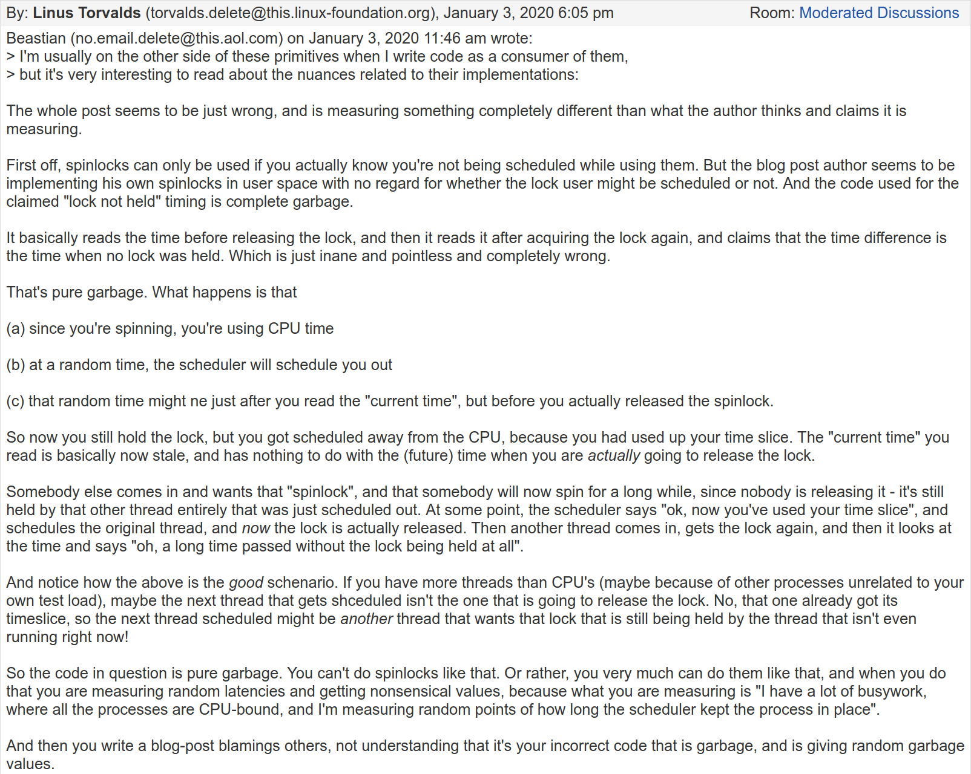
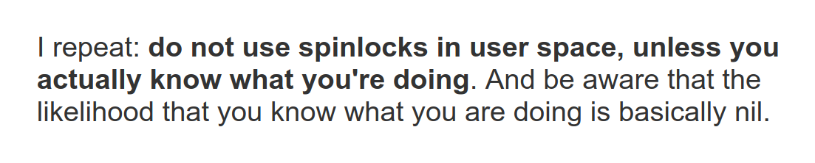
Latch Implementation Goals
Small memory footprint.
Fast execution path when no contention.
Decentralized management of latches.
Avoid expensive system calls.
Source: Filip Pizlo

Slide 10
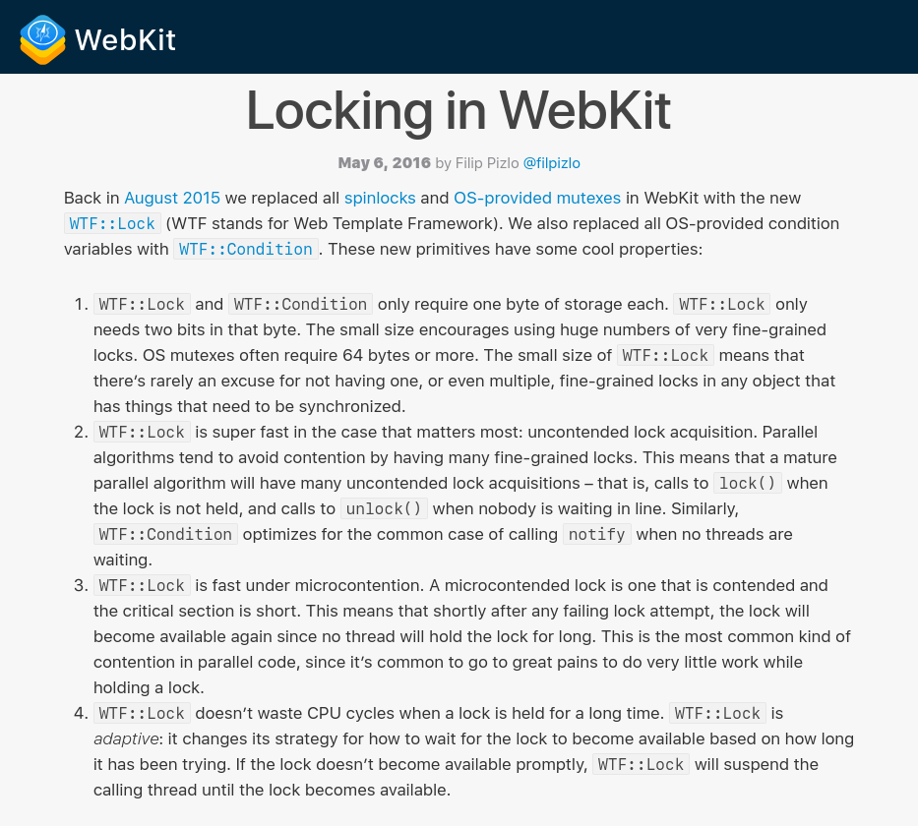
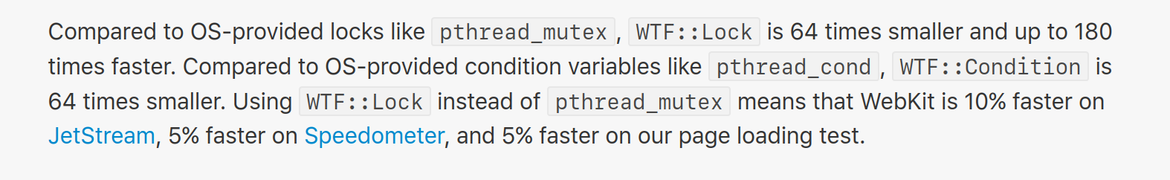
Latch Implementations
Atomic Instructions (i.e., roll your own)
Blocking OS Mutex
Reader-Writer Locks
Advanced approaches:
Adaptive Spinlock (Apple ParkingLot)
Queue-based Spinlock (MCS Locks)
Optimistic Lock Coupling (The Germans)

Slide 11
Latch Implementations
Approach #1: Test-and-Set Spin Latch (TAS)
Very efficient (single instruction to latch/unlatch)
Non-scalable, not cache friendly, not OS friendly.
Example: std::atomic_flag
Not std::atomic<bool>
std::atomic_flag latch;
⋮
while (latch.test_and_set()) {
// Retry? Yield? Abort?
}
test_and_set semantics:
-if flag is 1, return TRUE
-if flag is 0, flip it to 1 and return FALSE
-executes atomically, without using a lock

Slide 12



Latch Implementations
Approach #1: Test-and-Set Spin Latch (TAS)
Very efficient (single instruction to latch/unlatch)
Non-scalable, not cache friendly, not OS friendly.
Example: std::atomic_flag
Not std::atomic<bool>
std::atomic_flag latch;
⋮
while (latch.test_and_set()) {
// Retry? Yield? Abort?
}

Slide 13

Compare-and-swap (CAS)
Atomic instruction that compares contents of a memory location M to a given value V
If values are equal, installs new given value V’ in M, return TRUE
Otherwise, operation fails, return FALSE
See C++11 Atomics
New
Value
M
Address
30
20
__sync_bool_compare_and_swap(&M, 20, 30)
Compare Value

Slide 14
Skip Lists: INSERT w/ Spin Lock
Insert K₅
Levels
Problem: what happen if the INSERT thread gets swapped out by the OS?
End
K₅
∞
K₂
K₄
K₅
∞
K₁
K₂
K₃
K₄
K₅
K₆
∞
V₁
V₂
V₃
V₄
V₅
V₆

Slide 15

Skip Lists: INSERT w/ CAS
Insert K₅
Levels
Question: why CAS if 64-bit writes are already atomic?
End
K₅
∞
K₂
K₄
K₅
∞
K₁
K₂
K₃
K₄
K₅
K₆
∞
V₁
V₂
V₃
V₄
V₅
V₆

Slide 16


Latch Implementations
16
Approach #2: Blocking OS Mutex
Simple to use
Non-scalable (about 25ns per lock/unlock invocation)
Example: std::mutex
pthread_mutex_t
futex
std::mutex m;
⋮
m.lock();
// Do something special...
m.unlock();
OS Latch
Userspace Latch

Slide 17



Latch Implementations
17
Approach #3: Reader-Writer Latches
Allows for concurrent readers. Must manage read/write queues to avoid starvation.
Can be implemented on top of spinlocks.
Example: std::shared_mutex
pthread_mutex_t
pthread_cond_t
pthread_rwlock_t
Latch
read
write
=0
=1
=2
=0
=0
=1
=0
=1

Slide 18
Hash Table Latching
18
Easy to support concurrent access due to the limited ways threads access the data structure.
All threads move in the same direction and only access a single page/slot at a time.
Deadlocks are not possible.
To resize the table, take a global write latch on the entire table (e.g., in the header page).

Slide 19
Hash Table Latching
19
Approach #1: Page/Block Latches
Each page/block has its own reader-writer latch that protects its entire contents.
Threads acquire either a read or write latch before they access a page/block.
Approach #2: Slot Latches
Each slot has its own latch.
Can use a single-mode latch to reduce meta-data and computational overhead.

Slide 20

Hash Table: Page/Block Latches
20
It’s safe to release the latch on Page #1.
B
| value
0
T₁: Find D
T₂: Insert E
R
W
hash(D)
hash(E)
A
| value
1
C
| value
R
W
D
| value
2
E
| value

Slide 21

Hash Table: Slot Latches
21
B
| value
0
T₁: Find D
T₂: Insert E
hash(D)
R
hash(E)
It’s safe to release the latch on A
W
A
| value
R
W
1
C
| value
R
W
D
| value
W
2
E
| value

Slide 22
B+Tree Concurrency Control
22
We want to allow multiple threads to read and update a B+Tree at the same time.
We need to protect against two types of problems:
Threads trying to modify the contents of a node at the same time.
One thread traversing the tree while another thread splits/merges nodes.

Slide 23
B+Tree Multi-threaded Example
23
T₁: Delete 44
T₂: Find 41
20
A
10
35
B
6
12
23
31
C
38
44
D
41
Rebalance!
3
4
6
9
10
11
12
13
20
22
23
31
35
36
38
41
44
E
F
G
H
I
???

Slide 24
Latch Crabbing/Coupling
24
Protocol to allow multiple threads to access/modify B+Tree at the same time.
Get latch for parent
Get latch for child
Release latch for parent if “safe”
A safe node is one that will not split or merge when updated.
Not full (on insertion)
More than half-full (on deletion)

Slide 25
Latch Crabbing/Coupling
25
Find: Start at root and traverse down the tree:
Acquire R latch on child,
Then unlatch parent.
Repeat until we reach the leaf node.
Insert/Delete: Start at root and go down, obtaining W latches as needed. Once child is latched, check if it is safe:
If child is safe, release all latches on ancestors

Slide 26
Example #1 – FIND 38
26
R
T₁: Find 38
20
A
R
10
35
B
It is now safe to release the latch on A.
R
6
12
23
C
38
44
D
R
3
4
6
9
10
11
12
13
20
22
23
31
35
36
38
41
44
E
F
G
H
I

Slide 27
Example #2 – DELETE 38
27
W
T₁: Delete 38
20
A
W
10
35
B
We may need to coalesce B, so we can’t release the latch on A.
W
6
12
23
C
38
44
D
We know that D will not merge with C, so it is safe to release latches on A and B.
W
3
4
6
9
10
11
12
13
20
22
23
31
35
36
38
41
44
E
F
G
H
I

Slide 28
Example #3 – INSERT 45
28
W
T₁: Insert 45
20
A
W
10
35
B
We know that if D needs to split, B has room so it is safe to release the latch on A.
W
6
12
23
C
38
44
D
W
3
4
6
9
10
11
12
13
20
22
23
31
35
36
38
41
44
45
E
F
G
H
I
Node I will not split, so we can release B+D.

Slide 29
Example #4 – INSERT 25
29
W
T₁: Insert 25
20
A
W
10
35
B
W
6
12
23
31
C
38
44
D
W
3
4
6
9
10
11
12
13
20
22
23
31
25
35
31
36
38
41
44
We need to split F, so we need to hold the latch on its parent node.
J
E
F
G
H
I

Slide 30
Observation
30
What was the first step that all the update examples did on the B+Tree?
Taking a write latch on the root every time becomes a bottleneck with higher concurrency.
Delete 38
Insert 45
Insert 25
W
W
W
20
A
20
A
20
A

Slide 31
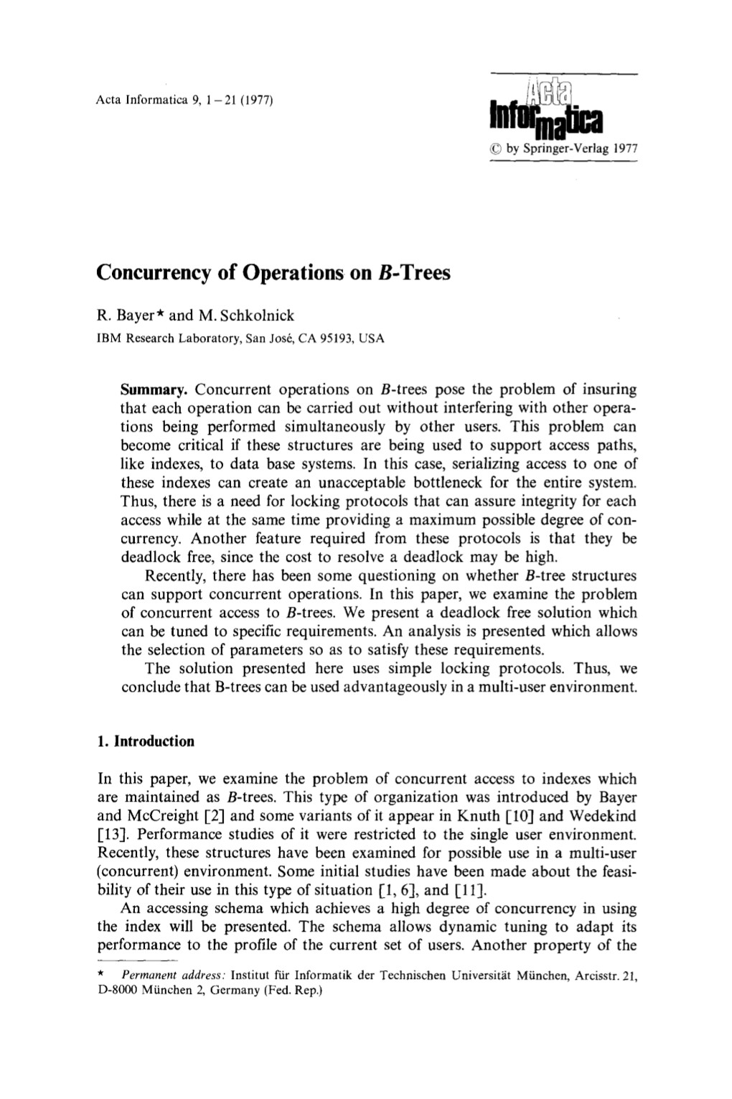
Better Latching Algorithm
Most modifications to a B+Tree will not require a split or merge.
Instead of assuming there will be a split/merge, optimistically traverse the tree using read latches.
If a worker guesses wrong, repeat traversal with pessimistic algorithm.

Slide 32
Better Latching Algorithm
32
Search: Same as before.
Insert/Delete:
Set latches as if for search, get to leaf, and set W latch on leaf.
If leaf is not safe, release all latches, and restart thread using previous insert/delete protocol with write latches.
This approach optimistically assumes that only leaf node will be modified; if not, R latches set on the first pass to leaf are wasteful.

Slide 33
Example #2 – DELETE 38
33
R
T₁: Delete 38
20
A
R
10
35
B
R
6
12
23
C
38
44
D
W
3
4
6
9
10
11
12
13
20
22
23
31
35
36
38
41
44
E
F
G
H
I
Node H will not coalesce, so we’re safe!

Slide 34
Example #4 – INSERT 25
34
R
T₁: Insert 25
20
A
R
10
35
B
R
6
12
23
C
38
44
D
W
3
4
6
9
10
11
12
13
20
22
23
31
35
36
38
41
44
We need to split F, so we have to restart and re-execute like before.
E
F
G
H
I

Slide 35
DELAYED PARENT UPDATES
Every time a leaf node overflows, we must update at least three nodes.
The leaf node being split.
The new leaf node being created.
The parent node.
B^{link}-Tree Optimization: When a leaf node overflows, delay updating its parent node.

Slide 36

EXAMPLE #4 – INSERT 25
R
T₁: Insert 25
C: Add 31
20
A
T₂: Find 31
R
T₃: Insert 33
10
35
B
Update C the next time that a thread takes a write latch on it.
R
W
6
12
23
31
C
38
44
D
W
3
4
6
9
10
11
12
13
20
22
23
31
25
35
36
38
41
44
Add the new leaf node as a sibling to F, but do not update C
W
E
F
G
H
I
31
33

Slide 37
Observation
37
The threads in all the examples so far have acquired latches in a "top-down" manner.
A thread can only acquire a latch from a node that is below its current node.
If the desired latch is unavailable, the thread must wait until it becomes available.
But what if threads want to move from one leaf node to another leaf node?

Slide 38
Leaf Node Scan Example #1
38
T₁: Find Keys < 4
R
3
A
Do not release latch on C until thread has latch on B
R
R
1
2
3
4
B
C

Slide 39
Leaf Node Scan Example #2
39
T₁: Find Keys < 4
T₂: Find Keys > 1
R
Both T₁ and T₂ now hold this read latch.
3
A
Only T₁ holds this read latch.
Both T₁ and T₂ now hold this read latch.
Only T₂ holds this read latch.
R
R
1
2
3
4
B
C

Slide 40



Leaf Node Scan Example #3
40
T₁: Delete 4
T₂: Find Keys > 1
R
3
A
T₂ cannot acquire the read latch on C
T₂ Choices?
Wait
R
W
Give up
1
2
3
4
B
C
Kill Other Thread
T₂ does not know what T₁ is doing…

Slide 41
Leaf Node Scans
41
Latches do not support deadlock detection or avoidance. The only way we can deal with this problem is through coding discipline.
The leaf node sibling latch acquisition protocol must support a “no-wait” mode.
The DBMS's data structures must cope with failed latch acquisitions.
Usually transparent to end-user / application.

Slide 42
Conclusion
42
Making a data structure thread-safe is notoriously difficult in practice.
We focused on B+Trees, but the same high-level techniques are applicable to other data structures.

Slide 43
Next Class
43
We are finally going to discuss how to execute some queries, starting with JOIN

Slide 44

Project #2
44
You will build a thread-safe B+tree backed by your buffer pool manager.
Page Layout
Insert/Delete/Find Operations
Iterator
Latch Crabbing
We define the API for you. You need to provide the method implementations.
WARNING: This is harder than Project #1. Start immediately!
WARNING: This is more difficult than Project #1. Start immediately!

Slide 45
Tasks
45
Task #1: Page Layouts
How each node will store its key/values in a page.
You only need to support unique keys.
Task #2: Operations
Support point queries (single key).
Support inserts with node splitting.
Support removal of keys with sibling stealing + merging.
Does not need to be thread-safe.

Slide 46
Tasks
46
Task #3: Index Iterator
Create a STL iterator for range scans on leaf nodes.
You only need to support ascending scans.
Task #4: Concurrent Index
Introduce latch crabbing/coupling protocol to support safe concurrent operations.
Make sure you have splits / merges working correctly before proceeding with this task.

Slide 47
Development Hints
47
Follow the textbook semantics and algorithms.
Set the page size to be small (e.g., 512B) when you first start so that you can see more splits/merges.
Make sure that you protect the internal B+Tree root_page_id member.

Slide 48
Extra Credit
48
Gradescope Leaderboard runs your code with a specialized in-memory version of BusTub.
The top 20 fastest implementations in the class will receive extra credit for this assignment.
#1: 50% bonus points
#2–10: 25% bonus points
#11–20: 10% bonus points
You must pass all the test cases to qualify!

Slide 49
LATCH IMPLEMENTATIONS
Approach #4: Adaptive Spinlock
Thread spins on a userspace lock for a brief time.
If they cannot acquire the lock, they then get descheduled and stored in a global "parking lot".
Threads check to see whether other threads are "parked" before spinning and then park themselves.
Example: Apple's WTF::ParkingLot

Slide 50
LATCH IMPLEMENTATIONS
50
Mellor-Crummey and Scott
Approach #5: Queue-based Spinlock (MCS)
More efficient than mutex, better cache locality
Non-trivial memory management
Example: std::atomic<Latch*>
Base Latch
CPU1 Latch
CPU2 Latch
CPU3 Latch
next
next
next
next
CPU1
CPU2
CPU3

Slide 51
VERSIONED LATCH COUPLING
51
Optimistic crabbing scheme where writers are not blocked on readers.
Every node now has a version number (counter).
Writers increment counter when they acquire latch.
Readers proceed if a node’s latch is available but then do not acquire it.
It then checks whether the latch’s counter has changed from when it checked the latch.
Relies on epoch GC to ensure pointers are valid.

Slide 52




VERSIONED LATCHES: SEARCH 44
52
T₁: Find 44
@A
A: Read v3
A: Examine Node
T₂: Insert 31
v3
20
A
B: Read v5
A: Recheck v3
B: Examine Node
@B
v4
10
v5
C: Read v9
B: Recheck v5
C: Examine Node
v6
35
B
REWIND
C
@C
v5
6
D
v4
12
E
v6
23
F
v9
38
44
G

