Slide 1
Lecture 13: Query Execution

Slide 2
Announcements
2
Midterm 1: Done grading, just a couple of make-ups still in the pipeline.
Monday: we'll discuss/release exam grades, mid-semester grades
Exam Solutions: we'll either release next week or make available in office hours

Slide 3
Last Class
Operator Execution
How to translate relational operators into fast code
Good news: one of the hard ones, sorting, we've already done
Today: the other hard one, joins
Goal: want fast, I/O efficient operators to use when we get to query planning and execution
Query Planning
Operator Execution
Access Methods
Buffer Pool Manager
Disk Manager

Slide 4
Query Plan
4
The operators are arranged in a tree.
Data flows from the leaves of the tree up towards the root.
We will discuss the granularity of the data movement next lecture.
The output of the root node is the result of the query.
SELECT R.id, S.cdate
FROM R JOIN S
ON R.id = S.id
WHERE S.value > 100
π
R.id, S.cdate
⨝
R.id=S.id
σ
value>100
R
S

Slide 5
Today's Agenda
Processing Models
Access Methods
Modification Queries
Expression Evaluation

Slide 6
Processing Model
A DBMS's processing model defines how the system executes a query plan and moves data from one operator to the next.
Different trade-offs for workloads (OLTP vs. OLAP).
Each processing model is comprised of two types of execution paths:
Control Flow: How the DBMS invokes an operator.
Data Flow: How an operator sends its results.
The output of an operator can be either whole tuples (NSM) or subsets of columns (DSM).

Slide 7
Query Execution
7
SELECT R.id, S.cdate
FROM R JOIN S
ON R.id = S.id
WHERE S.value > 100
A query plan is a DAG of operators.
Naïve idea: look for an operator whose children are complete, run this operator until done
Problem: what to do with intermediate results?
Spill to disk!
π
R.id, S.cdate
Spill to disk!
⨝
R.id=S.id
Spill to disk!
σ
value>100
R
S

Slide 8
Processing Model
Approach #1: Iterator Model
Approach #2: Materialization Model
Approach #3: Vectorized / Batch Model
Most Common
Rare
Common

Slide 9
Iterator Model
Each query plan operator implements a Next() function.
On each invocation, the operator returns either a single tuple or a EOF marker if there are no more tuples.
The operator implements a loop that calls Next() on its children to retrieve their tuples and then process them.
Each operator implementation also has Open() and Close() functions.
Analogous to constructors/destructors, but for operators.
Also called Volcano or Pipeline Model.

Slide 10
Iterator Model
Control Flow
Data Flow
SELECT R.id, S.cdate
FROM R JOIN S
ON R.id = S.id
WHERE S.value > 100
Next()
1
for t in child.Next():
emit(projection(t))
Next()
2
for t₁ in left.Next():
buildHashTable(t₁)
for t₂ in right.Next():
if probe(t₂): emit(t₁⨝t₂)
π
R.id, S.cdate
Next()
for t in child.Next():
if evalPred(t): emit(t)
4
⨝
Single Tuple
R.id=S.id
σ
value>100
Next()
3
for t in R:
emit(t)
Next()
for t in S:
emit(t)
5
R
S

Slide 11
Iterator Model
Control Flow
Data Flow
SELECT R.id, S.cdate
FROM R JOIN S
ON R.id = S.id
WHERE S.value > 100
1
for t in child.Next():
emit(projection(t))
2
for t₁ in left.Next():
buildHashTable(t₁)
for t₂ in right.Next():
if probe(t₂): emit(t₁⨝t₂)
Pipeline Edge
Pipeline #2
π
R.id, S.cdate
Blocking edge
(Pipeline Blocker)
for t in child.Next():
if evalPred(t): emit(t)
4
⨝
R.id=S.id
σ
value>100
3
for t in R:
emit(t)
for t in S:
emit(t)
5
R
S
Pipeline #1

Slide 12




















Iterator Model
The Iterator model is used in almost every DBMS.
Easy to implement / debug.
Output control works easily with this approach.
Benefits of pipelining
Within pipeline, never spill intermediate results to disk
Start returning results sooner
Secret reason #3: pipeline parallelism (next class)

Slide 13
Materialization Model
Each operator processes its input all at once and then emits its output all at once.
The operator "materializes" its output as a single result.
The DBMS can push down hints (e.g., LIMIT) to avoid scanning too many tuples.
Can send either a materialized row or a single column.
The output can be either whole tuples (NSM) or subsets of columns (DSM).
Originally developed by MonetDB in the 1990s to process entire columns at a time instead of single tuples.

Slide 14
Materialization Model
Control Flow
SELECT R.id, S.cdate
FROM R JOIN S
ON R.id = S.id
WHERE S.value > 100
Data Flow
out = [ ]
for t in child.Output():
out.add(projection(t))
return out
1
out = [ ]
for t₁ in left.Output():
buildHashTable(t₁)
for t₂ in right.Output():
if probe(t₂): out.add(t₁⨝t₂)
return out
2
π
R.id, S.cdate
⨝
R.id=S.id
out = [ ]
for t in S:
if evalPred(t): out.add(t)
return out
out = [ ]
for t in child.Output():
if evalPred(t): out.add(t)
return out
4
σ
value>100
All Tuples
3
Operator Fusion
R
S
out = [ ]
for t in R:
out.add(t)
return out
out = [ ]
for t in S:
out.add(t)
return out
5

Slide 15






Materialization Model
See your entire input set, pick the best algorithm
Better for OLTP workloads because queries only access a small number of tuples at a time.
Lower execution / coordination overhead.
Fewer function calls.
Not ideal for OLAP queries with large intermediate results, more optimizations needed

Slide 16
Vectorization Model
Like the Iterator Model where each operator implements a Next() function, but…
Each operator emits a batch of tuples instead of a single tuple.
The operator's internal loop processes multiple tuples at a time.
The size of the batch can vary based on hardware or query properties.
Each batch will contain one or more columns each their own null bitmaps.

Slide 17
Vectorization Model
Control Flow
SELECT R.id, S.cdate
FROM R JOIN S
ON R.id = S.id
WHERE S.value > 100
Data Flow
out = [ ]
for t in child.Next():
out.add(projection(t))
if |out|>n: emit(out)
1
2
out = [ ]
for t₁ in left.Next():
buildHashTable(t₁)
for t₂ in right.Next():
if probe(t₂): out.add(t₁⨝t₂)
if |out|>n: emit(out)
π
R.id, S.cdate
⨝
R.id=S.id
out = [ ]
for t in child.Next():
if evalPred(t): out.add(t)
if |out|>n: emit(out)
4
σ
value>100
3
Tuple Batch
R
S
out = [ ]
for t in R:
out.add(t)
if |out|>n: emit(out)
out = [ ]
for t in S:
out.add(t)
if |out|>n: emit(out)
5

Slide 18
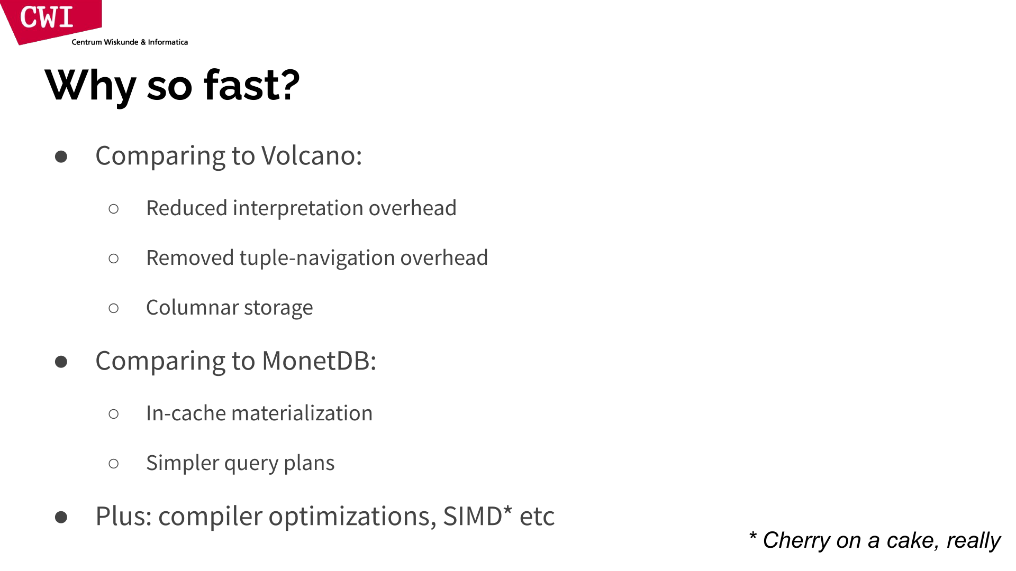



















Vectorization Model
Ideal for OLAP queries because it greatly reduces the number of invocations per operator.
Allows an out-of-order CPU to efficiently execute operators over batches of tuples.
Operators perform work in tight for-loops over arrays, which compilers know how to optimize / vectorize.
No data or control dependencies.
Hot instruction cache.

Slide 19
Observation
In the previous examples, the DBMS starts executing a query by invoking Next() at the root of the query plan and pulling data up from leaf operators.
This is the how most DBMSs implement their execution engine.

Slide 20
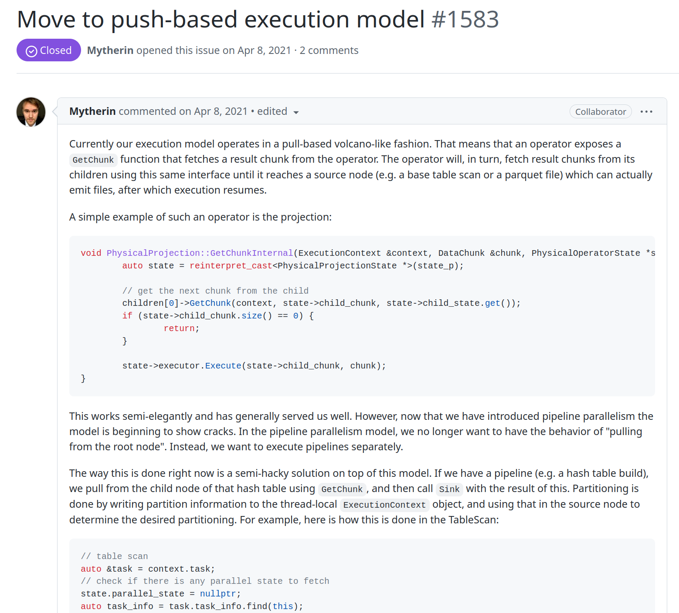

Plan Processing Direction
Approach #1: Top-to-Bottom (Pull)
Start with the root and "pull" data up from its children.
Tuples are always passed between operators using function calls (unless it's a pipeline breaker).
Approach #2: Bottom-to-Top (Push)
Start with leaf nodes and "push" data to their parents.
"fuse" operators together within a for-loop to minimize intermediate copies / function calls
Easier to orchestrate parallelism

Slide 21
Push-based Iterator Model
Control Flow
SELECT R.id, S.cdate
FROM R JOIN S
ON R.id = S.id
WHERE S.value > 100
Data Flow
Scheduler
1
for t₁ in R:
buildHashTable(t₁)
Pipeline #2
π
R.id, S.cdate
⨝
R.id=S.id
2
for t₂ in S:
if evalPred(t):
if probeHashTable(t₂):
emit(projection(t₁⨝t₂))
σ
value>100
R
S
Operator Fusion
Pipeline #1

Slide 22
Push-based Iterator Model
Control Flow
SELECT R.id, S.cdate
FROM R JOIN S
ON R.id = S.id
WHERE S.value > 100
Data Flow
Scheduler
1
for t₁ in R:
buildHashTable(t₁)
Pipeline #2
π
R.id, S.cdate
⨝
R.id=S.id
2
for t₂ in S:
if evalPred(t):
if probeHashTable(t₂):
emit(projection(t₁⨝t₂))
σ
value>100
R
S
Pipeline #1

Slide 23
Plan Processing Direction
Approach #1: Top-to-Bottom (Pull)
Easy to control output via LIMIT.
Parent operator blocks until its child returns with a tuple.
Additional overhead because operators' Next() functions are implemented as virtual functions.
Branching costs on each Next() invocation.
Approach #2: Bottom-to-Top (Push)
Allows for tighter control of caches/registers in pipelines.
May not have exact control of intermediate result sizes.
Difficult to implement some operators (Sort-Merge Join).
Most Common
Rare

Slide 24
Access Methods
24
SELECT R.id, S.cdate
FROM R JOIN S
ON R.id = S.id
WHERE S.value > 100
An access method is the way that the DBMS accesses the data stored in a table.
Not defined in relational algebra.
Three basic approaches:
Sequential Scan.
Index Scan (many variants).
Multi-Index Scan.
π
R.id, S.cdate
⨝
R.id=S.id
σ
value>100
R
S

Slide 25
Sequential Scan
25
for page in table.pages:
for t in page.tuples:
if evalPred(t):
// Do Something!
For each page in the table:
Retrieve it from the buffer pool manager.
Iterate over each tuple and check whether to include it.
The DBMS maintains an internal cursor that tracks the last page / slot it examined.

Slide 26
Sequential Scan: Optimizations
26
Lecture #5
Data Encoding / Compression
Prefetching / Scan Sharing / Buffer Bypass
Clustering / Sorting
Late Materialization
Materialized Views / Result Caching
Data Skipping
Code Specialization / Compilation
Data Parallelization / Vectorization
Task Parallelization / Multi-threading
Lecture #06
Lecture #08
Lecture #12
Lecture #14
Lecture #14

Slide 27
Data Skipping
27
Approach #1: Approximate Queries (Lossy)
Execute queries on a sampled subset of the entire table to produce approximate results.
Examples: BlinkDB, Redshift, ComputeDB, XDB, Oracle, Snowflake, Google BigQuery, DataBricks
Approach #2: Zone Maps (Lossless)
Pre-compute columnar aggregations per page that allow the DBMS to check whether queries need to access it.
Trade-off between page size vs. filter efficacy.
Examples: Oracle, Vertica, SingleStore, Netezza, Snowflake, Google BigQuery

Slide 28
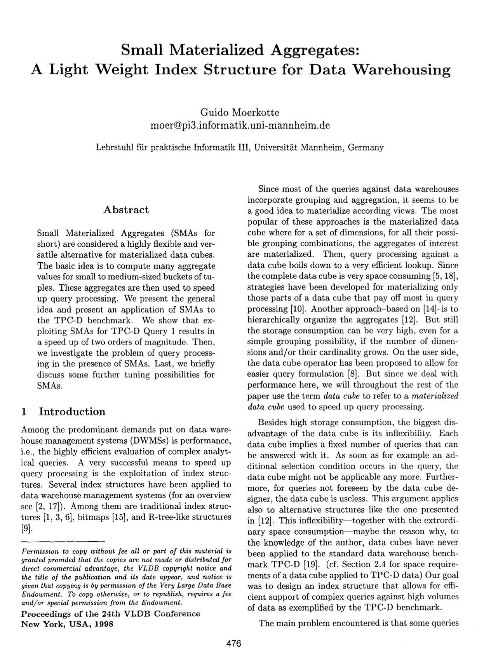



Zone Maps
28
Pre-computed aggregates for the attribute values in a page. DBMS checks the zone map first to decide whether it wants to access the page.
Original Data
Zone Map
val
type
val
SELECT * FROM table
WHERE val > 600
100
MIN
100
200
MAX
400
300
AVG
280
400
SUM
1400
400
COUNT
5

Slide 29
Index Scan
29
The DBMS picks an index to find the tuples that the query needs.
Which index to use depends on:
What attributes the index contains
What attributes the query references
The attribute's value domains
Predicate composition
Whether the index has unique or non-unique keys
Lecture #15

Slide 30
Index Scan
30
SELECT * FROM students
WHERE age < 30
AND dept = 'CS'
AND country = 'US'
Suppose that we have a single table with 100 tuples and two indexes:
Index #1: age
Index #2: dept
age<30
dept='CS'
fetch records
fetch records
dept='CS'
AND country='US'
Age<30
AND country='US'

Slide 31
Index Scan
31
SELECT * FROM students
WHERE age < 30
AND dept = 'CS'
AND country = 'US'
Suppose that we have a single table with 100 tuples and two indexes:
Index #1: age
Index #2: dept
Scenario #1
Scenario #2
There are 99 people under the age of 30 but only 2 people in the CS department.
There are 99 people in the CS department but only 2 people under the age of 30.

Slide 32
Multi-index Scan
32
If there are multiple indexes available for a query, the DBMS does not have to pick only one:
Compute sets of Record IDs using each matching index.
Combine these sets based on the query’s predicates (union vs. intersect).
Retrieve the records and apply any remaining predicates.
Examples:
DB2 Multi-Index Scan
PostgreSQL Bitmap Scan
MySQL Index Merge

Slide 33
Multi-index Scan
33
SELECT * FROM students
WHERE age < 30
AND dept = 'CS'
AND country = 'US'
Given the following query on a database with an index #1 on age and an index #2 on dept:
We can retrieve the Record IDs satisfying age<30 using index #1.
Then retrieve the Record IDs satisfying dept='CS' using index #2.
Take their intersection.
Retrieve records and check country='US'.

Slide 34
Multi-index Scan
34
SELECT * FROM students
WHERE age < 30
AND dept = 'CS'
AND country = 'US'
Set intersection can be done efficiently with bitmaps or hash tables.
age<30
dept='CS'
record ids
record ids
fetch records
country='US'

Slide 35
Modification Queries
35
Operators that modify the database (INSERT, UPDATE, DELETE) are responsible for modifying the target table and its indexes.
Constraint checks can either happen immediately inside of operator or deferred until later in query/transaction.
The output of these operators can either be Record IDs or tuple data (i.e., RETURNING).

Slide 36
Modification Queries
36
UPDATE/DELETE:
Child operators pass Record IDs for target tuples.
Must keep track of previously seen tuples.
INSERT:
Choice #1: Materialize tuples inside of the operator.
Choice #2: Operator inserts any tuple passed in from child operators.

Slide 37
Expression Evaluation
37
The DBMS represents a WHERE clause as an expression tree.
The nodes in the tree represent different expression types:
Comparisons (=, <, >, !=)
Conjunction (AND), Disjunction (OR)
Arithmetic Operators (+, -, *, /, %)
Constant Values
Tuple Attribute References
Functions
SELECT R.id, S.cdate
FROM R JOIN S
ON R.id = S.id
WHERE S.value > 100;
AND
=
>
Attribute(R.id)
Attribute(S.id)
Attribute(value)
Constant(100)

Slide 38
Expression Evaluation
38
PREPARE xxx AS SELECT * FROM S
WHERE S.val = $1 + 9
Execution Context
Current Tuple
(123, 1000)
Query Parameters
(int:991)
Table Schema
S→(int:id, int:val)
EXECUTE xxx(991)
=
true
Attribute(S.val)
+
1000
1000
Parameter($1)
Constant(9)
991
9

Slide 39
Expression Evaluation
39
Fundamentally, what did we want to do?
PREPARE xxx AS SELECT * FROM S
WHERE S.val = $1 + 9
cmp_eq $r1 $r2
je compare_true;
jmp compare_false;
EXECUTE xxx(991)
Is this a good idea?
=
We wanted ~2 instructions, we got hundreds or more!
Attribute(R.id)
Attribute(S.id)
Several Function calls (possible virtual)
Several pointer chases (depth-first traversal)
Dealing with schema / types / exec_ctx
Repeated work for every tuple

Slide 40

Expression / Query Compilation
40
SELECT * WHERE s.val = 1;
Evaluating predicates by traversing a tree is terrible for the CPU.
The DBMS traverses the tree and for each node that it visits, it must figure out what the operator needs to do.
A better approach is to evaluate the expression directly.
An even better approach is to vectorize it evaluate a batch of tuples at the same time…
=
Attribute(s.val)
Constant(1)
bool check(val) { return (val == 1); }
gcc, Clang, LLVM, …
Machine Code

Slide 41
CONCLUSION
41
The same query plan can be executed in multiple different ways.
(Most) DBMSs will want to use index scans as much as possible.
Expression trees are flexible but slow. JIT compilation can (sometimes) speed them up.

Slide 42
NEXT CLASS
42
Parallel Query Execution

Slide 43
Expression Evaluation: Optimizations
WHERE UPPER(col1) = UPPER('wutang');
Constant Folding:
Identify redundant / unnecessary operations that are wasteful.
Compute a sub-expression on a constant value once and reuse result per tuple.
Common Sub-Expr. Elimination:
Identify repeated sub-expressions that can be shared across expression tree.
Compute once and then reuse result.
=
UPPER()
Constant('WUTANG')
UPPER()
Attribute(col1)
Constant('wutang')
WHERE STRPOS('x', col1) < 2 OR STRPOS('x', col1) > 8
OR
Op(<)
Op(>)
STRPOS()
Constant(2)
STRPOS()
Constant(8)
Constant('x')
Attribute(col1)
Constant('x')
Attribute(col1)

Slide 44

Update Query Problem
44
Control Flow
Data Flow
CREATE INDEX idx_salary ON people (salary);
for t in child.Next():
removeFromIndex(idx_salary, t.salary, t)
updateTuple(t.salary = t.salary + 100)
insertIntoIndex(idx_salary, t.salary, t)
(1199,Andy)
(1099,Andy)
UPDATE people SET salary = salary + 100
WHERE salary < 1100
for t in Index_{people}:
if t.salary < 1100:
emit(t)
Index(people.salary)
(999,Andy)
(1099,Andy)

Slide 45
Halloween Problem
45
Anomaly where an update operation changes the physical location of a tuple, which causes a scan operator to visit the tuple multiple times.
Can occur on clustered tables or index scans.
First discovered by IBM researchers while working on System R on Halloween day in 1976.
Solution: Track modified record ids per query.

