Slide 1
Lecture 16: Concurrency Control

Slide 2
Announcements
2
Project 3 released on Wednesday
Due to recent adjustments, working on schedule for last third of the class, stay tuned.
We'll handle Project 2 on Wednesday once all late days are over

Slide 3
Course Status
A DBMS’s concurrency control and recovery components permeate throughout the design of its entire architecture.
Query Planning
Concurrency Control
Operator Execution
Access Methods
Buffer Pool Manager
Recovery
Disk Manager

Slide 4


Motivation Example #1
Application Logic
Read(A);
Check(A > $25);
Pay($25);
A = A – $25;
Write(A);
Read Balance: $100
Sufficient funds?
Bank Balance : $100
Bank Balance : $75
Pay $25
???
New balance: $75
Write Balance: $75

Slide 5
Motivation Example #2
Application Logic
Read(A);
Check(A > $25);
Pay($25);
A = A – $25;
Write(A);
Read Balance: $100
Read Balance: $100
Sufficient funds?
Sufficient funds?
Bank Balance : $100
Bank Balance : $75
Pay $25
Pay $25
New balance: $75
New balance: $75
Write Balance: $75
Write Balance: $75

Slide 6
Strawman System
Execute each txn one-by-one (i.e., serial order) as they arrive at the DBMS.
One and only one txn can be running simultaneously in the DBMS.
Before a txn starts, copy the entire database to a new file and make all changes to that file.
If the txn completes successfully, overwrite the original file with the new one.
If the txn fails, just remove the dirty copy.

Slide 7
Problem Statement
A (potentially) better approach is to allow concurrent execution of independent transactions.
Why do we want that?
Better utilization/throughput
Increased response times to users.
But we also would like:
Correctness
Fairness

Slide 8
Problem Statement
Arbitrary interleaving of operations can lead to:
Temporary Inconsistency (ok, unavoidable)
Permanent Inconsistency (bad!)
The DBMS is only concerned about what data is read/written from/to the database.
Changes to the “outside world” are beyond the scope of the DBMS.
We need formal correctness criteria to determine whether an interleaving is valid.

Slide 9
Formal Definitions
Database: A fixed set of named data objects (e.g., A, B, C, …).
We do not need to define what these objects are now.
We will discuss how to handle inserts/deletes next week.
Transaction: A sequence of read and write operations (e.g., R(A), W(B), …)
DBMS’s abstract view of a user program.
A new txn starts with the BEGIN command.
The txn stops with either COMMIT or ROLLBACK

Slide 10
Correctness Criteria: ACID
Atomicity | All actions in txn happen, or none happen. “All or nothing…”
Consistency | If each txn is consistent and the DB starts consistent, then it ends up consistent. “It looks correct to me…”
Isolation | Execution of one txn is isolated from that of other txns. “All by myself…”
Durability | If a txn commits, its effects persist. “I will survive…”
Key constraints, CHECKS, TRIGGERS, … hold before and after the txn completes.

Slide 11
Today's Agenda
Atomicity
Consistency
Isolation
Durability

Slide 12
Atomicity Of Transactions
A
Two possible outcomes of executing a txn:
Commit after completing all its actions.
Abort (or be aborted by the DBMS) after executing some actions.
DBMS guarantees that txns are atomic.
From user's point of view: txn always either executes all its actions or executes no actions at all.

Slide 13
Mechanisms For Ensuring Atomicity
A
Approach #1: Logging
DBMS logs all actions so that it can undo the actions of aborted transactions.
Maintain undo records both in memory and on disk.
Think of this like the black box in airplanes…
Logging is used by almost every DBMS.
Audit Trail
Efficiency Reasons

Slide 14

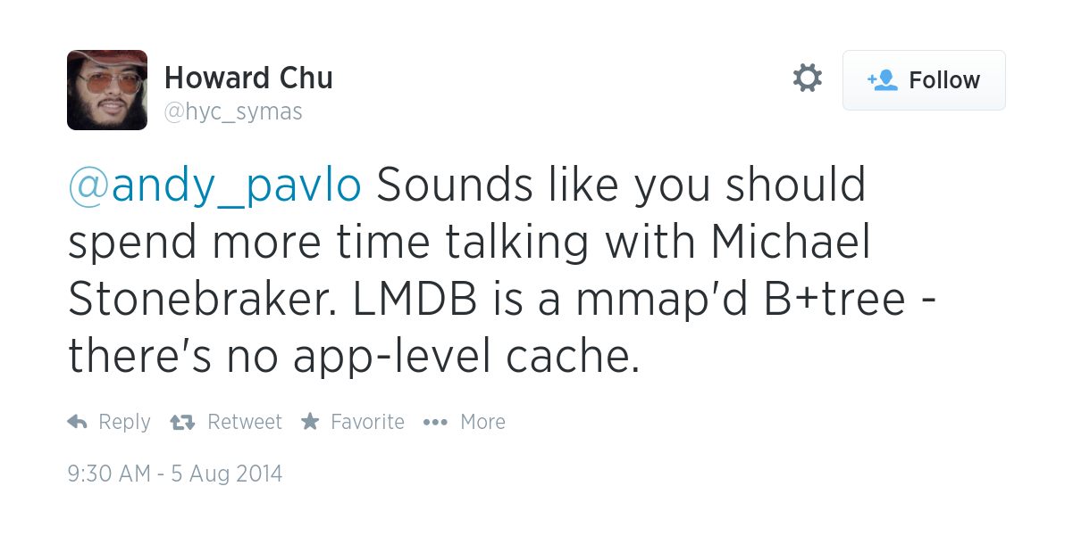
Mechanisms For Ensuring Atomicity
A
Approach #2: Shadow Paging
DBMS makes copies of pages and txns make changes to those copies. Only when the txn commits is the page made visible to others.
Originally from IBM System R.
Few systems do this:
CouchDB
Tokyo Cabinet
LMDB (OpenLDAP)
Don't Do This!

Slide 15
Consistency
C
The database accurately models the real world.
SQL has methods to specify integrity constraints (e.g., key definitions, CHECK and ADD CONSTRAINT) and the DBMS will enforce them.
Application must define these constraints.
DBMS ensures that all ICs are true before and after the transaction ends.
A note on Eventual Consistency.
A committed transaction may see inconsistent results (e.g., may not see the updates of an older committed txn).
Difficult for developers to reason about such semantics.
The trend is to move away from such models.
Lecture #23

Slide 16
Isolation Of Transactions
I
Users submit txns, and each txn executes as if it were running by itself.
Easier programming model to reason about.
But the DBMS achieves concurrency by interleaving the actions (reads/writes of DB objects) of txns.
We need a way to interleave txns but still make it appear as if they ran one-at-a-time.

Slide 17
Mechanisms For Ensuring Isolation
I
A concurrency control protocol is how the DBMS decides the proper interleaving of operations from multiple transactions.
Two categories of protocols:
Pessimistic: Don’t let problems arise in the first place.
Optimistic: Assume conflicts are rare; deal with them after they happen.

Slide 18
Example
I
Assume at first A and B each have $1000.
T₁ transfers $100 from A’s account to B’s
T₂ credits both accounts with 6% interest.
T₁
T₂
BEGIN
A=A-100
B=B+100
COMMIT
BEGIN
A=A*1.06 B=B*1.06
COMMIT

Slide 19
Example
I
Assume at first A and B each have $1000.
What are the possible outcomes of running T₁ and T₂?
T₁
T₂
BEGIN
A=A-100
B=B+100
COMMIT
BEGIN
A=A*1.06 B=B*1.06
COMMIT

Slide 20
Example
I
Assume at first A and B each have $1000.
What are the possible outcomes of running T₁ and T₂?
Many! But A+B should be:
$2000*1.06=$2120
There is no guarantee that T₁ will execute before T₂ or vice-versa, if both are submitted together.
But the net effect must be equivalent to these two transactions running serially in some order.

Slide 21
Example
I
Legal outcomes:
A=954, B=1166
A=960, B=1160
The outcome depends on whether T₁ executes before T₂ or vice versa.
→ A+B=$2120
→ A+B=$2120

Slide 22
Serial Execution Example
I
Schedule
Schedule
T₁
T₂
T₁
T₂
BEGIN
A=A-100
B=B+100
COMMIT
BEGIN
A=A*1.06
B=B*1.06
COMMIT
BEGIN
A=A-100
B=B+100
COMMIT
BEGIN
A=A*1.06
B=B*1.06
COMMIT
≡
TIME
A=954, B=1166
A=960, B=1160
A+B=$2120

Slide 23
Interleaving Transactions
I
We interleave txns to maximize concurrency.
Slow disk/network I/O.
Multi-core CPUs.
When one txn stalls because of a resource (e.g., page fault), another txn can continue executing and make forward progress.

Slide 24
Interleaving Example (Good)
I
Schedule
Schedule
T₁
T₂
T₁
T₂
BEGIN
A=A-100
B=B+100
COMMIT
BEGIN
A=A*1.06
B=B*1.06
COMMIT
BEGIN
A=A-100
B=B+100
COMMIT
BEGIN
A=A*1.06
B=B*1.06
COMMIT
≡
TIME
A=954, B=1166
A=960, B=1160
A+B=$2120

Slide 25
Interleaving Example (Bad)
I
Schedule
T₁
T₂
BEGIN
A=A-100
B=B+100
COMMIT
BEGIN
A=A*1.06
B=B*1.06
COMMIT
A=954, B=1166
or
A=960, B=1160
≢
TIME
A=954, B=1160
Off by $6!
A+B=$2114

Slide 26
Interleaving Example (Bad)
I
Schedule
DBMS View
T₁
T₂
T₁
T₂
BEGIN
A=A-100
B=B+100
COMMIT
BEGIN
A=A*1.06
B=B*1.06
COMMIT
How do we judge whether a schedule is correct?
If the schedule is equivalent to some serial execution.
BEGIN
R(A)
W(A)
R(B)
W(B)
COMMIT
BEGIN
R(A)
W(A)
R(B)
W(B)
COMMIT
TIME
A=954, B=1160
A+B=$2114

Slide 27
Formal Properties Of Schedules
I
Serial Schedule
A schedule that does not interleave the actions of different transactions.
Equivalent Schedules
For any database state, the effect of executing the first schedule is identical to the effect of executing the second schedule.

Slide 28
Formal Properties Of Schedules
I
Serializable Schedule
A schedule that is equivalent to some serial execution of the transactions.
If each transaction preserves consistency, every serializable schedule preserves consistency.
Serializability is a less intuitive notion of correctness compared to txn initiation time or commit order, but it provides the DBMS with more flexibility in scheduling operations.
More flexibility means better parallelism.

Slide 29
Conflicting Operations
I
We need a formal notion of equivalence that can be implemented efficiently based on the notion of “conflicting” operations.
Two operations conflict if:
They are by different transactions,
They are on the same object and one of them is a write.
Interleaved Execution Anomalies
Unrepeatable Read (Read-Write)
Dirty Read (Write-Read)
Lost Update (Write-Write)
Phantom Reads (Scan-Write)
Write-Skew (Read-Write)
Lecture #17
Lecture #19

Slide 30
Read-Write Conflicts
I
Unrepeatable Read: Txn gets different values when reading the same object multiple times.
T₁
T₂
BEGIN
R(A)
R(A)
COMMIT
BEGIN
R(A)
W(A)
COMMIT
$10
$10
$19
$19

Slide 31
Write-Read Conflicts
I
Dirty Read: One txn reads data written by another txn that has not committed yet.
T₁
T₂
BEGIN
R(A)
W(A)
ROLLBACK
BEGIN
R(A)
W(A)
COMMIT
$10
$12
$12
$14

Slide 32
Write-Write Conflicts
I
Lost Update: One txn overwrites uncommitted data from another uncommitted txn.
T₁
T₂
BEGIN
W(A)
W(B)
COMMIT
BEGIN
W(A)
W(B)
COMMIT
$10
$19
Bob
Alice

Slide 33
Formal Properties Of Schedules
I
Given these conflicts, we now can understand what it means for a schedule to be serializable.
This is to check whether schedules are correct.
This is not how to generate a correct schedule.
There are different levels of serializability:
Conflict Serializability
View Serializability
Most DBMSs try to support this.
No DBMS can do this.

Slide 34
Conflict Serializable Schedules
I
Two schedules are conflict equivalent iff:
They involve the same actions of the same transactions.
Every pair of conflicting actions is ordered the same way in time.
Schedule S is conflict serializable if:
S is conflict equivalent to some serial schedule.
Intuition: You can transform S into a serial schedule by swapping consecutive non-conflicting operations of different transactions.

Slide 35
Dependency Graphs
I
One node per txn.
Edge from T_{i} to T_{j} if:
An operation O_{i} of T_{i} conflicts with an operation O_{j} of T_{j} and
O_{i} appears earlier in the schedule than O_{j}.
Also known as a precedence graph. A schedule is conflict serializable iff its dependency graph is acyclic.
Dependency Graph
T_{i}
T_{j}

Slide 36
Example #1
I
Schedule
Dependency Graph
T₁
T₂
A
BEGIN
R(A)
W(A)
R(B)
W(B)
COMMIT
BEGIN
R(A)
W(A)
R(B)
W(B)
COMMIT
T₁
T₂
TIME
B
The cycle in the graph reveals the problem. The output of T₁ depends on T₂, and vice-versa.

Slide 37
Example #2 – Three Transactions
I
Schedule
Dependency Graph
T₁
T₂
T₃
T₁
T₂
BEGIN
R(A)
W(A)
R(B)
W(B)
COMMIT
BEGIN
R(B)
W(B)
COMMIT
BEGIN
R(A)
W(A)
COMMIT
B
A
TIME
T₃
Is this equivalent to a serial execution?
Yes (T₂, T₁, T₃)
Notice that T₃ should go after T₂, although it starts before it!

Slide 38
Example #3 – Inconsistent Analysis
I
Schedule
Dependency Graph
T₁
T₂
A
BEGIN
R(A)
A = A-10
W(A)
R(B)
B = B+10
W(B)
COMMIT
BEGIN
R(A)
sum = A
R(B)
sum += B
ECHO sum
COMMIT
T₁
T₂
TIME
B
if(A≥0): cnt++
if(B≥0): cnt++
Is it possible to modify only the application logic so that schedule produces a “correct” result but is still not conflict serializable?
ECHO cnt

Slide 39
View Serializability
I
Alternative (broader) notion of serializability.
Schedules S₁ and S₂ are view equivalent if:
If T₁ reads initial value of A in S₁, then T₁ also reads initial value of A in S₂.
If T₁ reads value of A written by T₂ in S₁, then T₁ also reads value of A written by T₂ in S₂.
If T₁ writes final value of A in S₁, then T₁ also writes final value of A in S₂.

Slide 40
View Serializability
I
Schedule
Dependency Graph
T₁
T₂
T₃
A
BEGIN
R(A)
W(A)
COMMIT
BEGIN
W(A)
COMMIT
BEGIN
W(A)
COMMIT
T₁
T₂
A
TIME
A
A
A
T₃

Slide 41
View Serializability
I
Schedule
Schedule
T₁
T₂
T₃
T₁
T₂
T₃
BEGIN
R(A)
W(A)
COMMIT
BEGIN
W(A)
COMMIT
BEGIN
W(A)
COMMIT
BEGIN
R(A)
W(A)
COMMIT
BEGIN
W(A)
COMMIT
BEGIN
W(A)
COMMIT
VIEW
≡
TIME
Allows all conflict serializable schedules + “blind writes”

Slide 42
Serializability
I
View Serializability allows for (slightly) more schedules than Conflict Serializability does.
But it is difficult to enforce efficiently.
Neither definition allows all schedules that you would consider “serializable.”
This is because they don’t understand the meanings of the operations or the data (recall example #3)
In practice, Conflict Serializability is what systems support because it can be enforced efficiently.

Slide 43
Universe of Schedules
I
All Schedules
View Serializable
Conflict Serializable
Serial

Slide 44
Transaction Durability
D
All the changes of committed transactions should be persistent.
No torn updates.
No changes from failed transactions.
The DBMS can use either logging or shadow paging to ensure that all changes are durable.

Slide 45
Correctness Criteria: ACID
Redo/Undo Mechanism
Atomicity | All actions in txn happen, or none happen. “All or nothing…”
Consistency | If each txn is consistent and the DB starts consistent, then it ends up consistent. “It looks correct to me…”
Isolation | Execution of one txn is isolated from that of other txns. “All by myself…”
Durability | If a txn commits, its effects persist. “I will survive…”
Integrity Constraints
Key constraints, CHECKS, TRIGGERS, … hold before and after the txn completes.
Concurrency Control
Redo/Undo Mechanism

Slide 46
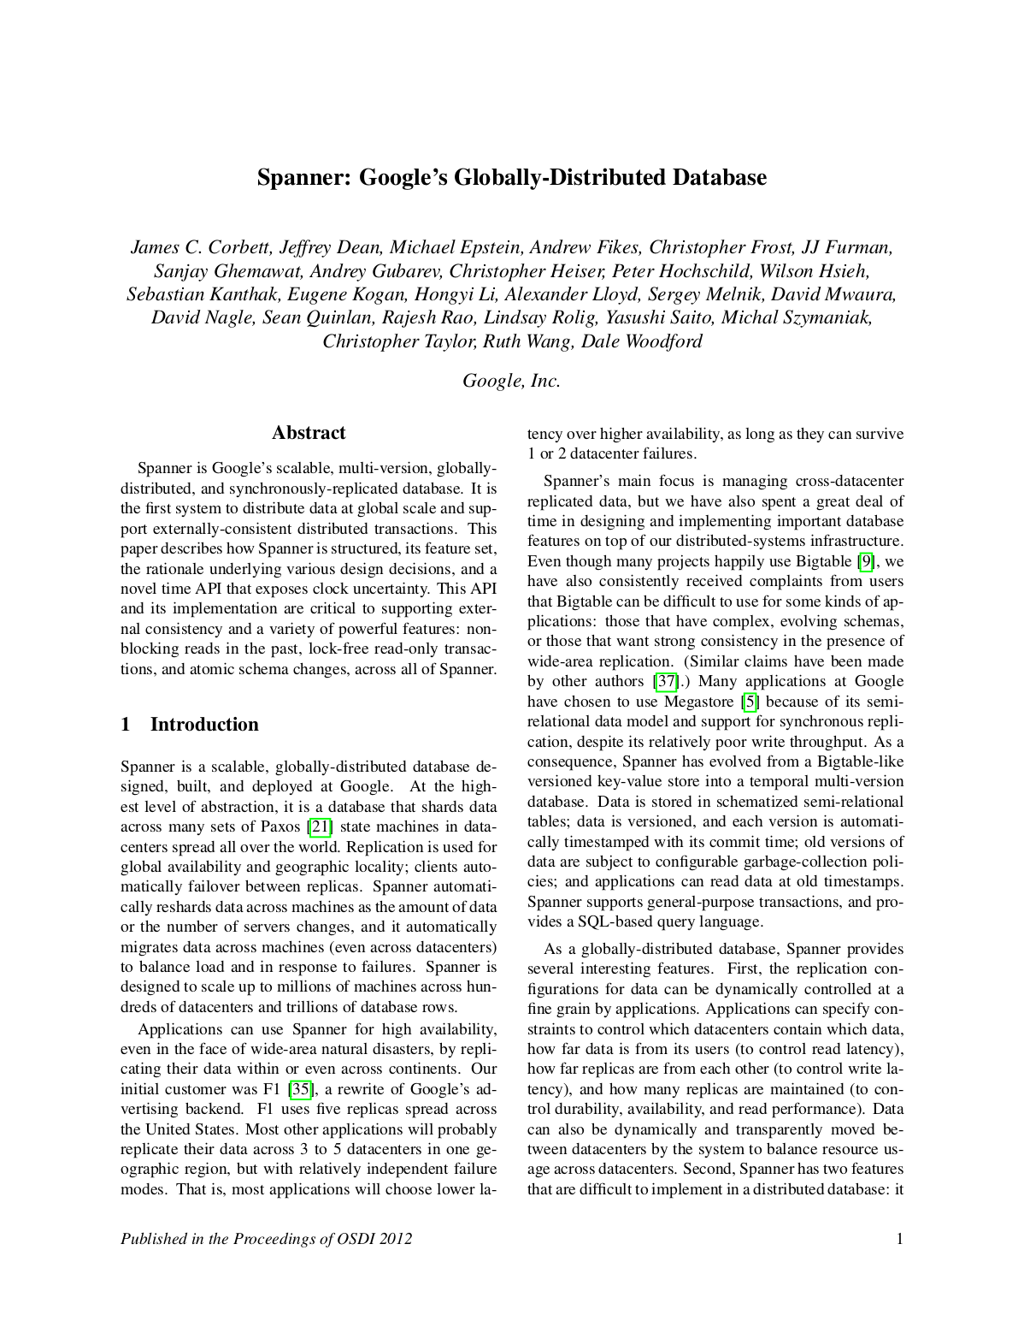
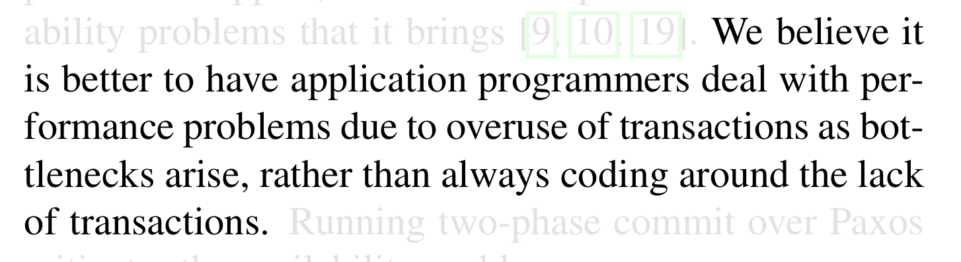
Conclusion
Concurrency control and recovery are among the most important functions provided by a DBMS.
Concurrency control is automatic
System automatically inserts lock/unlock requests and schedules actions of different txns.
Ensures that resulting execution is equivalent to executing the txns one after the other in some order.

Slide 47
Next Class
Two-Phase Locking
Isolation Levels

Slide 48

PROJECT #3 – QUERY EXECUTION
You will add support for executing queries in BusTub.
BusTub now supports (basic) SQL with a rule-based optimizer for converting AST into physical plans.
Prompt: A realistic photo of a bath tub with wheels and cartoon eyes driving down a city street.
https://15445.courses.cs.cmu.edu/fall2023/project3/

Slide 49
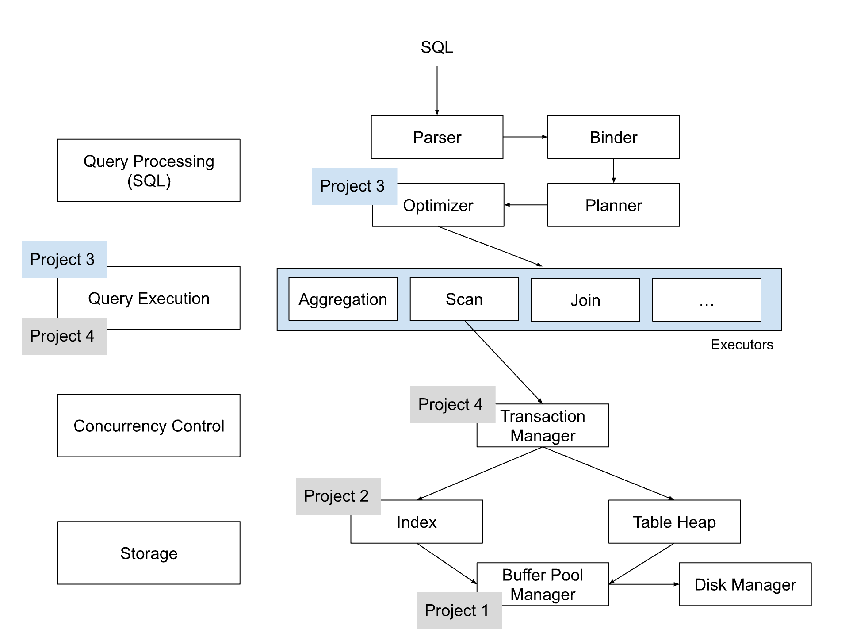
PROJECT #3 – QUERY EXECUTION

Slide 50
PROJECT #3 – TASKS
Plan Node Executors
Access Methods: Sequential Scan, Index Scan
Modifications: Insert, Delete, Update
Joins: Nest Loop Join, Hash Join
Miscellaneous: Window Aggregation, Aggregation, Limit, Sort, Top-k.
Optimizer Rule:
Convert a query with ORDER BY + LIMIT into a Top-k plan node.
Convert Nested Loops to Hash Join
Convert Sequential Scan to Index Scan

Slide 51
PROJECT #3 - LEADERBOARD
The leaderboard requires you to add additional rules to the optimizer to generate query plans.
It will be impossible to get a top ranking by just having the fastest implementations in Project #1 + Project #2.
Tasks:
Window Aggregation to Top-k
Column Pruning
More Aggressive Predicate Pushdown
Bloom Filter for Hash Join

Slide 52
DEVELOPMENT HINTS
Implement the Insert and Sequential Scan executors first so that you can populate tables and read from it.
Follow the Project Road Map rather than the order of the writeup.
You do not need to worry about transactions.
The aggregation hash table does not need to be backed by your buffer pool (i.e., use STL)
Gradescope is for meant for grading, not debugging. Write your own local tests.

Slide 53
THINGS TO NOTE
Do not change any file other than the ones that you submit to Gradescope.
Make sure you pull in the latest changes from the BusTub main branch.
Post your questions on Piazza or come to TA office hours.
Compare against our solution in your browser!

Slide 54

PLAGIARISM WARNING
Your project implementation must be your own work.
You may not copy source code from other groups or the web.
Do not publish your implementation on Github.
Plagiarism will not be tolerated. See CMU's Policy on Academic Integrity for additional information.

Slide 55
CONFLICT SERIALIZABILITY INTUITION
I
Schedule
Serial Schedule
T₁
T₂
T₁
T₂
BEGIN
R(A)
W(A)
COMMIT
BEGIN
R(B)
W(B)
COMMIT
BEGIN
R(A)
W(A)
R(B)
W(B)
COMMIT
BEGIN
R(A)
W(A)
R(B)
W(B)
COMMIT
R(B)
R(A)
≡
TIME
R(B)
W(B)
W(A)
R(A)
R(B)
W(B)
W(A)
R(A)
W(B)
W(A)

Slide 56
CONFLICT SERIALIZABILITY INTUITION
I
Schedule
Serial Schedule
T₁
T₂
T₁
T₂
BEGIN
R(A)
W(A)
COMMIT
BEGIN
R(A)
W(A)
COMMIT
BEGIN
R(A)
W(A)
COMMIT
BEGIN
R(A)
W(A)
COMMIT
≢
TIME

Slide 57
SERIALIZABILITY
I
Swapping operations is easy when there are only two txns in the schedule. It’s cumbersome when there are many txns.
Are there faster algorithms to figure this out other than transposing operations?

Slide 58
TRANSACTIONS
A transaction is the execution of a sequence of one or more operations (e.g., SQL queries) on a database to perform some higher-level function.
It is the basic unit of change in a DBMS:
Partial transactions are not allowed! In other words, the semantics that the application is protecting is encapsulated by Begin and End transaction calls.
Begin
Read (A);
A = A – 25;
Write (A);
Read (B);
B = B + 25;
Write (B);
Commit

Slide 59
TRANSACTION EXAMPLE
Move $100 from Andy's bank account to his bookie's account.
Transaction:
Check whether Andy has $100.
Deduct $100 from his account.
Add $100 to his bookie's account.

Slide 60
TRANSACTIONS
Hard to ensure correctness…
What happens if Andy only has $100 and tries to pay off two promotors at the same time?
Hard to execute quickly…
What happens if Andy tries to pay off his gambling debts at the exact same time?

Slide 61
MOTIVATION
We both change the same record in a table at the same time. How to avoid race condition?
You transfer $100 between bank accounts but there is a power failure. What is the correct database state?
Lost Updates
Concurrency Control
Durability
Recovery

Slide 62
CONSISTENCY
C
The “world” represented by the database is logically correct. All questions asked about the data are given logically correct answers.
Database Consistency
Transaction Consistency

Slide 63
DATABASE CONSISTENCY
C
The database accurately models the real world and follows integrity constraints.
Transactions in the future see the effects of transactions committed in the past inside of the database.

Slide 64
TRANSACTION CONSISTENCY
C
If the database is consistent before the transaction starts (running alone), it will also be consistent after.
Transaction consistency is the application’s responsibility. DBMS cannot control this.
We won’t discuss this issue further…

Slide 65
ATOMICITY OF TRANSACTIONS
A
Scenario #1:
We take $25 out of an account, but then the DBMS aborts the txn before we transfer it.
Scenario #2:
We take $25 out of an account, but then there is a power failure before we transfer it.
What should be the correct state of the account after both txns abort?

Slide 66
EXAMPLE #2 – LOST UPDATE
I
Schedule
Dependency Graph
T₁
T₂
A
BEGIN
R(A)
A = A-1
W(A)
COMMIT
BEGIN
R(A)
A = A-1
W(A)
COMMIT
T₁
T₂
TIME
A

