Slide 1
Lecture 17: 2 Phase, 2 Locking

Slide 2
Announcements
2
Leaderboard policy: mostly, defer to original course policy, 5 bonus slots taken from "Test Only" at end of day today
Project 3 releases later today
Project 2 scores/leaderboard... next week

Slide 3
Last Class
Conflict Serializable
Verify using either the “swapping” method or dependency graphs.
Any DBMS that says that they support “serializable” isolation does this.
View Serializable
No efficient way to verify.
No DBMS that supports this.

Slide 4
Observation
We need a way to guarantee that all execution schedules are correct (i.e., serializable) without knowing the entire schedule ahead of time.
Solution: Use locks to protect database objects.

Slide 5
Locks vs. Latches
5
 | Locks | Latches
Separate… | Transactions | Workers (threads, processes)
Protect… | Database Contents | In-Memory Data Structures
During… | Entire Transactions | Critical Sections
Modes… | Shared, Exclusive, Update, Intention | Read, Write
Deadlock | Detection & Resolution | Avoidance
…by… | Waits-for, Timeout, Aborts | Coding Discipline
Kept in… | Lock Manager | Protected Data Structure
Source: Goetz Graefe

Slide 6


Executing with Locks
Schedule
Lock Manager
T₁
T₂
BEGIN
LOCK(A)
R(A)
W(A)
R(A)
UNLOCK(A)
COMMIT
BEGIN
LOCK(A)
R(A)
W(A)
UNLOCK(A)
COMMIT
Granted (T₁→A)
Denied!
TIME
Released (T₁→A)
Granted (T₂→A)
Released (T₂→A)

Slide 7
Today's Agenda
Lock Types
Two-Phase Locking
Deadlock Detection + Prevention
Hierarchical Locking

Slide 8
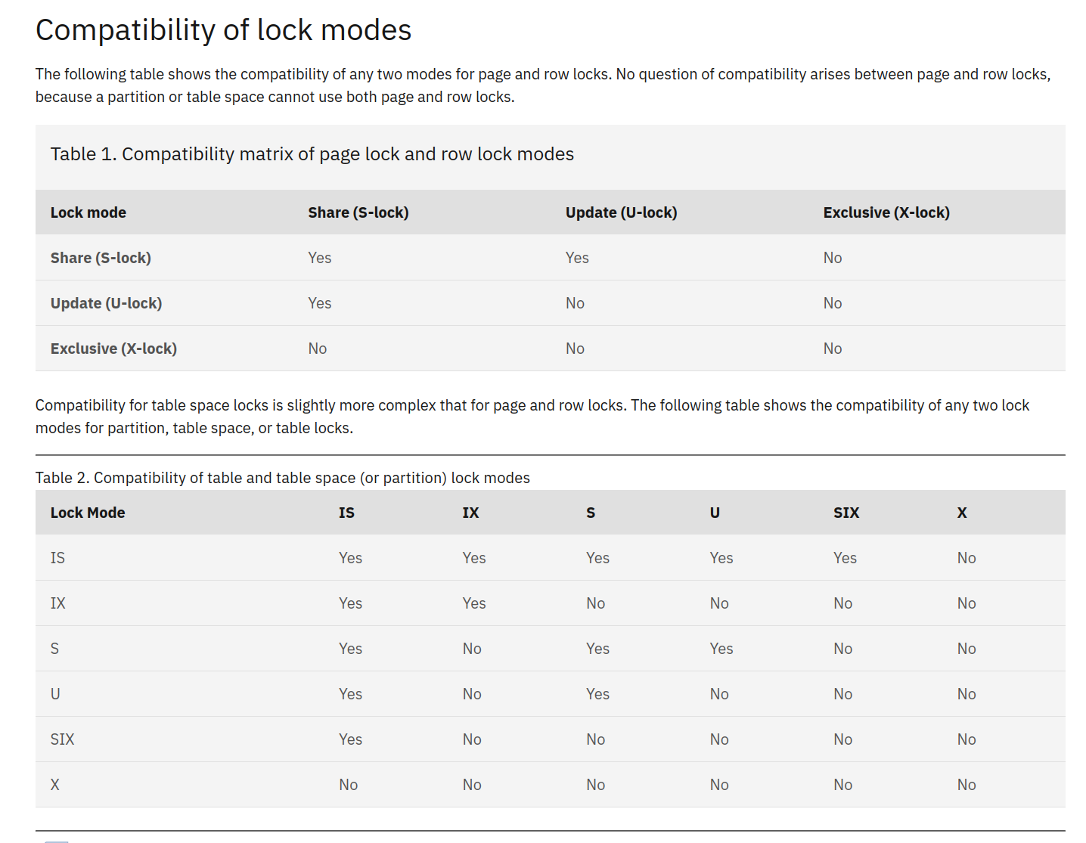
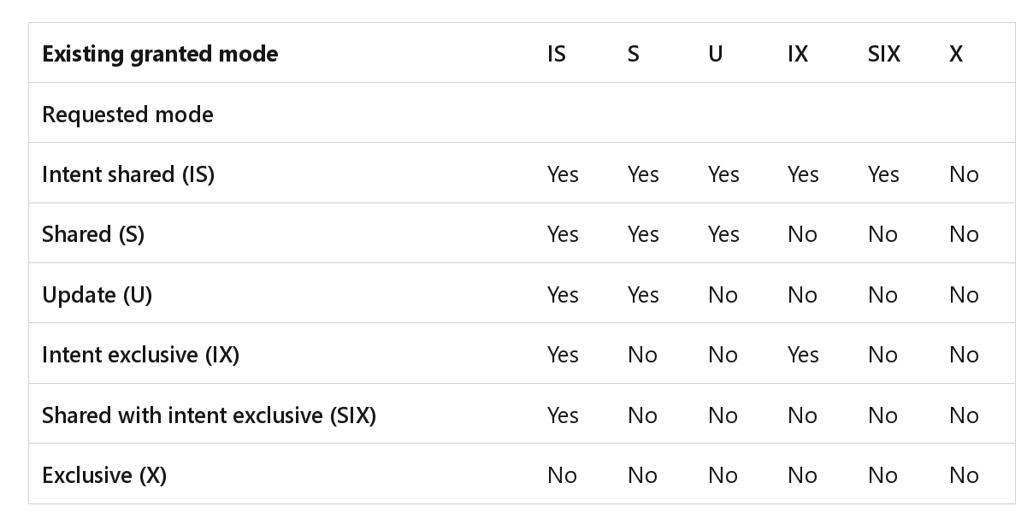
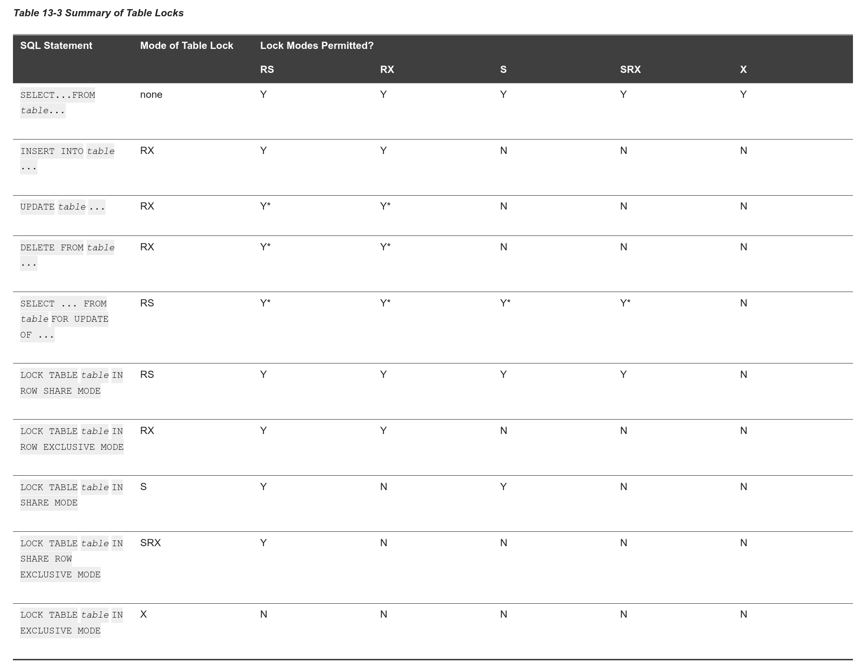



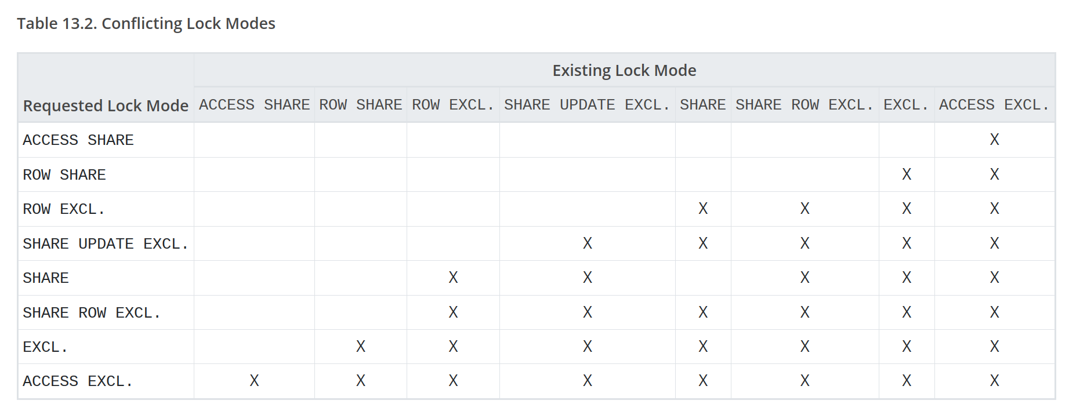
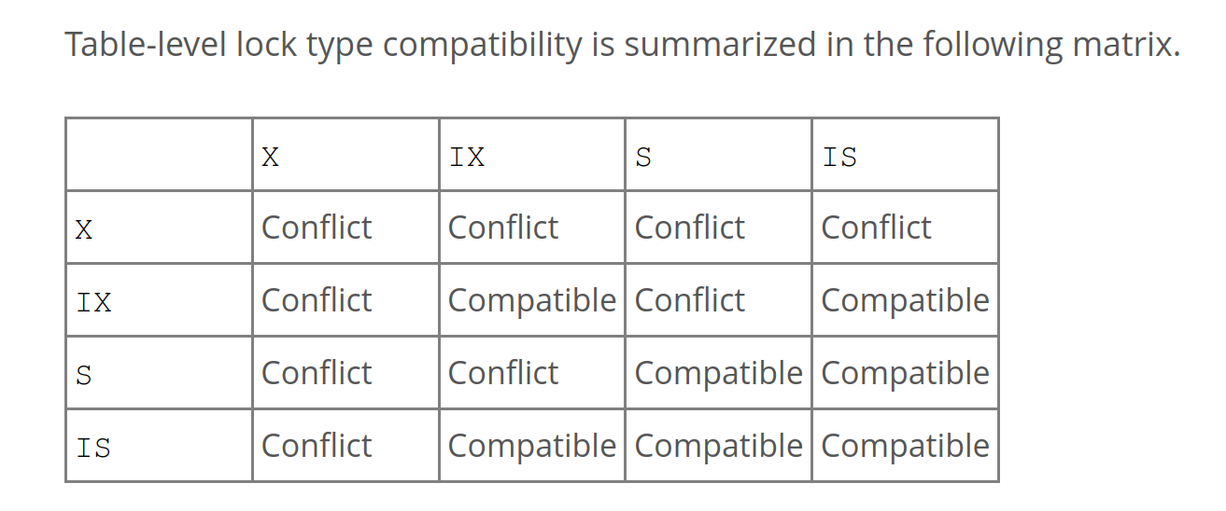


Basic Lock Types
S-LOCK: Shared locks for reads.
X-LOCK: Exclusive locks for writes.
Compatibility Matrix
 | Shared S-LOCK | Exclusive X-LOCK
Shared S-LOCK | ✔ | ×
Exclusive X-LOCK | × | ×

Slide 9
Executing With Locks
Transactions request locks (or upgrades).
Lock manager grants or blocks requests.
Transactions release locks.
Lock manager updates its internal lock-table.
It keeps track of what transactions hold what locks and what transactions are waiting to acquire any locks.

Slide 10

Executing With Locks
Schedule
Lock Manager
T₁
T₂
BEGIN
X-LOCK(A)
R(A)
W(A)
UNLOCK(A)
S-LOCK(A)
R(A)
UNLOCK(A)
COMMIT
BEGIN
X-LOCK(A)
W(A)
UNLOCK(A)
COMMIT
Granted (T₁→A)
TIME
Released (T₁→A)
Granted (T₂→A)
Released (T₂→A)
Granted (T₁→A)
Released (T₁→A)

Slide 11
Concurrency Control Protocol
Two-phase locking (2PL) is a concurrency control protocol that determines whether a txn can access an object in the database at runtime.
The protocol does not need to know all the queries that a txn will execute ahead of time.

Slide 12
Two-Phase Locking
Phase #1: Growing
Each txn requests the locks that it needs from the DBMS’s lock manager.
The lock manager grants/denies lock requests.
Phase #2: Shrinking
The txn is allowed to only release/downgrade locks that it previously acquired. It cannot acquire new locks.

Slide 13
Two-Phase Locking
The txn is not allowed to acquire/upgrade locks after the growing phase finishes.
Transaction Lifetime
Growing Phase
Shrinking Phase
TIME

Slide 14

Two-Phase Locking
The txn is not allowed to acquire/upgrade locks after the growing phase finishes.
Transaction Lifetime
2PL Violation!
Growing Phase
Shrinking Phase
TIME

Slide 15
Executing With 2PL
Schedule
Lock Manager
T₁
T₂
BEGIN
X-LOCK(A)
R(A)
W(A)
R(A)
UNLOCK(A)
COMMIT
BEGIN
X-LOCK(A)
W(A)
UNLOCK(A)
COMMIT
Granted (T₁→A)
TIME
Denied!
Released (T₁→A)
Granted (T₂→A)
Released (T₂→A)

Slide 16
Two-Phase Locking
2PL on its own is sufficient to guarantee conflict serializability because it generates schedules whose precedence graph is acyclic.
But it is subject to cascading aborts.

Slide 17
2PL: Cascading Aborts
Schedule
This is a permissible schedule in 2PL, but the DBMS has to also abort T₂ when T₁ aborts.
Any information about T₁ cannot be “leaked” to the outside world.
Any computation performed must be rolled back.
T₁
T₂
BEGIN
X-LOCK(A)
X-LOCK(B)
R(A)
W(A)
UNLOCK(A)
R(B)
W(B)
⋮
BEGIN
X-LOCK(A)
R(A)
W(A)
⋮
TIME
Wasted work!
ABORT

Slide 18
2PL Observations
There are potential schedules that are serializable but would not be allowed by 2PL because locking limits concurrency.
Most DBMSs prefer correctness before performance.
May still have “dirty reads”.
Solution: Strong Strict 2PL (aka Rigorous 2PL)
May lead to deadlocks.
Solution: Detection or Prevention

Slide 19
Strong Strict Two-Phase Locking
The txn is only allowed to release locks after it has ended (i.e., committed or aborted).
Allows only conflict serializable schedules, but it is often stronger than needed for some apps.
Release all locks at end of txn.
Growing Phase
Shrinking Phase
TIME

Slide 20
Strong Strict Two-Phase Locking
A schedule is strict if a value written by a txn is not read or overwritten by other txns until that txn finishes.
Advantages:
Does not incur cascading aborts.
Aborted txns can be undone by just restoring original values of modified tuples.

Slide 21
Examples
T₁ – Move $100 from Angela’s account (A) to Ben's account (B).
T₂ – Compute the total amount in all accounts and return it to the application.
T₁
T₂
BEGIN
A=A-100
B=B+100
COMMIT
BEGIN
ECHO A+B
COMMIT

Slide 22
Non-2PL Example
Schedule
Initial Database State
T₁
T₂
A=1000, B=1000
BEGIN
X-LOCK(A)
R(A)
A=A-100
W(A)
UNLOCK(A)
X-LOCK(B)
R(B)
B=B+100
W(B)
UNLOCK(B)
COMMIT
BEGIN
S-LOCK(A)
R(A)
UNLOCK(A)
S-LOCK(B)
R(B)
UNLOCK(B)
ECHO A+B
COMMIT
T₂ Output
TIME
A+B=1900

Slide 23
2PL Example
Schedule
Initial Database State
T₁
T₂
A=1000, B=1000
BEGIN
X-LOCK(A)
R(A)
A=A-100
W(A)
X-LOCK(B)
UNLOCK(A)
R(B)
B=B+100
W(B)
UNLOCK(B)
COMMIT
BEGIN
S-LOCK(A)
R(A)
S-LOCK(B)
R(B)
UNLOCK(A)
UNLOCK(B)
ECHO A+B
COMMIT
T₂ Output
TIME
A+B=2000

Slide 24
Strong Strict 2PL Example
Schedule
Initial Database State
T₁
T₂
A=1000, B=1000
BEGIN
X-LOCK(A)
R(A)
A=A-100
W(A)
X-LOCK(B)
R(B)
B=B+100
W(B)
UNLOCK(A)
UNLOCK(B)
COMMIT
BEGIN
S-LOCK(A)
R(A)
S-LOCK(B)
R(B)
ECHO A+B
UNLOCK(A)
UNLOCK(B)
COMMIT
T₂ Output
TIME
A+B=2000

Slide 25
Universe of Schedules
All Schedules
View Serializable
Conflict Serializable
No Cascading
Aborts
Strong Strict 2PL
Serial

Slide 26
2PL Observations
There are potential schedules that are serializable but would not be allowed by 2PL because locking limits concurrency.
Most DBMSs prefer correctness before performance.
May still have “dirty reads”.
Solution: Strong Strict 2PL (aka Rigorous 2PL)
May lead to deadlocks.
Solution: Detection or Prevention

Slide 27
It Just Got Real
Schedule
Lock Manager
T₁
T₂
BEGIN
X-LOCK(A)
R(A)
X-LOCK(B)
BEGIN
S-LOCK(B)
R(B)
S-LOCK(A)
Granted (T₁→A)
Granted (T₂→B)
TIME
Denied!
Denied!

Slide 28
2PL Deadlocks
A deadlock is a cycle of transactions waiting for locks to be released by each other.
Two ways of dealing with deadlocks:
Approach #1: Deadlock Detection
Approach #2: Deadlock Prevention

Slide 29
Deadlock Detection
The DBMS creates a waits-for graph to keep track of what locks each txn is waiting to acquire:
Nodes are transactions
Edge from T_{i} to T_{j} if T_{i} is waiting for T_{j} to release a lock.
The system periodically checks for cycles in waits-for graph and then decides how to break it.

Slide 30

Deadlock Detection
Schedule
Waits-For Graph
T₁
T₂
T₃
BEGIN
S-LOCK(A)
S-LOCK(B)
BEGIN
X-LOCK(B)
X-LOCK(C)
BEGIN
S-LOCK(C)
X-LOCK(A)
T₁
T₂
TIME
T₃

Slide 31
Deadlock Handling
When the DBMS detects a deadlock, it will select a “victim” txn to rollback to break the cycle.
The victim txn will either restart or abort (more common) depending on how it was invoked.
There is a trade-off between the frequency of checking for deadlocks and how long txns wait before deadlocks are broken.

Slide 32
Deadlock Handling: Victim Selection
Selecting the proper victim depends on a lot of different variables….
By age (lowest timestamp)
By progress (least/most queries executed)
By the # of items already locked
By the # of txns that we have to rollback with it
We also should consider the # of times a txn has been restarted in the past to prevent starvation.

Slide 33
Deadlock Handling: Rollback Length
After selecting a victim txn to abort, the DBMS can also decide on how far to rollback the txn's changes.
Approach #1: Completely
Rollback entire txn and tell the application it was aborted.
Approach #2: Partial (Savepoints)
DBMS rolls back a portion of a txn (to break deadlock) and then attempts to re-execute the undone queries.

Slide 34
Deadlock Prevention
When a txn tries to acquire a lock that is held by another txn, the DBMS kills one of them to prevent a deadlock.
This approach does not require a waits-for graph or detection algorithm.

Slide 35
Deadlock Prevention
Assign priorities based on timestamps:
Older Timestamp = Higher Priority
Wait-Die (“Old Waits for Young”)
If requesting txn has higher priority than holding txn, then requesting txn waits for holding txn.
Otherwise requesting txn aborts.
Wound-Wait (“Young Waits for Old”)
If requesting txn has higher priority than holding txn, then holding txn aborts and releases lock.
Otherwise requesting txn waits.

Slide 36
Deadlock Prevention
(T₁ older than T₂)
T₁
T₂
BEGIN
X-LOCK(A)
⋮
BEGIN
X-LOCK(A)
⋮
Wait-Die
Wound-Wait
T₁ waits
T₂ aborts
T₁
T₂
BEGIN
X-LOCK(A)
⋮
BEGIN
X-LOCK(A)
⋮
Wait-Die
Wound-Wait
T₂ aborts
T₂ waits

Slide 37
Deadlock Prevention
Why do these schemes guarantee no deadlocks?
Timestamps define a total ordering on transactions.
Waits-For Graph
Age Graph
T₁ older than T₂
T₁
T₂
T₁
T₂
T₃
T₃

Slide 38
Deadlock Prevention
Why do these schemes guarantee no deadlocks?
Timestamps define a total ordering on transactions.
In both schemes, arrows in "wait-for" only point in one direction
Waits-For Graph
Age Graph
Possible wait-die edges
T₁
T₂
T₁
T₂
T₃
T₃

Slide 39
Deadlock Prevention
Why do these schemes guarantee no deadlocks?
Timestamps define a total ordering on transactions.
In both schemes, arrows in "wait-for" only point in one direction
Waits-For Graph
Age Graph
Possible wound-wait edges
T₁
T₂
T₁
T₂
T₃
T₃

Slide 40
Deadlock Prevention
Why do these schemes guarantee no deadlocks?
Timestamps define a total ordering on transactions.
When a txn restarts, what is its (new) priority?
Its original timestamp to prevent it from getting starved for resources like an old man at a corrupt senior center.

Slide 41
Observation
All these examples have a one-to-one mapping from database objects to locks.
If a txn wants to update one billion tuples, then it must acquire one billion locks.
Acquiring locks is a more expensive operation than acquiring a latch even if that lock is available.

Slide 42
Lock Granularities
When a txn wants to acquire a “lock”, the DBMS can decide the granularity (i.e., scope) of that lock.
Attribute? Tuple? Page? Table?
The DBMS should ideally obtain fewest number of locks that a txn needs.
Trade-off between parallelism versus overhead.
Fewer Locks, Larger Granularity vs. More Locks, Smaller Granularity.

Slide 43
Database Lock Hierarchy
T₁
Database
Slightly Rare
Table 1
Table 2
Very Common
…
Page 1
Page 2
Page 3
Page n
Common
Tuple 1
Tuple 2
Tuple 3
…
Tuple n
Very Common
Attr 1
Attr 2
…
Attr n
Rare

Slide 44
Intention Locks
An intention lock allows a higher-level node to be locked in shared or exclusive mode without having to check all descendent nodes.
If a node is locked in an intention mode, then some txn is doing explicit locking at a lower level in the tree.

Slide 45
Intention Locks
Intention-Shared (IS)
Indicates explicit locking at lower level with S locks.
Intent to get S lock(s) at finer granularity.
Intention-Exclusive (IX)
Indicates explicit locking at lower level with X locks.
Intent to get X lock(s) at finer granularity.
Shared+Intention-Exclusive (SIX)
The subtree rooted by that node is locked explicitly in S mode and explicit locking is being done at a lower level with X locks.

Slide 46
Compatibility Matrix
T₂ Wants
 | IS | IX | S | SIX | X
IS | ✔ | ✔ | ✔ | ✔ | ×
IX | ✔ | ✔ | × | × | ×
S | ✔ | × | ✔ | × | ×
SIX | ✔ | × | × | × | ×
X | × | × | × | × | ×
T₁ Holds

Slide 47
Locking Protocol
Each txn obtains appropriate lock at highest level of the database hierarchy.
To get S or IS lock on a node, the txn must hold at least IS on parent node.
To get X, IX, or SIX on a node, must hold at least IX on parent node.

Slide 48
Example
T₁ – Get the balance of Angela’s bank account.
T₂ – Increase Ben's account balance by 1%.
What locks should these txns obtain?
Exclusive + Shared for leaf nodes of lock tree.
Special Intention locks for higher levels.

Slide 49
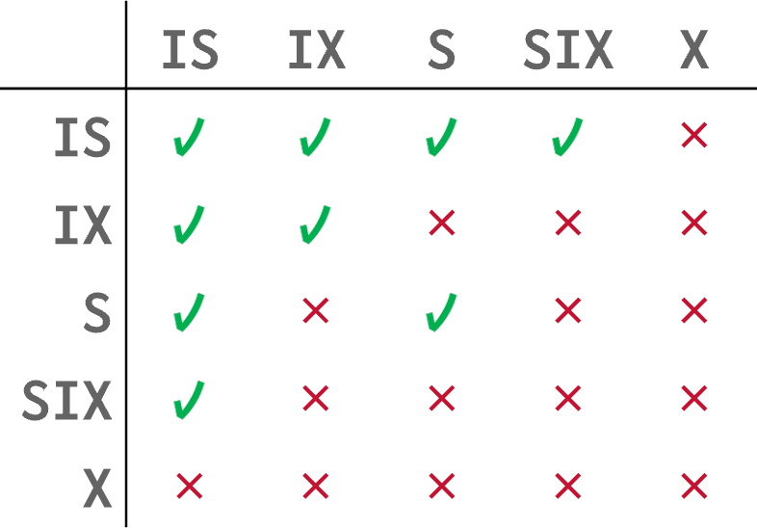
Example – Two-level Hierarchy
Read Angela’s record in R.
Update Ben's record in R.
T₁
T₂
T₁
IS
T₂
Table R
IX
T₁
T₂
S
X
…
Tuple 1
Tuple 2
Tuple n
Read
Write

Slide 50
Example – Three Txns
Assume three txns execute at same time:
T₁ – Scan all tuples in R and update one tuple.
T₂ – Read a single tuple in R.
T₃ – Scan all tuples in R.
Table R
…
Tuple 1
Tuple 2
Tuple n

Slide 51
Example – Three Txns
Scan all tuples in R.
Scan all tuples in R and update one tuple.
T₁
T₃
T₂
Read a single tuple in R.
S
T₁
T₃
SIX
S
T₂
Table R
IS
T₂
T₁
S
X
…
Tuple 1
Tuple 2
Tuple n
Read
Read
Read+Write
Read

Slide 52
Lock Escalation
The DBMS can automatically switch to coarser-grained locks when a txn acquires too many low-level locks.
This reduces the number of requests that the lock manager must process.

Slide 53
Locking In Practice
Applications typically do not acquire a txn's locks manually (i.e., explicit SQL commands).
Sometimes you need to provide the DBMS with hints to help it to improve concurrency.
Update a tuple after reading it.
Skip any tuple that is locked.
Explicit locks are also useful when doing major changes to the database.

Slide 54
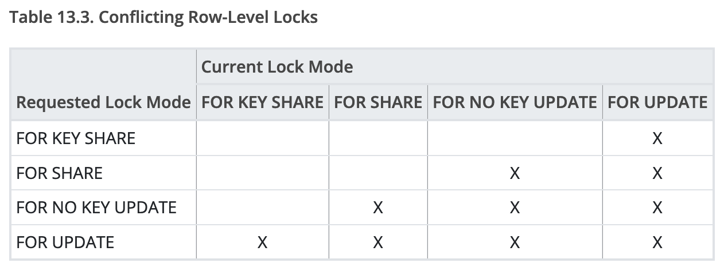
SELECT...FOR UPDATE
Perform a SELECT and then sets an exclusive lock on the matching tuples.
Can also set shared locks:
Postgres: FOR SHARE
MySQL: LOCK IN SHARE MODE
SELECT * FROM <table>
WHERE <qualification> FOR UPDATE;

Slide 55
SELECT...SKIP LOCKED
Perform a SELECT and automatically ignore any tuples that are already locked in an incompatible mode.
Useful for maintaining queues inside of a DBMS.
SELECT * FROM <table>
WHERE <qualification> SKIP LOCKED;

Slide 56
Conclusion
2PL is used in almost every DBMS.
Automatically generates correct interleaving:
Locks + protocol (2PL, SS2PL ...)
Deadlock detection + handling
Deadlock prevention
Many more things not discussed…
Nested Transactions
Savepoints

Slide 57
NEXT CLASS
Timestamp Ordering Concurrency Control
Isolation Levels

Slide 58
Project #3 – Query Execution
You will add support for optimizing and executing queries in BusTub.
BusTub supports (basic) SQL with a rule-based optimizer for converting AST into physical plans.

Slide 59
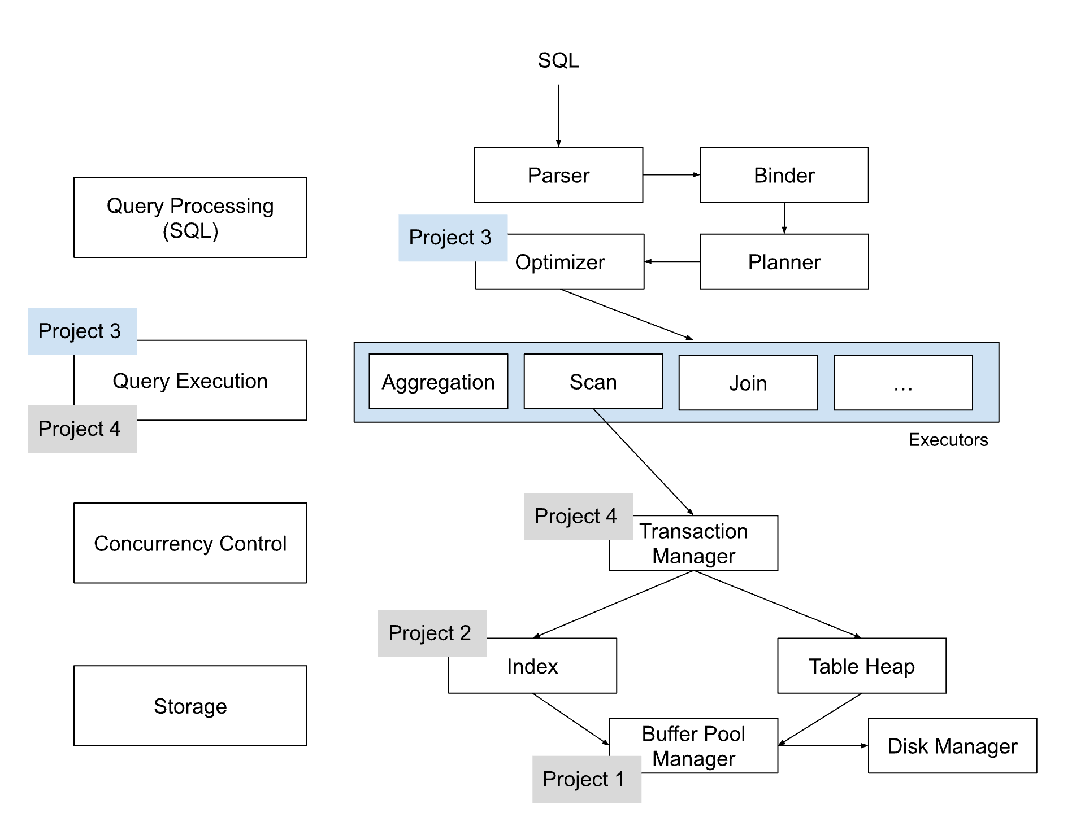
Project #3 – Query Execution

Slide 60
PROJECT #3 – TASKS
Plan Node Executors
Access Methods: Sequential Scan, Index Scan
Modifications: Insert, Delete, Update
Joins: Nested-Loop, Index Nested-Loop Hash Join
Miscellaneous: External Merge-Sort, Limit
Optimizer Rule:
Convert Nested Loops to Hash Join
Convert Sequential Scan to Index Scan

Slide 61
PROJECT #3 - LEADERBOARD
The leaderboard requires you to add additional rules to the optimizer to generate query plans.
It will be impossible to get a top ranking by just having the fastest implementations in Project #1 + Project #2.
Tasks:
Column Pruning
More Aggressive Predicate Pushdown
Bloom Filter for Hash Join

Slide 62
DEVELOPMENT HINTS
Implement the Insert and Sequential Scan executors first so that you can populate tables and read from it.
You do not need to worry about transactions.
The aggregation hash table does not need to be backed by your buffer pool (i.e., use STL)
Gradescope is for meant for grading, not debugging. Write your own local tests.

Slide 63
THINGS TO NOTE
Do not change any file other than the ones that you submit to Gradescope.
Make sure you pull in the latest changes from the BusTub main branch.
Come to TA office hours.
Compare against our solution in your browser!

Slide 64
CONFLICT SERIALIZABILITY INTUITION
I
Schedule
Serial Schedule
T₁
T₂
T₁
T₂
BEGIN
R(A)
W(A)
COMMIT
BEGIN
R(B)
W(B)
COMMIT
BEGIN
R(A)
W(A)
R(B)
W(B)
COMMIT
BEGIN
R(A)
W(A)
R(B)
W(B)
COMMIT
R(B)
R(A)
≡
TIME
R(B)
W(B)
W(A)
R(A)
R(B)
W(B)
W(A)
R(A)
W(B)
W(A)

Slide 65
CONFLICT SERIALIZABILITY INTUITION
I
Schedule
Serial Schedule
T₁
T₂
T₁
T₂
BEGIN
R(A)
W(A)
COMMIT
BEGIN
R(A)
W(A)
COMMIT
BEGIN
R(A)
W(A)
COMMIT
BEGIN
R(A)
W(A)
COMMIT
≢
TIME

Slide 66
SERIALIZABILITY
I
Swapping operations is easy when there are only two txns in the schedule. It’s cumbersome when there are many txns.
Are there faster algorithms to figure this out other than transposing operations?

