Slide 1
Lecture 18: Optimistic Concurrency Control

Slide 2
Last Class
We discussed concurrency control protocols for generating conflict serializable schedules without needing to know what queries a txn will execute.
The two-phase locking (2PL) protocol requires txns to acquire locks on database objects before they are allowed to access them.

Slide 3
Observation
3
If you assume that conflicts between txns are rare and that most txns are short-lived, then forcing txns to acquire locks adds unnecessary overhead.
A better concurrency control protocol could be one that is optimized for the no-conflict case…

Slide 4
Timestamp Ordering Concurrency Control
4
Use timestamps to determine the serializability order of txns.
If TS(T_{i}) < TS(T_{j}), then the DBMS must ensure that the execution schedule is equivalent to the serial schedule where T_{i} appears before T_{j}.
Each database object (e.g., tuple) will include additional fields to keep track of timestamp(s) of the txns that last accessed/modified them.

Slide 5
Timestamp Allocation
5
Each txn T_{i} is assigned a unique fixed timestamp that is monotonically increasing.
Let TS(T_{i}) be the timestamp allocated to txn T_{i}.
Different schemes assign timestamps at different times during the txn.
Multiple implementation strategies:
System/Wall Clock.
Logical Counter.
Hybrid.

Slide 6
Today’s Agenda
6
Optimistic Concurrency Control
Phantom Reads
Isolation Levels

Slide 7
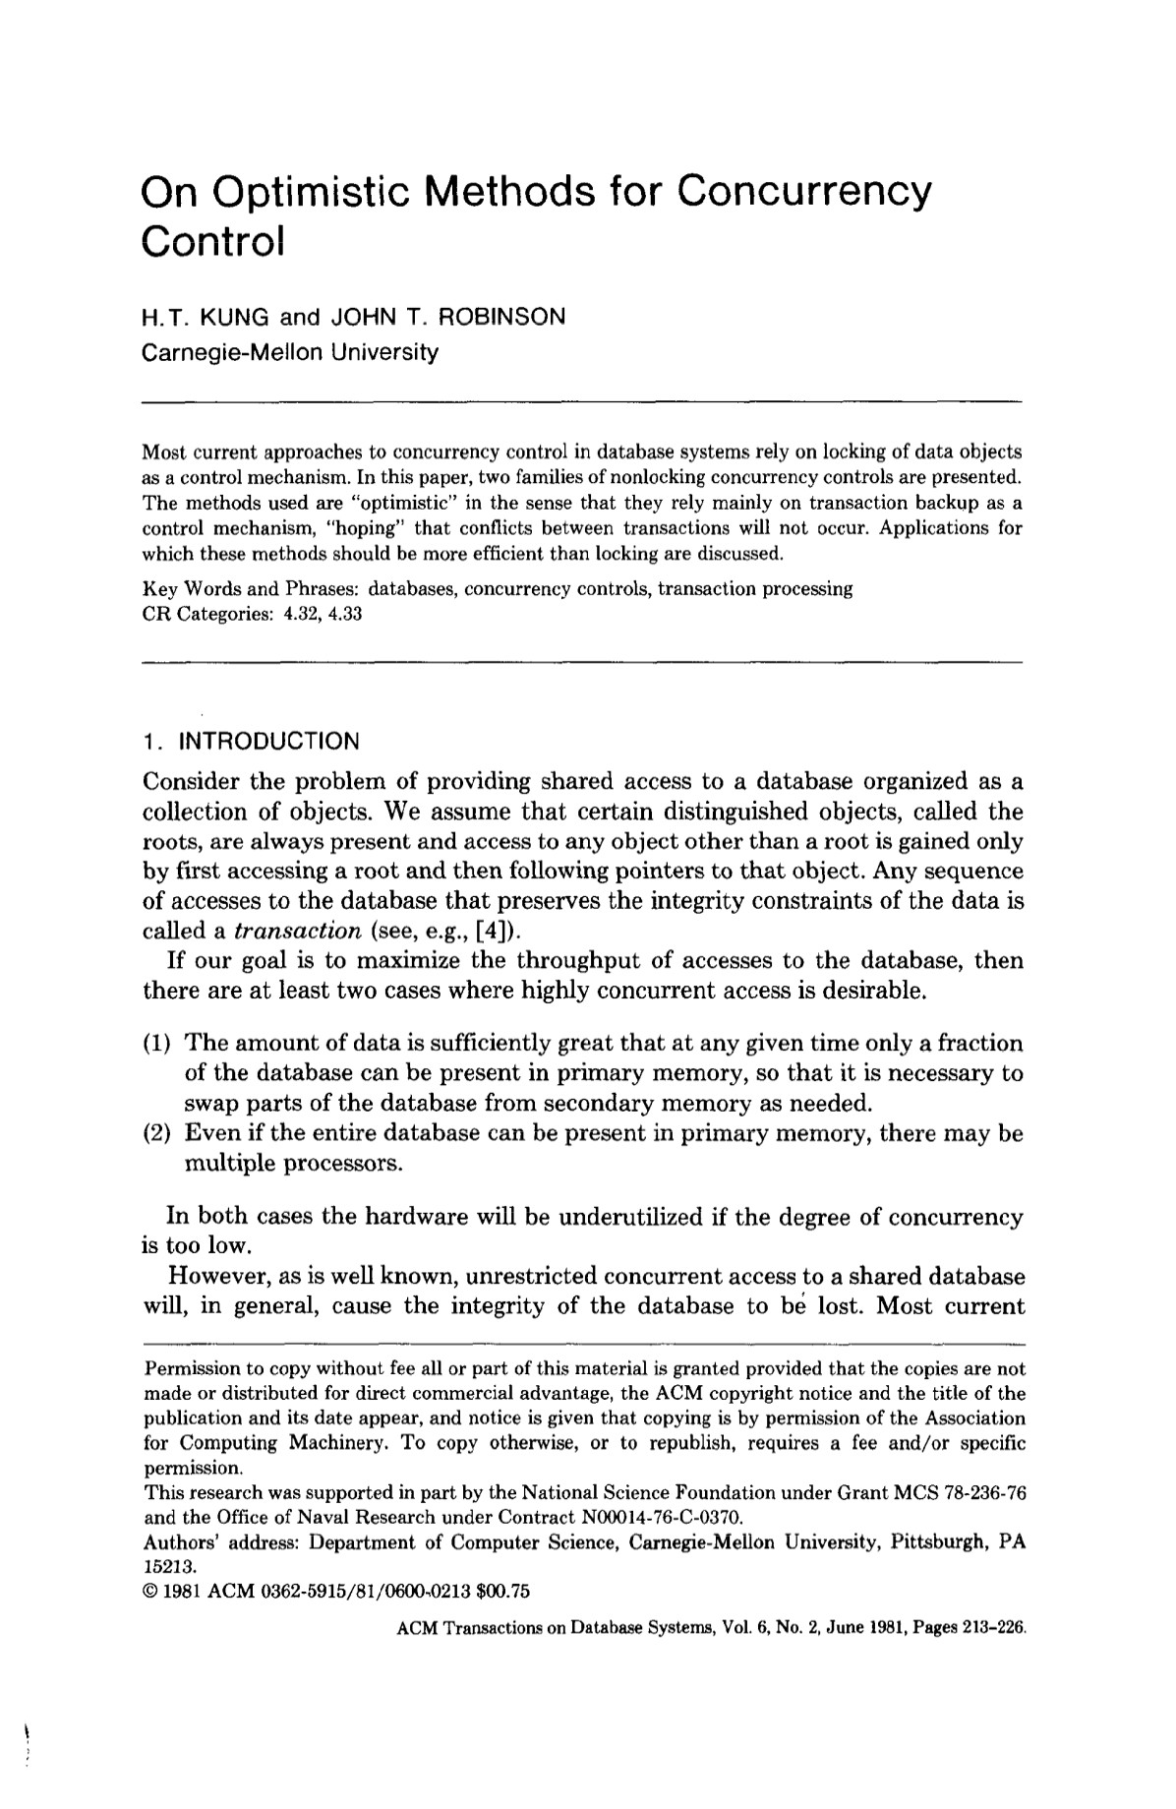
Optimistic Concurrency Control (OCC)
T/O protocol where DBMS creates a private workspace for each txn.
Any object read is copied into workspace.
Modifications are applied to workspace.
When a txn commits, the DBMS compares workspace write set to see whether it conflicts with other txns.
If there are no conflicts, the write set is installed into the “global” database.

Slide 8
OCC Phases
8
Phase #1 – Read
Track the read/write sets of txns and store their writes in a private workspace.
DBMS copies every tuple that the txn accesses from the shared database to its workspace ensure repeatable reads.
Phase #2 – Validation
Assign the txn a unique timestamp (TS) and then check whether it conflicts with other txns.
Phase #3 – Write
If validation succeeds, set the write timestamp (W-TS) to all modified objects in private workspace and install them atomically into the global database.
Otherwise abort txn.

Slide 9
OCC Example
9
Schedule
Database
T₁
T₂
BEGIN
READ
R(A)
W(A)
R(A)
VALIDATE
WRITE
COMMIT
BEGIN
READ
R(A)
VALIDATE
WRITE
COMMIT
Object | Value | W-TS
A | 123 | 0
- | - | -
456
2
TS(T₂)=1
TIME
T₁ Workspace
T₂ Workspace
Object | Value | W-TS
- | - | -
- | - | -
Object | Value | W-TS
- | - | -
- | - | -
TS(T₁)=2
2
A
456
∞
A
123
0
123
0
456
1

Slide 10
OCC: Read Phase
10
Track the read/write sets of txns and store their writes in a private workspace.
The DBMS copies every tuple that the txn accesses from the shared database to its workspace ensure repeatable reads.
We can ignore for now what happens if a txn reads/writes tuples via indexes.

Slide 11
OCC: Validation Phase
11
When txn T_{i} invokes COMMIT, the DBMS checks if it conflicts with other txns.
Original OCC algorithm uses serial validation.
Parallel validation requires each txn check read/write sets of other txns trying to validate at the same time.
DBMS needs to guarantee only serializable schedules are permitted.
Approach #1: Backward Validation
Approach #2: Forward Validation

Slide 12
OCC: Validation Phase
Forward Validation: Check whether the committing txn intersects its read/write sets with any active txns that have not yet committed.
Backward Validation: Check whether the committing txn intersects its read/write sets with those of any txns that have already committed.

Slide 13
OCC VALIDATION PHASE
13
Original OCC uses serial validation.
Parallel validation means that each txn must check the read/write sets of other txns that are trying to validate at the same time.
Each txn has to acquire locks for its write set records in some global order.
The txn does not need locks for read set records.

Slide 14
OCC: Forward Validation
14
Each txn's timestamp is assigned at the beginning of the validation phase.
Check the timestamp ordering of the committing txn with all other active txns.
If TS(T₁) < TS(T₂), then one of the following three conditions must hold…

Slide 15
OCC: Validation (T_{i} < T_{j}) Case #1
No conflict as all of T_{i}’s actions happen before T_{j}’s.
Need: T_{i} completes its write phase before T_{j} starts its read phase.
T_{i}
R
V
W
T_{j}
R
V
W
Time

Slide 16
OCC: Forward Validation Case #1
16
Schedule
If (T₁ < T₂), check if T₁ completes its Write phase before T₂ begins its Read phase.
No conflict as all T₁'s actions happen before T₂'s.
This just means that there is serial ordering.
T₁
T₂
BEGIN
READ
⋮
VALIDATE
WRITE
COMMIT
BEGIN
READ
⋮
VALIDATE
WRITE
COMMIT
TIME

Slide 17
OCC: VALIDATION (T_{i} < T_{j}) Case #2
AND Check that the write set of T_{i} does not intersect the read set of T_{j}, namely: WriteSet(T_{i}) ∩ ReadSet(T_{j}) = Ø
Need: T_{i} completes its write phase before T_{j} starts its write phase.
W(A)
T_{i}
R
V
W
T_{j}
R
V
W
R(A)
Time

Slide 18
OCC: Forward Validation Case #2
18
If (T₁ < T₂), check if T₁ completes its Write phase before T₂ starts its Write phase and T₁ does not modify to any object read by T₂.
WriteSet(T₁) ∩ ReadSet(T₂) = Ø

Slide 19
OCC: Forward Validation Case #2
19
Schedule
Database
T₁
T₂
BEGIN
READ
R(A)
W(A)
VALIDATE
BEGIN
READ
R(A)
VALIDATE
WRITE
COMMIT
Object | Value | W-TS
A | 123 | 0
- | - | -
TIME
T₁ Workspace
T₂ Workspace
Object | Value | W-TS
- | - | -
- | - | -
Object | Value | W-TS
- | - | -
- | - | -
456
1
∞
A
456
A
123
0
123
0
456
0
T₁ must abort even though T₂ did not modify the database.

Slide 20
OCC: Forward Validation Case #2
20
Schedule
Database
T₁
T₂
BEGIN
READ
R(A)
W(A)
VALIDATE
WRITE
BEGIN
READ
W(A)
VALIDATE
WRITE
COMMIT
Object | Value | W-TS
A | 123 | 0
- | - | -
456
1
TS(T₁)=1
TIME
T₁ Workspace
T₂ Workspace
Object | Value | W-TS
- | - | -
- | - | -
Object | Value | W-TS
- | - | -
- | - | -
456
1
∞
A
456
1
A
789
∞
123
0
456
0

Slide 21
OCC: Forward Validation Case #2
21
Schedule
Database
T₁
T₂
BEGIN
READ
R(A)
W(A)
VALIDATE
WRITE
COMMIT
BEGIN
READ
R(B)
R(A)
VALIDATE
WRITE
COMMIT
Object | Value | W-TS
A | 123 | 0
B | XYZ | 0
456
1
TS(T₁)=1
TIME
T₁ Workspace
T₂ Workspace
TS(T₂)=2
Object | Value | W-TS
- | - | -
- | - | -
Object | Value | W-TS
- | - | -
- | - | -
123
1
0
0
A
456
∞
B
XYZ
Safe to commit T₁ because T₂ sees the DB after T₁ has executed.
A
456
1

Slide 22
OCC: Forward Validation Case #2
22
If (T₁ < T₂), check if T₁ completes its Write phase before T₂ starts its Write phase and T₁ does not modify to any object read by T₂.
WriteSet(T₁) ∩ ReadSet(T₂) = Ø
Previous examples had to know write phase ordering at validation
Can enforce by making Validation+Write atomic (using locks)
Is this necessary?

Slide 23
OCC: VALIDATION (T_{i} < T_{j}) Case #3
Need: T_{i} completes its read phase before T_{j} completes its read phase.
AND Check that the write set of T_{i} does not intersect the read set of T_{j}, namely: WriteSet(T_{i}) ∩ ReadSet(T_{j}) = Ø
AND Check that the write set of T_{i} does not intersect the write set of T_{j}, namely: WriteSet(T_{i}) ∩ WriteSet(T_{j}) = Ø
W(A)
T_{i}
R
V
W
T_{j}
R
W
V
W(A)
Time

Slide 24
OCC: Forward Validation Case #3
24
If (T₁ < T₂), check if T₁ completes its Read phase before T₂ completes its Read phase and T₁ does not modify any object either read or written by T₂:
WriteSet(T₁) ∩ ReadSet(T₂) = Ø
WriteSet(T₁) ∩ WriteSet(T₂) = Ø

Slide 25
OCC: Forward Validation Case #3
25
Schedule
Database
T₁
T₂
BEGIN
READ
R(A)
W(A)
VALIDATE
WRITE
BEGIN
READ
W(A)
VALIDATE
WRITE
COMMIT
Object | Value | W-TS
A | 123 | 0
- | - | -
TIME
T₁ Workspace
T₂ Workspace
Object | Value | W-TS
- | - | -
- | - | -
Object | Value | W-TS
- | - | -
- | - | -
456
1
∞
A
456
A
123
0
123
0
456
0
If T₁ allows write phase overlap, T₂ might get clobbered. Abort.

Slide 26
OCC: Forward Validation Case #3
26
Schedule
Database
T₁
T₂
BEGIN
READ
R(A)
W(A)
R(B)
VALIDATE
WRITE
BEGIN
READ
W(B)
VALIDATE
WRITE
COMMIT
Object | Value | W-TS
A | 123 | 0
- | - | -
OK!
TIME
T₁ Workspace
T₂ Workspace
Object | Value | W-TS
- | - | -
- | - | -
Object | Value | W-TS
- | - | -
- | - | -
456
1
456
0

Slide 27
OCC: Forward Validation
27
Check whether the committing txn intersects its read/write sets with any active txns that have not yet committed.
Txn #1
COMMIT
Validation Scope
Txn #2
COMMIT
Txn #3
COMMIT
TIME

Slide 28
OCC: Backward Validation
28
Check whether the committing txn intersects its read/write sets with those of any txns that have already committed.
Validation Scope
Txn #1
COMMIT
Txn #2
COMMIT
Txn #3
COMMIT
TIME

Slide 29
OCC: Write Phase
29
Propagate changes in the txn’s write set to database to make them visible to other txns.
Serial Commits:
Use a global latch to limit a single txn to be in the Validation/Write phases at a time.
Parallel Commits:
Use fine-grained write latches to support parallel Validation/Write phases.
Txns acquire latches in a sequential key order to avoid deadlocks.

Slide 30
OCC: Observations
30
OCC works well when the # of conflicts is low:
All txns are read-only (ideal).
Txns access disjoint subsets of data.
But OCC has its own problems:
High overhead for copying data locally.
Validation/Write phase bottlenecks.
Aborts are more wasteful than in 2PL because they only occur after a txn has already executed.

Slide 31
Observation
31
We have only dealt with transactions that read and update existing objects in the database.
But now if txns perform insertions, updates, and deletions, we have new problems…

Slide 32

The Phantom Problem
32
Schedule
T₁
T₂
CREATE TABLE people (
id SERIAL,
name VARCHAR,
status VARCHAR
);
BEGIN
COMMIT
BEGIN
COMMIT
SELECT COUNT(*) AS cnt
FROM people
WHERE status='lit'
TIME
cnt=99
INSERT INTO people VALUES
(101,'Andy','lit');
SELECT COUNT(*) AS cnt
FROM people
WHERE status='lit'
cnt=100

Slide 33
Oops?
33
How did this happen?
Because T₁ locked only existing records and not ones that other txns are adding to the database!
Conflict serializability on reads and writes of individual items guarantees serializability only if the set of objects is fixed.
This is known as a phantom read.
A txn scans a range more than once and another txn inserts/removes tuples that fall within that range in between the scans.

Slide 34
Solutions To The Phantom Problem
34
Approach #1: Lock Everything!
Entire table or every page.
Approach #2: Re-Execute Scans
Run queries again at commit to see whether they produce a different result to identify missed changes.
Approach #3: Predicate Locking
Logically determine the overlap of predicates before queries start running.
Approach #4: Index Locking
Use keys in indexes to protect ranges.
Less Common
Rare
Very Rare
Common

Slide 35
Re-execute Scans
35
The DBMS tracks the WHERE clause for all queries that the txn executes.
Retain the scan set for every range query in a txn.
Upon commit, re-execute just the scan portion of each query and check whether it generates the same result.
Example: Run the scan for an UPDATE query but do not modify matching tuples.
If changed, abort.

Slide 36




Predicate Locking
36
Proposed locking scheme from System R.
Shared lock on the predicate in a WHERE clause of a SELECT query.
Exclusive lock on the predicate in a WHERE clause of any UPDATE, INSERT, or DELETE query.
This is difficult to implement efficiently. Some systems approximate it via precision locking.

Slide 37


Predicate Locking
37
SELECT COUNT(*) AS cnt
FROM people
WHERE status='lit'
INSERT INTO people VALUES
(101, 'Andy', 'lit')
Records in Table "people"
status='lit'
name='Andy' ∧
status='lit'

Slide 38
Index Locking Schemes
38
Key-Value Locks
Gap Locks
Key-Range Locks
Hierarchical Locking

Slide 39

Key-value Locks
39
Locks that cover a single key-value in an index.
Need “virtual keys” for non-existent values.
B+Tree Leaf Node
Key
[14, 14]
10
12
14
16

Slide 40
Gap Locks
40
Each txn acquires a key-value lock on the single key that it wants to access. Then get a gap lock on the next key gap.
B+Tree Leaf Node
10
12
14
16
{Gap}
{Gap}
{Gap}
Gap
(14, 16)

Slide 41
KEY-RANGE LOCKS
41
A txn takes locks on ranges in the key space.
Each range is from one key that appears in the relation, to the next that appears.
Define lock modes so conflict table will capture commutativity of the operations available.

Slide 42
Key-Range Locks
42
Locks that cover a key value and the gap to the next key value in a single index.
Need “virtual keys” for artificial values (infinity)
B+Tree Leaf Node
Next Key [14, 16)
10
12
14
16
{Gap}
{Gap}
{Gap}
Prior Key (12, 14]

Slide 43
Hierarchical Locking
43
Allow for a txn to hold wider key-range locks with different locking modes.
Reduces the number of visits to lock manager.
IX
B+Tree Leaf Node
X
X
IX
[12, 12]
[14, 16)
10
12
14
16
{Gap}
{Gap}
{Gap}
[10, 16)

Slide 44
Weaker Levels Of Isolation
44
Serializability is useful because it allows programmers to ignore concurrency issues.
But enforcing it may allow too little concurrency and limit performance.
We may want to use a weaker level of consistency to improve scalability.

Slide 45
Isolation Levels
45
Controls the extent that a txn is exposed to the actions of other concurrent txns.
Provides for greater concurrency at the cost of exposing txns to uncommitted changes:
Dirty Reads
Unrepeatable Reads
Lost Updates
Phantom Reads

Slide 46

Isolation Levels
46
SERIALIZABLE: No phantoms, all reads repeatable, no dirty reads.
REPEATABLE READS: Phantoms may happen.
READ COMMITTED: Phantoms, unrepeatable reads, and lost updates may happen.
READ UNCOMMITTED: All anomalies may happen.
Isolation (High→Low)

Slide 47
Isolation Levels
47
 | Dirty Read | Unrepeatable Read | Lost Updates | Phantom
SERIALIZABLE | No | No | No | No
REPEATABLE READ | No | No | No | Maybe
READ COMMITTED | No | Maybe | Maybe | Maybe
READ UNCOMMITTED | Maybe | Maybe | Maybe | Maybe

Slide 48
Isolation Levels
48
SERIALIZABLE: Strong Strict 2PL with phantom protection (e.g., index locks).
REPEATABLE READS: Same as above, but without phantom protection.
READ COMMITTED: Same as above, but S locks are released immediately. (No repeatable reads)
READ UNCOMMITTED: Same as above but allows dirty reads (no S locks).

Slide 49
SQL-92 Isolation Levels
49
The application can set a txn’s isolation level before it executes any queries in that txn.
Not all DBMS support all isolation levels in all execution scenarios
Replicated Environments
The default depends on implementation…
SET TRANSACTION ISOLATION LEVEL <isolation-level>;
BEGIN TRANSACTION ISOLATION LEVEL <isolation-level>;

Slide 50
Isolation Levels
50
 | Default | Maximum
Actian Ingres | SERIALIZABLE | SERIALIZABLE
IBM DB2 | CURSOR STABILITY | SERIALIZABLE
CockroachDB | SERIALIZABLE | SERIALIZABLE
Google Spanner | STRICT SERIALIZABLE | STRICT SERIALIZABLE
MSFT SQL Server | READ COMMITTED | SERIALIZABLE
MySQL | REPEATABLE READS | SERIALIZABLE
Oracle | READ COMMITTED | SNAPSHOT ISOLATION
PostgreSQL | READ COMMITTED | SERIALIZABLE
SAP HANA | READ COMMITTED | SERIALIZABLE
VoltDB | SERIALIZABLE | SERIALIZABLE
YugaByte | SNAPSHOT ISOLATION | SERIALIZABLE

Slide 51
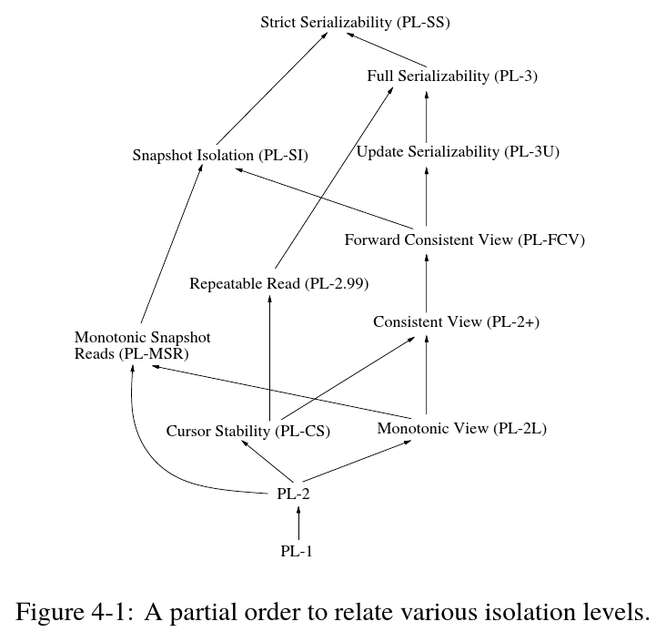
51
STRICT SERIALIZABLE
SERIALIZABLE
REPEATABLE READS
SNAPSHOT ISOLATION
CURSOR STABILITY
READ COMMITTED
READ UNCOMMITTED
Source: Atul Adya

Slide 52
Database Admin Survey
52
What isolation level do transactions execute at on this DBMS?
✔ Application Age
× Application Field
✔ DBMS Type

Slide 53
SQL-92 ACCESS MODES
53
The application can provide hints to the DBMS about whether a txn will modify the database during its lifetime.
Only two possible modes:
READ WRITE (Default)
READ ONLY
Not all DBMSs will optimize execution when a txn is in READ ONLY mode.
SET TRANSACTION <access-mode>;
BEGIN TRANSACTION <access-mode>;

Slide 54
Conclusion
54
Every concurrency control protocol can be broken down into the basic concepts that have been described in the last two lectures.
Pessimistic: Locking
Optimistic: Timestamps
There is no one protocol that is always better than all others…

Slide 55
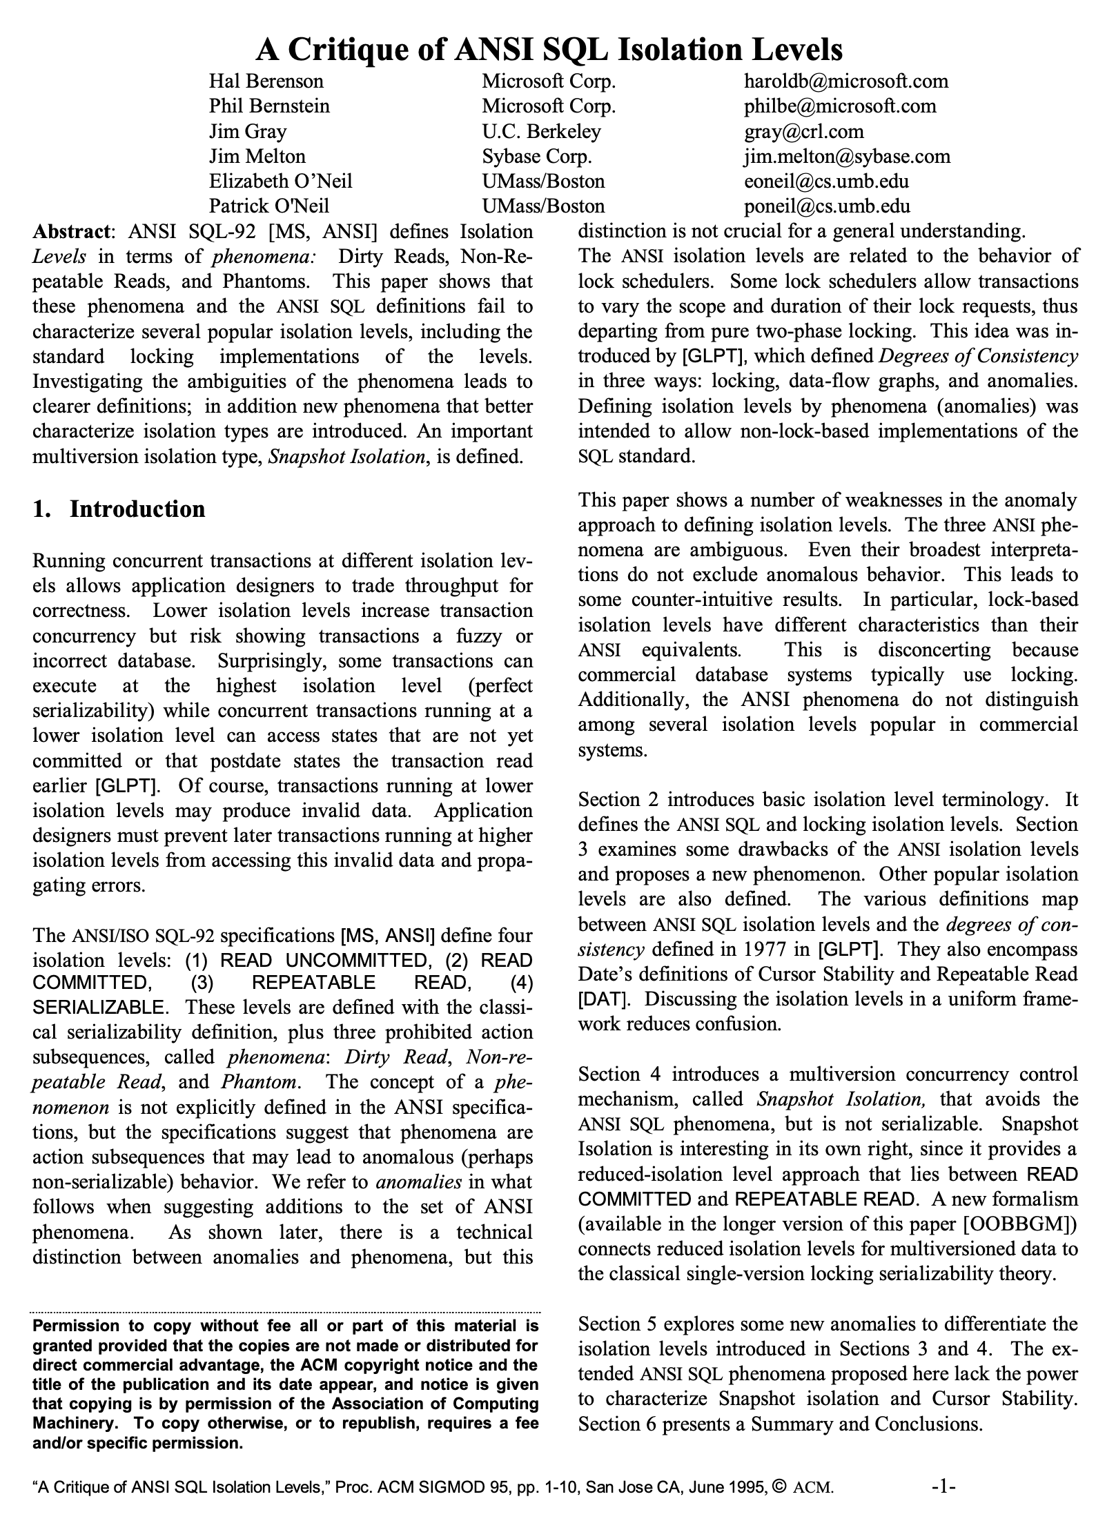
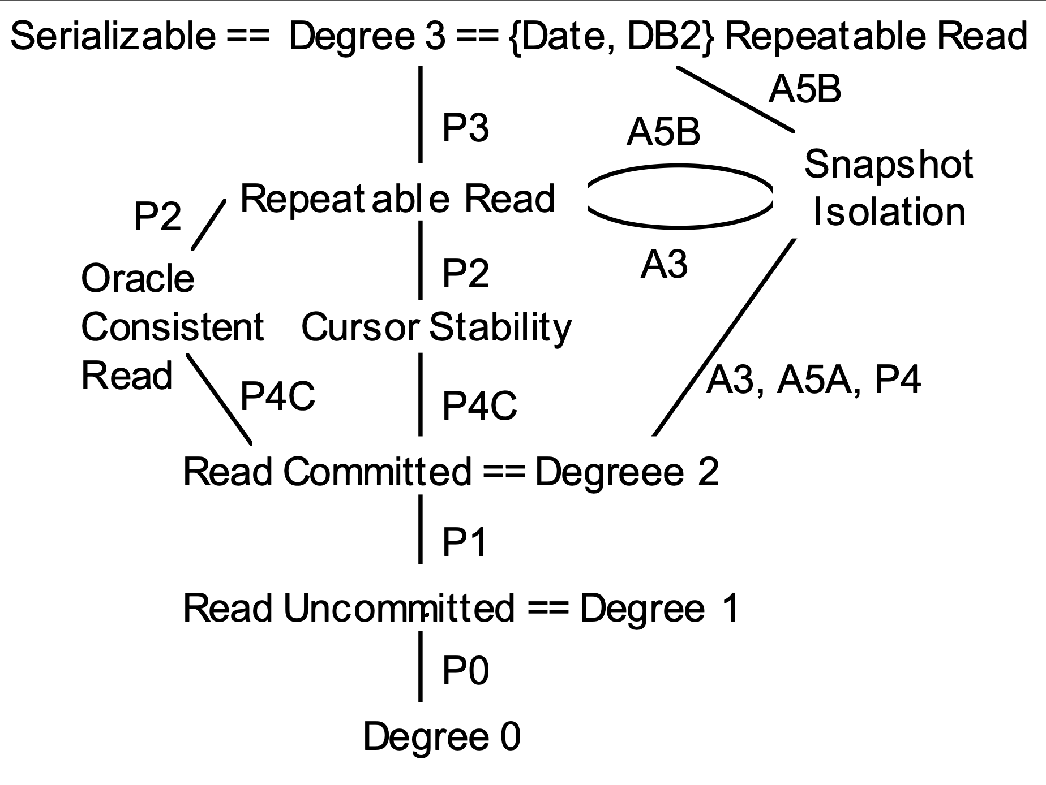
CRITIQUE OF SQL ISOLATION LEVELS
Bonus
“ANSI SQL-92 … defines Isolation Levels in terms of phenomena: Dirty Reads, Non-Repeatable Reads, and Phantoms. … these phenomena and the ANSI SQL definitions fail to characterize several popular isolation levels, including the standard locking implementations of the levels. Investigating the ambiguities of the phenomena leads to clearer definitions; in addition new phenomena that better characterize isolation types are introduced. An important multiversion isolation type, Snapshot Isolation, is defined.”

Slide 56
NEXT CLASS
56
Multi-Version Concurrency Control

Slide 57
OCC: Forward Validation Case #2
57
Schedule
Database
T₁
T₂
BEGIN
READ
R(A)
W(A)
VALIDATE
WRITE
COMMIT
BEGIN
READ
R(A)
VALIDATE
WRITE
COMMIT
Object | Value | W-TS
A | 123 | 0
- | - | -
Safe to commit because T₂ finishes before T₁
TIME
T₁ Workspace
T₂ Workspace
Object | Value | W-TS
- | - | -
- | - | -
Object | Value | W-TS
- | - | -
- | - | -
A
456
∞
123
0
456
0
A
123
0
Safe to commit T₁ because T₂ commits logically before T₁

Slide 58
OBSERVATION
58
Crabbing ensures that txns do not corrupt the internal data structure during modifications.
But because txns release latches on each node as soon as they are finished their operations, we cannot guarantee that phantoms do not occur…

Slide 59





PROBLEM SCENARIO #1
59
R
READ(25)
W
Txn #1:
20
A
INSERT(25)
R
Txn #2:
W
10
B
35
C
INSERT(25)
Txn #1:
R
W
6
D
12
E
23
25
F
38
44
G
!

Slide 60
PROBLEM SCENARIO #2
60
R
[12,23]
W
Txn #1:
20
A
INSERT(21)
R
W
Txn #2:
10
B
35
C
[12,23]
Txn #1:
R
R
W
6
D
12
E
23
F
38
44
G
21
23

Slide 61
INDEX LOCKS
61
Need a way to protect the index’s logical contents from other txns to avoid phantoms.
Difference with index latches:
Locks are held for the entire duration of a txn.
Only acquired at the leaf nodes.
Not physically stored in index data structure.
Can be used with any order-preserving index.

Slide 62
INDEX LOCKS
62
Lock Table
txn1
txn2
txn3
• • •
X
S
S
txn3
txn2
txn4
• • •
S
S
S
txn4
txn6
txn5
• • •
IX
X
S

Slide 63
INDEX LOCKING SCHEMES
63
Predicate Locks
Key-Value Locks
Gap Locks
Key-Range Locks
Hierarchical Locking

Slide 64
PREDICATE LOCKS
64
Proposed locking scheme from System R.
Shared lock on the predicate in a WHERE clause of a SELECT query.
Exclusive lock on the predicate in a WHERE clause of any UPDATE, INSERT, or DELETE query.
Never implemented in any system.

Slide 65
OBSERVATION
65
When a txn commits, all previous T/O schemes check to see whether there is a conflict with concurrent txns.
This requires latches.
If you have a lot of concurrent txns, then this is slow even if the conflict rate is low.

Slide 66
PARTITION-BASED T/O
66
Split the database up in disjoint subsets called horizontal partitions (aka shards).
Use timestamps to order txns for serial execution at each partition.
Only check for conflicts between txns that are running in the same partition.

Slide 67
DATABASE PARTITIONING
67
CREATE TABLE customer (
c_id INT PRIMARY KEY,
c_email VARCHAR UNIQUE,
⋮
);
CREATE TABLE orders (
o_id INT PRIMARY KEY,
o_c_id INT REFERENCES ⮱customer (c_id),
⋮
);
CREATE TABLE oitems (
oi_id INT PRIMARY KEY,
oi_o_id INT REFERENCES ⮱orders (o_id),
oi_c_id INT REFERENCES ⮱orders (o_c_id),
⋮
);

Slide 68


HORIZONTAL PARTITIONING
68
Partitions
Get C_ID=1
CUSTOMERS
BEGIN
COMMIT
Customers
1-1000
ORDERS
OITEMS
Application
Server
CUSTOMERS
Customers
1001-2000
ORDERS
OITEMS

Slide 69




PARTITION-BASED T/O
69
Txns are assigned timestamps based on when they arrive at the DBMS.
Partitions are protected by a single lock:
Each txn is queued at the partitions it needs.
The txn acquires a partition’s lock if it has the lowest timestamp in that partition’s queue.
The txn starts when it has all of the locks for all the partitions that it will read/write.

Slide 70
PARTITION-BASED T/O – READS
70
Txns can read anything that they want at the partitions that they have locked.
If a txn tries to access a partition that it does not have the lock, it is aborted + restarted.

Slide 71
PARTITION-BASED T/O – WRITES
71
All updates occur in place.
Maintain a separate in-memory buffer to undo changes if the txn aborts.
If a txn tries to write to a partition that it does not have the lock, it is aborted + restarted.

Slide 72
PARTITION-BASED T/O
72
Partitions
Txn Queue
Get C_ID=1
BEGIN
COMMIT
Txn #100
Txn #101
Server1: 100
Server2: 101
CUSTOMERS
Server2: 101
Customers
1-1000
ORDERS
Server #1
BEGIN
OITEMS
CUSTOMERS
Customers
1001-2000
Server #2
ORDERS
OITEMS

Slide 73
PARTITIONED T/O – PERFORMANCE ISSUES
73
Partition-based T/O protocol is fast if:
The DBMS knows what partitions the txn needs before it starts.
Most (if not all) txns only need to access a single partition.
Multi-partition txns causes partitions to be idle while txn executes.

Slide 74
OCC – SERIAL VALIDATION/WRITE
74
Maintain global view of all active txns.
Record read set and write set while txns are running and write into private workspace.
Execute Validation and Write phase inside a protected critical section.

Slide 75
BASIC T/O
75
Txns read and write objects without locks.
Every object X is tagged with timestamp of the last txn that successfully did read/write:
W-TS(X) – Write timestamp on X
R-TS(X) – Read timestamp on X
Check timestamps for every operation:
If txn tries to access an object “from the future”, it aborts and restarts.

Slide 76
BASIC T/O – READS
76
Don’t read stuff from the “future.”
Action: Transaction T_{i} wants to read object X.
If TS(T_{i}) < W-TS(X), this violates the timestamp order of T_{i} with regard to the writer of X.
Abort T_{i} and restart it with a new TS.
Else:
Allow T_{i} to read X.
Update R-TS(X) to max(R-TS(X), TS(T_{i}))
Make a local copy of X to ensure repeatable reads for T_{i}.

Slide 77
BASIC T/O – WRITES
77
Can’t write if a future transaction has read or written to the object.
Action: Transaction T_{i} wants to write object X.
If TS(T_{i}) < R-TS(X) or TS(T_{i}) < W-TS(X)
Abort and restart T_{i}.
Else:
Allow T_{i} to write X and update W-TS(X)
Also, make a local copy of X to ensure repeatable reads.

Slide 78
BASIC T/O – EXAMPLE #1
78
Schedule
Database
TS(T₁)=1
TS(T₁) < TS(T₂)
T₁
T₂
Object | R-TS | W-TS
A | 0 | 0
B | 0 | 0
BEGIN
R(B)
R(A)
R(A)
COMMIT
BEGIN
R(B)
W(B)
R(A)
W(A)
COMMIT
TS(T₂)=2
1
2
2
1
2
2
TIME
No violations so both txns are safe to commit.

Slide 79
BASIC T/O – EXAMPLE #2
79
Schedule
Database
T₁
T₂
Object | R-TS | W-TS
A | 0 | 0
B | 0 | 0
BEGIN
R(A)
W(A)
R(A)
COMMIT
BEGIN
W(A)
COMMIT
1
2
Violation:
TS(T₁) < W-TS(A)
TIME
T₁ cannot overwrite update by T₂, so the DBMS must abort it!

Slide 80
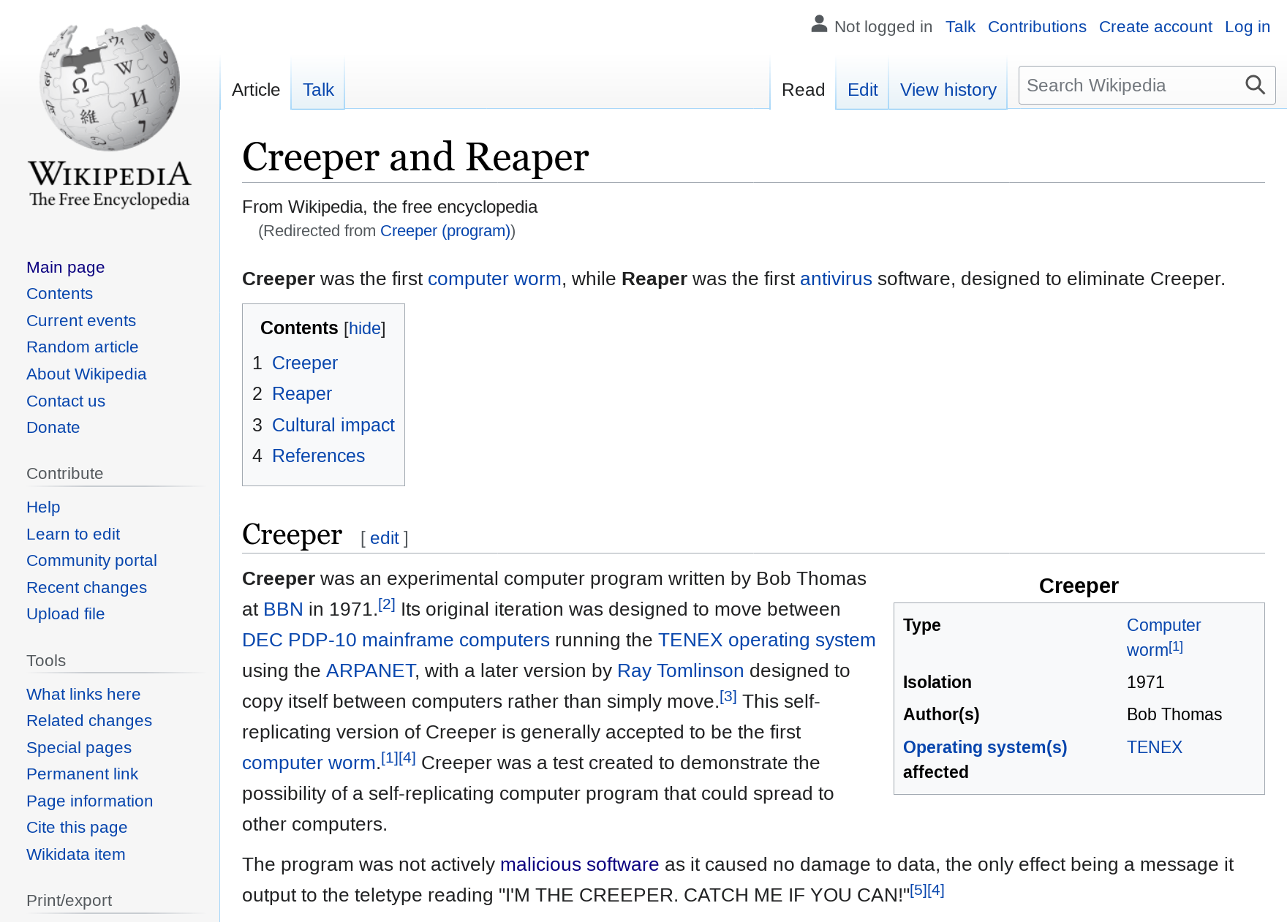
THOMAS WRITE RULE
80
If TS(T_{i}) < R-TS(X):
Abort and restart T_{i}.
If TS(T_{i}) < W-TS(X):
Thomas Write Rule: Ignore the write to allow the txn to continue executing without aborting.
This violates timestamp order of T_{i}.
Else:
Allow T_{i} to write X and update W-TS(X)

Slide 81
BASIC T/O – EXAMPLE #2
81
Schedule
Database
T₁
T₂
Object | R-TS | W-TS
A | 0 | 0
B | 0 | 0
BEGIN
R(A)
W(A)
R(A)
COMMIT
BEGIN
W(A)
COMMIT
1
2
We do not update W-TS(A)
TIME
Skip doing the actual write and allow T₁ to commit. (Do write to the local copy if repeatable read is required.)

Slide 82
BASIC T/O
82
Generates a schedule that is conflict serializable if you do not use the Thomas Write Rule.
No deadlocks because no txn ever waits.
Possibility of starvation for long txns if short txns keep causing conflicts.
Not aware of any DBMS that uses the basic T/O protocol described here.
It provides the building blocks for OCC / MVCC.

Slide 83
RECOVERABLE SCHEDULES
83
A schedule is recoverable if txns commit only after all txns whose changes they read, commit.
Otherwise, the DBMS cannot guarantee that txns read data that will be restored after recovering from a crash.

Slide 84
RECOVERABLE SCHEDULES
84
Schedule
T₁
T₂
BEGIN
W(A)
⋮
BEGIN
R(A)
W(B)
COMMIT
T₂ can read the writes of T₁.
TIME
This is not recoverable because we cannot restart T₁.
ABORT
T₁ aborts after T₂ has committed.

Slide 85
BASIC T/O – PERFORMANCE ISSUES
85
High overhead from copying data to txn’s workspace and from updating timestamps.
Every read requires the txn to write to the database.
Long running txns can get starved.
The likelihood that a txn will read something from a newer txn increases.

