Slide 1
L19: Multi-Version Concurrency Control

Slide 2
Multi-Version Concurrency Control
The DBMS maintains multiple physical versions of a single logical object in the database:
When a txn writes to an object, the DBMS creates a new version of that object.
When a txn reads an object, it reads the newest version that existed when the txn started.

Slide 3




MVCC History
Protocol was first proposed in 1978 MIT PhD dissertation.
First implementations was Rdb/VMS and InterBase at DEC in early 1980s.
Both were by Jim Starkey, co-founder of NuoDB.
DEC Rdb/VMS is now “Oracle Rdb”.
InterBase was open-sourced as Firebird.

Slide 4
Multi-Version Concurrency Control
Writers do not block readers. Readers do not block writers.
Read-only txns can read a consistent snapshot without acquiring locks.
Use timestamps to determine visibility.
MVCC naturally supports Snapshot Isolation (SI).
Easily support time-travel queries.

Slide 5
MVCC – Example #1
5
TS(T₁)=1
Schedule
TS(T₂)=2
Database
T₁
T₂
Version | Value | Begin | End
A₀ | 123 | 0 | -
BEGIN
R(A)
R(A)
COMMIT
BEGIN
W(A)
COMMIT
2
A₁
456
2
-
TIME
T₁ reads version A₀.
T₂ creates version A₁ and sets A₀ End-TS.

Slide 6

MVCC – Example #2
6
TS(T₁)=1
Schedule
TS(T₂)=2
Database
T₁
T₂
Version | Value | Begin | End
A₀ | 123 | 0
BEGIN
R(A)
W(A)
R(A)
COMMIT
BEGIN
R(A)
W(A)
COMMIT
1
A₁
456
1
2
-
A₂
789
2
-
TIME
Txn Status Table
T₂ reads version A₀ because T₁ has not committed yet.
T₂ must stall until T₁ commits, then restart.
TxnId | Timestamp | Status
T₁ | 1 | Active
T₁ reads version A₁ that it wrote earlier.
1
Committed
T₁
Now T₂ can create the new version.
2
Active
T₂

Slide 7
Snapshot Isolation (SI)
When a txn starts, it sees a consistent snapshot of the database that existed when that the txn started.
No torn writes from active txns.
If two txns update the same object, then first writer wins.
SI is susceptible to the Write Skew Anomaly.

Slide 8
Write Skew Anomaly
8
Txn #1 Change white marbles to black.
Txn #1 Change white marbles to black.
Txn #2 Change black marbles to white.
Txn #2 Change black marbles to white.

Slide 9






































Multi-Version Concurrency Control
MVCC is more than just a concurrency control protocol. It completely affects how the DBMS manages transactions and the database.

Slide 10
MVCC Design Decisions
Concurrency Control Protocol
Version Storage
Garbage Collection
Index Management
Deletes

Slide 11
Concurrency Control Protocol
Approach #1: Timestamp Ordering
Assign txns timestamps that determine serial order.
Gives Snapshot Isolation
Approach #2: Optimistic Concurrency Control
Three-phase protocol from last class.
Use private workspace for new versions.
Approach #3: Two-Phase Locking
Txns acquire appropriate lock on physical version before they can read/write a logical tuple.

Slide 12
Version Storage
The DBMS uses the tuples’ pointer field to create a version chain per logical tuple.
This allows the DBMS to find the version that is visible to a particular txn at runtime.
Indexes always point to the “head” of the chain.
Different storage schemes determine where/what to store for each version.

Slide 13
Version Storage
Approach #1: Append-Only Storage
New versions are appended to the same table space.
Approach #2: Time-Travel Storage
Old versions are copied to separate table space.
Approach #3: Delta Storage
The original values of the modified attributes are copied into a separate delta record space.

Slide 14
Append-Only Storage
14
All the physical versions of a logical tuple are stored in the same table space. The versions are inter-mixed.
On every update, append a new version of the tuple into an empty space in the table.
Main Table
TUPLE
POINTER
A₀
$111
A₁
$222
Ø
B₁
$10
Ø
A₂
$333
Ø

Slide 15
Version Chain Ordering
Approach #1: Oldest-to-Newest (O2N)
Append new version to end of the chain.
Must traverse chain on look-ups.
Approach #2: Newest-to-Oldest (N2O)
Must update index pointers for every new version.
Do not have to traverse chain on look-ups.

Slide 16
Time-Travel Storage
16
Main Table
Time-Travel Table
TUPLE
POINTER
TUPLE
POINTER
A₂
$222
A₁
$111
Ø
A₃
$333
B₁
$10
A₂
$222
Overwrite primary version in the main table and update pointers.
On every update, copy the current version to the time-travel table. Update pointers.

Slide 17
Delta Storage
17
Main Table
Delta Storage Segment
VALUE
ID
POINTER
DELTA
POINTER
A₁
$111
A₁
(VALUE→$111)
Ø
$222
A₂
$333
A₃
B₁
$10
A₂
(VALUE→$222)
On every update, copy only the column values that were modified to the delta storage and overwrite the primary version.
Txns can recreate old versions by applying the delta in reverse order.

Slide 18
Garbage Collection
The DBMS needs to remove reclaimable physical versions from the database over time.
No active txn in the DBMS can “see” that version (SI).
The version was created by an aborted txn.
Two additional design decisions:
How to look for expired versions?
How to decide when it is safe to reclaim memory?

Slide 19
Garbage Collection
Approach #1: Tuple-level
Find old versions by examining tuples directly.
Background Vacuuming vs. Cooperative Cleaning
Approach #2: Transaction-level
Txns keep track of their old versions so the DBMS does not have to scan tuples to determine visibility.

Slide 20



Tuple-Level GC
20
Txn #1
Vacuum
BEGIN-TS
END-TS
T_{id}=12
GET(A)
A₀
A₁
A₂
A₃
INDEX
A₁₀₀
1
9
Dirty Block BitMap
Txn #2
B₁₀₀
1
9
B₀
B₁
B₂
B₃
T_{id}=25
B₁₀₁
10
20
Background Vacuuming: Separate thread(s) periodically scan the table and look for reclaimable versions. Works with any storage.
Cooperative Cleaning: Worker threads identify reclaimable versions as they traverse version chain. Only works with O2N.

Slide 21
Transaction-Level GC
Each txn keeps track of its read/write set.
On commit/abort, the txn provides this information to a centralized vacuum worker.
The DBMS periodically determines when all versions created by a finished txn are no longer visible.

Slide 22

Transaction-Level GC
22
Txn #1
UPDATE(A)
BEGIN-TS
END-TS
DATA
BEGIN @ 10
A₂
1
∞
-
10
COMMIT @ 15
10
UPDATE(B)
B₆
8
∞
-
10
10
Old Versions
A₃
10
∞
-
A₂
10
B₇
10
∞
-
10
B₆
Vacuum
TS<10

Slide 23
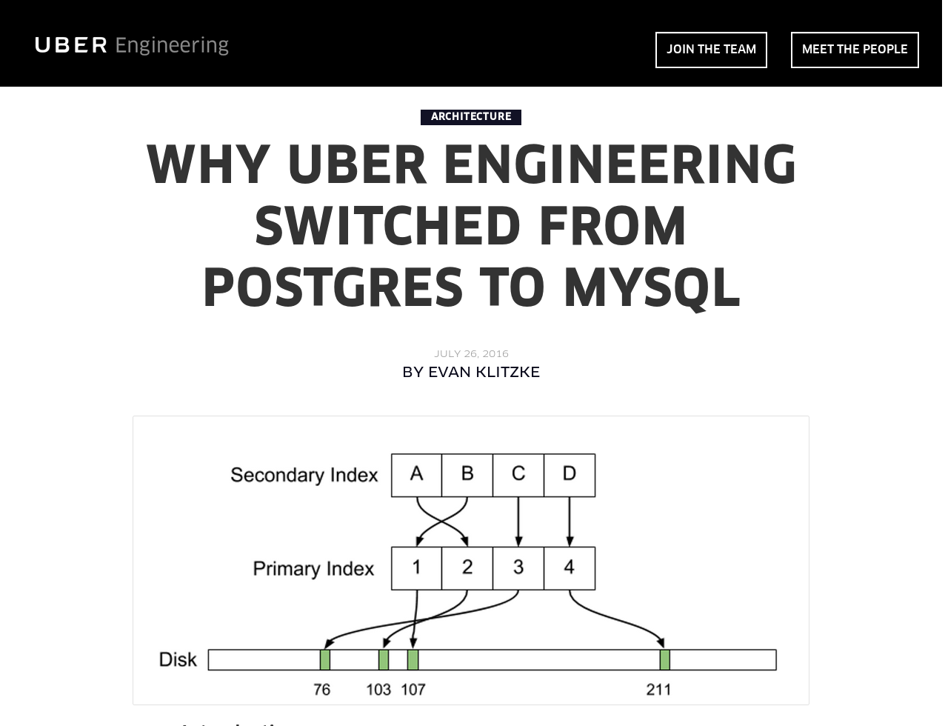
Index Management
Primary key indexes point to version chain head.
How often the DBMS must update the pkey index depends on whether the system creates new versions when a tuple is updated.
If a txn updates a tuple’s pkey attribute(s), then this is treated as a DELETE followed by an INSERT.
Secondary indexes are more complicated…

Slide 24
Secondary Indexes
Approach #1: Logical Pointers
Use a fixed identifier per tuple that does not change.
Requires an extra indirection layer.
Primary Key vs. Tuple Id
Approach #2: Physical Pointers
Use the physical address to the version chain head.

Slide 25
Index Pointers
25
GET(A)
GET(A)
PRIMARY INDEX
SECONDARY INDEX
SECONDARY INDEX
Primary Key
Record Id
SECONDARY INDEX
Record Id
SECONDARY INDEX
A₄
A₃
A₂
A₁
Append-Only
Newest-to-Oldest

Slide 26
MVCC Indexes
MVCC DBMS indexes (usually) do not store version information about tuples with their keys.
Exception: Index-organized tables (e.g., MySQL)
Every index must support duplicate keys from different snapshots:
The same key may point to different logical tuples in different snapshots.

Slide 27



MVCC Duplicate Key Problem
27
Txn #1
Index
READ(A)
READ(A)
BEGIN @ 10
Txn #2
UPDATE(A)
DELETE(A)
BEGIN @ 20
COMMIT @ 25
BEGIN-TS
END-TS
POINTER
A₁
1
∞
Ø
20
Txn #3
20
INSERT(A)
A₂
20
∞
Ø
BEGIN @ 30
20
20
A₃
30
∞
Ø

Slide 28
MVCC Indexes
Each index’s underlying data structure must support the storage of non-unique keys.
Use additional execution logic to perform conditional inserts for pkey / unique indexes.
Atomically check whether the key exists and then insert.
Workers may get back multiple entries for a single fetch. They then must follow the pointers to find the proper physical version.

Slide 29
MVCC Deletes
The DBMS physically deletes a tuple from the database only when all versions of a logically deleted tuple are not visible.
If a tuple is deleted, then there cannot be a new version of that tuple after the newest version.
No write-write conflicts / first-writer wins
We need a way to denote that tuple has been logically delete at some point in time.

Slide 30
MVCC Deletes
Approach #1: Deleted Flag
Maintain a flag to indicate that the logical tuple has been deleted after the newest physical version.
Can either be in tuple header or a separate column.
Approach #2: Tombstone Tuple
Create an empty physical version to indicate that a logical tuple is deleted.
Use a separate pool for tombstone tuples with only a special bit pattern in version chain pointer to reduce the storage overhead.

Slide 31
MVCC Implementations
31
 | Protocol | Version Storage | Garbage Collection | Indexes
Oracle | MV2PL | Delta | Vacuum | Logical
Postgres | MV-2PL/MV-TO | Append-Only | Vacuum | Physical
MySQL-InnoDB | MV-2PL | Delta | Vacuum | Logical
HYRISE | MV-OCC | Append-Only | – | Physical
Hekaton | MV-OCC | Append-Only | Cooperative | Physical
MemSQL (2015) | MV-OCC | Append-Only | Vacuum | Physical
SAP HANA | MV-2PL | Time-travel | Hybrid | Logical
NuoDB | MV-2PL | Append-Only | Vacuum | Logical
HyPer | MV-OCC | Delta | Txn-level | Logical
CockroachDB | MV-2PL | Delta (LSM) | Compaction | Logical

Slide 32
CONCLUSION
MVCC is the widely used scheme in DBMSs. Even systems that do not support multi-statement txns (e.g., NoSQL) use it.

Slide 33
NEXT CLASS
Logging and recovery!

Slide 34

INDEX POINTERS
34
GET(A)
GET(A)
PRIMARY INDEX
SECONDARY INDEX
SECONDARY INDEX
Primary Key
TupleId
Record Id
TupleId→Address
SECONDARY INDEX
Record Id
SECONDARY INDEX
Record Id
A₄
A₃
A₂
A₁
Append-Only
Newest-to-Oldest

