Slide 1
Lecture 20: It's Log!

Slide 2
Announcements
2
Reminder: Project 3 due 12/3, final exam 12/12
Final: Cumulative, focus on material after midterm
Scheduling Question: What to do on 12/3?

Slide 3
Last Class
We discussed multi-version concurrency control (MVCC) and how it effects the design of the entire DBMS architecture.
A DBMS's concurrency control protocol gives it Atomicity + Consistency + Isolation.
We now need ensure Atomicity + Durability…

Slide 4




MOTIVATION
4
Schedule
T₁
BEGIN
R(A)
W(A)
⋮
COMMIT
Buffer Pool
A=1
TIME
A=2
A=1
Page

Slide 5
Crash Recovery
5
Recovery algorithms are techniques to ensure database consistency, transaction atomicity, and durability despite failures.
Recovery algorithms have two parts:
Actions during normal txn processing to ensure that the DBMS can recover from a failure.
Actions after a failure to recover the database to a state that ensures atomicity, consistency, and durability.
Today

Slide 6
Today’s Agenda
6
Buffer Pool Policies
Shadow Paging
Write-Ahead Log
Logging Schemes
Checkpoints

Slide 7
Observation
7
The database’s primary storage location is on non-volatile storage, but this is slower than volatile storage. Use volatile memory for faster access:
First copy target record into memory.
Perform the writes in memory.
Write dirty records back to disk.
The DBMS needs to ensure the following:
The changes for any txn are durable once the DBMS has told somebody that it committed.
No partial changes are durable if the txn aborted.

Slide 8
Undo vs. Redo
8
Undo: The process of removing the effects of an incomplete or aborted txn.
Redo: The process of re-applying the effects of a committed txn for durability.
How the DBMS supports this functionality depends on how it manages the buffer pool …

Slide 9

Buffer Pool
9
Schedule
T₁
T₂
Do we force T₂’s changes to be written to disk?
BEGIN
R(A)
W(A)
⋮
ROLLBACK
BEGIN
R(B)
W(B)
COMMIT
Is T₁ allowed to overwrite A even though it has not committed?
Buffer Pool
A=1
A=3
B=9
B=8
C=7
TIME
A=1
A=3
B=9
B=8
C=7
What happens when we need to rollback T₁?

Slide 10
Steal Policy
10
Whether the DBMS can evict a dirty object in the buffer pool modified by an uncommitted txn and overwrite the most recent committed version of that object in non-volatile storage.
STEAL: Eviction + overwriting is allowed.
NO-STEAL: Eviction + overwriting is not allowed.

Slide 11
Force Policy
11
Whether the DBMS requires that all updates made by a txn are written back to non-volatile storage before the txn can commit.
FORCE: Write-back is required.
NO-FORCE: Write-back is not required.

Slide 12
No-Steal + Force
12
Schedule
T₁
T₂
NO-STEAL means that T₁ changes cannot be written to disk yet.
BEGIN
R(A)
W(A)
⋮
ROLLBACK
BEGIN
R(B)
W(B)
COMMIT
Buffer Pool
A=1
A=3
B=9
TIME
B=8
C=7
A=1
B=9
Copy
B=8
C=7
A=1
B=8
C=7
FORCE means that T₂ changes must be written to disk at this point.
Now it’s trivial to rollback T₁

Slide 13
No-Steal + Force
13
This approach is the easiest to implement:
Never have to undo changes of an aborted txn because the changes were not written to disk.
Never have to redo changes of a committed txn because all the changes are guaranteed to be written to disk at commit time (assuming atomic hardware writes).
Previous example cannot support write sets that exceed the amount of physical memory available.

Slide 14
Buffer Pool + WAL
14
Steal
No
Yes
Desired
No-Force
Concern: Crash before a page is flushed to disk. Durability?
Force
Yes
No
Force (on every update, flush the updated page to disk)
Poor response time, but enforces durability of committed txns.
Trivial
No-Steal
Low throughtput, but works for aborted txns.
Steal (flush an unpinned dirty page even if the updating txn is active)
Concern: A stolen+flushed page was modified by an uncommitted txn. T.
If T aborts, how is atomicity enforced?

Slide 15
Shadow Paging
15
Instead of copying the entire database, the DBMS copies pages on write to create two versions:
Primary: Contains only changes from committed txns.
Shadow: Temporary database with changes made from uncommitted txns.
To install updates when a txn commits, overwrite the root so it points to the shadow, thereby swapping the master and shadow.
Buffer Pool Policy: NO-STEAL + FORCE

Slide 16

Shadow Paging – Example
16
Read-only txns access the current primary.
Memory
Disk
Update
Primary Pointer
Txn T₂
1
2
3
4
Primary
Page Table
Primary Pointer
Txn T₁
1
Update
2
COMMIT
3
4
Shadow
Page Table
Primary
Page Table
Active modifying txn updates shadow pages.

Slide 17
Shadow Paging – Undo/Redo
17
Supporting rollbacks and recovery is easy with shadow paging.
Undo: Remove the shadow pages. Leave the primary and the DB root pointer alone.
Redo: Not needed at all.

Slide 18
Shadow Paging – Disadvantages
18
Copying the entire page table is expensive:
Use a page table structured like a B+tree (LMDB).
No need to copy entire tree, only need to copy paths in the tree that lead to updated leaf nodes.
Commit overhead is high:
Flush every updated page, page table, and root.
Data gets fragmented (bad for sequential scans).
Need garbage collection.
Only supports one writer txn at a time or txns in a batch.

Slide 19

SQLite (Pre-2010)
19
When a txn modifies a page, the DBMS copies the original page to a separate journal file before overwriting primary version.
Called rollback mode.
After restarting, if a journal file exists, then the DBMS restores it to undo changes from uncommitted txns.
Memory
Page 1
Page 2
Page 2
Page 3
Page 3
Disk
Page 1
Page 4
Journal File
Page 2
Page 2
Page 5
Page 2
Page 3
Page 6
Page 3

Slide 20
Observation
20
Shadowing page requires the DBMS to perform writes to random non-contiguous pages on disk.
We need a way for the DBMS convert random writes into sequential writes…

Slide 21
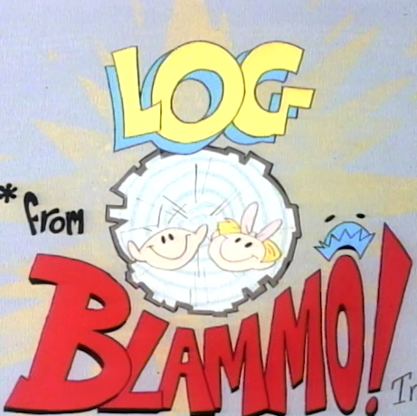
It's Log!

Slide 22
Write-Ahead Log (WAL)
22
Maintain a log file separate from data files that contains the changes that txns make to database.
Assume that the log is on stable storage.
Log contains enough information to perform the necessary undo and redo actions to restore the database.
DBMS must write to disk the log file records that correspond to changes made to a database object before it can flush that object to disk.
Buffer Pool Policy: STEAL + NO-FORCE

Slide 23
Buffer Pool + WAL
23
Steal
No
Yes
Desired
No-Force
Concern: Crash before a page is flushed to disk. Durability?
Solution: Force a summary/log @ commit. Use to REDO.
Force
Yes
No
Force (on every update, flush the updated page to disk)
Poor response time, but enforces durability of committed txns.
Trivial
No-Steal
Low throughtput, but works for aborted txns.
Steal (flush an unpinned dirty page even if the updating txn is active)
Concern: A stolen+flushed page was modified by an uncommitted txn. T.
If T aborts, how is atomicity enforced?
Solution: Remember old value (logs). Use to UNDO.

Slide 24
WAL Protocol
24
The DBMS stages all a txn’s log records in volatile storage (usually backed by buffer pool).
All log records pertaining to an updated page are written to non-volatile storage before the page itself is over-written in non-volatile storage.
A txn is not considered committed until all its log records have been written to stable storage.

Slide 25
WAL Protocol
25
Write a <BEGIN> record to the log for each txn to mark its starting point.
Append a record every time a txn changes an object:
Transaction Id
Object Id
Before Value (UNDO)
After Value (REDO)
When a txn finishes, the DBMS appends a <COMMIT> record to the log.
Make sure that all log records are flushed before it returns an acknowledgement to application.
Not necessary if using append-only MVCC

Slide 26
WAL – Example
26
Everything we need to restore T₁ is in the log!
Schedule
T₁
WAL Buffer
<T₁ BEGIN>
<T₁, A, 1, 8>
<T₁, B, 5, 9>
<T₁ COMMIT>
BEGIN
W(A)
W(B)
⋮
COMMIT
<T₁ BEGIN>
<T₁, A, 1, 8>
<T₁, B, 5, 9>
<T₁ COMMIT>
⋮
1
TIME
Before
After
A=1
B=5
C=7
Txn result is now safe to return to application.
Buffer Pool
A=1
A=8
B=9
C=7
B=5
2

Slide 27
WAL – Implementation
27
Flushing the log buffer to disk every time a txn commits will become a bottleneck.
The DBMS can use the group commit optimization to batch multiple log flushes together to amortize overhead.
When the buffer is full, flush it to disk.
Or if there is a timeout (e.g., 5 ms).

Slide 28


WAL – Group Commit
28
Schedule
Flush the buffer when it is full.
T₁
T₂
WAL Buffers
<T₁ BEGIN>
<T₁, A, 1, 8>
<T₁, B, 5, 9>
<T₂ BEGIN>
<T₂, C, 1, 2>
BEGIN
W(A)
W(B)
⋮
COMMIT
BEGIN
W(C)
W(D)
⋮
COMMIT
<T₁ BEGIN>
<T₁, A, 1, 8>
<T₁, B, 5, 9>
<T₂ BEGIN>
<T₂, C, 1, 2>
<T₁ COMMIT>
<T₂ COMMIT>
<T₂, D, 3, 4>
TIME
Flush after an elapsed amount of time.
<T₂, D, 3, 4>

Slide 29
Buffer Pool Policies
29
Almost every DBMS uses NO-FORCE + STEAL
Runtime Performance
Recovery Performance
 | NO-STEAL | STEAL
NO-FORCE | – | Fastest
FORCE | Slowest | –
 | NO-STEAL | STEAL
NO-FORCE | – | Slowest
FORCE | Fastest | –
Undo + Redo
No Undo + No Redo

Slide 30
Logging Schemes
30
Physical Logging
Record the byte-level changes made to a specific page.
Example: git diff
Logical Logging
Record the high-level operations executed by txns.
Example: UPDATE, DELETE, and INSERT queries.
Physiological Logging
Physical-to-a-page, logical-within-a-page.
Hybrid approach with byte-level changes for a single tuple identified by page id + slot number.
Does not specify organization of the page.

Slide 31
Logging Schemes
31
UPDATE foo SET val = XYZ WHERE id = 1;
Physical
Logical
Physiological
<T₁,
Table=X,
Page=99,
Offset=1024, Before=ABC,
After=XYZ>
<T₁,
Index=X_PKEY,
Page=45,
Offset=9,
Key=(1,Record1)>
<T₁,
Query="UPDATE foo SET val=XYZ
WHERE id=1">
<T₁,
Table=X,
Page=99, Slot=1,
Before=ABC,
After=XYZ>
<T₁,
Index=X_PKEY,
IndexPage=45,
Key=(1,Record1)>

Slide 32
Physical vs. Logical Logging
32
Logical logging requires less data written in each log record than physical logging.
Difficult to implement recovery with logical logging if you have concurrent txns running at lower isolation levels.
Hard to determine which parts of the database may have been modified by a query before crash.
Recovery takes longer because DBMS re-executes every query in the log again.

Slide 33
Observation
33
The DBMS's WAL will grow forever.
After a crash, the DBMS must replay the entire log, which will take a long time.
The DBMS periodically takes a checkpoint where it flushes all buffers out to disk.
This provides a hint on how far back it needs to replay the WAL after a crash.
Notes all current, uncommitted transactions
Truncate the WAL up to a certain safe point in time.

Slide 34
Checkpoints
34
Blocking / Consistent Checkpoint Protocol:
Pause all queries.
Flush all WAL records in memory to disk.
Flush all modified pages in the buffer pool to disk.
Write a <CHECKPOINT> entry to WAL and flush to disk.
Resume queries.

Slide 35
Checkpoints
35
Use the <CHECKPOINT> record as the starting point for analyzing the WAL.
Any txn that committed before the checkpoint is ignored (T₁).
T₂ + T₃ did not commit before the last checkpoint.
Need to redo T₂ because it committed after checkpoint.
Need to undo T₃ because it did not commit before the crash.
WAL
<T1 BEGIN>
<T1, A, 1, 2>
<T1 COMMIT>
<T2 BEGIN>
<T2, A, 2, 3>
<T3 BEGIN>
<CHECKPOINT>
<T2, B, 4, 5>
<T2 COMMIT>
<T3, A, 3, 4>
⋮

Slide 36
Checkpoints – Challenges
36
In this example, the DBMS must stall txns when it takes a checkpoint to ensure a consistent snapshot.
We will see how to get around this problem next class.
Scanning the log to find uncommitted txns can take a long time.
Unavoidable but we will add hints to the <CHECKPOINT> record to speed things up next class.
How often the DBMS should take checkpoints depends on many different factors…

Slide 37
Checkpoints – Frequency
37
Checkpointing too often causes the runtime performance to degrade.
System spends too much time flushing buffers.
But waiting a long time is just as bad:
The checkpoint will be large and slow.
Makes recovery time much longer.
Tunable option that depends on application recovery time requirements.

Slide 38
Conclusion
38
Write-Ahead Logging is (almost) always the best approach to handle loss of volatile storage.
Use incremental updates (STEAL + NO-FORCE) with checkpoints.
On Recovery: undo uncommitted txns + redo committed txns.

Slide 39
Next Class
39
Better Checkpoint Protocols.
Recovery with ARIES.

Slide 40





CHANGE DATA CAPTURE (CDC)
Automatically propagate changes to external sources to replicate and synchronize database contents.
Extract Transform Load (ETL)
Some systems can do this automatically. Others require third-party tools.
Approach #1: WAL
Approach #2: Triggers
Approach #3: Timestamps
<T₁ BEGIN>
<T₁, A, 1, 8>
<T₁, B, 5, 9>
<T₁ COMMIT>

Slide 41
WAL – DEFERRED UPDATES
41
If we prevent the DBMS from writing dirty records to disk until the txn commits, then the DBMS does not need to store their original values.
WAL
<T₁ BEGIN>
<T₁, A, 1, 8>
<T₁, B, 5, 9>
<T₁ COMMIT>
X
X
Replay the log and redo each update.
Simply ignore all of T₁'s updates.
WAL
WAL
<T₁ BEGIN>
<T₁, A, 8>
<T₁, B, 9>
<T₁ COMMIT>
CRASH!
<T₁ BEGIN>
<T₁, A, 8>
<T₁, B, 9>
CRASH!

Slide 42
WAL – DEFERRED UPDATES
42
This technique will not work if the change set of a txn is larger than the amount of memory available.
The DBMS cannot undo changes for an aborted txn if it does not have the tuples' original values in the log.
We need to use the STEAL policy.

Slide 43
LOG-STRUCTURED SYSTEMS
43
Log-structured DBMSs do not have dirty pages.
Any page retrieved from disk is immutable.
The DBMS buffers log records in in-memory pages (MemTable). If this buffer is full, it must be flushed to disk. But it may contain changes uncommitted txns.
These DBMSs still maintain a separate WAL to recreate the MemTable on crash.

Slide 44
STORAGE TYPES
44
Volatile Storage:
Data does not persist after power loss or program exit.
Examples: DRAM, SRAM
Non-volatile Storage:
Data persists after power loss and program exit.
Examples: HDD, SDD, cloud storage (S3)
Stable Storage:
A non-existent form of non-volatile storage that survives all possible failures scenarios.

Slide 45
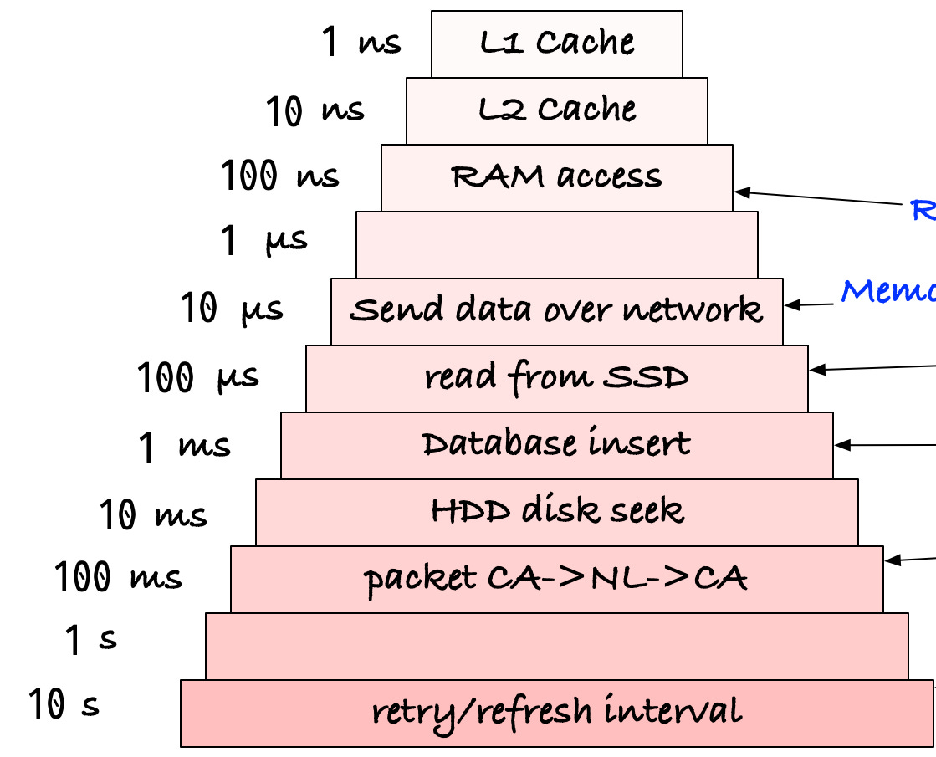
CRASH RECOVERY: Intuition
45
Volatile storage where the buffer pool sits, and non-volatile storage below it.
We want high performance, hence want to write to volatile storage.
Allow dirty pages in the buffer pool for performance, with buffer pool replacement policy dictating flush to non-volatile storage.

Slide 46
CRASH RECOVERY
46
Volatile storage where the buffer pool sits, and non-volatile storage below it.
We want high performance, hence want to write to volatile storage.
Allow dirty pages in the buffer pool for performance, with buffer pool replacement policy dictating flush to non-volatile storage.
We must classify the types of failures that the DBMS needs to handle…

Slide 47
FAILURE CLASSIFICATION
47
Type #1 – Transaction Failures
Type #2 – System Failures
Type #3 – Storage Media Failures

Slide 48
TYPE #1: TRANSACTION FAILURES
48
Logical Errors:
Transaction cannot complete due to some internal error condition (e.g., integrity constraint violation).
Internal State Errors:
DBMS must terminate an active transaction due to an error condition (e.g., deadlock).

Slide 49
TYPE #2: SYSTEM FAILURES
49
Software Failure:
Problem with the OS or DBMS implementation (e.g., uncaught divide-by-zero exception).
Hardware Failure:
The computer hosting the DBMS crashes (e.g., power plug gets pulled).
Fail-stop Assumption: Non-volatile storage contents are assumed to not be corrupted by system crash.

Slide 50
TYPE #3: STORAGE MEDIA FAILURE
50
Non-Repairable Hardware Failure:
A head crash or similar disk failure destroys all or part of non-volatile storage.
Or the whole machine catches on fire!
Such destruction is assumed to be detectable
Disk controller use checksums to detect failures.
The fire department calls you.
No DBMS can recover from this!
Database must be restored from an archived version or a replica (more on that later).

