Slide 1
Lecture 5: Buffer Pool Manager

Slide 2
Last Class
2
Problem #1: How the DBMS represents the database in files on disk.
Problem #2: How the DBMS manages its memory and move data back-and-forth from disk.

Slide 3
Database Storage
3
Spatial Control:
Where to write pages on disk.
The goal is to keep pages that are used together often as physically close together as possible on disk.
Temporal Control:
When to read pages into memory, and when to write them to disk.
The goal is to minimize the number of stalls from having to read data from disk.

Slide 4



Disk-oriented DBMS
4
Get Page #2
Execution Engine
Pointer to Page #2
Directory
2
Header
Buffer Pool
Frames
Memory
3
…
Header
5
1
Header
Header
2
Header
4
Directory
Header
Database File
Pages
Disk

Slide 5
Disk-oriented DBMS
5
Get Page #2
Execution Engine
3
Directory
Header
2
1
Header
Header
Buffer Pool
Frames
Memory
3
…
Header
5
1
Header
Header
2
Header
4
Directory
Header
Database File
Pages
Disk

Slide 6
Other Memory Pools
6
The DBMS needs memory for things other than just tuples and indexes.
These other memory pools may not always backed by disk. Depends on implementation.
Sorting + Join Buffers
Query Caches
Maintenance Buffers
Log Buffers
Dictionary Caches

Slide 7
Today's Agenda
7
Buffer Pool Manager
Why mmap Will Murder Your DBMS
Disk I/O Scheduling
Replacement Policies
Optimizations

Slide 8
Buffer Pool Organization
8
Memory region organized as an array of fixed-size pages. An array entry is called a frame.
When the DBMS requests a page, an exact copy is placed into one of these frames.
When page is written in memory, it is marked "dirty"
Dirty pages are buffered and not written to disk immediately
Write-Back Cache
Buffer Pool
page1
frame1
page3
frame2
frame3
frame4
page1
page2
page3
page4
On-Disk File

Slide 9


Buffer Pool Metadata
9
The page table keeps track of pages that are currently in memory.
Usually a fixed-size hash table protected with latches to ensure thread-safe access.
Additional meta-data per page:
Dirty Flag
Pin/Reference Counter
Access Tracking Information
Page Table
Buffer Pool
frame1
page1 meta-data
page1
page3 meta-data
page3
frame2
page2
page2 meta-data
frame3
frame4
page1
page2
page3
page4
On-Disk File

Slide 10
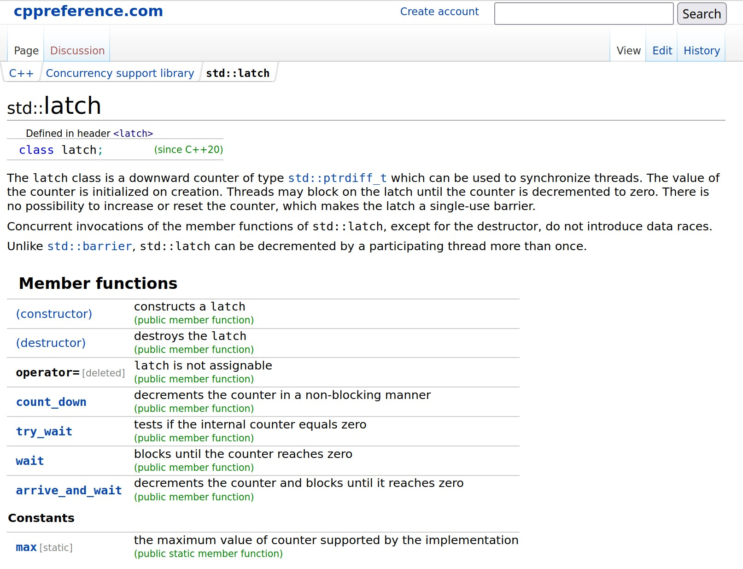

Locks vs. Latches
10
Locks:
Protects the database's logical contents from other transactions.
Held for transaction duration.
Need to be able to rollback changes.
Latches:
Protects the critical sections of the DBMS's internal data structure from other threads.
Held for operation duration.
Do not need to be able to rollback changes.
←Mutex

Slide 11
Page Table vs. Page Directory
11
The page directory is the mapping from page ids to page locations in the database files.
All changes must be recorded on disk to allow the DBMS to find on restart.
The page table is the mapping from page ids to a copy of the page in buffer pool frames.
This is an in-memory data structure that does not need to be stored on disk.

Slide 12

The Dark Side
mmap

Slide 13
Virtual Memory Crash Course
This is not a full intro! Take COMP 530!
Main purpose is to create indirection between "virtual" (logical) memory addresses and "physical" memory
Ease of programming
Process isolation/security
One of the great ideas in CS systems, beyond the scope of COMP 421
Virtual Memory
Physical Memory
0x1
0x1
0x1
0x2
0x2
0x2
0x3
0x3
0x3
0x4
0x3
Extra "swap" space on disk

Slide 14
Virtual Memory Crash Course
This is not a full intro! Take COMP 530!
Main purpose is to create indirection between "virtual" (logical) memory addresses and "physical" memory
Ease of programming
Process isolation/security
One of the great ideas in CS systems, beyond the scope of COMP 421
Virtual Memory
Physical Memory
0x1
0x1
0x1
0x2
0x2
0x2
0x3
0x3
0x1
0x4
0x2
0x1
0x2
0x2
0x3
0x4

Slide 15

Why Not Use The OS?
Use OS memory mapping (mmap) to store the contents of a file into the address space of a program.
OS is responsible for moving file pages in and out of memory, so the DBMS doesn't need to worry about it.
What if DBMS allows multiple threads to access mmap files to hide page fault stalls?
Virtual Memory
Physical Memory
page1
page1
page1
???
page2
page3
page3
page3
page4
page1
page2
page3
page4
On-Disk File

Slide 16
Memory Mapped I/O Problems
16
Problem #1: Transaction Safety
OS can flush dirty pages at any time.
Problem #2: I/O Stalls
DBMS doesn't know which pages are in memory. The OS will stall a thread on page fault.
Problem #3: Error Handling
Difficult to validate pages. Any access can cause a SIGBUS that the DBMS must handle.
Problem #4: Performance Issues
OS data structure contention. (also, TLB shootdowns.)

Slide 17












Why Not Use The OS?
17
Full Usage
There are some solutions to some of these problems:
madvise: Tell the OS how you expect to read certain pages.
mlock: Tell the OS that memory ranges cannot be paged out.
msync: Tell the OS to flush memory ranges out to disk.
Using these syscalls to get the OS to behave correctly is just as onerous as managing memory yourself.
Partial Usage

Slide 18
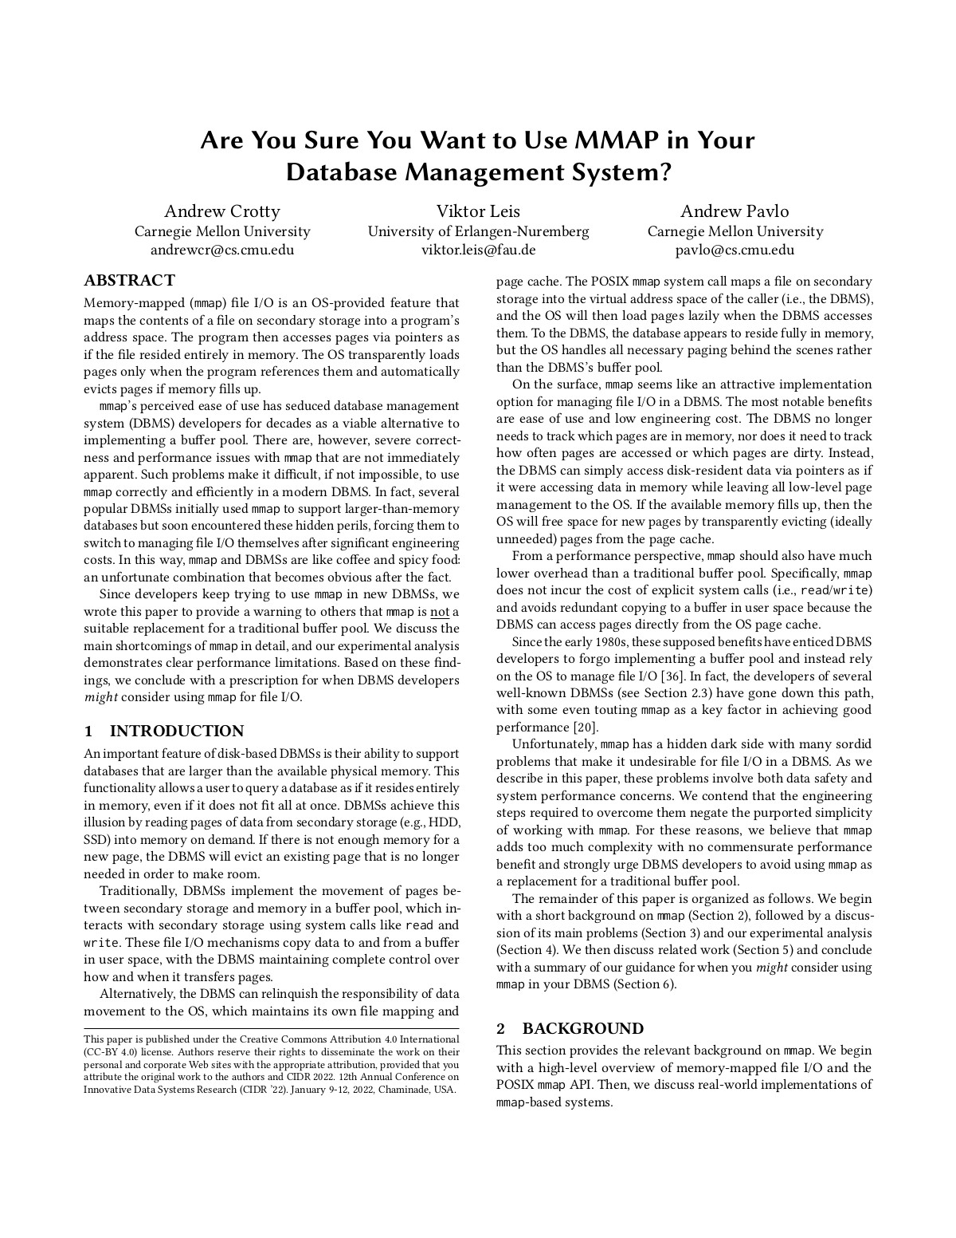
Why Not Use The OS?
18
DBMS (almost) always wants to control things itself and can do a better job than the OS.
Flushing dirty pages to disk in the correct order.
Specialized prefetching.
Buffer replacement policy.
Thread/process scheduling.
The OS is not your friend.
https://db.cs.cmu.edu/mmap-cidr2022

Slide 19
Buffer Replacement Policies
19
When the DBMS needs to free up a frame to make room for a new page, it must decide which page to evict from the buffer pool.
Goals:
Correctness
Accuracy
Speed
Meta-data overhead

Slide 20
Least Recently Used (LRU)
20
Maintain a single timestamp of when each page was last accessed. When the DBMS needs to evict a page, select the one with the oldest timestamp.
Keep the pages in sorted order to reduce the search time on eviction.
Disk Pages
page0
Q1
page1
page2
page3
LRU List
page1
page4
page0
page0
page1
page2
page2
Newest←Oldest
page5

Slide 21
CLOCK
21
Approximation of LRU that does not need a separate timestamp per page.
Each page has a reference bit.
When a page is accessed, set its bit to 1.
Organize pages in a circular buffer with a "clock hand" that sweeps over pages in order:
As the hand visits each page, check if its bit is set to 1.
If yes, set to zero. If no, then evict.
ref=0
ref=1
page1
ref=0
ref=1
ref=0
page4
page5
page2
page3
ref=0
ref=1

Slide 22
Observation
22
LRU + CLOCK replacement policies are susceptible to sequential flooding.
A query performs a sequential scan that reads every page in a table one or more times (e.g., blocked nested-loop joins).
This pollutes the buffer pool with pages that are read once and then evicted
For scanning workloads, the most recently used page is often the best page to evict.
LRU + CLOCK only tracks when a page was last accessed, but not how often a page is accessed.

Slide 23
Sequential Flooding
23
Q1
SELECT * FROM A WHERE id = 1
Disk Pages
Q1
page0
Q2
Q2
SELECT AVG(val) FROM A
Q2
Q3
SELECT * FROM A WHERE id = 1
page1
page2
Buffer Pool
page0
page3
page3
page1
page4
page2
page5

Slide 24
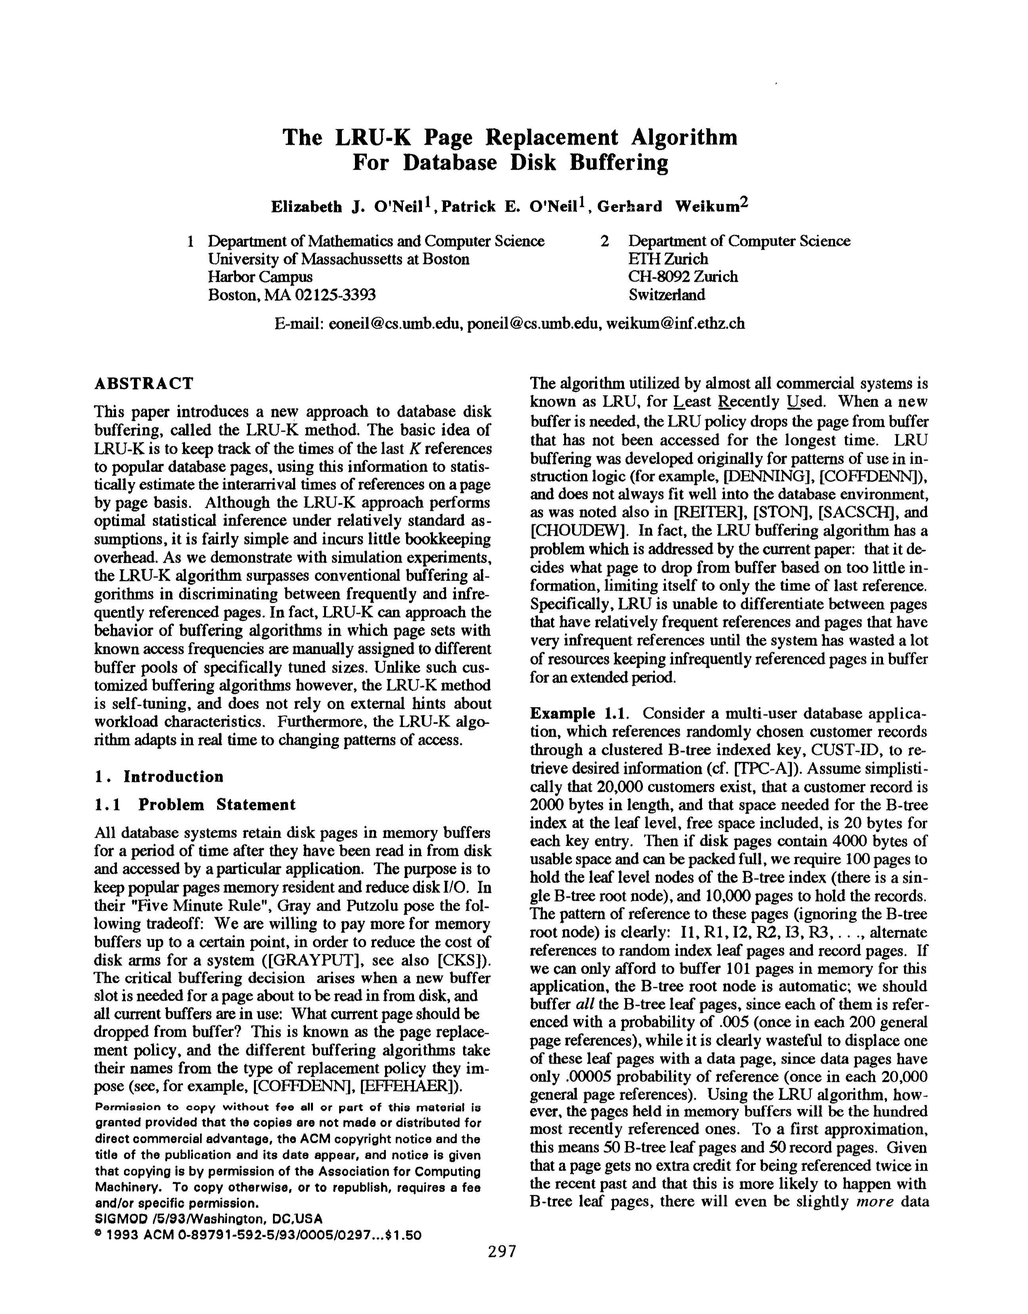


Better Policies: LRU-K
24
Track the history of last K references to each page as timestamps and compute the interval between subsequent accesses.
Can distinguish between reference types
Use this history to estimate the next time that page is going to be accessed.
Replace the page with the oldest "K-th" access.
Balances recency vs. frequency of access.
Maintain an ephemeral in-memory cache for recently evicted pages to prevent them from always being evicted.

Slide 25
MySQL: Approximate LRU-K
25
Single LRU linked list but with two entry points ("old" vs "young").
New pages are always inserted to the head of the old list.
If pages in the old list is accessed again, then insert into the head of the young list.
Disk Pages
page0
Q1
page1
Q2
page2
page3
HEAD
Young List
HEAD
Old List
page4
page4
page1
page6
page2
page1
page5
page4
page9
page5
page3
page9
page6
page2
page8
page3
page5
Newest←Oldest

Slide 26
Better Policies: Localization
26
The DBMS chooses which pages to evict on a per query basis. This minimizes the pollution of the buffer pool from each query.
Keep track of the pages that a query has accessed.
Example: Postgres assigns a limited number of buffer pool pages to a query and uses it as a circular ring buffer.

Slide 27
Better Policies: Priority Hints
27
The DBMS knows about the context of each page during query execution.
It can provide hints to the buffer pool on whether a page is important or not.
Q1
INSERT INTO A VALUES (id++)
index-page0
Q2
SELECT * FROM A WHERE id = ?
index-page1
index-page4
index-page2
index-page3
index-page5
index-page6
MIN
id
MAX

Slide 28
Dirty Pages
28
Fast Path: If a page in the buffer pool is not dirty, then the DBMS can simply "drop" it.
Slow Path: If a page is dirty, then the DBMS must write back to disk to ensure that its changes are persisted.
Trade-off between fast evictions versus writing dirty pages that will not be read again in the future.

Slide 29
Background Writing
29
The DBMS can periodically walk through the page table and write dirty pages to disk.
When a dirty page is safely written, the DBMS can either evict the page or just unset the dirty flag.
Need to be careful that the system writes dirty pages in a safe order
Need to able to recover from a crash
How would I transfer $$$ from one account to another?

Slide 30
Observation
OS/hardware tries to maximize disk bandwidth by reordering and batching I/O requests.
But they do not know which I/O requests are more important than others.
Many DBMSs tell you to switch Linux to use the deadline or noop (FIFO) scheduler.
Example: Oracle, Vertica, MySQL

Slide 31
Disk I/O Scheduling
The DBMS maintains internal queue(s) to track page read/write requests from the entire system.
Compute priorities based on several factors:
Sequential vs. Random I/O
Critical Path Task vs. Background Task
Table vs. Index vs. Log vs. Ephemeral Data
Transaction Information
User's performance targets
The OS doesn't know these things and is going to get into the way…

Slide 32
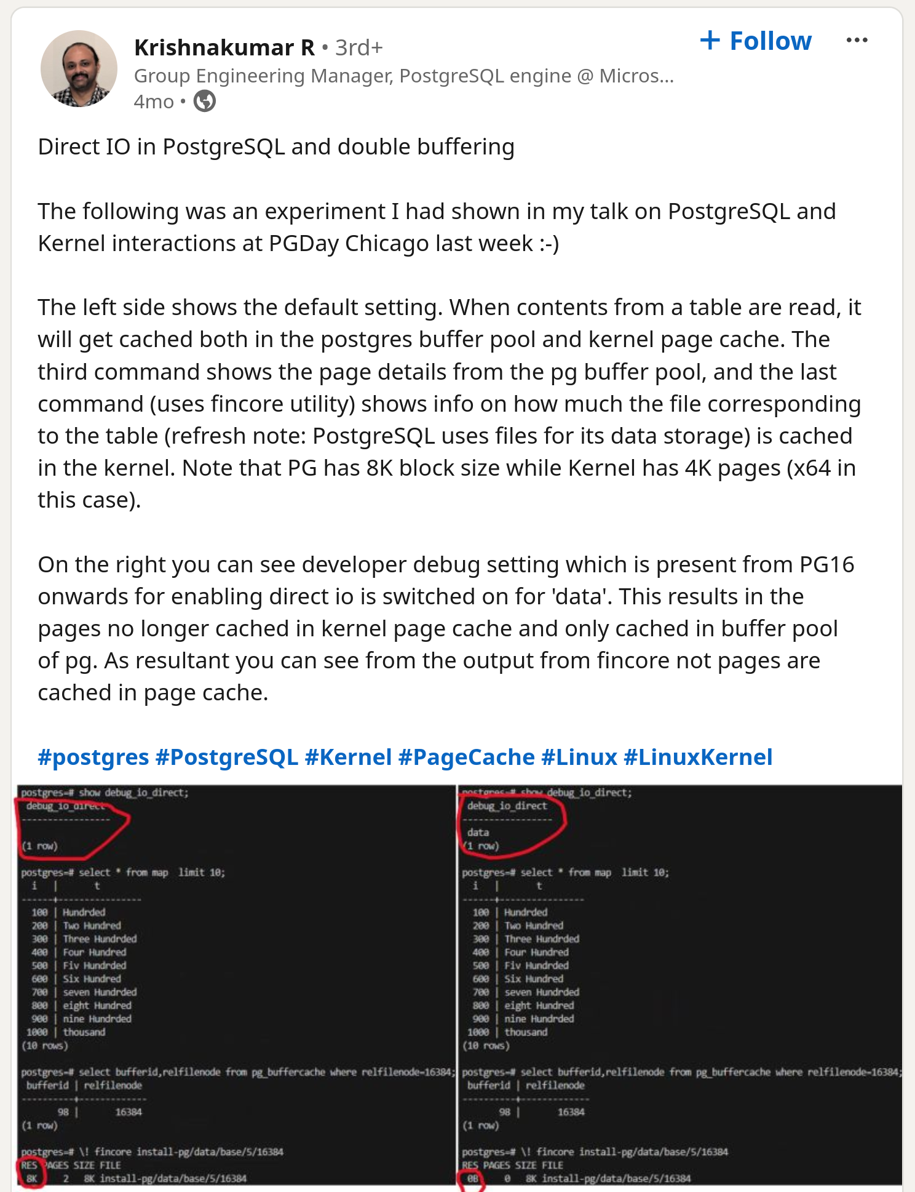
OS Page Cache
Most disk operations go through the OS API. Unless the DBMS tells it not to, the OS maintains its own filesystem cache (aka page cache, buffer cache).
Most DBMSs use direct I/O (O_DIRECT) to bypass the OS's cache.
Redundant copies of pages.
Different eviction policies.
Loss of control over file I/O.
DBMS
User-space
read(...)
Kernel-space
Filesystem
OS Page Cache

Slide 33
Buffer Pool Optimizations
33
Multiple Buffer Pools
Pre-Fetching
Scan Sharing
Buffer Pool Bypass

Slide 34





Multiple Buffer Pools
34
The DBMS does not always have a single buffer pool for the entire system.
Multiple buffer pool instances
Per-database buffer pool
Per-page type buffer pool
Partitioning memory across multiple pools helps reduce latch contention and improve locality.
Avoids contention on LRU tracking metadata.

Slide 35
Multiple Buffer Pools
35
Approach #1: Object Id
Embed an object identifier in record ids and then maintain a mapping from objects to specific buffer pools.
Approach #2: Hashing
Hash the page id to select which buffer pool to access.
Q1
GET RECORD #123
<ObjectId, PageId, SlotNum>
HASH(123) % n
Buffer Pool #1
Buffer Pool #2

Slide 36
Pre-Fetching
36
The DBMS can also prefetch pages based on a query plan.
Examples: Sequential vs. Index Scans
Some DBMS prefetch to fill in empty frames upon start-up.
Disk Pages
Q1
page0
page1
page2
Buffer Pool
page0
page3
page3
page1
page4
page4
page2
page5
page5

Slide 37
Pre-Fetching
37
index-page0
Disk Pages
Q1
SELECT * FROM A WHERE val BETWEEN 100 AND 250
index-page0
index-page1
index-page4
Q1
index-page2
index-page3
index-page5
index-page6
index-page1
0
99
100
199
200
299
300
399
index-page2
Buffer Pool
index-page0
index-page3
index-page1
index-page4
index-page5

Slide 38
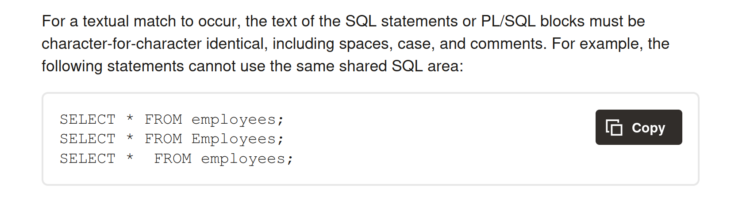

Scan Sharing
38
Allow multiple queries to attach to a single cursor that scans a table.
Also called synchronized scans.
This is different from result caching.
Examples:
Fully supported in DB2, MSSQL, Teradata, and Postgres.
Oracle only supports cursor sharing for identical queries.

Slide 39
Scan Sharing
39
Disk Pages
Q1
SELECT SUM(val) FROM A
Q2
page0
Q1
Q2
Q2
SELECT AVG(val) FROM A
SELECT AVG(val) FROM A LIMIT 100
page1
page2
Buffer Pool
page0
page3
page3
Q2
page1
page4
page4
page2
page5
page5

Slide 40
Buffer Pool Bypass
40
The sequential scan operator will not store fetched pages in the buffer pool to avoid overhead.
Memory is local to running query.
Works well if operator needs to read a large sequence of pages that are contiguous on disk.
Can also be used for temporary data (sorting, joins).
Called "Light Scans" in Informix.

Slide 41
Conclusion
41
The DBMS can almost always manage memory better than the OS.
Leverage the semantics about the query plan to make better decisions:
Evictions
Allocations
Pre-fetching

Slide 42
Next Class
42
Wrapping up storage...
Column stores and compression

Slide 43

Project #1
43
You will build the first component of your storage manager.
LRU-K Replacement Policy
Disk Scheduler
Buffer Pool Manager Instance
We will provide you with the basic APIs for these components.
Due Date: Sunday Sept 29th @ 11:59pm

Slide 44
Task #1 – LRU-K Replacement Policy
44
Build a data structure that tracks the usage of pages using the LRU-K policy.
General Hints:
Your LRUKReplacer needs to check the "pinned" status of a Page.
If there are no pages touched since last sweep, then return the lowest page id.

Slide 45
Task #2 – Disk Scheduler
Create a background worker to read/write pages from disk.
Single request queue.
Simulates asynchronous IO using std::promise for callbacks.
It's up to you to decide how you want to batch, reorder, and issue read/write requests to the local disk.
Make sure it is thread-safe!
Database (On-Disk)
page0
Disk Scheduler
page1
page2

Slide 46
Task #3 – Buffer Pool Manager
46
Use your LRU-K replacer to manage the allocation of pages.
Need to maintain internal data structures to track allocated + free pages.
Implement page guards.
Use whatever data structure you want for the page table.
Make sure you get the order of operations correct when pinning!
Buffer Pool
(In-Memory)
Database (On-Disk)
page6
page0
Disk Scheduler
page1
page2
page4
page2

Slide 47
Things To Note
47
Do not change any file other than the six that you must hand in. Other changes will not be graded.
The projects are cumulative.
We will not be providing solutions.
Come to office hours for high-level questions, but we will not help you debug.

Slide 48
Code Quality
48
We will automatically check whether you are writing good code.
Google C++ Style Guide
Doxygen Javadoc Style
You need to run these targets before you submit your implementation to Gradescope.
make format
make check-clang-tidy-p1

Slide 49
Extra Credit
49
Gradescope Leaderboard runs your code with a specialized in-memory version of BusTub.
The top 20 fastest implementations in the class will receive extra credit for this assignment.
#1: 50% bonus points
#2–10: 25% bonus points
#11–20: 10% bonus points
Student with the most bonus points at the end of the semester will get some prize TBD

Slide 50
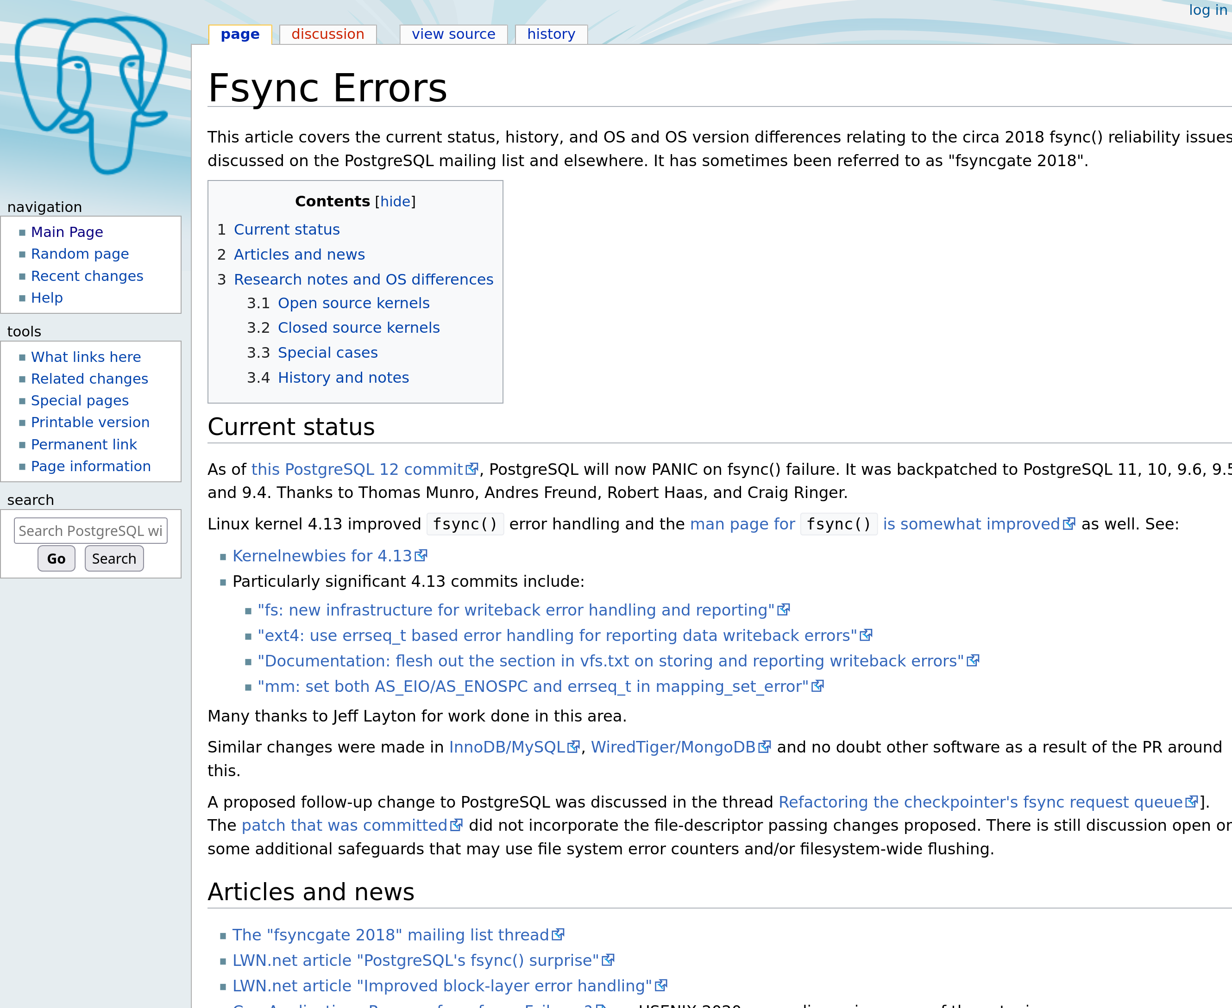

FSYNC Problems
If the DBMS calls fwrite, what happens?
If the DBMS calls fsync, what happens?
If fsync fails (EIO), what happens?
Linux marks the dirty pages as clean.
If the DBMS calls fsync again, then Linux tells you that the flush was successful. Since the DBMS thought the OS was its friend, it assumed the write was successful…
Don't Do This!

Slide 51
TASK #1 – EXTENDIBLE HASH TABLE
51
Build a thread-safe extendible hash table to manage the DBMS's buffer pool page table.
Use unordered buckets to store key/value pairs.
You must support growing table size.
You do not need to support shrinking.
General Hints:
You can use std::hash and std::mutex.
1
2
00
2
01
10
11
2

Slide 52
TASK #3 – MULTIPLE BUFFER POOLS
52
Approach #1: Object Id
Embed an object identifier in record ids and then maintain a mapping from objects to specific buffer pools.
Approach #2: Hashing
Hash the page id to select which buffer pool to access.
Q1
GET RECORD 123
HASH(123)%n
Buffer Pool #1
Buffer Pool #2
page_id mod num_instances

Slide 53
MULTIPLE BUFFER POOLS
53
CREATE BUFFERPOOL custom_pool
⮱SIZE 250 PAGESIZE 8k;
CREATE TABLESPACE custom_tablespace
⮱PAGESIZE 8k BUFFERPOOL custom_pool;
CREATE TABLE new_table
⮱TABLESPACE custom_tablespace ( ... );
DB2

Slide 54

CONTIONOUS SCAN SHARING
54
Instead of trying to be clever, the DBMS continuously scans the database files repeatedly.
One continuous cursor per table.
Queries "hop" on board the cursor while it is running and then disconnect once they have enough data.
Not viable if you pay per IOP.
Only done in academic prototypes.
Disk Pages
page0
Q1
page1
page2
page3
page4
page5

Slide 55
ALLOCATION POLICIES
55
Global Policies:
Make decisions for all active queries.
Local Policies:
Allocate frames to a specific queries without considering the behavior of concurrent queries.
Still need to support sharing pages.

Slide 56
LRU-K
56
Q1
SELECT * FROM A WHERE id = 1
Disk Pages
Q2
page0
SELECT AVG(val) FROM A
Q1
page1
page2
page3
LRU List
page0
page4
page1
page1
page0
page2
page2
Newest←Oldest
page5

