Slide 1
Lecture 6: Column Stores and Compression

Slide 2
Announcements
2
Project 1 is due 9/29
If you have not started, you are now behind

Slide 3
Storage so far
3
We discussed storage architecture alternatives to tuple-oriented scheme.
Buffer pool for memory mgmt
Heap file with slotted pages
Log-structured storage
These approaches are ideal for write-heavy (INSERT/UPDATE/DELETE) workloads.
But the most important query for some workloads may be read (SELECT ) performance…

Slide 4
Today's Agenda
4
Database Workloads
Storage Models
Data Compression

Slide 5
Database Workloads
5
On-Line Transaction Processing (OLTP)
Fast operations that only read/update a small amount of data each time.
On-Line Analytical Processing (OLAP)
Complex queries that read a lot of data to compute aggregates.
Hybrid Transaction + Analytical Processing
OLTP + OLAP together on the same database instance

Slide 6
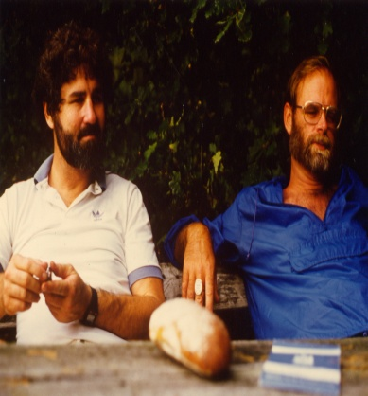

Database Workloads
6
Complex
OLAP
HTAP
Operation Complexity
OLTP
Jim Gray
Simple
Write-Heavy
Read-Heavy
Workload Focus
Source: Mike Stonebraker

Slide 7
Wikipedia Example
7
CREATE TABLE useracct (
userID INT PRIMARY KEY,
userName VARCHAR UNIQUE,
⋮
);
CREATE TABLE pages (
pageID INT PRIMARY KEY,
title VARCHAR UNIQUE,
latest INT ⮱REFERENCES revisions (revID),
);
CREATE TABLE revisions (
revID INT PRIMARY KEY,
userID INT REFERENCES useracct (userID),
pageID INT REFERENCES pages (pageID),
content TEXT,
updated DATETIME
);

Slide 8
Observation
8
The relational model does not specify that the DBMS must store all a tuple's attributes together in a single page.
This may not actually be the best layout for some workloads…

Slide 9
OLTP
9
On-line Transaction Processing:
Simple queries that read/update a small amount of data that is related to a single entity in the database.
This is usually the kind of application that people build first.
SELECT P.*, R.*
FROM pages AS P
INNER JOIN revisions AS R
ON P.latest = R.revID
WHERE P.pageID = ?
UPDATE useracct
SET lastLogin = NOW(),
hostname = ?
WHERE userID = ?
SELECT * FROM useracct
WHERE userName = ?
AND userPass = ?
INSERT INTO revisions VALUES (?,?…,?)

Slide 10
OLAP
On-line Analytical Processing:
Complex queries that read large portions of the database spanning multiple entities.
You execute these workloads on the data you have collected from your OLTP application(s).
SELECT COUNT(U.lastLogin),
EXTRACT(month FROM U.lastLogin) AS month
FROM useracct AS U
WHERE U.hostname LIKE '%.gov'
GROUP BY EXTRACT(month FROM U.lastLogin)

Slide 11
Storage Models
11
A DBMS's storage model specifies how it physically organizes tuples on disk and in memory.
Can have different performance characteristics based on the target workload (OLTP vs. OLAP).
Influences the design choices of the rest of the DBMS.
Choice #1: N-ary Storage Model (NSM)
Choice #2: Decomposition Storage Model (DSM)
Choice #3: Hybrid Storage Model (PAX)

Slide 12
N-ary Storage Model (NSM)
12
The DBMS stores (almost) all attributes for a single tuple contiguously in a single page.
Also commonly known as a row store
Ideal for OLTP workloads where queries are more likely to access individual entities and execute write-heavy workloads.
NSM database page sizes are typically some constant multiple of 4 KB hardware pages.
See Lecture #03

Slide 13
NSM: Physical Organization
13
A disk-oriented NSM system stores a tuple's fixed-length and variable-length attributes contiguously in a single slotted page.
The tuple's record id (page#, slot#) is how the DBMS uniquely identifies a physical tuple.
Col A
Col B
Col C
Row #0
a0
b0
c0
Row #1
a1
b1
c1
Row #2
a2
b2
c2
Row #3
a3
b3
c3
Row #4
a4
b4
c4
Row #5
a5
b5
c5
Slot Array
header
header
a5
b5
c5
header
a4
Database Page
b4
c4
header
a3
b3
c3
header
a2
b2
c2
header
a1
b1
c1
header
a0
b0
c0

Slide 14

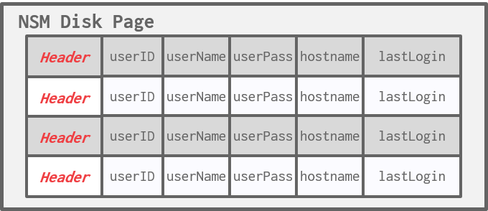
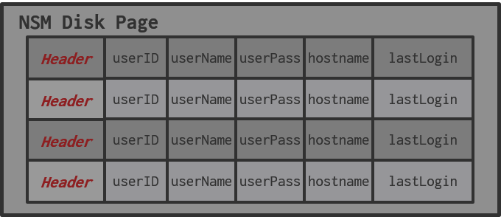
NSM: OLTP Example
14
SELECT * FROM useracct
WHERE userName = ?
AND userPass = ?
Index
Next class!
INSERT INTO useracct
VALUES (?,?,…?)
NSM Disk Page
header
userID
userName
userPass
hostname
lastLogin
header
userID
userName
userPass
hostname
lastLogin
header
userID
userName
userPass
hostname
lastLogin
Database File
header
header
userID
userName
userPass
hostname
lastLogin
-
-
-
-
-
Disk

Slide 15

NSM: OLAP Example
15
SELECT COUNT(U.lastLogin),
EXTRACT(month FROM U.lastLogin) AS month
FROM useracct AS U
WHERE U.hostname LIKE '%.gov'
GROUP BY EXTRACT(month FROM U.lastLogin)
NSM Disk Page
header
userID
userName
userPass
hostname
lastLogin
header
userID
userName
userPass
hostname
lastLogin
header
userID
userName
userPass
hostname
lastLogin
Database File
header
userID
userName
userPass
hostname
lastLogin
Disk
Useless Data!

Slide 16
NSM: SUMMARY
16
Advantages
Fast inserts, updates, and deletes.
Good for queries that need the entire tuple (OLTP).
Can use index-oriented physical storage for clustering.
Disadvantages
Not good for scanning large portions of the table and/or a subset of the attributes.
Terrible memory locality in access patterns.
Not ideal for compression because of multiple value domains within a single page.

Slide 17
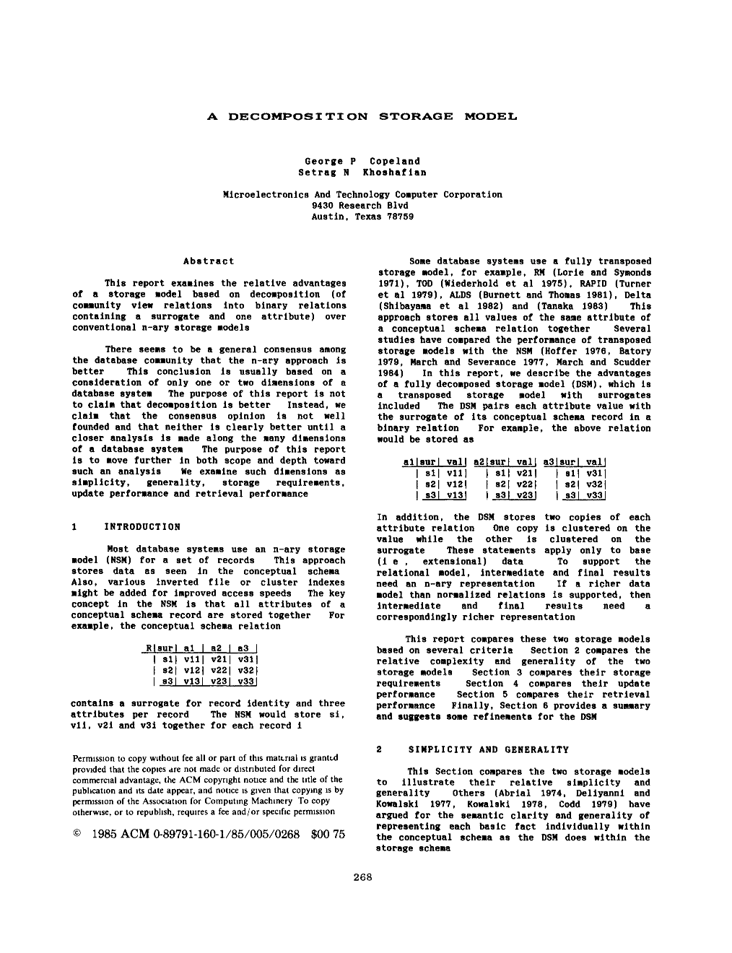
Decomposition Storage Model (DSM)
17
Store a single attribute for all tuples contiguously in a block of data.
Also known as a "column store"
Ideal for OLAP workloads where read-only queries perform large scans over a subset of the table’s attributes.
DBMS is responsible for combining/splitting a tuple's attributes when reading/writing.

Slide 18
DSM: Physical Organization
18
Store attributes and meta-data (e.g., nulls) in separate arrays of fixed-length values.
Most systems identify unique physical tuples using offsets into these arrays.
Need to handle variable-length values…
Maintain separate pages per attribute with a dedicated header area for meta-data about entire column.
Col A
Col B
Col C
Row #0
a0
b0
c0
Row #1
a1
b1
c1
Row #2
a2
b2
c2
Row #3
a3
b3
c3
Row #4
a4
b4
c4
Row #5
a5
b5
c5
header
null bitmap
Page #1
a0
a1
a2
a3
a4
a5
header
null bitmap
Page #2
b0
b1
b2
b3
b4
b5
header
null bitmap
Page #3
c0
c1
c2
c3
c4
c5

Slide 19
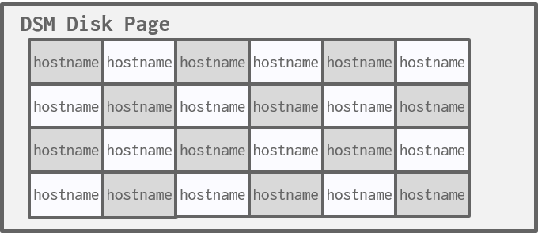
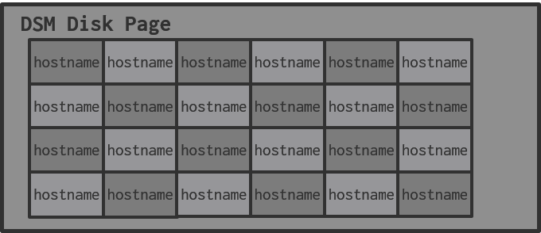
DSM: OLAP Example
19
SELECT COUNT(U.lastLogin),
EXTRACT(month FROM U.lastLogin) AS month
FROM useracct AS U
WHERE U.hostname LIKE '%.gov'
GROUP BY EXTRACT(month FROM U.lastLogin)
DSM Disk Page
DSM Disk Page
hostname
lastLogin
hostname
lastLogin
hostname
hostname
lastLogin
header
lastLogin
header
header
userID
userName
userPass
hostname
lastLogin
userID
hostname
lastLogin
hostname
lastLogin
hostname
hostname
lastLogin
hostname
lastLogin
lastLogin
hostname
lastLogin
lastLogin
header
userID
userName
userPass
hostname
lastLogin
hostname
lastLogin
hostname
lastLogin
hostname
hostname
lastLogin
hostname
lastLogin
lastLogin
hostname
lastLogin
header
userID
userName
userPass
hostname
lastLogin
Database File
header
hostname
lastLogin
hostname
lastLogin
hostname
hostname
lastLogin
hostname
lastLogin
lastLogin
hostname
lastLogin
userID
userName
userPass
hostname
lastLogin
userName
Disk
userPass

Slide 20
DSM: Tuple Identification
20
Choice #1: Fixed-length Offsets
Each value is the same length for an attribute.
Choice #2: Embedded Tuple Ids
Each value is stored with its tuple id in a column.
Don't Do This!
Offsets
Embedded Ids
A
B
C
D
A
B
C
D
0
0
0
0
0
1
1
1
1
1
2
2
2
2
2
3
3
3
3
3

Slide 21
DSM: Variable-length Data
21
Padding variable-length fields to ensure they are fixed-length is wasteful, especially for large attributes.
A better approach is to use dictionary compression to convert repetitive variable-length data into fixed-length values (typically 32-bit integers).
More on this later in this lecture…

Slide 22
Decomposition Storage Model (DSM)
22
Advantages
Reduces the amount wasted I/O per query because the DBMS only reads the data that it needs.
Faster query processing because of increased locality and cached data reuse (Lecture #13).
Better data compression.
Disadvantages
Slow for point queries, inserts, updates, and deletes because of tuple splitting/stitching/reorganization.

Slide 23
Observation
23
OLAP queries almost never access a single column in a table by itself.
At some point during query execution, the DBMS must get other columns and stitch the original tuple back together.
But we still need to store data in a columnar format to get the storage + execution benefits.
We need columnar scheme that still stores attributes separately but keeps the data for each tuple physically close to each other…

Slide 24
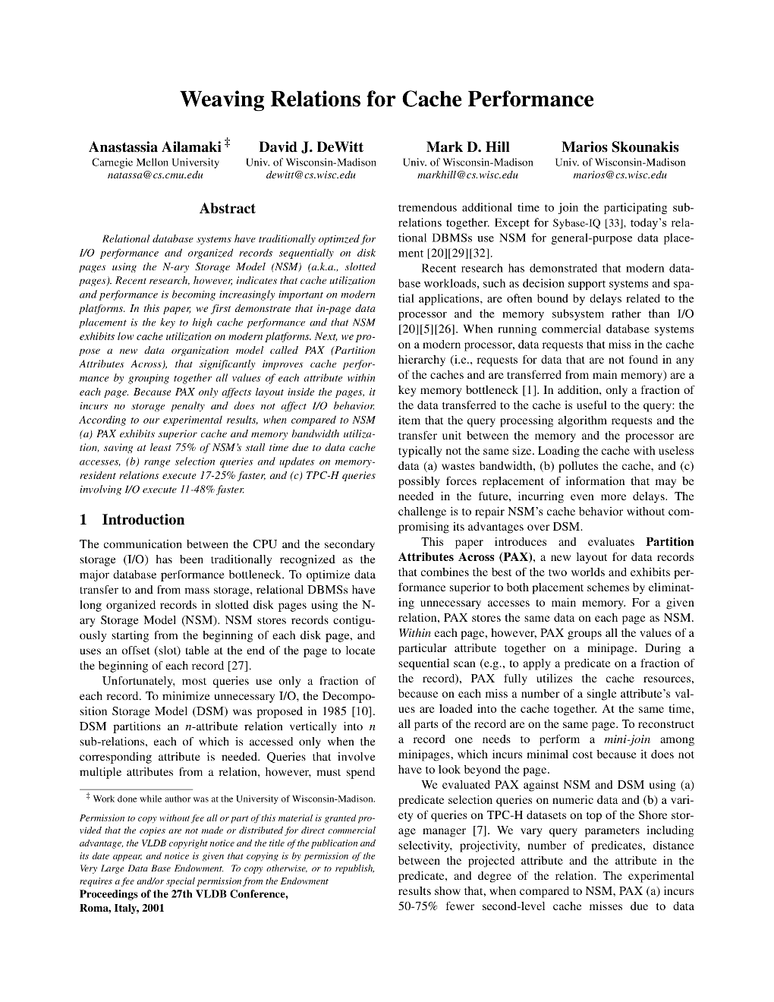
PAX Storage Model
24
Partition Attributes Across (PAX) is a hybrid storage model that vertically partitions attributes within a database page.
Examples: Parquet, ORC, and Arrow.
The goal is to get the benefit of faster processing on columnar storage while retaining the spatial locality benefits of row storage.

Slide 25
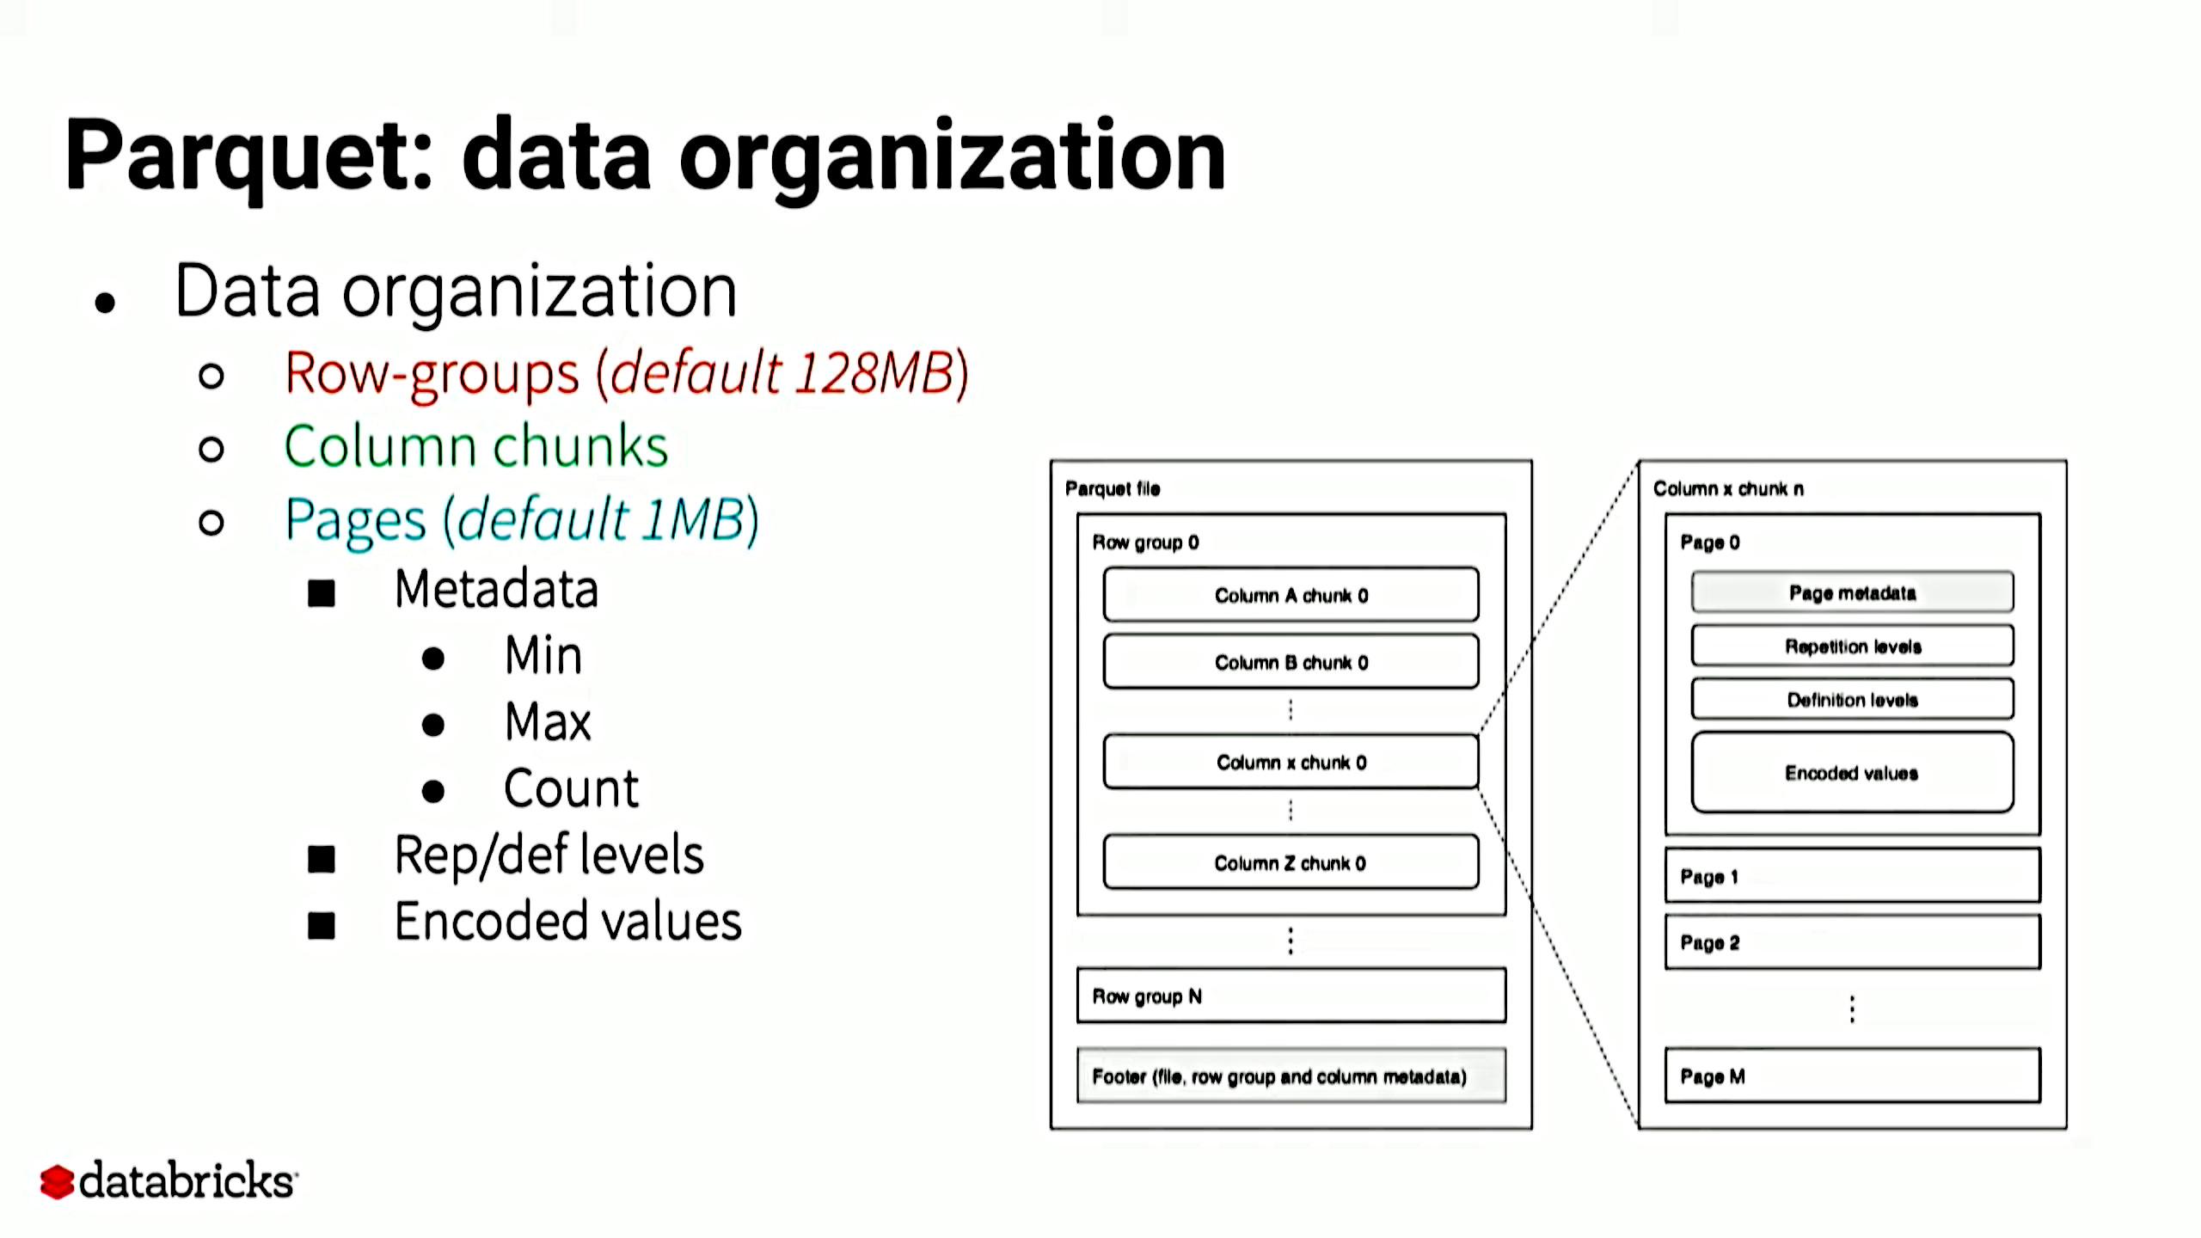
PAX: Physical Organization
Col A
Col B
Col C
Horizontally partition data into row groups. Then vertically partition their attributes into column chunks.
Global meta-data directory contains offsets to the file's row groups.
This is stored in the footer if the file is immutable (Parquet, Orc).
Each row group contains its own meta-data header about its contents.
Row #0
a0
b0
c0
Row #1
a1
b1
c1
Row #2
a2
b2
c2
Row #3
a3
b3
c3
Row #4
a4
b4
c4
Row #5
a5
b5
c5
Column Chunk
Row Group Meta-Data
a0
a1
a2
b0
b1
b2
Row Group
c0
c1
c2
PAX File
Row Group Meta-Data
a3
a4
a5
b3
b4
b5
Row Group
c3
c4
c5
File Meta-Data

Slide 26
Observation
26
I/O is the main bottleneck if the DBMS fetches data from disk during query execution.
The DBMS can compress pages to increase the utility of the data moved per I/O operation.
Key trade-off is speed vs. compression ratio
Compressing the database reduces DRAM requirements.
It may decrease CPU costs during query execution.

Slide 27
Database Compression
27
Goal #1: Must produce fixed-length values.
Only exception is var-length data stored in separate pool.
Goal #2: Postpone decompression for as long as possible during query execution.
Also known as late materialization.
Goal #3: Must be a lossless scheme.
People (typically) don't like losing data.
Any lossy compression must be performed by application.

Slide 28
Compression Granularity
28
Choice #1: Block-level
Compress a block of tuples for the same table.
Choice #2: Tuple-level
Compress the contents of the entire tuple (NSM-only).
Choice #3: Attribute-level
Compress a single attribute within one tuple (overflow).
Can target multiple attributes for the same tuple.
Choice #4: Column-level
Compress multiple values for one or more attributes stored for multiple tuples (DSM-only).

Slide 29
Naïve Compression
29
Compress data using a general-purpose algorithm. Scope of compression is only based on the data provided as input.
LZO (1996), LZ4 (2011), Snappy (2011), Oracle OZIP (2014), Zstd (2015)
Considerations
Computational overhead
Compress vs. decompress speed.

Slide 30

MySQL InnoDB Compression
30
Buffer Pool
Database File
Write
Read
mod log
mod log
[1,2,4,8] KB
Compressed Page₀
Compressed Page₀
Uncompressed
Page₀
mod log
Read
Compressed Page₁
16 KB
mod log
Compressed Page₂
Source: MySQL 5.7 Documentation

Slide 31
Naïve Compression
31
The DBMS must decompress data first before it can be read and (potentially) modified.
This limits the "scope" of the compression scheme.
These schemes also do not consider the high-level meaning or semantics of the data.

Slide 32

Observation
32
Ideally, we want the DBMS to operate on compressed data without decompressing it first.
Database Magic!
SELECT * FROM users
WHERE name = 'Andy'
SELECT * FROM users
WHERE name = XX
NAME
SALARY
NAME
SALARY
Andy
99999
XX
AA
Jignesh
88888
YY
BB

Slide 33
Compression Granularity
33
Choice #1: Block-level
Compress a block of tuples for the same table.
Choice #2: Tuple-level
Compress the contents of the entire tuple (NSM-only).
Choice #3: Attribute-level
Compress a single attribute within one tuple (overflow).
Can target multiple attributes for the same tuple.
Choice #4: Column-level
Compress multiple values for one or more attributes stored for multiple tuples (DSM-only).

Slide 34
Columnar Compression
34
Run-length Encoding
Bit-Packing Encoding
Bitmap Encoding
Delta / Frame-of-Reference Encoding
Incremental Encoding
Dictionary Encoding

Slide 35
Run-length Encoding (RLE)
35
Compress runs of the same value in a single column into triplets:
The value of the attribute.
The start position in the column segment.
The # of elements in the run.
Requires the columns to be sorted intelligently to maximize compression opportunities.

Slide 36
Run-length Encoding
36
Original Data
Sorted Data
Compressed Data
id
id
isDead
isDead
id
id
isDead
isDead
1
1
Y
Y
1
1
(Y,0,3)
(Y,0,6)
2
2
Y
Y
2
2
(N,3,1)
SELECT isDead, COUNT(*) FROM users GROUP BY isDead
(N,7,2)
3
3
Y
Y
3
3
(Y,4,1)
4
6
N
Y
4
6
(N,5,1)
6
8
Y
Y
6
8
(Y,6,2)
7
9
N
Y
7
9
RLE Triplet
- Value
- Offset
- Length
8
4
Y
N
8
4
9
7
Y
N
9
7

Slide 37

Bit Packing
If the values for an integer attribute are smaller than the range of its given data type size, then reduce the number of bits to represent each value.
Use bit-shifting tricks to operate on multiple values in a single word.
Original Data
Original: 8 × 32-bits = 256 bits
int32
00000000 00000000 00000000 00001101
13
00001101
00000000 00000000 00000000 10111111
191
10111111
00000000 00000000 00000000 00111000
56
00111000
00000000 00000000 00000000 01011100
92
01011100
00000000 00000000 00000000 01010001
81
01010001
00000000 00000000 00000000 01111000
120
01111000
00000000 00000000 00000000 11100111
231
11100111
00000000 00000000 00000000 10101100
172
10101100
Compressed: 8 × 8-bits = 64 bits

Slide 38
Patching / Mostly Encoding
A variation of bit packing for when an attribute's values are "mostly" less than the largest size, store them with smaller data type.
The remaining values that cannot be compressed are stored in their raw form.
Original Data
Compressed Data
int32
mostly8
offset
value
Original: 8 × 32-bits = 256 bits
13
13
3
99999999
Compressed: (8 × 8-bits) +
16-bits + 32-bits
= 112 bits
191
181
99999999
XXX
92
92
81
81
120
120
Source: Redshift Documentation
231
231
172
172

Slide 39
Bitmap Encoding
39
Store a separate bitmap for each unique value for an attribute where an offset in the vector corresponds to a tuple.
The i^{th} position in the Bitmap corresponds to the i^{th} tuple in the table.
Typically segmented into chunks to avoid allocating large blocks of contiguous memory.
Only practical if the value cardinality is low.
Some DBMSs provide bitmap indexes.

Slide 40
Bitmap Encoding
Compressed:
16 bits + 16 bits = 32 bits
Original Data
Compressed Data
id
isDead
isDead
id
Y
N
2 × 8-bits = 16 bits
1
Y
2
Y
1
1
0
3
Y
2
1
0
4
N
3
1
0
Original:
8 × 8-bits = 64 bits
5
Y
4
0
1
8 × 2-bits = 16 bits
6
N
5
1
0
7
Y
6
0
1
8
Y
7
1
0
8
1
0

Slide 41








Bitmap Encoding: Example
Assume we have 10 million tuples. 43,000 zip codes in the US.
10000000 × 32-bits = 40 MB
10000000 × 43000 = 53.75 GB
Every time the application inserts a new tuple, the DBMS must extend 43,000 different bitmaps.
There are compressed data structures for sparse data sets:
Roaring Bitmaps
CREATE TABLE customer (
id INT PRIMARY KEY,
name VARCHAR(32),
email VARCHAR(64),
address VARCHAR(64),
zip_code INT
);

Slide 42
Delta Encoding
42
Recording the difference between values that follow each other in the same column.
Store base value in-line or in a separate look-up table.
Combine with RLE to get even better compression ratios.
Frame-of-Reference Variant: Use global min value.
Original Data
Compressed Data
Compressed Data
time64
temp
time64
temp
time64
temp
12:00
99.5
12:00
99.5
12:00
99.5
12:01
99.4
+1
-0.1
(+1,4)
-0.1
12:02
99.5
+1
+0.1
+0.1
12:03
99.6
+1
+0.1
+0.1
12:04
99.4
+1
-0.2
-0.2
5 × 64-bits = 320 bits
64-bits + (4 × 16-bits) = 128 bits
64-bits + (2 × 16-bits) = 96 bits

Slide 43
Dictionary Compression
Replace frequent values with smaller fixed-length codes and then maintain a mapping (dictionary) from the codes to the original values
Typically, one code per attribute value.
Most widely used native compression scheme in DBMSs.
The ideal dictionary scheme supports fast encoding and decoding for both point and range queries.
Encode/Locate: For a given uncompressed value, convert it into its compressed form.
Decode/Extract: For a given compressed value, convert it back into its original form.

Slide 44
Dictionary: Order-preserving
44
The encoded values need to support the same collation as the original values.
SELECT * FROM users
WHERE name LIKE 'And%'
SELECT * FROM users
WHERE name BETWEEN 10 AND 20
Original Data
Compressed Data
name
name
value
code
Andrea
10
Andrea
10
Mr.Pickles
40
Andy
20
Sorted Dictionary
Andy
20
Jignesh
30
Jignesh
30
Mr.Pickles
40
Mr.Pickles
40

Slide 45
Order-preserving Encoding
45
SELECT name FROM users
WHERE name LIKE 'And%'
Still must perform scan on column
SELECT DISTINCT name FROM users
WHERE name LIKE 'And%'
Only need to access dictionary
Original Data
Compressed Data
name
name
value
code
Andrea
10
Andrea
10
Sorted Dictionary
Mr.Pickles
40
Andy
20
Andy
20
Jignesh
30
Jignesh
30
Mr.Pickles
40
Mr.Pickles
40

Slide 46
DICTIONARY: ARRAY
First sort the values and then store them sequentially in a byte array.
Need to also store the size of the value if they are variable-length.
Replace the original data with dictionary codes that are the (byte) offset into this array.
Original Data
Compressed Data
name
name
Andrea
0
Wan
17
Andy
7
Matt
12
len|val
6|Andrea
4|Andy
4|Matt
3|Wan

Slide 47
Conclusion
47
It is important to choose the right storage model for the target workload:
OLTP = Row Store
OLAP = Column Store
DBMSs can combine different approaches for even better compression.
Dictionary encoding is probably the most useful scheme because it does not require pre-sorting.

Slide 48

Next Class
48
SELECT * FROM useracct
WHERE userName = ?
AND userPass = ?
Index
Next class!
INSERT INTO useracct
VALUES (?,?,…?)
NSM Disk Page
header
userID
userName
userPass
hostname
lastLogin
header
userID
userName
userPass
hostname
lastLogin
header
userID
userName
userPass
hostname
lastLogin
In-Memory DBMSs
15-721 – Spring 2019
Database File
header
header
userID
userName
userPass
hostname
lastLogin
-
-
-
-
-
Disk

Slide 49








BIFURCATED ENVIRONMENT
49
Extract
Transform
Load
Extract
Load
Extract
Load
Transform
Transform
OLTP Databases
OLAP Database

Slide 50
MULTI-ATTRIBUTE ENCODING
50
Instead of storing a single value per dictionary entry, store entries that span attributes.
I’m not sure any DBMS implements this.
Original Data
Compressed Data
val1
val2
val1+val2
val1
val2
code
A
202
XX
A
202
XX
B
101
YY
B
101
YY
A
202
XX
C
101
ZZ
C
101
ZZ
B
101
YY
A
202
XX
C
101
ZZ
B
101
YY

Slide 51
DICTIONARY CONSTRUCTION
51
Choice #1: All At Once
Compute the dictionary for all the tuples at a given point of time.
New tuples must use a separate dictionary, or the all tuples must be recomputed.
Choice #2: Incremental
Merge new tuples in with an existing dictionary.
Likely requires re-encoding to existing tuples.

Slide 52
DICTIONARY SCOPE
52
Choice #1: Block-level
Only include a subset of tuples within a single table.
Potentially lower compression ratio but can add new tuples more easily.
Choice #2: Table-level
Construct a dictionary for the entire table.
Better compression ratio, but expensive to update.
Choice #3: Multi-Table
Can be either subset or entire tables.
Sometimes helps with joins and set operations.

Slide 53




BIFURCATED ENVIRONMENT
53
Transactions
Analytical Queries
Extract
Transform
Load
HTAP Database
OLTP Data Silos
OLAP Data Warehouse

Slide 54






































DSM: SYSTEM HISTORY
54
1970s: Cantor DBMS
1980s: DSM Proposal
1990s: SybaseIQ (in-memory only)
2000s: Vertica, Vectorwise, MonetDB
2010s: Everyone + Parquet / ORC

Slide 55
NAÏVE COMPRESSION
55
Choice #1: Entropy Encoding
More common sequences use less bits to encode, less common sequences use more bits to encode.
Choice #2: Dictionary Encoding
Build a data structure that maps data segments to an identifier. Replace those segments in the original data with a reference to the segments position in the dictionary data structure.

Slide 56
BIT-PACKING ENCODING
56
When values for an attribute are always less than the value's declared largest size, store them as smaller data type.
Original Data
Compressed Data
int64
int64
packed-int8
0000000000000000000000000000000000000000000000000000000000000010
5 × 64-bits = 320 bits
2
00000010
(5 × 8-bits) = 40 bits
0000000000000000000000000000000000000000000000000000000000000011
4
00000011
0000000000000000000000000000000000000000000000000000000000011101
45
00011101
0000000000000000000000000000000000000000000000000000000000000110
6
00000110
0000000000000000000000000000000000000000000000000000000000010010
18
00010010

Slide 57
REAL-WORLD DATA CHARACTERISTICS
57
Data sets tend to have highly skewed distributions for attribute values.
Example: Zipfian distribution of the Brown Corpus
Data sets tend to have high correlation between attributes of the same tuple.
Example: Zip Code to City, Order Date to Ship Date

Slide 58
INCREMENTAL ENCODING
58
Type of delta encoding that avoids duplicating common prefixes/suffixes between consecutive tuples. This works best with sorted data.
Original Data
Common Prefix
Compressed Data
3 × 8-bits = 24 bits
rob
-
0
rob
3 × 8-bits = 24 bits
6 × 8-bits = 48 bits
robbed
rob
3
bed
3 × 8-bits = 24 bits
7 × 8-bits = 56 bits
robbing
robb
4
ing
3 × 8-bits = 24 bits
5 × 8-bits = 40 bits
robot
rob
3
ot
2 × 8-bits = 16 bits
= 168 bits
= 88 bits
Prefix Length
Suffix
4 × 8-bits = 32 bits

Slide 59
DICTIONARY: EXAMPLE
59
SELECT * FROM users
WHERE name = 'Andy'
SELECT * FROM users
WHERE name = 30
Original Data
Compressed Data
name
name
value
code
Andrea
10
Andrea
10
Jignesh
20
Jignesh
Dictionary
20
Andy
30
Andy
30
Mr.Pickles
40
Mr.Pickles
40
Jignesh
20

Slide 60
DICTIONARY: ENCODING / DECODING
60
A dictionary needs to support two operations:
Encode/Locate: For a given uncompressed value, convert it into its compressed form.
Decode/Extract: For a given compressed value, convert it back into its original form.
No magic hash function will do this for us.

Slide 61
DICTIONARY: DATA STRUCTURES
Choice #1: Array
One array of variable length strings and another array with pointers that maps to string offsets.
Expensive to update so only usable in immutable files.
Choice #2: Hash Table
Fast and compact.
Unable to support range and prefix queries.
Choice #3: B+Tree
Slower than a hash table and takes more memory.
Can support range and prefix queries.

