Slide 1
Lecture 7: Indexes, B+ Trees

Slide 2
Announcements
2
Project #1 is due Sept 29th @ 11:59pm
Project #2 will be released Sept 29th
Mid-term Exam on Oct 15th
In-class in this room.
Get accommodations in now if you have not

Slide 3
Last Class
3
OLAP workloads demand specialized storage solutions
For OLTP, mostly targeted lookups, updates, deletes, inserts
How do we find the data we need?
Which record IDs to request from storage manager?

Slide 4



Disk-oriented DBMS
4
Get Page #2
Execution Engine
Pointer to Page #2
Directory
2
Header
Buffer Pool
Frames
Memory
3
…
Header
5
1
Header
Header
2
Header
4
Directory
Header
Database File
Pages
Disk

Slide 5
Moving Up The Stack...
Disk manager and Buffer Pool Manager operate on low-level constructs: page #, record ID
Which pages to get? This comes from higher layers!
Query Planning
Operator Execution
Access Methods
Buffer Pool Manager
Disk Manager

Slide 6
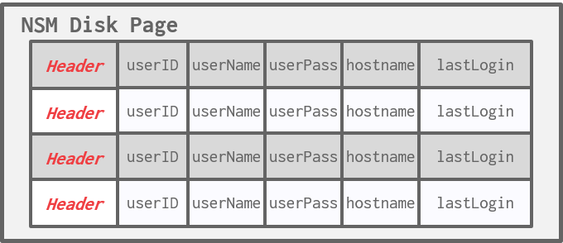
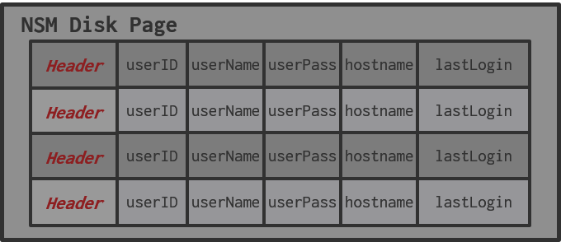
Searching a Heap File
6
SELECT * FROM useracct
WHERE userName = ?
AND userPass = ?
Index
NSM Disk Page
header
userID
userName
userPass
hostname
lastLogin
header
userID
userName
userPass
hostname
lastLogin
header
userID
userName
userPass
hostname
lastLogin
Database File
header
-
-
-
-
-
Disk

Slide 7
Indexes vs. Filters
7
An index data structure over a subset of a table's attributes that are organized and/or sorted to provide the location of specific tuples using those attributes.
Example: B+Tree
A filter is a data structure that answers set membership queries; it tells you whether a record (likely) exists for a key but not where it is located.
Example: Bloom Filter

Slide 8
Today's Agenda
8
B+Tree Overview
Design Choices
Optimizations

Slide 9
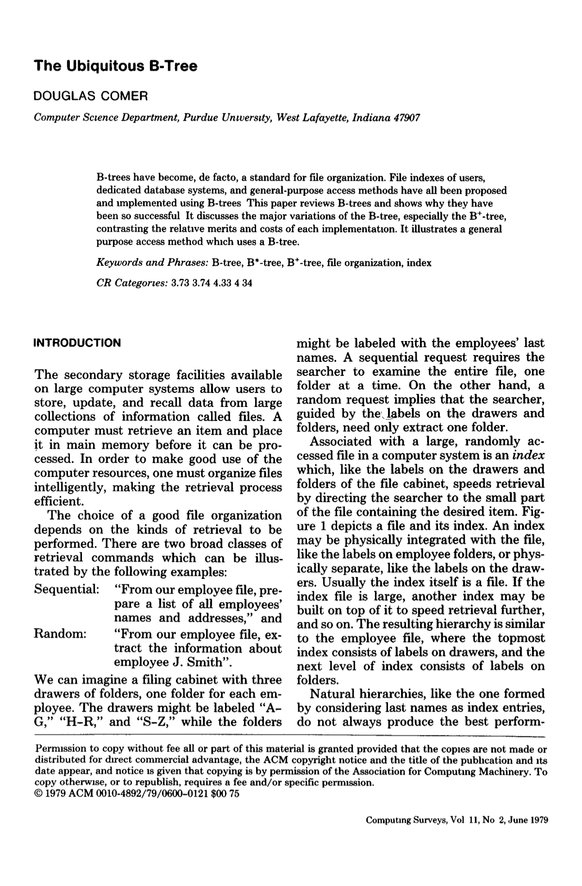
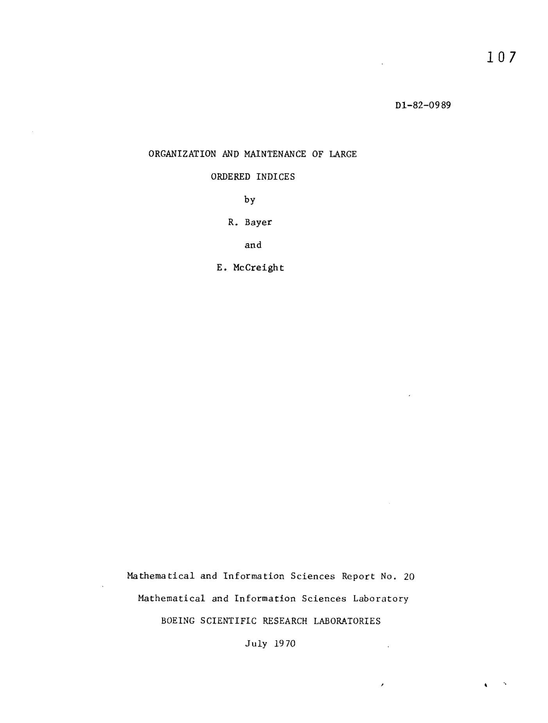
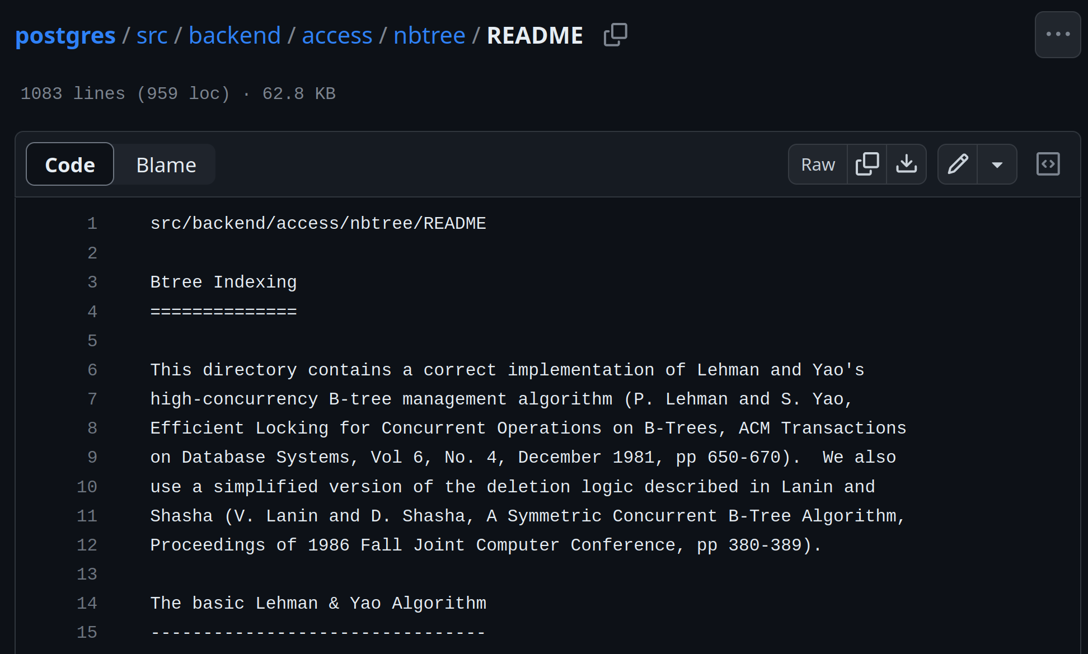
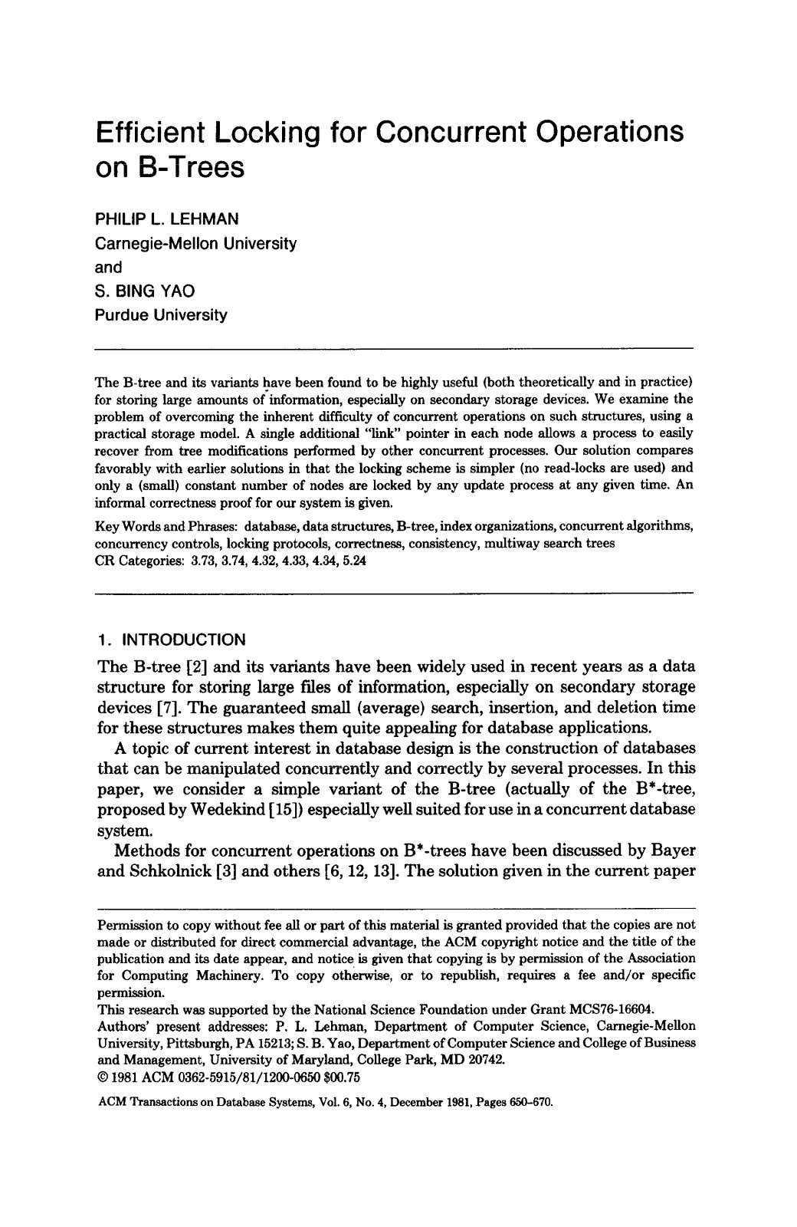
B-Tree Family
9
There is a specific data structure called a B-Tree.
People also use the term to generally refer to a class of balanced tree data structures:
B-Tree (1970)
B+Tree (1973)
B*Tree (1977?)
B^{link}-Tree (1981)
Bε-Tree (2003)
Bw-Tree (2013)

Slide 10
B+Tree
10
A B+Tree is a self-balancing, ordered m-way tree for searches, sequential access, insertions, and deletions in O(log_{m} n) where m is the tree fanout.
It is perfectly balanced (i.e., every leaf node is at the same depth in the tree)
Every node other than the root is at least half-full m/2-1 ≤ #keys ≤ m-1
Every inner node with k keys has k+1 non-null children.
Optimized for reading/writing large data blocks.
Some real-world implementations relax these properties, but we will ignore that for now…

Slide 11
B+Tree Example
<node*>|<key>|<node*>|<key>|<node*>
20
Root Node
<20
≥20
Sibling Pointers
Inner / Non-Leaf Nodes
10
35
<10
≥10
<35
≥35
6
10
20
31
38
44
Leaf Nodes
Index Key(s) Low→High
<key>|<value>|<key>|<value>

Slide 12

B+Tree Example
20
<20
≥20
10
35
<10
≥10
<35
≥35
6
10
20
31
38
44
Index Key(s) Low→High
"M words begin here"

Slide 13
Nodes
13
Every B+Tree node is comprised of an array of key/value pairs.
The keys are derived from the index's target attribute(s).
The associated data will differ based on whether the node is classified as an inner node or a leaf node.
The arrays are (usually) kept in sorted key order.
Store all NULL keys at either first or last leaf nodes.

Slide 14
B+tree Leaf Nodes
14
B+Tree Leaf Node
Level
Slots
Prev
Next
#
#
¤
¤
Prev
Next
Sorted Keys
Sorted Key/Value Pairs
PageID
¤
K₁
V₁
• • •
K_{n}
V_{n}
¤
PageID
¤
¤
K₁
K₂
K₃
K₄
K₅
K_{n}
K₁
¤
K₂
¤
K₃
¤
• • •
K₄
¤
K₅
¤
• • •
Values
Key + Value
¤
¤
¤
¤
¤
• • •
¤

Slide 15






Leaf Node Values
Approach #1: Record IDs
A pointer to the location of the tuple to which the index entry corresponds.
Most common implementation.
Approach #2: Tuple Data
Index-Organized Storage
Primary Key Index: Leaf nodes store the contents of the tuple.
Secondary Indexes: Leaf nodes store tuples' primary key as their values.

Slide 16
B-Tree Vs. B+Tree
16
The original B-Tree from 1971 stored keys and values in all nodes in the tree.
More space-efficient, since each key only appears once in the tree.
A B+Tree only stores values in leaf nodes. Inner nodes only guide the search process.

Slide 17
B+Tree – INSERT
17
Find correct leaf node L. Insert data entry into L in sorted order.
If L has enough space, done!
Otherwise, split L keys into L and a new node L₂
Redistribute entries evenly, copy up middle key.
Insert index entry pointing to L₂ into parent of L.
To split inner node, redistribute entries evenly, but push up middle key.
Source: Chris Re

Slide 18
B+Tree – INSERT Example (1)
18
Insert 6
4
12
<4
≥4 and <12
[4,12)
≥12
1
3
5
9
10
12
13
Node is full!

Slide 19
B+TREE – INSERT EXAMPLE (1)
19
Insert 6
4
12
<4
[4,12)
1
3
5
6
9
10
12
13

Slide 20
B+TREE – INSERT EXAMPLE (1)
20
Insert 6
4
9
?
12
<4
[4,12)
[4,9)
[9,12)
≥12
1
3
5
6
9
10
12
13

Slide 21
B+TREE – INSERT EXAMPLE (1)
21
Insert 6
Insert 8
4
9
12
1
3
5
6
8
9
10
12
13

Slide 22
B+TREE – INSERT EXAMPLE (2)
Insert 17
5
9
13
19
1
3
5
7
9
11
13
14
15
17
20
21
23
Note: New Example/Tree.

Slide 23
B+TREE – INSERT EXAMPLE (3)
Insert 17
Insert 16
5
9
13
19
1
3
5
7
9
11
13
14
15
17
20
21
23
Split the node!
Copy the middle key.
Push the key up.
No space in the node where the new key “belongs”.

Slide 24
B+TREE – INSERT EXAMPLE (3)
Insert 17
Insert 16
5
9
13
19
1
3
5
7
9
11
13
14
15
17
20
21
23
New Node!
Shuffle keys from the node that triggered the split.

Slide 25
B+TREE – INSERT EXAMPLE (3)
Insert 17
Want to create a key, pointer pair like this. But cannot insert it in the root node, which is full.
Insert 16
5
9
13
19
16
Split the root. Grow the tree!
1
3
5
7
9
11
13
14
15
16
17
20
21
23
But this is an “orphan” node! No parent node points to it.

Slide 26
B+TREE – INSERT EXAMPLE (3)
Insert 17
Insert 16
5
9
13
19
16
Split the root. Grow the tree!
1
3
5
7
9
11
13
14
15
16
17
20
21
23

Slide 27
B+TREE – INSERT EXAMPLE (3)
Insert 17
13
Insert 16
Next, need to split the “old” root, then point to the split nodes from the new root.
5
9
16
19
1
3
5
7
9
11
13
14
15
16
17
20
21
23

Slide 28
B+TREE – INSERT EXAMPLE (3)
Insert 17
13
Insert 16
<13
≥13
5
9
16
19
<5
[5,9)
[9,13)
[13,16)
[16,19)
≥19
1
3
5
7
9
11
13
14
15
16
17
20
21
23

Slide 29
B+Tree – DELETE
29
Start at root, find leaf L where entry belongs. Remove the entry. If L is at least half-full, done! If L has only m/2-1 entries,
Try to re-distribute, borrowing from sibling (adjacent node with same parent as L).
If re-distribution fails, merge L and sibling.
If merge occurred, must delete entry (pointing to L or sibling) from parent of L.
Source: Chris Re

Slide 30

B+Tree – DELETE Example (1)
Delete 6
4
9
12
1
3
5
6
9
10
9
10
12

Slide 31
B+Tree – DELETE Example (1)
Delete 6
4
9
12
1
3
5
9
10
9
12
14
Borrow from a “rich” sibling node.
Could borrow from either sibling.

Slide 32
B+Tree – DELETE Example (1)
Delete 6
4
12
9
≥9
≥12
1
3
5
9
9
10
12
14
Need to update parent node!

Slide 33
B+Tree – DELETE Example (2)
Delete 15
13
5
9
17
21
1
3
5
7
9
11
13
15
17
19
20
21
23
Borrow from a “rich” sibling node.
Note: New Example/Tree.

Slide 34
B+Tree – DELETE Example (2)
Delete 15
13
5
9
19
17
21
1
3
5
7
9
11
13
17
19
20
21
23
Need to update parent node!

Slide 35
B+Tree – DELETE Example (3)
Delete 15
13
Delete 19
5
9
19
21
1
3
5
7
9
11
13
17
19
20
21
23
Under-filled!
No “rich” sibling nodes to borrow.
Merge with a sibling

Slide 36
B+Tree – DELETE Example (3)
Delete 15
13
Delete 19
This node is under-filled!
Pull-down.
5
9
19
1
3
5
7
9
11
13
17
20
21
23

Slide 37
B+Tree – DELETE Example (3)
Delete 15
Delete 19
The tree has shrunk in height.
5
9
13
19
<5
[5,9)
[9,13)
[13,19)
≥19
1
3
5
7
9
11
13
17
20
21
23

Slide 38
Composite Index
38
A composite index is when the key is comprised of two or more attributes.
Example: Index on <a,b,c>
DBMS can use B+Tree index if the query provides a “prefix” of composite key.
Supported: (a=1 AND b=2 AND c=3)
Supported: (a=1 AND b=2)
Rarely Supported: (b=2), (c=3)
Sort Order
CREATE INDEX my_idx ON xxx (a, b DESC, c NULLS FIRST);
Null Handling

Slide 39
SELECTION CONDITIONS
39
The DBMS can use a B+Tree index if the query provides any of the attributes of the search key.
Example: Index on <a,b,c>
Supported (a=1 AND b=2 AND c=3)
Supported: (a=1 AND b=2)
Supported: (b=2), (c=3)
Not all DBMSs support this.
For a hash index, we must have all attributes in search key.

Slide 40
Selection Conditions
40
Find Key=(1,2)
Find Key=(1,*)
1 ≤ 1
2 ≤ 3
1 ≤ 1
*,1 < *,3
Find Key=(*,1)
1,3
2,2
3,3
1,1
1,2
1,3
2,1
2,2
2,3
3,3
3,4
4,1
(1,*) ≤ (2,*)
(1,1)
(1,1)
(2,1)
∅
(4,1)

Slide 41
B+Tree – Duplicate Keys
41
Approach #1: Append Record ID
Add the tuple's unique Record ID as part of the key to ensure that all keys are unique.
The DBMS can still use partial keys to find tuples.
Approach #2: Overflow Leaf Nodes
Allow leaf nodes to spill into overflow nodes that contain the duplicate keys.
This is more complex to maintain and modify.

Slide 42
B+Tree – Append Record ID
42
Insert 6
Insert <6,(Page,Slot)>
5
7
9
9
<5
<9
<7
<9
≥9
≥9
1
3
6
6
7
8
7
9
8
13
<Key,RecordId>

Slide 43
B+Tree – Overflow Leaf Nodes
43
Insert 6
Insert 7
5
9
Insert 6
<5
<7
≥9
1
3
6
7
8
9
13
6
7
6

Slide 44
NON-UNIQUE: DUPLICATE KEYS
B+Tree Leaf Node
Level
Slots
Prev
Next
#
#
¤
¤
Sorted Keys
K1
K1
K1
K2
K2
• • •
Kn
Values
¤
¤
¤
¤
¤
• • •
¤

Slide 45
NON-UNIQUE: VALUE LISTS
B+Tree Leaf Node
Level
Slots
Prev
Next
#
#
¤
¤
Sorted Keys
K1
K2
K3
K4
K5
• • •
Kn
Values
¤
¤
¤
¤
¤
• • •

Slide 46
Clustered Indexes
46
The table is stored in the sort order specified by the primary key.
Can be either heap- or index-organized storage.
Some DBMSs always use a clustered index.
If a table does not contain a primary key, the DBMS will automatically make a hidden primary key.
Other DBMSs cannot use them at all.

Slide 47
Index Scan Page Sorting
47
Retrieving tuples in the order they appear in a is generally inefficient due to redundant reads.
A better approach is to find all the tuples that the query needs and then sort them based on their page ID.
The DBMS retrieves each page once.
Scan Direction
101
102
103
104
Page 102
Page 101
Page 103
Page 101
Page 104
Page 102
Page 104
Page 102
Page 102
Page 102
Page 103
Page 102
Page 102
Page 103
Page 102
Page 103
Page 101
Page 103
Page 103
Page 104
Page 104
Page 104
Page 103
Page 104

Slide 48
Clustered Indexes
An extreme solution is "index organized storage"
-Store pages in sorted order also
Traverse to the left-most leaf page and then retrieve tuples from all leaf pages.
This will always be better than sorting data for each query.
Scan Direction
101
102
103
104
Table Pages

Slide 49


B+Tree Design Choices
Node Size
Merge Threshold
Variable-Length Keys
Intra-Node Search

Slide 50
Node Size
50
The slower the storage device, the larger the optimal node size for a B+Tree.
HDD: ~1MB
SSD: ~10KB
In-Memory: ~512B
Optimal sizes can vary depending on the workload
Leaf Node Scans vs. Root-to-Leaf Traversals

Slide 51
Merge Threshold
51
Some DBMSs do not always merge nodes when they are half full.
Average occupancy rate for B+Tree nodes is 69%.
Delaying a merge operation may reduce the amount of reorganization.
It may also be better to let smaller nodes exist and then periodically rebuild entire tree.
This is why PostgreSQL calls their B+Tree a "non-balanced" B+Tree (nbtree).

Slide 52
Variable-length Keys
52
Approach #1: Pointers
Store the keys as pointers to the tuple’s attribute.
Also called T-Trees (in-memory DBMSs)
Approach #2: Variable-Length Nodes
The size of each node in the index can vary.
Requires careful memory management.
Approach #3: Padding
Always pad the key to be max length of the key type.
Approach #4: Key Map / Indirection
Embed an array of pointers that map to the key + value list within the node.

Slide 53
Intra-Node Search
0
0
0
0
1
0
0
0
Approach #1: Linear
Scan node keys from beginning to end.
Use SIMD to vectorize comparisons.
Approach #2: Binary
Jump to middle key, pivot left/right depending on comparison.
Approach #3: Interpolation
Approximate location of desired key based on known distribution of keys.
Find Key=8
4
5
6
7
8
9
10
8
8
Find Key=8
8
8
4
5
6
7
8
9
10
_mm_cmpeq_epi32_mask(a, b)
Find Key=8
Offset: (8-4)*7/(10-4)=4
4
5
6
7
8
9
10

Slide 54
Optimizations
54
Prefix Compression
Deduplication
Suffix Truncation
Pointer Swizzling
Bulk Insert
Buffered Updates
Many more…

Slide 55
Prefix Compression
55
Sorted keys in the same leaf node are likely to have the same prefix.
Instead of storing the entire key each time, extract common prefix and store only unique suffix for each key.
Many variations.
robbed
robbing
robot
Prefix: rob
bed
bing
ot

Slide 56
KEY MAP / INDIRECTION
B+Tree Leaf Node
Level
Slots
Prev
Next
#
#
¤
¤
Sorted Key Map
¤
P·¤
A·¤
¤
L·¤
¤
O·¤
¤
Key+Values
Prashanth
V4
Lin
V2
Andy
V1
Obama
V3

Slide 57
Deduplication
Non-unique indexes can end up storing multiple copies of the same key in leaf nodes.
The leaf node can store the key once and then maintain a "posting list" of tuples with that key.
K₁
V₁
K₁
V₂
K₁
V₃
K₂
V₄
K₁
V₁
V₂
V₃
K₂
V₄

Slide 58
Suffix Truncation
58
The keys in the inner nodes are only used to "direct traffic".
We don't need the entire key.
Store a minimum prefix that is needed to correctly route probes into the index.
abcdefghijk
abc
lmn
lmnopqrstuv
…
…
…
…

Slide 59
Pointer Swizzling
Nodes use page ids to reference other nodes in the index. The DBMS must get the memory location from the page table during traversal.
If a page is pinned in the buffer pool, then we can store raw pointers instead of page ids. This avoids address lookups from the page table.
Find(3)
6
9
Page #2
<Page*>
Page #3
<Page*>
1
3
6
7
Page #2 → <Page*>
Page #3 → <Page*>
1
Header
2
Header
3
Header
Buffer Pool

Slide 60
Bulk Insert
60
The fastest way to build a new B+Tree for an existing table is to first sort the keys and then build the index from the bottom up.
Keys: 3, 7, 9, 13, 6, 1
Sorted Keys: 1, 3, 6, 7, 9, 13
6
9
1
3
6
7
9
13

Slide 61
Observation
Modifying a B+tree is expensive when the DBMS has to split/merge nodes.
Worst case is when DBMS reorganizes the entire tree.
The worker that causes a split/merge is responsible for doing the work.
What if there was a way to delay updates and then apply multiple changes together in a batch?

Slide 62





Write-Optimized B+Tree (Bε-Tree)
Instead of immediately applying updates, store changes to key/value entries in log buffers at inner nodes.
aka Fractal Trees / Bε-trees.
Updates cascade down to lower nodes incrementally when buffers get full.
Insert 7
Find 10
Insert 40
Delete 10
Insert 7
20
Mod Log
Insert 40
Delete 10
10
35
6
10
20
38

Slide 63
PARTIAL INDEXES
Create an index on a subset of the entire table. This potentially reduces its size and the amount of overhead to maintain it.
One common use case is to partition indexes by date ranges.
Create a separate index per month, year.
CREATE INDEX idx_foo ON foo (a, b)
WHERE c = 'WuTang';
SELECT b FROM foo WHERE a = 123 AND c = 'WuTang';

Slide 64
COVERING INDEXES
If all the fields needed to process the query are available in an index, then the DBMS does not need to retrieve the tuple.
This reduces contention on the DBMS's buffer pool resources.
Also called index-only scans.
CREATE INDEX idx_foo ON foo (a, b);
SELECT b FROM foo WHERE a = 123;

Slide 65
INDEX INCLUDE COLUMNS
Embed additional columns in indexes to support index-only queries.
These extra columns are only stored in the leaf nodes and are not part of the search key.
CREATE INDEX idx_foo ON foo (a, b)
INCLUDE (c);
SELECT b FROM foo WHERE a = 123 AND c = 'WuTang';

Slide 66

FUNCTIONAL/EXPRESSION INDEXES
An index does not need to store keys in the same way that they appear in their base table.
You can use expressions when declaring an index.
SELECT * FROM users
WHERE EXTRACT(dow ⮱FROM login) = 2;
CREATE INDEX idx_user_login ON users (login);
CREATE INDEX idx_user_login ON users (EXTRACT(dow FROM login));
CREATE INDEX idx_user_login ON foo (login) WHERE EXTRACT(dow FROM login) = 2;

Slide 67
IMPLICIT INDEXES
Most DBMSs automatically create an index to enforce integrity constraints but not referential constraints (foreign keys).
Primary Keys
Unique Constraints
CREATE INDEX foo_val1_key ON foo (val1);
CREATE TABLE foo (
id SERIAL PRIMARY KEY,
val1 INT NOT NULL,
val2 VARCHAR(32) UNIQUE
);
X
CREATE TABLE foo (
id SERIAL PRIMARY KEY,
val1 INT NOT NULL UNIQUE,
val2 VARCHAR(32) UNIQUE
);
CREATE UNIQUE INDEX foo_pkey ON foo (id);
CREATE TABLE bar (
id INT REFERENCES foo (val1),
val VARCHAR(32)
);
CREATE UNIQUE INDEX foo_val2_key ON foo (val2);

Slide 68
Conclusion
68
The venerable B+Tree is (almost) always a good choice for your DBMS.

Slide 69
Next Week
69
Zhongrui takes over for 2 classes
More algorithms and data structures used inside the DBMS
Hash Tables
Sorting (external sort)

Slide 70
TABLE INDEXES
70
It is the DBMS's job to figure out the best index(es) to use to execute each query.
There is a trade-off regarding the number of indexes to create per database.
Storage Overhead
Maintenance Overhead

Slide 71
DEMO
B+Tree vs. Hash Indexes
Table Clustering

Slide 72
B+TREE PROPERTIES
72
A B+Tree is an m-way search tree with the following properties:
It is perfectly balanced (i.e., every leaf node is at the same depth in the tree)
Every node other than the root is at least half-full m/2-1 ≤ #keys ≤ m-1
Every inner node with k keys has k+1 non-null children.

