Slide 1
COMP 421: Files & Databases
Lecture 1: The Relational Algebra

Slide 2
Announcements
Thanks for RSVPing to Bootcamp 1:
Monday, 8/24 @ 6:30
Tuesday, 8/25 @ 6:30

Slide 3
Announcements
Please fill out the when2meet poll for office hours on canvas
Stopgap office hours: Friday 8/21, 10:00 - 12:00, FB 336
You should be starting on P0
Please have your dev environment set up before Bootcamp 1
Follow instructions on P0 / Github README
Come resolve issues on Friday

Slide 4
Today…
4
Database Systems Background
Relational Model
Relational Algebra
Alternative Data Models

Slide 5
Database
5
Organized collection of inter-related data that models some aspect of the real-world.
Databases are the core component of most computer applications.

Slide 6
Database Example
6
Create a database that models a digital music store to keep track of artists and albums.
Information we need to keep track of in our store:
Information about Artists
The Albums those Artists released

Slide 7
Flat File Strawman
7
Store our database as comma-separated value (CSV) files that we manage ourselves in application code.
Use a separate file per entity.
The application must parse the files each time they want to read/update records.
Artist(name, year, country)
Album(name, artist, year)
"Wu-Tang Clan",1992,"USA"
"Notorious BIG",1993,"USA"
"GZA",1991,"USA"
"Enter the Wu-Tang","Wu-Tang Clan",1993
"St.Ides Mix Tape","Wu-Tang Clan",1994
"Liquid Swords","GZA",1995

Slide 8
Flat File Strawman
8
Example: Get the year of the first GZA album.
Artist(name, year, country)
"Wu-Tang Clan",1992,"USA"
"Notorious BIG",1993,"USA"
"GZA",1991,"USA"
for line in file.readlines():
record = parse(line)
if record[0] == "GZA":
print(int(record[1]))

Slide 9
Flat Files: Data Integrity
9
How do we ensure that the artist is spelled the same for each album entry?
What if somebody overwrites the album year with an invalid string?
What if there are multiple artists on an album?
What happens if we delete an artist that has albums?

Slide 10
Flat Files: Implementation
10
How do you find a particular record?
What if we now want to create a new application that uses the same database? What if that application is running on a different machine?
What if two threads try to write to the same file at the same time?

Slide 11
Flat Files: Durability
11
What if the machine crashes while our program is updating a record?
What if we want to replicate the database on multiple machines for high availability?

Slide 12

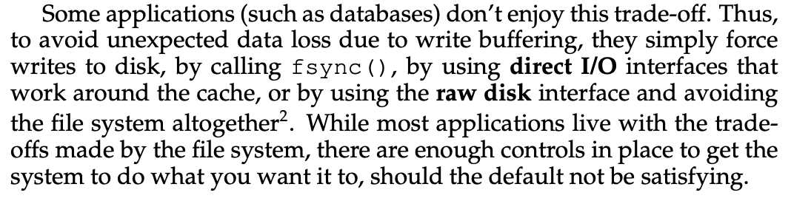
Flat Files: Durability
12

Slide 13
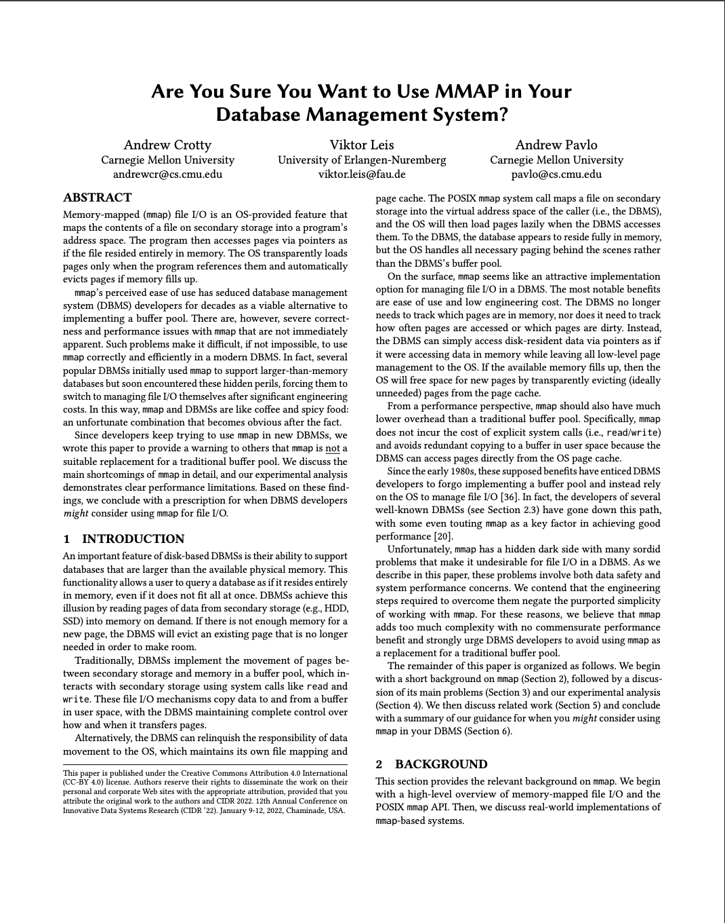
Flat Files: Durability
13

Slide 14
Database Management System
14
A database management system (DBMS) is software that allows applications to store and analyze information in a database.
A general-purpose DBMS supports the definition, creation, querying, update, and administration of databases in accordance with some data model.

Slide 15
Data Models
15
A data model is a collection of concepts for describing the data in a database.
A schema is a description of a particular collection of data, using a given data model.
This defines the structure of data for a data model.
Otherwise, you have random bits with no meaning.
Preview of the relational model
CREATE TABLE Artist(name VARCHAR, year DATE, country CHAR(60));
CREATE TABLE Album(Albumid INTEGER, name VARCHAR, year DATE);
● ● ●

Slide 16
Data Models
← Most DBMSs
← This Course
Relational
Key/Value
Graph
Document / JSON / XML / Object
Wide-Column / Column-family
Array (Vector, Matrix, Tensor)
Hierarchical
Network
Semantic
Entity-Relationship
← Simple Apps / Caching
← NoSQL
← ML / Science
← Obsolete / Legacy / Rare

Slide 17
Early DBMSs
17
Early database applications were difficult to build and maintain on available DBMSs in the 1960s.
Examples: IDS, IMS, CODASYL
Computers were expensive, humans were cheap.
Tight coupling between logical and physical layers.
Programmers had to (roughly) know what queries the application would execute before they could deploy the database.

Slide 18
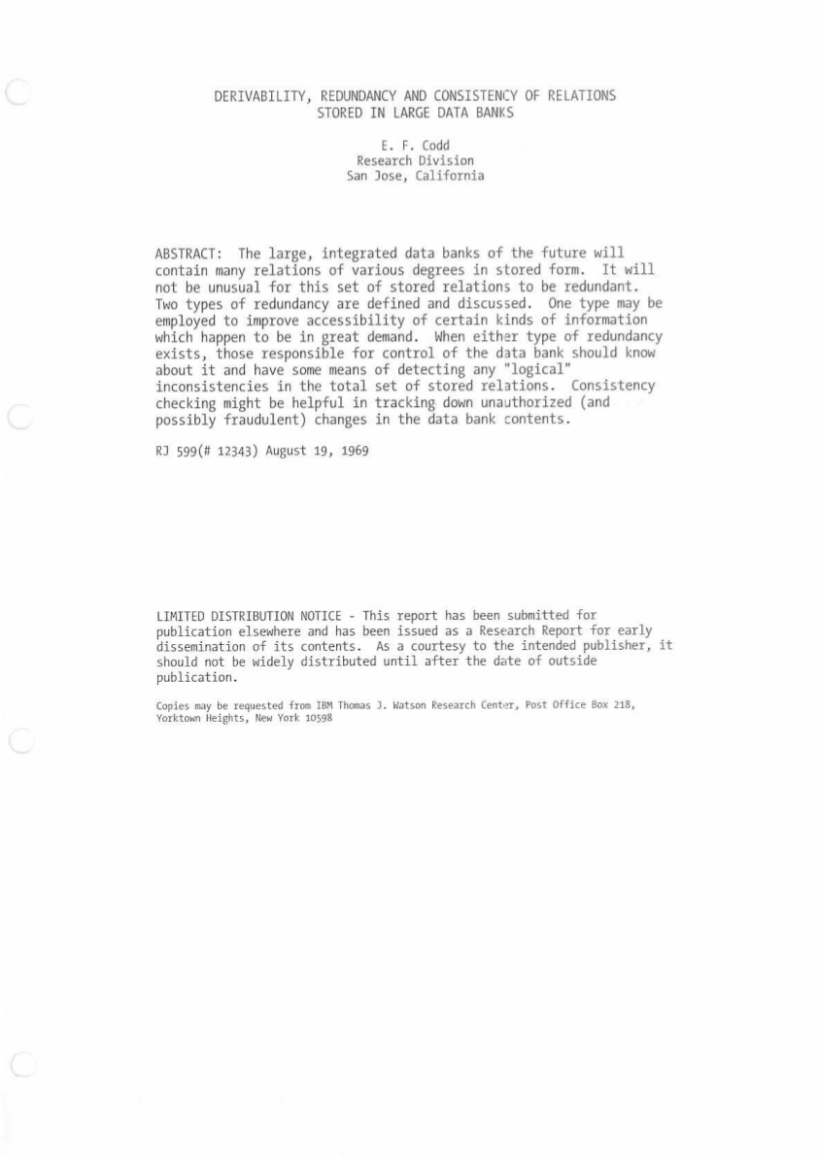
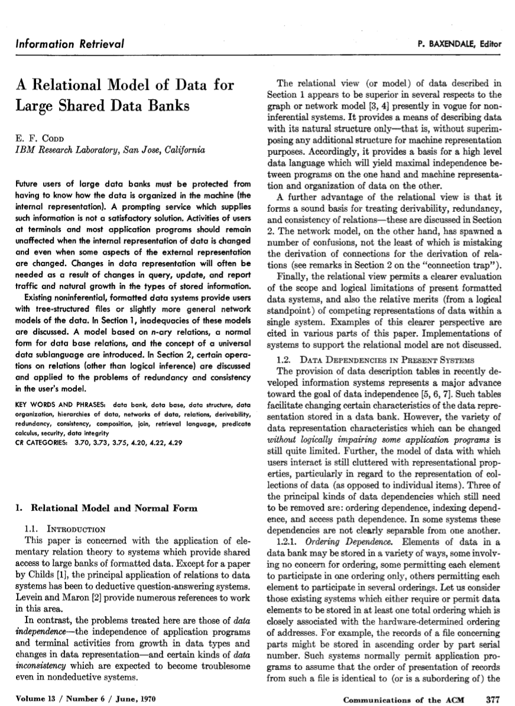
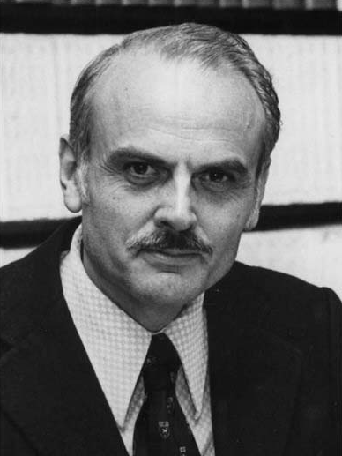
Early DBMSs
18
Ted Codd was a mathematician at IBM Research in the late 1960s.
Codd saw IBM’s developers rewriting database programs every time the database’s schema or layout changed.
Devised the relational model in 1969.
Edgar F. Codd

Slide 19
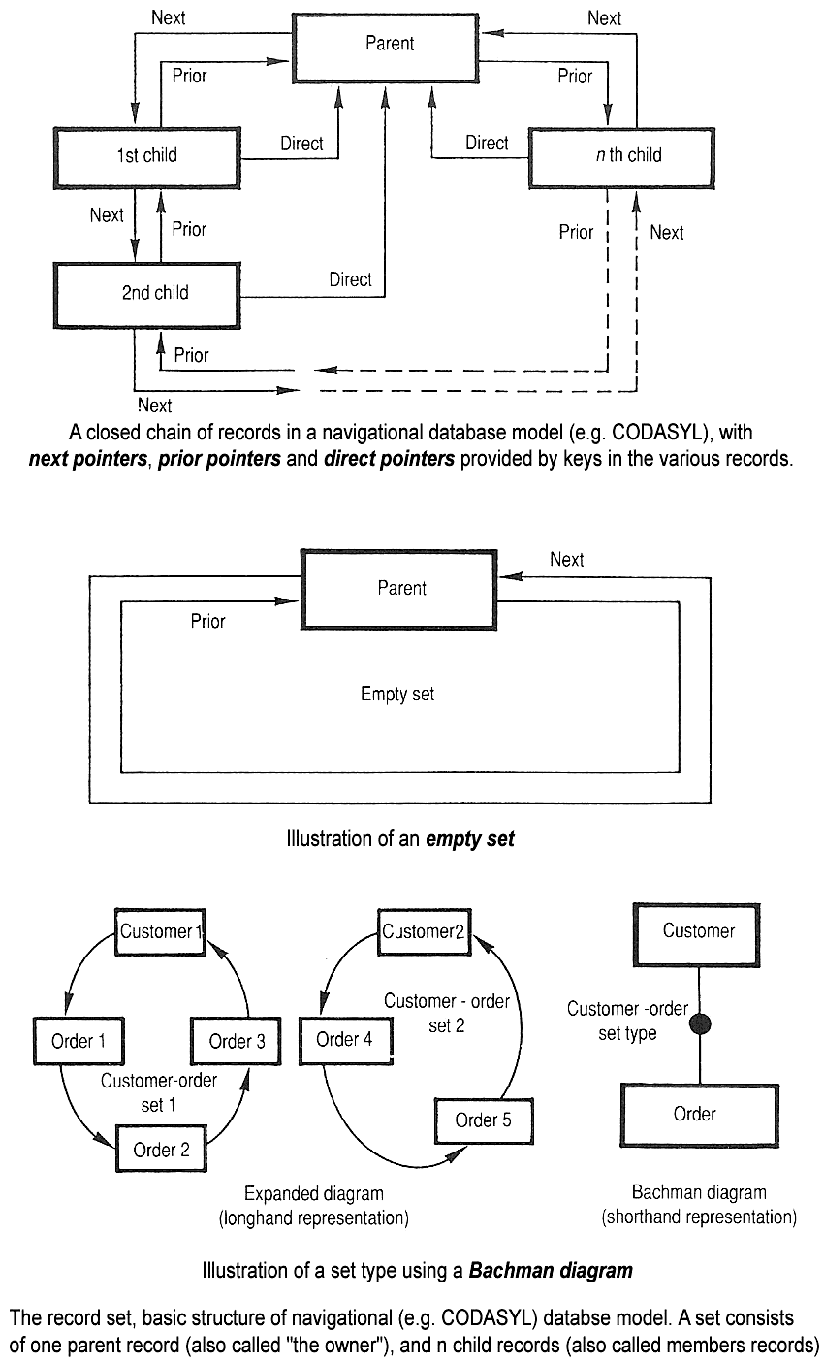
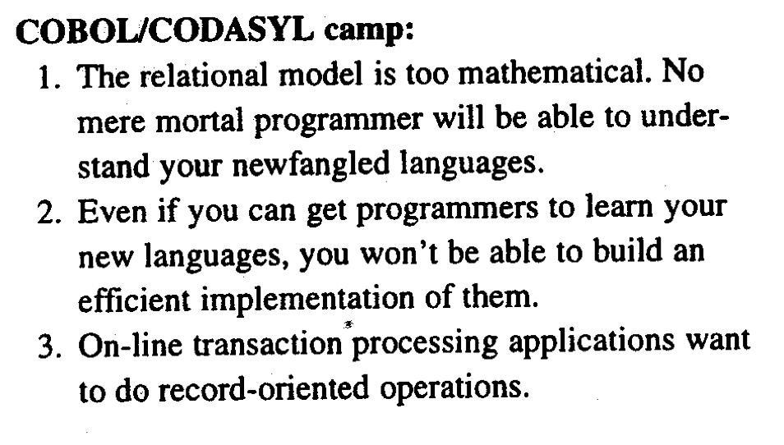
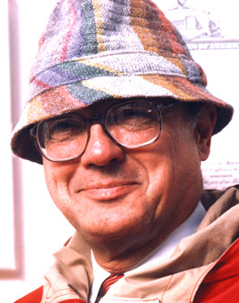
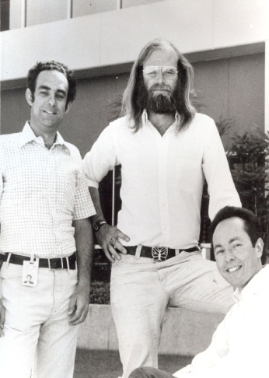
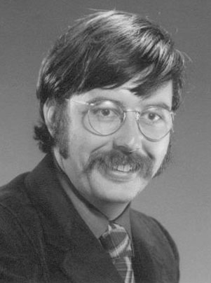
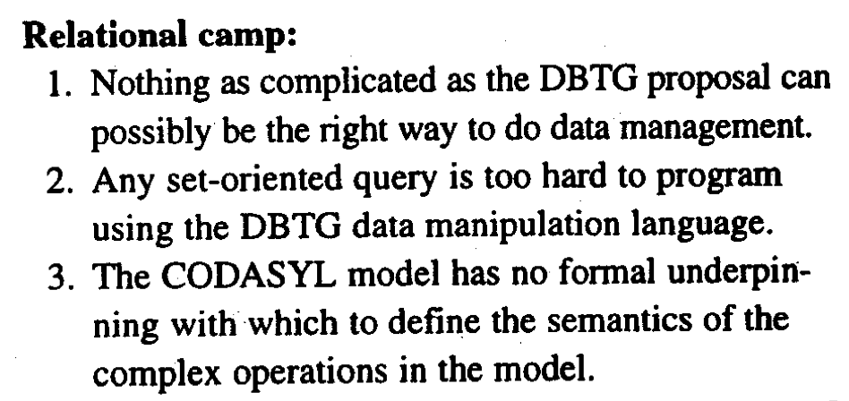
CODASYL
The Differences and Similarities Between the Data Base Set and Relational Views of Data.
ACM SIGFIDET Workshop on Data Description, Access, and Control in Ann Arbor, Michigan, held 1–3 May 1974
Codd
Bachman
Gray
Stonebraker

Slide 20
Relational Model
20
The relational model defines a database abstraction based on relations to avoid maintenance overhead.
Key tenets:
Represent database using simple data structures (relations).
Physical storage left up to the DBMS implementation.
Access data through high-level language, DBMS figures out best execution strategy.

Slide 21
Relational Model
21
Structure: The definition of the database’s relations and their contents independent of their physical representation.
Integrity: Ensure the database’s contents satisfy constraints.
Manipulation: Programming interface for accessing and modifying a database's contents.

Slide 22
Data Independence
22
Isolate the user/application from low-level data representation.
The user only worries about high-level application logic.
DBMS optimizes the layout according to operating environment, database contents, and workload.
DBMS can then re-optimize the database if/when these factors changes.
Application
Application
External Schema
External Schema
Views (SQL)
Logical Data Independence
Logical Schema
Physical Data Independence
Schema, Constraints… (SQL)
Physical Schema
Pages, Files, Extents…
Database Storage

Slide 23
Relational Model
23
A relation is an unordered set of elements describing some entities. Each element in a relation is described via the same attributes.
Elements are modeled as tuples: a list of attribute values.
Domain: possible attribute values
Values are (normally) atomic/scalar.
The special value NULL is a member of every domain (if allowed).
Artist(name, year, country)
name | year | country
Wu-Tang Clan | 1992 | USA
Notorious BIG | 1992 | USA
GZA | 1990 | USA
n-ary Relation
=
Table with n columns

Slide 24
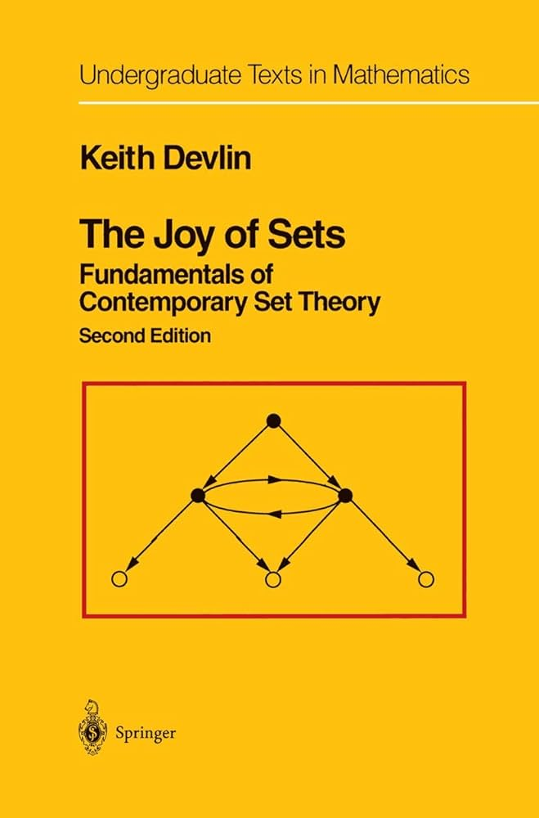
Relational Model
24
A relation is an unordered set of elements describing some entities. Each element in a relation is described via the same attributes.
Elements are modeled as tuples: a list of attribute values.
Domain: possible attribute values
Values are (normally) atomic/scalar.
The special value NULL is a member of every domain (if allowed).
Artist(name, year, country)
name | year | country
Wu-Tang Clan | 1992 | USA
Notorious BIG | 1992 | USA
GZA | 1990 | USA
n-ary Relation
=
Table with n columns

Slide 25
Relational Model
25
Structure: The definition of the database’s relations and their contents independent of their physical representation.
Integrity: Ensure the database’s contents satisfy constraints.
Manipulation: Programming interface for accessing and modifying a database's contents.

Slide 26
Relational Model: Primary Keys
26
A relation's primary key uniquely identifies a single tuple.
Some DBMSs automatically create an internal primary key if a table does not define one.
DBMS can auto-generation unique primary keys via an identity column:
IDENTITY (SQL Standard)
SEQUENCE (PostgreSQL / Oracle)
AUTO_INCREMENT (MySQL)
Artist(id, name, year, country)
Artist(name, year, country)
id | name | year | country
101 | Wu-Tang Clan | 1992 | USA
102 | Notorious BIG | 1992 | USA
103 | GZA | 1990 | USA
name | year | country
Wu-Tang Clan | 1992 | USA
Notorious BIG | 1992 | USA
GZA | 1990 | USA

Slide 27
Relational Model: Foreign Keys
27
A foreign key specifies that an attribute from one relation must map to some attribute of a tuple in another relation.
Artist(id, name, year, country)
id | name | year | country
101 | Wu-Tang Clan | 1992 | USA
102 | Notorious BIG | 1992 | USA
103 | GZA | 1990 | USA
ArtistAlbum(artist_id, album_id)
artist_id | album_id
101 | 11
101 | 22
103 | 22
102 | 22
Album(id, name, artists, year)
Album(id, name, year)
id | name | artists | year
11 | Enter the Wu-Tang | 101 | 1993
22 | St.Ides Mix Tape | ??? | 1994
33 | Liquid Swords | 103 | 1995
id | name | year
11 | Enter the Wu-Tang | 1993
22 | St.Ides Mix Tape | 1994
33 | Liquid Swords | 1995

Slide 28
Relational Model: Foreign Keys
28
Parent
Artist(id, name, year, country)
id | name | year | country
101 | Wu-Tang Clan | 1992 | USA
102 | Notorious BIG | 1992 | USA
103 | GZA | 1990 | USA
Child
Child
ArtistAlbum(artist_id, album_id)
artist_id | album_id
101 | 11
101 | 22
103 | 22
102 | 22
Parent
Album(id, name, year)
id | name | year
11 | Enter the Wu-Tang | 1993
22 | St.Ides Mix Tape | 1994
33 | Liquid Swords | 1995

Slide 29
Relational Model: Constraints
29
Artist(id, name, year, country)
User-defined conditions that must hold for any instance of the database.
Can validate data within a single tuple or across entire relation(s).
DBMS prevents modifications that violate any constraint.
Unique key and referential (fkey) constraints are the most common.
SQL:92 supports global asserts but these are rarely used (too slow).
id | name | year | country
101 | Wu-Tang Clan | 1992 | USA
102 | Notorious BIG | 1992 | USA
103 | GZA | 1990 | USA
CREATE TABLE Artist ( name VARCHAR NOT NULL, year INT, country CHAR(60),
CHECK (year > 1900)
);
CREATE ASSERTION myAssert CHECK ( <SQL> );

Slide 30
Relational Model
30
Structure: The definition of the database’s relations and their contents independent of their physical representation.
Integrity: Ensure the database’s contents satisfy constraints.
Manipulation: Programming interface for accessing and modifying a database's contents.

Slide 31
Data Manipulation Languages (DML)
31
The API that a DBMS exposes to applications to store and retrieve information from a database.
Procedural:
The query specifies the (high-level) strategy to find the desired result based on sets / bags.
Non-Procedural (Declarative):
The query specifies only what data is wanted and not how to find it.
← Relational Algebra
← Relational Calculus

Slide 32
Relational Algebra
32
Fundamental operations to retrieve and manipulate tuples in a relation.
Based on set algebra (unordered lists with no duplicates).
Each operator takes one or more relations as its inputs and outputs a new relation.
We can “chain” operators together to create more complex operations.
σ | Select
π | Projection
∪ | Union
∩ | Intersection
– | Difference
× | Product
⋈ | Join

Slide 33
Relational Algebra: Select
33
Choose a subset of the tuples from a relation that satisfies a selection predicate.
Predicate acts as a filter to retain only tuples that fulfill its qualifying requirement.
Can combine multiple predicates using conjunctions / disjunctions.
Syntax: σ_{predicate}(R)
R(a_id,b_id)
a_id | b_id
a1 | 101
a2 | 102
a2 | 103
a3 | 104
σ_{a_id='a2'}(R)
σ_{a_id='a2'∧ b_id>102}(R)
a_id | b_id
a2 | 102
a2 | 103
a_id | b_id
a2 | 103
SELECT * FROM R WHERE a_id='a2' AND b_id>102;

Slide 34
Relational Algebra: Projection
34
Generate a relation with tuples that contains only the specified attributes.
Rearrange attributes’ ordering.
Remove unwanted attributes.
Manipulate values to create derived attributes.
Syntax: Π_{A1,A2,…,An}(R)
R(a_id,b_id)
a_id | b_id
a1 | 101
a2 | 102
a2 | 103
a3 | 104
Π_{b_id-100,a_id}(σ_{a_id='a2'}(R))
b_id-100 | a_id
2 | a2
3 | a2
SELECT b_id-100, a_id FROM R WHERE a_id = 'a2';

Slide 35
Relational Algebra: Union
35
Generate a relation that contains all tuples that appear in at least one input relation.
Syntax: (R ∪ S)
R(a_id,b_id)
S(a_id,b_id)
a_id | b_id
a1 | 101
a2 | 102
a3 | 103
a_id | b_id
a3 | 103
a4 | 104
a5 | 105
(R ∪ S)
a_id | b_id
a1 | 101
a2 | 102
a3 | 103
a4 | 104
a5 | 105
(SELECT * FROM R)
UNION
(SELECT * FROM S);

Slide 36
Relational Algebra: Intersection
36
Generate a relation that contains only the tuples that appear in both of the input relations.
Syntax: (R ∩ S)
R(a_id,b_id)
S(a_id,b_id)
a_id | b_id
a1 | 101
a2 | 102
a3 | 103
a_id | b_id
a3 | 103
a4 | 104
a5 | 105
(R ∩ S)
a_id | b_id
a3 | 103
(SELECT * FROM R)
INTERSECT
(SELECT * FROM S);

Slide 37
Relational Algebra: Difference
37
Generate a relation that contains only the tuples that appear in the first and not the second of the input relations.
Syntax: (R – S)
R(a_id,b_id)
S(a_id,b_id)
a_id | b_id
a1 | 101
a2 | 102
a3 | 103
a_id | b_id
a3 | 103
a4 | 104
a5 | 105
(R – S)
a_id | b_id
a1 | 101
a2 | 102
(SELECT * FROM R)
EXCEPT
(SELECT * FROM S);

Slide 38
Relational Algebra: Cartesian Product
38
Generate a relation that contains all possible combinations of tuples from the input relations.
Syntax: (R × S)
R(a_id,b_id)
S(a_id,b_id)
a_id | b_id
a1 | 101
a2 | 102
a3 | 103
a_id | b_id
a3 | 103
a4 | 104
a5 | 105
(R × S)
R.a_id | R.b_id | S.a_id | S.b_id
a1 | 101 | a3 | 103
a1 | 101 | a4 | 104
a1 | 101 | a5 | 105
a2 | 102 | a3 | 103
a2 | 102 | a4 | 104
a2 | 102 | a5 | 105
a3 | 103 | a3 | 103
a3 | 103 | a4 | 104
a3 | 103 | a5 | 105
SELECT * FROM R CROSS JOIN S;
SELECT * FROM R, S;

Slide 39
Relational Algebra: Join
39
Generate a relation that contains all tuples that are a combination of two tuples (one from each input relation) with a common value(s) for one or more attributes.
Syntax: (R ⋈ S)
R(a_id,b_id)
S(a_id,b_id,val)
a_id | b_id
a1 | 101
a2 | 102
a3 | 103
a_id | b_id | val
a3 | 103 | XXX
a4 | 104 | YYY
a5 | 105 | ZZZ
(R ⋈ S)
R.a_id | R.b_id | S.a_id | S.b_id | S.val
a3 | 103 | a3 | 103 | XXX
a_id | b_id | val
a3 | 103 | XXX
SELECT * FROM R NATURAL JOIN S;
SELECT * FROM R JOIN S USING (a_id, b_id);
SELECT * FROM R JOIN S ON R.a_id = S.a_id AND R.b_id = S.b_id;

Slide 40
Relational Algebra: Extra Operators
40
Rename (ρ)
Assignment (R←S)
Duplicate Elimination (δ)
Aggregation (γ)
Sorting (τ)
Division (R÷S)

Slide 41
Observation
41
Relational algebra defines an ordering of the high-level steps of how to compute a query.
Example: σ_{b_id=102}(R⋈S) vs. R⋈(σ_{b_id=102}(S))
A better approach is to state the high-level answer that you want the DBMS to compute.
Example: Retrieve the joined tuples from R and S where b_id equals 102.

Slide 42

Data Manipulation Languages (DML)
42
Procedural:
The query specifies the (high-level) strategy to find the desired result based on sets / bags.
Non-Procedural (Declarative):
The query specifies only what data is wanted and not how to find it.
← Relational Algebra
← Relational Calculus
Codd’s Theorem
Relational Algebra
Relational Calculus
$$⟺$$
“Logically Equivalent”

Slide 43
Relational Model: Queries
43
The relational model is independent of any query language implementation.
SQL is the de facto standard (many dialects).
for line in file.readlines():
record = parse(line)
if record[0] == "GZA":
print(int(record[1]))
SELECT year FROM artists WHERE name = 'GZA';

Slide 44
Data Models
44
Relational
Key/Value
Graph
Document / JSON / XML / Object
Wide-Column / Column-family
Array (Vector, Matrix, Tensor)
Hierarchical
Network
Semantic
Entity-Relationship
← This Course
← New Hotness
← Leading Alternative
← New Hotness

Slide 45

Document Data Model
45
A collection of record documents containing a hierarchy of named field/value pairs.
A field’s value can be either a scalar type, an array of values, or another document.
Modern implementations use JSON. Older systems use XML or custom object representations.
Avoid “relational-object impedance mismatch” by tightly coupling objects and database.

Slide 46
Document Data Model
46
Application Code
{
"name": "GZA",
"year": 1990,
"albums": [
{
"name": "Liquid Swords",
"year": 1995
},
{
"name": "Beneath the Surface",
"year": 1999
}
]
}
Artist
class Artist {
int id;
String name;
int year;
Album albums[];
}
class Album {
int id;
String name;
int year;
}
R₁(id,…)
⨝
ArtistAlbum
R₂(artist_id,album_id)
Artist
⨝
Album
Album
Album
R₃(id,…)

Slide 47
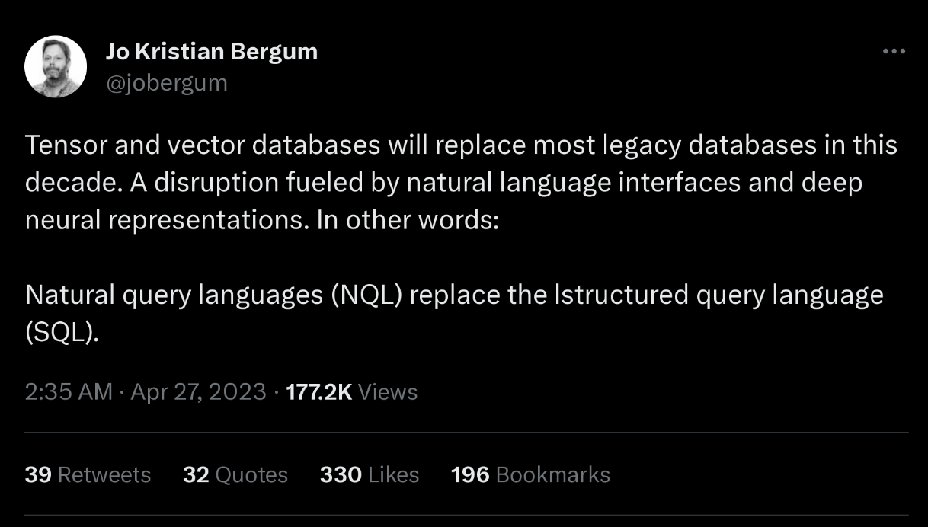

Vector Data Model
47
One-dimensional arrays used for nearest-neighbor search (exact or approximate).
Used for semantic search on embeddings generated by ML-trained transformer models (think ChatGPT).
Native integration with modern ML tools and APIs (e.g., LangChain, OpenAI).
At their core, these systems use specialized indexes to perform NN searches quickly.

Slide 48
Vector Data Model
48
Album(id, name, year)
Embeddings
id | name | year
11 | Enter the Wu-Tang | 1993
22 | St.Ides Mix Tape | 1994
33 | Liquid Swords | 1995
Id1 → [0.32, 0.78, 0.30, ...]
Id2 → [0.99, 0.19, 0.81, ...]
Transformer
Id3 → [0.01, 0.18, 0.85, ...]
⋮
Query
[0.02, 0.10, 0.24, ...]
Find albums similar to "Liquid Swords"
Vector
Index
Ranked List of Ids
HNSW, IVFFlat Meta Faiss, Spotify Annoy

Slide 49
Conclusion
49
Databases are ubiquitous.
Relational algebra defines the primitives for processing queries on a relational database.
We will see relational algebra again when we talk about query optimization + execution.

Slide 50
Next Class
50
Modern SQL
Make sure you understand basic SQL (e.g. textbook Ch. 3) before the lecture.

