Slide 1
Lecture 8: Hash Tables

Slide 2
Announcements
2
Project #1: less than 80%, come to my office hours or make an appointment. Must be working to complete project 2.
Project #2 released
Code review 1 sign ups posted

Slide 3
Project #2
3
You will build a thread-safe B+tree backed by your buffer pool manager.
  Page Layout
  Insert/Delete/Find Operations
  Iterator
  Latch Crabbing
We define the API for you. You need to provide the method implementations.
WARNING:
This is more difficult than Project #1.
Start immediately!
WARNING:
This is harder than Project #1. Start immediately!

Slide 4
Tasks
4
Task #1: Page Layouts
  How each node will store its key/values in a page.
  You only need to support unique keys.
Task #2: Operations
  Support point queries (single key).
  Support inserts with node splitting.
  Support removal of keys with sibling stealing + merging.
  Does not need to be thread-safe.

Slide 5
Tasks
5
Task #3: Index Iterator
  Create a STL iterator for range scans on leaf nodes.
  You only need to support ascending scans.
Task #4: Concurrent Index
  Introduce latch crabbing/coupling protocol to support safe concurrent operations.
  Make sure you have splits / merges working correctly before proceeding with this task.

Slide 6
Latch Crabbing/Coupling
6
Protocol to allow multiple threads to access/modify B+Tree at the same time.
  Get latch for parent
  Get latch for child
  Release latch for parent if “safe”
A safe node is one that will not split or merge when updated.
  Not full (on insertion)
  More than half-full (on deletion)

Slide 7
Latch Crabbing/Coupling
7
Find: Start at root and traverse down the tree:
  Acquire R latch on child,
  Then unlatch parent.
  Repeat until we reach the leaf node.
Insert/Delete: Start at root and go down, obtaining W latches as needed. Once child is latched, check if it is safe:
  If child is safe, release all latches on ancestors

Slide 8
Example #1 – FIND 38
8
R
T₁: Find 38
20
A
R
10
35
B
It is now safe to release the latch on A.
R
6
12
23
C
38
44
D
R
3
4
6
9
10
11
12
13
20
22
23
31
35
36
38
41
44
E
F
G
H
I

Slide 9
Example #2 – DELETE 38
9
W
T₁: Delete 38
20
A
W
10
35
B
We may need to coalesce B, so we can’t release the latch on A.
W
6
12
23
C
38
44
D
We know that D will not merge with C, so it is safe to release latches on A and B.
W
3
4
6
9
10
11
12
13
20
22
23
31
35
36
38
41
44
E
F
G
H
I

Slide 10
Example #3 – INSERT 45
10
W
T₁: Insert 45
20
A
W
10
35
B
We know that if D needs to split, B has room so it is safe to release the latch on A.
W
6
12
23
C
38
44
D
W
3
4
6
9
10
11
12
13
20
22
23
31
35
36
38
41
44
45
E
F
G
H
I
Node I will not split, so we can release B+D.

Slide 11
Example #4 – INSERT 25
11
W
T₁: Insert 25
20
A
W
10
35
B
W
6
12
23
31
C
38
44
D
W
3
4
6
9
10
11
12
13
20
22
23
31
25
35
31
36
38
41
44
We need to split F, so we need to hold the latch on its parent node.
J
E
F
G
H
I

Slide 12
Development Hints
12
Follow the textbook semantics and algorithms.
Set the page size to be small (e.g., 512B) when you first start so that you can see more splits/merges.
Make sure that you protect the internal B+Tree root_page_id member.

Slide 13
Extra Credit
13
Gradescope Leaderboard runs your code with a specialized in-memory version of BusTub.
The top 20 fastest implementations in the class will receive extra credit for this assignment.
  #1: 50% bonus points
  #2–5: 25% bonus points
  #6–10: 10% bonus points
You must pass all the test cases to qualify!

Slide 14
Observation
14
What was the first step that all the update examples did on the B+Tree?
Taking a write latch on the root every time becomes a bottleneck with higher concurrency.
Delete 38
Insert 45
Insert 25
W
W
W
20
A
20
A
20
A

Slide 15
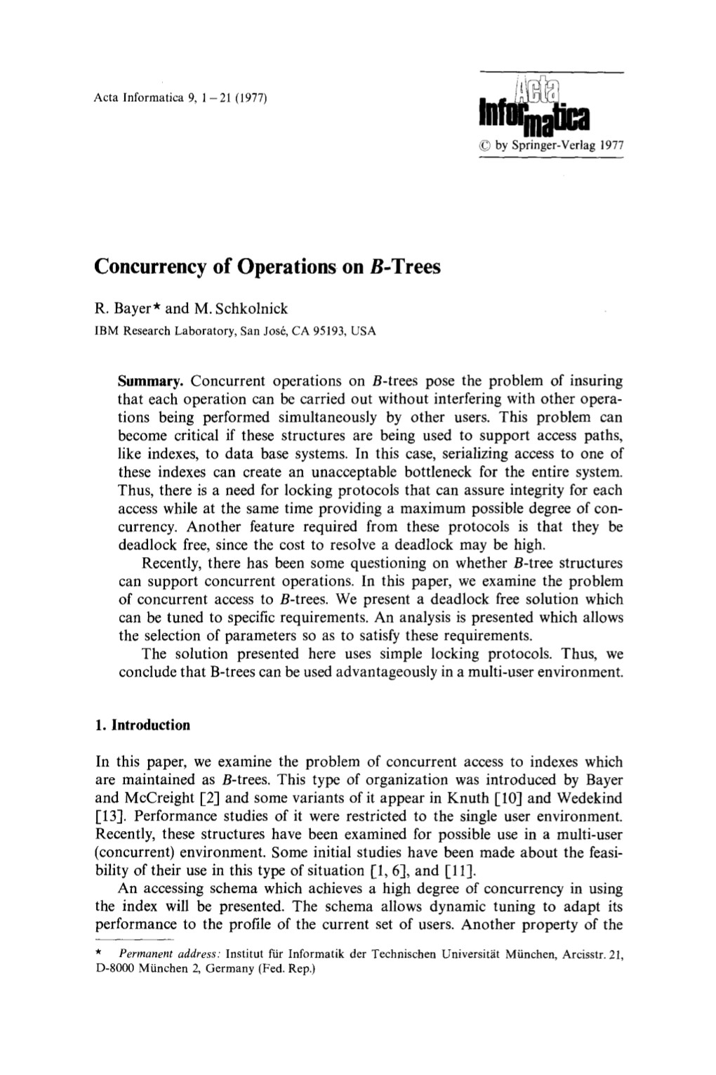
Better Latching Algorithm
Most modifications to a B+Tree will not require a split or merge.
Instead of assuming there will be a split/merge, optimistically traverse the tree using read latches.
If a worker guesses wrong, repeat traversal with pessimistic algorithm.

Slide 16
Better Latching Algorithm
16
Search: Same as before.
Insert/Delete:
  Set latches as if for search, get to leaf, and set W latch on leaf.
  If leaf is not safe, release all latches, and restart thread using previous insert/delete protocol with write latches.
This approach optimistically assumes that only leaf node will be modified; if not, R latches set on the first pass to leaf are wasteful.

Slide 17
Example #2 – DELETE 38
17
R
T₁: Delete 38
20
A
R
10
35
B
R
6
12
23
C
38
44
D
W
3
4
6
9
10
11
12
13
20
22
23
31
35
36
38
41
44
E
F
G
H
I
Node H will not coalesce,
so we’re safe!

Slide 18
Example #4 – INSERT 25
18
R
T₁: Insert 25
20
A
R
10
35
B
R
6
12
23
C
38
44
D
W
3
4
6
9
10
11
12
13
20
22
23
31
35
36
38
41
44
We need to split F, so we have to restart and re-execute like before.
E
F
G
H
I

Slide 19
Course Outline
19
We are now going to talk about how to support the DBMS's execution engine to read/write data from pages.
Two types of data structures:
  Hash Tables (Unordered)
  Trees (Ordered)
Query Planning
Operator Execution
Access Methods
Buffer Pool Manager
Disk Manager

Slide 20
Today's Agenda
20
Background
Hash Functions
Static Hashing Schemes
Dynamic Hashing Schemes

Slide 21
Data Structures
21
Internal Meta-data
Core Data Storage
Temporary Data Structures
Table Indexes

Slide 22
Design Decisions
22
Data Organization
  How we layout data structure in memory/pages and what information to store to support efficient access.
Concurrency
  How to enable multiple threads to access the data structure at the same time without causing problems.

Slide 23
Hash Tables
23
A hash table implements an unordered associative array that maps keys to values.
It uses a hash function to compute an offset into this array for a given key, from which the desired value can be found.
Space Complexity: O(n)
Time Complexity:
  Average: O(1)
  Worst: O(n)
Databases care about constants!

Slide 24
Static Hash Table
24
Allocate a giant array that has one slot for every element you need to store.
To find an entry, mod the key by the number of elements to find the offset in the array.
hash(key) % n
0
A
1
Ø
A | value
2
B
Z | value
⋮
B | value
n
Z

Slide 25
Unrealistic Assumptions
25
Assumption #1: Number of elements is known ahead of time and fixed.
Assumption #2: Each key is unique.
Assumption #3: Perfect hash function guarantees no collisions.
  If key1≠key2, then
  hash(key1)≠hash(key2)
hash(key) % n
0
1
A | value
2
Z | value
⋮
B | value
n

Slide 26
Hash Table
26
Design Decision #1: Hash Function
  How to map a large key space into a smaller domain.
  Trade-off between being fast vs. collision rate.
Design Decision #2: Hashing Scheme
  How to handle key collisions after hashing.
  Trade-off between allocating a large hash table vs. additional instructions to get/put keys.

Slide 27
Hash Functions
27
For any input key, return an integer representation of that key.
  Converts arbitrary byte array into a fixed-length code.
We want something that is fast and has a low collision rate.
We do not want to use a cryptographic hash function for DBMS hash tables (e.g., SHA-2).

Slide 28
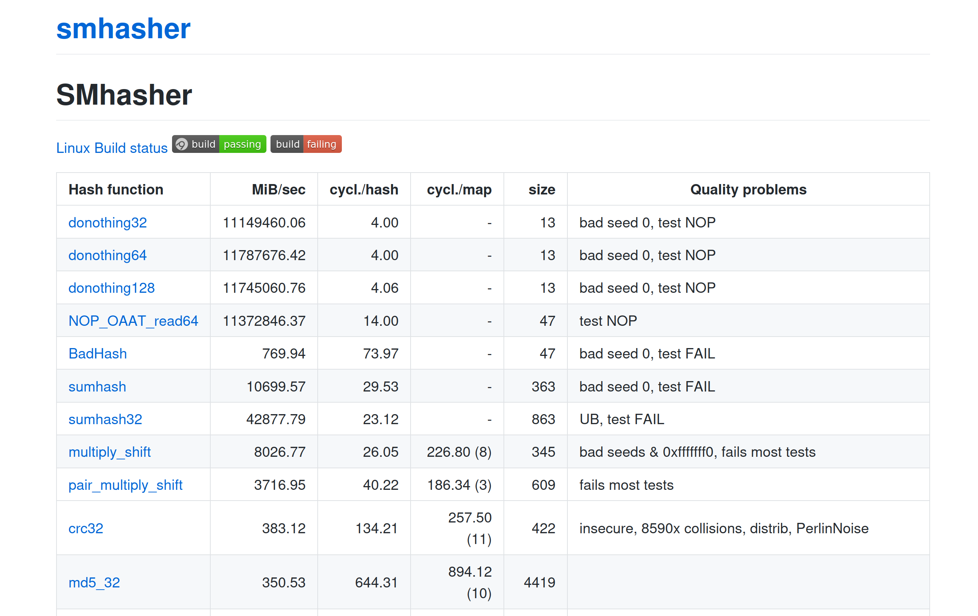
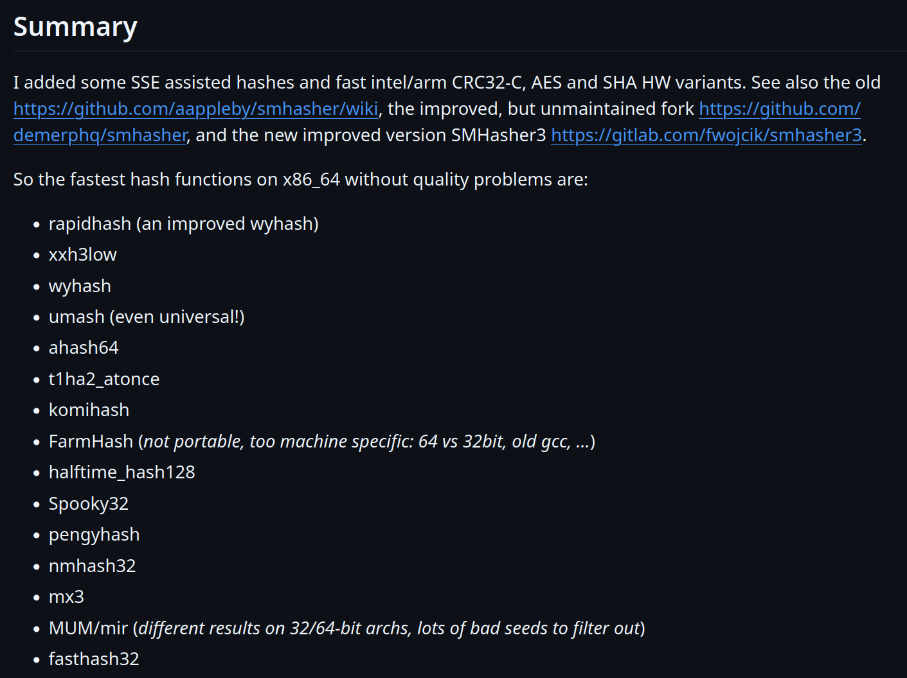
Hash Functions
28
CRC-64 (1975)
  Used in networking for error detection.
MurmurHash (2008)
  Designed as a fast, general-purpose hash function.
Google CityHash (2011)
  Designed to be faster for short keys (<64 bytes).
Facebook XXHash (2012)
  From the creator of zstd compression.
Google FarmHash (2014)
  Newer version of CityHash with better collision rates.
← State-of-the-art

Slide 29
Static Hashing Schemes
29
Approach #1: Linear Probe Hashing
Approach #2: Cuckoo Hashing
More complex schemes exist, rarely used in practice
  Robin Hood Hashing
  Hopscotch Hashing
  Swiss Tables
←
Open Addressing

Slide 30
Linear Probe Hashing
30
Single giant table of fixed-length slots.
Resolve collisions by linearly searching for the next free slot in the table.
  To determine whether an element is present, hash to a location in the table and scan for it.
  Store keys in table to know when to stop scanning.
  Insertions and deletions are generalizations of lookups.
The table's load factor determines when it is becoming too full and should be resized.
  Allocate a new table twice as large and rehash entries.

Slide 31
Linear Probe Hashing
31
hash(key) % n
B
| value
A
B
<key>|<value>
A
| value
C
C
| value
D
E
D
| value
F
E
| value
F
| value

Slide 32
Hash Table – Key/Value Entries
Fixed-length Key/Values:
  Store inline within the hash table pages.
  Optional: Store the key's hash with the key for faster comparisons.
Variable-length Key/Values:
  Insert key/value data in separate a private temporary table.
  Store the hash as the key and use the record id pointing to its corresponding entry in the temporary table as the value.
hash
key
value
hash
key
value
hash
key
value
⋮
hash
RecordId
hash
RecordId
hash
RecordId
⋮
Temp Table Page
key | value
key | value
key | value

Slide 33
Linear Probe Hashing – Deletes
33
hash(key) % n
B
| value
Approach #1: Movement
  Rehash keys until you find the first empty slot.
  Expensive! May need to reorganize the entire table.
  No DBMS does this.
A
B
A
| value
Delete
C
C
| value
Get
D
E
D
| value
F
E
| value
F
| value

Slide 34
Linear Probe Hashing – Deletes
34
hash(key) % n
Approach #2: Tombstone
  Maintain separate bit map to indicate that the entry in the slot is logically deleted.
  Reuse the slot for new keys.
  May need periodic garbage collection.
B
| value
A
B
A
| value
Delete
C
G
| value
C
| value
Get
D
E
D
| value
F
E
| value
Put
G
F
| value

Slide 35
Hash Table – Non-unique Keys
35
Value Lists
Choice #1: Separate Linked List
  Store values in separate storage area for each key.
  Value lists can overflow to multiple pages if the number of duplicates is large.
Choice #2: Redundant Keys
  Store duplicate keys entries together in
  the hash table.
  This is what most systems do.
XYZ
value1
ABC
value2
value3
value1
value2
XYZ | value2
ABC | value1
XYZ | value3
XYZ | value1
ABC | value2

Slide 36
Hash Table Latching
36
Easy to support concurrent access due to the limited ways threads access the data structure.
  All threads move in the same direction and only access a single page/slot at a time.
  Deadlocks are not possible.
To resize the table, take a global write latch on the entire table (e.g., in the header page).

Slide 37
Hash Table Latching
37
Approach #1: Page/Block Latches
  Each page/block has its own reader-writer latch that protects its entire contents.
  Threads acquire either a read or write latch before they access a page/block.
Approach #2: Slot Latches
  Each slot has its own latch.
  Can use a single-mode latch to reduce meta-data and computational overhead.

Slide 38
Hash Table: Page/Block Latches
38
It’s safe to release the latch on Page #1.
B
| value
0
T₁: Find D
T₂: Insert E
R
W
hash(D)
hash(E)
A
| value
1
C
| value
R
W
D
| value
2
E
| value

Slide 39
Hash Table: Slot Latches
39
B
| value
0
T₁: Find D
T₂: Insert E
hash(D)
R
hash(E)
It’s safe to release the latch on A
W
A
| value
R
W
1
C
| value
R
W
D
| value
W
2
E
| value

Slide 40
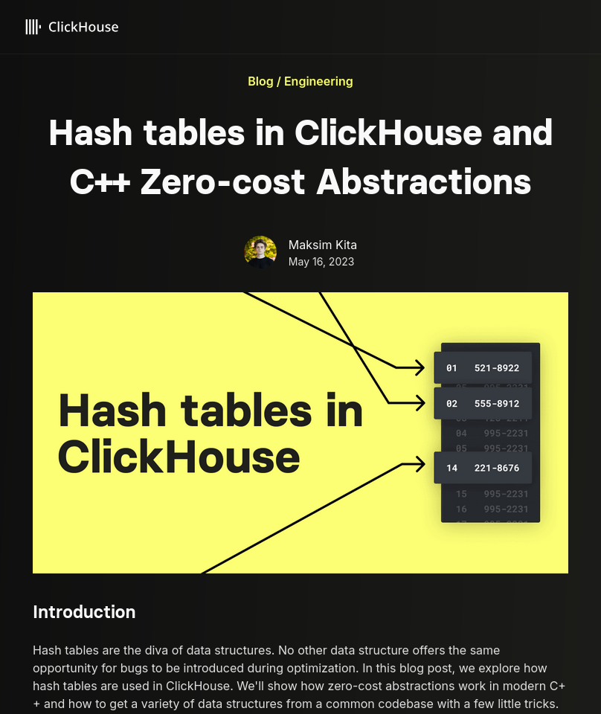
Optimizations
Specialized hash table implementations based on key type(s) and sizes.
  Example: Maintain multiple hash tables for different string sizes for a set of keys.
Store metadata separate in a separate array.
  Packed bitmap tracks whether a slot is empty/tombstone.
Use table + slot versioning metadata to quickly invalidate all entries in the hash table.
  Example: If table version does not match slot version, then treat the slot as empty.
Source: Maksim Kita

Slide 41
Cuckoo Hashing
41
Use multiple hash functions to find multiple locations in the hash table to insert records.
  On insert, check multiple locations and pick the one that is empty.
  If no location is available, evict the element from one of them and then re-hash it find a new location.
Look-ups and deletions are always O(1) because only one location per hash table is checked.

Slide 42
Cuckoo Hashing
42
Put A:
hash₁(A)
C
| value
B
| value
hash₂(A)
Put B:
hash₁(B)
| value
A
| value
hash₂(B)
B
Put C:
hash₁(C)
hash₂(C)
hash₁(B)
A
| value
hash₂(A)
Get B:
hash₁(B)
hash₂(B)

Slide 43
Observation
43
The previous hash tables require the DBMS to know the number of elements it wants to store.
  Otherwise, it must rebuild the table if it needs to grow/shrink in size.
Dynamic hash tables incrementally resize themselves as needed.
  Chained Hashing
  Extendible Hashing

Slide 44
Chained Hashing
44
Maintain a linked list of buckets for each slot in the hash table.
Resolve collisions by placing all elements with the same hash key into the same bucket.
  To determine whether an element is present, hash to its bucket and scan for it.
  Insertions and deletions are generalizations of lookups.

Slide 45
Chained Hashing
45
B
| value
hash(key) % n
Bucket
Pointers
Put A
Put B
Filter
Put C
A
| value
D
| value
Get G
Filter
n Buckets
Put D
Filter
C
| value
E
| value
Put E
Put F
Does key 'G' exist?
F
| value

Slide 46
Extendible Hashing
46
Chained-hashing approach that splits buckets incrementally instead of letting the linked list grow forever.
Multiple slot locations can point to the same bucket chain.
Reshuffle bucket entries on split and increase the number of bits to examine.
  Data movement is localized to just the split chain.

Slide 47
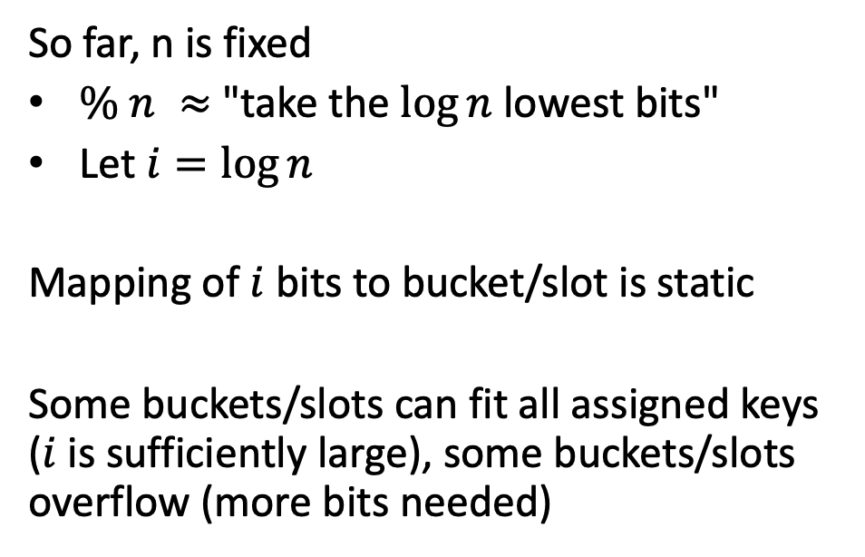
Observation
47
So far, n is fixed
$\% n ≈$ "take the $\log{n}$ lowest bits"
Let $i=\log{n}$
Mapping of $i$ bits to bucket/slot is static
Some buckets/slots can fit all assigned keys ($i$ is sufficiently large), some buckets/slots overflow (more bits needed)
hash(key) % n
0
1
A | value
2
Z | value
⋮
B | value
n
Idea: Dynamically set $i$ for each bucket to get the right number of keys

Slide 48
Extendible Hashing
48
Max number of bits to examine in hashes
global
2
00010…
1
local
3
Get A
01110…
hash(A) = 01110…
00
000
01
010
2
10101…
3
local
Hash Bits
Put B
10
100
10011…
10011…
hash(B) = 10111…
10111…
Overflow!
11
110
2
001
11010…
3
local
Put C
10101…
011
10100…
hash(C) = 10100…
10111…
101
111

Slide 49
Linear Hashing
49
The hash table maintains a pointer that tracks the next bucket to split.
  When any bucket overflows, split the bucket at the pointer location.
Use multiple hashes to find the right bucket for a given key.
Can use different overflow criterion:
  Space Utilization
  Average Length of Overflow Chains

Slide 50
Linear Hashing
50
Get 6
Split Pointer
Bucket
Pointers
8
hash₁(6) = 6%4=2
20
0
Put 17
1
5
17
hash₁(17) = 17%4=1
2
9
hash₂(8) = 8%8=0
13
3
hash₂(20) = 20%8=4
Overflow!
4
6
Get 20
hash₁(20) = 20%4=0
hash₁(key) = key % n
hash₂(20) = 20%8=4
7
hash₂(key) = key % 2n
11
20
Get 9
hash₁(9) = 9%4=1

Slide 51
Linear Hashing – Resizing
51
Splitting buckets based on the split pointer will eventually get to all overflowed buckets.
  When the pointer reaches the last slot, remove the first hash function and move pointer back to beginning.
If the "highest" bucket below the split pointer is empty, the hash table could remove it and move the splinter pointer in reverse direction.

Slide 52
Linear Hashing – Deletes
52
Split Pointer
8
Delete 20
hash₁(20) = 20%4=0
0
hash₂(20) = 20%8=4
1
5
17
2
9
21
Put 21
13
hash₁(21) = 21%4=1
3
Overflow!
4
6
hash₁(key) = key % n
7
hash₂(key) = key % 2n
11
20

Slide 53
Conclusion
53
Fast data structures that support O(1) look-ups that are used all throughout DBMS internals.
  Trade-off between speed and flexibility.
Hash tables are less common is table indexing because they are unordered

Slide 54
Next Class
54
Sorting…

Slide 55
BLOOM FILTERS
Probabilistic data structure (bitmap) that answers set membership queries.
  False negatives will never occur.
  False positives can sometimes occur.
  See Bloom Filter Calculator.
Insert(x):
  Use k hash functions to set bits in the filter to 1.
Lookup(x):
  Check whether the bits are 1 for each hash function.

Slide 56
BLOOM FILTERS
Insert('RZA')
Insert('GZA')
Lookup(RZA')
Lookup('Raekwon')
Lookup('ODB')
Bloom Filter
0
1
2
3
4
5
6
7
0
0
1
0
0
1
0
1
0
0
1
0
→ TRUE
hash₁('Raekwon') = 3333 % 8 =
hash₁('ODB') = 6699 % 8 =
hash₁('RZA') = 2222 % 8 =
hash₁('GZA') = 5555 % 8 =
6
3
5
→ FALSE
3
hash₂('Raekwon') = 8899 % 8 =
hash₂('ODB') = 9966 % 8 =
hash₂('RZA') = 4444 % 8 =
hash₂('GZA') = 7777 % 8 =
4
1
3
6
→ TRUE

Slide 57
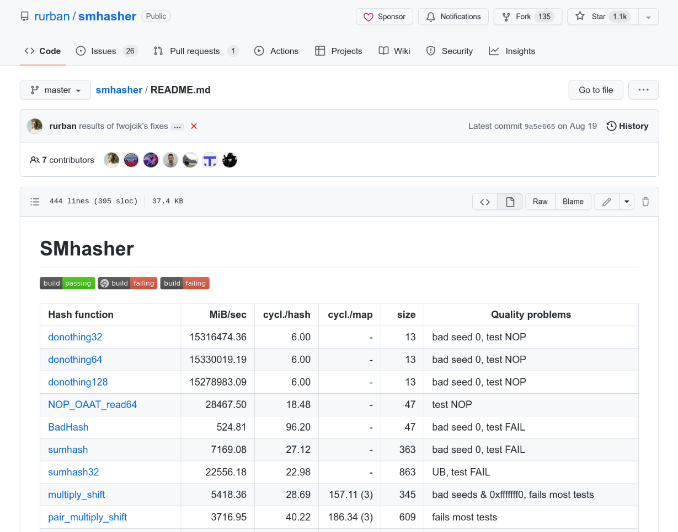
HASH FUNCTION BENCHMARK
57
Intel Core i7-8700K @ 3.70GHz
128
64
192
32
Source: Fredrik Widlund

Slide 58
ROBIN HOOD HASHING
58
Variant of linear probe hashing that steals slots from "rich" keys and give them to "poor" keys.
  Each key tracks the number of positions they are from where its optimal position in the table.
  On insert, a key takes the slot of another key if the first key is farther away from its optimal position than the second key.

Slide 59
ROBIN HOOD HASHING
59
hash(key) % N
B
| value [0]
A
B
A
| value [0]
# of "Jumps" From First Position
A[0] == C[0]
A[0] == E[0]
C
C
| value [1]
C[1] == E[1]
D
C[1] > D[0]
| value [1]
D[1] < E[2]
D
| value [2]
E
E
F
D
| value [2]
D[2] > F[0]
F
| value [1]

Slide 60
LINEAR PROBE HASHING – METADATA
How to represent that a slot is empty while also supporting null keys and tombstones?
<empty>
A
| value
Get null:
null
| value
<empty>
hash(null) % N

Slide 61
61
Be sure to pull slides from S23 to fix the cuckoo hashing example, to use only one hash table. The slide is actually in 08-trees.pptx, because I fixed it at the start of the next lecture.
Also, I think we shouldn’t bother teaching Robin Hood Hashing…

Slide 62
CUCKOO HASHING
62
Hash Table #1
Put A
Hash Table #2
hash₁(A)
hash₂(A)
C | value
B | value
Put B
A | value
B | value
hash₁(B)
hash₂(B)
Put C
A | value
hash₁(C)
hash₂(C)
⋮
⋮
hash₁(B)
hash₂(A)
Get B
hash₁(B)
hash₂(B)

Slide 63
CUCKOO HASHING PARAMETERS
# of buckets
# of hash functions
# of slots per bucket

