Slide 1
Lecture 4: It's log!

Slide 2
Last Class
2
We presented a disk-oriented architecture where the DBMS assumes that the primary storage location of the database is on non-volatile disk.
We then discussed a page-oriented storage scheme for organizing tuples across heap files.
We had just gotten to talking about how to organize bytes within a page...

Slide 3
Disk-oriented DBMS
3
Get Page #2
Execution Engine
Directory
2
Pointer to Page #2
Header
Interpret Page #2 layout
Buffer Pool
Update Page #2
Memory
3
…
Header
5
1
Header
Header
2
Header
4
Directory
Header
Database File
Pages
Disk

Slide 4
Slotted Pages
4
The most common layout scheme is called slotted pages.
The slot array maps "slots" to the tuples' starting position offsets.
The header keeps track of:
The # of used slots
The offset of the starting location of the last slot used.
Slot Array
1
2
3
4
5
6
7
Header
Tuple #4
Tuple #3
Tuple #2
Tuple #1
Fixed- and Var-length Tuple Data

Slide 5
Record IDs
5
The DBMS assigns each logical tuple a unique record identifier that represents its physical location in the database.
File Id, Page Id, Slot #
Most DBMSs do not store ids in tuple.
SQLite uses ROWID as the true primary key and stores them as a hidden attribute.
Applications should never rely on these IDs to mean anything.
CTID (6-bytes)
ROWID (8-bytes)
%%physloc%% (8-bytes)
ROWID (10-bytes)

Slide 6
Tuple-oriented Storage
6
Insert a new tuple:
Check page directory to find a page with a free slot.
Retrieve the page from disk (if not in memory).
Check slot array to find empty space in page that will fit.
Update an existing tuple using its record id:
Check page directory to find location of page.
Retrieve the page from disk (if not in memory).
Find offset in page using slot array.
If new data fits, overwrite existing data. Otherwise, mark existing tuple as deleted and insert new version in a different page.

Slide 7
Today's Agenda
7
Tuple Structure
Log-Structured Storage
Slot Array
1
2
3
4
5
6
7
Header
Tuple #4
Tuple #3
Tuple #2
Tuple #1

Slide 8
Tuple Storage
8
A tuple is essentially a sequence of bytes prefixed with a header that contains meta-data about it.
It is the job of the DBMS to interpret those bytes into attribute types and values.
The DBMS's catalogs contain the schema information about tables that the system uses to figure out the tuple's layout.

Slide 9
Data Layout
unsigned char[]
CREATE TABLE foo (
id INT PRIMARY KEY,
value BIGINT
);
header
id
value
reinterpret_cast<int32_t*>(address)

Slide 10
Word-aligned Tuples
All attributes in a tuple must be word aligned to enable the CPU to access it without any unexpected behavior or additional work.
CREATE TABLE foo (
id INT PRIMARY KEY,
cdate TIMESTAMP,
color CHAR(2),
zipcode INT
);
unsigned char[]
32-bits
64-bits
id
cdate
c
zipc
16-bits
32-bits
64-bit Word
64-bit Word
64-bit Word
64-bit Word

Slide 11
Word-alignment: Padding
Add empty bits after attributes to ensure that tuple is word aligned. Essentially round up the storage size of types to the next largest word size.
CREATE TABLE foo (
id INT PRIMARY KEY,
cdate TIMESTAMP,
color CHAR(2),
zipcode INT
);
32-bits
64-bits
id
00000000
00000000
00000000
00000000
cdate
c
zipc
00000000
00000000
16-bits
32-bits
64-bit Word
64-bit Word
64-bit Word
64-bit Word

Slide 12
Word-alignment: Reordering
Switch the order of attributes in the tuples' physical layout to make sure they are aligned.
May still have to use padding to fill remaining space.
CREATE TABLE foo (
id INT PRIMARY KEY,
cdate TIMESTAMP,
color CHAR(2),
zipcode INT
);
32-bits
32-bits
64-bits
id
cdate
c
zipc
000000000000
000000000000 000000000000
000000000000
64-bits
16-bits
16-bits
32-bits
32-bits
64-bit Word
64-bit Word
64-bit Word
64-bit Word

Slide 13
Data Representation
13
INTEGER/BIGINT/SMALLINT/TINYINT
Same as in C/C++.
FLOAT/REAL vs. NUMERIC/DECIMAL
IEEE-754 Standard / Fixed-point Decimals.
VARCHAR/VARBINARY/TEXT/BLOB
Header with length, followed by data bytes OR pointer to another page/offset with data.
Need to worry about collations / sorting.
TIME/DATE/TIMESTAMP/INTERVAL
32/64-bit integer of (micro/milli)-seconds since Unix epoch (January 1st, 1970).

Slide 14
Variable Precision Numbers
Inexact, variable-precision numeric type that uses the "native" C/C++ types.
Store directly as specified by IEEE-754.
Example: FLOAT, REAL/DOUBLE
These types are typically faster than fixed precision numbers because CPU ISA's (Xeon, Arm) have instructions / registers to support them.
But they do not guarantee exact values…

Slide 15
Variable Precision Numbers
15
Rounding Example
Output
#include <stdio.h>
int main(int argc, char* argv[]) {
float x = 0.1;
float y = 0.2;
printf("x+y = %f\n", x+y);
printf("0.3 = %f\n", 0.3);
}
x+y = 0.300000
0.3 = 0.300000
#include <stdio.h>
int main(int argc, char* argv[]) {
float x = 0.1;
float y = 0.2;
printf("x+y = %.20f\n", x+y);
printf("0.3 = %.20f\n", 0.3);
}
x+y = 0.30000001192092895508
0.3 = 0.29999999999999998890

Slide 16


Variable Precision Numbers
16
Rounding Example
Output
#include <stdio.h>
int main(int argc, char* argv[]) {
float x = 0.1;
float y = 0.2;
printf("x+y = %f\n", x+y);
printf("0.3 = %f\n", 0.3);
}
x+y = 0.300000
0.3 = 0.300000
#include <stdio.h>
int main(int argc, char* argv[]) {
float x = 0.1;
float y = 0.2;
printf("x+y = %.20f\n", x+y);
printf("0.3 = %.20f\n", 0.3);
}
x+y = 0.30000001192092895508
0.3 = 0.29999999999999998890

Slide 17
Fixed Precision Numbers
Numeric data types with (potentially) arbitrary precision and scale. Used when rounding errors are unacceptable.
Example: NUMERIC, DECIMAL
Many different implementations.
Example: Store in an exact, variable-length binary representation with additional meta-data.
Can be less expensive if the DBMS does not provide arbitrary precision (e.g., decimal point can be in a different position per value).

Slide 18
Postgres: NUMERIC
18
# of Digits
typedef unsigned char NumericDigit;
typedef struct {
int ndigits;
int weight;
int scale;
int sign;
NumericDigit *digits;
} numeric;
Weight of 1st Digit
Scale Factor
Positive/Negative/NaN
Digit Storage

Slide 19
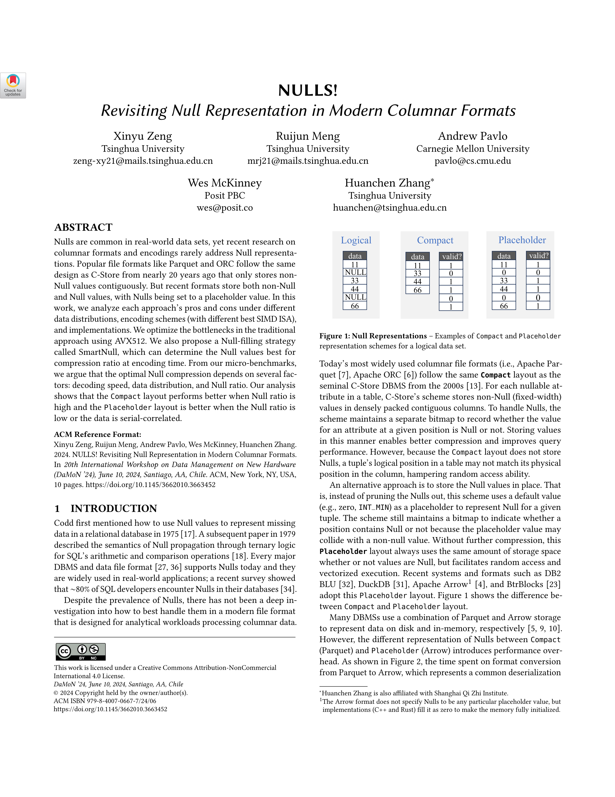
NULL Data Types
Choice #1: Null Column Bitmap Header
Store a bitmap in a centralized header that specifies what attributes are null.
This is the most common approach in row-stores.
Choice #2: Special Values
Designate a placeholder value to represent NULL for a data type (e.g., INT32_MIN). More common in column-stores.
Choice #3: Per Attribute Null Flag
Store a flag that marks that a value is null.
Must use more space than just a single bit because this messes up with word alignment.
Don't Do This!

Slide 20
Large Values
CREATE TABLE foo (
id INT PRIMARY KEY,
data INT,
contents TEXT
);
Most DBMSs do not allow a tuple to exceed the size of a single page.
To store values that are larger than a page, the DBMS uses separate overflow storage pages.
Postgres: TOAST (>2KB)
MySQL: Overflow (>½ size of page)
SQL Server: Overflow (>size of page)
Lots of potential optimizations:
Overflow Compression, German Strings
Tuple
Header
INT
INT
TEXT
size
location
Overflow Page
VARCHAR DATA

Slide 21
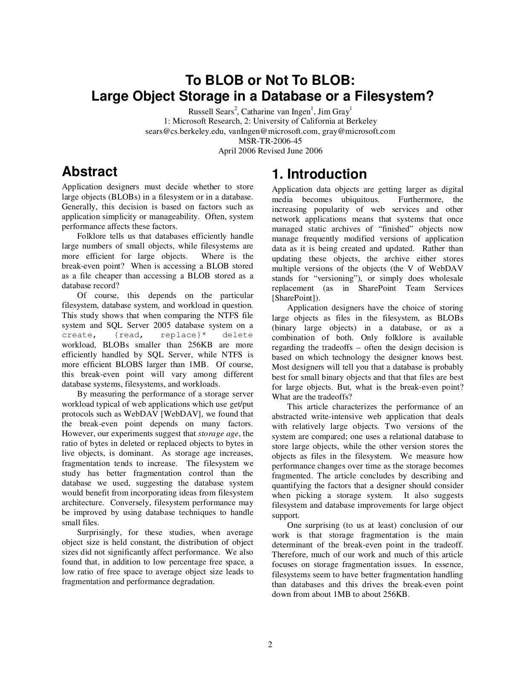
External Value Storage
Some systems allow you to store a large value in an external file. Treated as a BLOB type.
Oracle: BFILE data type
Microsoft: FILESTREAM data type
The DBMS cannot manipulate the contents of an external file.
No durability protections.
No transaction protections.
Tuple
Header
a
b
c
d
e
External File
Data

Slide 22

The Trouble with Tuples

Slide 23
Tuple-oriented Storage
23
Problem #1: Fragmentation
Pages are not fully utilized (unusable space, empty slots).
Problem #2: Useless Disk I/O
DBMS must fetch entire page to update one tuple.
Problem #3: Random Disk I/O
Worst case scenario when updating multiple tuples is that each tuple is on a separate page.
What if the DBMS cannot overwrite data in pages and could only create new pages?
Examples: Some object stores, HDFS, Google Colossus

Slide 24
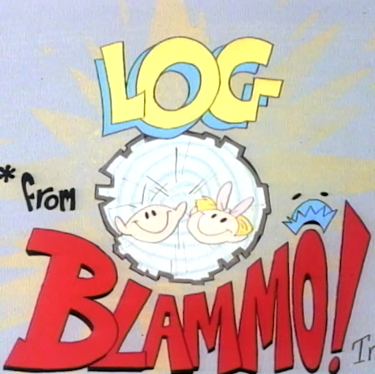
It's Log!

Slide 25
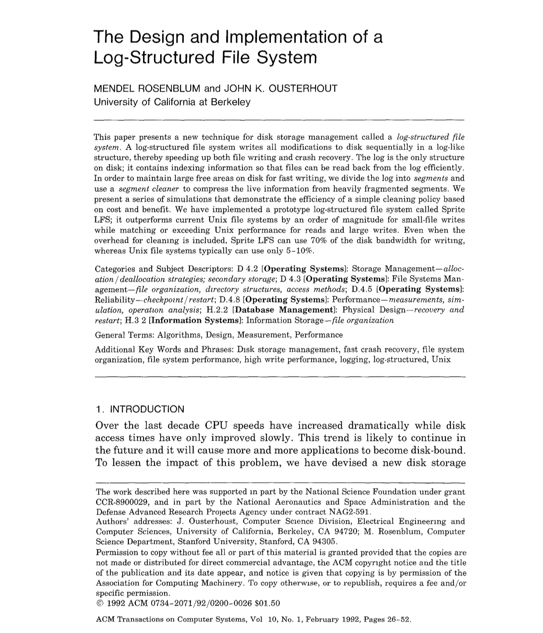
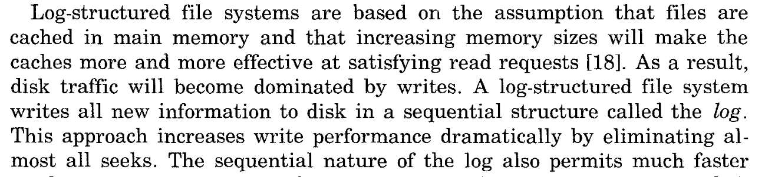
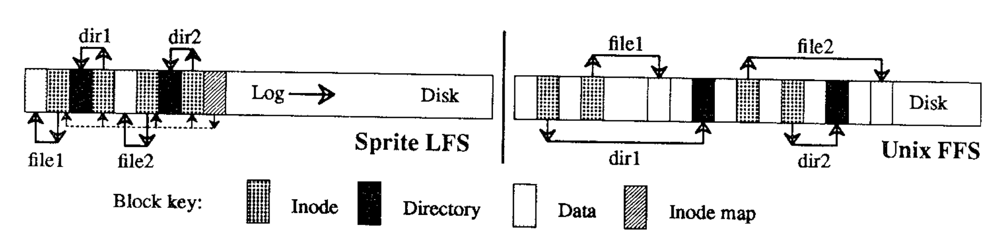
Log-structured Storage

Slide 26
Log-structured Storage
Instead of storing tuples in pages and updating them in-place, the DBMS maintains a log that records changes to tuples.
Each log entry represents a tuple PUT/DELETE operation.
Originally proposed as log-structure merge trees (LSM Trees) in 1996.
The DBMS applies changes to an in-memory data structure (MemTable) and then writes out the changes sequentially to disk (SSTable).

Slide 27
Log-structured Storage
PUT (key101,a₁)
PUT (key102,b₁)
PUT (key101,a₂)
PUT (key103,c₁)
GET (key101)
MemTable
SSTable
PUT (key101,a₂)
SummaryTable
Min/Max Key Per SSTable
Key Filter Per Level
PUT (key102,b₁)
Key Low→High
PUT (key103,c₁)
Memory
SSTable
SSTable
Newest→Oldest
Level #0
SSTable
Level #1
SSTable
Disk
Level #2
SSTable

Slide 28
Log-structured Storage
28
Key-value storage that appends log records on disk to represent changes to tuples (PUT, DELETE).
Each log record must contain the tuple's unique identifier.
Put records contain the tuple contents.
Deletes marks the tuple as deleted.
As the application makes changes to the database, the DBMS appends log records to the end of the file without checking previous log records.
SSTable
DEL (key100)
PUT (key101,a₃)
Key Low→High
PUT (key102,b₂)
PUT (key103,c₁)

Slide 29
Log-structured Compaction
29
Periodically compact SSTAbles to reduce wasted space and speed up reads.
Only keep the "latest" values for each key using a sort-merge algorithm.
SSTable
SSTable
SSTable
DEL (key100)
PUT (key101,a₂)
DEL (key100)
PUT (key101,a₃)
+
PUT (key102,b₁)
PUT (key101,a₃)
PUT (key102,b₂)
DEL (key103)
PUT (key102,b₂)
PUT (key103,c₁)
PUT (key104,d₂)
PUT (key103,c₁)
PUT (key104,d₂)
Newest→Oldest

Slide 30

Discussion
30
Log-structured storage managers are more common today than in previous decades.
This is partly due to the proliferation of RocksDB.
What are some downsides of this approach?
Read Amplification
Write Amplification
Compaction is Expensive

Slide 31
More Tuples, More Troubles
Unsorted heap files, in the absence of other data structures, make it slow to look up particular tuples (e.g. search by primary key)
LSM trees helped with writes at the cost of read/write amplification
How can we go the other way, and get faster lookups at the expense of slower writes/updates?

Slide 32
Best of Both Worlds?
Want sorted structure of LSM tree for faster lookups
Avoid read/write amplification by having a single, sorted "level"
min, max key values
Header
key→ offset
key→ offset
key→ offset
Sort by key
Tuple #3
Tuple #2
Tuple #6

Slide 33
Best of Both Worlds?
Want sorted structure of LSM tree for faster lookups
Avoid read/write amplification by having a single, sorted "level"
min, max key values
Page ID
min, max key values
Page ID
Sort by key

Slide 34
Index-organized Storage
DBMS stores a table's tuples as the value of an index data structure.
Still use a page layout that looks like a slotted page.
Tuples are typically sorted in page based on key.
Indexing pays maintenance costs upfront, whereas LSMs pay for it later.
Inner Nodes
Header
key→ offset
key→ offset
key→ offset
Leaf Nodes
Sort by key
Tuple #3
Tuple #2
Tuple #6

Slide 35
Lookup time? It's Log!

Slide 36
Conclusion
36
Log-structured storage is an alternative approach to the tuple-oriented architecture.
Ideal for write-heavy workloads because it maximizes sequential disk I/O.

Slide 37
Next Class
How to make pages stored on disk available in memory? The buffer pool manager!

Slide 38
LOG-STRUCTURED STORAGE
Compaction method: Leveling
Write: (k1, v1)
Write: (k2, v2)
Read: (k1)
Summary Table:
Min-max range of each SST
Bloom filter for each level
New Memtable
Memtable is full
Other compaction method: Tiering
If not found
Root
Memory
flush
Level 1
Disk
If not found
compaction
Read: (k11)
Level 2
compaction
compaction
Level k
What happens if one searches for a key that is not present?
May have to search all the levels one-by-one. Expensive!
Summary table info can help. Skip the levels that don’t hit in the corresponding bloom filter.

Slide 39
LOG-STRUCTURED STORAGE
39
DBMS stores log records that contain changes to tuples (PUT, DELETE).
Each log record must contain the tuple’s unique identifier.
Put records contain the tuple contents.
Deletes marks the tuple as deleted.
As the application changes the database, the DBMS appends log records to the end of the file without checking previous log records.
In-Memory Page
PUT #103 {val=a₁}
PUT #104 {val=b₁}
Newest←Oldest
DEL #102
PUT #103 {val=a₂}
PUT #105 {val=c₁}
PUT #103 {val=a₃}

Slide 40
LOG-STRUCTURED STORAGE
40
When the page gets full, the DBMS writes it out disk and starts filling up the next page with records.
All disk writes are sequential.
On-disk pages are immutable.
The DBMS may also flush partially full pages for transactions but we will ignore that for now…
In-Memory Page
PUT #104 {val=b₂}
PUT #105 {val=c₂}
Newest←Oldest
PUT #102 {val=d₁}
DEL #101
DEL #102
PUT #105 {val=c₃}
…

Slide 41
LOG-STRUCTURED STORAGE
41
To read a tuple with a given id, the DBMS finds the newest log record corresponding to that id.
Scan log from newest to oldest.
Maintain an index that maps a tuple id to the newest log record.
If log record is in-memory, just read it.
If log record is on a disk page, retrieve it.
We will discuss indexes in two weeks.
GET #104
In-Memory Page
PUT #104 {val=b₂}
PUT #105 {val=c₂}
id=#101
PUT #102 {val=d₁}
id=#102
DEL #101
id=#103
DEL #102
id=#104
PUT #105 {val=c₃}
id=#105
…
SELECT * FROM table WHERE id = 1

Slide 42
LOG-STRUCTURED COMPACTION
42
After a page is compacted, the DBMS does not need to maintain temporal ordering of records within the page.
Each tuple id is guaranteed to appear at most once in the page.
The DBMS can instead sort the page based on id order to improve efficiency of future look-ups.
Called Sorted String Tables (SSTables)
Embed indexes / filters in the header for reducing search times.
SSTable
PUT #103 {val=a₃}
DEL #101
PUT #103 {val=a3}
PUT #104 {val=b₂}
DEL #102
PUT #104 {val=b2}
DEL #101
PUT #105 {val=c₃}
Newest←Oldest
Key Order
DEL #102
PUT #105 {val=c₃}

Slide 43
LOG-STRUCTURED COMPACTION
43
Coalesce larger disk-resident log files into smaller files by removing unnecessary records.
Universal Compaction
Level Compaction
Sorted Log File
Sorted Log File
Sorted Log File
Sorted Log File
Level #0
Sorted Log File
Sorted Log File
Oldest→Newest
Sorted Log File
Sorted Log File
Sorted Log File
Sorted Log File
Level #1
Sorted Log File
Sorted Log File
Sorted Log File
Level #2
Sorted Log File

Slide 44
LOG-STRUCTURED COMPACTION
44
After a page is compacted, the DBMS does not need to maintain temporal ordering of records within the page.
Each tuple id is guaranteed to appear at most once in the page.
The DBMS can instead sort the page based on id to improve the efficiency of future look-ups.
Called Sorted String Tables (SSTables/SSTs).
SSTs which are multi-page long, so think GB or more.
Embed indexes / filters in the header to reduce search times.
Disk Page
DEL #101
PUT #103 {val=a₃}
PUT #104 {val=b₂}
DEL #102
PUT #104 {val=b₂}
PUT #103 {val=a₃}
DEL #101
Newest←Oldest
PUT #105 {val=c₃}
Tuple Id Order
DEL #102
PUT #105 {val=c₃}

Slide 45
VARIABLE-LENGTH FIELDS
char[]
CREATE TABLE foo (
value VARCHAR(1024)
);
header
id
64-BIT POINTER
Andy|64-BIT POINTER
Variable-Length Data Blocks
INSERT INTO foo VALUES ("Andy has the worst hygiene that I have ever seen. I hate him so much.");
Andy has the worst hygiene that I have ever seen. I hate
LENGTH
NEXT
him so much.
LENGTH
NEXT

Slide 46
WORD-ALIGNED TUPLES
Approach #1: Perform Extra Reads
Execute two reads to load the appropriate parts of the data word and reassemble them.
Approach #2: Random Reads
Read some unexpected combination of bytes assembled into a 64-bit word.
Approach #3: Reject
Throw an exception and hope app handles it.
Source: Levente Kurusa

Slide 47
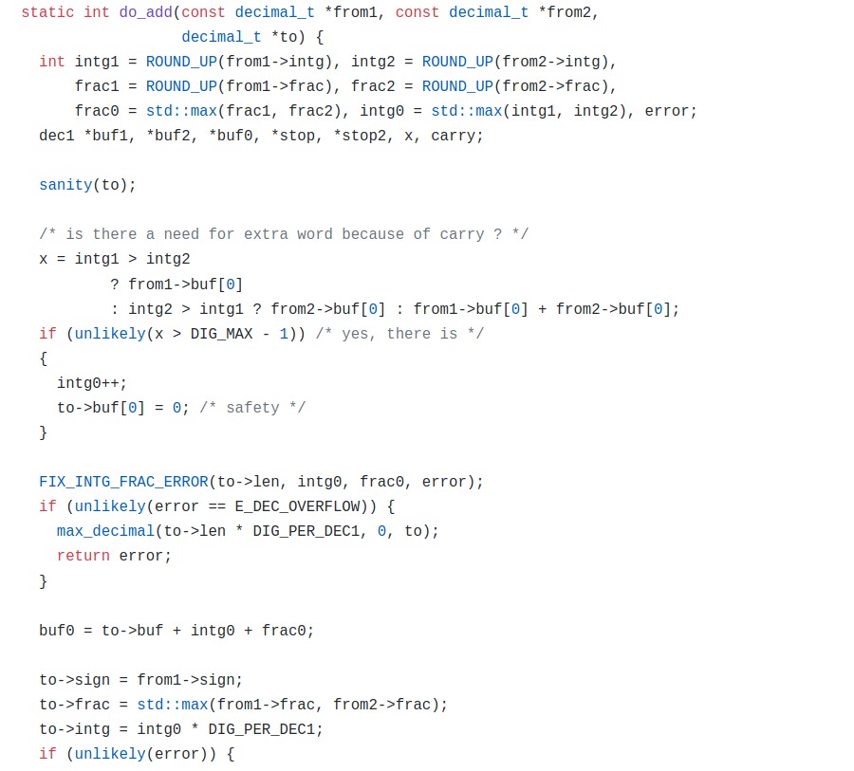
MYSQL: NUMERIC
47
# of Digits Before Point
typedef int32 decimal_digit_t; struct decimal_t {
int intg, frac, len;
bool sign;
decimal_digit_t *buf;
};
# of Digits After Point
Length (Bytes)
Positive/Negative
Digit Storage

Slide 48
LARGE VALUES: GERMAN STRINGS
size
pointer
Arrow originally stored strings as fixed-length pointers to an offset in a byte array.
Velox extended Arrow it to use
Fixed-length portion contains size + prefix + payload.
Payload contains full-string if it is 16-bytes or less. Otherwise, it is pointer ot the full string.
AndyP smells bad!
5
AndyP
4-bytes
8-bytes
AndyP|AndyP sm ells bad!|...
size
prefix
suffix
German String Storage
AndyP
5
Andy
P
4-bytes
4-bytes
8-bytes
pointer
AndyP smells bad!
17
Andy
full string
AndyP smells bad!

Slide 49
TREES IN DATABASE STORAGE
B-tree: Ubiquitous in database systems
Balanced tree. Node = page.
Same page size (KBs) in size across the tree.
O(log(n)) for search, insert, delete.
Entries: key-value (KV) pairs.
Values could be record id, or tuple.
Pointers across nodes across the levels.
Writes may update multiple pages.
Log-structured Storage: Based on Log-Structured File System (LSFS) by Rosenblum & Ousterhout’92 and Log-structured Merge Trees (LSM Tree) by O’Neil, Cheng, & Gawlick’96
Write to a sequentially-growing log rather an update in-place.
Flush logs to SSTs (many MBs in size). Merge logs periodically.
Entries: key-value pairs. Values are records.
No pointers across SSTs. SST size grows as the levels increase.
Writes are fast, but reads may be slow.
Root
Root
In-memory log: organized a skip list, trie, … This level is called a MemTable.
Level 1
sorted
Level 1
A Level = sequence of SSTs
sorted
Larger SSTs at lower levels.
Level 2
Level 2
sorted
Level k
Level k
sorted

Slide 50
#0
#1
#2
#3
Header
804
924
720
NULL
720
Empty Space on Page
Tuple C (84 bytes)
Tuple B (120 bytes)
Tuple A (100 bytes)
804
924

Slide 51
SYSTEM CATALOGS
51
A DBMS stores meta-data about databases in its internal catalogs.
Tables, columns, indexes, views
Users, permissions
Internal statistics
Almost every DBMS stores the database's catalog inside itself (i.e., as tables).
Wrap object abstraction around tuples.
Specialized code for "bootstrapping" catalog tables.

Slide 52
SYSTEM CATALOGS
52
You can query the DBMS’s internal INFORMATION_SCHEMA catalog to get info about the database.
ANSI standard set of read-only views that provide info about all the tables, views, columns, and procedures in a database
DBMSs also have non-standard shortcuts to retrieve this information.

Slide 53
ACCESSING TABLE SCHEMA
53
List all the tables in the current database:
SELECT * FROM INFORMATION_SCHEMA.TABLES
WHERE table_catalog = '<db name>';
SQL-92
\d;
Postgres
SHOW TABLES;
MySQL
.tables
SQLite

Slide 54
ACCESSING TABLE SCHEMA
54
List all the tables in the student table:
SELECT * FROM INFORMATION_SCHEMA.TABLES
WHERE table_name = 'student'
SQL-92
\d student;
Postgres
DESCRIBE student;
MySQL
.schema student
SQLite

Slide 55
SCHEMA CHANGES
55
ADD COLUMN:
NSM: Copy tuples into new region in memory.
DSM: Just create the new column segment on disk.
DROP COLUMN:
NSM #1: Copy tuples into new region of memory.
NSM #2: Mark column as "deprecated", clean up later.
DSM: Just drop the column and free memory.
CHANGE COLUMN:
Check whether the conversion is allowed to happen. Depends on default values.

Slide 56
INDEXES
56
CREATE INDEX:
Scan the entire table and populate the index.
Have to record changes made by txns that modified the table while another txn was building the index.
When the scan completes, lock the table and resolve changes that were missed after the scan started.
DROP INDEX:
Just drop the index logically from the catalog.
It only becomes "invisible" when the txn that dropped it commits. All existing txns will still have to update it.

