Slide 1
Lecture 12: Joins

Slide 2
Announcements
2
Mid-term Exam on Monday Oct 20th
In-class in this room.
Review session in class on Oct. 15th
Format: 5 Big Questions: Q1 will have some multiple choice, other questions mostly open response
Know the material, but do not focus on memorizing every minute detail, we will try and test concepts.
Know design, guarantees, runtimes of algos and data structures from lecture
Textbook provides many good problem with solutions for practice
Come to class Wednesday with specific questions! I will pull up slides and explain anything you want in greater detail. No questions? We'll talk about more data structures.

Slide 3
Last Week
Last week was data structure week!
In addition to previously discussed B+Tree...
Bloom Filters
Skip Lists
How to make these things concurrent/thread-safe
Atomic instructions (compare-and-swap)
OS-level mutexes (futex)
Reader-writer latches
Latch protocols (e.g., latch crabbing for B+Trees)

Slide 4
Course Progress Check-In
We are done with Access Methods!
Operator Execution
How to translate relational operators into fast code
Good news: one of the hard ones, sorting, we've already done
Today: the other hard one, joins
Goal: want fast, I/O efficient operators to use when we get to query planning and execution
Query Planning
Operator Execution
Access Methods
Buffer Pool Manager
Disk Manager

Slide 5
Why Do We Need To Join?
5
We normalize tables in a relational database to avoid unnecessary repetition of information.
We then use the join operator to reconstruct the original tuples without any information loss.

Slide 6
Join Algorithms
6
We will focus on performing binary joins (two tables) using inner equijoin algorithms.
These algorithms can be tweaked to support other joins.
Multi-way joins exist primarily in research literature (e.g., worst-case optimal joins).
In general, join algorithms work better when we can identify the smaller of the two tables
The optimizer will (try to) figure this out when generating the physical plan.

Slide 7
Query Plan
7
The operators are arranged in a tree.
Data flows from the leaves of the tree up towards the root.
We will discuss the granularity of the data movement next lecture.
The output of the root node is the result of the query.
SELECT R.id, S.cdate
FROM R JOIN S
ON R.id = S.id
WHERE S.value > 100
π
R.id, S.cdate
⨝
R.id=S.id
σ
value>100
R
S

Slide 8
Join Operators
8
Decision #1: Output
For each row of the join, what data is emitted to the parent operator in the query plan tree?
Decision #2: Cost Analysis Criteria
How to design/choose an algorithm to identify which rows to emit?
SELECT R.id, S.cdate
FROM R JOIN S
ON R.id = S.id
WHERE S.value > 100
π
R.id, S.cdate
⨝
R.id=S.id
σ
value>100
R
S

Slide 9
Operator Output
9
For tuple r ∈ R and tuple s ∈ S that match on join attributes, concatenate r and s together into a new tuple.
Output contents can vary:
Depends on processing model
Depends on storage model
Depends on data requirements in query
SELECT R.id, S.cdate
FROM R JOIN S
ON R.id = S.id
WHERE S.value > 100
π
R.id, S.cdate
⨝
R.id=S.id
σ
value>100
R
S

Slide 10
Operator Output: Tuple Data
10
Early Materialization:
Copy values for the attributes in outer and inner tuples into new output tuple.
Subsequent operators in the query plan never need to go back to the base tables to get more data.
SELECT R.id, S.cdate
FROM R JOIN S
ON R.id = S.id
WHERE S.value > 100
R(id,name)
S(id,value,cdate)
π
R.id, S.cdate
id | name
123 | abc
id | value | cdate
123 | 1000 | 10/10/25
123 | 2000 | 10/10/25
⨝
⨝
R.id=S.id
σ
value>100
R.id | R.name | S.id | S.value | S.cdate
123 | abc | 123 | 1000 | 10/10/25
123 | abc | 123 | 2000 | 10/10/25
R
S

Slide 11
Operator Output: Record IDs
Late Materialization:
Only copy the joins keys along with the Record IDs of the matching tuples.
Ideal for column stores because the DBMS does not copy data that is not needed for the query.
SELECT R.id, S.cdate
FROM R JOIN S
ON R.id = S.id
WHERE S.value > 100
R(id,name)
S(id,value,cdate)
π
R.id, S.cdate
id | name
123 | abc
id | value | cdate
123 | 1000 | 10/10/25
123 | 2000 | 10/10/25
⨝
⨝
R.id=S.id
σ
value>100
R.id | R.RID | S.id | S.RID
123 | R.### | 123 | S.###
123 | R.### | 123 | S.###
R
S

Slide 12
What Algorithm to Use?
12
Given a query that joins table R with table S, assume the DBMS has the following information those tables:
M pages in table R, m tuples in R
N pages in table S, n tuples in S
Cost Metric: # of I/Os to compute join
Ignore result output costs because it depends on the data and is the same for all algorithms.
Ignore computation / network costs (for now).
When sequential vs. random I/O is an issue, I'll point it out
SELECT R.id, S.cdate
FROM R JOIN S
ON R.id = S.id
WHERE S.value > 100

Slide 13
Join Algorithms
13
Nested Loop Join
Naïve
Block
Index
Sort-Merge Join
Hash Join
Simple
GRACE (Externally Partitioned)
Hybrid

Slide 14

Naïve Nested Loop Join
14
SELECT R.id, S.cdate
FROM R JOIN S
ON R.id = S.id
WHERE S.value > 100
foreach tuple r ∈ R: foreach tuple s ∈ S: if r and s match then emit
⨝
Outer
Inner
Don't Do This!
R
S
R(id,name)
S(id,value,cdate)
id | name
600 | MethodMan
200 | GZA
100 | Andy
300 | ODB
500 | RZA
700 | Ghostface
400 | Raekwon
id | value | cdate
100 | 2222 | 10/10/25
500 | 7777 | 10/10/25
400 | 6666 | 10/10/25
100 | 9999 | 10/10/25
200 | 8888 | 10/10/25

Slide 15
Naïve Nested Loop Join
15
Why is this algorithm bad?
R(id,name)
S(id,value,cdate)
id | name
600 | MethodMan
200 | GZA
100 | Andy
300 | ODB
500 | RZA
700 | Ghostface
400 | Raekwon
id | value | cdate
100 | 2222 | 10/10/25
500 | 7777 | 10/10/25
400 | 6666 | 10/10/25
100 | 9999 | 10/10/25
200 | 8888 | 10/10/25
N pages n tuples
M pages m tuples

Slide 16
Naïve Nested Loop Join
16
Why is this algorithm bad?
Read every tuple in R
For every tuple in R, scans S once
Cost: M + (m ∙ N)
R(id,name)
S(id,value,cdate)
id | name
600 | MethodMan
200 | GZA
100 | Andy
300 | ODB
500 | RZA
700 | Ghostface
400 | Raekwon
id | value | cdate
100 | 2222 | 10/10/25
500 | 7777 | 10/10/25
400 | 6666 | 10/10/25
100 | 9999 | 10/10/25
200 | 8888 | 10/10/25
N pages n tuples
M pages m tuples

Slide 17
Naïve Nested Loop Join
17
Example database:
Table R: M = 1000, m = 100,000
Table S: N = 500, n = 40,000
Cost Analysis:
M + (m ∙ N) = 1000 + (100000 ∙ 500) = 50,001,000 IOs
At 0.1 ms/IO, Total time ≈ 1.3 hours
What if smaller table (S) is used as the outer table?
N + (n ∙ M) = 500 + (40000 ∙ 1000) = 40,000,500 IOs
At 0.1 ms/IO, Total time ≈ 1.1 hours
4 KB pages → 6 MB

Slide 18
Block Nested Loop Join
18
foreach block B_{R} ∈ R:
foreach block B_{S} ∈ S:
foreach tuple r ∈ B_{R}:
foreach tuple s ∈ B_{s}: if r and s match then emit
All in memory!
R(id,name)
S(id,value,cdate)
id | name
600 | MethodMan
200 | GZA
100 | Andy
300 | ODB
500 | RZA
700 | Ghostface
400 | Raekwon
id | value | cdate
100 | 2222 | 10/10/25
500 | 7777 | 10/10/25
400 | 6666 | 10/10/25
100 | 9999 | 10/10/25
200 | 8888 | 10/10/25
N pages n tuples
M pages m tuples

Slide 19
Block Nested Loop Join
19
This algorithm performs fewer disk accesses.
For every block in R, it scans S once.
Cost: M + (M ∙ N )
R(id,name)
S(id,value,cdate)
id | name
600 | MethodMan
200 | GZA
100 | Andy
300 | ODB
500 | RZA
700 | Ghostface
400 | Raekwon
id | value | cdate
100 | 2222 | 10/10/25
500 | 7777 | 10/10/25
400 | 6666 | 10/10/25
100 | 9999 | 10/10/25
200 | 8888 | 10/10/25
N pages n tuples
M pages m tuples

Slide 20
Block Nested Loop Join
20
The smaller table should be the outer table.
Compare: M + (M ∙ N ) vs. N + (N ∙ M)
It turns out this also improves sequential I/O
R(id,name)
S(id,value,cdate)
id | name
600 | MethodMan
200 | GZA
100 | Andy
300 | ODB
500 | RZA
700 | Ghostface
400 | Raekwon
id | value | cdate
100 | 2222 | 10/10/25
500 | 7777 | 10/10/25
400 | 6666 | 10/10/25
100 | 9999 | 10/10/25
200 | 8888 | 10/10/25
N pages n tuples
M pages m tuples

Slide 21
What About The Buffer Pool?
21
If we have B buffers available:
Use B-2 buffers for each chunk of the outer table.
Use one buffer for the inner table, one buffer for output.
foreach B - 2 pages p_{R} ∈ R: foreach page p_{S} ∈ S:
foreach tuple r ∈ B - 2 pages:
foreach tuple s ∈ p_{s}: if r and s match then emit
All in memory!
R(id,name)
S(id,value,cdate)
id | name
600 | MethodMan
200 | GZA
100 | Andy
300 | ODB
500 | RZA
700 | Ghostface
400 | Raekwon
id | value | cdate
100 | 2222 | 10/10/25
500 | 7777 | 10/10/25
400 | 6666 | 10/10/25
100 | 9999 | 10/10/25
200 | 8888 | 10/10/25
N pages n tuples
M pages m tuples

Slide 22
Block Nested Loop Join
22
This algorithm uses B-2 buffers for scanning R.
Cost: M + ( ⎡M / (B-2)⎤ ∙ N)
If the outer relation fits in memory (B - 2 > M):
Cost: M + N = 1000 + 500 = 1500 I/Os
At 0.1ms per I/O, Total time ≈ 0.15 seconds
If we have B=102 buffer pages:
Cost: M + ( ⎡M / (B-2)⎤ ∙ N) = 1000 + 10∙500 = 6000 I/Os
Or can switch inner/outer relations, giving us cost:
500 + 5∙1000 = 5500 I/Os
Total time ≈ 0.55 seconds

Slide 23
Nested Loop Join
23
Why is the basic nested loop join so bad?
For each tuple in the outer table, we do a sequential scan to check for a match in the inner table.
Quadratic # of comparisons to find a linear number of matches
Lots of wasted work
Idea: Data structure / algorithm to find matches with fewer comparisons
id | name
600 | MethodMan
200 | GZA
100 | Andy
300 | ODB
500 | RZA
700 | Ghostface
400 | Raekwon
id | value | cdate
100 | 2222 | 10/10/25
500 | 7777 | 10/10/25
400 | 6666 | 10/10/25
100 | 9999 | 10/10/25
200 | 8888 | 10/10/25

Slide 24
Index Nested Loop Join
foreach tuple r ∈ R: foreach tuple s ∈ Index(r_{i} = s_{j}): if r and s match then emit
24
Assume the cost of each index lookup is C per tuple.
Cost: M + (m ∙ C)
Index(S.id)
R(id,name)
S(id,value,cdate)
id | name
600 | MethodMan
200 | GZA
100 | Andy
300 | ODB
500 | RZA
700 | Ghostface
400 | Raekwon
id | value | cdate
100 | 2222 | 10/10/25
500 | 7777 | 10/10/25
400 | 6666 | 10/10/25
100 | 9999 | 10/10/25
200 | 8888 | 10/10/25
N pages n tuples
M pages m tuples

Slide 25
Index Nested Loop Join
foreach tuple r ∈ R: foreach tuple s ∈ Index(r_{i} = s_{j}): if r and s match then emit
25
The hidden cost of index nested loop joins: random I/O
Block nested loop join: # Disk Seeks = 2M
Index nested loop join: # Disk Seeks = M + m ∙ C_{seek}
Index(S.id)
R(id,name)
S(id,value,cdate)
id | name
600 | MethodMan
200 | GZA
100 | Andy
300 | ODB
500 | RZA
700 | Ghostface
400 | Raekwon
id | value | cdate
100 | 2222 | 10/10/25
500 | 7777 | 10/10/25
400 | 6666 | 10/10/25
100 | 9999 | 10/10/25
200 | 8888 | 10/10/25
N pages n tuples
M pages m tuples

Slide 26
Index Nested Loop Join
Assume 0.1 ms I/Os and 4 ms seek times
Block nested loop join (minimal buffers):
# I/Os = N + (N ∙ M) = 500,500 I/Os
# Disk Seeks = 2N = 1000 seeks
Total time ≈ 50 seconds + 4 seconds = 54 seconds
Index nested loop join using a B+Tree of height 5:
# I/Os = N + (n ∙ 5) = 1000 + 200,000 = 200,100 I/Os
# Disk Seeks = N + (n ∙ 5) = 200,100 seeks
Total time ≈ ≈ 20 seconds + 800 seconds = 820 seconds

Slide 27
Nested Loop Join Summary
27
Key Takeaways
Pick the smaller table as the outer table.
Buffer as much of the outer table in memory as possible.
Loop over the inner table (or use an index).
Algorithms
Naïve
Block
Index
What to improve?
Index-based method didn't "glue together" the index and the algorithm. Need to jointly optimize algorithm and data structure.

Slide 28
Sort-Merge Join
28
Phase #1: Sort
Sort both tables on the join key(s).
You can use any appropriate sort algorithm
These phases are distinct from the sort/merge phases of an external merge sort, from the previous class
Phase #2: Merge
Step through the two sorted tables with cursors and emit matching tuples.
May need to backtrack to handle duplicates

Slide 29
Sort-Merge Join
29
R(id,name)
S(id,value,cdate)
SELECT R.id, S.cdate
FROM R JOIN S
ON R.id = S.id
WHERE S.value > 100
id | name
600 | MethodMan
200 | GZA
100 | Andy
300 | ODB
500 | RZA
700 | Ghostface
200 | GZA
400 | Raekwon
id | name
100 | Andy
200 | GZA
200 | GZA
300 | ODB
400 | Raekwon
500 | RZA
600 | MethodMan
700 | Ghostface
id | value | cdate
100 | 2222 | 10/10/25
500 | 7777 | 10/10/25
400 | 6666 | 10/10/25
100 | 9999 | 10/10/25
200 | 8888 | 10/10/25
id | value | cdate
100 | 2222 | 10/10/25
100 | 9999 | 10/10/25
200 | 8888 | 10/10/25
400 | 6666 | 10/10/25
500 | 7777 | 10/10/25
Output Buffer
200
---
100
400
500
R.id | R.name | S.id | S.value | S.cdate
Last Value:
Sort!
100 | Andy | 100 | 2222 | 10/10/25
100 | Andy | 100 | 9999 | 10/10/25
200 | GZA | 200 | 8888 | 10/10/25
Sort!
200 | GZA | 200 | 8888 | 10/10/25
400 | Raekwon | 200 | 6666 | 10/10/25
500 | RZA | 500 | 7777 | 10/10/25

Slide 30
Sort-Merge Join Cost (Best Case)
30
Sort Cost (R): 2M ∙ (1 + ⌈ log_{B-1} ⌈M / B⌉ ⌉)
Sort Cost (S): 2N ∙ (1 + ⌈ log_{B-1} ⌈N / B⌉ ⌉)
Merge Cost: (M + N)
Total Cost: Sort + Merge

Slide 31
Sort-Merge Join Cost (Best Case)
31
Example database:
Table R: M = 1000, m = 100,000
Table S: N = 500, n = 40,000
With B=100 buffer pages, both R and S can be sorted in two passes:
Sort Cost (R) = 2000 ∙ (1 + ⌈log₉₉ 1000 /100⌉) = 4000 I/Os
Sort Cost (S) = 1000 ∙ (1 + ⌈ log₉₉ 500 / 100⌉) = 2000 I/Os
Merge Cost = (1000 + 500) = 1500 I/Os
Total Cost = 4000 + 2000 + 1500 = 7500 I/Os
At 0.1 ms/IO, Total time ≈ 0.75 seconds

Slide 32
Sort-Merge Join Cost (Worst Case)
32
The worst case for the merging phase is when the join attribute of all the tuples in both relations contains the same value.
Cost: (M ∙ N) + (sort cost)

Slide 33
When Is Sort-Merge Join Useful?
33
One or both tables are already sorted on join key.
Output must be sorted on join key.
The input relations may be sorted either by an explicit sort operator, or by scanning the relation using an index on the join key.

Slide 34
Observation
Sort-Merge Join pros and cons:
Used block-based layout and
Could take advantage of buffer pool
Still suffered from indexing overhead
Still suffered from excessive random I/O
Hash join tries to avoid these issues
Make use of blocks/buffers
Mostly sequential I/O
Low indexing overhead

Slide 35

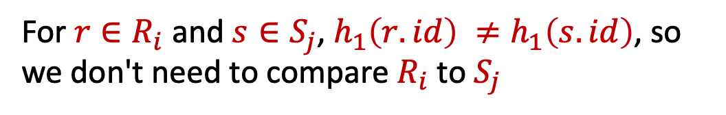







Hash Join
35
Idea: Hash tuples into n buckets based on join key (e.g., id)
R(id,name)
S(id,value,cdate)
$$R_{1}$$
$$S_{1}$$
$$R_{2}$$
$$S_{2}$$
h₁
$$R_{3}$$
$$S_{3}$$
h₁
⋮
⋮
$$R_{n}$$
$$S_{n}$$
For $r∈R_{i}$ and $s∈S_{j}$, $h_{1}\left(r.id\right) ≠h_{1}\left(s.id\right)$, so we don't need to compare $R_{i}$ to $S_{j}$

Slide 36
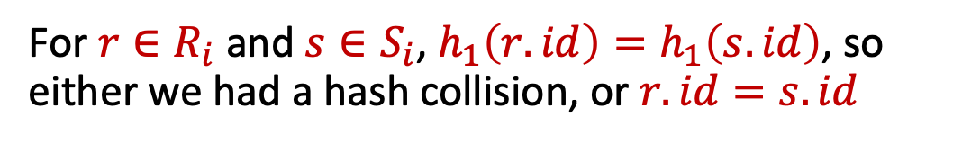
Hash Join
36
Idea: Hash tuples into n buckets based on join key (e.g., id)
R(id,name)
Inspect for matches
S(id,value,cdate)
$$R_{1}$$
$$S_{1}$$
$$R_{2}$$
$$S_{2}$$
h₁
$$R_{3}$$
$$S_{3}$$
h₁
⋮
⋮
$$R_{n}$$
$$S_{n}$$
For $r∈R_{i}$ and $s∈S_{i}$, $h_{1}\left(r.id\right)=h_{1}\left(s.id\right)$, so either we had a hash collision, or $r.id=s.id$

Slide 37
Simple Hash Join Algorithm
37
Phase #1: Build
Scan the outer relation and populate a hash table, HT , using the hash function h₁ on the join attributes.
We can use any hash table that we discussed before but in practice linear probing works the best.
Phase #2: Probe
Scan the inner relation and use h₁ on each tuple to jump to a location in the hash table and find a matching tuple.
For starters, assume HT fits in memory on B buffers

Slide 38

Simple Hash Join Algorithm
38
foreach tuple r ∈ R:
insert h₁(r) into hash table HT_{R}
foreach tuple s ∈ S: output, if h₁(s) ∈ HT_{R}
R(id,name)
Hash Table
S(id,value,cdate)
HT_{R}
insert
lookup
h₁
h₁
⋮

Slide 39
Hash Joins Of Large Relations
39
What happens if we do not have enough memory to fit the entire hash table?
Buffer pool manager might swap out pages of HT at random
Need a principled approach to minimize I/O in this case

Slide 40
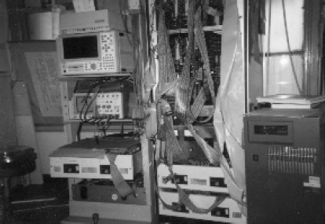
Partitioned Hash Join
40
Hash join when tables do not fit in memory.
Partition Phase: Hash both tables on the join attribute into partitions.
Probe Phase: Compares tuples in corresponding partitions for each table.
Sometimes called GRACE Hash Join.
Named after the GRACE database machine from Japan in the 1980s.
GRACE University of Tokyo

Slide 41
Partitioned Hash Join (Partition Phase)
41
Hash R into B buckets.
Hash S into B buckets with same hash function.
Write buckets to disk when they get full.
R(id,name)
HT_{R}
HT_{S}
S(id,value,cdate)
0
1
h₁
2
h₁
⋮
⋮
B-1

Slide 42

Partitioned Hash Join Probe Phase
42
Read corresponding partitions into memory one pair at a time, use simple hash join on their contents.
But wait, $R_{i}$ might have many blocks, will it fit in memory?
R(id,name)
HT_{R}
HT_{S}
S(id,value,cdate)
0
1
h₁
2
h₁
⋮
⋮
B-1

Slide 43
Partitioned Hash Join Edge Cases
43
Option 1: If a single join key has too many matching records that do not fit in memory, use a block nested loop join just for that key.
Avoids random I/O in exchange for sequential I/O.
Option 2: If a partition does not fit in memory, recursively partition it with a different hash function
Repeat as needed
Eventually hash join the corresponding (sub-)partitions

Slide 44
Recursive Partitioning
44
R(id,name)
0
S(id,value,cdate)
0
1'
h₁
h₂
h₂
h₁
1
1''
⋮
B-1
1'''
B-1

Slide 45
Cost Of Partitioned Hash Join
45
If we do not need recursive partitioning:
Cost: 3(M + N)
Partition phase:
Read+write both tables
2(M+N) I/Os
Probe phase:
Read both tables (in total, one partition at a time)
M+N I/Os

Slide 46
Partitioned Hash Join
46
Example database:
M = 1000, m = 100,000
N = 500, n = 40,000
Cost Analysis:
3(M + N) = 3 ∙(1000 + 500) = 4,500 IOs
At 0.1 ms/IO, Total time ≈ 0.45 seconds

Slide 47
Hash Join Observations
47
The inner table can be any size .
Only outer table (or its partitions) need to fit in memory
If we know the size of the outer table, then we can use a static hash table.
Less computational overhead
If we do not know the size, then we must use a dynamic hash table or allow for overflow pages.

Slide 48
Join Algorithms: Summary
48
Algorithm | IO Cost | Example
Naïve Nested Loop Join | M + (m ∙ N) | 1.3 hours
Block Nested Loop Join | M + ( ⎡M / (B-2)⎤ ∙ N) | 0.55 seconds
Index Nested Loop Join | M + (m ∙ C) | >20 seconds
Sort-Merge Join | M + N + (sort cost) | 0.75 seconds
Hash Join | 3 ∙ (M + N) | 0.45 seconds

Slide 49
Conclusion
49
Hashing is almost always better than sorting for operator execution.
Caveats:
Sorting is better on non-uniform data.
Sorting is better when result needs to be sorted.
Good DBMSs use many/all approaches when needed

Slide 50
Next Class
50
Midterm Review
Come with questions!

Slide 51
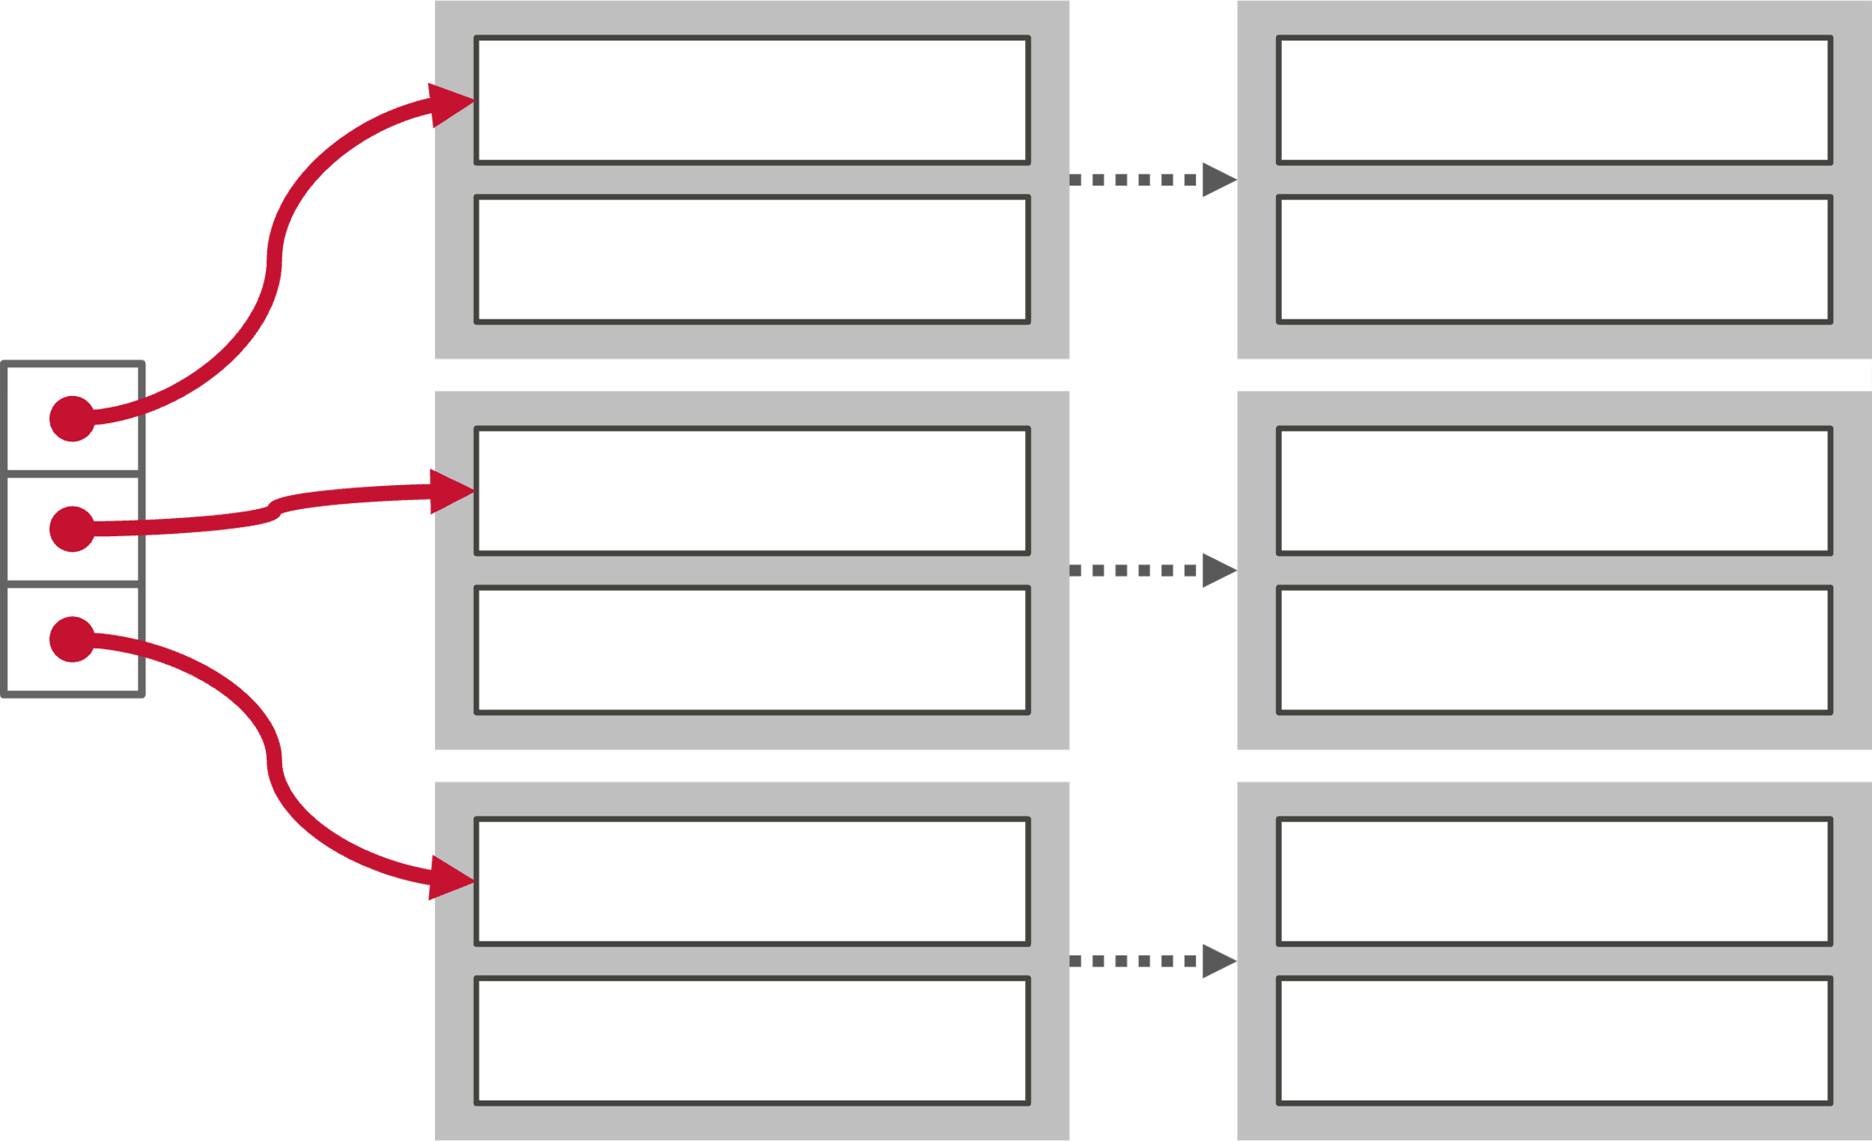

Optimization: Probe Filter
51
Create a probe filter (Bloom Filter) as the DBMS builds the hash table on the outer table in the first phase.
Always check the filter before probing the hash table.
Faster than probing hash table because the filter fits in CPU cache.
This technique is sometimes called sideways information passing.
⨝
Bloom Filter
R
S

Slide 52

Optimization: Hybrid Hash Join
52
If the keys are skewed, then the DBMS keeps the hot partition in-memory and immediately perform the comparison instead of spilling it to disk.
Difficult to get to work correctly. Rarely done in practice.
R(id,name)
S(id,value,cdate)
0
1
h₁
2
h₁
⋮
⋮
max

Slide 53
Sort-Merge Join
53
sort R,S on join keys
cursor_{R} ← R_{sorted}, cursor_{S} ← S_{sorted}
while cursor_{R} and cursor_{S}:
if cursor_{R} > cursor_{S}:
increment cursor_{S}
if cursor_{R} < cursor_{S}:
increment cursor_{R}
backtrack cursor_{s} (if necessary)
elif cursor_{R} and cursor_{S} match:
emit
increment cursor_{S}

Slide 54
SORT-MERGE JOIN: THE ADVANCED VERSION
Merge the run-generation phase and the join phase.
Produce initial runs for R. These are ≈B pages long.
Produce initial runs for S. These are also ≈B pages long.
If there are enough pages to hold one page from each run in memory, do the join and merge passes together. Need ⌈R / B⌉ + ⌈S / B⌉ pages
Can compute join in two passes (1 initial run creation, then sort-merge-join pass).
Some more modifications are possible, including making the initial runs be of size 2B, which guarantees that a 2-pass sort-merge join can be done if B > √MAX(R, S)

Slide 55
SORT-MERGE JOIN: THE ADVANCED VERSION
Relation R
Relation S
…
…
…
…
…
…
…
…
…
…
…
…
…
…
…
…
Pass #1: B-page runs
Using tournament sort, with B buffer pool pages, the initial run can be 2B in size (on average).
…
…
…
…
…
…
…
…
…
…
…
…
…
…
…
…
Pass #2: Merge and Join
…
…
…
…
…
…
…
…
Join Result

Slide 56
LATE MATERIALIZATION
56
DSM DBMSs can delay stitching together tuples until the upper parts of the query plan.
SELECT AVG(foo.c) FROM foo JOIN bar ON foo.b = bar.b
WHERE foo.a > 100
γ
AVG(foo.c)
Result
⨝
foo.b=bar.b
Offsets
a
b
c
σ
a>100
Offsets
0
1
bar
foo
2
3

Slide 57
BLOCK NESTED LOOP JOIN
57
Example database:
Table R: M = 1000, m = 100,000
Table S: N = 500, n = 40,000
Cost Analysis:
M + (M ∙ N) = 1000 + (1000 ∙ 500) = 501,000 IOs
At 0.1 ms/IO, Total time ≈ 50 seconds

Slide 58
HASH TABLE VALUES
58
Approach #1: Full Tuple
Avoid having to retrieve the outer relation's tuple contents on a match.
Takes up more space in memory.
Approach #2: Tuple Identifier
Could be to either the base tables or the intermediate output from child operators in the query plan.
Ideal for column stores because the DBMS does not fetch data from disk that it does not need.
Also better if join selectivity is low.

Slide 59
CHAINED HASHING
59

Slide 60
ANALYSIS OF PARTITIONED HASH JOIN
60
How big a table can be joined without recursive partitioning ?
Up to B-1 partitions
Each could be about (0.5 ∙ B) pages
About (0.5 ∙ (B-1) ∙ B) pages
If the partitions are approximately equal size, a table of N pages needs about sqrt(N) buffers
In practice, use a "fudge factor" (f> : sqrt(f ∙ N))
Only partitions of the outer table need to fit in memory

