Slide 1
Lecture 15: Query Optimization

Slide 2
Announcements
2
Exams: handed back on Wednesday.
Proposal: Wednesday, right after lecture, 30 min. exam review.
Next week: no class, P3 will be released by EOW

Slide 3
Last Class
We talked about how to design the DBMS's architecture to execute queries in parallel.
The query plan is comprised of physical operators that specify the algorithm to invoke at each step of the plan.
But how do we go from SQL to a query plan?

Slide 4
Motivation
Total: 2M I/Os
π_{ename}
SELECT DISTINCT ename
FROM Emp E JOIN Dept D
ON E.did = D.did
WHERE D.dname = 'Toy'
4 reads + 1 write
σ_{dname = 'Toy'}
Catalog
2,000 reads + 4 writes
(10K/500 = 20 emps per dept)
clustered
unclustered
unclustered
Emp(ssn,ename,addr,sal,did)
σ_{Emp.did = Dept.did}
10,000 records
1,000 pages
1,000,000 reads + 2,000 writes
(FK join, 10k tuples in temp T2)
clustered
unclustered
×
Dept(did,dname,floor,mgr)
(50 + 50,000) reads
+ 1,000,000 writes
Write temp file T1
5 tuples per page in T1
500 records
50 pages
Emp
Dept

Slide 5
Motivation
SELECT DISTINCT ename
FROM Emp E JOIN Dept D
ON E.did = D.did
WHERE D.dname = 'Toy'
Total: 54k I/Os
π_{ename}
Catalog
4 reads + 4 writes
Read temp T2
clustered
unclustered
unclustered
Emp(ssn,ename,addr,sal,did)
σ_{dname = 'Toy'}
10,000 records
1,000 pages
2,000 reads + 4 writes
Read temp T1, Write temp T2
clustered
unclustered
⋈_{Emp.did = Dept.did}
Dept(did,dname,floor,mgr)
(50 + 50,000) reads
+ 2,000 writes
Block Nested-Loop Join
Write Temp T1
500 records
50 pages
Emp
Dept

Slide 6
Motivation
SELECT DISTINCT ename
FROM Emp E JOIN Dept D
ON E.did = D.did
WHERE D.dname = 'Toy'
Vectorization Model
Total: 3,151 I/Os
No Pipelining!
Materialization Model
Total: 7,159 I/Os
π_{ename}
Catalog
4 reads + 4 writes
Read temp T2
clustered
unclustered
unclustered
Emp(ssn,ename,addr,sal,did)
σ_{dname = 'Toy'}
10,000 records
1,000 pages
2,000 reads + 4 writes
Read temp T1, Write temp T2
clustered
unclustered
⋈_{Emp.did = Dept.did}
Dept(did,dname,floor,mgr)
3×(|Emp| + |Dept| =
3,150 reads + 2,000 writes
Sort-Merge Join (50 Buffers)
Write Temp T1
500 records
50 pages
Emp
Dept

Slide 7
Motivation
SELECT DISTINCT ename
FROM Emp E JOIN Dept D
ON E.did = D.did
WHERE D.dname = 'Toy'
Total: 37 I/Os
π_{ename}
Catalog
4 reads + 1 writes
Read temp T2
clustered
unclustered
unclustered
Emp(ssn,ename,addr,sal,did)
σ_{dname = 'Toy'}
10,000 records
1,000 pages
1 + 3 (idx) + 20 (ptr chase) reads
+ 4 writes
Index Nested-Loop Join
clustered
unclustered
⋈_{Emp.did = Dept.did}
⋈_{Emp.did = Dept.did}
Dept(did,dname,floor,mgr)
500 records
50 pages
3 reads + 1 writes
Access: Index(dname)
Emp
Dept
Emp

Slide 8
Today's Agenda
8
Background
Heuristic / Ruled-based Optimization
Cost-based Optimization
Cost Model Estimation
Warning #1: This is hard.
Warning #2: There could be a whole course in this, we have one lecture.

Slide 9
Architecture Overview
Cost
Model
Application
System
Catalog
Schema Info
1
SQL Query
Estimates
Optimizer
Parser
4
Physical Plan
Name→Internal ID
Binder
2
Abstract
Syntax
Tree
3
Logical Plan

Slide 10
Logical vs Physical Plans
The optimizer generates a mapping of a logical algebra expression to the optimal equivalent physical algebra expression.
Physical operators define a specific execution strategy using an access path.
  They can depend on the physical format of the data that they process (i.e., sorting, compression).
  Not always a 1:1 mapping from logical to physical.

Slide 11
Query Optimization (QO)
Identify candidate equivalent trees (logical). It is an NP-hard problem, so the space is large.
For each candidate, find the execution plan (physical). Estimate the cost of each plan.
Choose the best (physical) plan.
Practically: Choose from a subset of all possible plans.
Subspace that a practical QO searches
p_{n}
p₁
p_{i}
p₂
p₃
Entire search space very large, as QO is NP-hard
(w.r.t. # joins)

Slide 12
Query Optimization
Heuristics / Rules
  Rewrite the query to remove (guessed) inefficiencies.
  Examples: always do selections first or push down projections as early as possible.
  These techniques may need to examine catalog, but they do not need to examine data.
Cost-based Search
  Use a model to estimate the cost of executing a plan.
  Enumerate multiple equivalent plans for a query and pick the one with the lowest cost.

Slide 13
Logical Plan Optimization
Transform a logical plan into an equivalent logical plan using pattern matching rules.
The goal is to increase the likelihood of enumerating the optimal plan in the search.
  Many equivalence rules for relational algebra!
Cannot compare plans because there is no cost model but can "direct" a transformation to a preferred side.

Slide 14
Predicate Pushdown
π_{ename}
π_{ename}
σ_{dname = 'Toy'}
⋈_{Emp.did = Dept.did}
⋈_{Emp.did = Dept.did}
σ_{dname = 'Toy'}
Emp
Dept
Emp
Dept
π_{ename} (σ_{dname = 'Toy'} (Dept ⋈ Emp))
Rewrite
π_{ename} (Emp ⋈ σ_{dname = 'Toy'} (Dept))

Slide 15
Replace Cartesian Product
σ_{Emp.did = Dept.did}
×
⋈_{Emp.did = Dept.did}
Emp
Dept
Emp
Dept
… (σ_{Dept.did = Emp.did} (Dept × Emp))
Rewrite
… (Emp ⋈_{Emp.did = Dept.did} Dept)

Slide 16
Projection Pushdown
π_{ename}
π_{ename}
⋈_{Emp.did = Dept.did}
⋈_{Emp.did = Dept.did}
π_{ename,did}
…
…
Emp
Emp
π_{Emp.ename} (… ⋈_{did} Emp)
Rewrite
π_{Emp.ename} (… ⋈_{did} (π_{ename, did} Emp))

Slide 17
Equivalence
σ_{P1} (σ_{P2}(R)) ≡ σ_{P2} (σ_{P1}(R)) (σ commutativity)
σ_{P1⋀P2 … ⋀Pn} (R) ≡ σ_{P1}(σ_{P2}( … σ_{Pn}(R))) (cascading σ)
∏_{a1}(R) ≡ ∏_{a1}(∏_{a2}(…∏_{ak} (R)…)), a_{i} ⊆ a_{i+1} (cascading ∏)
R ⋈ S ≡ S ⋈ R (join commutativity)
R ⋈ (S ⋈ T) ≡ (R ⋈ S) ⋈ T (join associativity)
σ_{P} (R X S) ≡ (R ⋈_{P} S), if P is a join predicate
σ_{P} (R X S) ≡ σ_{P1} (σ_{P2}(R) ⋈_{P4} σ_{P3}(S)) , where P = p1 ∧ p2 ∧ p3 ∧ p4
∏_{A1,A2,…An}(σ_{P} (R)) ≡ ∏_{A1,A2,…An}(σ_{P} (∏_{A1,…An, B1,… BM}R)), where B1 … BM are columns in P
…

Slide 18
Query Optimization
Heuristics / Rules
  Rewrite the query to remove (guessed) inefficiencies.
  Examples: always do selections first or push down projections as early as possible.
  These techniques may need to examine catalog, but they do not need to examine data.
Cost-based Search
  Use a model to estimate the cost of executing a plan.
  Enumerate multiple equivalent plans for a query and pick the one with the lowest cost.

Slide 19
Cost-Based Query Optimization
We will start with cost-based, bottom-up QO
  Aka the "classic" IBM System R optimizer
Approach: Enumerate different plans for the query and estimate their costs.
  Single relation.
  Multiple relations.
  Nested sub-queries.
It chooses the best plan it has seen for the query after exhausting all plans or some timeout.

Slide 20
Single-Relation Query Planning
Pick the best access method.
  Sequential Scan
  Binary Search (clustered indexes)
  Index Scan
Predicate evaluation ordering.
Simple heuristics are often good enough for this.

Slide 21
Multi-Relation Query Planning
Approach #1: Generative / Bottom-Up
  Start with nothing and then iteratively assemble and add building blocks to generate a query plan.
  Examples: System R, Starburst
Approach #2: Transformation / Top-Down
  Start with the outcome that the query wants, and then transform it to equivalent alternative sub-plans to find the optimal plan that gets to that goal.
  Examples: Volcano, Cascades

Slide 22
Bottom-Up Optimization
Use static rules to perform initial optimization.
Then use dynamic programming to determine
the best join order for tables using a divide-and-conquer search method
Examples: IBM System R, DB2, MySQL, Postgres, most open-source DBMSs.

Slide 23
System R Optimizer
Left-Deep Tree
Break query into blocks and generate logical operators for each block.
For each logical operator, generate a set of physical operators that implement it.
  All combinations of join algorithms and access paths
Then, iteratively construct a “left-deep” join tree that minimizes the estimated amount of work to execute the plan.
D
C
A
B
outer
inner
Bushy Tree
A
B
C
D

Slide 24
System R Optimizer
SELECT ARTIST.NAME
FROM ARTIST, APPEARS, ALBUM
WHERE ARTIST.ID=APPEARS.ARTIST_ID
AND APPEARS.ALBUM_ID=ALBUM.ID
AND ALBUM.NAME=“Andy's OG Remix”
ORDER BY ARTIST.ID
ARTIST: | Sequential Scan
APPEARS: | Sequential Scan
ALBUM: | Index Look-up on NAME
Step #1: Choose the best access paths to each table
ARTIST ⨝ APPEARS ⨝ ALBUM
APPEARS ⨝ ALBUM ⨝ ARTIST
ALBUM ⨝ APPEARS ⨝ ARTIST
APPEARS ⨝ ARTIST ⨝ ALBUM
ARTIST × ALBUM ⨝ APPEARS
ALBUM × ARTIST ⨝ APPEARS
⋮ ⋮ ⋮
Step #2: Enumerate all possible join orderings for tables
Step #3: Determine the join ordering with the lowest cost

Slide 25
System R Optimizer
Logical Op
Physical Op
ARTIST ⨝ APPEARS ⨝ ALBUM
The query has ORDER BY on ARTIST.ID but the logical plans do not contain sorting properties.
HASH_JOIN(A1⨝A3,A2)
MERGE_JOIN(A1⨝A3,A2)
HASH_JOIN(A2⨝A3,A1)
MERGE_JOIN(A2⨝A3,A1)
HASH_JOIN(A3⨝A2,A1)
MERGE_JOIN(A3⨝A2,A1)
• • •
APPEARS.ALBUM_ID=ALBUM.ID
APPEARS.ARTIST_ID=ARTIST.ID
APPEARS.ARTIST_ID=ARTIST.ID
ARTIST⨝APPEARS
ALBUM
ALBUM⨝APPEARS
ARTIST
APPEARS⨝ALBUM
ARTIST
• • •
Hack: Keep track of best plans with and without data in proper physical form, and then check whether tacking on a sort operator at the end is better.
HASH_JOIN(A1,A3)
MERGE_JOIN(A1,A3)
HASH_JOIN(A2,A3)
MERGE_JOIN(A2,A3)
HASH_JOIN(A3,A2)
MERGE_JOIN(A3,A2)
• • •
ALBUM.ID=APPEARS.ALBUM_ID
ARTIST.ID=APPEARS.ARTIST_ID
APPEARS.ALBUM_ID=ALBUM.ID
ARTIST ALBUM APPEARS

Slide 26
SYSTEM R OPTIMIZER
Π_{year, artist_name, album_name}
ARTIST ⨝ APPEARS ⨝ ALBUM
Hash Join …
Estimates: output cardinality = …
⋈_{artist_id}
HASH_JOIN(A2⨝A3,A1)
Hash Join …
output cardinality = …
⋈_{album_id}
File Scan
output cardinality = 10K
ALBUM⨝APPEARS
ARTIST
Artists
ALBUM.ID=APPEARS.ALBUM_ID
σ_{genre = ‘Blues’}
Appears
File Scan
output cardinality = 10K
HASH_JOIN(A2,A3)
Unclustered B-tree
output cardinality = …
ARTIST ALBUM APPEARS
Album

Slide 27
Top-Down Optimization
Start with a logical plan of what we want the query to be. Perform a branch-and-bound search to traverse the plan tree by converting logical operators into physical operators.
  Keep track of global best plan during search.
  Treat physical properties of data as first-class entities during planning.
Examples: MSSQL, Greenplum, CockroachDB

Slide 28
Top-Down Optimization
Logical Op
Physical Op
Start with a logical plan of what we want the query to be.
ARTIST ⨝ APPEARS ⨝ ALBUM
ORDER-BY(ARTIST.ID)
Invoke rules to create new nodes and traverse tree.
  Logical→Logical:
  JOIN(A,B) to JOIN(B,A)
  Logical→Physical:
  JOIN(A,B) to HASH_JOIN(A,B)
QUICKSORT(A1.ID)
HASH_JOIN(A1⨝A2,A3)
MERGE_JOIN(A1⨝A2,A3)
HASH_JOIN(A1⨝A2,A3)
ARTIST⨝APPEARS
ALBUM⨝APPEARS
ARTIST⨝ALBUM
Can create "enforcer" rules
that require input to have certain properties.
HASH_JOIN(A1,A2)
MERGE_JOIN(A1,A2)
ARTIST
ALBUM
APPEARS

Slide 29
Observation
Applications often execute nested queries.
  We could optimize each block using the methods we have discussed.
  However, this may be inefficient since we optimize each block separately without a global approach.
What if we could flatten a nested query into a single block and optimize it?
  Then, apply single-block query optimization methods.
  Even if one cannot flatten to a single block, flattening to fewer blocks is still beneficial.

Slide 30
Nested Sub-Queries
The DBMS treats nested sub-queries in the where clause as functions that take parameters and return a single value or set of values.
Approach #1: Rewrite to de-correlate and/or flatten them.
Approach #2: Decompose nested query and store results in a temporary table.

Slide 31
Nested Sub-queries: Rewrite
SELECT name FROM sailors AS S
WHERE EXISTS (
SELECT * FROM reserves AS R
WHERE S.sid = R.sid
AND R.day = '2022-10-25'
)
SELECT name
FROM sailors AS S, reserves AS R
WHERE S.sid = R.sid
AND R.day = '2022-10-25'

Slide 32
Decomposing Queries
For harder queries, the optimizer breaks up queries into blocks and then concentrates on one block at a time.
Sub-queries are written to temporary tables that are discarded after the query finishes.

Slide 33
Decomposing Queries
Inner Block
SELECT MAX(rating) FROM sailors
SELECT S.sid, MIN(R.day)
FROM sailors S, reserves R, boats B
WHERE S.sid = R.sid
AND R.bid = B.bid
AND B.color = 'red'
AND S.rating = (SELECT MAX(S2.rating)
FROM sailors S2)
GROUP BY S.sid
HAVING COUNT(*) > 1
###
Outer Block
Nested Block

Slide 34
Expression Rewriting
An optimizer transforms a query’s expressions (e.g., WHERE/ON clause predicates) into the minimal set of expressions.
Implemented using if/then/else clauses or a pattern-matching rule engine.
  Search for expressions that match a pattern.
  When a match is found, rewrite the expression.
  Halt if there are no more rules that match.

Slide 35
Expression Rewriting
Impossible / Unnecessary Predicates
Merging Predicates
SELECT * FROM A WHERE 1 = 0;
SELECT * FROM A WHERE false;
SELECT * FROM A WHERE NOW() IS NULL;
SELECT * FROM A WHERE false;
SELECT * FROM A WHERE RANDOM() IS NULL;
SELECT * FROM A
WHERE val BETWEEN 1 AND 100
OR val BETWEEN 50 AND 150;
SELECT * FROM A
WHERE val BETWEEN 1 AND 150;

Slide 36
Observation
We have formulas for the operator algorithms (e.g. the cost formulas for hash join, sort merge join, …), but we also need to estimate the size of the output that an operator produces.
This is hard because the output of each operators depends on its input.
π_{ename}
???
⋈_{Emp.did = Dept.did}
???
σ_{ename,did}
Dept
???
Emp

Slide 37
Cost Estimation
The DBMS uses a cost model to predict the behavior of a query plan given a database state.
  This is an internal cost that allows the DBMS to compare one plan with another.
It is too expensive to run every possible plan to determine this information, so the DBMS need a way to derive this information.

Slide 38
Cost Model Components
Choice #1: Physical Costs
  Predict CPU cycles, I/O, cache misses, RAM consumption, network messages…
  Depends heavily on hardware.
Choice #2: Logical Costs
  Estimate output size per operator.
  Independent of the operator algorithm.
  Need estimations for operator result sizes.

Slide 39
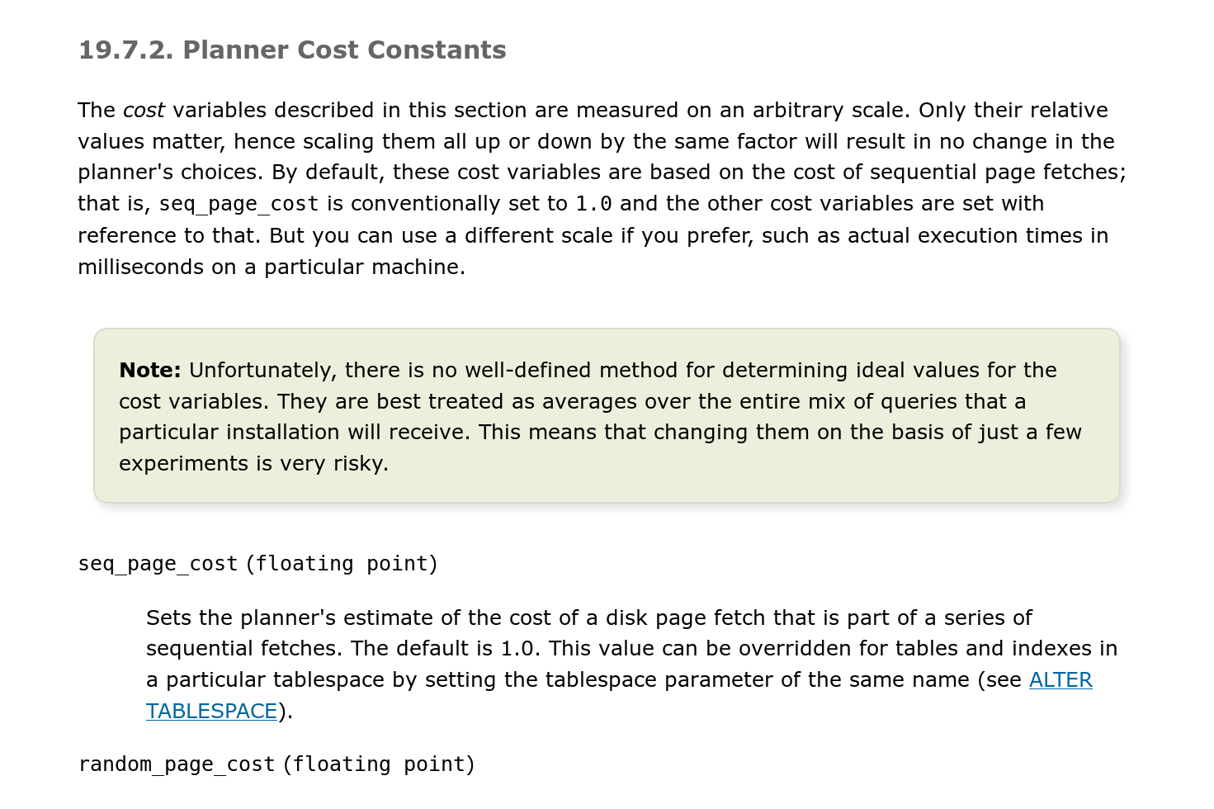
Postgres Cost Model
Uses a combination of CPU and I/O costs that are weighted by “magic” constant factors.
Default settings are obviously for a disk-resident database without a lot of memory:
  Processing a tuple in memory is 400x faster than reading a tuple from disk.
  Sequential I/O is 4x faster than random I/O.

Slide 40
Statistics
The DBMS stores internal statistics about tables, attributes, and indexes in its internal catalog.
Different systems update them at different times.
Manual invocations:
  Postgres/SQLite: ANALYZE
  Oracle/MySQL: ANALYZE TABLE
  SQL Server: UPDATE STATISTICS
  DB2: RUNSTATS

Slide 41
Selection Cardinality
The selectivity (sel) of a predicate P is the fraction of tuples that qualify.
Equality Predicate: A=constant
  sel(A=constant) = #occurences/|R|
  Example: sel(age=9) =
SELECT * FROM people
WHERE age = 9
4/45
# of occurrences
SC(age=9)=4
Distinct values
of attribute

Slide 42
Selection Cardinality
Assumption #1: Uniform Data
  The distribution of values (except for the heavy hitters) is the same.
Assumption #2: Independent Predicates
  The predicates on attributes are independent
Assumption #3: Inclusion Principle
  The domain of join keys overlap such that each key in the inner relation will also exist in the outer table.

Slide 43
Correlated Attributes
Consider a database of automobiles:
  # of Makes = 10, # of Models = 100
And the following query:
  (make=“Honda” AND model=“Accord”)
With the independence and uniformity assumptions, the selectivity is:
  1/10 × 1/100 = 0.001
But since only Honda makes Accords the real selectivity is 1/100 = 0.01
Source: Guy Lohman

Slide 44
Statistics
Choice #1: Histograms
  Maintain an occurrence count per value (or range of values) in a column.
Choice #2: Sketches
  Probabilistic data structure that gives an approximate count for a given value.
Choice #3: Sampling
  DBMS maintains a small subset of each table that it then uses to evaluate expressions to compute selectivity.

Slide 45
Histograms
Our formulas are nice, but we assume that data values are uniformly distributed.
# of occurrences
Distinct values of attribute
15 Keys × 32-bits = 60 bytes

Slide 46
Equi-width Histogram
Maintain counts for a group of values instead of each unique key. All buckets have the same width (i.e., same # of value).
Bucket Ranges
Bucket #1
Count=8
Bucket #2
Count=4
Bucket #3
Count=15
Bucket #4
Count=3
Bucket #5
Count=14

Slide 47
Equi-depth Histograms
Vary the width of buckets so that the total number of occurrences for each bucket is roughly the same.
Bucket #1
Count=12
Bucket #2
Count=12
Bucket #3
Count=9
Bucket #4
Count=12

Slide 48
Sketches
Probabilistic data structures that generate approximate statistics about a data set.
Cost-model can replace histograms with sketches to improve its selectivity estimate accuracy.
Most common examples:
  Count-Min Sketch (1988): Approximate frequency count of elements in a set.
  HyperLogLog (2007): Approximate the number of distinct elements in a set.

Slide 49
Sampling
Modern DBMSs also collect samples from tables to estimate selectivities.
Update samples when the underlying tables changes significantly.
SELECT AVG(age)
FROM people
WHERE age > 50
id | name | age | status
1001 | Obama | 63 | Rested
1002 | Swift | 34 | Paid
1003 | Tupac | 25 | Dead
1004 | Bieber | 30 | Crunk
1005 | Andy | 43 | Illin
1006 | TigerKing | 61 | Jailed
Table Sample
1001 | Obama | 63 | Rested
1003 | Tupac | 25 | Dead
1005 | Andy | 43 | Illin
sel(age>50) =
1/3
⋮
1 billion tuples

Slide 50
Conclusion
Query optimization is critical for a database system.
  SQL → Logical Plan → Physical Plan
  Flatten queries before going to the optimization part. Expression handling is also important.
  Estimate costs using models based on summarizations.
QO enumeration can be bottom-up or top-down.

Slide 51
Next Class
Transactions!

Slide 52
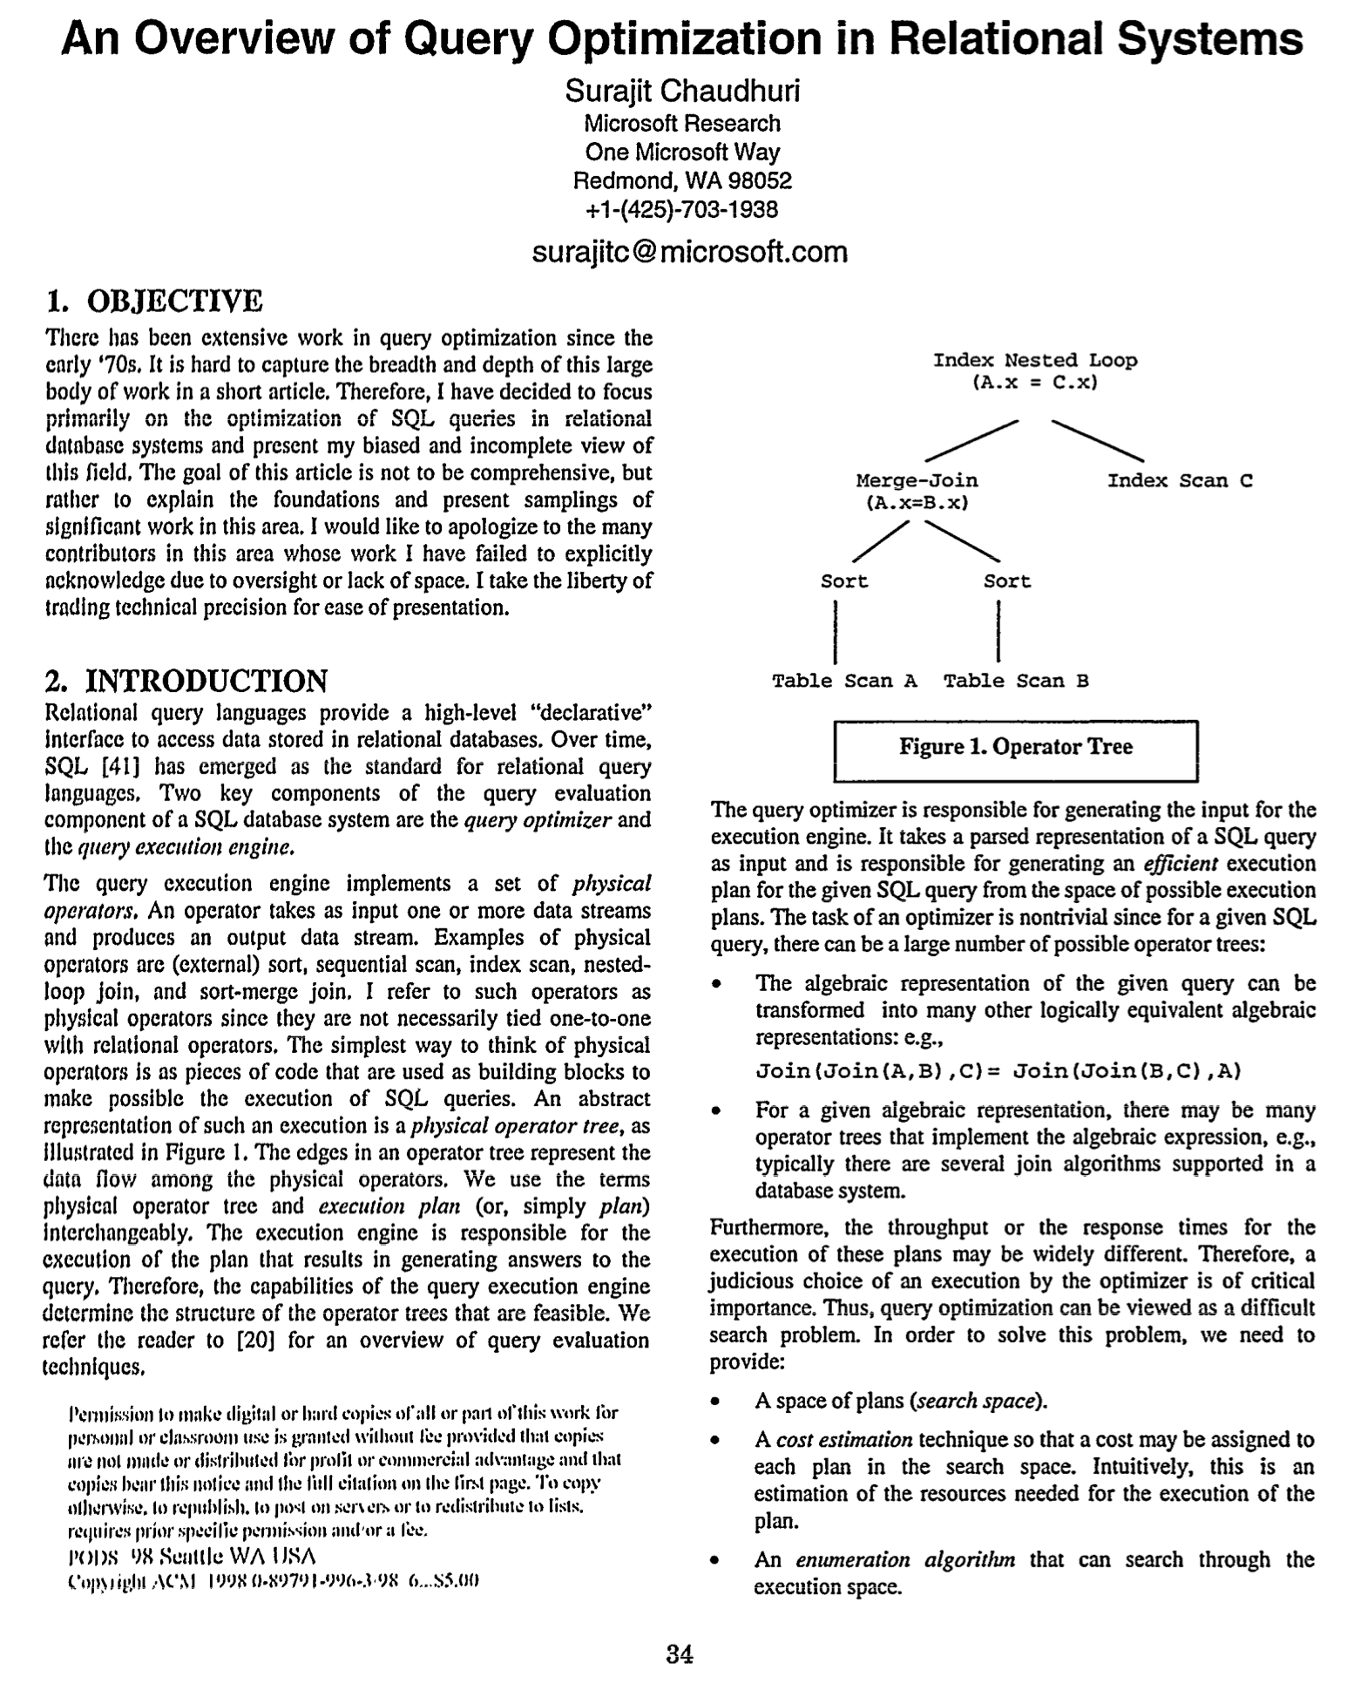
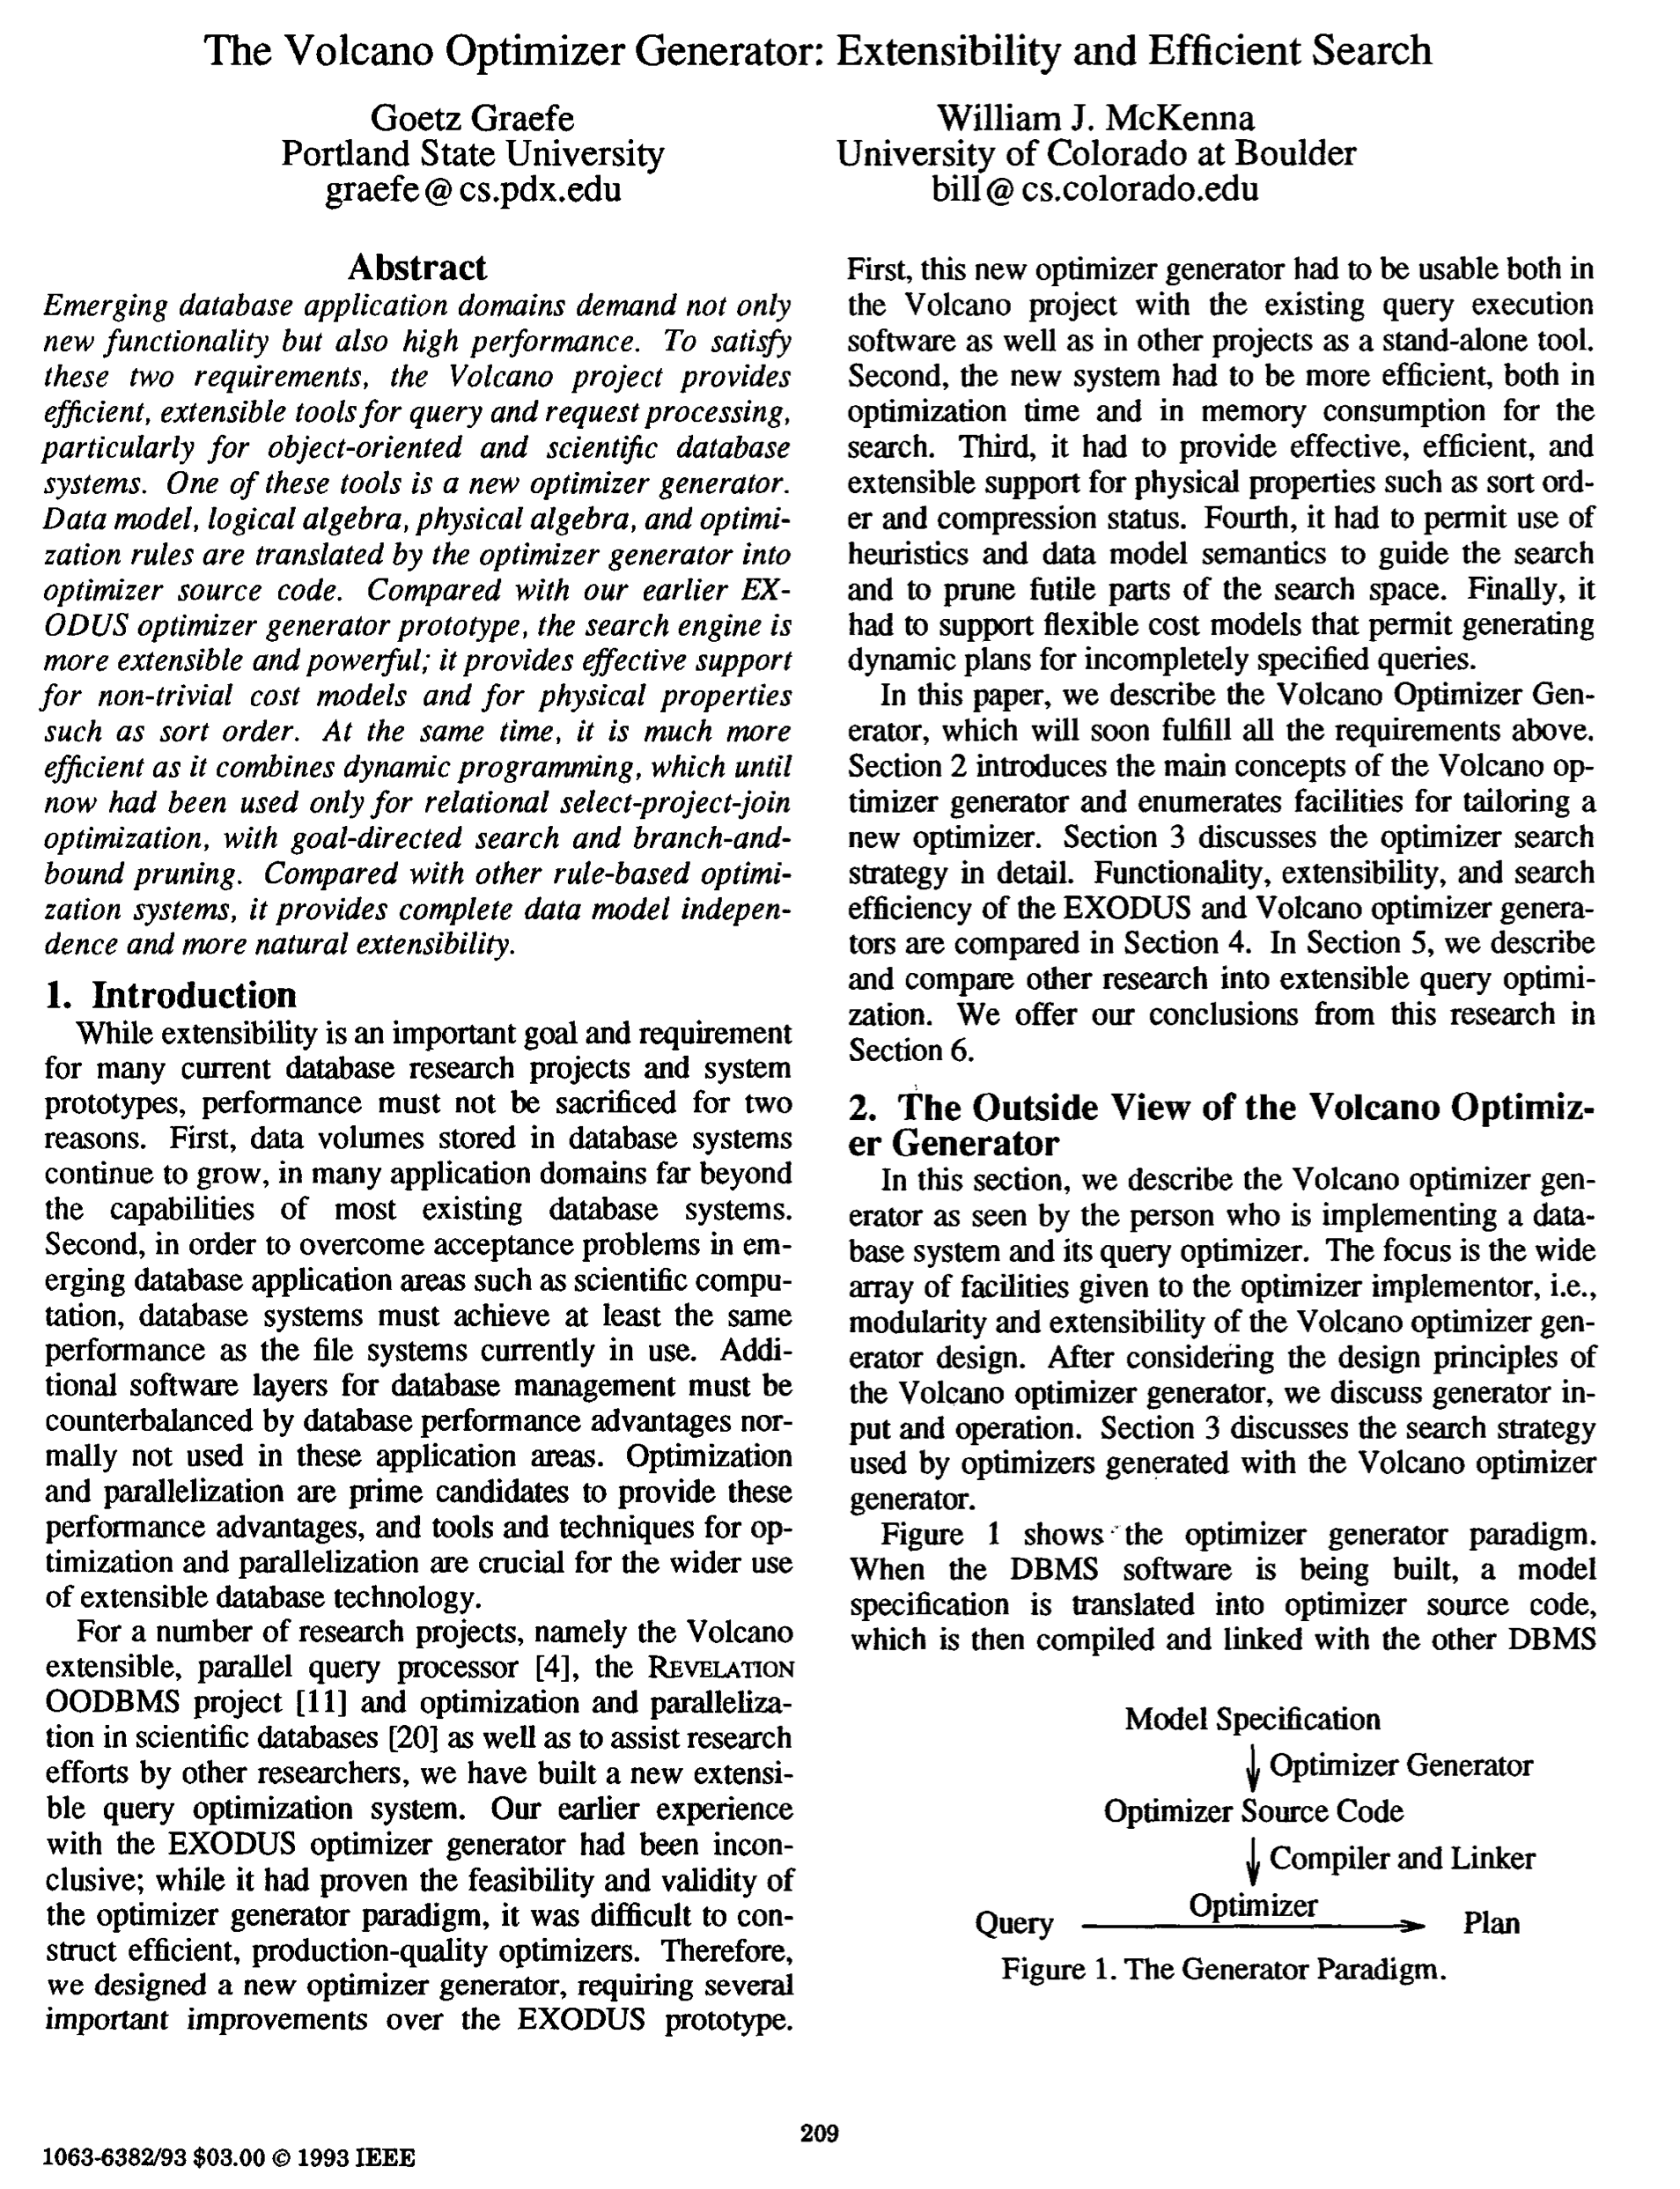
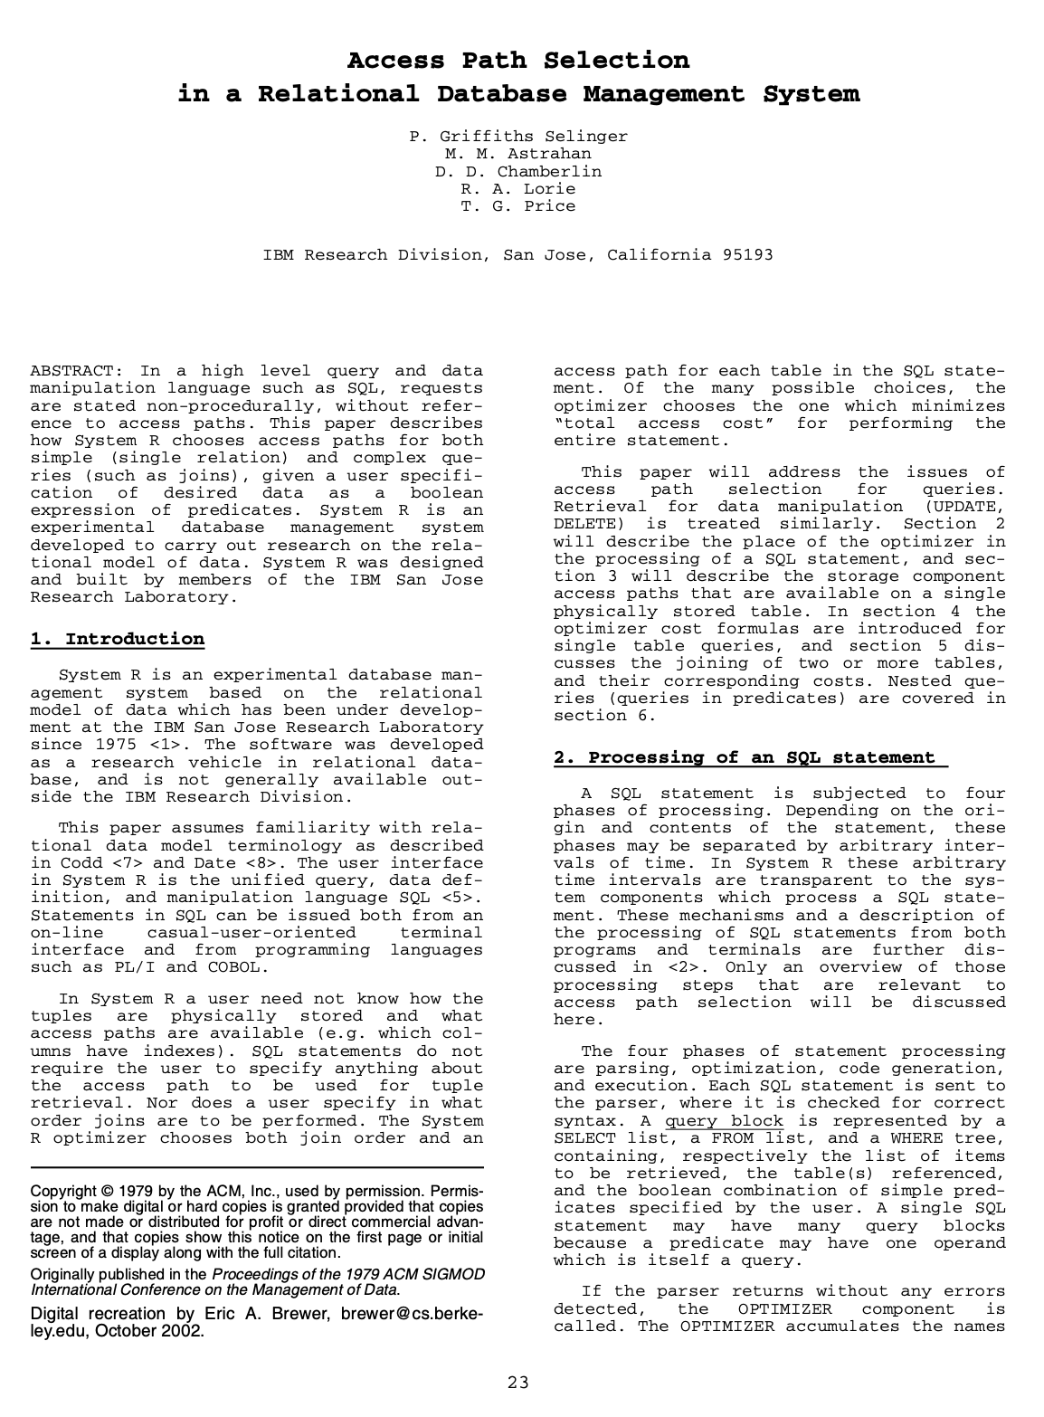
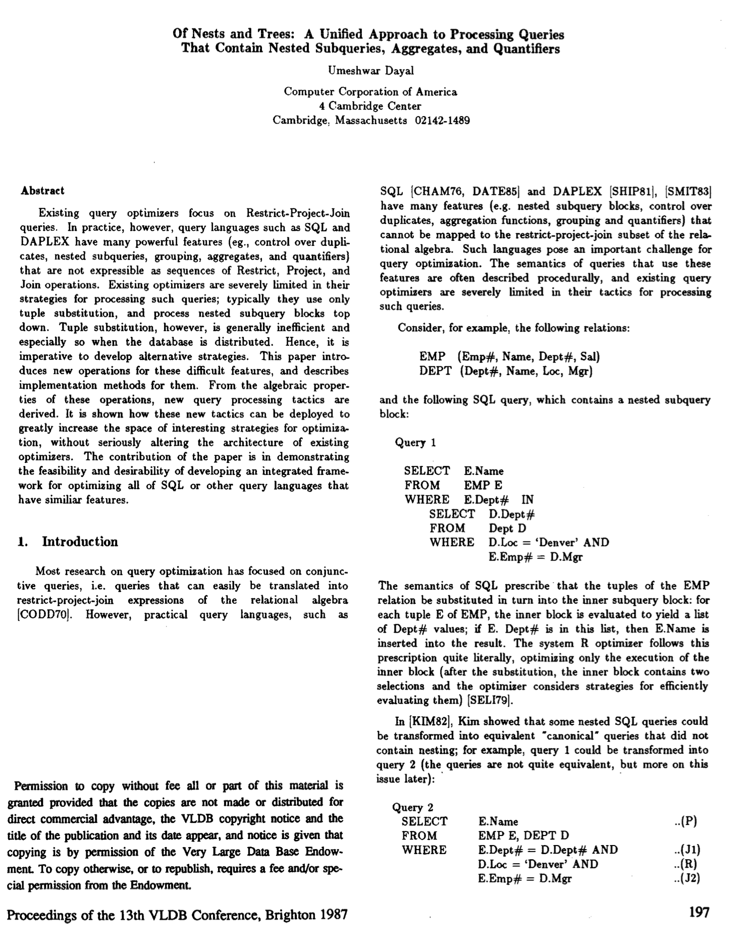
Essential Query Optimization papers
Bonus
Surajit Chaudhuri: An Overview of Query Optimization in Relational Systems. PODS 1998: 34-43
Goetz Graefe, William J. McKenna: The Volcano Optimizer Generator: Extensibility and Efficient Search. ICDE 1993: 209-218
Patricia G. Selinger, Morton M. Astrahan, Donald D. Chamberlin, Raymond A. Lorie, Thomas G. Price: Access Path Selection in a Relational Database Management System. SIGMOD Conference 1979: 23-34
Umeshwar Dayal: Of Nests and Trees: A Unified Approach to Processing Queries That Contain Nested Subqueries, Aggregates, and Quantifiers. VLDB 1987: 197-208

Slide 53
Suggestions if you are going to build a QO
Bonus
Rule 1: Read lots of papers, especially from the 80s & 90s.
  Expect new combinations, only partially new core inventions.
Rule 2: Early on, test various workloads on the QO.
  QOs harden over time as they “see” new workloads. Let them see more ASAP.
Rule 3: Throw away the initial one (or two) and start anew.
  The hard part is going to be nitty-gritty details like data structures and pointers to shared objects; e.g., the list of predicates and the query graph structure, … You will NOT get this right in the first pass. Don’t try to patch; be prepared to rewrite.

Slide 54
RELATIONAL ALGEBRA EQUIVALENCES
Two relational algebra expressions are equivalent if they generate the same set of tuples.
The DBMS can identify better query plans without a cost model.
This is often called query rewriting.

Slide 55
PREDICATE PUSHDOWN
SELECT s.name, e.cid
FROM student AS s JOIN enrolled AS e
ON s.sid = e.sid
WHERE e.grade = 'A'
π
π
π_{name, cid}(σ_{grade='A'}(student⋈enrolled))
s.name,e.cid
s.name,e.cid
σ
grade='A'
⨝
s.sid=e.sid
⨝
s.sid=e.sid
σ
grade='A'
student
enrolled
student
enrolled

Slide 56
RELATIONAL ALGEBRA EQUIVALENCES
SELECT s.name, e.cid
FROM student AS s JOIN enrolled AS e
ON s.sid = e.sid
WHERE e.grade = 'A'
π_{name, cid}(σ_{grade='A'}(student⋈enrolled))
=
π_{name, cid}(student⋈(σ_{grade='A'}(enrolled)))

Slide 57
RELATIONAL ALGEBRA EQUIVALENCES
Selections:
  Perform filters as early as possible.
  Break a complex predicate, and push down
  σ_{p1∧p2∧…pn}(R) = σ_{p1}(σ_{p2}(…σ_{pn}(R)))
Simplify a complex predicate
  (X=Y AND Y=3) → X=3 AND Y=3

Slide 58
RELATIONAL ALGEBRA EQUIVALENCES
Joins:
  Commutative, associative
  R⋈S = S⋈R
  (R⋈S)⋈T = R⋈(S⋈T)
The number of different join orderings for an n-way join is a Catalan Number (≈4^{n})
  Exhaustive enumeration will be too slow.

Slide 59
RELATIONAL ALGEBRA EQUIVALENCES
Projections:
  Perform them early to create smaller tuples and reduce intermediate results (if duplicates are eliminated)
  Project out all attributes except the ones requested or required (e.g., joining keys)
This is not important for a column store…

Slide 60
PROJECTION PUSHDOWN
SELECT s.name, e.cid
FROM student AS s JOIN enrolled AS e
ON s.sid = e.sid
WHERE e.grade = 'A'
π
π
s.name,e.cid
s.name,e.cid
⨝
s.sid=e.sid
⨝
s.sid=e.sid
π
sid,cid
σ
grade='A'
sid,name
π
σ
grade='A'
student
enrolled
student
enrolled

Slide 61
STATISTICS
For each relation R, the DBMS maintains the following information:
  N_{R}: Number of tuples in R.
  V(A,R): Number of distinct values for attribute A.

Slide 62
DERIVABLE STATISTICS
The selection cardinality SC(A,R) is the average number of records with a value for an attribute A given N_{R} / V(A,R)
Note that this formula assumes data uniformity where every value has the same frequency as all other values.
  Example: 10,000 students, 10 colleges – how many students in SCS?

Slide 63
LOGICAL COSTS
Equality predicates on unique keys are easy to estimate.
Computing the logical cost of complex predicates is more difficult…
CREATE TABLE people (
id INT PRIMARY KEY,
val INT NOT NULL,
age INT NOT NULL,
status VARCHAR(16)
);
SELECT * FROM people
WHERE id = 123
SELECT * FROM people
WHERE age = 30
AND status = 'Lit'
AND age+id IN (1,2,3)
SELECT * FROM people
WHERE val > 1000

Slide 64
SELECTIONS – COMPLEX PREDICATES
Range Predicate:
  sel(A>=a) = (A_{max}– a+1) / (A_{max}– A_{min}+1)
  Example: sel(age>=2)
SELECT * FROM people
WHERE age >= 2
≈ (4–2+1) / (4–0+1)
≈ 3/5
age_{min} = 0
age_{max} = 4

Slide 65
SELECTIONS – COMPLEX PREDICATES
Negation Query:
  sel(not P) = 1 – sel(P)
  Example: sel(age != 2)
Observation: Selectivity ≈ Probability
SELECT * FROM people
WHERE age != 2
= 1 – (1/5) = 4/5
SC(age!=2)=2
SC(age!=2)=2
SC(age=2)=1

Slide 66
SELECTIONS – COMPLEX PREDICATES
Conjunction:
  sel(P1 ⋀ P2) = sel(P1) ∙ sel(P2)
  sel(age=2 ⋀ name LIKE 'A%')
This assumes that the predicates are independent.
SELECT * FROM people
WHERE age = 2
AND name LIKE 'A%'
Not always true in practice!
P₁
P₂

Slide 67
SELECTIONS – COMPLEX PREDICATES
Disjunction:
  sel(P1 ⋁ P2)
  = sel(P1) + sel(P2) – sel(P1⋀P2)
  = sel(P1) + sel(P2) – sel(P1) ∙ sel(P2)
  sel(age=2 OR name LIKE 'A%')
This again assumes that the
selectivities are independent.
SELECT * FROM people
WHERE age = 2
OR name LIKE 'A%'
P₁
P₂

Slide 68
RESULT SIZE ESTIMATION FOR JOINS
Given a join of R and S, what is the range of possible result sizes in # of tuples?
  In other words, for a given tuple of R, how many tuples of S will it match?
Assume each key in the inner relation will exist in the outer table.
This is super hard.

Slide 69
RESULT SIZE ESTIMATION FOR JOINS
General case: R_{cols}⋂S_{cols}={A} where A is not a primary key for either table.
  Match each R-tuple with S-tuples:
  estSize ≈ N_{R} ∙ N_{S} / V(A,S)
  Symmetrically, for S:
  estSize ≈ N_{R} ∙ N_{S} / V(A,R)
Overall:
  estSize ≈ N_{R} ∙ N_{S} / max({V(A,S), V(A,R)})

Slide 70
LOGICAL PLAN OPTIMIZATION
Transform a logical plan into an equivalent logical plan using pattern matching rules.
The goal is to increase the likelihood of enumerating the optimal plan in the search.
Cannot compare plans because there is no cost model but can "direct" a transformation to a preferred side.

Slide 71
LOGICAL QUERY OPTIMIZATION
Split Conjunctive Predicates
Predicate Pushdown
Replace Cartesian Products with Joins
Projection Pushdown
Source: Thomas Neumann

Slide 72
SPLIT CONJUNCTIVE PREDICATES
SELECT ARTIST.NAME
FROM ARTIST, APPEARS, ALBUM
WHERE ARTIST.ID=APPEARS.ARTIST_ID
AND APPEARS.ALBUM_ID=ALBUM.ID
AND ALBUM.NAME="Andy's OG Remix"
π
ARTIST.NAME
σ
ARTIST.ID=APPEARS.ARTIST_ID
σ
ARTIST.ID=APPEARS.ARTIST_ID AND
APPEARS.ALBUM_ID=ALBUM.ID AND
ALBUM.NAME="Andy's OG Remix"
σ
APPEARS.ALBUM_ID=ALBUM.ID
Decompose predicates into their simplest forms to make it easier for the optimizer to move them around.
σ
ALBUM.NAME="Andy's OG Remix"
×
×
ARTIST
APPEARS
ALBUM

Slide 73
SELECTION CARDINALITY
Formula depends on type of predicate:
  Equality
  Range
  Negation
  Conjunction
  Disjunction
sel(P) = SC(P) / NR
# of tuples
Selection Cardinality

Slide 74
EXPRESSION REWRITING
Join Elimination with Sub-Query
CREATE TABLE A (
id INT PRIMARY KEY,
val INT NOT NULL );
SELECT * FROM A AS A1
WHERE EXISTS(SELECT val FROM A AS A2
WHERE A1.id = A2.id);
SELECT * FROM A;
Source: Lukas Eder

Slide 75
IBM DB2 COST MODEL
Database characteristics in system catalogs
Hardware environment (microbenchmarks)
Storage device characteristics (microbenchmarks)
Communications bandwidth (distributed only)
Memory resources (buffer pools, sort heaps)
Concurrency Environment
  Average number of users
  Isolation level / blocking
  Number of available locks
Source: Guy Lohman

