Slide 1
Lecture 2: It’s SQL Week!

Slide 2
Last Class
2
We introduced the Relational Model as the superior data model for databases.
We then showed how Relational Algebra is the building blocks that will allow us to query and modify a relational database.

Slide 3
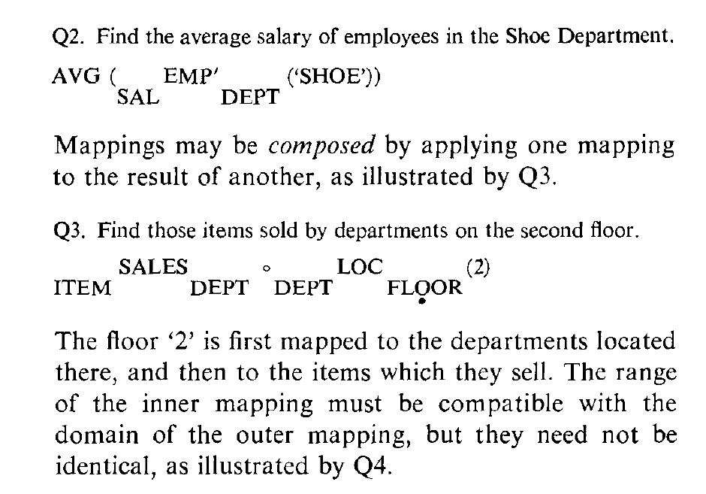
SQL History
3
In 1971, IBM created its first relational query language called SQUARE.
IBM then created "SEQUEL" in 1972 for IBM System R prototype DBMS.
Structured English Query Language
IBM releases commercial SQL-based DBMSs:
System/38 (1979), SQL/DS (1981), and DB2 (1983).

Slide 4

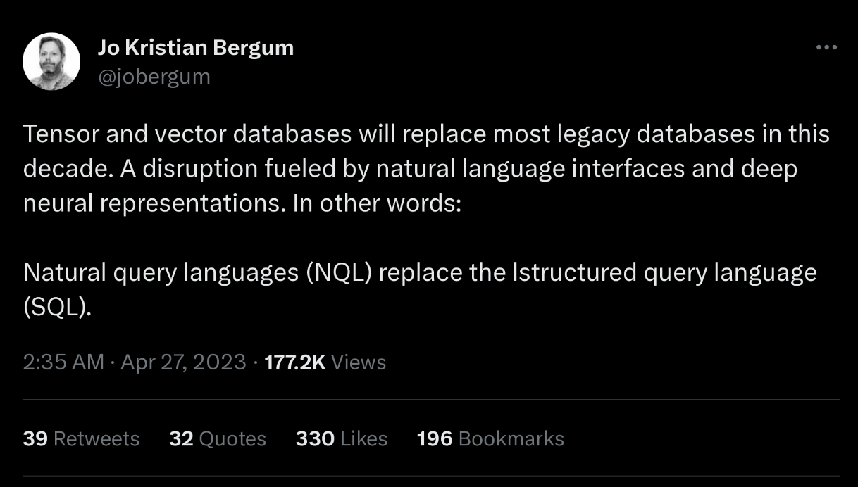

SQL History
4
ANSI Standard in 1986. ISO in 1987
Structured Query Language
Current standard is SQL:2023
SQL:2023 → Property Graph Queries, Muti-Dim. Arrays
SQL:2016 → JSON, Polymorphic tables
SQL:2011 → Temporal DBs, Pipelined DML
SQL:2008 → Truncation, Fancy Sorting
SQL:2003 → XML, Windows, Sequences, Auto-Gen IDs.
SQL:1999 → Regex, Triggers, OO
The minimum language syntax a system needs to say that it supports SQL is SQL-92.

Slide 5
Relational Languages
5
Data Manipulation Language (DML) Data Definition Language (DDL) Data Control Language (DCL)
Also includes:
View definition
Integrity & Referential Constraints
Transactions
Important: SQL is based on bags (duplicates) not sets (no duplicates).

Slide 6
Today's Agenda
6
Aggregations + Group By
String / Date / Time Operations
Output Control + Redirection
Window Functions
Nested Queries
Lateral Joins
Common Table Expressions

Slide 7

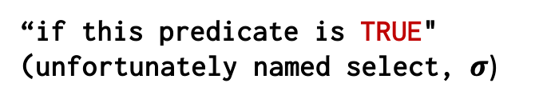
From Last Lecture…
“Some column names (projection, $Π$)”
“This is DML, get some rows”
SELECT b_id-100, a_id FROM R WHERE a_id = 'a2';
“Some table or result set to pull from”
“if this predicate is TRUE"
(unfortunately named select, $σ$)

Slide 8
Example Database
8
student(sid,name,login,gpa)
enrolled(sid,cid,grade)
sid | name | login | age | gpa
53666 | RZA | rza@cs | 55 | 4.0
53688 | Taylor | swift@cs | 27 | 3.9
53655 | Tupac | shakur@cs | 25 | 3.5
sid | cid | grade
53666 | 15-445 | C
53688 | 15-721 | A
53688 | 15-826 | B
53655 | 15-445 | B
53666 | 15-721 | C
course(cid,name)
cid | name
15-445 | Database Systems
15-721 | Advanced Database Systems
15-826 | Data Mining
15-799 | Special Topics in Databases

Slide 9






Example Database

Slide 10
Aggregates
10
Functions that return a single value from a bag of tuples:
AVG(col)→ Return the average col value.
MIN(col)→ Return minimum col value.
MAX(col)→ Return maximum col value.
SUM(col)→ Return sum of values in col.
COUNT(col)→ Return # of values for col.

Slide 11
Aggregates
11
Aggregate functions can (almost) only be used in the SELECT output list.
Get # of students with a “@cs” login:
SELECT COUNT(login) AS cnt
FROM student WHERE login LIKE '%@cs'
cnt
12
SELECT COUNT(*) AS cnt
FROM student WHERE login LIKE '%@cs'
SELECT COUNT(1) AS cnt
FROM student WHERE login LIKE '%@cs'
SELECT COUNT(1+1+1) AS cnt
FROM student WHERE login LIKE '%@cs'

Slide 12
Multiple Aggregates
12
Get the number of students and their average GPA that have a “@cs” login.
AVG(gpa) | COUNT(sid)
3.8 | 3
SELECT AVG(gpa), COUNT(sid)
FROM student WHERE login LIKE '%@cs'

Slide 13
DISTINCT AGGREGATES
13
COUNT, SUM, AVG support DISTINCT modifier.
Get the number of unique students that have an “@cs” login.
COUNT(DISTINCT login)
3
SELECT COUNT(DISTINCT login)
FROM student WHERE login LIKE '%@cs'

Slide 14

Aggregates
14
Output of other columns outside of an aggregate is undefined.
Get the average GPA of students enrolled in each course.
AVG(s.gpa) | e.cid
3.86 | ???
SELECT AVG(s.gpa), e.cid
FROM enrolled AS e JOIN student AS s
ON e.sid = s.sid
AVG(s.gpa) | e.cid
3.86 | 15-445
SELECT AVG(s.gpa), ANY_VALUE(e.cid)
FROM enrolled AS e JOIN student AS s
ON e.sid = s.sid

Slide 15
GROUP BY
15
Project tuples into subsets and calculate aggregates against each subset.
SELECT AVG(s.gpa), e.cid
FROM enrolled AS e JOIN student AS s
ON e.sid = s.sid
GROUP BY e.cid
e.sid | s.sid | s.gpa | e.cid
53435 | 53435 | 2.25 | 15-721
53439 | 53439 | 2.70 | 15-721
56023 | 56023 | 2.75 | 15-826
59439 | 59439 | 3.90 | 15-826
53961 | 53961 | 3.50 | 15-826
58345 | 58345 | 1.89 | 15-445
AVG(s.gpa) | e.cid
2.46 | 15-721
3.39 | 15-826
1.89 | 15-445

Slide 16
GROUP BY
16
Non-aggregated values in SELECT output clause must appear in GROUP BY clause.
SELECT AVG(s.gpa), e.cid, s.name
FROM enrolled AS e, student AS s
WHERE e.sid = s.sid
GROUP BY e.cid
SELECT AVG(s.gpa), e.cid, s.name
FROM enrolled AS e JOIN student AS s
ON e.sid = s.sid
GROUP BY e.cid, s.name

Slide 17
HAVING
17
Filters results based on aggregation computation.
Like a WHERE clause for a GROUP BY
SELECT AVG(s.gpa) AS avg_gpa, e.cid
FROM enrolled AS e, student AS s
WHERE e.sid = s.sid
AND avg_gpa > 3.9
GROUP BY e.cid
SELECT AVG(s.gpa) AS avg_gpa, e.cid
FROM enrolled AS e, student AS s
WHERE e.sid = s.sid
GROUP BY e.cid
HAVING avg_gpa > 3.9;
SELECT AVG(s.gpa) AS avg_gpa, e.cid
FROM enrolled AS e, student AS s
WHERE e.sid = s.sid
GROUP BY e.cid
HAVING AVG(s.gpa) > 3.9;
AVG(s.gpa) | e.cid
3.75 | 15-415
3.950000 | 15-721
3.900000 | 15-826
avg_gpa | e.cid
3.950000 | 15-721

Slide 18
String Operations
18
 | String Case | String Quotes
SQL-92 | Sensitive | Single Only
Postgres | Sensitive | Single Only
MySQL | Insensitive | Single/Double
SQLite | Sensitive | Single/Double
MSSQL | Sensitive | Single Only
Oracle | Sensitive | Single Only
WHERE UPPER(name) = UPPER('TuPaC')
SQL-92
WHERE name = "TuPaC"
MySQL

Slide 19
String Operations
19
LIKE is used for string matching.
String-matching operators
'%' Matches any substring (including empty strings).
'_' Match any one character
SELECT * FROM enrolled AS e
WHERE e.cid LIKE '15-%'
SELECT * FROM student AS s
WHERE s.login LIKE '%@c_'

Slide 20
String Operations
20
SQL-92 defines string functions.
Many DBMSs also have their own unique functions
Can be used in either output and predicates:
SELECT SUBSTRING(name,1,5) AS abbrv_name
FROM student WHERE sid = 53688
SELECT * FROM student AS s
WHERE UPPER(s.name) LIKE 'KAN%'

Slide 21
String Operations
21
SQL standard defines the || operator for concatenating two or more strings together.
SELECT name FROM student WHERE login = LOWER(name) || '@cs'
SQL-92
SELECT name FROM student WHERE login = LOWER(name) + '@cs'
MSSQL
SELECT name FROM student WHERE login = CONCAT(LOWER(name), '@cs')
MySQL

Slide 22
DATE/TIME Operations
22
Operations to manipulate and modify DATE/TIME attributes.
Can be used in both output and predicates.
Support/syntax varies wildly…
Demo: Get the # of days since the beginning of the year.

Slide 23
Output Redirection
23
Store query results in another table:
Table must not already be defined.
Table will have the same # of columns with the same types as the input.
SELECT DISTINCT cid INTO CourseIds
FROM enrolled;
SQL-92
SELECT DISTINCT cid INTO TEMPORARY CourseIds
FROM enrolled;
Postgres
CREATE TABLE CourseIds (
SELECT DISTINCT cid FROM enrolled);
MySQL

Slide 24
Output Redirection
24
Insert tuples from query into another table:
Inner SELECT must generate the same columns as the target table.
DBMSs have different options/syntax on what to do with integrity violations (e.g., invalid duplicates).
INSERT INTO CourseIds
(SELECT DISTINCT cid FROM enrolled);
SQL-92

Slide 25
Output Control
25
ORDER BY <column*> [ASC|DESC]
Order the output tuples by the values in one or more of their columns.
sid | grade
53123 | A
53334 | A
53650 | B
53666 | D
SELECT sid, grade FROM enrolled
WHERE cid = '15-721'
ORDER BY grade
SELECT sid, grade FROM enrolled
WHERE cid = '15-721'
ORDER BY 2
sid
53666
53650
53123
53334
SELECT sid FROM enrolled
WHERE cid = '15-721'
ORDER BY grade DESC, sid ASC
SELECT sid FROM enrolled
WHERE cid = '15-721'
ORDER BY grade DESC, 1 ASC

Slide 26
Output Control
26
FETCH {FIRST|NEXT} <count> ROWS OFFSET <count> ROWS
Limit the # of tuples returned in output.
Can set an offset to return a “range”
SELECT sid, name FROM student
WHERE login LIKE '%@cs'
FETCH FIRST 10 ROWS ONLY;
SELECT TOP 10 sid, name FROM student
WHERE login LIKE '%@cs'
MSSQL
SELECT sid, name FROM student
WHERE login LIKE '%@cs'
ORDER BY gpa
OFFSET 10 ROWS
FETCH FIRST 10 ROWS WITH TIES;

Slide 27
Window Functions
27
Performs a calculation across a set of tuples that are related to the current tuple, without collapsing them into a single output tuple, to support running totals, ranks, and moving averages.
Like an aggregation but tuples are not grouped into a single output tuples.
How to “slice” up data
Can also sort tuples
SELECT FUNC-NAME(...) OVER (...) FROM tableName
Aggregation Functions Special Functions

Slide 28
Window Functions
28
Aggregation functions:
Anything that we discussed earlier
Special window functions:
ROW_NUMBER()→ # of the current row
RANK()→ Order position of the current row.
sid | cid | grade | row_num
53666 | 15-445 | C | 1
53688 | 15-721 | A | 2
53688 | 15-826 | B | 3
53655 | 15-445 | B | 4
53666 | 15-721 | C | 5
SELECT *, ROW_NUMBER() OVER () AS row_num FROM enrolled

Slide 29
Window Functions
29
The OVER keyword specifies how to group together tuples when computing the window function.
Use PARTITION BY to specify group.
cid | sid | row_number
15-445 | 53666 | 1
15-445 | 53655 | 2
15-721 | 53688 | 1
15-721 | 53666 | 2
15-826 | 53688 | 1
SELECT cid, sid,
ROW_NUMBER() OVER (PARTITION BY cid) FROM enrolled ORDER BY cid

Slide 30
Window Functions
30
You can also include an ORDER BY in the window grouping to sort entries in each group.
SELECT *,
ROW_NUMBER() OVER (ORDER BY cid) FROM enrolled ORDER BY cid

Slide 31
Window Functions
31
Find the student with the second highest grade for each course.
Group tuples by cid
Then sort by grade
SELECT * FROM (
SELECT *, RANK() OVER (PARTITION BY cid ORDER BY grade ASC) AS rank FROM enrolled) AS ranking
WHERE ranking.rank = 2

Slide 32
Nested Queries
32
Invoke a query inside of another query to compose more complex computations.
Inner queries can appear (almost) anywhere in query.
Outer Query
SELECT name FROM student WHERE
sid IN (SELECT sid FROM enrolled)
Inner Query
SELECT sid,
(SELECT name FROM student AS s WHERE s.sid = e.sid) AS name
FROM enrolled AS e;
SELECT * FROM student ORDER BY (SELECT MAX(sid) FROM student);

Slide 33
Nested Queries
33
Get the names of students in '15-445'
SELECT name FROM student
WHERE ...
SELECT name FROM student
WHERE ...
SELECT sid FROM enrolled
WHERE cid = '15-445'
SELECT name FROM student
WHERE sid IN (
SELECT sid FROM enrolled
WHERE cid = '15-445'
)
sid in the set of people that take 15-445

Slide 34
Nested Queries
34
ALL→ Must satisfy expression for all rows in the sub-query.
ANY→ Must satisfy expression for at least one row in the sub-query.
IN→ Equivalent to '=ANY()' .
EXISTS→ At least one row is returned without comparing it to an attribute in outer query.

Slide 35
Nested Queries
35
Get the names of students in '15-445'
SELECT name FROM student
WHERE sid = ANY(
SELECT sid FROM enrolled
WHERE cid = '15-445'
)

Slide 36
Nested Queries
36
Find student record with the highest id that is enrolled in at least one course.
This won't work in SQL-92. It runs in SQLite, but not Postgres or MySQL (v8 with strict mode).
SELECT MAX(e.sid), s.name FROM enrolled AS e, student AS s
WHERE e.sid = s.sid;

Slide 37
Nested Queries
37
Find student record with the highest id that is enrolled in at least one course.
SELECT sid, name FROM student
WHERE sid
SELECT MAX(sid) FROM enrolled
SELECT sid, name FROM student
WHERE ...
SELECT sid, name FROM student
WHERE sid IN (
SELECT MAX(sid) FROM enrolled
)
sid | name
53688 | Taylor
SELECT sid, name FROM student
WHERE sid IN (
SELECT sid FROM enrolled
ORDER BY sid DESC FETCH FIRST 1 ROW ONLY
)
is the
SELECT student.sid, name FROM student JOIN (SELECT MAX(sid) AS sid FROM enrolled) AS max_e ON student.sid = max_e.sid;
"Is the highest enrolled sid"

Slide 38
Nested Queries
38
Find all courses that have no students enrolled in it.
SELECT * FROM course
WHERE ...
SELECT * FROM course
WHERE NOT EXISTS(
)
SELECT * FROM course
WHERE NOT EXISTS(
SELECT * FROM enrolled
WHERE course.cid = enrolled.cid
)
tuples in the enrolled table
“with no tuples in the enrolled table”
sid | cid | grade
53666 | 15-445 | C
53688 | 15-721 | A
53688 | 15-826 | B
53655 | 15-445 | B
53666 | 15-721 | C
cid | name
15-445 | Database Systems
15-721 | Advanced Database Systems
15-826 | Data Mining
15-799 | Special Topics in Databases
cid | name
15-799 | Special Topics in Databases

Slide 39
Lateral Joins
39
The LATERAL operator allows a nested query to reference attributes in other nested queries that precede it.
You can think of it like a for loop that allows you to invoke another query for each tuple in a table.
t1.x | t2.y
1 | 2
SELECT * FROM
(SELECT 1 AS x) AS t1,
LATERAL (SELECT t1.x+1 AS y) AS t2;

Slide 40
Lateral Join
40
Calculate the number of students enrolled in each course and the average GPA.
cid | name | cnt | avg
15-445 | Database Systems | 2 | 3.75
15-721 | Advanced Database Systems | 2 | 3.95
15-826 | Data Mining | 1 | 3.9
15-799 | Special Topics in Databases | 0 | null
SELECT * FROM course AS c,
LATERAL (SELECT COUNT(*) AS cnt FROM enrolled WHERE enrolled.cid = c.cid) AS t1,
LATERAL (SELECT AVG(gpa) AS avg FROM student AS s JOIN enrolled AS e ON s.sid = e.sid
WHERE e.cid = c.cid) AS t2;

Slide 41
Lecture 2: It’s SQL Week!

Slide 42
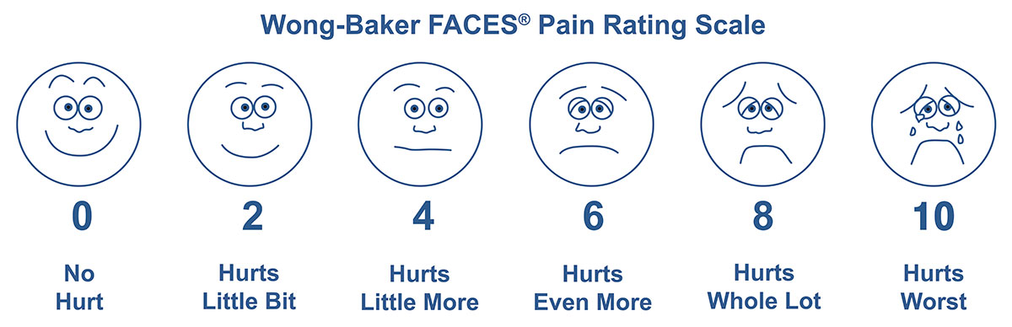
My voice today

Slide 43
Last Class
43
IT'S SQL WEEK!!!!1. SQL is feature rich and standardized. Unfortunately, no one exactly follows the standard and every system is slightly different
We discussed....

Slide 44
Today's Agenda
44
Aggregations + Group By
String / Date / Time Operations
Output Control + Redirection
Window Functions
Nested Queries
Lateral Joins
Common Table Expressions
SQL Practice
Last class
Today

Slide 45
Common Table Expressions
45
Specify a temporary result set that can then be referenced by another part of that query.
Think of it like a temp table just for one query.
Alternative to nested queries, views, and explicit temp tables.
WITH cteName AS (
SELECT 1
)
SELECT * FROM cteName

Slide 46
Common Table Expressions
46
You can bind/alias output columns to names before the AS keyword.
WITH cteName (col1, col2) AS (
SELECT 1, 2
)
SELECT col1 + col2 FROM cteName
WITH cteName (colXXX, colXXX) AS (
SELECT 1, 2
)
SELECT colXXX + colXXX FROM cteName
WITH cteName (colXXX, colXXX) AS (
SELECT 1, 2
)
SELECT * FROM cteName
Postgres

Slide 47
Common Table Expressions
47
Find student record with the highest id that is enrolled in at least one course.
WITH cteSource (maxId) AS (
SELECT MAX(sid) FROM enrolled
)
SELECT name FROM student, cteSource
WHERE student.sid = cteSource.maxId

Slide 48
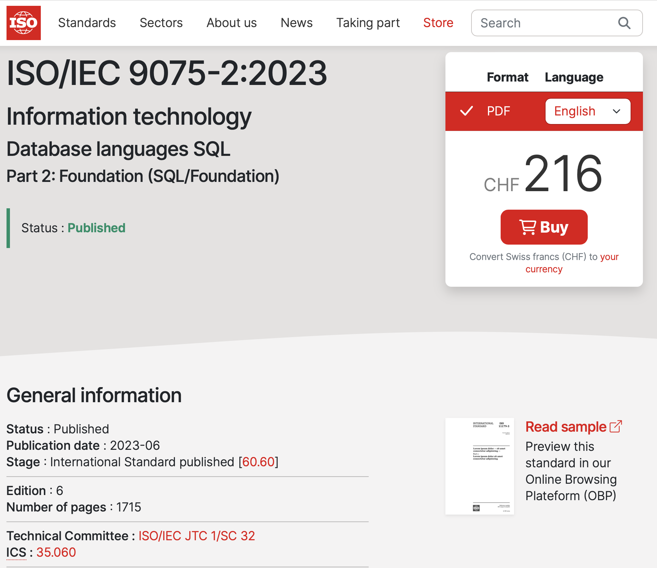
Other Things To Note
Identifiers (e.g. table and column names) are case-insensitive.
Makes it harder for applications that care about case (e.g., use CamelCased names).
One often sees quotes around names:
SELECT "ArtistList.firstName"
You have to pay cash money to get the standard documents.

Slide 49
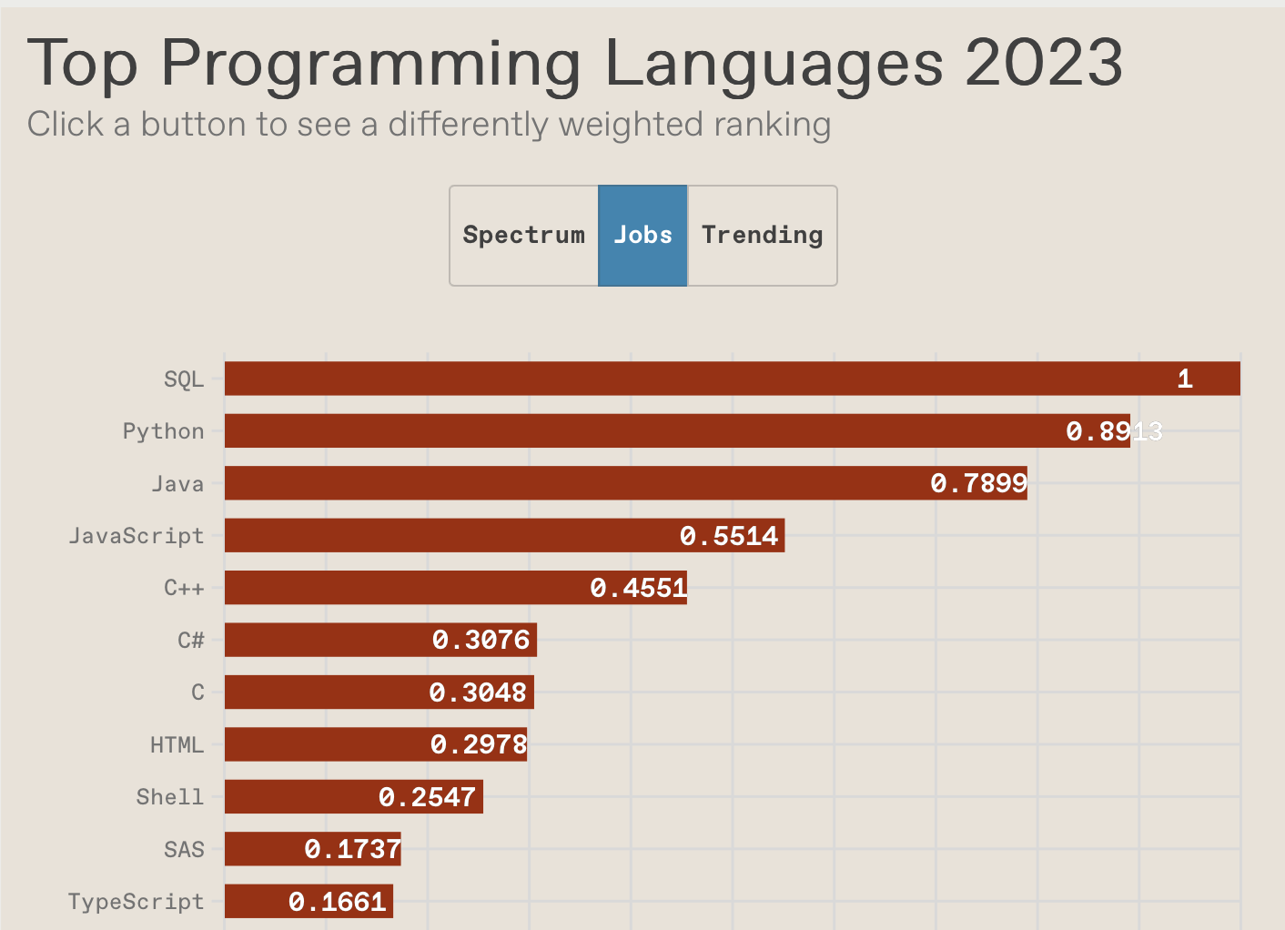
Conclusion
49
SQL is a hot language.
Lots of NL2SQL tools, but writing SQL is not going away.
You should (almost) always strive to compute your answer as a single SQL statement.

Slide 50
Now, DIY
50
Write SQL queries to perform basic data analysis.
Subset of IMDb data
Open devcontainer for Bootcamp 1, go to ./sql/
To check: ./sql/check.py PATH_TO_FILE
Where the files are like ./sql/q1_sample.sql

Slide 51
Next Class
51
We go from history / applications to present day systems. Starting with storage.

Slide 52
LATE POLICY
52
You have a total of 4 late days for projects only.
E.g., one project 4 days late, or four projects each 1 day late.
Late days rounded up to nearest integer. E.g., a submission that is 4 hours late will count as 1 day late.
If you hand in a homework late (or have used up your extension days for projects), you will lose 25% per day. After 4 days, the grade will be 0%.

Slide 53
OFFICE HOURS
53
TA office hours have been added to the website.
We will have both in-person and remote (Zoom) options.
For in-person office hours, we are currently booking space.
Will be finalized by the end of this week.

Slide 54
BASIC SYNTAX
54
As we saw last class, the basic syntax for a query is:
SELECT column1, column2, ...
FROM table
WHERE predicate1, predicate2, ...

Slide 55
BASIC SYNTAX
55
Get the names and GPAs of all students who are older than 25 years old.
SELECT name, gpa
FROM student
WHERE age > 25
Π_{name,gpa} (Projection)
σ_{age>25} (Selection)

Slide 56
BASIC SYNTAX: JOINS
56
Recall the relational algebra join operator (⋈) from last class.
Which students got an A in 15-721?
SELECT s.name
FROM enrolled AS e, student AS s
WHERE e.grade = 'A' AND e.cid = '15-721'
AND e.sid = s.sid

Slide 57
CTE – RECURSION
57
Print the sequence of numbers from 1 to 10.
Demo: CTEs!
WITH RECURSIVE cteSource (counter) AS (
(SELECT 1)
UNION ALL
(SELECT counter + 1 FROM cteSource
WHERE counter < 10)
)
SELECT * FROM cteSource

Slide 58
WINDOW FUNCTIONS
58
Get the name of the student with the second highest grade for each course.
SELECT * FROM (
) AS ranking WHERE ranking.grade_rank = 2;
SELECT C.name, S.name, E.grade, RANK() OVER (PARTITION BY E.cid ORDER BY E.grade ASC ) AS grade_rank FROM student S, course C, enrolled E WHERE S.sid = E.sid AND C.cid = E.cid

