Slide 1
Lecture 11: B+Tree Optimizations and Concurrency

Slide 2
Announcements
2
P1 Due Today!
P2 Released Tonight
Code reviews will be week of October 5th

Slide 3
Last Class
3
A B+Tree is a self-balancing, ordered m-way tree for searches, sequential access, insertions, and deletions in O(log_{m} n) where m is the tree fanout.
  It is perfectly balanced (i.e., every leaf node is at the same depth in the tree)
  Every node other than the root is at least half-full
  m/2-1 ≤ #keys ≤ m-1
  Every inner node with k keys has k+1 non-null children.
  Optimized for reading/writing large data blocks.
Some real-world implementations relax these properties, but we will ignore that for now…

Slide 4
Last Class
<node*>|<key>|<node*>|<key>|<node*>
20
Root Node
<20
≥20
Sibling Pointers
Inner / Non-Leaf Nodes
10
35
<10
≥10
<35
≥35
6
10
20
31
38
44
Leaf Nodes
Index Key(s) Low→High
<key>|<value>|<key>|<value>

Slide 5
B+TREE – INSERT EXAMPLE (3)
Insert 17
Insert 16
5
9
13
19
1
3
5
7
9
11
13
14
15
17
20
21
23
Split the node!
Copy the middle key.
Push the key up.
No space in the node where the new key “belongs”.

Slide 6
B+TREE – INSERT EXAMPLE (3)
Insert 17
Insert 16
5
9
13
19
1
3
5
7
9
11
13
14
15
17
20
21
23
New Node!
Shuffle keys from the node that triggered the split.

Slide 7
B+TREE – INSERT EXAMPLE (3)
Insert 17
Want to create a key, pointer pair like this. But cannot insert it in the root node, which is full.
Insert 16
5
9
13
19
16
Split the root. Grow the tree!
1
3
5
7
9
11
13
14
15
16
17
20
21
23
But this is an “orphan” node! No parent node points to it.

Slide 8
B+TREE – INSERT EXAMPLE (3)
Insert 17
Insert 16
5
9
13
19
16
Split the root. Grow the tree!
1
3
5
7
9
11
13
14
15
16
17
20
21
23

Slide 9
B+TREE – INSERT EXAMPLE (3)
Insert 17
13
Insert 16
Next, need to split the “old” root, then point to the split nodes from the new root.
5
9
16
19
1
3
5
7
9
11
13
14
15
16
17
20
21
23

Slide 10
B+TREE – INSERT EXAMPLE (3)
Insert 17
13
Insert 16
<13
≥13
5
9
16
19
<5
[5,9)
[9,13)
[13,16)
[16,19)
≥19
1
3
5
7
9
11
13
14
15
16
17
20
21
23

Slide 11
Today
B+Tree Optimizations, Design Choices
Locks, Latches, and Synchronization
B+Tree Concurrency

Slide 12


B+Tree Design Choices
Node Size
Merge Threshold
Variable-Length Keys
Intra-Node Search

Slide 13
Node Size
13
The slower the storage device, the larger the optimal node size for a B+Tree.
  HDD: ~1MB
  SSD: ~10KB
  In-Memory: ~512B
Optimal sizes can vary depending on the workload
  Leaf Node Scans vs. Root-to-Leaf Traversals

Slide 14
Merge Threshold
14
Some DBMSs do not always merge nodes when they are half full.
  Average occupancy rate for B+Tree nodes is 69%.
Delaying a merge operation may reduce the amount of reorganization.
It may also be better to let smaller nodes exist and then periodically rebuild entire tree.
This is why PostgreSQL calls their B+Tree a "non-balanced" B+Tree (nbtree).

Slide 15
Variable-length Keys
15
Approach #1: Pointers
  Store the keys as pointers to the tuple’s attribute.
  Also called T-Trees (in-memory DBMSs)
Approach #2: Variable-Length Nodes
  The size of each node in the index can vary.
  Requires careful memory management.
Approach #3: Padding
  Always pad the key to be max length of the key type.
Approach #4: Key Map / Indirection
  Embed an array of pointers that map to the key + value list within the node.

Slide 16
Intra-Node Search
0
0
0
0
1
0
0
0
Approach #1: Linear
  Scan node keys from beginning to end.
  Use SIMD to vectorize comparisons.
Approach #2: Binary
  Jump to middle key, pivot left/right depending on comparison.
Approach #3: Interpolation
  Approximate location of desired key based on known distribution of keys.
Find Key=8
4
5
6
7
8
9
10
8
8
Find Key=8
8
8
4
5
6
7
8
9
10
_mm_cmpeq_epi32_mask(a, b)
Find Key=8
Offset: (8-4)*7/(10-4)=4
4
5
6
7
8
9
10

Slide 17
Optimizations
17
Prefix Compression
Deduplication
Suffix Truncation
Pointer Swizzling
Bulk Insert
Buffered Updates
Many more…

Slide 18
Prefix Compression
18
Sorted keys in the same leaf node are likely to have the same prefix.
Instead of storing the entire key each time, extract common prefix and store only unique suffix for each key.
  Many variations.
robbed
robbing
robot
Prefix: rob
bed
bing
ot

Slide 19
Deduplication
Non-unique indexes can end up storing multiple copies of the same key in leaf nodes.
The leaf node can store the key once and then maintain a "posting list" of tuples with that key.
K₁
V₁
K₁
V₂
K₁
V₃
K₂
V₄
K₁
V₁
V₂
V₃
K₂
V₄

Slide 20
Suffix Truncation
20
The keys in the inner nodes are only used to "direct traffic".
  We don't need the entire key.
Store a minimum prefix that is needed to correctly route probes into the index.
abcdefghijk
abc
lmn
lmnopqrstuv
…
…
…
…

Slide 21
Pointer Swizzling
Nodes use page ids to reference other nodes in the index. The DBMS must get the memory location from the page table during traversal.
If a page is pinned in the buffer pool, then we can store raw pointers instead of page ids. This avoids address lookups from the page table.
Find(3)
6
9
Page #2
<Page*>
Page #3
<Page*>
1
3
6
7
Page #2 → <Page*>
Page #3 → <Page*>
1
Header
2
Header
3
Header
Buffer Pool

Slide 22
Bulk Insert
22
The fastest way to build a new B+Tree for an existing table is to first sort the keys and then build the index from the bottom up.
Keys: 3, 7, 9, 13, 6, 1
Sorted Keys: 1, 3, 6, 7, 9, 13
6
9
1
3
6
7
9
13

Slide 23
Observation
Modifying a B+tree is expensive when the DBMS has to split/merge nodes.
  Worst case is when DBMS reorganizes the entire tree.
  The worker that causes a split/merge is responsible for doing the work.
What if there was a way to delay updates and then apply multiple changes together in a batch?

Slide 24


Write-Optimized B+Tree (Bε-Tree)
Instead of immediately applying updates, store changes to key/value entries in log buffers at inner nodes.
  aka Fractal Trees / Bε-trees.
Updates cascade down to
lower nodes incrementally
when buffers get full.
Insert 7
Find 10
Insert 40
Delete 10
Insert 7
20
Mod Log
Insert 40
Delete 10
10
35
6
10
20
38

Slide 25

Observation
25
So far, we have given thread unsafe B+Tree algorithms
A modern DBMS needs to allow multiple threads to safely access data structures to take advantage of additional CPU cores and hide disk I/O stalls.
They Don't Do This!

Slide 26
B+Tree Multi-threaded Example
26
T₁: Delete 44
T₂: Find 41
20
A
10
35
B
6
12
23
31
C
38
44
D
41
Rebalance!
3
4
6
9
10
11
12
13
20
22
23
31
35
36
38
41
44
E
F
G
H
I
???

Slide 27
Concurrency Control
27
A concurrency control protocol is the method that the DBMS uses to ensure “correct” results for concurrent operations on a shared object.
A protocol's correctness criteria can vary:
  Logical Correctness: Can a thread see the data that it is supposed to see?
  Physical Correctness: Is the internal representation of the object sound?

Slide 28
B+ Tree Concurrency Control
28
Latches Overview
B+Tree Latching
Leaf Node Scans

Slide 29
Locks vs. Latches
29
Locks (Transactions)
  Protect the database's logical contents from other transactions.
  Held for transaction's duration.
  Need to be able to rollback changes.
Latches (Workers)
  Protect the critical sections of the DBMS's internal data structure from other workers (e.g., threads).
  Held for operation duration.
  Do not need to be able to rollback changes.

Slide 30
Locks vs. Latches
30
Lecture #15
 | Locks | Latches
Separate… | Transactions | Workers (threads, processes)
Protect… | Database Contents | In-Memory Data Structures
During… | Entire Transactions | Critical Sections
Modes… | Shared, Exclusive, Update, Intention | Read, Write
Deadlock | Detection & Resolution | Avoidance
…by… | Waits-for, Timeout, Aborts | Coding Discipline
Kept in… | Lock Manager | Protected Data Structure
Source: Goetz Graefe

Slide 31
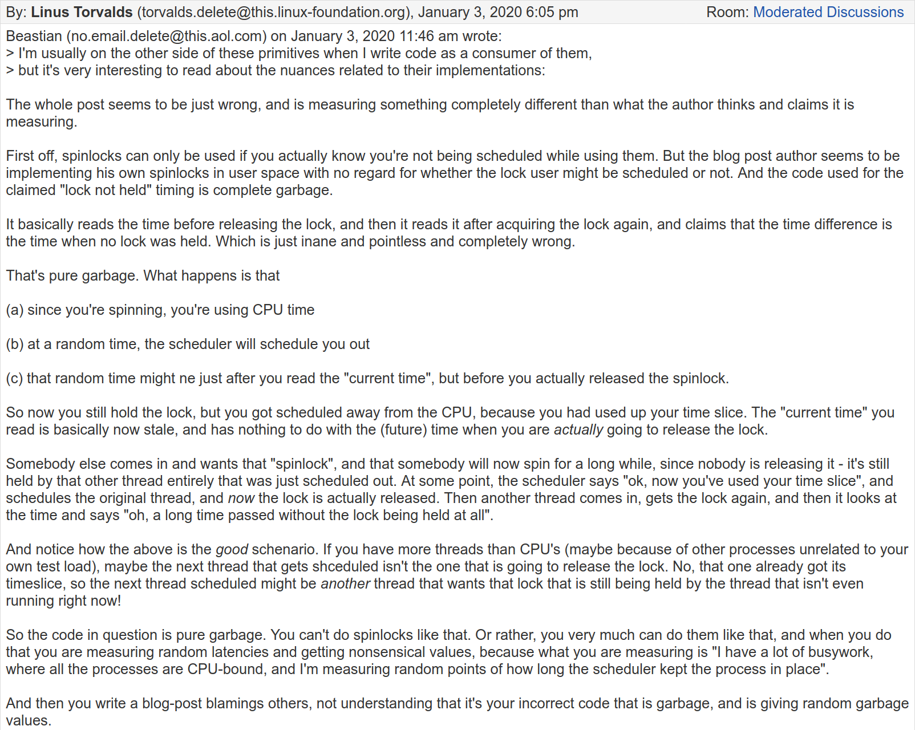
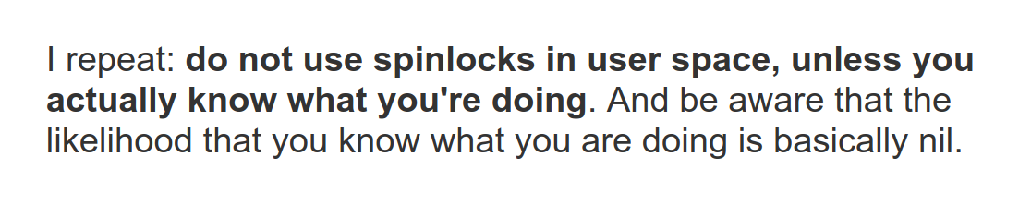
Latch Implementation Goals
Small memory footprint.
Fast execution path when no contention.
Decentralized management of latches.
Avoid expensive system calls.
Source: Filip Pizlo

Slide 32
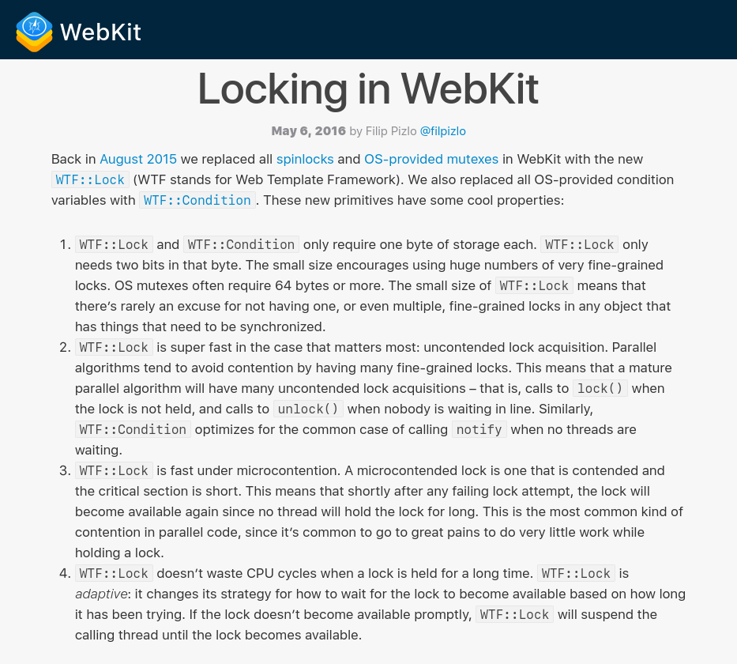
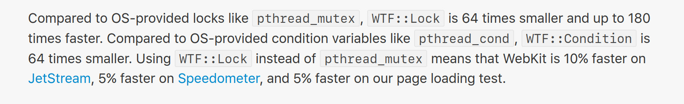
Latch Implementations
Atomic Instructions (i.e., roll your own)
Blocking OS Mutex
Reader-Writer Locks
Advanced approaches:
  Adaptive Spinlock (Apple ParkingLot)
  Queue-based Spinlock (MCS Locks)
  Optimistic Lock Coupling (The Germans)

Slide 33
Latch Implementations
Approach #1: Test-and-Set Spin Latch (TAS)
  Very efficient (single instruction to latch/unlatch)
  Non-scalable, not cache friendly, not OS friendly.
  Example: std::atomic_flag
Not std::atomic<bool>
std::atomic_flag latch;
⋮
while (latch.test_and_set()) {
// Retry? Yield? Abort?
}
test_and_set semantics:
-if flag is 1, return TRUE
-if flag is 0, flip it to 1 and return FALSE
-executes atomically, without using a lock

Slide 34
Latch Implementations
Approach #1: Test-and-Set Spin Latch (TAS)
  Very efficient (single instruction to latch/unlatch)
  Non-scalable, not cache friendly, not OS friendly.
  Example: std::atomic_flag
Not std::atomic<bool>
std::atomic_flag latch;
⋮
while (latch.test_and_set()) {
// Retry? Yield? Abort?
}

Slide 35

Compare-and-swap (CAS)
Atomic instruction that compares contents of a memory location M to a given value V
  If values are equal, installs new given value V’ in M, return TRUE
  Otherwise, operation fails, return FALSE
See C++11 Atomics
New
Value
M
Address
30
20
__sync_bool_compare_and_swap(&M, 20, 30)
Compare Value

Slide 36
Skip Lists: INSERT w/ Spin Lock
Insert K₅
Levels
Problem: what happen if the INSERT thread gets swapped out by the OS?
End
K₅
∞
K₂
K₄
K₅
∞
K₁
K₂
K₃
K₄
K₅
K₆
∞
V₁
V₂
V₃
V₄
V₅
V₆

Slide 37
Skip Lists: INSERT w/ CAS
Insert K₅
Levels
Question: why CAS if 64-bit writes are already atomic?
End
K₅
∞
K₂
K₄
K₅
∞
K₁
K₂
K₃
K₄
K₅
K₆
∞
V₁
V₂
V₃
V₄
V₅
V₆

Slide 38
Latch Implementations
38
Approach #2: Blocking OS Mutex
  Simple to use
  Non-scalable (about 25ns per lock/unlock invocation)
  Example: std::mutex
pthread_mutex_t
futex
std::mutex m;
⋮
m.lock();
// Do something special...
m.unlock();
OS Latch
Userspace Latch

Slide 39
Observation
5
9
13
19
find(17)
1
3
5
7
9
11
13
14
15
17
20
21
23
find(13)
find(17)
insert(16)

Slide 40
Observation
5
9
13
19
16
find(17)
1
3
5
7
9
11
13
14
15
16
17
20
21
23
Idea: Readers can share access with other readers.
Writers can't share access with anyone (readers or writers).
find(13)
find(17)
insert(16)

Slide 41

Latch Implementations
41
Approach #3: Reader-Writer Latches
  Allows for concurrent readers. Must manage read/write queues to avoid starvation.
  Can be implemented on top of spinlocks.
  Example: std::shared_mutex
pthread_mutex_t
pthread_cond_t
pthread_rwlock_t
Latch
read
write
=0
=1
=2
=0
=0
=1
=0
=1

Slide 42
Latch Modes
Read Mode
  Multiple threads can read the same object at the same time.
  A thread can acquire the read latch if another thread has it in read mode.
Write Mode
  Only one thread can access the object.
  A thread cannot acquire a write latch if another thread has it in any mode.
Compatibility Matrix
 | Read | Write
Read | ✔ | X
Write | X | X

Slide 43
Hash Table Latching
43
Easy to support concurrent access due to the limited ways threads access the data structure.
  All threads move in the same direction and only access a single page/slot at a time.
  Deadlocks are not possible.
To resize the table, take a global write latch on the entire table (e.g., in the header page).

Slide 44
Hash Table Latching
44
Approach #1: Page/Block Latches
  Each page/block has its own reader-writer latch that protects its entire contents.
  Threads acquire either a read or write latch before they access a page/block.
Approach #2: Slot Latches
  Each slot has its own latch.
  Can use a single-mode latch to reduce meta-data and computational overhead.

Slide 45
Hash Table: Page/Block Latches
45
It’s safe to release the latch on Page #1.
B
| value
0
T₁: Find D
T₂: Insert E
R
W
hash(D)
hash(E)
A
| value
1
C
| value
R
W
D
| value
2
E
| value

Slide 46
Hash Table: Slot Latches
46
B
| value
0
T₁: Find D
T₂: Insert E
hash(D)
R
hash(E)
It’s safe to release the latch on A
W
A
| value
R
W
1
C
| value
R
W
D
| value
W
2
E
| value

Slide 47
B+Tree Concurrency Control
47
We want to allow multiple threads to read and update a B+Tree at the same time.
We need to protect against two types of problems:
  Threads trying to modify the contents of a node at the same time.
  One thread traversing the tree while another thread splits/merges nodes.

Slide 48
Latch Crabbing/Coupling
48
Protocol to allow multiple threads to access/modify B+Tree at the same time.
  Get latch for parent
  Get latch for child
  Release latch for parent if “safe”
A safe node is one that will not split or merge when updated.
  Not full (on insertion)
  More than half-full (on deletion)

Slide 49
Latch Crabbing/Coupling
49
Find: Start at root and traverse down the tree:
  Acquire R latch on child,
  Then unlatch parent.
  Repeat until we reach the leaf node.
Insert/Delete: Start at root and go down, obtaining W latches as needed. Once child is latched, check if it is safe:
  If child is safe, release all latches on ancestors

Slide 50
Example #1 – FIND 38
50
R
T₁: Find 38
20
A
R
10
35
B
It is now safe to release the latch on A.
R
6
12
23
C
38
44
D
R
3
4
6
9
10
11
12
13
20
22
23
31
35
36
38
41
44
E
F
G
H
I

Slide 51
Example #2 – DELETE 38
51
W
T₁: Delete 38
20
A
W
10
35
B
We may need to coalesce B, so we can’t release the latch on A.
W
6
12
23
C
38
44
D
We know that D will not merge with C, so it is safe to release latches on A and B.
W
3
4
6
9
10
11
12
13
20
22
23
31
35
36
38
41
44
E
F
G
H
I

Slide 52
Example #3 – INSERT 45
52
W
T₁: Insert 45
20
A
W
10
35
B
We know that if D needs to split, B has room so it is safe to release the latch on A.
W
6
12
23
C
38
44
D
W
3
4
6
9
10
11
12
13
20
22
23
31
35
36
38
41
44
45
E
F
G
H
I
Node I will not split, so we can release B+D.

Slide 53
Example #4 – INSERT 25
53
W
T₁: Insert 25
20
A
W
10
35
B
W
6
12
23
31
C
38
44
D
W
3
4
6
9
10
11
12
13
20
22
23
31
25
35
31
36
38
41
44
We need to split F, so we need to hold the latch on its parent node.
J
E
F
G
H
I

Slide 54
Observation
54
What was the first step that all the update examples did on the B+Tree?
Taking a write latch on the root every time becomes a bottleneck with higher concurrency.
Delete 38
Insert 45
Insert 25
W
W
W
20
A
20
A
20
A

Slide 55
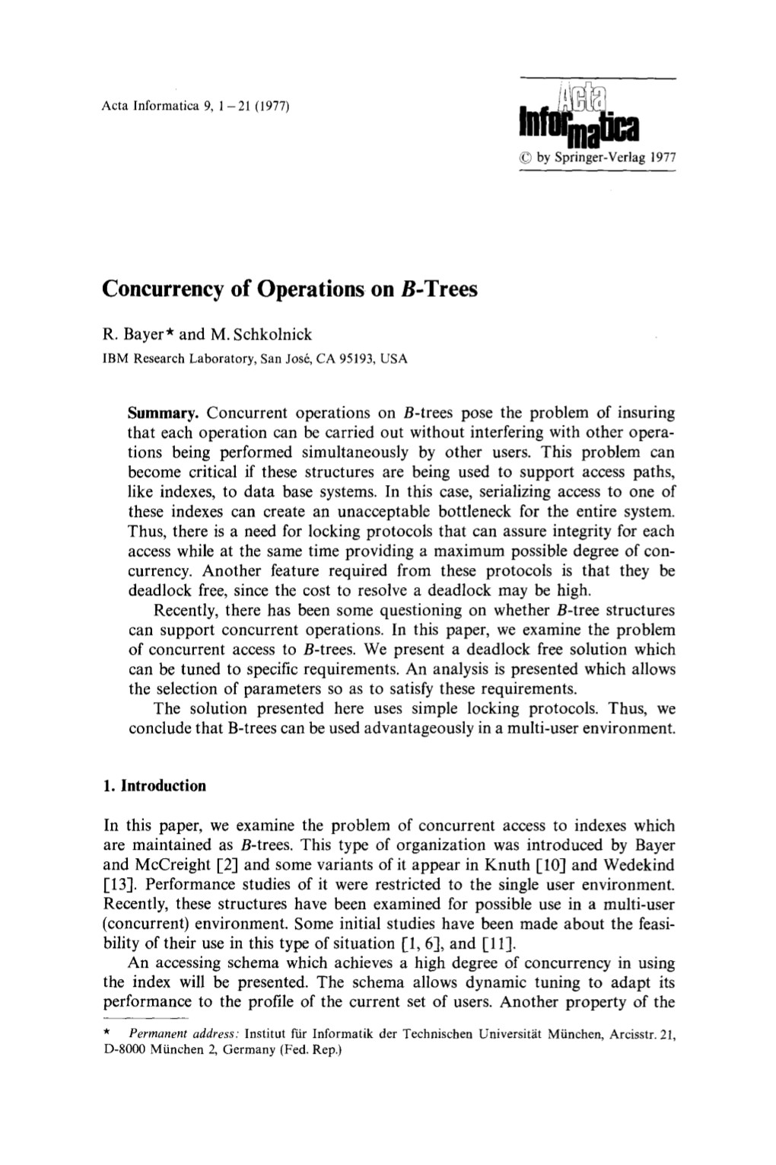
Better Latching Algorithm
Most modifications to a B+Tree will not require a split or merge.
Instead of assuming there will be a split/merge, optimistically traverse the tree using read latches.
If a worker guesses wrong, repeat traversal with pessimistic algorithm.

Slide 56
Better Latching Algorithm
56
Search: Same as before.
Insert/Delete:
  Set latches as if for search, get to leaf, and set W latch on leaf.
  If leaf is not safe, release all latches, and restart thread using previous insert/delete protocol with write latches.
This approach optimistically assumes that only leaf node will be modified; if not, R latches set on the first pass to leaf are wasteful.

Slide 57
Example #2 – DELETE 38
57
R
T₁: Delete 38
20
A
R
10
35
B
R
6
12
23
C
38
44
D
W
3
4
6
9
10
11
12
13
20
22
23
31
35
36
38
41
44
E
F
G
H
I
Node H will not coalesce,
so we’re safe!

Slide 58
Example #4 – INSERT 25
58
R
T₁: Insert 25
20
A
R
10
35
B
R
6
12
23
C
38
44
D
W
3
4
6
9
10
11
12
13
20
22
23
31
35
36
38
41
44
We need to split F, so we have to restart and re-execute like before.
E
F
G
H
I

Slide 59
DELAYED PARENT UPDATES
Every time a leaf node overflows, we must update at least three nodes.
  The leaf node being split.
  The new leaf node being created.
  The parent node.
B^{link}-Tree Optimization: When a leaf node overflows, delay updating its parent node.

Slide 60
EXAMPLE #4 – INSERT 25
R
T₁: Insert 25
C: Add 31
20
A
T₂: Find 31
R
T₃: Insert 33
10
35
B
Update C the next time that a thread takes a write latch on it.
R
W
6
12
23
31
C
38
44
D
W
3
4
6
9
10
11
12
13
20
22
23
31
25
35
36
38
41
44
Add the new leaf node as a sibling to F, but do not update C
W
E
F
G
H
I
31
33

Slide 61
Observation
61
The threads in all the examples so far have acquired latches in a "top-down" manner.
  A thread can only acquire a latch from a node that is below its current node.
  If the desired latch is unavailable, the thread must wait until it becomes available.
But what if threads want to move from one leaf node to another leaf node?

Slide 62
Leaf Node Scan Example #1
62
T₁: Find Keys < 4
R
3
A
Do not release latch on C until thread has latch on B
R
R
1
2
3
4
B
C

Slide 63
Leaf Node Scan Example #2
63
T₁: Find Keys < 4
T₂: Find Keys > 1
R
Both T₁ and T₂ now hold this read latch.
3
A
Only T₁ holds
this read latch.
Both T₁ and T₂ now hold this read latch.
Only T₂ holds
this read latch.
R
R
1
2
3
4
B
C

Slide 64
Leaf Node Scan Example #3
64
T₁: Delete 4
T₂: Find Keys > 1
R
3
A
T₂ cannot acquire the read latch on C
T₂ Choices?
Wait
R
W
Give up
1
2
3
4
B
C
Kill Other Thread
T₂ does not know what T₁ is doing…

Slide 65
Leaf Node Scans
65
Latches do not support deadlock detection or avoidance. The only way we can deal with this problem is through coding discipline.
The leaf node sibling latch acquisition protocol must support a “no-wait” mode.
The DBMS's data structures must cope with failed latch acquisitions.
  Usually transparent to end-user / application.

Slide 66
Conclusion
66
Making a data structure thread-safe is notoriously difficult in practice.
We focused on B+Trees, but the same high-level techniques are applicable to other data structures.

Slide 67

Next Class
67
Hash tables and sorting in the real world

Slide 68
Project #2
68
You will build a thread-safe B+tree backed by your buffer pool manager.
  Page Layout
  Insert/Delete/Find Operations
  Iterator
  Latch Crabbing
We define the API for you. You need to provide the method implementations.
WARNING:
This is more difficult than Project #1.
Start immediately!
WARNING:
This is harder than Project #1. Start immediately!

Slide 69
Tasks
69
Task #1: Page Layouts
  How each node will store its key/values in a page.
  You only need to support unique keys.
Task #2: Operations
  Support point queries (single key).
  Support inserts with node splitting.
  Support removal of keys with sibling stealing + merging.
  Does not need to be thread-safe.

Slide 70
Tasks
70
Task #3: Index Iterator
  Create a STL iterator for range scans on leaf nodes.
  You only need to support ascending scans.
Task #4: Concurrent Index
  Introduce latch crabbing/coupling protocol to support safe concurrent operations.
  Make sure you have splits / merges working correctly before proceeding with this task.

Slide 71
Development Hints
71
Follow the textbook semantics and algorithms.
Set the page size to be small (e.g., 512B) when you first start so that you can see more splits/merges.
Make sure that you protect the internal B+Tree root_page_id member.

Slide 72
Extra Credit
72
Gradescope Leaderboard runs your code with a specialized in-memory version of BusTub.
The top 20 fastest implementations in the class will receive extra credit for this assignment.
  #1: 50% bonus points
  #2–5: 25% bonus points
  #6–10: 10% bonus points
You must pass all the test cases to qualify!

Slide 73
LATCH IMPLEMENTATIONS
Approach #4: Adaptive Spinlock
  Thread spins on a userspace lock for a brief time.
  If they cannot acquire the lock, they then get descheduled and stored in a global "parking lot".
  Threads check to see whether other threads are "parked" before spinning and then park themselves.
  Example: Apple's WTF::ParkingLot

Slide 74
LATCH IMPLEMENTATIONS
74
Mellor-Crummey and Scott
Approach #5: Queue-based Spinlock (MCS)
  More efficient than mutex, better cache locality
  Non-trivial memory management
  Example: std::atomic<Latch*>
Base Latch
CPU1 Latch
CPU2 Latch
CPU3 Latch
next
next
next
next
CPU1
CPU2
CPU3

Slide 75
VERSIONED LATCH COUPLING
75
Optimistic crabbing scheme where writers are not blocked on readers.
Every node now has a version number (counter).
  Writers increment counter when they acquire latch.
  Readers proceed if a node’s latch is available but then do not acquire it.
  It then checks whether the latch’s counter has changed from when it checked the latch.
Relies on epoch GC to ensure pointers are valid.

Slide 76
VERSIONED LATCHES: SEARCH 44
76
T₁: Find 44
@A
A: Read v3
A: Examine Node
T₂: Insert 31
v3
20
A
B: Read v5
A: Recheck v3
B: Examine Node
@B
v4
10
v5
C: Read v9
B: Recheck v5
C: Examine Node
v6
35
B
REWIND
C
@C
v5
6
D
v4
12
E
v6
23
F
v9
38
44
G

