Slide 1
Lecture 8: Hash Tables

Slide 2
Announcements
2
Project #1 is due Sept 29th @ 11:59pm
Project #2 released later today
Midterm Exam:
Because of the missed class, the midterm will be Monday, 10/20. This should resolve a couple of exam conflicts for 1 or 2 students.
The midterm will include material up to and including "joins (10/13)"

Slide 3
Course Outline
3
We are now going to talk about how to support the DBMS's execution engine to read/write data from pages.
Two types of data structures:
Hash Tables (Unordered)
Trees (Ordered)
Query Planning
Operator Execution
Access Methods
Buffer Pool Manager
Disk Manager

Slide 4
Today's Agenda
4
Background
Hash Functions
Static Hashing Schemes
Dynamic Hashing Schemes

Slide 5
Data Structures
5
Internal Meta-data
Core Data Storage
Temporary Data Structures
Table Indexes

Slide 6
Design Decisions
6
Data Organization
How we layout data structure in memory/pages and what information to store to support efficient access.
Concurrency
How to enable multiple threads to access the data structure at the same time without causing problems.

Slide 7
Hash Tables
7
A hash table implements an unordered associative array that maps keys to values.
It uses a hash function to compute an offset into this array for a given key, from which the desired value can be found.
Space Complexity: O(n) Time Complexity:
Average: O(1)
Worst: O(n)
Databases care about constants!

Slide 8
Static Hash Table
8
Allocate a giant array that has one slot for every element you need to store.
To find an entry, mod the key by the number of elements to find the offset in the array.
hash(key) % N
0
A
1
Ø
A | value
2
B
Z | value
⋮
B | value
n
Z

Slide 9
Unrealistic Assumptions
9
Assumption #1: Number of elements is known ahead of time and fixed.
Assumption #2: Each key is unique.
Assumption #3: Perfect hash function guarantees no collisions.
If key1≠key2, then hash(key1)≠hash(key2)
hash(key) % N
0
1
A | value
2
Z | value
⋮
B | value
n

Slide 10
Hash Table
10
Design Decision #1: Hash Function
How to map a large key space into a smaller domain.
Trade-off between being fast vs. collision rate.
Design Decision #2: Hashing Scheme
How to handle key collisions after hashing.
Trade-off between allocating a large hash table vs. additional instructions to get/put keys.

Slide 11
Hash Functions
11
For any input key, return an integer representation of that key.
Converts arbitrary byte array into a fixed-length code.
We want something that is fast and has a low collision rate.
We do not want to use a cryptographic hash function for DBMS hash tables (e.g., SHA-2).

Slide 12
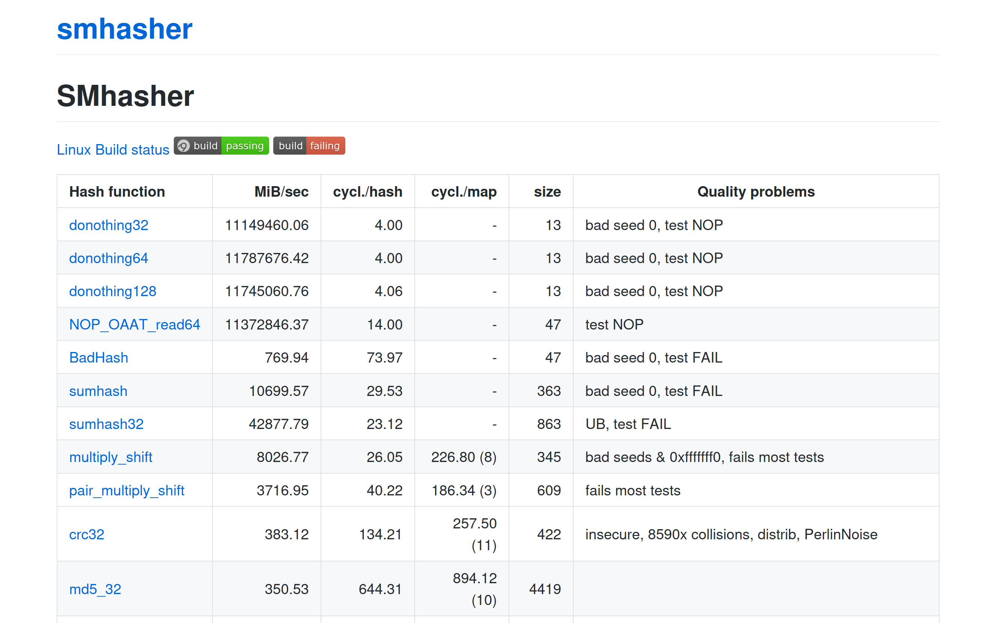
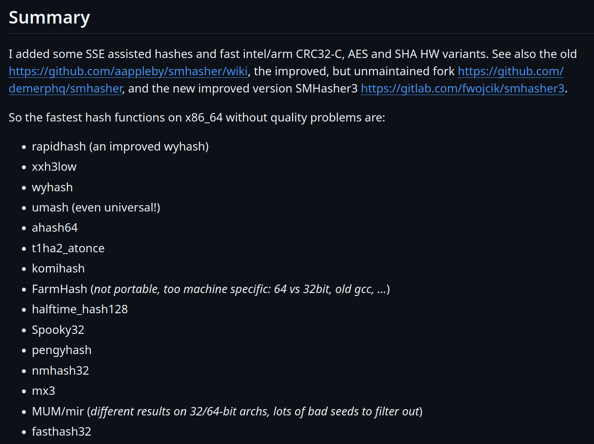
Hash Functions
12
CRC-64 (1975)
Used in networking for error detection.
MurmurHash (2008)
Designed as a fast, general-purpose hash function.
Google CityHash (2011)
Designed to be faster for short keys (<64 bytes).
Facebook XXHash (2012)
From the creator of zstd compression.
Google FarmHash (2014)
Newer version of CityHash with better collision rates.
← State-of-the-art

Slide 13
Static Hashing Schemes
13
Approach #1: Linear Probe Hashing
Approach #2: Cuckoo Hashing
There are several other schemes covered in the Advanced DB course:
Robin Hood Hashing
Hopscotch Hashing
Swiss Tables
←
Open Addressing

Slide 14


Linear Probe Hashing
14
Single giant table of fixed-length slots.
Resolve collisions by linearly searching for the next free slot in the table.
To determine whether an element is present, hash to a location in the table and scan for it.
Store keys in table to know when to stop scanning.
Insertions and deletions are generalizations of lookups.
The table's load factor determines when it is becoming too full and should be resized.
Allocate a new table twice as large and rehash entries.

Slide 15
Linear Probe Hashing
15
hash(key) % N
B
| value
A
B
<key>|<value>
A
| value
C
C
| value
D
E
D
| value
F
E
| value
F
| value

Slide 16
Hash Table – Key/Value Entries
Fixed-length Key/Values:
Store inline within the hash table pages.
Optional: Store the key's hash with the key for faster comparisons.
Variable-length Key/Values:
Insert key/value data in separate a private temporary table.
Store the hash as the key and use the record id pointing to its corresponding entry in the temporary table as the value.
hash
key
value
hash
key
value
hash
key
value
⋮
hash
RecordId
hash
RecordId
hash
RecordId
⋮
Temp Table Page
key | value
key | value
key | value

Slide 17

Linear Probe Hashing – Deletes
17
hash(key) % N
B
| value
Approach #1: Movement
Rehash keys until you find the first empty slot.
Expensive! May need to reorganize the entire table.
No DBMS does this.
A
B
A
| value
Delete
C
C
| value
Get
D
E
D
| value
F
E
| value
F
| value

Slide 18

Linear Probe Hashing – Deletes
18
hash(key) % N
Approach #2: Tombstone
Maintain separate bit map to indicate that the entry in the slot is logically deleted.
Reuse the slot for new keys.
May need periodic garbage collection.
B
| value
A
B
A
| value
Delete
C
G
| value
C
| value
Get
D
E
D
| value
F
E
| value
Put
G
F
| value

Slide 19
Hash Table – Non-unique Keys
19
Value Lists
Choice #1: Separate Linked List
Store values in separate storage area for each key.
Value lists can overflow to multiple pages if the number of duplicates is large.
Choice #2: Redundant Keys
Store duplicate keys entries together in the hash table.
This is what most systems do.
XYZ
value1
ABC
value2
value3
value1
value2
XYZ | value2
ABC | value1
XYZ | value3
XYZ | value1
ABC | value2

Slide 20
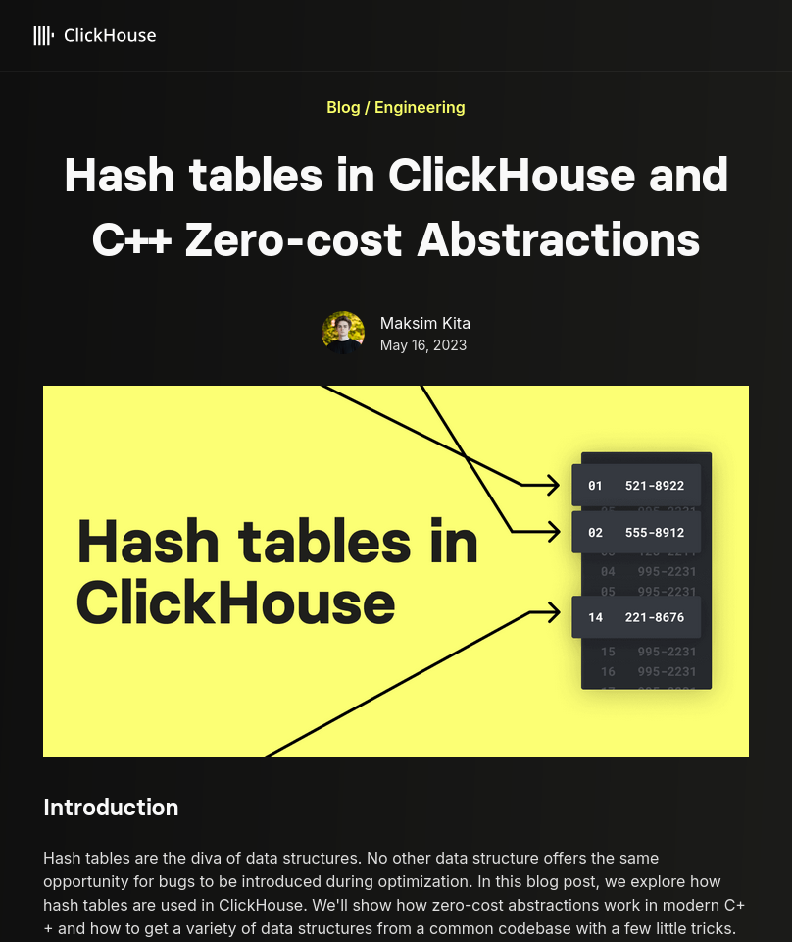
Optimizations
Specialized hash table implementations based on key type(s) and sizes.
Example: Maintain multiple hash tables for different string sizes for a set of keys.
Store metadata separate in a separate array.
Packed bitmap tracks whether a slot is empty/tombstone.
Use table + slot versioning metadata to quickly invalidate all entries in the hash table.
Example: If table version does not match slot version, then treat the slot as empty.
Source: Maksim Kita

Slide 21

Cuckoo Hashing
21
Use multiple hash functions to find multiple locations in the hash table to insert records.
On insert, check multiple locations and pick the one that is empty.
If no location is available, evict the element from one of them and then re-hash it find a new location.
Look-ups and deletions are always O(1) because only one location per hash table is checked.
Best open-source implementation is from CMU.

Slide 22
Cuckoo Hashing
22
Put A:
hash₁(A)
C
| value
B
| value
hash₂(A)
Put B:
hash₁(B)
| value
A
| value
hash₂(B)
B
Put C:
hash₁(C)
hash₂(C)
hash₁(B)
A
| value
hash₂(A)
Get B:
hash₁(B)
hash₂(B)

Slide 23
Observation
23
The previous hash tables require the DBMS to know the number of elements it wants to store.
Otherwise, it must rebuild the table if it needs to grow/shrink in size.
Dynamic hash tables incrementally resize themselves as needed.
Chained Hashing
Extendible Hashing
Linear Hashing

Slide 24
Chained Hashing
24
Maintain a linked list of buckets for each slot in the hash table.
Resolve collisions by placing all elements with the same hash key into the same bucket.
To determine whether an element is present, hash to its bucket and scan for it.
Insertions and deletions are generalizations of lookups.

Slide 25


Chained Hashing
25
B
| value
hash(key) % N
Bucket
Pointers
Put A
Put B
Filter
Put C
A
| value
D
| value
Get G
Filter
Buckets
Put D
Filter
C
| value
E
| value
Put E
Put F
Does key 'G' exist?
F
| value

Slide 26


Extendible Hashing
26
Chained-hashing approach that splits buckets incrementally instead of letting the linked list grow forever.
Multiple slot locations can point to the same bucket chain.
Reshuffle bucket entries on split and increase the number of bits to examine.
Data movement is localized to just the split chain.

Slide 27
Extendible Hashing
27
Max number of bits to examine in hashes
global
2
00010…
1
local
3
Get A
01110…
hash(A) = 01110…
00
000
01
010
2
10101…
3
local
Hash Bits
Put B
10
100
10011…
10011…
hash(B) = 10111…
10111…
Overflow!
11
110
2
001
11010…
3
local
Put C
10101…
011
10100…
hash(C) = 10100…
10111…
101
111

Slide 28


Linear Hashing
28
The hash table maintains a pointer that tracks the next bucket to split.
When any bucket overflows, split the bucket at the pointer location.
Use multiple hashes to find the right bucket for a given key.
Can use different overflow criterion:
Space Utilization
Average Length of Overflow Chains

Slide 29
Linear Hashing
29
Get 6
Split Pointer
Bucket
Pointers
8
hash₁(6) = 6%4=2
20
0
Put 17
1
5
17
hash₁(17) = 17%4=1
2
9
hash₂(8) = 8%8=0
13
3
hash₂(20) = 20%8=4
Overflow!
4
6
Get 20
hash₁(20) = 20%4=0
hash₁(key) = key % n
hash₂(20) = 20%8=4
7
hash₂(key) = key % 2n
11
20
Get 9
hash₁(9) = 9%4=1

Slide 30
Linear Hashing – Resizing
30
Splitting buckets based on the split pointer will eventually get to all overflowed buckets.
When the pointer reaches the last slot, remove the first hash function and move pointer back to beginning.
If the "highest" bucket below the split pointer is empty, the hash table could remove it and move the splinter pointer in reverse direction.

Slide 31
Linear Hashing – Deletes
31
Split Pointer
8
Delete 20
hash₁(20) = 20%4=0
0
hash₂(20) = 20%8=4
1
5
17
2
9
21
Put 21
13
hash₁(21) = 21%4=1
3
Overflow!
4
6
hash₁(key) = key % n
7
hash₂(key) = key % 2n
11
20

Slide 32

Conclusion
32
Fast data structures that support O(1) look-ups that are used all throughout DBMS internals.
Trade-off between speed and flexibility.
Hash tables are usually not what you want to use for a table index…
CREATE INDEX ON xxx (val);
CREATE INDEX ON xxx USING BTREE (val);
CREATE INDEX ON xxx USING HASH (val);

Slide 33
Next Class
33
Sorting…

Slide 34
BLOOM FILTERS
Probabilistic data structure (bitmap) that answers set membership queries.
False negatives will never occur.
False positives can sometimes occur.
See Bloom Filter Calculator.
Insert(x):
Use k hash functions to set bits in the filter to 1.
Lookup(x):
Check whether the bits are 1 for each hash function.

Slide 35
BLOOM FILTERS
Insert('RZA')
Insert('GZA')
Lookup(RZA')
Lookup('Raekwon')
Lookup('ODB')
Bloom Filter
0
1
2
3
4
5
6
7
0
0
1
0
0
1
0
1
0
0
1
0
→ TRUE
hash₁('Raekwon') = 3333 % 8 =
hash₁('ODB') = 6699 % 8 =
hash₁('RZA') = 2222 % 8 =
hash₁('GZA') = 5555 % 8 =
6
3
5
→ FALSE
3
hash₂('Raekwon') = 8899 % 8 =
hash₂('ODB') = 9966 % 8 =
hash₂('RZA') = 4444 % 8 =
hash₂('GZA') = 7777 % 8 =
4
1
3
6
→ TRUE

Slide 36
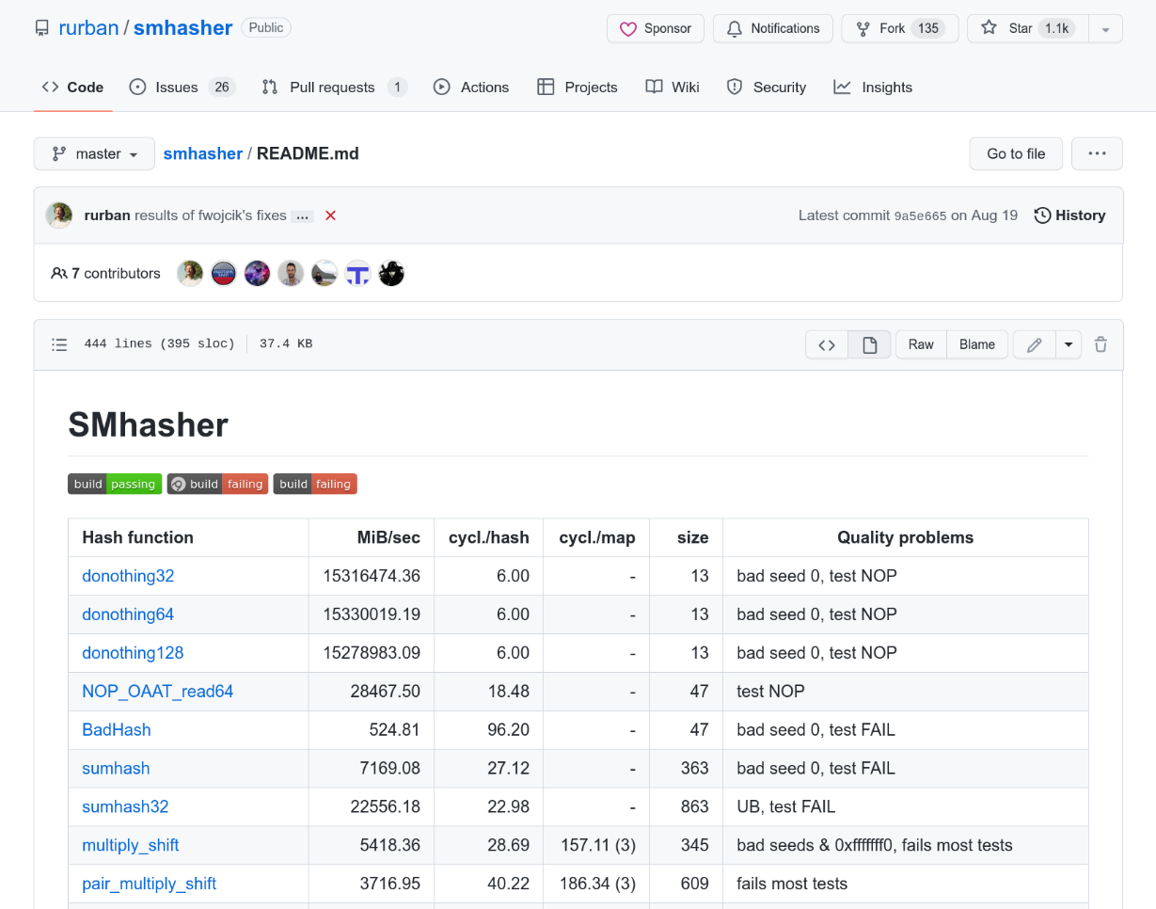
HASH FUNCTION BENCHMARK
36
Intel Core i7-8700K @ 3.70GHz
128
64
192
32
Source: Fredrik Widlund

Slide 37
ROBIN HOOD HASHING
37
Variant of linear probe hashing that steals slots from "rich" keys and give them to "poor" keys.
Each key tracks the number of positions they are from where its optimal position in the table.
On insert, a key takes the slot of another key if the first key is farther away from its optimal position than the second key.

Slide 38
ROBIN HOOD HASHING
38
hash(key) % N
B
| value [0]
A
B
A
| value [0]
# of "Jumps" From First Position
A[0] == C[0]
A[0] == E[0]
C
C
| value [1]
C[1] == E[1]
D
C[1] > D[0]
| value [1]
D[1] < E[2]
D
| value [2]
E
E
F
D
| value [2]
D[2] > F[0]
F
| value [1]

Slide 39
LINEAR PROBE HASHING – METADATA
How to represent that a slot is empty while also supporting null keys and tombstones?
<empty>
A
| value
Get null:
null
| value
<empty>
hash(null) % N

Slide 40
40
Be sure to pull slides from S23 to fix the cuckoo hashing example, to use only one hash table. The slide is actually in 08-trees.pptx, because I fixed it at the start of the next lecture.
Also, I think we shouldn’t bother teaching Robin Hood Hashing…

Slide 41
CUCKOO HASHING
41
Hash Table #1
Put A
Hash Table #2
hash₁(A)
hash₂(A)
C | value
B | value
Put B
A | value
B | value
hash₁(B)
hash₂(B)
Put C
A | value
hash₁(C)
hash₂(C)
⋮
⋮
hash₁(B)
hash₂(A)
Get B
hash₁(B)
hash₂(B)

Slide 42
CUCKOO HASHING PARAMETERS
# of buckets
# of hash functions
# of slots per bucket

