Slide 1
Lecture 7: Indexes, B+ Trees

Slide 2
Announcements
2
Project #1 is due Sept 23rd @ 11:59pm
Project #2 will be released Sept 23th
Mid-term Exam on Oct 19th
  In-class in this room.
  Please send accommodations soon if you have not already

Slide 3
Last Class
3
OLAP workloads demand specialized storage solutions
For OLTP, mostly targeted lookups, updates, deletes, inserts
How do we find the data we need?
Which record IDs to request from storage manager?

Slide 4
Disk-oriented DBMS
4
Get Page #2
Execution
Engine
Pointer to Page #2
Directory
2
Header
Buffer Pool
Frames
Memory
3
…
Header
5
1
Header
Header
2
Header
4
Directory
Header
Database File
Pages
Disk

Slide 5
Moving Up The Stack...
Disk manager and Buffer Pool Manager operate on low-level constructs: page #, record ID
Which pages to get? This comes from higher layers!
Query Planning
Operator Execution
Access Methods
Buffer Pool Manager
Disk Manager

Slide 6
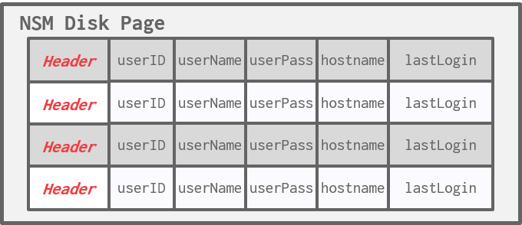
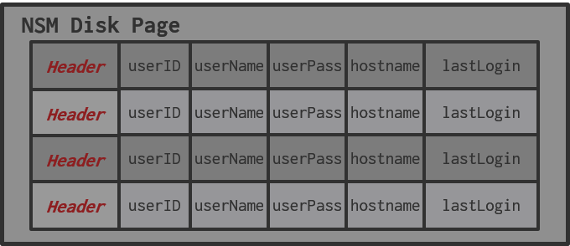
Searching a Heap File
6
SELECT * FROM useracct
WHERE userName = ?
AND userPass = ?
Index
NSM Disk Page
header
userID
userName
userPass
hostname
lastLogin
header
userID
userName
userPass
hostname
lastLogin
header
userID
userName
userPass
hostname
lastLogin
Database File
header
-
-
-
-
-
Disk

Slide 7
Indexes vs. Filters
7
An index data structure over a subset of a table's attributes that are organized and/or sorted to provide the location of specific tuples using those attributes.
  Example: B+Tree
A filter is a data structure that answers set membership queries; it tells you whether a record (likely) exists for a key but not where it is located.
  Example: Bloom Filter

Slide 8
Today's Agenda
8
B+Tree Overview
Design Choices
Optimizations

Slide 9
Index Goals
Goal #1: Fast point lookups
  SELECT * WHERE 'id' = %userid%
Goal #2: Fast writes
  INSERT, UPDATE, DELETE
Goal #3: Fast range scans
  SELECT * WHERE 'id' > 10 AND 'id' < 100
Here, "fast" usually measured in # IO operations to disk
Sequential IO faster than random IO
Care about both average case and worst case

Slide 10
A Hash Table?
Goal #1: Fast point lookups
  SELECT * WHERE 'id' = %userid%
Goal #2: Fast writes
  INSERT, UPDATE, DELETE
Goal #3: Fast range scans
  SELECT * WHERE 'id' > 10 AND 'id' < 100
Probably O(1)
given good design
(see Lecture #8)
No!
values unsorted

Slide 11

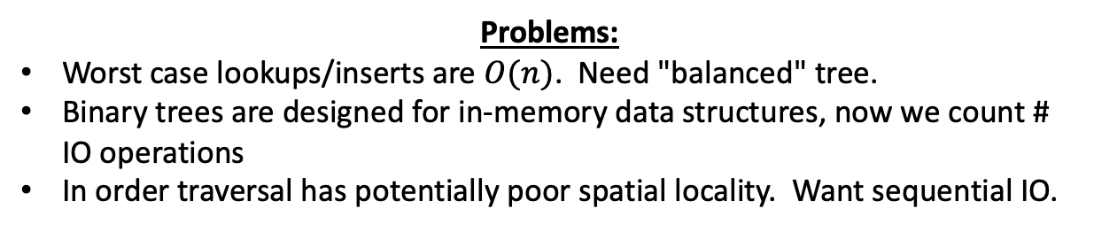
A Tree?
Goal #1: Fast point lookups
  SELECT * WHERE 'id' = %userid%
Goal #2: Fast writes
  INSERT, UPDATE, DELETE
Goal #3: Fast range scans
  SELECT * WHERE 'id' > 10 AND 'id' < 100
$O(\log{n})$,
hopefully
In-order
traversal
Problems:
Worst case lookups/inserts are $O(n)$. Need "balanced" tree.
Binary trees are designed for in-memory data structures, now we count # IO operations
In order traversal has potentially poor spatial locality. Want sequential IO.

Slide 12

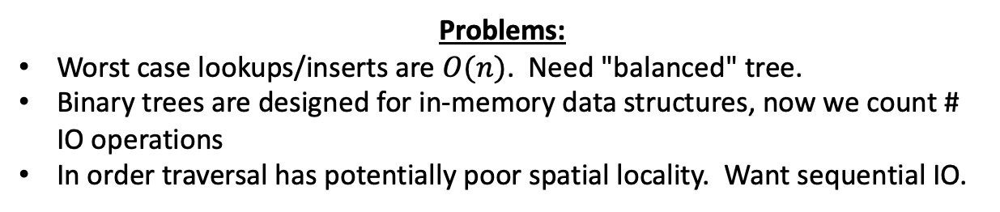
A Tree?
Problems:
Worst case lookups/inserts are $O(n)$. Need "balanced" tree.
Binary trees are designed for in-memory data structures, now we count # IO operations
In order traversal has potentially poor spatial locality. Want sequential IO.
$O(n)$ path
Want all "leaf" nodes at same height
...

Slide 13


A Tree?
Problems:
Worst case lookups/inserts are $O(n)$. Need "balanced" tree.
Binary trees are designed for in-memory data structures, now we count # IO operations
In order traversal has potentially poor spatial locality. Want sequential IO.
...
...
$O(n)$ time to search single node
Need maximum node size $m$

Slide 14



A Tree?
Problems:
Worst case lookups/inserts are $O(n)$. Need "balanced" tree.
Binary trees are designed for in-memory data structures, now we count # IO operations
In order traversal has potentially poor spatial locality. Want sequential IO.
Balanced binary tree: $\log_{2}{n}$
m-way tree: $\log_{m}{n}$
Each pointer chase is potentially a new page read!
Need minimum node size $≈m$

Slide 15
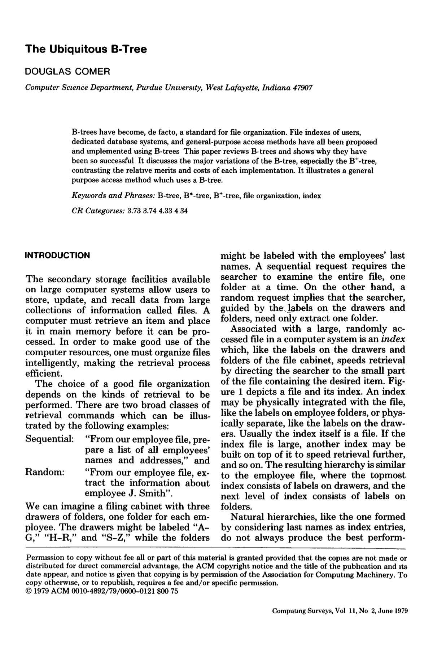
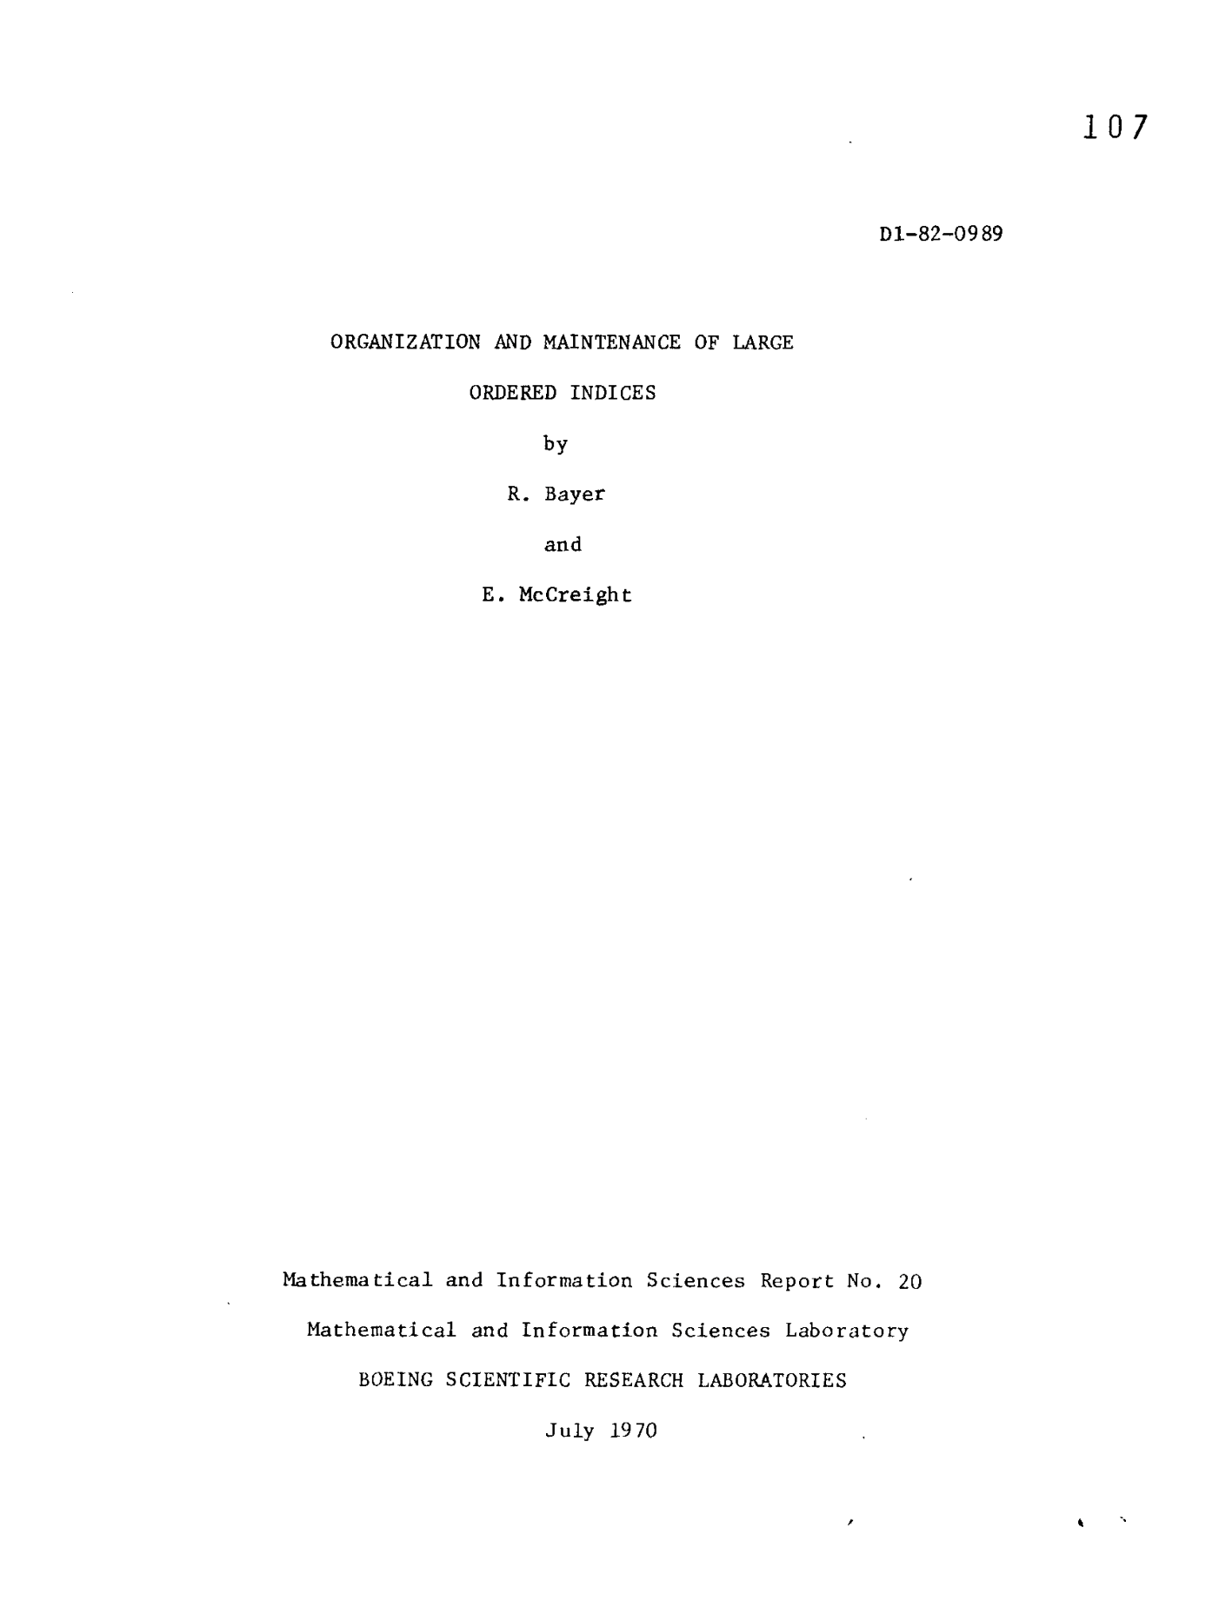
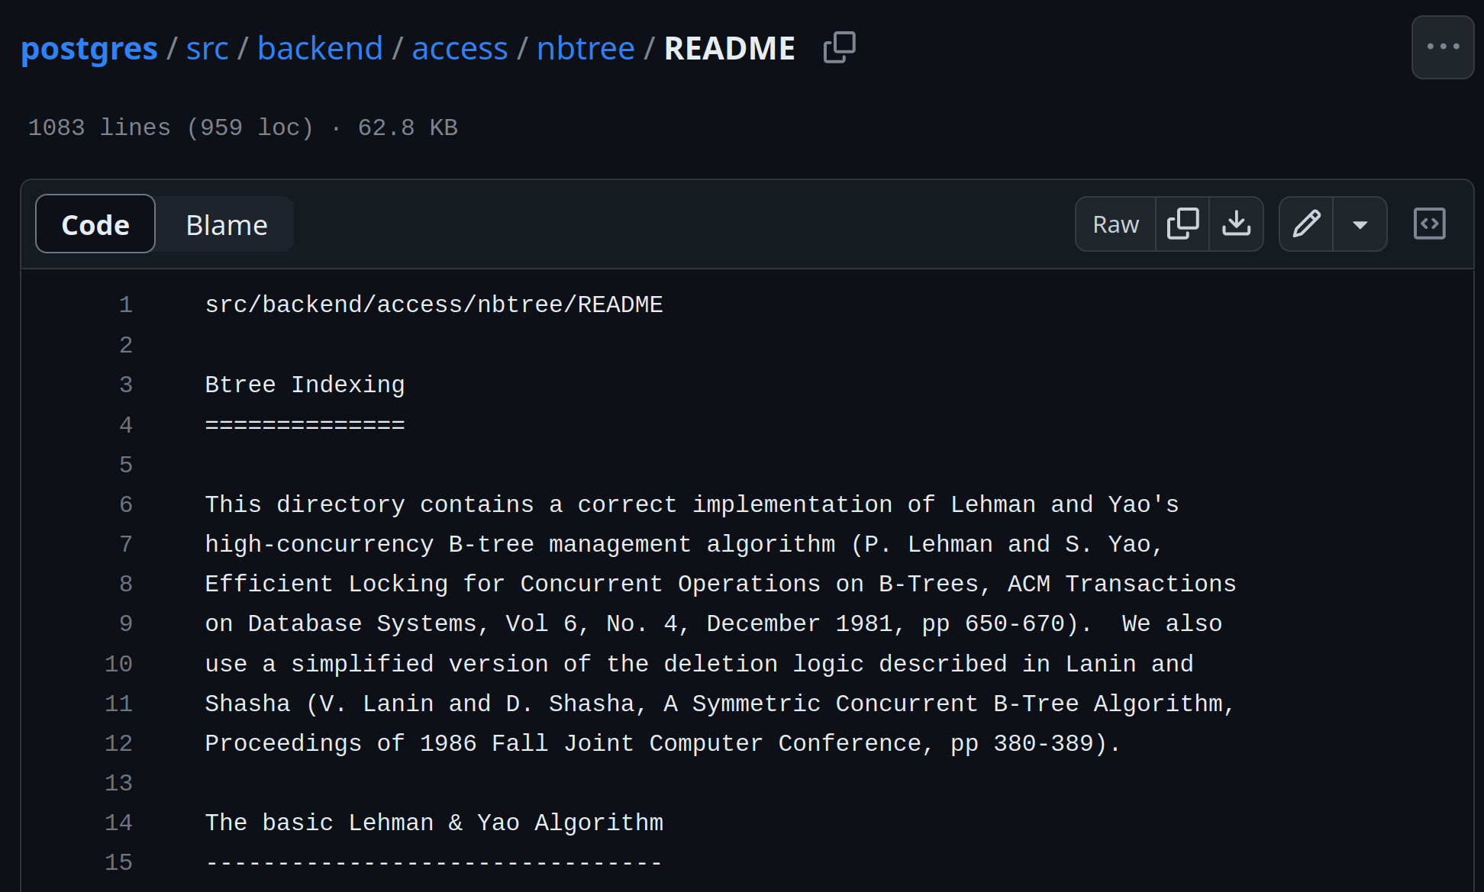
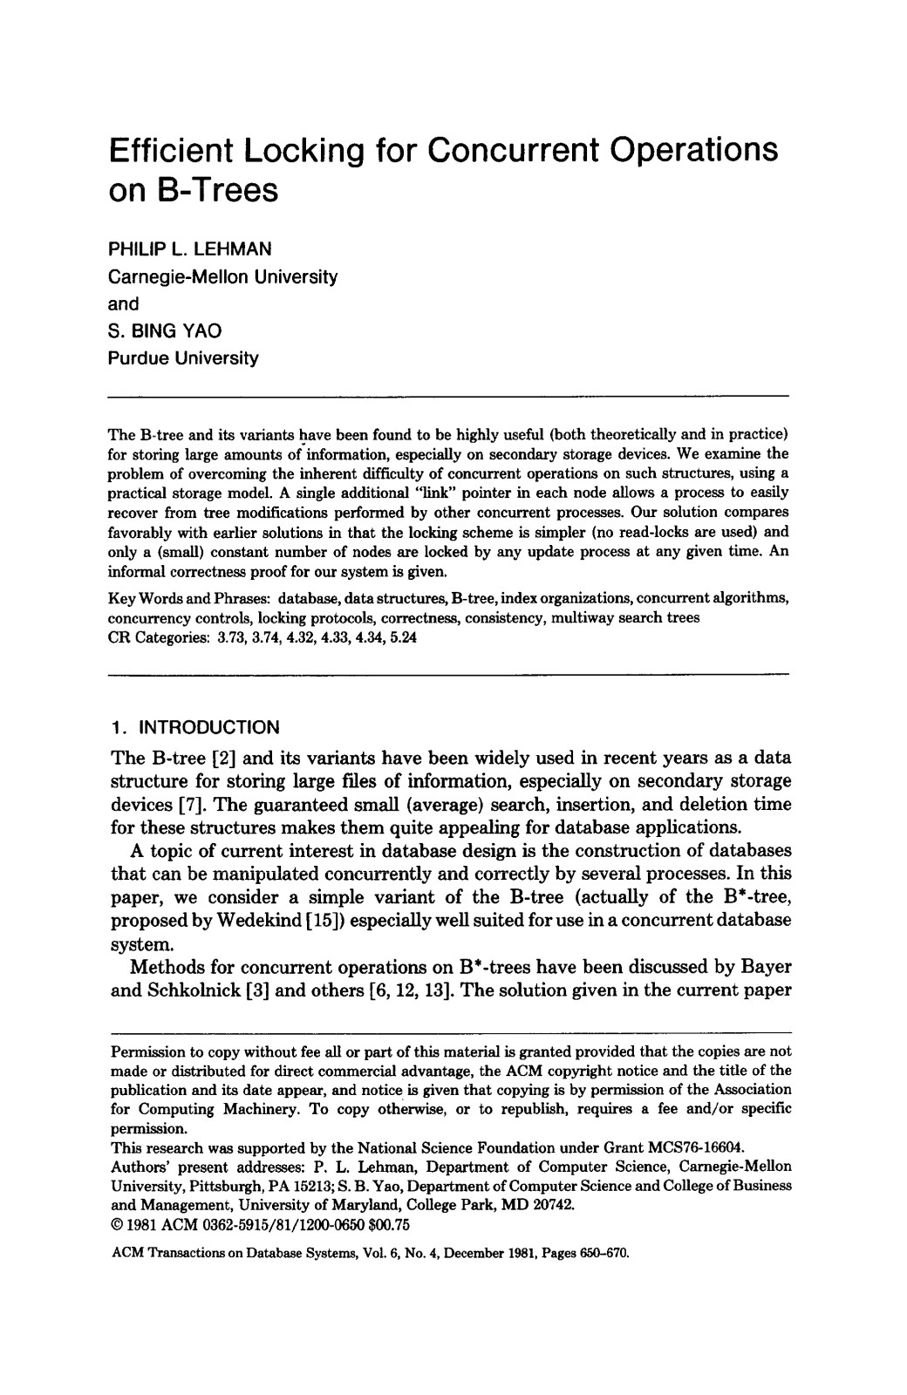
B-Tree Family
15
There is a specific data structure called a B-Tree.
People also use the term to generally refer to a class of balanced tree data structures:
  B-Tree (1970)
  B+Tree (1973)
  B*Tree (1977?)
  B^{link}-Tree (1981)
  Bε-Tree (2003)
  Bw-Tree (2013)

Slide 16
B+Tree
16
A B+Tree is a self-balancing, ordered m-way tree for searches, sequential access, insertions, and deletions in O(log_{m} n) where m is the tree fanout.
  It is perfectly balanced (i.e., every leaf node is at the same depth in the tree)
  Every node other than the root is at least half-full
  m/2-1 ≤ #keys ≤ m-1
  Every inner node with k keys has k+1 non-null children.
  Optimized for reading/writing large data blocks.
Some real-world implementations relax these properties, but we will ignore that for now…

Slide 17
B+Tree Example
<node*>|<key>|<node*>|<key>|<node*>
20
Root Node
<20
≥20
Sibling Pointers
Inner / Non-Leaf Nodes
10
35
<10
≥10
<35
≥35
6
10
20
31
38
44
Leaf Nodes
Index Key(s) Low→High
<key>|<value>|<key>|<value>

Slide 18

B+Tree Example
20
<20
≥20
10
35
<10
≥10
<35
≥35
6
10
20
31
38
44
Index Key(s) Low→High
"M words begin here"

Slide 19
Nodes
19
Every B+Tree node is comprised of an array of key/value pairs.
  The keys are derived from the index's target attribute(s).
  The associated data will differ based on whether the node is classified as an inner node or a leaf node.
The arrays are (usually) kept in sorted key order.
Store all NULL keys at either first or last leaf nodes.

Slide 20
B+tree Leaf Nodes
20
B+Tree Leaf Node
Level
Slots
Prev
Next
#
#
¤
¤
Prev
Next
Sorted Keys
Sorted Key/Value Pairs
PageID
¤
K₁
V₁
• • •
K_{n}
V_{n}
¤
PageID
¤
¤
K₁
K₂
K₃
K₄
K₅
K_{n}
K₁
¤
K₂
¤
K₃
¤
• • •
K₄
¤
K₅
¤
• • •
Values
Key + Value
¤
¤
¤
¤
¤
• • •
¤

Slide 21
Leaf Node Values
Approach #1: Record IDs
  A pointer to the location of the tuple to which the index entry corresponds.
  Most common implementation.
Approach #2: Tuple Data
  Index-Organized Storage
  Primary Key Index: Leaf nodes store the contents of the tuple.
  Secondary Indexes: Leaf nodes store tuples' primary key as their values.

Slide 22
B-Tree Vs. B+Tree
22
The original B-Tree from 1971 stored keys and values in all nodes in the tree.
  More space-efficient, since each key only appears once in the tree.
A B+Tree only stores values in leaf nodes. Inner nodes only guide the search process.

Slide 23
B+Tree – INSERT
23
Find correct leaf node L.
Insert data entry into L in sorted order.
If L has enough space, done!
Otherwise, split L keys into L and a new node L₂
  Redistribute entries evenly, copy up middle key.
  Insert index entry pointing to L₂ into parent of L.
To split inner node, redistribute entries evenly, but push up middle key.
Source: Chris Re

Slide 24
B+Tree – INSERT Example (1)
24
Insert 6
4
12
<4
≥4 and
<12
[4,12)
≥12
1
3
5
9
10
12
13
Node is full!

Slide 25
B+TREE – INSERT EXAMPLE (1)
25
Insert 6
4
12
<4
[4,12)
1
3
5
6
9
10
12
13

Slide 26
B+TREE – INSERT EXAMPLE (1)
26
Insert 6
4
9
?
12
<4
[4,12)
[4,9)
[9,12)
≥12
1
3
5
6
9
10
12
13

Slide 27
B+TREE – INSERT EXAMPLE (1)
27
Insert 6
Insert 8
4
9
12
1
3
5
6
8
9
10
12
13

Slide 28
B+TREE – INSERT EXAMPLE (2)
Insert 17
5
9
13
19
1
3
5
7
9
11
13
14
15
17
20
21
23
Note: New Example/Tree.

Slide 29
B+TREE – INSERT EXAMPLE (3)
Insert 17
Insert 16
5
9
13
19
1
3
5
7
9
11
13
14
15
17
20
21
23
Split the node!
Copy the middle key.
Push the key up.
No space in the node where the new key “belongs”.

Slide 30
B+TREE – INSERT EXAMPLE (3)
Insert 17
Insert 16
5
9
13
19
1
3
5
7
9
11
13
14
15
17
20
21
23
New Node!
Shuffle keys from the node that triggered the split.

Slide 31
B+TREE – INSERT EXAMPLE (3)
Insert 17
Want to create a key, pointer pair like this. But cannot insert it in the root node, which is full.
Insert 16
5
9
13
19
16
Split the root. Grow the tree!
1
3
5
7
9
11
13
14
15
16
17
20
21
23
But this is an “orphan” node! No parent node points to it.

Slide 32
B+TREE – INSERT EXAMPLE (3)
Insert 17
Insert 16
5
9
13
19
16
Split the root. Grow the tree!
1
3
5
7
9
11
13
14
15
16
17
20
21
23

Slide 33
B+TREE – INSERT EXAMPLE (3)
Insert 17
13
Insert 16
Next, need to split the “old” root, then point to the split nodes from the new root.
5
9
16
19
1
3
5
7
9
11
13
14
15
16
17
20
21
23

Slide 34
B+TREE – INSERT EXAMPLE (3)
Insert 17
13
Insert 16
<13
≥13
5
9
16
19
<5
[5,9)
[9,13)
[13,16)
[16,19)
≥19
1
3
5
7
9
11
13
14
15
16
17
20
21
23

Slide 35
B+Tree – DELETE
35
Start at root, find leaf L where entry belongs.
Remove the entry.
If L is at least half-full, done!
If L has only m/2-1 entries,
  Try to re-distribute, borrowing from sibling (adjacent node with same parent as L).
  If re-distribution fails, merge L and sibling.
If merge occurred, must delete entry (pointing to L or sibling) from parent of L.
Source: Chris Re

Slide 36
B+Tree – DELETE Example (1)
Delete 6
4
9
12
1
3
5
6
9
10
9
10
12

Slide 37
B+Tree – DELETE Example (1)
Delete 6
4
9
12
1
3
5
9
10
9
12
14
Borrow from a “rich” sibling node.
Could borrow from either sibling.

Slide 38
B+Tree – DELETE Example (1)
Delete 6
4
12
9
≥9
≥12
1
3
5
9
9
10
12
14
Need to update parent node!

Slide 39
B+Tree – DELETE Example (2)
Delete 15
13
5
9
17
21
1
3
5
7
9
11
13
15
17
19
20
21
23
Borrow from a “rich” sibling node.
Note: New Example/Tree.

Slide 40
B+Tree – DELETE Example (2)
Delete 15
13
5
9
19
17
21
1
3
5
7
9
11
13
17
19
20
21
23
Need to update parent node!

Slide 41
B+Tree – DELETE Example (3)
Delete 15
13
Delete 19
5
9
19
21
1
3
5
7
9
11
13
17
19
20
21
23
Under-filled!
No “rich” sibling nodes to borrow.
Merge with a sibling

Slide 42
B+Tree – DELETE Example (3)
Delete 15
13
Delete 19
This node is
under-filled!
Pull-down.
5
9
19
1
3
5
7
9
11
13
17
20
21
23

Slide 43
B+Tree – DELETE Example (3)
Delete 15
Delete 19
The tree has shrunk in height.
5
9
13
19
<5
[5,9)
[9,13)
[13,19)
≥19
1
3
5
7
9
11
13
17
20
21
23

Slide 44
Composite Index
44
A composite index is when the key is comprised of two or more attributes.
  Example: Index on <a,b,c>
DBMS can use B+Tree index if the query provides a “prefix” of composite key.
  Supported: (a=1 AND b=2 AND c=3)
  Supported: (a=1 AND b=2)
  Rarely Supported: (b=2), (c=3)
Sort Order
CREATE INDEX my_idx ON xxx (a, b DESC, c NULLS FIRST);
Null Handling

Slide 45
SELECTION CONDITIONS
45
The DBMS can use a B+Tree index if the query provides any of the attributes of the search key.
Example: Index on <a,b,c>
  Supported (a=1 AND b=2 AND c=3)
  Supported: (a=1 AND b=2)
  Supported: (b=2), (c=3)
Not all DBMSs support this.
For a hash index, we must have all attributes in search key.

Slide 46
Selection Conditions
46
Find Key=(1,2)
Find Key=(1,*)
1 ≤ 1
2 ≤ 3
1 ≤ 1
*,1 < *,3
Find Key=(*,1)
1,3
2,2
3,3
1,1
1,2
1,3
2,1
2,2
2,3
3,3
3,4
4,1
(1,*) ≤ (2,*)
(1,1)
(1,1)
(2,1)
∅
(4,1)

Slide 47
B+Tree – Duplicate Keys
47
Approach #1: Append Record ID
  Add the tuple's unique Record ID as part of the key to ensure that all keys are unique.
  The DBMS can still use partial keys to find tuples.
Approach #2: Overflow Leaf Nodes
  Allow leaf nodes to spill into overflow nodes that contain the duplicate keys.
  This is more complex to maintain and modify.

Slide 48
B+Tree – Append Record ID
48
Insert 6
Insert <6,(Page,Slot)>
5
7
9
9
<5
<9
<7
<9
≥9
≥9
1
3
6
6
7
8
7
9
8
13
<Key,RecordId>

Slide 49
B+Tree – Overflow Leaf Nodes
49
Insert 6
Insert 7
5
9
Insert 6
<5
<7
≥9
1
3
6
7
8
9
13
6
7
6

Slide 50
NON-UNIQUE: DUPLICATE KEYS
B+Tree Leaf Node
Level
Slots
Prev
Next
#
#
¤
¤
Sorted Keys
K1
K1
K1
K2
K2
• • •
Kn
Values
¤
¤
¤
¤
¤
• • •
¤

Slide 51
NON-UNIQUE: VALUE LISTS
B+Tree Leaf Node
Level
Slots
Prev
Next
#
#
¤
¤
Sorted Keys
K1
K2
K3
K4
K5
• • •
Kn
Values
¤
¤
¤
¤
¤
• • •

Slide 52
Clustered Indexes
52
The table is stored in the sort order specified by the primary key.
  Can be either heap- or index-organized storage.
Some DBMSs always use a clustered index.
  If a table does not contain a primary key, the DBMS will automatically make a hidden primary key.
Other DBMSs cannot use them at all.

Slide 53
Index Scan Page Sorting
53
Retrieving tuples in the order they appear is generally inefficient due to redundant reads.
A better approach is to find all the tuples that the query needs and then sort them based on their page ID.
The DBMS retrieves each page once.
Scan Direction
101
102
103
104
Page 102
Page 101
Page 103
Page 101
Page 104
Page 102
Page 104
Page 102
Page 102
Page 102
Page 103
Page 102
Page 102
Page 103
Page 102
Page 103
Page 101
Page 103
Page 103
Page 104
Page 104
Page 104
Page 103
Page 104

Slide 54
Clustered Indexes
An extreme solution is "index organized storage"
-Store pages in sorted order also
Traverse to the left-most leaf page and then retrieve tuples from all leaf pages.
This will always be better than
sorting data for each query.
Scan Direction
101
102
103
104
Table Pages

Slide 55


B+Tree Design Choices
Node Size
Merge Threshold
Variable-Length Keys
Intra-Node Search

Slide 56
Node Size
56
The slower the storage device, the larger the optimal node size for a B+Tree.
  HDD: ~1MB
  SSD: ~10KB
  In-Memory: ~512B
Optimal sizes can vary depending on the workload
  Leaf Node Scans vs. Root-to-Leaf Traversals

Slide 57
Merge Threshold
57
Some DBMSs do not always merge nodes when they are half full.
  Average occupancy rate for B+Tree nodes is 69%.
Delaying a merge operation may reduce the amount of reorganization.
It may also be better to let smaller nodes exist and then periodically rebuild entire tree.
This is why PostgreSQL calls their B+Tree a "non-balanced" B+Tree (nbtree).

Slide 58
Variable-length Keys
58
Approach #1: Pointers
  Store the keys as pointers to the tuple’s attribute.
  Also called T-Trees (in-memory DBMSs)
Approach #2: Variable-Length Nodes
  The size of each node in the index can vary.
  Requires careful memory management.
Approach #3: Padding
  Always pad the key to be max length of the key type.
Approach #4: Key Map / Indirection
  Embed an array of pointers that map to the key + value list within the node.

Slide 59
Intra-Node Search
0
0
0
0
1
0
0
0
Approach #1: Linear
  Scan node keys from beginning to end.
  Use SIMD to vectorize comparisons.
Approach #2: Binary
  Jump to middle key, pivot left/right depending on comparison.
Approach #3: Interpolation
  Approximate location of desired key based on known distribution of keys.
Find Key=8
4
5
6
7
8
9
10
8
8
Find Key=8
8
8
4
5
6
7
8
9
10
_mm_cmpeq_epi32_mask(a, b)
Find Key=8
Offset: (8-4)*7/(10-4)=4
4
5
6
7
8
9
10

Slide 60
Optimizations
60
Prefix Compression
Deduplication
Suffix Truncation
Pointer Swizzling
Bulk Insert
Buffered Updates
Many more…

Slide 61
Prefix Compression
61
Sorted keys in the same leaf node are likely to have the same prefix.
Instead of storing the entire key each time, extract common prefix and store only unique suffix for each key.
  Many variations.
robbed
robbing
robot
Prefix: rob
bed
bing
ot

Slide 62
KEY MAP / INDIRECTION
B+Tree Leaf Node
Level
Slots
Prev
Next
#
#
¤
¤
Sorted Key Map
¤
P·¤
A·¤
¤
L·¤
¤
O·¤
¤
Key+Values
Prashanth
V4
Lin
V2
Andy
V1
Obama
V3

Slide 63
Deduplication
Non-unique indexes can end up storing multiple copies of the same key in leaf nodes.
The leaf node can store the key once and then maintain a "posting list" of tuples with that key.
K₁
V₁
K₁
V₂
K₁
V₃
K₂
V₄
K₁
V₁
V₂
V₃
K₂
V₄

Slide 64
Suffix Truncation
64
The keys in the inner nodes are only used to "direct traffic".
  We don't need the entire key.
Store a minimum prefix that is needed to correctly route probes into the index.
abcdefghijk
abc
lmn
lmnopqrstuv
…
…
…
…

Slide 65
Pointer Swizzling
Nodes use page ids to reference other nodes in the index. The DBMS must get the memory location from the page table during traversal.
If a page is pinned in the buffer pool, then we can store raw pointers instead of page ids. This avoids address lookups from the page table.
Find(3)
6
9
Page #2
<Page*>
Page #3
<Page*>
1
3
6
7
Page #2 → <Page*>
Page #3 → <Page*>
1
Header
2
Header
3
Header
Buffer Pool

Slide 66
Bulk Insert
66
The fastest way to build a new B+Tree for an existing table is to first sort the keys and then build the index from the bottom up.
Keys: 3, 7, 9, 13, 6, 1
Sorted Keys: 1, 3, 6, 7, 9, 13
6
9
1
3
6
7
9
13

Slide 67
Observation
Modifying a B+tree is expensive when the DBMS has to split/merge nodes.
  Worst case is when DBMS reorganizes the entire tree.
  The worker that causes a split/merge is responsible for doing the work.
What if there was a way to delay updates and then apply multiple changes together in a batch?

Slide 68


Write-Optimized B+Tree (Bε-Tree)
Instead of immediately applying updates, store changes to key/value entries in log buffers at inner nodes.
  aka Fractal Trees / Bε-trees.
Updates cascade down to
lower nodes incrementally
when buffers get full.
Insert 7
Find 10
Insert 40
Delete 10
Insert 7
20
Mod Log
Insert 40
Delete 10
10
35
6
10
20
38

Slide 69
PARTIAL INDEXES
Create an index on a subset of the entire table. This potentially reduces its size and the amount of overhead
to maintain it.
One common use case is to partition indexes by date ranges.
  Create a separate index per month, year.
CREATE INDEX idx_foo
ON foo (a, b)
WHERE c = 'WuTang';
SELECT b FROM foo
WHERE a = 123
AND c = 'WuTang';

Slide 70
COVERING INDEXES
If all the fields needed to process the query are available in an index, then the DBMS does not need to retrieve the tuple.
This reduces contention on the DBMS's buffer pool resources.
Also called index-only scans.
CREATE INDEX idx_foo
ON foo (a, b);
SELECT b FROM foo
WHERE a = 123;

Slide 71
INDEX INCLUDE COLUMNS
Embed additional columns in indexes to support index-only queries.
These extra columns are only stored in the leaf nodes and are not part of the search key.
CREATE INDEX idx_foo
ON foo (a, b)
INCLUDE (c);
SELECT b FROM foo
WHERE a = 123
AND c = 'WuTang';

Slide 72
FUNCTIONAL/EXPRESSION INDEXES
An index does not need to store keys in the same way that they appear in their base table.
You can use expressions when declaring an index.
SELECT * FROM users
WHERE EXTRACT(dow
⮱FROM login) = 2;
CREATE INDEX idx_user_login
ON users (login);
CREATE INDEX idx_user_login
ON users (EXTRACT(dow FROM login));
CREATE INDEX idx_user_login
ON foo (login)
WHERE EXTRACT(dow FROM login) = 2;

Slide 73
IMPLICIT INDEXES
Most DBMSs automatically create an index to enforce integrity constraints but not referential constraints (foreign keys).
  Primary Keys
  Unique Constraints
CREATE INDEX foo_val1_key
ON foo (val1);
CREATE TABLE foo (
id SERIAL PRIMARY KEY,
val1 INT NOT NULL,
val2 VARCHAR(32) UNIQUE
);
X
CREATE TABLE foo (
id SERIAL PRIMARY KEY,
val1 INT NOT NULL UNIQUE,
val2 VARCHAR(32) UNIQUE
);
CREATE UNIQUE INDEX foo_pkey
ON foo (id);
CREATE TABLE bar (
id INT REFERENCES foo (val1),
val VARCHAR(32)
);
CREATE UNIQUE INDEX foo_val2_key
ON foo (val2);

Slide 74
Conclusion
74
The venerable B+Tree is (almost) always a good choice for your DBMS.

Slide 75
Next Week
75
More algorithms and data structures used inside the DBMS
Hash Tables
Sorting (external sort)

Slide 76
TABLE INDEXES
76
It is the DBMS's job to figure out the best index(es) to use to execute each query.
There is a trade-off regarding the number of indexes to create per database.
  Storage Overhead
  Maintenance Overhead

Slide 77
DEMO
B+Tree vs. Hash Indexes
Table Clustering

Slide 78
B+TREE PROPERTIES
78
A B+Tree is an m-way search tree with the following properties:
  It is perfectly balanced (i.e., every leaf node is at the same depth in the tree)
  Every node other than the root is at least half-full
  m/2-1 ≤ #keys ≤ m-1
  Every inner node with k keys has k+1 non-null children.

