Slide 1
Lecture 14: Query Execution 2:
Electric Boogaloo

Slide 2
Announcements
2
Exam Review Next Lecture
Exam Next Wednesday, 10/21

Slide 3
Query Execution 1
SELECT R.id, S.cdate
FROM R JOIN S
ON R.id = S.id
WHERE S.value > 100
We discussed composing operators into a plan to execute a query.
We assumed that queries execute with a single worker (e.g., a thread).
We will now discuss how to execute queries in parallel using multiple workers.
π
R.id, S.cdate
⨝
R.id=S.id
σ
value>100
R
S

Slide 4
Parallel Query Execution
The database is spread across multiple resources to
  Deal with large data sets that don’t fit on a single machine/node
  Higher performance
  Redundancy/Fault-tolerance
Appears as a single logical database instance to the application, regardless of physical organization.
  SQL query for a single-resource DBMS should generate the same result on a parallel or distributed DBMS.

Slide 5
Parallel vs. Distributed
Parallel DBMSs
  Resources are physically close to each other.
  Resources communicate over high-speed interconnect.
  Communication is assumed to be cheap and reliable.
Distributed DBMSs
  Resources can be far from each other.
  Resources communicate using slow(er) interconnect.
  Communication costs and problems cannot be ignored.

Slide 6
Today’s Agenda
Process Models
Execution Parallelism
I/O Parallelism

Slide 7
Process Model
A DBMS’s process model defines how the system is architected to support concurrent requests / queries.
A worker is the DBMS component responsible for executing tasks on behalf of the client and returning the results.

Slide 8
Process Model
Approach #1: Process per DBMS Worker
Approach #2: Thread per DBMS Worker
Approach #3: Embedded DBMS
Most Common

Slide 9



Process Per Worker
Each worker is a separate OS process.
  Relies on the OS dispatcher.
  Use shared-memory for global data structures.
  A process crash does not take down the entire system.
  Examples: IBM DB2, Postgres, Oracle
SQL Commands
Connect
Application
Dispatcher
Worker Processes

Slide 10
Thread Per Worker
Single process with multiple worker threads.
  DBMS (mostly) manages its own scheduling.
  May or may not use a dispatcher thread.
  Thread crash (may) kill the entire system.
  Examples: MSSQL, MySQL, DB2, Oracle (2014)
  Almost every DBMS created in the last 20 years!
SQL Commands
Connect
Application
Dispatcher
Worker Threads

Slide 11

Embedded DBMS
DBMS runs inside the same address space as the application. Application is (primarily) responsible for threads and scheduling.
The application may support outside connections.
  Examples: BerkeleyDB, SQLite, RocksDB, LevelDB
Application

Slide 12
Scheduling
For each query plan, the DBMS decides where, when, and how to execute it.
  How many tasks should it use?
  How many CPU cores should it use?
  What CPU core should the tasks execute on?
  Where should a task store its output?
The DBMS nearly always knows more than the OS.

Slide 13
Process Models
Advantages of a multi-threaded architecture:
  Less overhead per context switch.
  Do not have to manage shared memory / IPC.
The thread per worker model does not mean that the DBMS supports intra-query parallelism.
DBMS from the last 15 years use native OS threads unless they are Redis or Postgres forks.

Slide 14
Parallel Execution
The DBMS executes multiple tasks simultaneously to improve hardware utilization.
  Active tasks do not need to belong to the same query.
  High-level approaches do not vary on whether the DBMS is multi-threaded, multi-process, or multi-node.
Approach #1: Inter-Query Parallelism
Approach #2: Intra-Query Parallelism

Slide 15
Inter-Query Parallelism
Improve overall performance by allowing multiple queries to execute simultaneously.
  Most DBMSs use a simple first-come, first-served policy.
If queries are read-only, then this requires almost no explicit coordination between the queries.
  Buffer pool can handle most of the sharing if necessary.
If multiple queries are updating the database at the same time, then this is tricky to do correctly…
Lecture #16

Slide 16
Intra-Query Parallelism
Improve the performance of a single query by executing its operators in parallel.
  Think of the organization of operators in terms of a producer/consumer paradigm.
Approach #1: Intra-Operator (Horizontal)
Approach #2: Inter-Operator (Vertical)
These techniques are not mutually exclusive.
There are parallel versions of every operator.
  Can either have multiple threads access centralized data structures or use partitioning to divide work up.

Slide 17
Parallel GRACE Hash Join
Use a separate worker to perform the join for each level of buckets for R and S after partitioning.
R(id,name)
HT_{R}
HT_{S}
S(id,value,cdate)
1
0
1
h₁
2
h₁
2
3
⋮
⋮
max
n

Slide 18
Intra-Query Parallelism
Approach #1: Intra-Operator (Horizontal)
Approach #2: Inter-Operator (Vertical)
Approach #3: Bushy
Most Common
Less Common
Higher-end Systems
First, consider pull-based systems, which dominated historically

Slide 19
Intra-Operator Parallelism
Approach #1: Intra-Operator (Horizontal)
  Operators are decomposed into independent instances that perform the same function on different subsets of data.
The DBMS inserts an exchange operator into the query plan to coalesce/split results from multiple children/parent operators.
  Postgres calls this “gather”

Slide 20
Intra-Operator Parallelism
SELECT A.id, B.value
FROM A JOIN B
ON A.id = B.id
WHERE A.value < 99
AND B.value > 100
Exchange
⨝
Exchange
π
Build HT
Build HT
Build HT
Probe HT
Probe HT
Probe HT
π
π
π
π
π
π
⨝
σ
σ
σ
σ
σ
σ
A₁
A₂
A₃
B₁
B₂
B₃
σ
σ
1
2
3
1
2
3
A
B

Slide 21
Exchange Operator
Exchange Type #1 – Gather
  Combine the results from multiple workers into a single output stream.
Exchange Type #2 – Distribute
  Split a single input stream into multiple output streams.
Exchange Type #3 – Repartition
  Shuffle multiple input streams across multiple output streams.
  Some DBMSs always perform this step after every pipeline (e.g., Dremel/BigQuery).
Gather
Operator
Operator
Operator
Operator
Operator
Operator
Distribute
Operator
Operator
Repartition
Operator
Operator
Operator
Source: Craig Freedman

Slide 22
Inter-Operator Parallelism
Approach #2: Inter-Operator (Vertical)
  Operations are overlapped to pipeline data from one stage to the next without materialization.
  Workers execute multiple operators from different segments of a query plan at the same time.
  Still need exchange operators to combine intermediate results from segments.
Also called pipelined parallelism.

Slide 23

Inter-Operator Parallelism
SELECT A.id, B.value
FROM A JOIN B
ON A.id = B.id
WHERE A.value < 99
AND B.value > 100
for r ∊ incoming:
emit(π(r))
π
2
π
⨝
for r₁ ∊ outer:
for r₂ ∊ inner:
emit(r₁⨝r₂)
⨝
σ
σ
1
A
B

Slide 24
Bushy Parallelism
Approach #3: Bushy Parallelism
  Hybrid of intra- and inter-operator parallelism where workers execute multiple operators from different segments of a query plan at the same time.
  Still need exchange operators to combine intermediate results from segments.

Slide 25

Bushy Parallelism
SELECT *
FROM A
JOIN B
JOIN C
JOIN D
3
Exchange
4
⨝
⨝
Exchange
Exchange
⨝
⨝
⨝
⨝
⨝
A
B
C
D
A
B
C
D
1
2

Slide 26
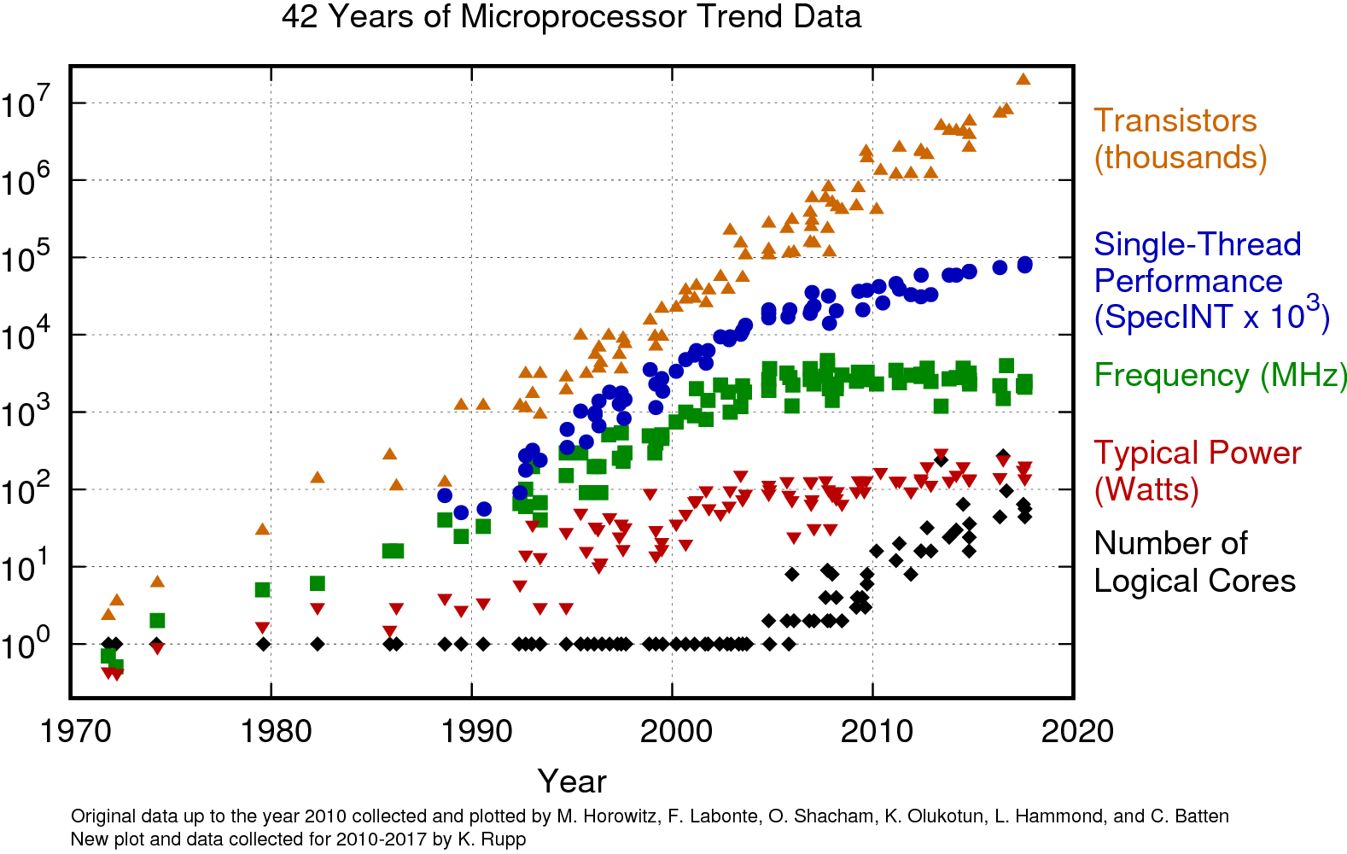
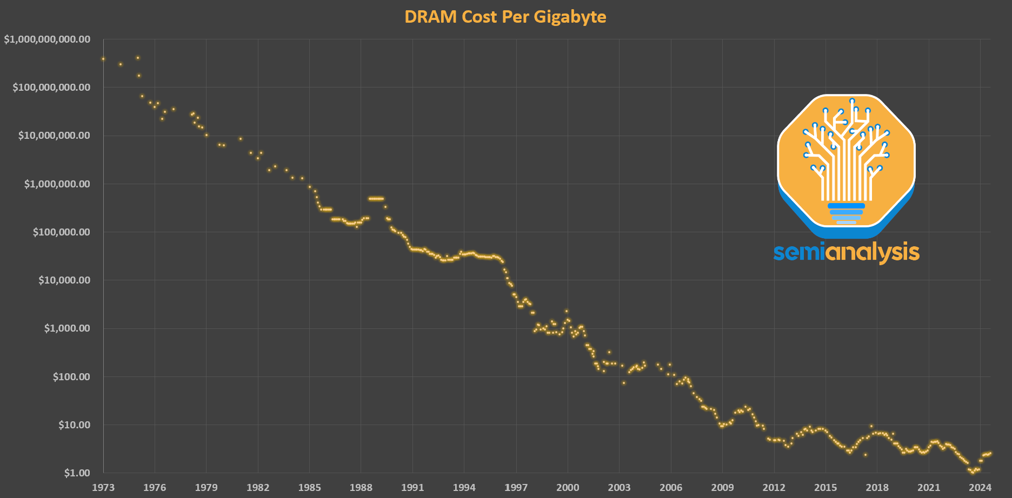
Gimme Gimme Moore
More cores, clock speed increases slow, DRAM capacity grows:
  Bottleneck shifts from I/O to CPU+memory bandwidth
  Increased sensitivity to CPU overheads (e.g., calling next() repeatedly)
  Desire to simplify operator implementations

Slide 27
Push-based Iterator Model
Control Flow
SELECT R.id, S.cdate
FROM R JOIN S
ON R.id = S.id
WHERE S.value > 100
Data Flow
Scheduler
1
for t₁ in R:
buildHashTable(t₁)
Pipeline #2
π
R.id, S.cdate
⨝
R.id=S.id
2
for t₂ in S:
if evalPred(t):
if probeHashTable(t₂):
emit(projection(t₁⨝t₂))
σ
value>100
R
S
Operator Fusion
Pipeline #1

Slide 28
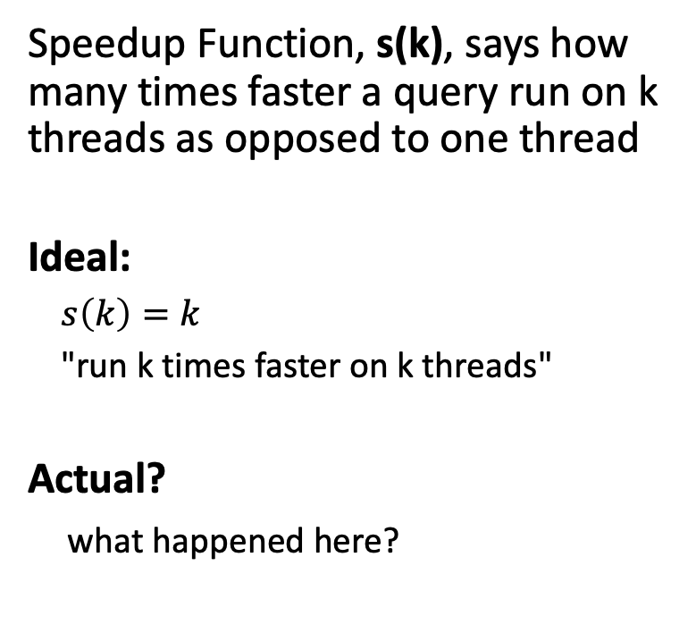
Speedup Functions
Speedup Function, s(k), says how many times faster a query run on k threads as opposed to one thread
Ideal:
$s\left(k\right)=k$
"run k times faster on k threads"
Actual?
what happened here?
Speedup
s(k)
ideal
4
4
8
16
# of Threads, k

Slide 29
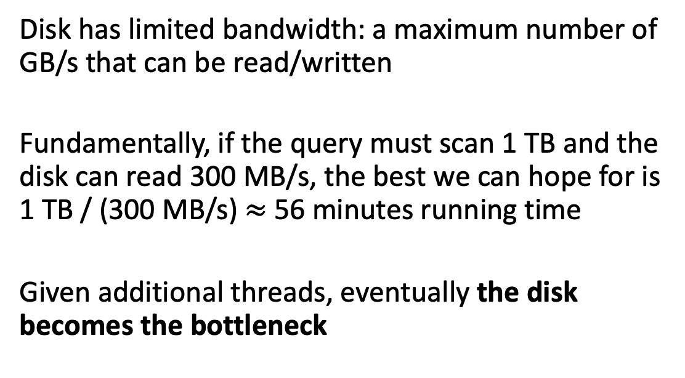
Observation
Disk has limited bandwidth: a maximum number of GB/s that can be read/written
Fundamentally, if the query must scan 1 TB and the disk can read 300 MB/s, the best we can hope for is 1 TB / (300 MB/s) $≈$ 56 minutes running time
Given additional threads, eventually the disk becomes the bottleneck

Slide 30
I/O Parallelism + RAID
Split the DBMS across multiple storage devices to improve disk bandwidth latency.
Many different options that have trade-offs:
  Multiple Disks per Database
  One Database per Disk
  One Relation per Disk
  Split Relation across Multiple Disks
Some DBMSs support this natively. Others require admin to configure outside of DBMS.

Slide 31
RAID for Multi-Disk Parallelism
Store data across multiple disks to improve performance + durability.
Hardware-based: I/O controller makes multiple physical devices appear as single logical device.
  Transparent to DBMS (e.g., RAID).
Software-based: DBMS manages erasure codes at the file/object level.
  Faster and more flexible.
File of 6 pages (logical view):
Performance
page
1
page
2
page
3
page
4
page
5
page
6
Striping (RAID 0)
Mirroring (RAID 1)
Durability
Capacity
page
3
page
2
page
1
page
1
page
1
page
1
page
6
page
5
page
2
page
4
page
2
page
2
Physical layout of pages across disks

Slide 32
Conclusion
Parallel execution is important, which is why (almost) every major DBMS supports it.
However, it is hard to get right.
  Coordination Overhead
  Scheduling
  Concurrency Issues
  Resource Contention

Slide 33
Next Class
Exam Review after fall break, come prepared with questions!

Slide 34
Database Partitioning
Some DBMSs allow you to specify the disk location of each individual database.
  The buffer pool manager maps a page to a disk location.
This is also easy to do at the filesystem level if the DBMS stores each database in a separate directory.
  The DBMS recovery log file might still be shared if transactions can update multiple databases.

Slide 35
Partitioning
Split a single logical table into disjoint physical segments that are stored/managed separately.
Partitioning should (ideally) be transparent to the application.
  The application should only access logical tables and not have to worry about how things are physically stored.
We will cover this further when we talk about distributed databases.

Slide 36
Scheduler
36
Bonus
So far, we have largely taken a data flow perspective of the query processing model.
The control flow was implicit in the processing model. We can make the control flow more explicit with a scheduler.
Query schedulers are often not discussed in database papers. We’ll look at what was done in the Quickstep (academic) project. Based on allowing frequent switches between data flow and control flow.

Slide 37
37
Bonus
Clean Separation of Data Flow and Control Flow
The “traditional” way
The Quickstep way
⨝
σ
σ
R
S
SELECT * FROM R, S
WHERE R.b > 10
AND S.c >100
AND R.a= S.a

Slide 38
The Quickstep Scheduler
38
Bonus
Clean Separation of Data Flow and Control Flow
Network
Pending work orders
⨝
σ (s1)
σ (r2)
σ (r1)
. . .
Buffer Pool
Pool of Worker Threads
σ
σ
r1
s1
s2
r’
s’
r2
s3
s4
s’’
r1
r2
s1
s2
R
S
s3
s4
SELECT * FROM R, S
WHERE R.b > 10
AND S.c >100
AND R.a= S.a
Buffer pool: Abstraction to manage “data blocks”/pages using LRU-2.
Data blocks = base data, intermediate results, QP data structures (Hash tables)
Variable length, but multiples of a base block size. Thus, hash tables can grow (via doubling in size)

Slide 39
The Quickstep Scheduler
39
Bonus
Clean Separation of Data Flow and Control Flow
Network
Pending work orders
⨝
Probe Hash (h’, s2)
Probe Hash (h’, s1)
Build Hash (r’)
Buffer Pool
Pool of Worker Threads
σ
σ
r’
s’
h’
s’’
r1
r2
s1
s2
R
S
s3
s4
Advantages
+ Cleaner Abstraction
+ Dynamic Optimization
+ In-built query suspension
+ Better p9X
+ Manageability and Debug-ability
SELECT * FROM R, S
WHERE R.b > 10
AND S.c >100
AND R.a= S.a

Slide 40
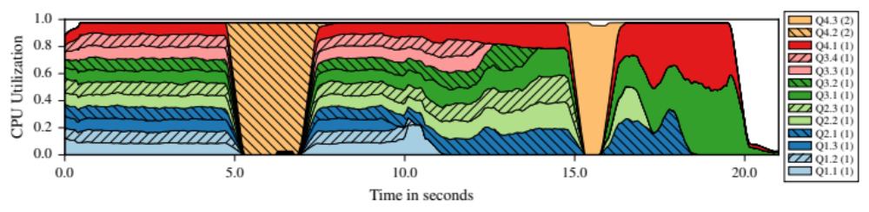
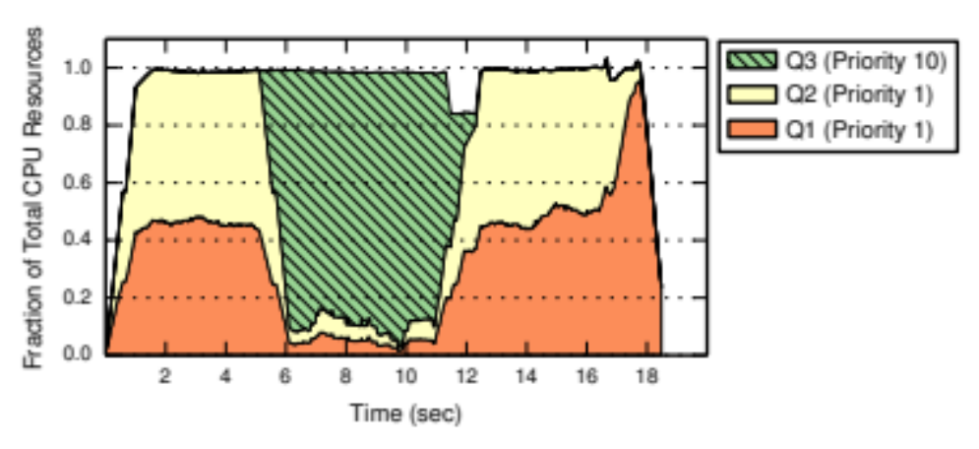
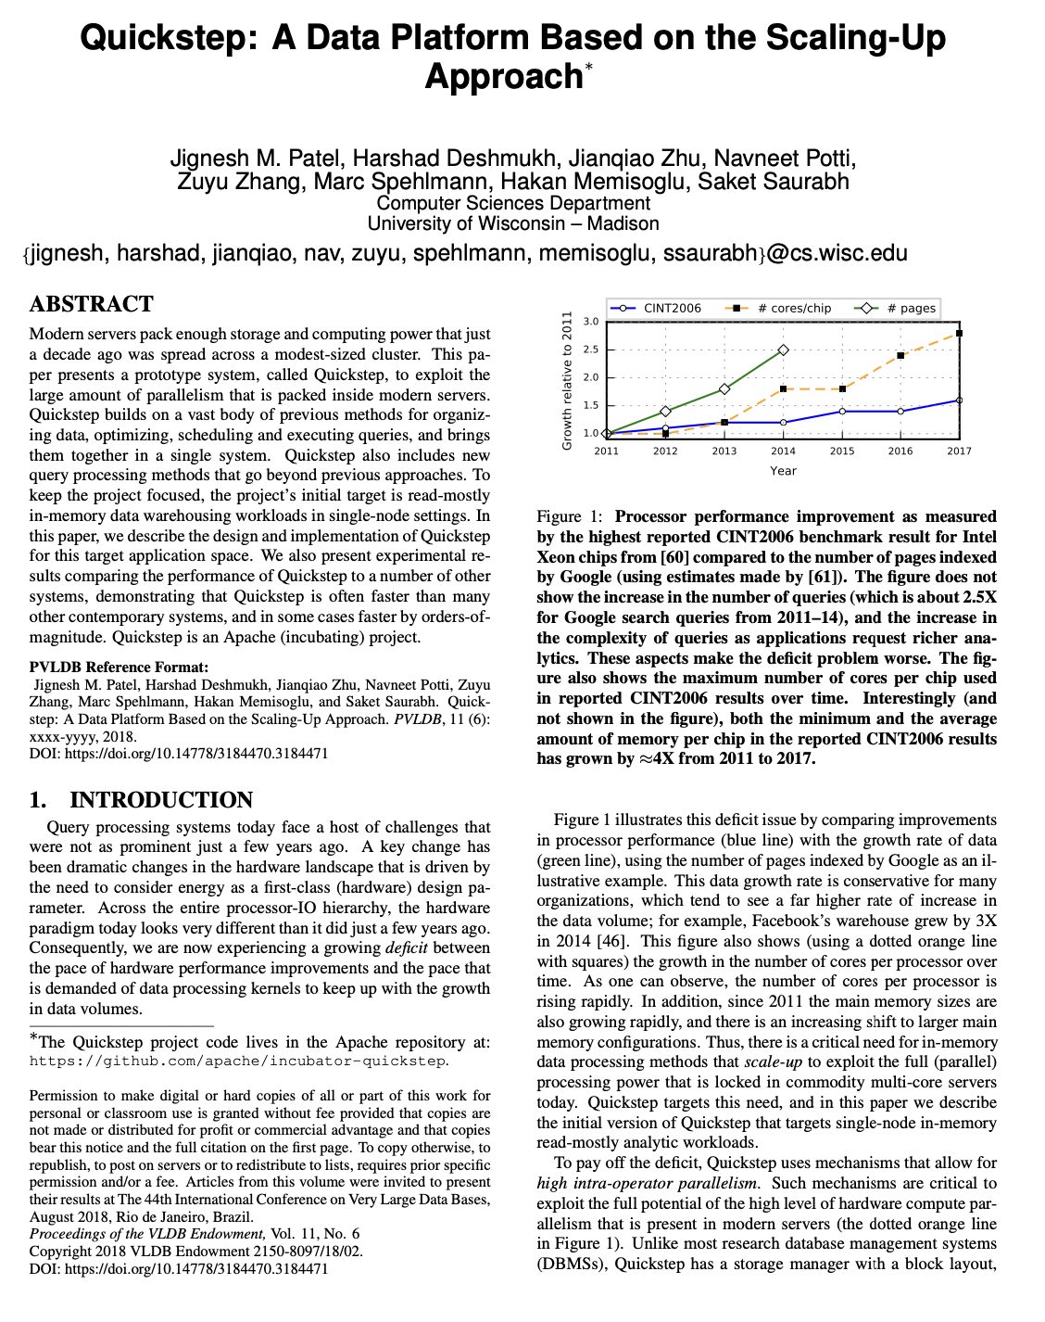
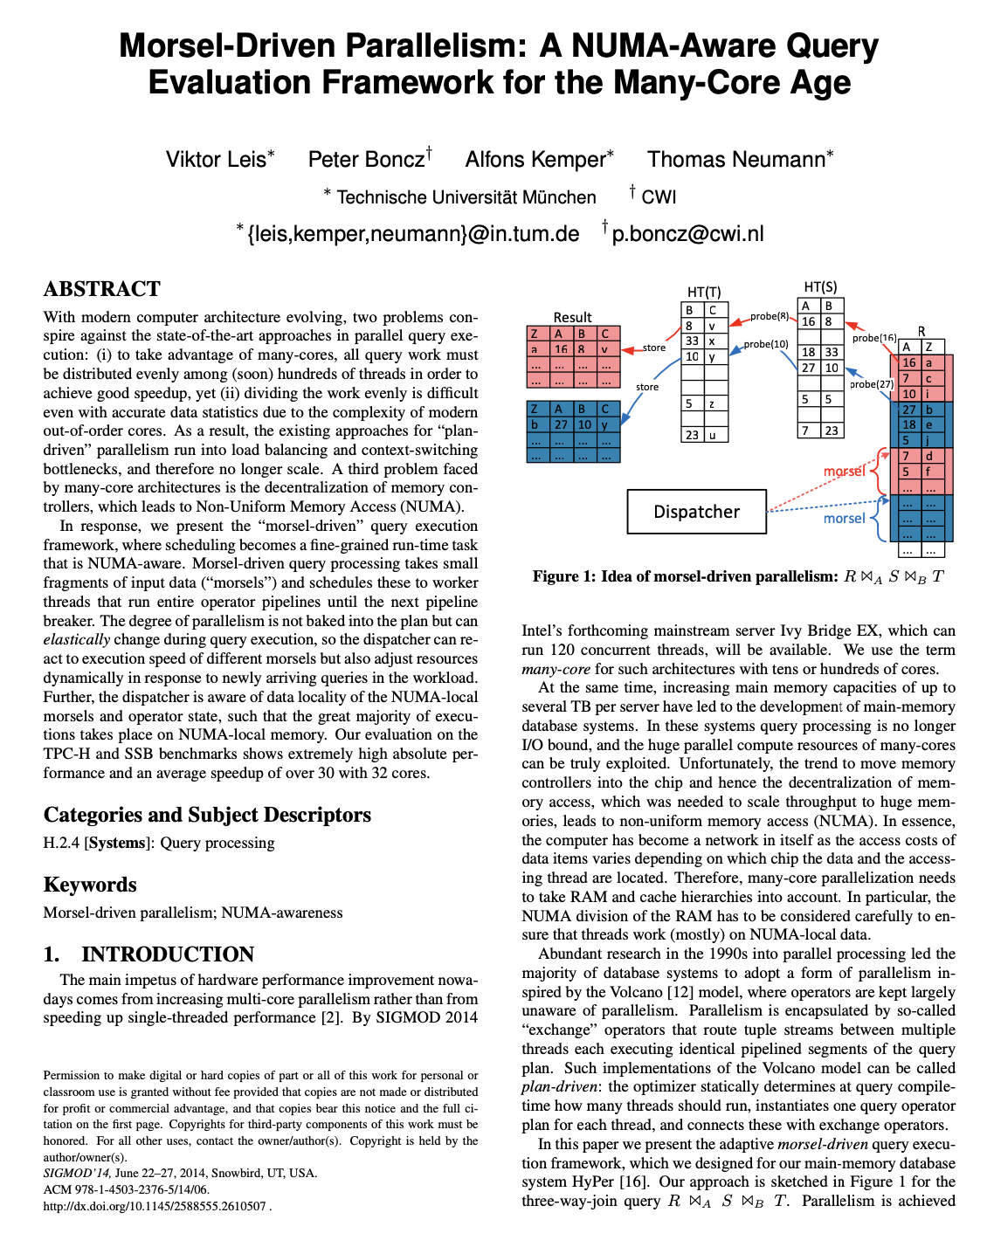
Priority scheduling = Elastic behavior
40
Bonus

Slide 41
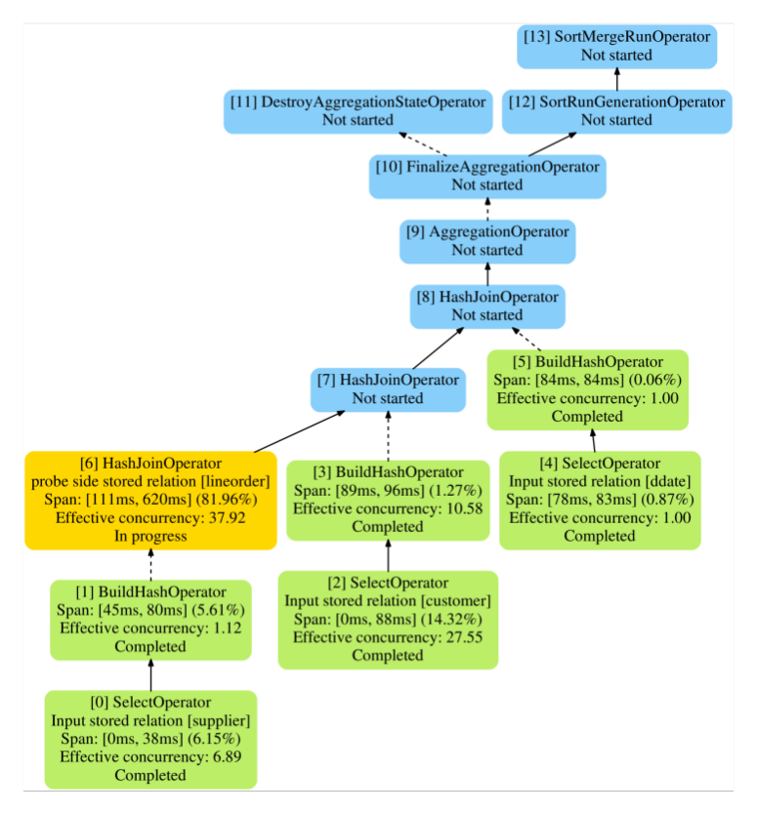
In-built Query Progress Monitoring
41
Bonus

Slide 42
PROCESS POOL
A worker uses any free process from the pool.
  Still relies on OS scheduler and shared memory.
  Bad for CPU cache locality.
  Examples: IBM DB2, Postgres (2015)
Dispatcher
Worker Pool

Slide 43
INTRA-OPERATOR PARALLELISM
SELECT A.id, B.value
FROM A JOIN B
ON A.id = B.id
WHERE A.value < 99
AND B.value > 100
Exchange
⨝
Exchange
π
Build HT₁
Build HT₂
Build HT₃
Probe HT
Probe HT
Probe HT
⨝
π
π
π
π
π
π
σ
σ
σ
σ
σ
σ
σ
σ
A₁
A₂
A₃
B₁
B₂
B₃
A
B
1
2
3
1
2
3

Slide 44
INTRA-OPERATOR PARALLELISM
SELECT * FROM A
WHERE A.val > 99
Next
Exchange
Fragment
σ
σ
Next
σ
σ
value>99
A₁
A₂
A₃
A
1
2
3
1
2
3
4
5
Pages

Slide 45
INTER- VS. INTRA-QUERY PARALLELISM
Inter-Query: Execute multiple disparate queries simultaneously.
  Increases throughput & reduces latency.
Intra-Query: Execute the operations of a single query in parallel.
  Decreases latency for long-running queries, especially for OLAP queries.

Slide 46


INTER-OPERATOR PARALLELISM
Approach #2: Inter-Operator (Vertical)
  Operations are overlapped to pipeline data from one stage to the next without materialization.
  Workers execute operators from different segments of a query plan at the same time.
  More common in streaming systems (continuous queries)
Also called pipeline parallelism.

Slide 47
BUSHY PARALLELISM
Approach #3: Bushy Parallelism
  Hybrid of intra- and inter-operator parallelism where workers execute multiple operators from different segments of a query plan at the same time.
  Still need exchange operators to combine intermediate results from segments.
3
Exchange
4
⨝
⨝
Exchange
Exchange
⨝
⨝
SELECT *
FROM A JOIN B JOIN C JOIN D
A
B
C
D
1
2

