Slide 1
Lecture 10: It's Data Structure Week!

Slide 2
Announcements
2
Code reviews start today. Look at the office hours schedule to get the location for your slot.

Slide 3
Today's Agenda
Bloom Filters
Skip Lists
Tries / Radix Trees
Inverted Indexes
Vector Indexes

Slide 4
Indexes vs. Filters
4
An index data structure of a subset of a table's attributes that are organized and/or sorted to the location of specific tuples using those attributes.
  Example: B+Tree
A filter is a data structure that answers set membership queries; it tells you whether a key (likely) exists in a set but not where it is located.
  Example: Bloom Filter

Slide 5
Bloom Filters
Probabilistic data structure (bitmap) that answers set membership queries.
  False negatives will never occur.
  False positives can sometimes occur.
  See Bloom Filter Calculator.
Insert(x):
  Use k hash functions to set bits in the filter to 1.
Lookup(x):
  Check whether the bits are 1 for each hash function.

Slide 6
Bloom Filters
Insert 'RZA'
Insert 'GZA'
Lookup 'RZA'
Lookup 'Raekwon'
Lookup 'ODB'
Bloom Filter
0
1
2
3
4
5
6
7
0
0
1
0
0
1
0
1
0
0
1
0
→ TRUE
hash₁('RZA') = 2222 % 8 =
hash₁('GZA') = 5555 % 8 =
hash₁('Raekwon') = 3333 % 8 =
hash₁('ODB') = 6699 % 8 =
3
3
6
5
→ FALSE
hash₂('Raekwon') = 8899 % 8 =
hash₂('RZA') = 4444 % 8 =
hash₂('GZA') = 7777 % 8 =
hash₂('ODB') = 9966 % 8 =
6
4
1
3
→ TRUE

Slide 7
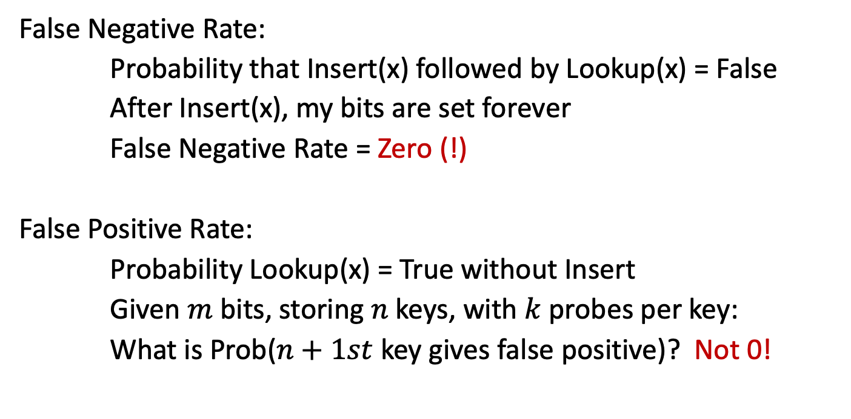
Bloom Filters
False Negative Rate:
Probability that Insert(x) followed by Lookup(x) = False
After Insert(x), my bits are set forever
False Negative Rate = Zero (!)
False Positive Rate:
Probability Lookup(x) = True without Insert
Given $m$ bits, storing $n$ keys, with $k$ probes per key:
What is Prob($n+1st$ key gives false positive)? Not 0!

Slide 8
Log-structured Storage
GET (key101)
MemTable
SSTable
PUT (key101,a₂)
SummaryTable
Min/Max Key Per SSTable
Key Filter Per Level
PUT (key102,b₁)
Key Low→High
PUT (key103,c₁)
Memory
Bloom Filter
SSTable
SSTable
Newest→Oldest
Level #0
Bloom Filter
SSTable
Level #1
SSTable
Disk
Bloom Filter
Level #2
SSTable

Slide 9
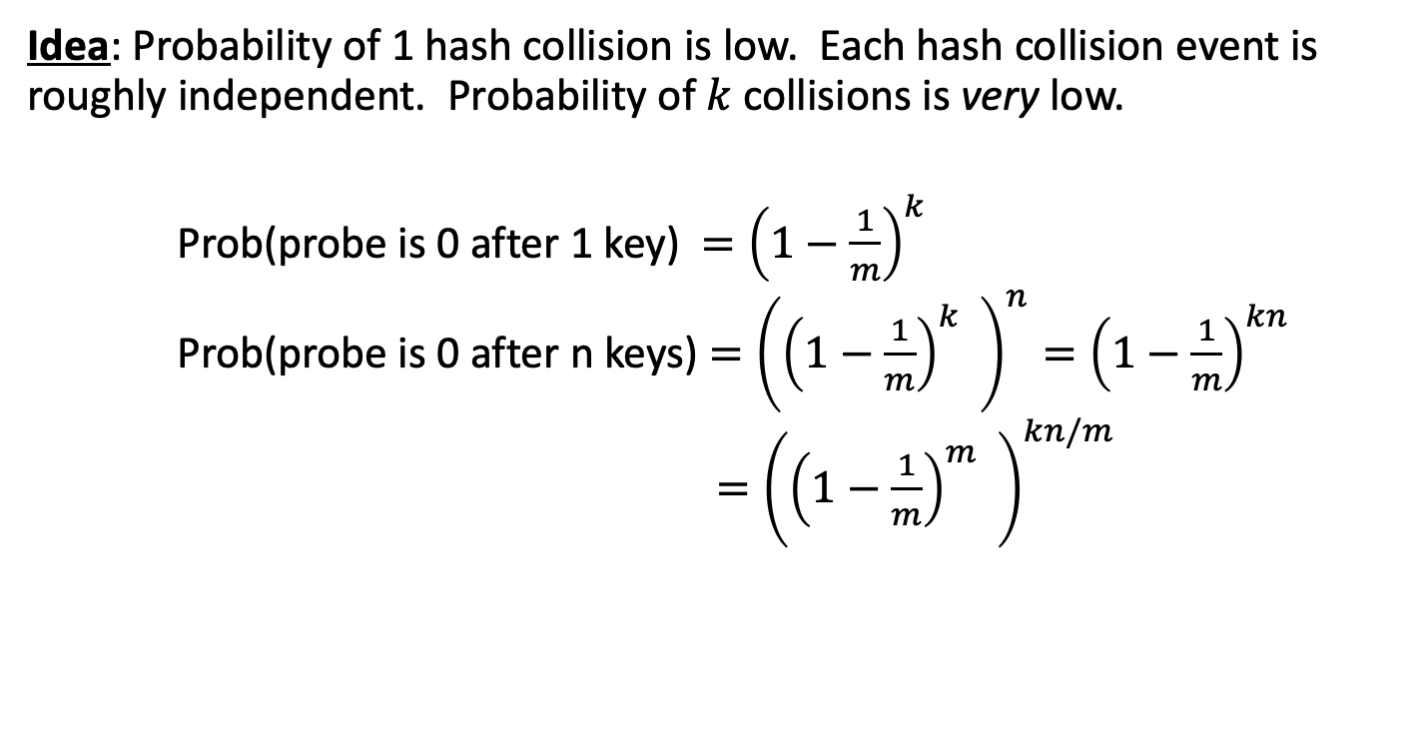
Bloom Filter Math
Idea: Probability of 1 hash collision is low. Each hash collision event is roughly independent. Probability of $k$collisions is very low.
Prob(probe is 0 after 1 key) $={\left(1−\frac{1}{m}\right)}^{k}$
Prob(probe is 0 after n keys) $={\left({\left(1−\frac{1}{m}\right)}^{k} \right)}^{n}={\left(1−\frac{1}{m}\right)}^{kn}$
$={\left({\left(1−\frac{1}{m}\right)}^{m} \right)}^{kn/m}$

Slide 10
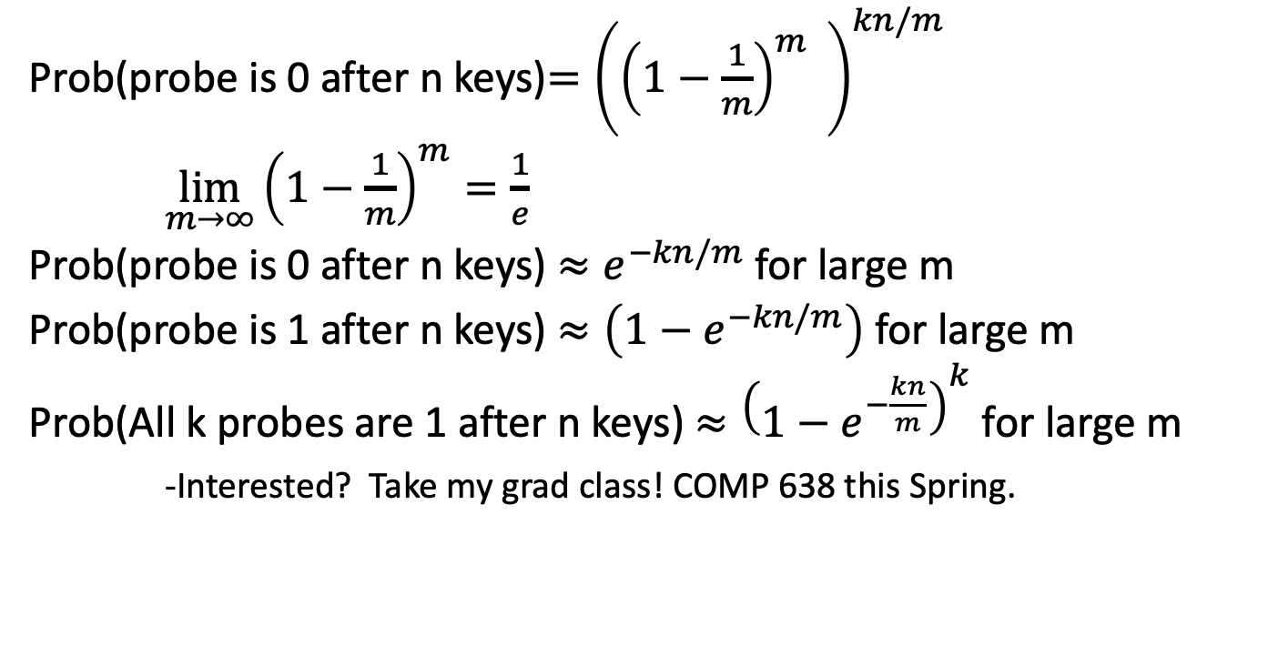
Bloom Filter Math
Prob(probe is 0 after n keys)$={\left({\left(1−\frac{1}{m}\right)}^{m} \right)}^{kn/m}$
$\lim_{m→∞}{\left(1−\frac{1}{m}\right)}^{m}=\frac{1}{e}$
Prob(probe is 0 after n keys) $≈e^{−kn/m}$ for large m
Prob(probe is 1 after n keys) $≈\left(1−e^{−kn/m}\right)\text{ for large m}$
Prob(All k probes are 1 after n keys) $≈{\left(1−e^{−\frac{kn}{m}}\right)}^{k}\text{ for large m}$
-Interested? Take my grad class! COMP 638 this Spring.
(wat?)
(!)

Slide 11
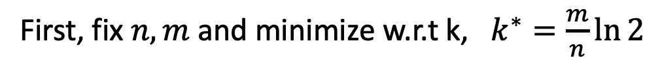
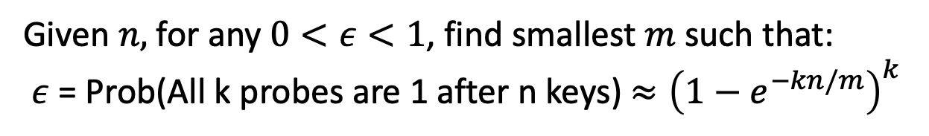
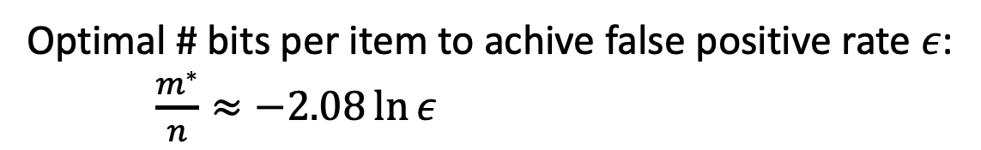
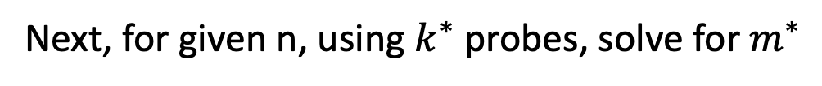
Bloom Filters IRL
Given $n,$ for any $0<ε<1$, find smallest$m$ such that:
$ε$ = Prob(All k probes are 1 after n keys) $≈{\left(1−e^{−kn/m}\right)}^{k}$
First, fix $n,m$ and minimize w.r.t k, $k^{∗}=\frac{m}{n}\ln{2}$
Next, for given n, using $k^{∗}$ probes, solve for $m^{∗}$
Optimal # bits per item to achive false positive rate $ε$:
$\frac{m^{∗}}{n}≈−2.08\ln{ε}$

Slide 12
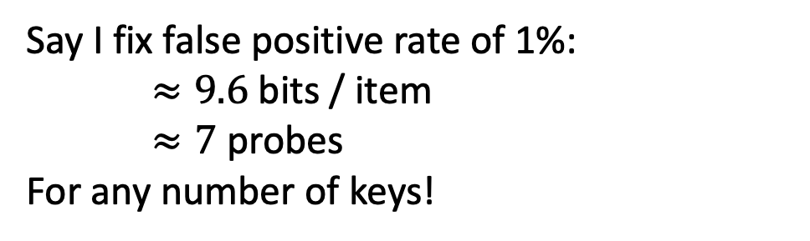
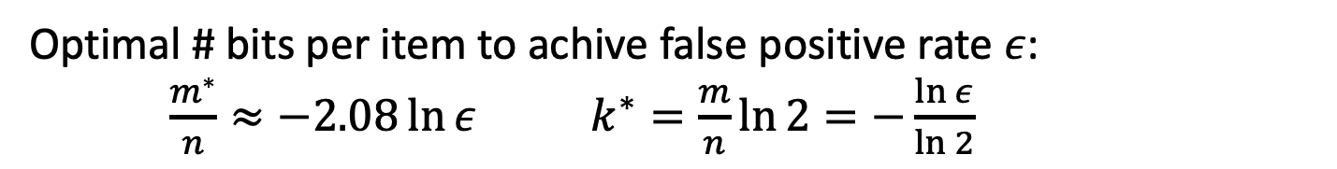
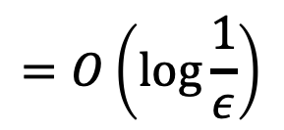
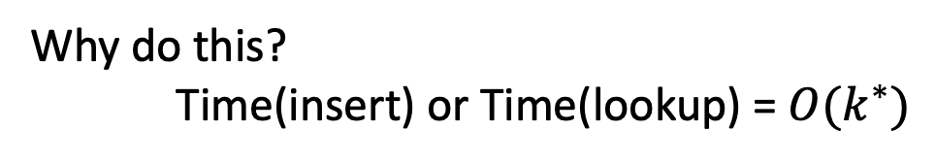
Bloom Filters IRL
Optimal # bits per item to achive false positive rate $ε$:
$\frac{m^{∗}}{n}≈−2.08\ln{ε}$ $k^{∗}=\frac{m}{n}\ln{2}=−\frac{\ln{ε}}{\ln{2}}$
Why do this?
Time(insert) or Time(lookup) = $O(k^{∗})$
$$=O\left(\log{\frac{1}{ε}}\right)$$
Say I fix false positive rate of 1%:
$≈9.6$ bits / item
$≈7$ probes
For any number of keys!
sizeof(ptr)=32 bits

Slide 13
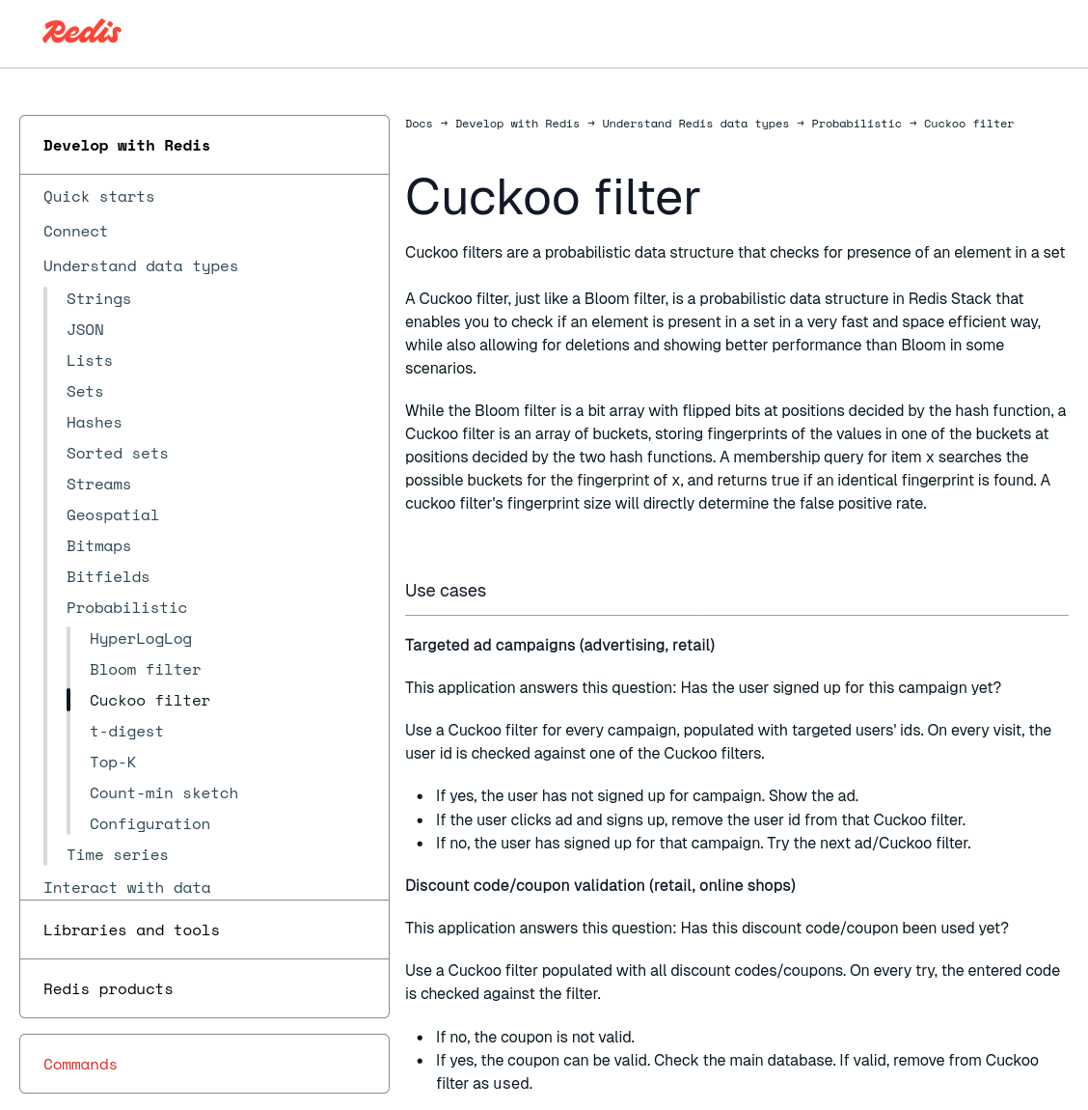
Other Filters
Counting Bloom Filter
  Supports dynamically adding and removing keys.
  Uses integers instead of bits to count the number of occurrences of a key in a set.
Cuckoo Filter
  Also supports dynamically adding and removing keys.
  Uses a Cuckoo Hash Table but stores fingerprints instead of full keys.
Succinct Range Filter (SuRF)
  Immutable compact trie that supports approximate exact matches and range filtering.

Slide 14
Today's Agenda
Bloom Filters
Skip Lists
Tries / Radix Trees
Inverted Indexes
Vector Indexes

Slide 15
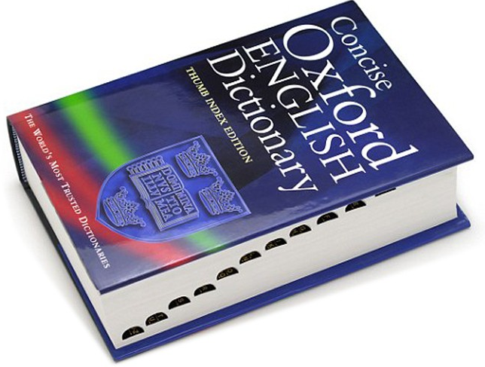
B+Trees as Fancy Linked Lists
20
<20
≥20
10
35
<10
≥10
<35
≥35
6
10
20
31
38
44
Index Key(s) Low→High
"M words begin here"

Slide 16
Observation
Linked lists are "simplest" index, but...
All operations have to linear search.
  Average Cost: O(n)
  More than one way to index a linked list...
K₁
K₂
K₃
K₄
K₅
K₆
K₇

Slide 17
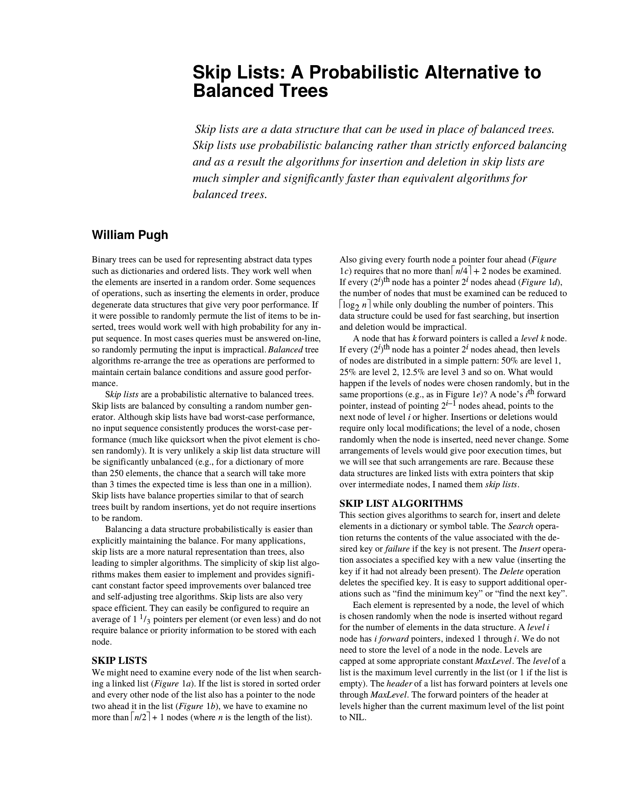
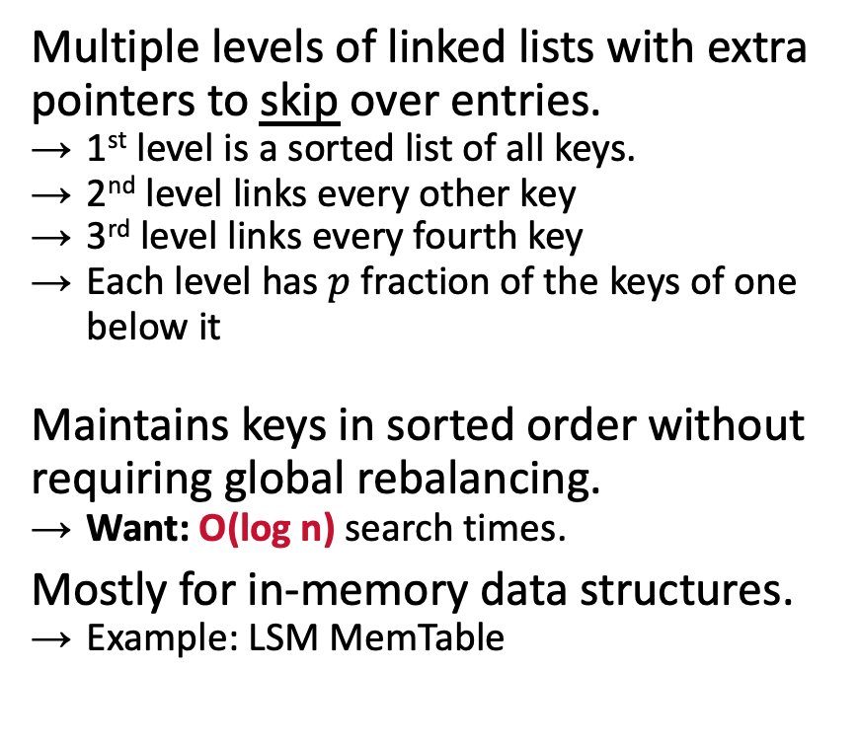
Skip Lists
Multiple levels of linked lists with extra pointers to skip over entries.
  1st level is a sorted list of all keys.
  2nd level links every other key
  3rd level links every fourth key
  Each level has $p$ fraction of the keys of one below it
Maintains keys in sorted order without requiring global rebalancing.
  Want: O(log n) search times.
Mostly for in-memory data structures.
  Example: LSM MemTable

Slide 18




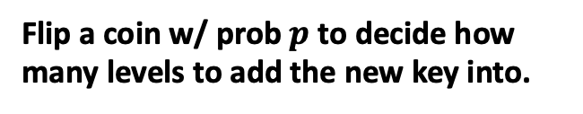

Skip Lists Basics
Flip a coin w/ prob $p$ to decide how many levels to add the new key into.
Levels
End
How many levels in expectation?
$$p^{L}N≈1→$$
$$\log_{1/p}{N}$$
∞
$$E\left[L_{3}\right]=p^{2}N$$
K₂
K₄
∞
$$E\left[L_{2}\right]=pN$$
K₁
K₂
K₃
K₄
K₆
∞
$E[L_{1}]$=N
V₁
V₂
V₃
V₄
V₆

Slide 19
Skip Lists: INSERT
Insert K₅
Levels
End
K₅
∞
K₂
K₄
K₅
∞
K₁
K₂
K₃
K₄
K₅
K₆
∞
V₁
V₂
V₃
V₄
V₅
V₆

Slide 20
Skip Lists: SEARCH
Find K₃
Levels
End
K₃<K₅
K₅
∞
K₃>K₂
K₃<K₄
K₂
K₄
K₅
∞
K₁
K₂
K₃
K₄
K₅
K₆
∞
V₁
V₂
V₃
V₄
V₅
V₆

Slide 21
Skip Lists: DELETE
First logically remove a key from the index by setting a flag to tell threads to ignore.
Then physically remove the key once we know that no other thread is holding the reference.

Slide 22
Skip Lists: DELETE
Delete K₅
Levels
End
K₅
∞
K₂
K₄
K₅
∞
K₁
K₂
K₃
K₄
K₅
K₆
∞
Del?
false
Del?
false
Del?
false
Del?
false
Del?
true
V₁
V₂
V₃
V₄
V₅
Del?
false
V₆
Del?
false

Slide 23
Skip List Math
Find K₄
Levels
End
K₅
∞
K₂
K₄
K₅
∞
K₁
K₂
K₃
K₄
K₅
K₆
∞
V₁
V₂
V₃
V₄
V₅
V₆

Slide 24
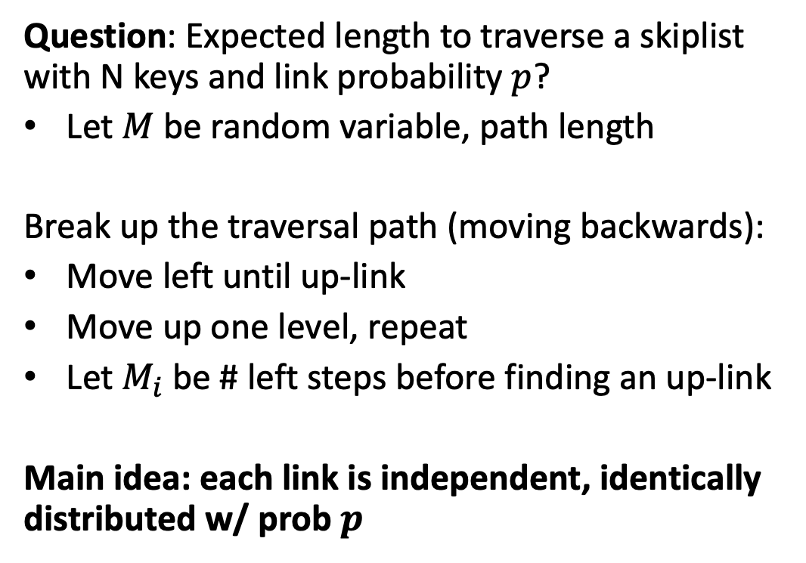
Skip List Math
Question: Expected length to traverse a skiplist with N keys and link probability $p$?
Let $M$ be random variable, path length
Break up the traversal path (moving backwards):
Move left until up-link
Move up one level, repeat
Let $M_{i}$ be # left steps before finding an up-link
Main idea: each link is independent, identically distributed w/ prob $p$

Slide 25
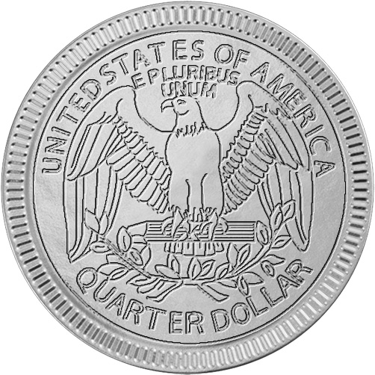


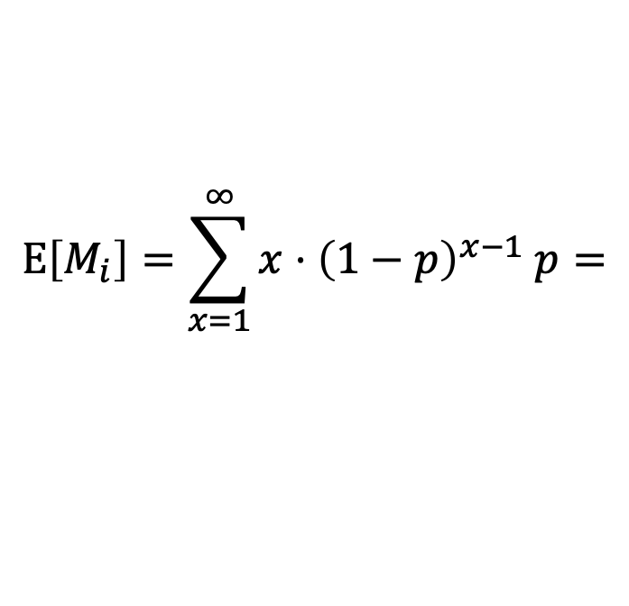
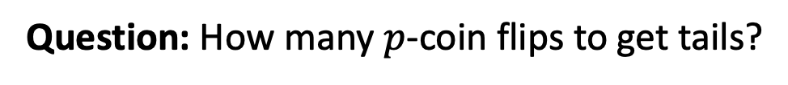
Skip List Math
Question: Starting at any node, how many steps left until up-link?
Question: How many $p$-coin flips to get tails?
$$M_{i}\sim Geometric\left(p\right); Pr\left(M_{i}=x\right)={\left(1−p\right)}^{x−1} p$$
$$E\left[M_{i}\right]=\sum_{x=1}^{∞}{x⋅{\left(1−p\right)}^{x−1} p}=$$
$$\frac{1}{p}$$
Left steps per up-link (expected)
K₁
K₂
K₃
K₄
K₅
K₆
V₁
V₂
V₃
V₄
V₅
V₆

Slide 26
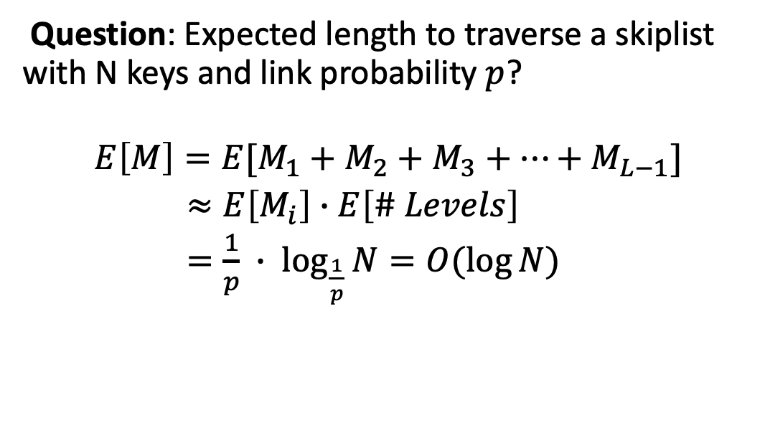
Skip List Math
Question: Expected length to traverse a skiplist with N keys and link probability $p$?
$$E\left[M\right]=E[M_{1}+M_{2}+M_{3}+…+M_{L−1}]$$
$≈E\left[M_{i}\right]∙E\left[\# Levels\right]$
$=\frac{1}{p} ∙ \log_{\frac{1}{p}}{N}=O(\log{N)}$

Slide 27
Skip Lists
Advantages:
  Uses less memory than a typical B+Tree if you do not include reverse pointers.
  Insertions and deletions do not require rebalancing.
Disadvantages:
  Not disk/cache friendly because they do not optimize locality of references.
  Reverse search is non-trivial.

Slide 28
Today's Agenda
Bloom Filters
Skip Lists
Tries / Radix Trees
Inverted Indexes
Vector Indexes

Slide 29
We stopped here in class because I decided to focus more on the internals of Bloom filters and skip lists. The rest of these slides will not be covered, but cover some good-to-know data structures for indexing

Slide 30
Observation
Both B+Trees and Skip Lists have the same weakness: Lookup(x) == full traversal
Lookup for keys that don't exist are slow
Want: Best of both worlds. An index data structure with filter-like properties

Slide 31
Trie Index
Use a digital representation of keys to examine prefixes one-by-one.
  aka Digital Search Tree, Prefix Tree.
Shape depends on keys and lengths.
  Does not depend on existing keys or insertion order.
  Does not require rebalancing operations.
All operations have O(k) complexity where k is the length of the key.
  Path to a leaf node represents a key.
  Keys are stored implicitly and can be reconstructed from paths.
Keys: HELLO, HAT, HAVE
H
A
E
T
V
L
¤
E
L
¤
O
¤

Slide 32
Trie Key Span
The span of a trie level is the number of bits that each partial key / digit represents.
  If the digit exists in the corpus, then store a pointer to the next level in the trie branch. Otherwise, store null.
This determines the fan-out of each node and the physical height of the tree.
  n-way Trie = Fan-Out of n

Slide 33
Trie Key Span
1-bit Span Trie
Keys: K10,K25,K31
0
¤
¤
Ø
1
Ø
0
¤
¤
Ø
1
Ø
Repeat 10x
K10→ 00000000 00001010
0
¤
¤
¤
1
¤
K25→ 00000000 00011001
0
Ø
1
¤
Ø
¤
Ø
¤
0
Ø
1
¤
K31→ 00000000 00011111
0
¤
1
¤
¤
Ø
Ø
0
¤
¤
1
¤
0
Ø
1
Ø
¤
Ø
¤
¤
0
¤
¤
1
Ø
Ø
0
Ø
1
¤
0
¤
1
¤
¤
Ø
Ø
0
Ø
Ø
1
¤
¤
Ø
0
Ø
1
¤
Tuple Pointer
Node Pointer

Slide 34



Radix Tree
1-bit Span Radix Tree
Vertically compressed trie that compacts nodes with a single child.
  Also known as Patricia Tree.
Can produce false positives, so the DBMS always checks the original tuple to see whether a key matches.
¤
Ø
¤
Ø
Repeat 10x
¤
¤
Ø
¤
¤
¤
Tuple Pointer
Node Pointer

Slide 35
Observation
revisions(id,content,…)
The indexes that we've discussed are useful for "point" and "range" queries:
  Find all customers in the 15217 zipcode.
  Find all orders between June 2024 and September 2024.
They are not good at keyword searches:
  Example: Find all Wikipedia articles that contain the word "Pavlo"
id | content
11 | Wu-Tang Clan is an American hip hop musical collective formed in Staten Island, New York City, in 1992...
22 | Carnegie Mellon University (CMU) is a private research university in Pittsburgh, Pennsylvania. The institution was established in 1900 by Andrew Carnegie...
33 | In computing, a database is an organized collection of data or a type of data store based on the use of a database management system (DBMS), the software...
44 | Andrew Pavlo, best known as Andy Pavlo, is an associate professor of Computer Science at Carnegie Mellon University. He conducts research on database...
CREATE INDEX idx_rev_cntnt
ON revisions (content);
SELECT pageID FROM revisions
WHERE content LIKE '%Pavlo%';

Slide 36

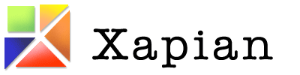


Inverted Index
revisions(id,content,…)
An inverted index stores a mapping of terms to records that contain those terms in the target attribute.
  Sometimes called a full-text search index.
  Originally called a concordance (1200s).
Many major DBMSs support these natively. But there are also specialized DBMSs and libraries.
id | content
11 | Wu-Tang Clan is an American hip hop musical collective formed in Staten Island, New York City, in 1992...
22 | Carnegie Mellon University (CMU) is a private research university in Pittsburgh, Pennsylvania. The institution was established in 1900 by Andrew Carnegie...
33 | In computing, a database is an organized collection of data or a type of data store based on the use of a database management system (DBMS), the software...
44 | Andrew Pavlo, best known as Andy Pavlo, is an associate professor of Computer Science at Carnegie Mellon University. He conducts research on database...
Dictionary
Posting Lists
Wu-Tang|2
11
44
Term /
Frequency
22
33
44
Carnegie|3
Database|2
33
44
⋮

Slide 37
Inverted Index: Lucene
Dictionary
Find PAV
Uses a Finite State Transducer for determining offset of terms in dictionary.
Incrementally create dictionary segments and then merge them in the background.
  Uses compression methods we previously discussed (e.g., delta, bit packing).
  Also supports precomputed aggregations for terms and occurrences.
1
BR
2
BRAV
P
weight=2
B
weight=1
3
PAV
4
PLA
R
weight=0
A
weight=1
L
weight=2
A
weight=1
V
weight=0
A
weight=0
Offset=
3
4
0

Slide 38
Inverted Index: PostgreSQL
PostgreSQL's Generalized Inverted Index (GIN) uses a B+Tree for the term dictionary that map to a posting list data structure.
Posting list contents varies depending on number of records per term:
  Few: Sorted list of record ids.
  Many: Another B+Tree of record ids.
Uses a separate "pending list" log to avoid incremental updates.
Dictionary
Pending List
mod log
Posting List
Posting List
Posting Tree

Slide 39
OBSERVATION
Inverted indexes search data based on its contents.
  There is a little magic to tweak terms based on linguistic models.
  Example: Normalization ("Wu-Tang" matches "Wu Tang").
Instead of searching for records containing exact keywords (e.g., "Wu-Tang"), an application may want search for records that are related to topics (e.g., "hip-hop groups whose lyrics reference kung-fu cinema").

Slide 40
Semantic Search
40
Album(id, name, year)
Embeddings
id | name | year
11 | Enter the Wu-Tang | 1993
22 | St.Ides Mix Tape | 1994
33 | Liquid Swords | 1995
Id1 → [0.32, 0.78, 0.30, ...]
Transformer
Id2 → [0.99, 0.19, 0.81, ...]
Id3 → [0.01, 0.18, 0.85, ...]
⋮
Query
[0.02, 0.10, 0.24, ...]
Find albums that reference kung-fu cinema
Vector
Index
Ranked List of Ids
HNSW, IVFFlat
Meta Faiss, Spotify Annoy

Slide 41
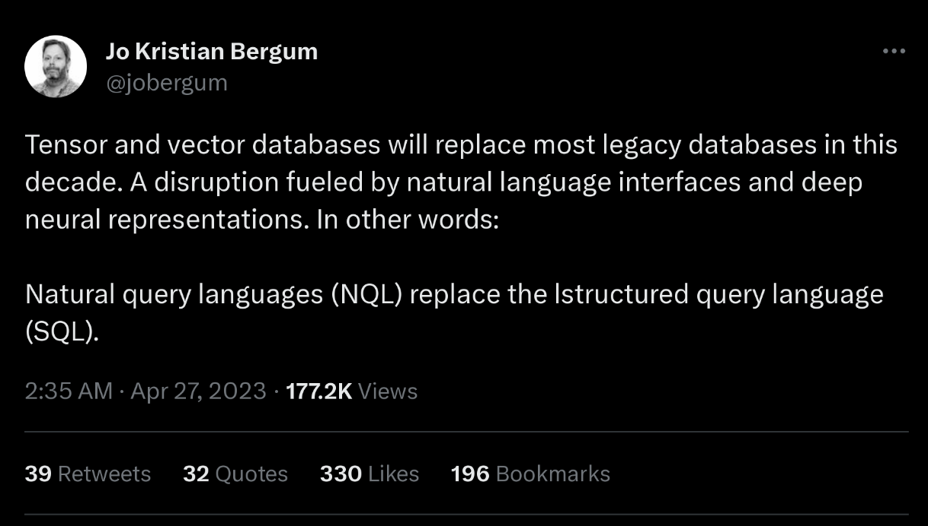
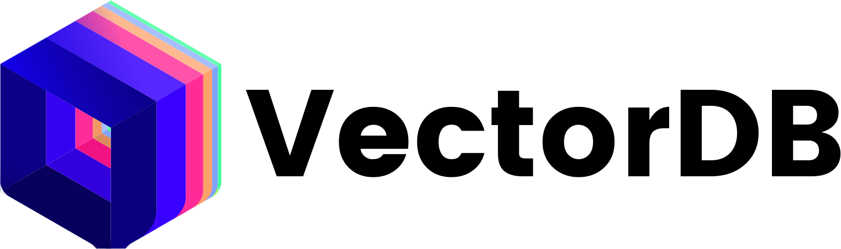
Vector Indexes
Specialized data structures to perform nearest-neighbor searches on embeddings.
  An embedding is an array of floating point numbers.
  May also need to filter data before / after vector searches.
The correctness of a query depends on whether the result "feels right".

Slide 42
Vector Indexes: Inverted File
Partition vectors into smaller groups using a clustering algorithm.
To find a match, use same clustering algorithm to map into a group, then scan that group's vectors.
  Also check nearby groups to improve accuracy.
Preprocess / quantize vectors to reduce dimensionality.
Example: IVFFlat
Source: Chi Zhang

Slide 43
VECTOR SEARCH: GRAPH
Build a graph where each node represents a vector and it has edges to (at most) its n nearest neighbors.
  Can use multiple levels of graphs (HNSW)
  Examples: Faiss, hnswlib, DiskANN
To find a match for a given vector, enter the graph and then greedily choose the next edge that moves closer to that vector.
Vector Graph
Search
Vector
Entry
Point
Source: Chi Zhang

Slide 44
VECTOR SEARCH: GRAPH
Hierarchical Graph
Build a graph where each node represents a vector and it has edges to (at most) its n nearest neighbors.
  Can use multiple levels of graphs (HNSW)
  Examples: Faiss, hnswlib, DiskANN
To find a match for a given vector, enter the graph and then greedily choose the next edge that moves closer to that vector.
Entry
Point
Search
Vector
Search
Vector
Search
Vector

Slide 45
Conclusion
Wide variety of data structures, a great place to see theory in action in real systems.
If that is an exciting idea, take COMP 638!

Slide 46
Next Class
On to query execution

Slide 47
RADIX TREE: MODIFICATIONS
Insert HAIR
H
Delete HAT
ELLO
A
AIR
Delete HAVE
¤
VE
¤
T
IR
¤
¤
¤

Slide 48
IN-MEMORY TABLE INDEXES
Processor: 1 socket, 10 cores w/ 2×HT
Workload: 50m Random Integer Keys (64-bit)
Source: Ziqi Wang

Slide 49
SKIP LISTS: EXAMPLE
Levels
End
∞
P=N/4
K₂
K₄
∞
P=N/2
K₁
K₂
K₃
K₄
K₆
∞
P=N
V₁
V₂
V₃
V₄
V₆

Slide 50
WIKIPEDIA EXAMPLE
CREATE TABLE useracct (
userID INT PRIMARY KEY,
userName VARCHAR UNIQUE,
⋮
);
CREATE TABLE pages (
pageID INT PRIMARY KEY,
title VARCHAR UNIQUE,
latest INT
⮱REFERENCES revisions (revID),
);
CREATE TABLE revisions (
revID INT PRIMARY KEY,
userID INT REFERENCES useracct (userID),
pageID INT REFERENCES pages (pageID),
content TEXT,
updated DATETIME
);

Slide 51
TRIE INDEX PROPERTIES
Shape only depends on key space and lengths.
  Does not depend on existing keys or insertion order.
  Does not require rebalancing operations.
All operations have O(k) complexity where k is the length of the key.
  The path to a leaf node represents the key of the leaf
  Keys are stored implicitly and can be reconstructed from paths.

Slide 52
RADIX TREE: BINARY COMPARABLE KEYS
Not all attribute types can be decomposed into binary comparable digits for a radix tree.
  Unsigned Integers: Byte order must be flipped for little endian machines.
  Signed Integers: Flip two’s-complement so that negative numbers are smaller than positive.
  Floats: Classify into group (neg vs. pos, normalized vs. denormalized), then store as unsigned integer.
  Compound: Transform each attribute separately.

Slide 53
RADIX TREE: BINARY COMPARABLE KEYS
8-bit Span Radix Tree
0D
0A
0A
Int Key: 168496141
0C
0B
0B
0C
0B
0F
Hex Key: 0A 0B 0C 0D
0A
0D
0B
0C
1D
¤
Little
Endian
Big
Endian
¤
0B
0D
¤
Find 658205
Hex 0A 0B 1D
¤
¤

Slide 54
QUERY TYPES
Phrase Searches
  Find records that contain a list of words in the given order.
Proximity Searches
  Find records where two words occur within n words of each other.
Wildcard Searches
  Find records that contain words that match some pattern (e.g., regular expression).

Slide 55
DESIGN DECISIONS
Decision #1: What To Store
  The index needs to store at least the words contained in each record (separated by punctuation characters).
  Can also store frequency, position, and other meta-data.
Decision #2: When To Update
  Maintain auxiliary data structures to "stage" updates and then update the index in batches.

